Slide 1
Encoding and Decoding

Slide 2
Your Mission
The following slides contain encoded sentences.
Decode the sentences.
Describe the set of rules or pattern that encoded the sentence.

Slide 3
25-15-21 19-15-12-22-5-4 20-8-5 6-9-18-19-20 15-14-5
Encoded Sentence:
Rules/Pattern
Decoded sentence
Every letter corresponds to a number.
A = 1, B = 2, C = 3, ...
(Use this space to work it out)

Slide 4
KVTU LFFQ TXJNNJOH
Encoded Sentence:
Rules/Pattern
Decoded sentence
Every letter is shifted by one.
A = B
B = C
C = D, ...
(Use this space to work it out)

Slide 5
REVELC SI SECNETNES GNISREVER
Encoded Sentence:
Rules/Pattern
Decoded sentence
(Use this space to work it out)
(Use this space to work it out)

Slide 6
SENTENCE WIT MISSIN LETTER AR CONFUSIN
Encoded Sentence:
Rules/Pattern
Decoded sentence
(Use this space to work it out)
(Use this space to work it out)

Slide 7
UOY ERA YAWFLAH ENOD
Encoded Sentence:
Rules/Pattern
Decoded sentence
(Use this space to work it out)
(Use this space to work it out)

Slide 8
VEREOYEN OLEVS OCPMTURE CSEICNE
Encoded Sentence:
Rules/Pattern
Decoded sentence
(Use this space to work it out)
EVERYONE LOVES
COMPUTER SCIENCE

Slide 9
VOWOLS ORO OMPORTONT ON SONTONCOS
Encoded Sentence:
Rules/Pattern
Decoded sentence
Every vowel is replaced with an “O”.
(Use this space to work it out)

Slide 10
IS IT CATS RAINING DOGS AND
Encoded Sentence:
Rules/Pattern
Decoded sentence
(Use this space to work it out)
(Use this space to work it out)

Slide 11
PUPPIES ARE CUTE
Decoded Sentence:
Rules/Pattern
Encoded sentence
Pig Latin:
If a word begins with a consonant:
  the consonant is moved to the end
  and an “ay” is added.
If not:
  only “ay” is added.
Note: This time you are encoding the sentence.

Slide 12
Encoded Sentence:
Rules/Pattern
Decoded sentence
This time, come up with your own code. Then use it to encode a secret message!
Write your cleverly coded secret message here

Slide 13
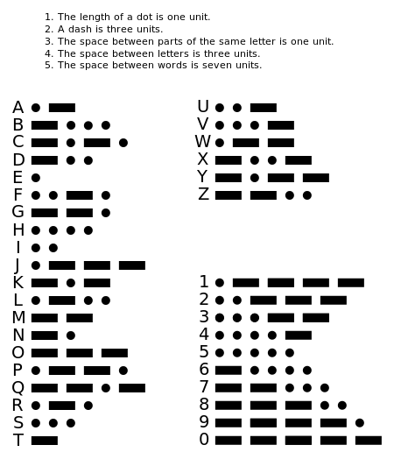
Morse Code
You will use these Morse Code rules to decode the next few secret messages.

Slide 14
Morse Code
Rules/Pattern
Encoded Sentence:
Decoded sentence
_ _ _ _ _ . _ . . . . .
_ . _ . _ _ _ _ . . . . . . . .
_ . _ . _ _ _ _ _ _ . _ . .
(Use this space to work it out)

Slide 15
Morse Code
Rules/Pattern
Encoded Sentence:
Decoded sentence
_ . _ . _ _ _ _ . _ _ . . _ .
. _ _ . . _ . _ . . . _ _ . .
_ _ _ _ . . . . _ . _ _
_ _ _ . . _ . . _ . . . _ .
. . . . . . . . . . _ . .
(Use this space to work it out)

