Slide 1
Encoding and Decoding

Slide 2
Your Mission
The following slides contain encoded sentences.
Decode the sentences.
Describe the set of rules or pattern that encoded the sentence.

Slide 3
25-15-21 19-15-12-22-5-4 20-8-5 6-9-18-19-20 15-14-5
Encoded Sentence:
Rules/Pattern
Decoded sentence
Every letter corresponds to a number.
A = 1, B = 2, C = 3, ...
YOU SOLVED THE FIRST ONE

Slide 4
KVTU LFFQ TXJNNJOH
Encoded Sentence:
Rules/Pattern
Decoded sentence
Every letter is shifted by one.
A = B
B = C
C = D, ...
JUST KEEP SWIMMING

Slide 5
REVELC SI SECNETNES GNISREVER
Encoded Sentence:
Rules/Pattern
Decoded sentence
Reverse the entire sentence
REVERSING SENTENCES IS CLEVER

Slide 6
SENTENCE WIT MISSIN LETTER AR CONFUSIN
Encoded Sentence:
Rules/Pattern
Decoded sentence
Taking the last letter off each word
SENTENCES WITH MISSING LETTERS ARE CONFUSING

Slide 7
UOY ERA YAWFLAH ENOD
Encoded Sentence:
Rules/Pattern
Decoded sentence
Reversing each word
YOU ARE HALFWAY DONE

Slide 8
VEREOYEN OLEVS OCPMTURE CSEICNE
Encoded Sentence:
Rules/Pattern
Decoded sentence
Switching every 2 letters of each word
EVERYONE LOVES
COMPUTER SCIENCE

Slide 9
VOWOLS ORO OMPORTONT ON SONTONCOS
Encoded Sentence:
Rules/Pattern
Decoded sentence
Every vowel is replaced with an “O”.
VOWELS ARE IMPORTANT IN SENTENCES

Slide 10
IS IT CATS RAINING DOGS AND
Encoded Sentence:
Rules/Pattern
Decoded sentence
Switching every 2 words
IT IS RAINING CATS AND DOGS

Slide 11
PUPPIES ARE CUTE
Decoded Sentence:
Rules/Pattern
Encoded sentence
Pig Latin:
If a word begins with a consonant:
  the consonant is moved to the end
  and an “ay” is added.
If not:
  only “ay” is added.
Note: This time you are encoding the sentence.
UPPIESPAY AREAY UTECAY

Slide 12
Encoded Sentence:
Rules/Pattern
Decoded sentence
This time, come up with your own code. Then use it to encode a secret message!
Write your cleverly coded secret message here

Slide 13
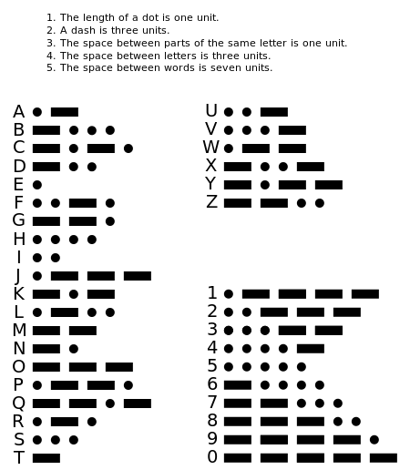
Morse Code
You will use these Morse Code rules to decode the next few secret messages.

Slide 14
Morse Code
Rules/Pattern
Encoded Sentence:
Decoded sentence
_ _ _ _ _ . _ . . . . .
_ . _ . _ _ _ _ . . . . . . . .
_ . _ . _ _ _ _ _ _ . _ . .
MORSE CODE IS COOL

Slide 15
Morse Code
Rules/Pattern
Encoded Sentence:
Decoded sentence
_ . _ . _ _ _ _ . _ _ . . _ .
. _ _ . . _ . _ . . . _ _ . .
_ _ _ _ . . . . _ . _ _
_ _ _ . . _ . . _ . . . _ .
. . . . . . . . . . _ . .
CONGRATULATIONS YOU FINISHED

