Slide 1
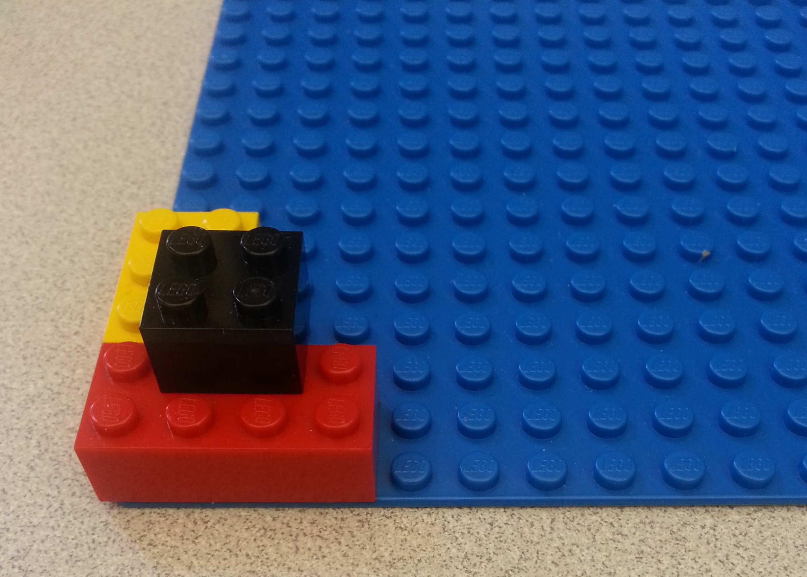
Understanding Block Encoding and Decoding
SOLUTIONS
In the space below, create a set of building instructions so that a friend can make the exact same LEGO tower shown in the picture.
Answers will vary. They should describe a series of steps someone would be able to follow to reconstruct this tower.
Ambiguous or incorrect instructions warrant the necessity for a systematic way of describing LEGO blocks. This is a nice transition to the video in which the four attributes of LEGO blocks are described.
How clear were your instructions? How precise? Was a friend able to follow them to build the correct tower?

Slide 2
SOLUTIONS
Now try describing the four attributes of each block to help you make instructions: color, size, position, and orientation.
Do these four attributes fully describe each LEGO block in the tower?
Color | Size | Orientation | Position
Red | 2 x 4 | Horizontal | Bottom left corner
Yellow | 2 x 3 | Vertical | 2 units up from the bottom of the board, but along the left edge of the board.
Black | 2 x 2 | Doesn’t matter | On top of the red block and yellow block. 1 unit in from each of the edges.
These answers might also vary, but students should be getting closer to creating a good description of how to build this tower. These attributes should fully describe each block in the tower!

Slide 3
SOLUTIONS
We want to be able to describe all the attributes in binary encoding. Let’s start with color and size.
In the table below, make a legend that matches each color and size to its binary encoding.
Color | Binary Color | Size | Binary Size
Red | 001 | 2 x 4 | 010100
Yellow | 010 | 2 x 3 | 010011
Black | 011 | 2 x 2 | 010010
It would be helpful for the whole class to create a legend that matches this one.
The colors are not numerical, so the binary encoding is somewhat arbitrary.
The sizes of each block are numerical, so we can encode them simply by converting the dimensions of each block into binary.
Note that 2 is 010 and 4 is 100, so a 2 x 4 block has the size encoding 010100

Slide 4

SOLUTIONS
y
Next, let’s think about position. Look at the table you made on page 2. Did you define position the same way that your classmates did?
15
14
13
12
11
10
9
8
7
6
5
4
3
2
1
0
Probably not.
Look at this coordinate system. If I told you the bottom left corner of the block was at x=4 and y=2, would you know exactly where the block is?
0 | 1 | 2 | 3 | 4 | 5 | 6 | 7 | 8 | 9 | 10 | 11 | 12 | 13 | 14 | 15
x
Yes

Slide 5
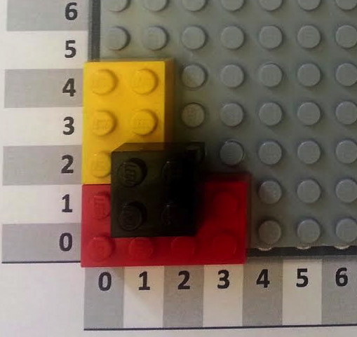
SOLUTIONS
Using the coordinate system on the last page, give the position of each block in base-10 (regular counting numbers like 1, 2, 3, 4, 5…) and in binary (1, 10, 11, 100, 101…).
For consistency, give the position of the bottom left corner of each block.
Block | X Coordinate (base 10) | X Coordinate (binary) | Y Coordinate (base 10) | Y Coordinate (binary)
Red 2 x 4 | 0 | 000 | 0 | 000
Yellow 2 x 3 | 0 | 000 | 2 | 010
Black 2 x 2 | 1 | 001 | 1 | 001
The binary numbers all have 3 digits even if the binary numbers don’t need to be

Slide 6
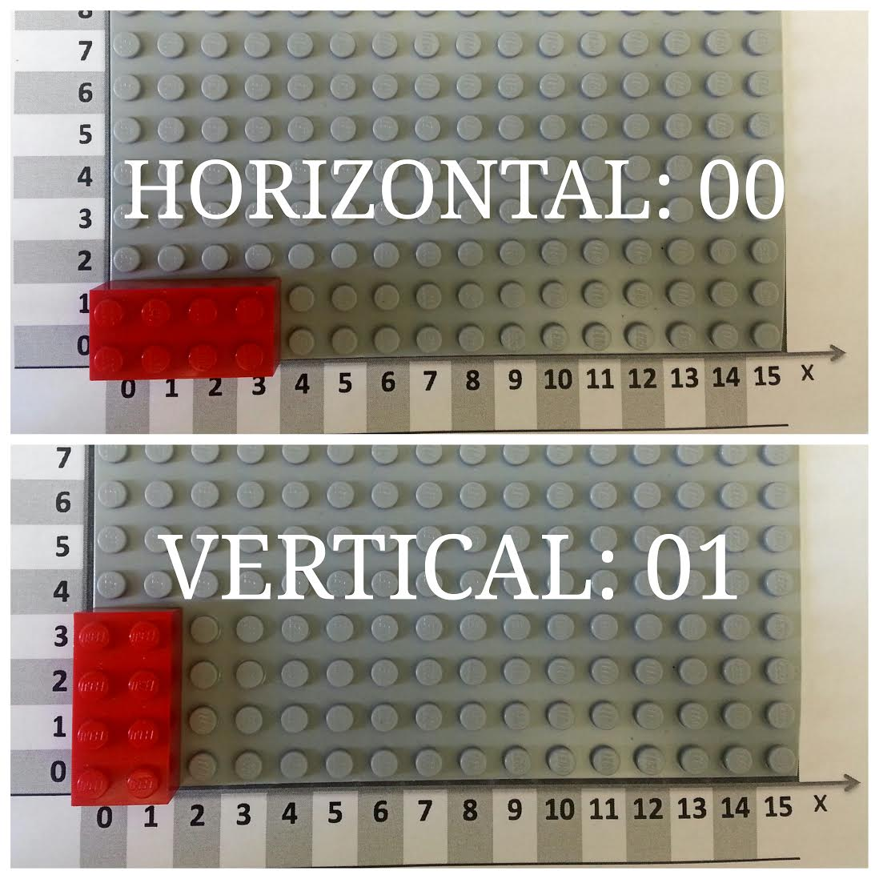
SOLUTIONS
Now let’s encode the orientation of each block into binary.
Each block can either be horizontal or vertical. We can let 00 represent horizontal, and let
01 represent vertical, as shown in the picture below. Now encode the orientation of the blocks in the tower!
Block | Orientation | Binary Orientation
Red 2 x 4 | Horizontal | 00
Yellow 2 x 3 | Vertical | 01
Black 2 x 2 | Horizontal or Vertical | 00 or 01

Slide 7
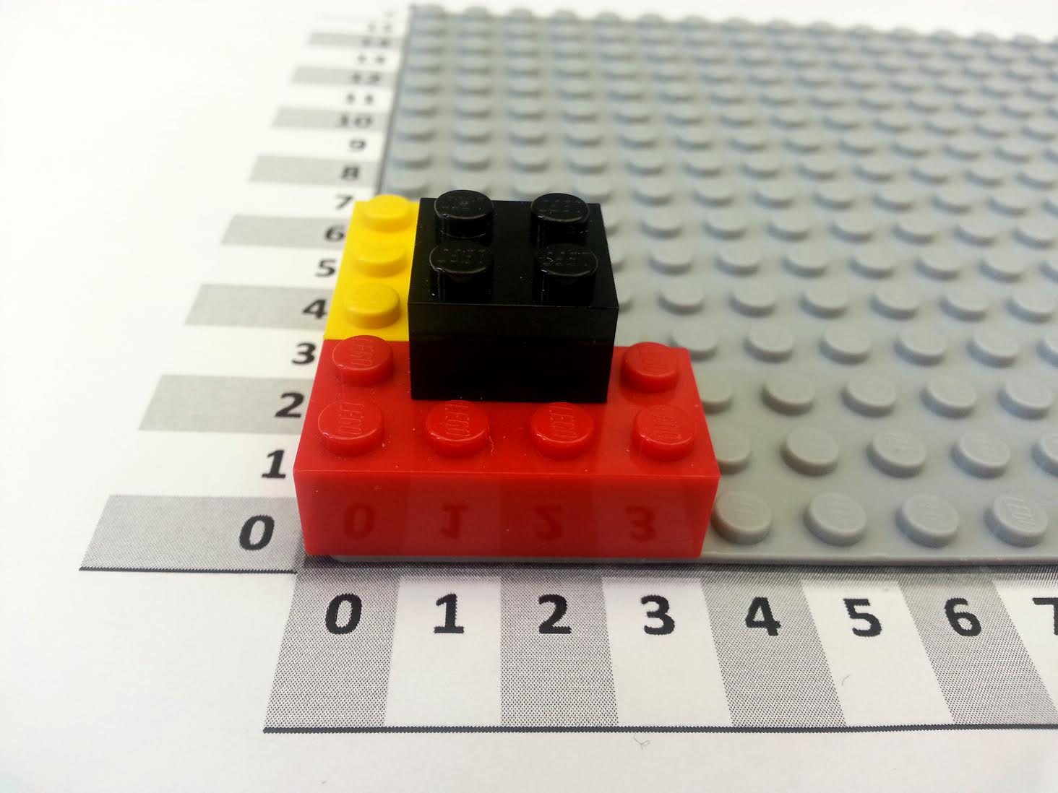
SOLUTIONS
When we give instructions, the order of the steps can matter! If you crack an egg and then cook it, you have a poached egg. If you cook an egg and then crack it, you have a hard-boiled egg.
We can represent each step as the addition of another block. Look at the instruction tables below. Do they produce the same LEGO tower? In other words, does order matter?
Block | Color | Size | Orientation | X | Y
0 | Red | 2 x 4 | Horizontal | 0 | 0
1 | Yellow | 2 x 3 | Vertical | 0 | 2
2 | Black | 2 x 2 | Horizontal | 1 | 1
Block | Color | Size | Orientation | X | Y
0 | Black | 2 x 2 | Horizontal | 1 | 1
1 | Yellow | 2 x 3 | Vertical | 0 | 2
2 | Red | 2 x 4 | Horizontal | 0 | 0

Slide 8
SOLUTIONS
Color
Red | 001
Yellow | 010
Black | 011
Here’s a legend for the encoding we’ve been using to convert our regular instruction table to a binary instruction table.
You’ve already converted the color, size, orientation, and position. Now convert the block number from base 10 to binary.
Size
2 x 2 | 010010
2 x 3 | 010011
2 x 4 | 010100
Block | Color | Size | Orientation | X | Y
0 | Red | 2 x 4 | Horizontal | 0 | 0
1 | Yellow | 2 x 3 | Vertical | 0 | 2
2 | Black | 2 x 2 | Horizontal | 1 | 1
Orientation
Horizontal | 00
Vertical | 01
Numbers
1 | 001
2 | 010
3 | 011
4 | 100
5 | 101
6 | 110
Block | Color | Size | Orientation | X | Y
000 | 001 | 010100 | 00 | 000 | 000
001 | 010 | 010011 | 01 | 000 | 010
010 | 011 | 010010 | 00 | 001 | 001
Now you have a complete binary instruction table!

Slide 9
Activity: Building the Encoding
SOLUTIONS
Color
Red | 001
Yellow | 010
Black | 011
Here’s an encoded instruction table for a small LEGO tower. Can you figure out what this tower is supposed to look like?
Hint: first, decode the instruction table using the legend on the left, and then follow the instructions to recreate the tower.
Size
2 x 2 | 010010
2 x 3 | 010011
2 x 4 | 010100
Block | Color | Size | Orientation | X | Y
0000 | 010 | 010010 | 01 | 000 | 000
0001 | 001 | 010010 | 01 | 011 | 000
0010 | 001 | 010011 | 00 | 001 | 000
0011 | 010 | 010011 | 00 | 001 | 000
Orientation
Horizontal | 00
Vertical | 01
Numbers
1 | 001
2 | 010
3 | 011
4 | 100
5 | 101
6 | 110
Block | Color | Size | Orientation | X | Y
0 | Yellow | 010010 | 01 | 000 | 000
1 | Red | 010010 | 01 | 011 | 000
2 | Red | 010011 | 00 | 001 | 000
3 | Yellow | 010011 | 00 | 001 | 000

