Slide 1
Encoding LEGO Blocks Additional Practice
Name(s): _______________________
You’ve already tried encoding instructions to build a LEGO tower into binary and decoding binary instructions to build a LEGO tower.
What are some advantages of encoding the instructions?
What are some disadvantages of encoding the instructions into binary?
How might you some some of those problems?

Slide 2
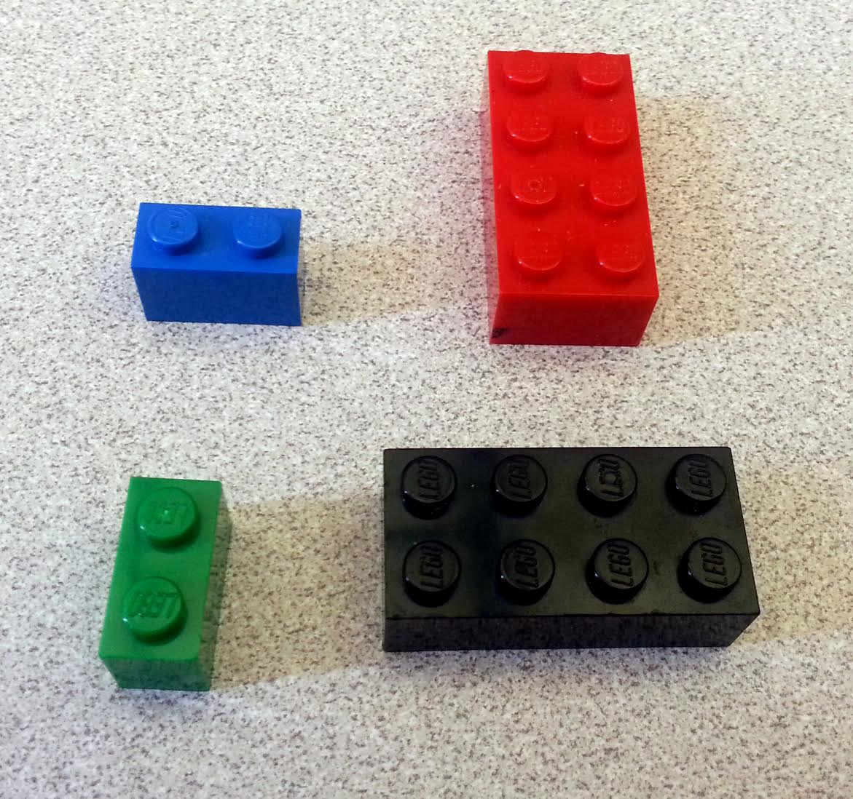
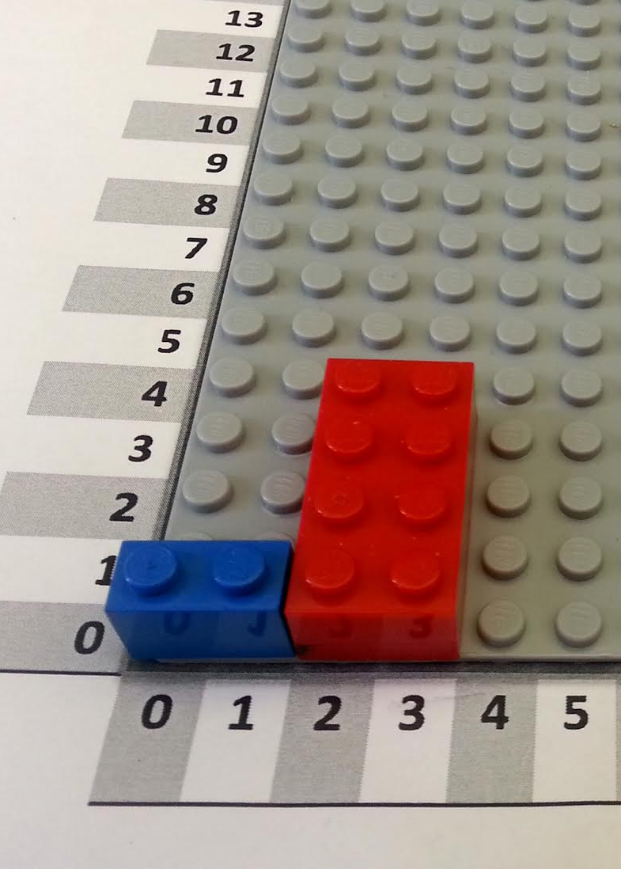
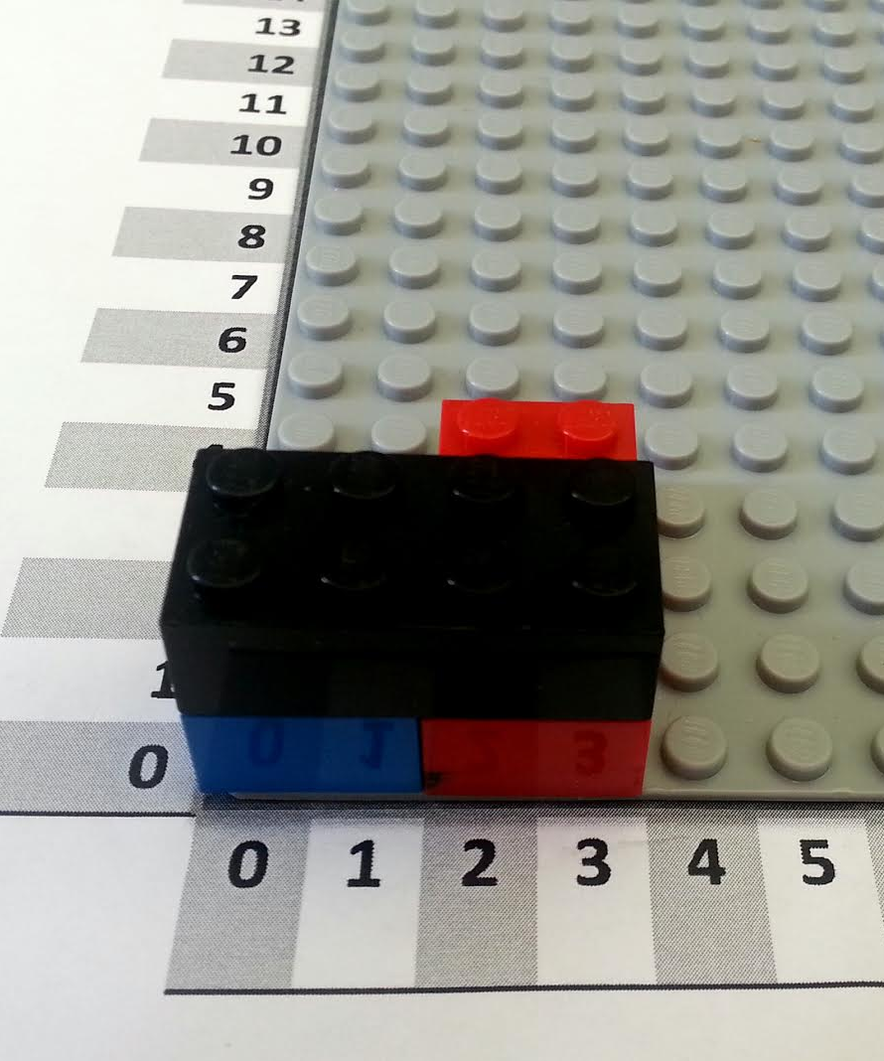
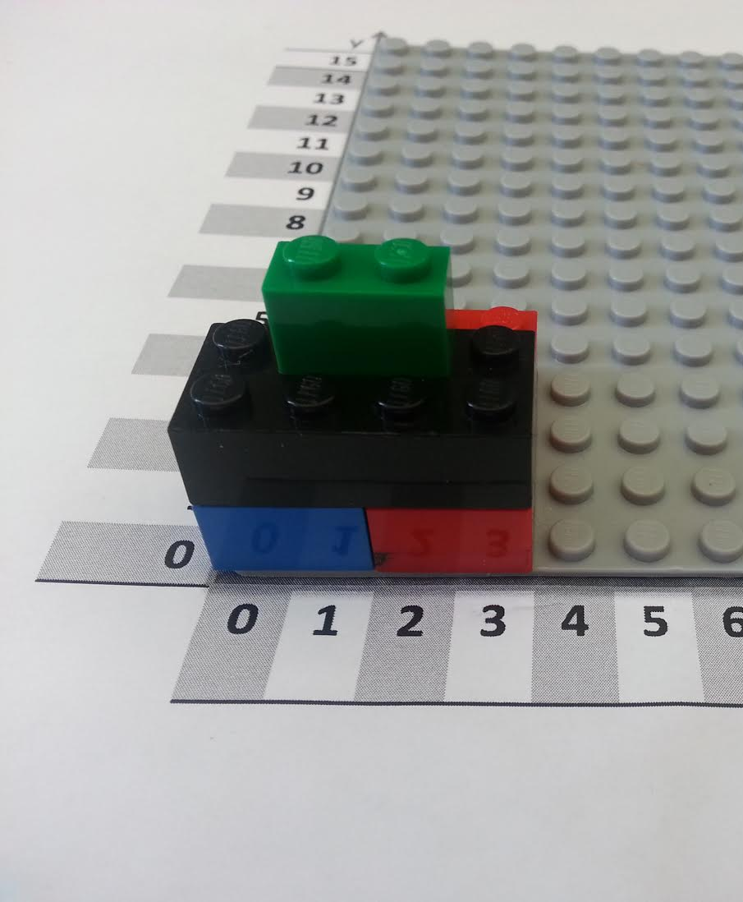
Color
Red | 001
Yellow | 010
Black | 011
Brick Type
2 x 4 | 010100
2 x 3 | 010011
2 x 2 | 010010
Can you make an instruction table for this tower?
Hint: start with a normal instruction table, and then encode it into binary afterwards.
You might need to add some colors and sizes to the legend on the left!
Block | Color | Size | Orientation | X | Y
Orientation
Horizontal | 00
Vertical | 01
Block | Color | Size | Orientation | X | Y
Number
1 | 001
2 | 010
3 | 011
4 | 100
5 | 101
6 | 110

Slide 3
Color
Red | 001
Yellow | 010
Black | 011
Blue | 100
White | 101
Here’s an encoded instruction table for a small LEGO tower. Can you figure out what this tower is supposed to look like?
Hint: first, decode the instruction table using the legend on the left, and then follow the instructions to recreate the tower.
Block | Color | Size | Orientation | X | Y
000 | 100 | 010100 | 00 | 010 | 001
001 | 100 | 010100 | 00 | 001 | 001
010 | 100 | 010010 | 01 | 101 | 001
011 | 011 | 001001 | 01 | 011 | 010
100 | 101 | 001011 | 00 | 010 | 010
101 | 101 | 001010 | 00 | 011 | 010
Brick Type
2 x 4 | 010100
2 x 3 | 010011
2 x 2 | 010010
1 x 1 | 001001
1 x 2 | 001010
1 x 3 | 001011
Orientation
Horizontal | 00
Vertical | 01
Here’s an empty table you can fill with the decoded block attributes:
Block | Color | Size | Orientation | X | Y
Number
1 | 001
2 | 010
3 | 011
4 | 100
5 | 101
6 | 110

