Slide 1
Encoding LEGO Blocks Additional Practice
SOLUTIONS
You’ve already tried encoding instructions to build a LEGO tower into binary and decoding binary instructions to build a LEGO tower.
What are some advantages of encoding the instructions?
Computers and machines ultimately carry out instructions in binary via the presence or absence of an electric signal, which is represented as a 1 or 0
Encoding requires a systematic, consistent definition of attributes like color, size, position, and orientation. The legend needs to include all cases and encode the same attribute the same way every time! Humans describe things inconsistently.
Lots of other possibilities here! Creativity is welcome.
What are some disadvantages of encoding the instructions into binary?
How might you some some of those problems?
1s and 0s are incomprehensible to most humans. We can solve this problem by including a legend so that we can decode the binary instructions. We can also create binary encodings that are intuitive, or follow some pattern, rather than ones that are random and need to be memorized. An example is encoding the size of the blocks by converting their dimensions into binary, rather than just number all the possible sizes (1 x 1 is 00, 1 x 2 is 01, 2 x 2 is 10, and so on)
Again, lots of possibilities! Creativity welcome.

Slide 2
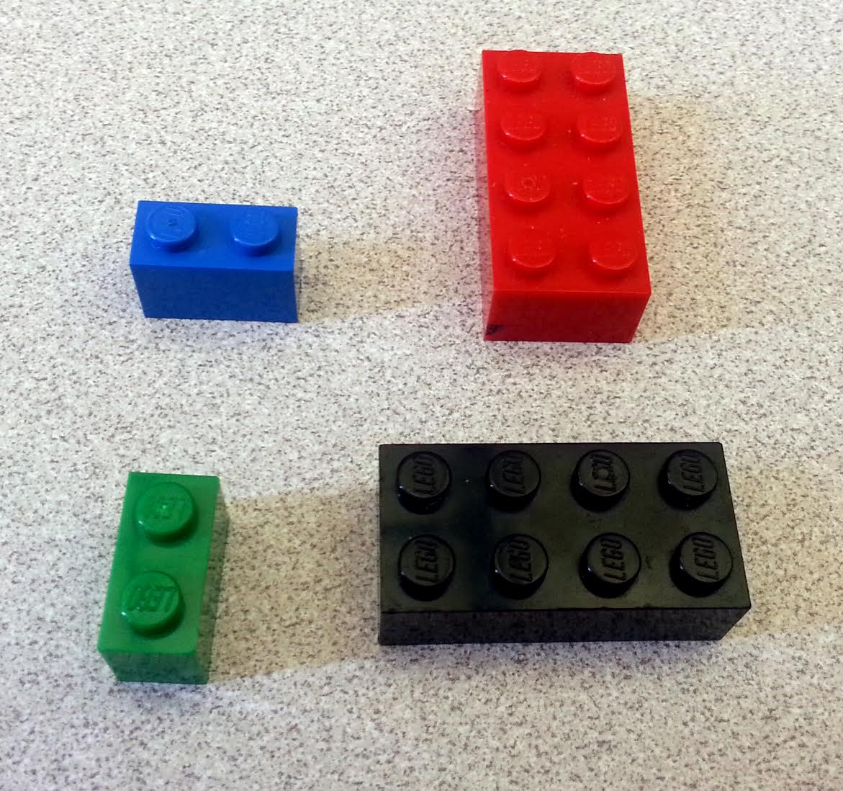
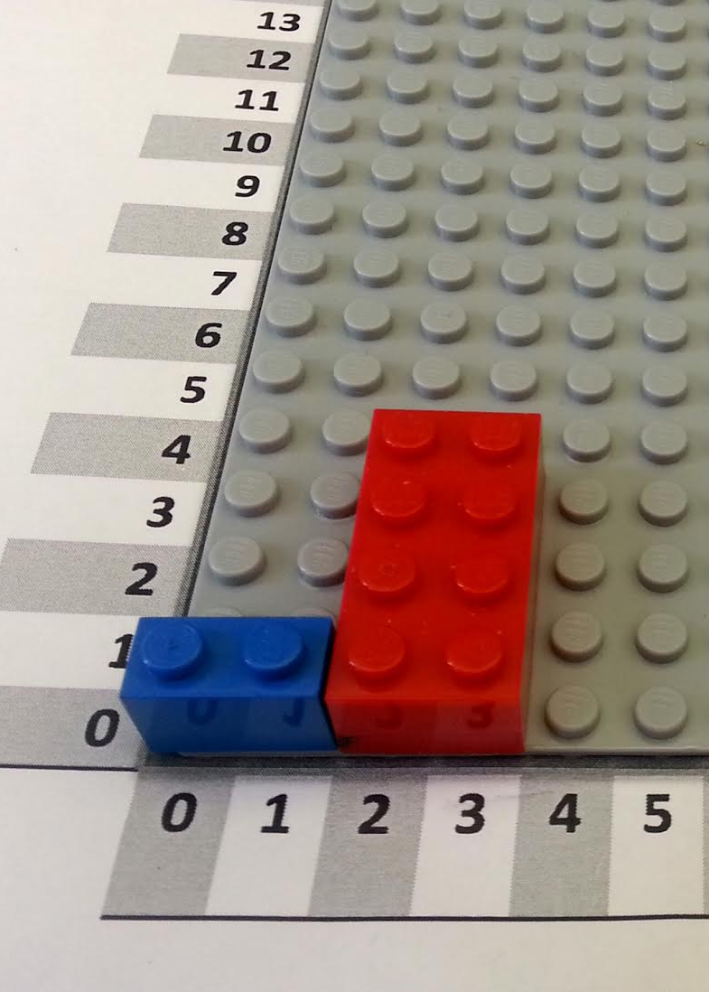
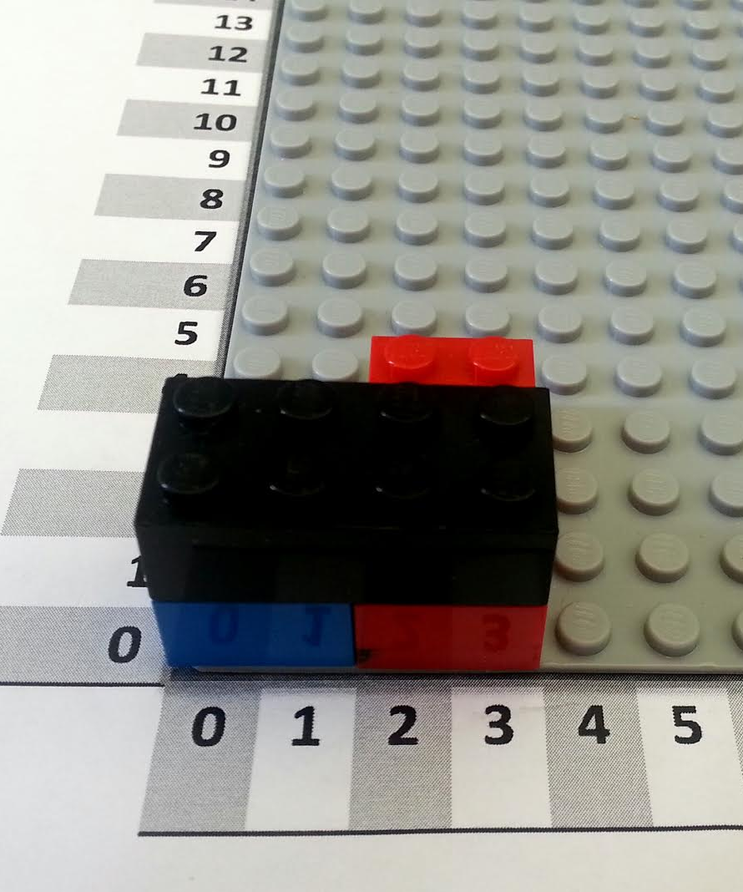
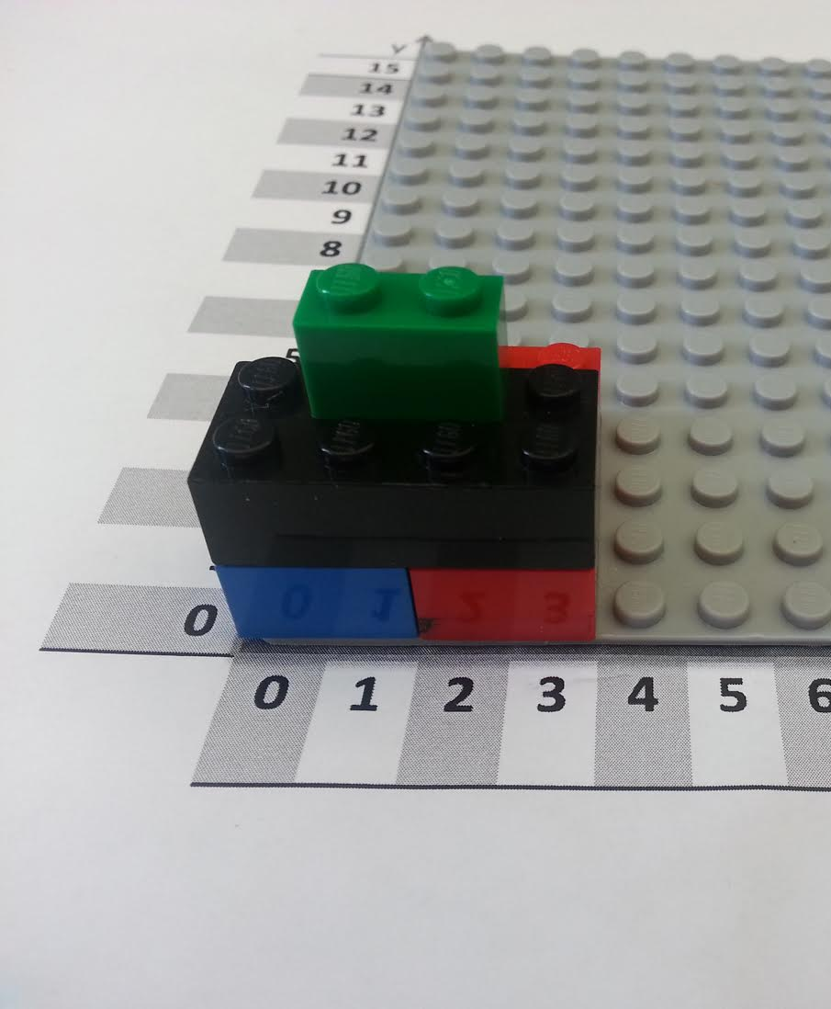
SOLUTIONS
Color
Red | 001
Yellow | 010
Black | 011
Blue | 100
Green | 101
Brick Type
2 x 4 | 010100
2 x 3 | 010011
2 x 2 | 010010
1 x 2 | 001010
Can you make an instruction table for this tower?
Hint: start with a normal instruction table, and then encode it into binary afterwards.
You might need to add some colors and sizes to the legend on the left.
Block | Color | Size | Orientation | X | Y
0 | Blue | 1 x 2 | Horizontal | 0 | 0
1 | Red | 2 x 4 | Vertical | 2 | 0
2 | Black | 2 x 4 | Horizontal | 0 | 0
3 | Green | 1 x 2 | Horizontal | 1 | 1
Orientation
Horizontal | 00
Vertical | 01
The binary instruction table may vary depending on what they put in their legend!
Number
1 | 001
2 | 010
3 | 011
4 | 100
5 | 101
6 | 110
Block | Color | Size | Orientation | X | Y
00 | 100 | 001010 | 00 | 000 | 000
01 | 001 | 010100 | 01 | 010 | 000
10 | 011 | 010100 | 00 | 000 | 000
11 | 101 | 001010 | 00 | 001 | 001

Slide 3
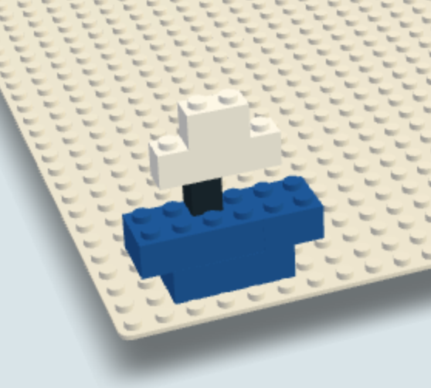
Color
Red | 001
Yellow | 010
Black | 011
Blue | 100
White | 101
SOLUTIONS
Can you figure out what this tower is supposed to look like?
Hint: first, decode the instruction table using the legend on the left, and then follow the instructions to recreate the tower.
Block | Color | Size | Orientation | X | Y
000 | 100 | 010100 | 00 | 010 | 001
001 | 100 | 010011 | 00 | 001 | 001
010 | 100 | 010010 | 01 | 101 | 001
011 | 011 | 001001 | 01 | 011 | 010
100 | 101 | 001100 | 00 | 010 | 010
101 | 101 | 001010 | 00 | 011 | 010
Brick Type
2 x 4 | 010100
2 x 3 | 010011
2 x 2 | 010010
1 x 1 | 001001
1 x 2 | 001010
1 x 4 | 001100
Orientation
Horizontal | 00
Vertical | 01
Here is an image of the resulting structure built from the the decoded instruction table
Block | Color | Size | Orientation | X | Y
0 | Blue | 2 x 4 | Horizontal | 2 | 1
1 | Blue | 2 x 3 | Horizontal | 1 | 1
2 | Blue | 2 x 2 | Vertical | 5 | 1
3 | Black | 1 x 1 | Vertical | 3 | 2
4 | White | 1 x 4 | Horizontal | 2 | 2
5 | White | 1 x 2 | Horizontal | 3 | 2

