Slide 1
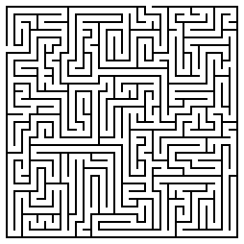
Name(s): _______________________
Problem Solving and Mazes
The Basic Maze:
Can you solve the maze on the left? Start at the entrance on the left, and try to exit out of the top.
As you work, make note of the steps and strategies you used to solve the maze below:
http://www.uefap.com/speaking/exercise/mazes/mazes.htm

Slide 2
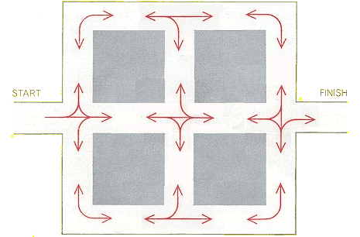
Name(s): _______________________
The Restricted Maze:
Travel along the white roads from start to finish. At each intersection, you must follow one of the red arrows. You may only travel in a certain direction only when there is an arrow that follows the same path. For example, You cannot make a right turn from the starting point.
http://www.logicmazes.com/
How is this maze different from the first one? What strategies did you use to solve it?

Slide 3
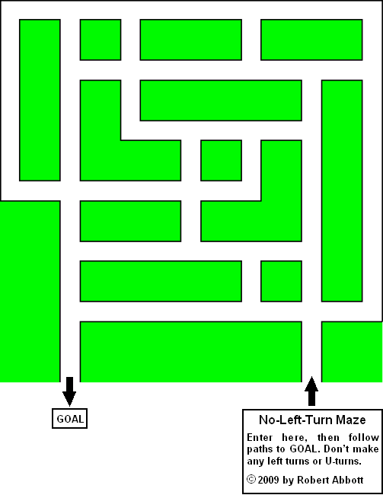
Name(s): _______________________
The No-Left-Turn Maze:
Can you solve this maze? Follow the path to get to the goal, but do NOT make any LEFT turns. At each intersection, you may only go straight or turn right.
How is this maze different?
What were the strategies you used to solve this maze?
http://www.logicmazes.com/

Slide 4
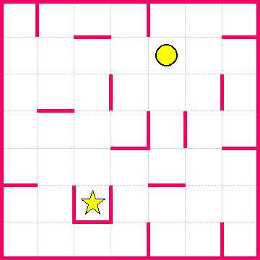
Name(s): _______________________
The Tilt Maze:
This maze is like the party favor toy: you are the yellow ball and you want to get to the yellow star. When you choose a direction to go in, you must keep traveling in that direction until you hit one of the red barriers. You must travel in a straight line, and you can only choose a new direction to move in if you’ve been stopped by a barrier.
How is this puzzle different from the first three? What new rules did you have to follow?
What strategies did you use to solve this maze?
http://www.logicmazes.com/

Slide 5
Name(s): _______________________
Create Your Own Maze:
In the space below, draw your own maze and write down a set of rules for your maze next to your maze (it could be as simple as “start here and end at the star” or it could be more complicated!). When you are finished, hand your maze to your partner and go onto the next page.

Slide 6
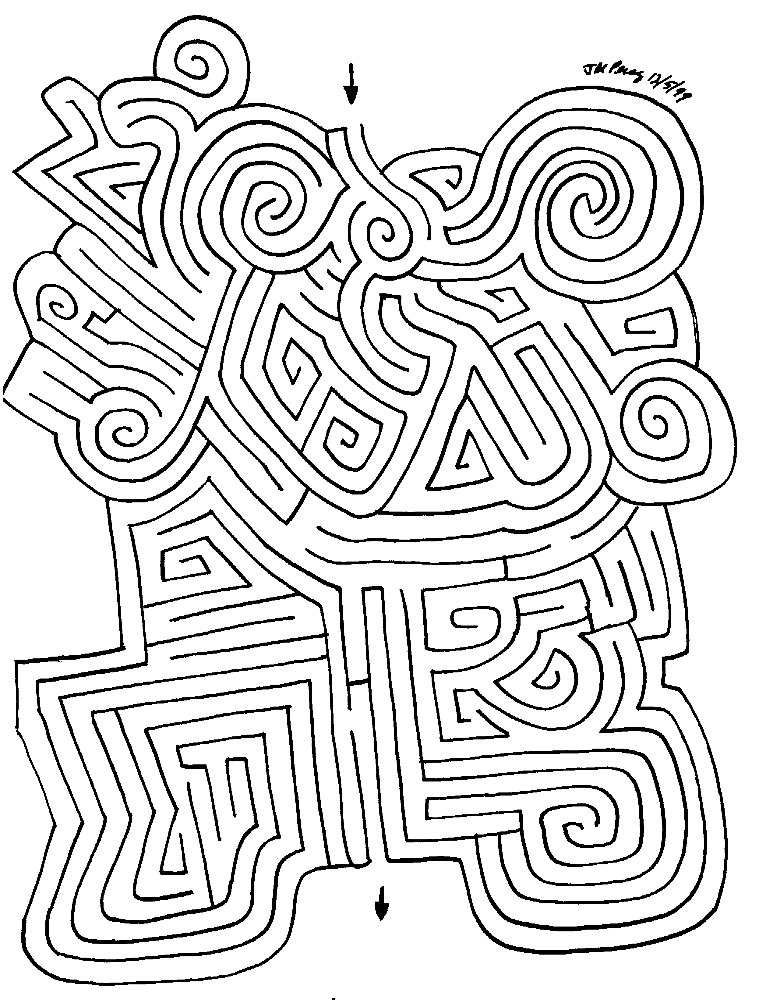
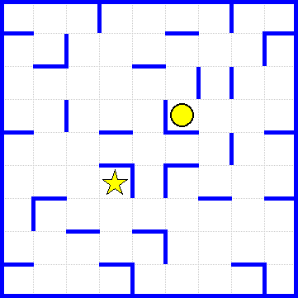
Name(s): _______________________
Bonus Mazes: If you finish early, work on the mazes below.

