Slide 1
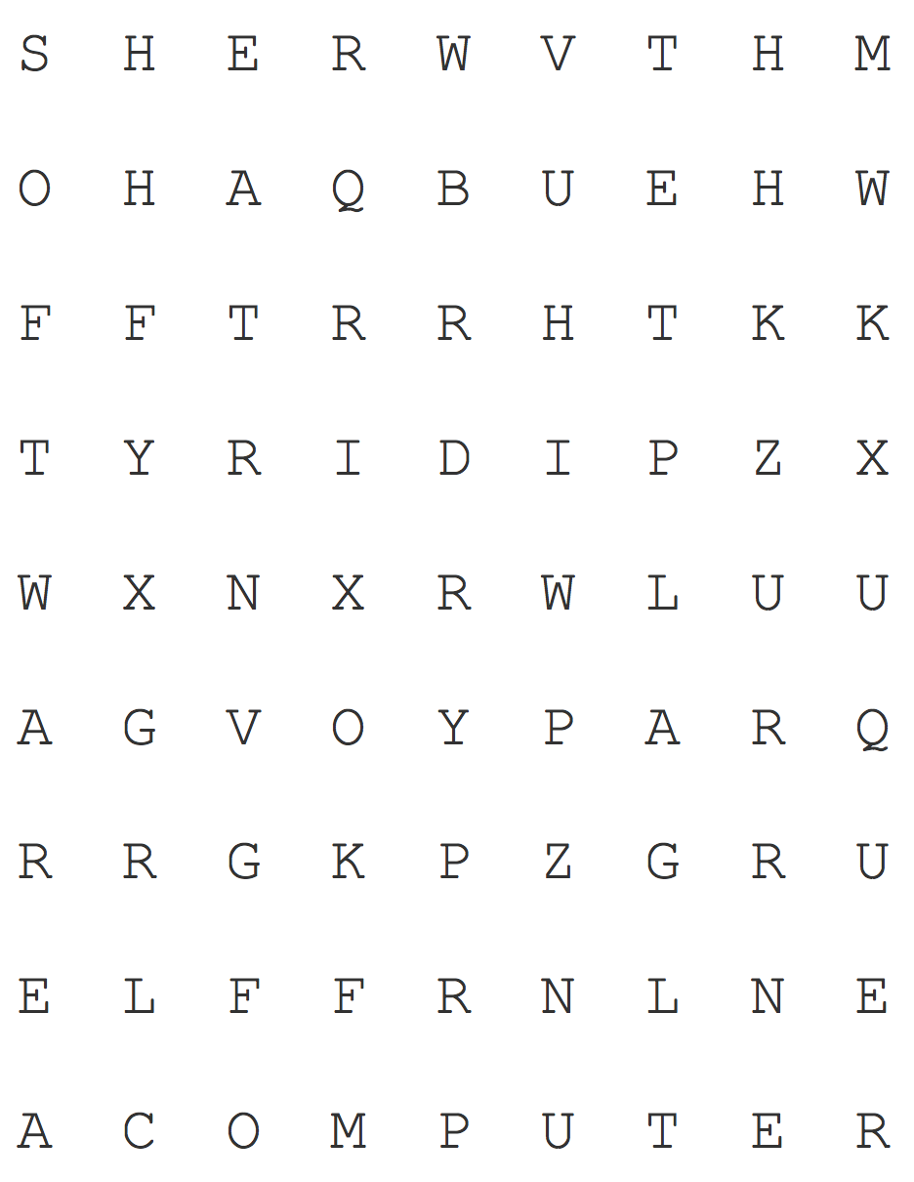
Solutions
Solving Puzzles
Puzzle 1: Word Search
Sample Algorithm:
Pick a word from the list of words you need to find.
Go through each of the letters in the grid one by one and see if it’s the same letter as the first letter of the the word you’re trying to find.
If it is, check its 8 neighboring letters (up, down, left, right, and 4 diagonals) to see if it’s the second letter in the word you’re trying to find. Then, check for the 3rd, 4th… letters until you’ve found all of the letters that make the word. Go to step 3.
If it’s not, go back to step 2 and keep going through the grid of letters.
Cross out the word you’ve just found and move onto the next word. Repeat steps 1-3 until you’ve found and crossed out all of the words on your list.
Algorithms may vary, but the idea is that they should have a series of “foolproof” steps that anyone would be able to follow to solve the puzzle.

Slide 2
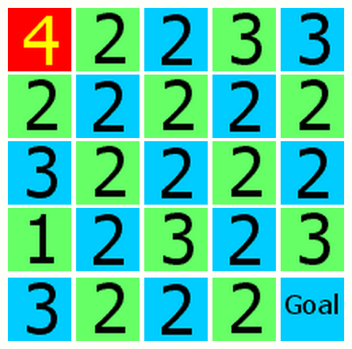
Puzzle 2: Number Maze
Solutions
Steps 1-4
Steps 5-8
Sample algorithm:
Start at the goal and look at all the tiles in its horizontal and vertical paths.
For each tile, see if it contains the correct number of steps to get to the goal.
For each tile that works, check its horizontal and vertical paths for tiles that contain the right number of steps to get to it.
Repeat until one of the tiles you get is the start tile.
You now have a reverse sequence of tiles, from goal to start. Reverse the path to get the sequence of tiles from start to goal.

Slide 3
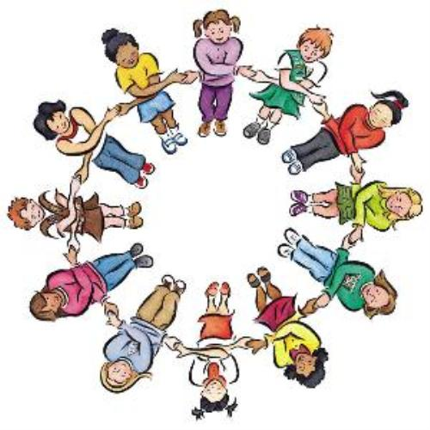
Name(s): _______________________
Puzzle 3: How many handshakes?
Each dot represents a person, and all the dots must be connected to one another with no repeats:
Instructions may vary, but here’s one set of instructions that works:
Have everyone stand in a circle
The first person should go around the circle and shake every other person’s hand.
The next person should go around the circle and shake every other person’s hand except for the first person.
The next person should go around the circle and shake every other person’s hand except for the first two people.
The next person should go around the circle and shake every other person’s hand except for the first three people.
Repeat, with each successive person going around the circle to shake everyone else’s hand until you get to the second-to-last person, who will shake one hand and complete the handshakes required.

Slide 4
Name(s): _______________________
Puzzle 3: How many handshakes?
Number of People | Number of Handshakes
2 | 1
3 | 3
4 | 6
5 | 10
6 | 15
7 | 21
8 | 28
9 | 36
10 | 47
Extra Credit: If there were 20 people at the party, it would take 190 handshakes
Extra Credit: If there were N people at the party, there would be handshakes
[(N-1)] + [(N-1) – 1] + [(N-1) – 2] + …. + [(N-1) – (N-2)] + [(N-1) – (N-1)]
= (N-1) + (N-2) + (N-3) + …. + 2 + 1 + 0
= (N-1) + (N-2+1) + (N-3+2) +…. = (N-1) + (N-1) + (N-1) + …. =

