Slide 1
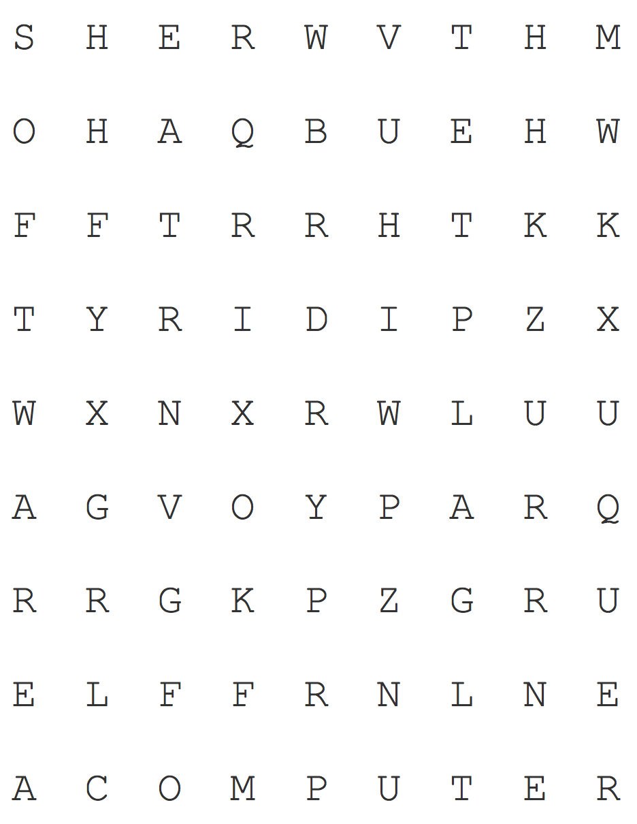
Name(s): _______________________
Solving Puzzles
Puzzle 1: Word Search
Find the following words:
Algorithm Software Hardware
Turing Computer
How did you solve the puzzle? Describe the steps you used to solve this particular word search.
Puzzle courtesy of http://puzzlemaker.discoveryeducation.com/

Slide 2

Name(s): _______________________
Now suppose you had to find 20 words in this puzzle, and then do 50 more like it—it would take a long time, and it probably wouldn’t be very fun, but you have an assistant who has a lot of free time and wants to help! However, your assistant has never done a word search before, and has no idea how to complete the puzzle!
In the space below, write a list of detailed, precise instructions for solving a word search that he or she can follow every time.
Puzzle courtesy of http://puzzlemaker.discoveryeducation.com/

Slide 3
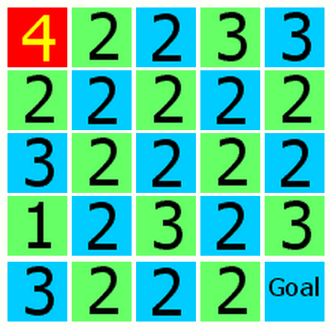
Name(s): _______________________
Puzzle 2: Number Maze
The number maze is a little trickier than the word search…
Start on the square at the upper left corner (in red). Make a series of moves that will take you to the square marked "Goal,” at the bottom right corner.
Each square has a number that indicates how far you must move when you leave the square. You can move horizontally or vertically, but only in a straight line: no turning! The two options for a first move are shown with red arrows.
Were you able to solve the puzzle? What strategies did you try?
Bonus: can you write a set of instructions to help someone solve any number maze?

Slide 4
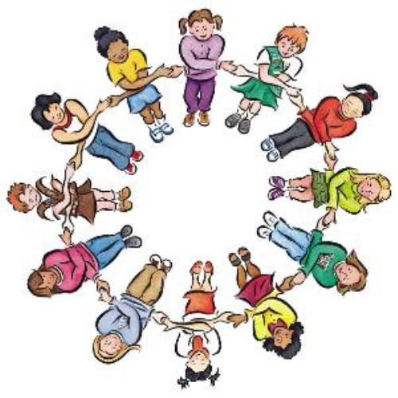
Name(s): _______________________
Puzzle 3: How many handshakes?
You’re throwing a party, but none of your guests know each other. You want them to introduce themselves to and shake hands with every other person in the party. How can you organize this so that you can make sure everyone shakes every other person’s hand without the party turning into chaos? Try drawing lines into the figures below for parties of 3, 4, 5, and 6 people. Each dot represents a person:
Create a set of step-by-step instructions to make sure everyone gets to shake every other person’s hand:

Slide 5
Name(s): _______________________
Puzzle 3: How many handshakes?
How many handshakes would be exchanged for a party of 3 people? 4? Fill in the table below:
Scratchwork:
Use this space to draw more pictures or do arithmetic
Number of People | Number of Handshakes
2 | 1
3 | 3
4
5
6
7
8
9
10
Extra Credit: If there were 20 people at the party, how many handshakes would it take?
Extra Credit: If there were N people at the party, how many handshakes would it take? N is a variable that represents the number of people at the party, and it can have any value that’s a whole number.

