Slide 1
Directions
Find a partner
Choose one person to be the artist and one person to be the chef
The artist should cut up the “color cards” while the chef cuts up the “food cards.”
The artist should shuffle the color cards and then place them in a row on the desk.
The chef should now try to find the “red” card by turning over one card at a time.
After the chef finds the “red” card, the chef should shuffle the the food cards and place them in a row on the desk.
The artist should now try to find the “pizza” card by turning over one card at a time.

Slide 2
Color Cards
RED
YELLOW
GREEN
BLUE
PURPLE
ORANGE
BLACK
WHITE

Slide 3


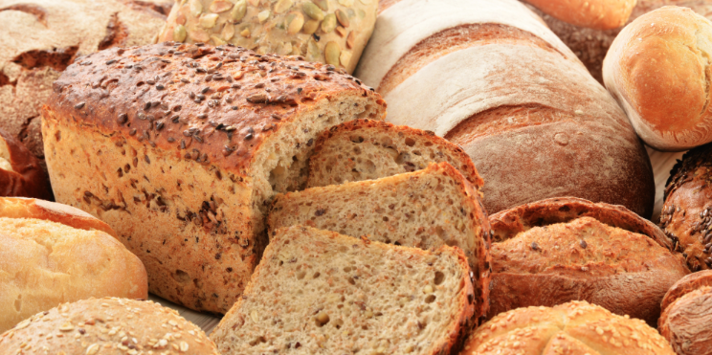



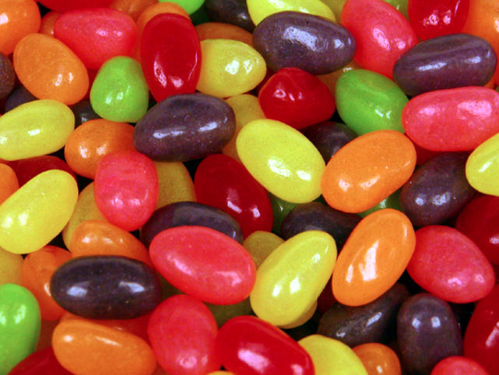
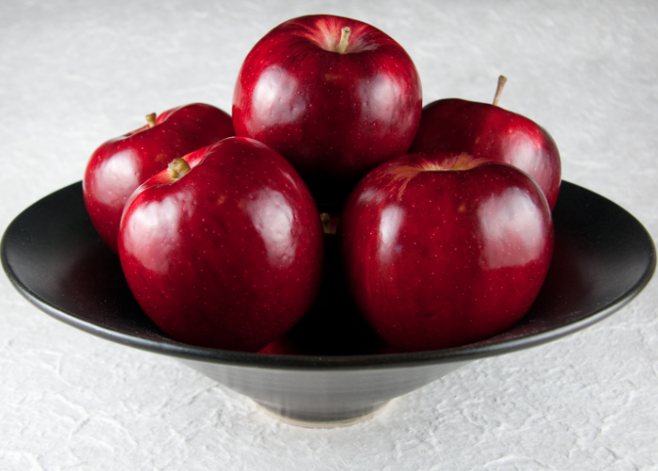
Food Cards
PIZZA
CARROTS
YOGURT
BREAD
SOUP
EGGS
JELLY BEANS
APPLE

