Slide 1
MyCS
Middle-years' Computer Science
Welcome
everyone!
July 21 – June 25, 2014

Slide 2
Day 1: Computers & CS
Welcome to Harvey Mudd College’s Middle Years’ Computer Science workshop, 2014! We have both a workshop and a MyCS website:
workshop website
MyCS website
www.cs.hmc.edu/MyCS
www.muddx.com
Username: muddxguest@gmail.com
Password: welcometomuddx
Here is a brief outline of today’s activities!
Segment 1:
“What is a Computer?” video
“What is a Computer?” post-it activity
Segment 2:
Computer disassembly & hardware activity
20 questions (if time permits)
Segment 3 (WhyCS):
IBM’s Watson
Segment 4:
Flappy Bird activity
Programming! through graphical mazes…

Slide 3
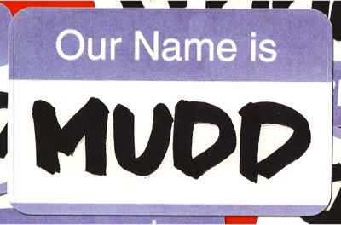
Housekeeping: where? when?
Introductions: who?
Welcome: Why CS? and MyCS...
Dive in!

Slide 4
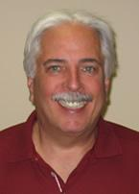
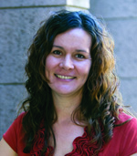
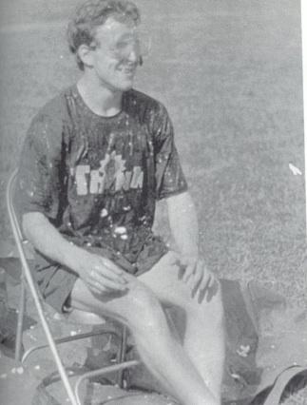
Housekeeping
Restrooms...
Parking… ?
Introductions:
gone to NSF
Mike Erlinger
Gabriela Gamiz
Zach Dodds
and many more introductions…

Slide 5
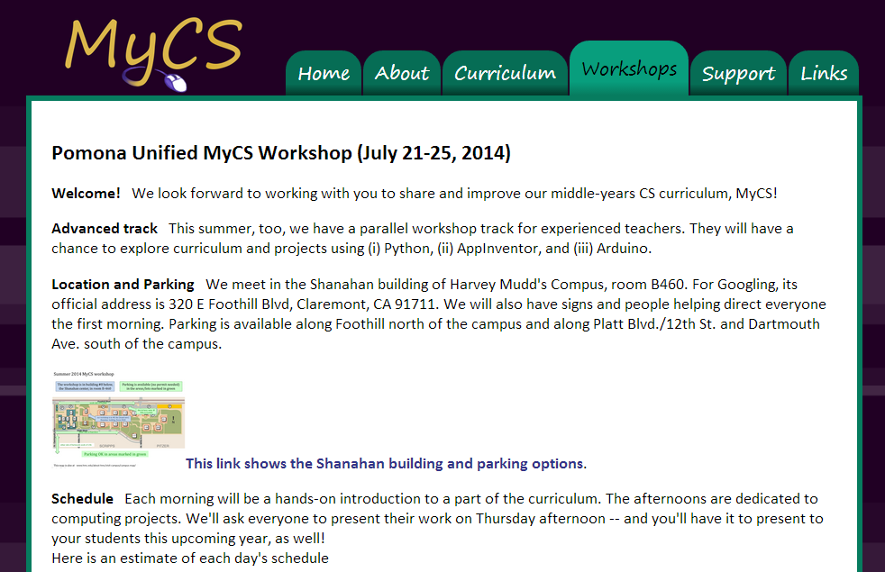
Workshop site…
Two workshop tracks…
www.cs.hmc.edu/MyCS

Slide 6
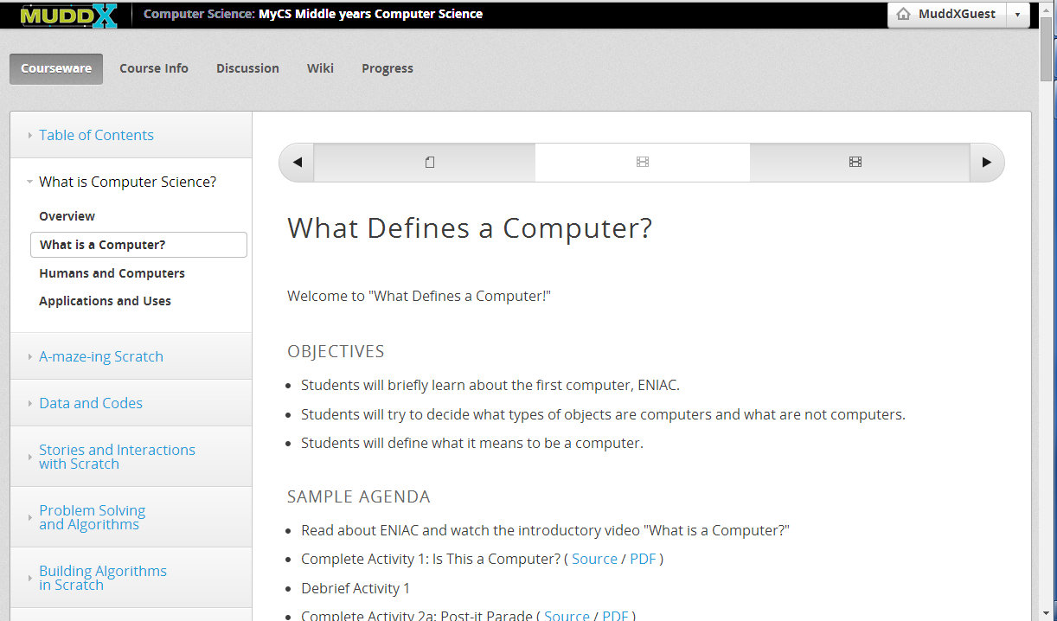
Online curriculum
login provided
all of the lesson plans incl. videos, context, + activities

Slide 7
This week's schedule
Newcomers
MyCS
Mon.
Tue.
Wed.
Thu.
Morning – activities and demonstrations for the full group.
Afternoon everyone shows off one of the projects they built this week. primarily because we hope you will show it to your students…!
Fri.

Slide 8
This week's schedule
Returners
Newcomers
MyCS
Mon.
Python programming
AppInventor
Tue.
Python programming
Arduino, Circuits, and Robots
Wed.
AppInventor
Arduino, Circuits, and Robots
Thu.
Morning – activities and demonstrations for the full group.
Afternoon everyone shows off one of the projects they built this week. primarily because we hope you will show it to your students…!
Fri.
No workshop on Friday.

Slide 9
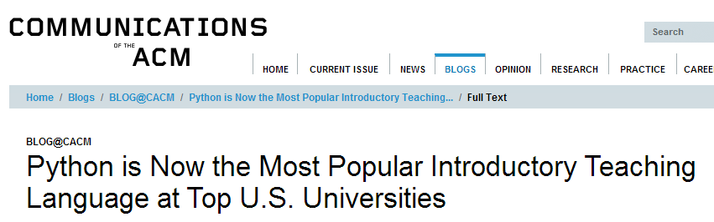
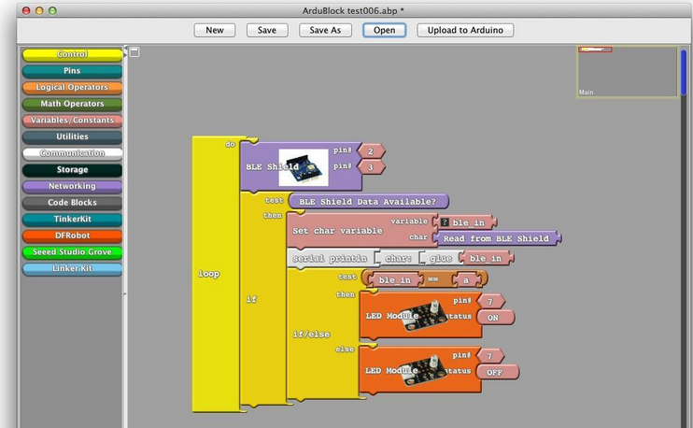
Returning track? Three modules:
Python
AppInventor
Arduino, circuits, and robots

Slide 10
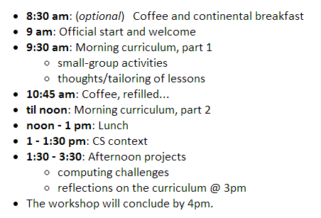
Daily Schedule
"get involved in projects which are as meaningful as possible"
S.L.

Slide 11
Daily Schedule
"get involved in projects which are as meaningful as possible"
S.L.

Slide 12
Why CS?
MyCS
Computer Science
Middle-years CS

Slide 13
Why CS?
CS is "good for you."
CS is interesting + important.
CS is empowering + fun.
Notes:
the medium is, in fact, the message (for the time being) -- absolutely true in the first world, and increasingly so in less wealthy nations, as well

Slide 14
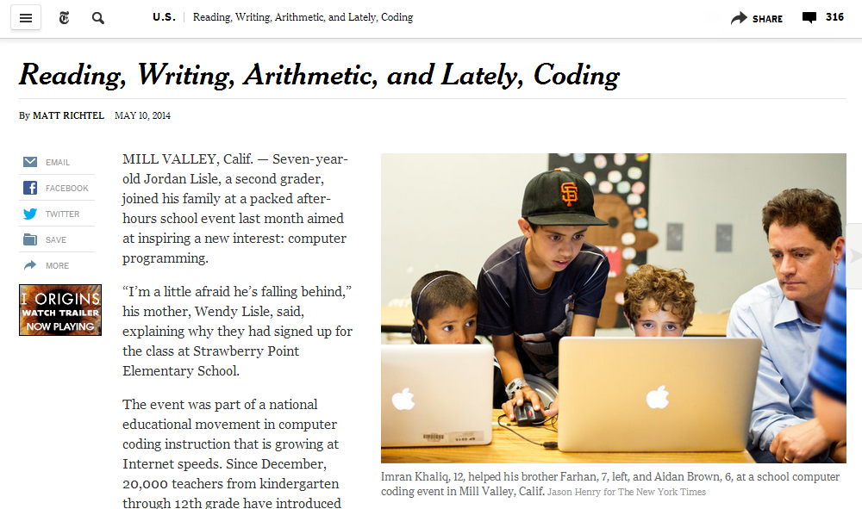
"good for you"?
We are in an era of Computer Science.
http://www.nytimes.com/2014/05/11/us/reading-writing-arithmetic-and-lately-coding.html
Notes:
the medium is, in fact, the message (for the time being) -- absolutely true in the first world, and increasingly so in less wealthy nations, as well

Slide 15
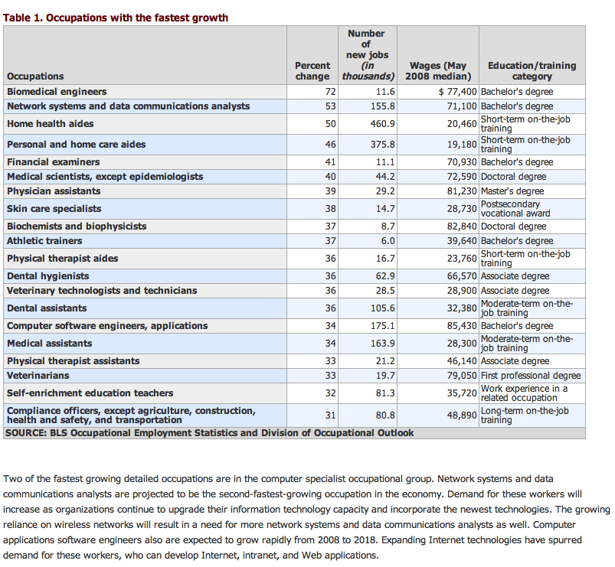
"good for you"?
Who reads these charts anyway?
Notes:
first-world flirting: we want to fall for a calling far more than third-world folks... (ROSE data)

Slide 16
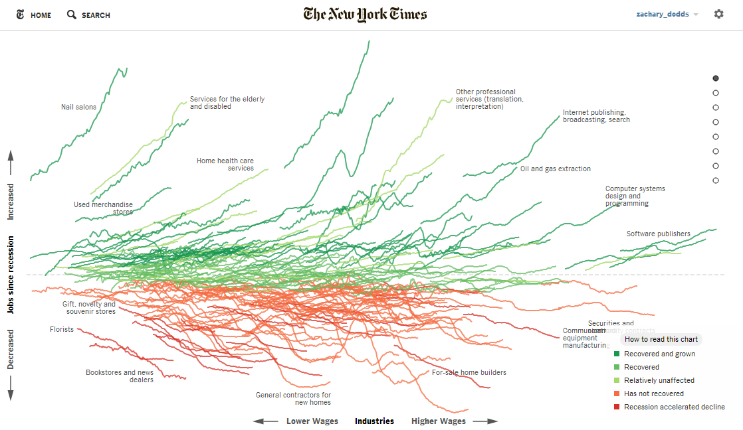
"good for you"?
http://www.nytimes.com/interactive/2014/06/05/upshot/how-the-recession-reshaped-the-economy-in-255-charts.html?_r=0
Notes:
first-world flirting: we want to fall for a calling far more than third-world folks... (ROSE data)

Slide 17
Why CS?
CS is good for you.
CS is engaging + important.
CS is empowering + fun.
Notes:
the medium is, in fact, the message (for the time being) -- absolutely true in the first world, and increasingly so in less wealthy nations, as well

Slide 18
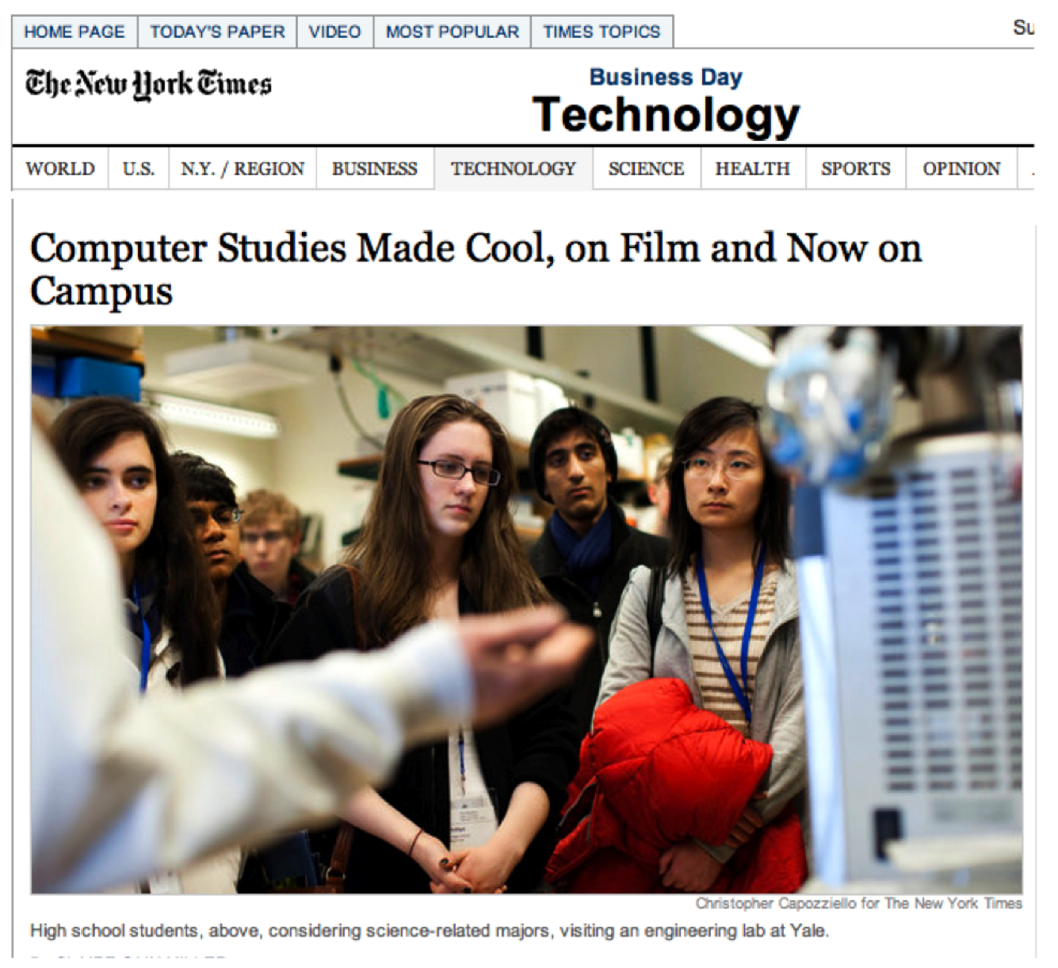
Why CS?
CS is engaging and important...
http://www.nytimes.com/2011/06/11/technology/11computing.html?scp=2&sq=computer%20science&st=cse

Slide 19
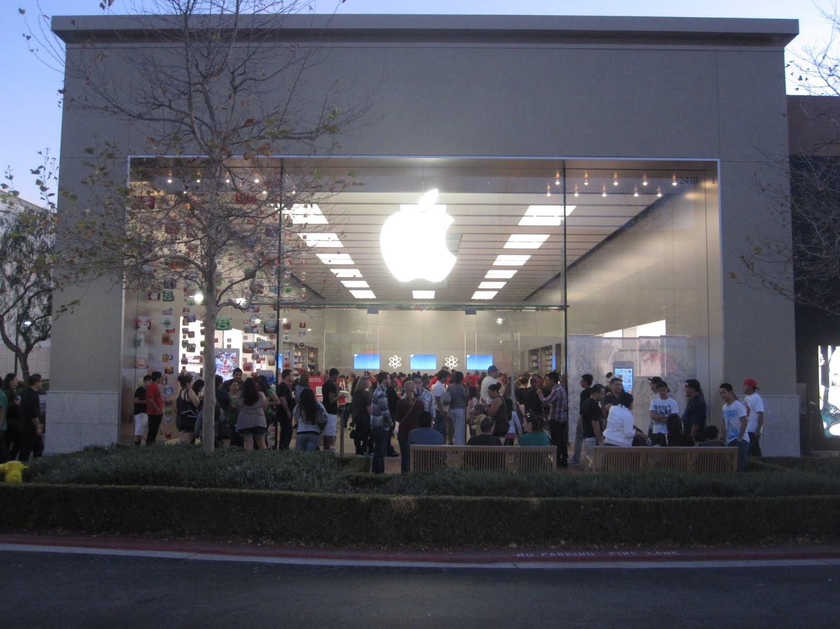
We buy in
January at the Victoria Gardens Apple Store

Slide 20
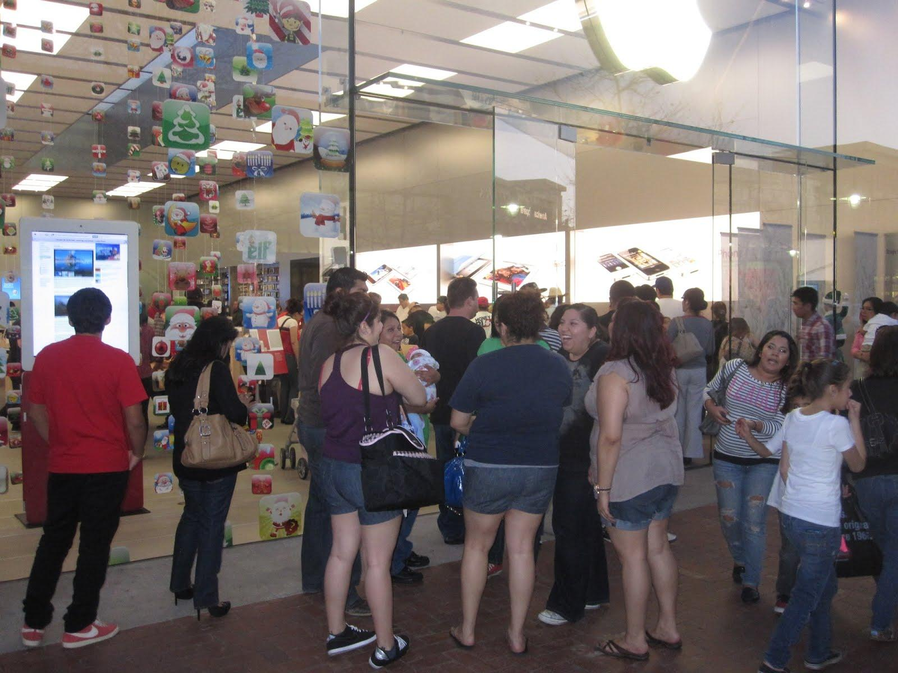
CS is us

Slide 21
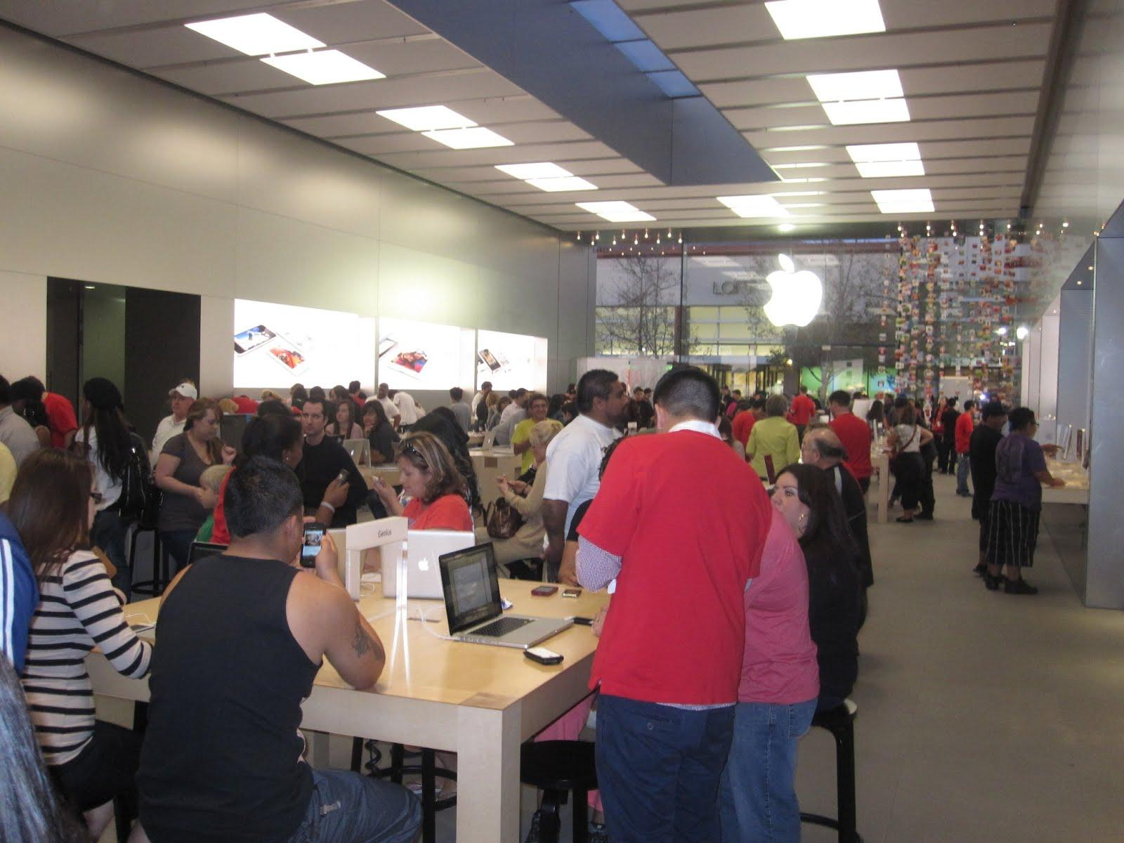
CS is us
it's not vs. !
Shifting roles: consumer vs. creator
January at the Victoria Gardens Apple Store
Notes:
phone interview with Pasadena magazine: "What do you do to get people interested in computer science?"

Slide 22
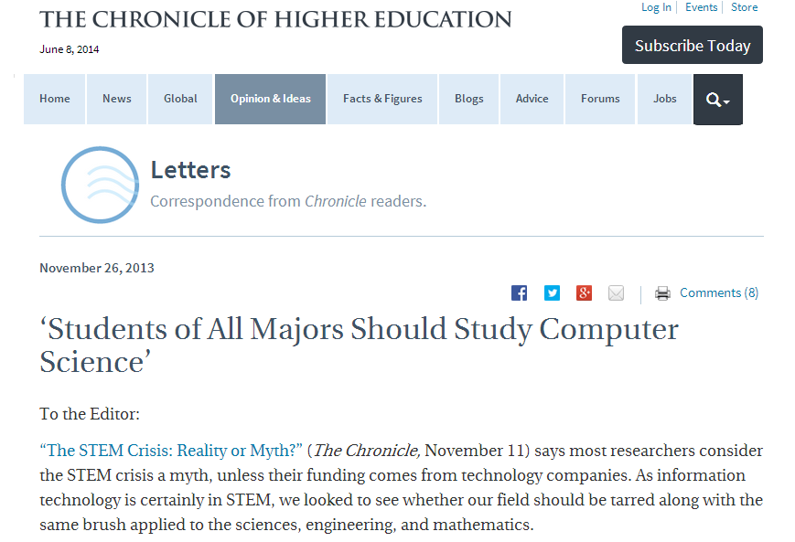
Why CS?
CS is engaging and important...
TBD: Who will consume vs. create it?
http://chronicle.com/blogs/letters/students-of-all-majors-should-study-computer-science/

Slide 23
Why CS?
CS is good for you.
CS is interesting + important.
CS is empowering + fun.
But, why does fun matter...?
Notes:
the medium is, in fact, the message (for the time being) -- absolutely true in the first world, and increasingly so in less wealthy nations, as well

Slide 24
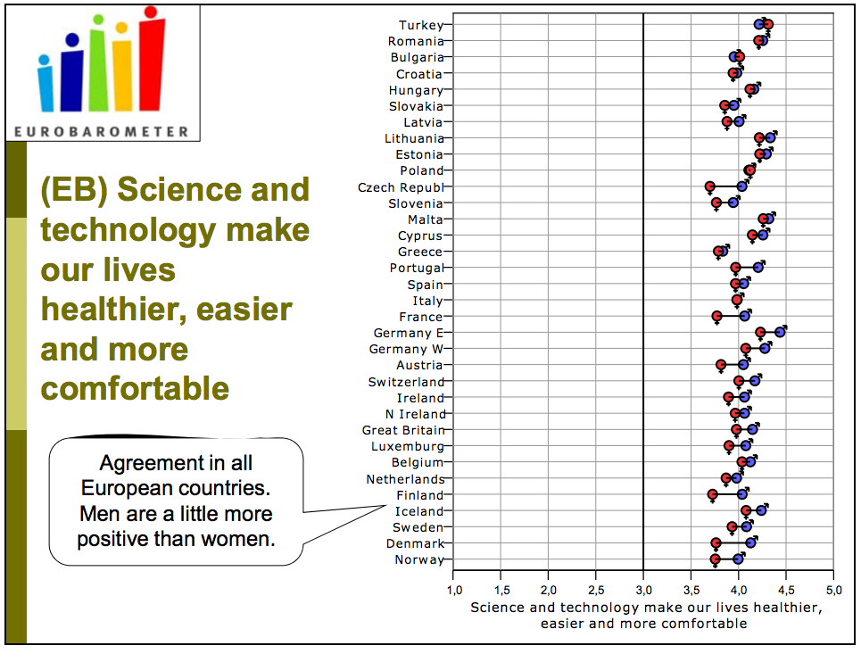
from the 40-nation study entitled ROSE: the Relevance of Science Education
Everyone likes CS!
Agreement across all cultures – not much gender difference
http://roseproject.no/network/countries/norway/eng/nor-Sjoberg-Schreiner-overview-2010.pdf

Slide 25
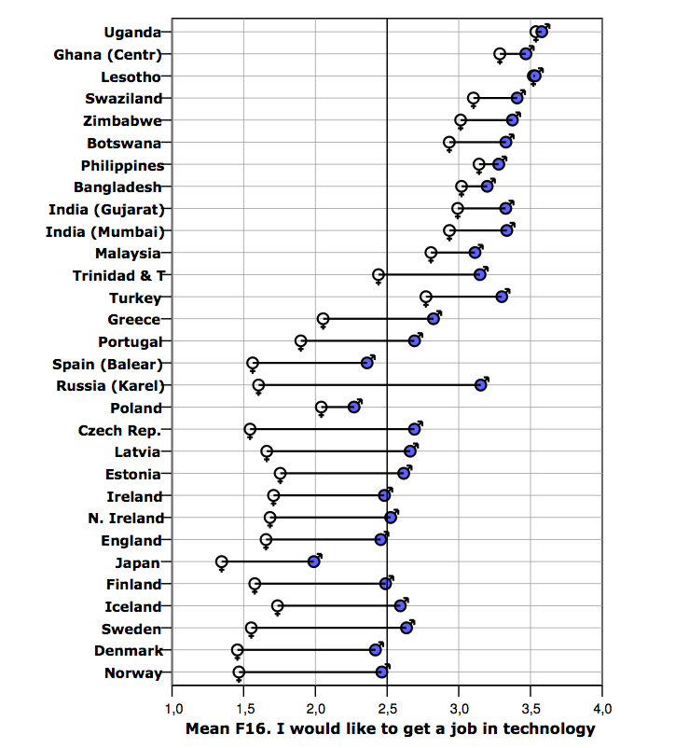
At least two major trends are evident here...
from the 40-nation study entitled ROSE: the Relevance of Science Education
among 15–16 yr. olds
"First-world problem" ?

Slide 26
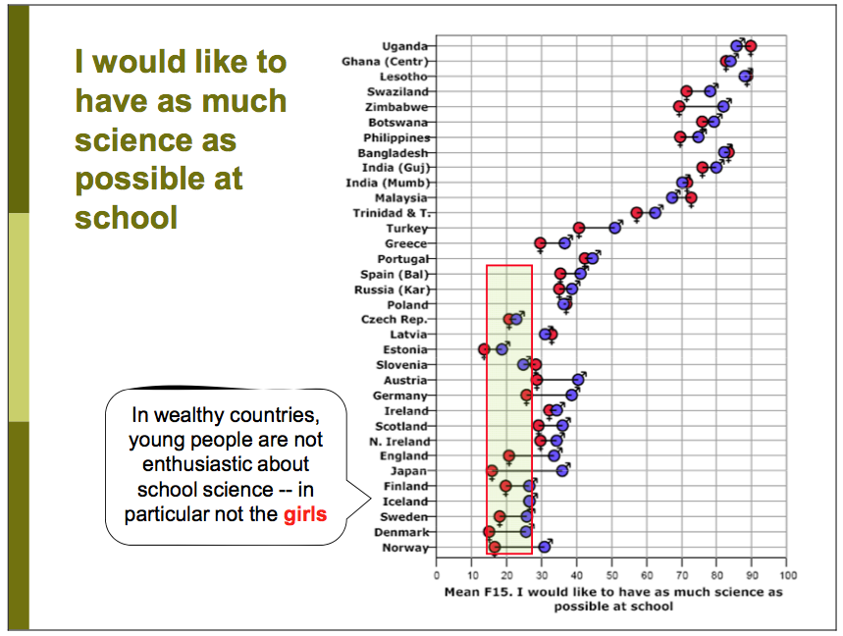

Slide 27
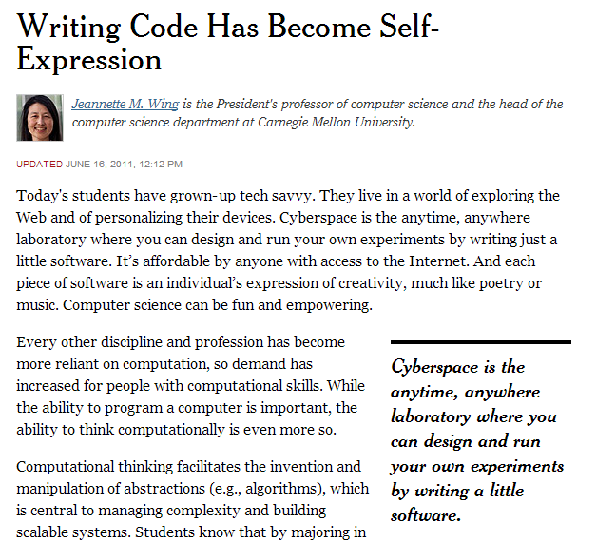
Fun?
CS is empowering + fun.

Slide 28
MyCS's goal…
… that more students say
Computing is something people like me do.
to measure this?

Slide 29
MyCS's goal…
… that more students say
Computing is something people like me do.
Computing is fun.
I like the challenge of computing.
I am good at computing.
Computer jobs are boring.
Programming is hard.
I'm interested in more computing.
I can become good at computing.
I'm interested in a computing career.
Pre vs. post interest
surveys are NSF's currency!

Slide 30
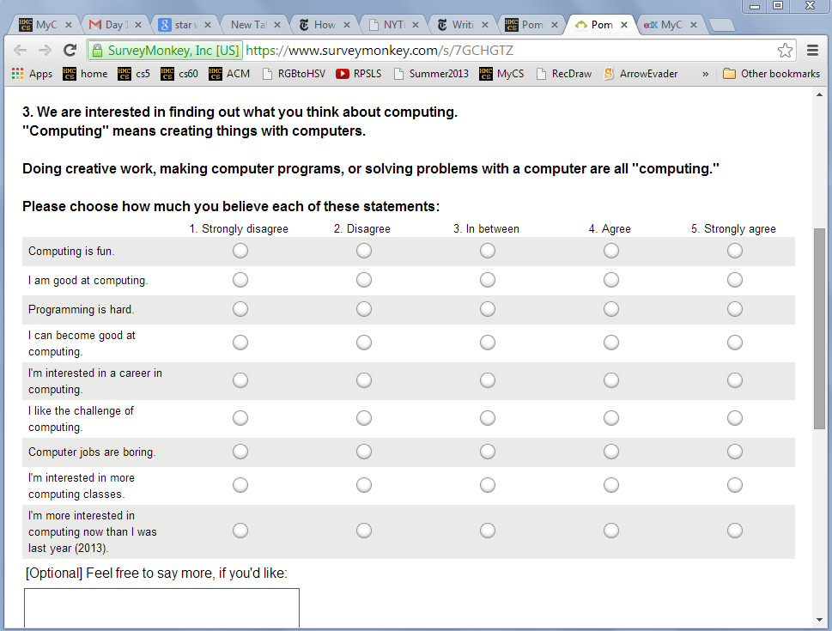
Student survey…
You'll take it this morning (~ 60 seconds)
Don't elaborate, because we have some ice-breaking surveys, as well…

Slide 31
Our pedagogy ?

Slide 32
Our pedagogy ?
yours

Slide 33
lesson contents
Our pedagogy ?
yours
personal interactions
you
us
n
We hope to learn from you
We hope to provide
what's worthwhile
what's not, and
why.
CS content
its context
a starting point

Slide 34
Now!
Newcomers
Returners
stay here in this room
half try Python; half try AppInventor
Introductions + surveys
Everyone should take our student survey – so you know what it is!
Then, take our background survey – mostly an ice-breaker/discussion prompts
Dive in to CS!

Slide 35
MyCS ?
MyCS is a one-term CS course developed for middle-school and "middle-years" audiences.
CS ideas and activities (vs. programming)
student creativity via hands-on skills,
can be spliced with technology classes, art and media arts classes, English, Math, science, and any other courses at all ... !
what
we adapt ECS, CommonSenseMedia, CSUnplugged, ...
look for what teachers will find most useful in terms of CS content and support materials
how

Slide 36
What is computing?
What is a computer?
a bit abstract...
everyone "knows" this
Where to start?

Slide 37
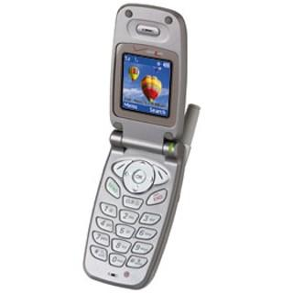
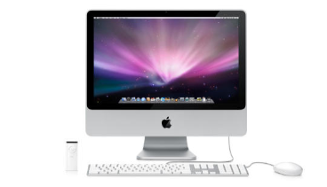
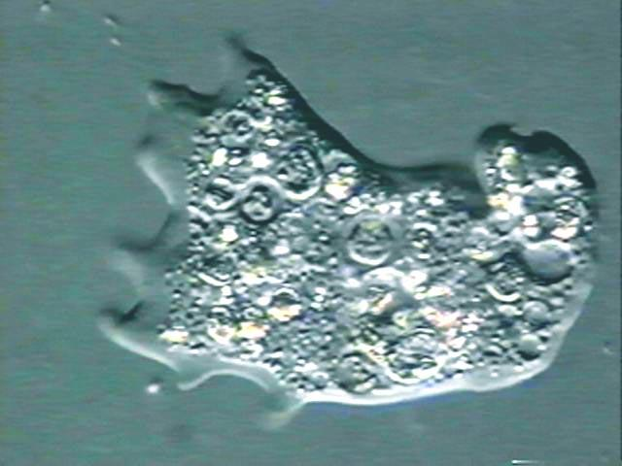
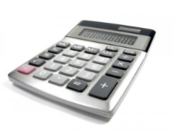
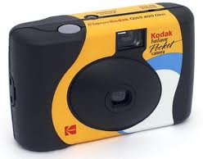
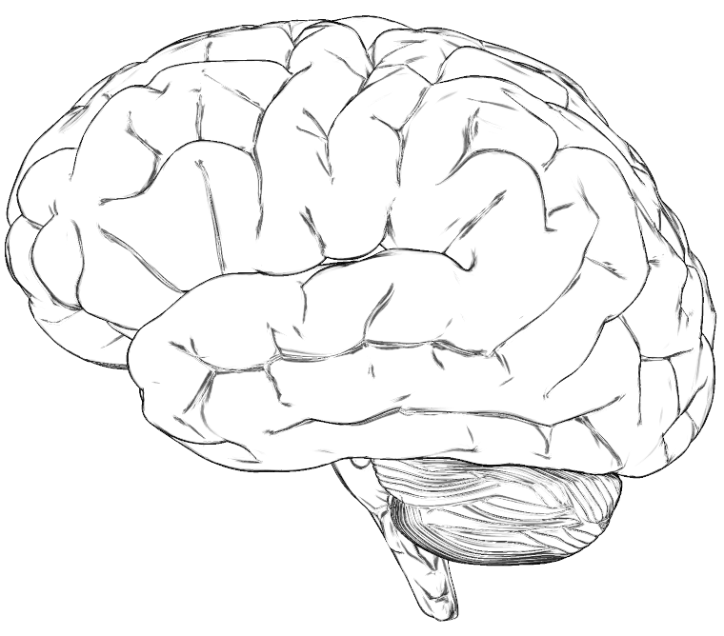
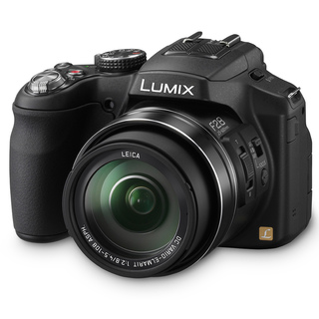
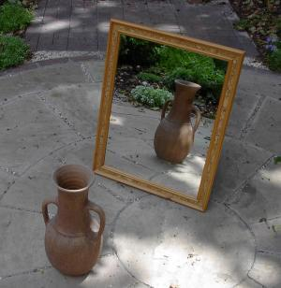
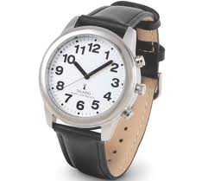
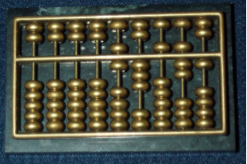
For the assigned item(s), decide if it's a computer...and why
1)
2)
3)
4)
Mac
flip phone
amoeba(single cell)
iPhone
5)
6)
7)
8)
flower
calculator
Disposable Camera
brain
9)
10)
12)
11)
abacus
digital camera
mirror
analog watch

Slide 38
What is a Computer? Post-it Parade Group Activity
Materials: Post-it Notes of different colors
Instructions:
1. Have students pair up into groups of 2 or more. Draw the scale below on a whiteboard
2. On the previous page there is a set of twelve numbered objects. Choose the 4-6 most controversial and assign a post-it color to each of those.
3. Have the students write the name of the object and their names on the post-it notes, by color. Have the students discuss where on the "computer" scale the object should fall. Then, have students write a 1-2 sentence explanation of their reasoning on the post-it note.
4. After writing and deciding, have the teams place their post-it notes onto the the whiteboard.
5. As a class, discuss the placement of each item on the scale, give each group the opportunity to discuss and present their viewpoints.
Not a
Computer
Probably not a
Computer
Not Sure
Most likely a
Computer
Definitely a
Computer

Slide 39
Round-Robin Debate (Collaborative Learning possibility)
x4

Slide 40
What is a computer? and why?
What are three traits or characteristics that make something a "computer"?
What are three traits that make something not a computer?
1.
2.
3.
1.
2.
3.
Are there other examples that are/are not computers to help clarify what is meant?
Notes:
Print out a copy of this slide for each person or each pair

Slide 41
Should there be a final answer…?!
Notes:
Print out a copy of this slide for each person or each pair

Slide 42
We've considered what computers do...
They make and manipulate data representations of the world
Let's consider what computers are...
They are a 100% understandable assembly of lots and lots of parts

Slide 43
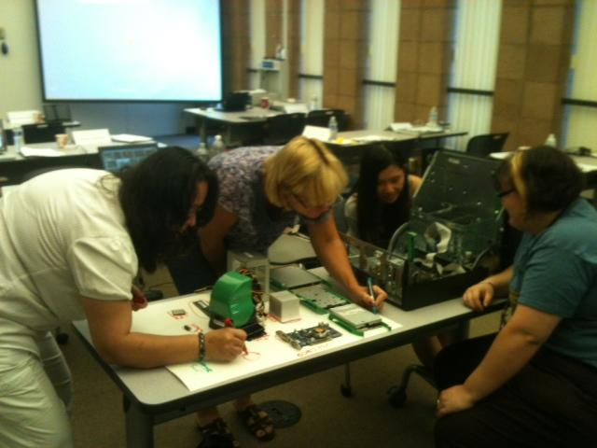
Poster-making: what's IN a computer?
also – you'll learn about the parts -- and use that background to solve three "mystery" cases…

Slide 44
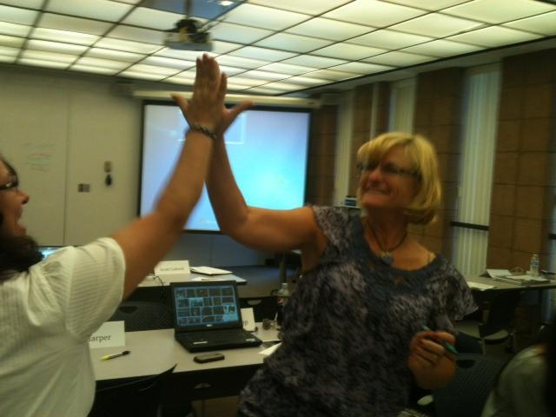
Poster-making: high-five-lights

Slide 45
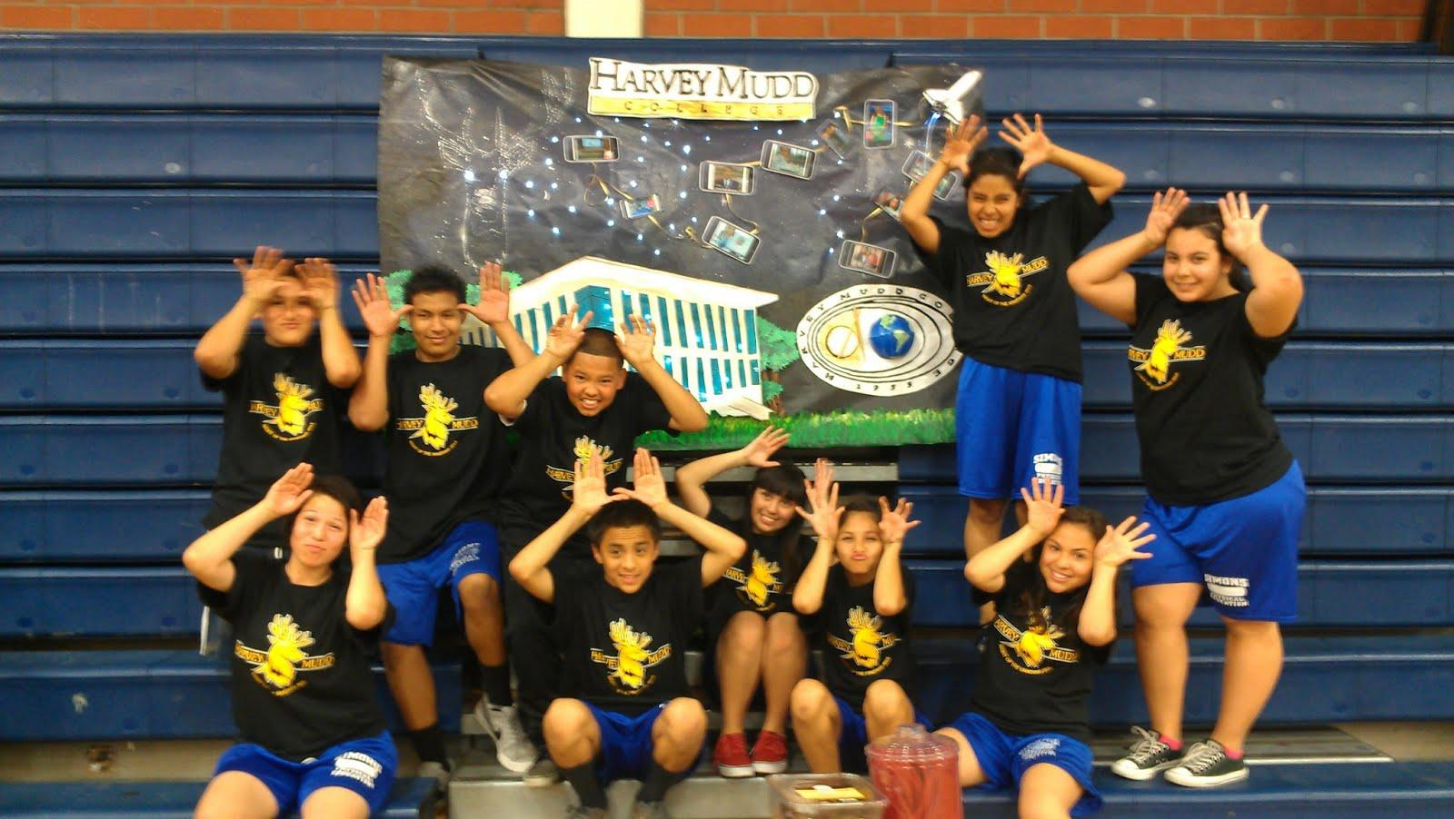
Other posters: Thanks, Abi

Slide 46
Hardware: What's IN a computer?!
(1) Read over the following hardware profiles:
CPU, harddrive, RAM, optical drive, graphics card, motherboard – 1 per page
(2) As you read, take apart one of the computers…
(3) Collect the parts onto a poster and label them
label them with post-it notes or with the handout pages themselves
(4) There's also a challenge list of other computer parts!
you'll need to use Google or other on-line resources to help with those!!
(5) Read the 3 "case studies" + decide how to solve them…

Slide 47
CPU
Full name: Central Processing Unit
Skills: handles most system input, like mouse clicks and running applications
Favorite color:
Glow-in-the-dark
Image courtesy of:
Free online computer courses and tutorials for seniors and beginners from www.meganga.com

Slide 48
Hard Drive
Full name: Hard Disk Drive
Occupation: permanently stores all information saved to the computer, then retrieves it later when it is needed.
Favorite hobbies: Reading and writing. A lot.

Slide 49
RAM
Full name: Random Access Memory
When you open a program, it gets loaded from the hard drive into the RAM. RAM is much faster than the hard drive, so this allows your computer to run smoothly. Only temporary things access RAM; anything that is saved permanently is sent back to the hard drive.
Favorite activity: Juggling
Image courtesy of:
http://www.quickboise.com

Slide 50
Optical Drive
Other names: CD Drive
Skills: Loading information from CDs, DVDs, and Blu-Rays, or writing information back onto them
Favorite artist: Taylor Swift
Image courtesy of:
http://www.maximumpc.com

Slide 51
Graphics Card
Also known as: Video Card
Skills: Converts information from the CPU into actual images on your monitor.
Favorite activity: rollerblading
Image courtesy of:
http://news.techgenie.com, author: Harmeet

Slide 52
Motherboard
The motherboard is a circuit board that connects the main parts of the hardware, allowing them to communicate with each other
Favorite activity: Playing board games with her daughterboard.

Slide 53
Other items to label in your poster…
Power supply
Cooling fan
Heat sink
LEDs
Crystal oscillators
Transistors
Capacitors
Use Google or other online resources to help you identify these for your poster!

Slide 54
Now, see if you can solve these case-mysteries!

Slide 55
Case #1
The Story:
Further Clues:
You get a call from a frustrated girl named Meg A. Byte. She is trying to watch the latest funny cat YouTube video, but the video won’t load. Her computer is being very slow and she’s not sure why.
After asking a few more questions, you gather the following information:
She has 37 internet tabs open
She is streaming music from Spotify
She is also on a Skype call with her best friend
Your Mission:
Meg doesn’t know it, but she’s really overworking one of Team Hardware’s agents. Using what you just learned about the team, figure out which member it is, and write your answer in this box.

Slide 56
Case #2
The Story:
Further Clues:
Next, Meg’s big brother Terry Byte calls. He is trying to download Google Earth and running into trouble. He says his computer has been able to store lots of data before, and doesn’t know why it won’t store more.
Terry’s computer is permanently storing:
35,000 songs
200,000 pictures
42 video games
300 movies
Your Mission:
Terry is also overworking an agent from Team Hardware. Using what you just learned about the team, figure out which member it is, and write your answer in this box.

Slide 57
Case #3
The Story:
Further Clues:
Yolanda made a beautiful slideshow for her mother’s birthday and tried to save it on a CD. But when she took out the CD, it was all scratched and the slideshow was nowhere to be found.
After asking a few more questions, you gather the following information:
A Blu-Ray she tried earlier wouldn’t play
She couldn’t load the music from her favorite CD
Your Mission:
Yolanda isn’t doing anything wrong, but some of her hardware is malfunctioning. Help her figure out which member it is so that Team Hardware can call in a replacement, and write your answer in this box.

Slide 58
... so, can these machines be intelligent?
We've considered what computers do...
They make and manipulate data representations of the world
We've considered what computers are...
They are a 100% understandable assembly of lots and lots of parts

Slide 59
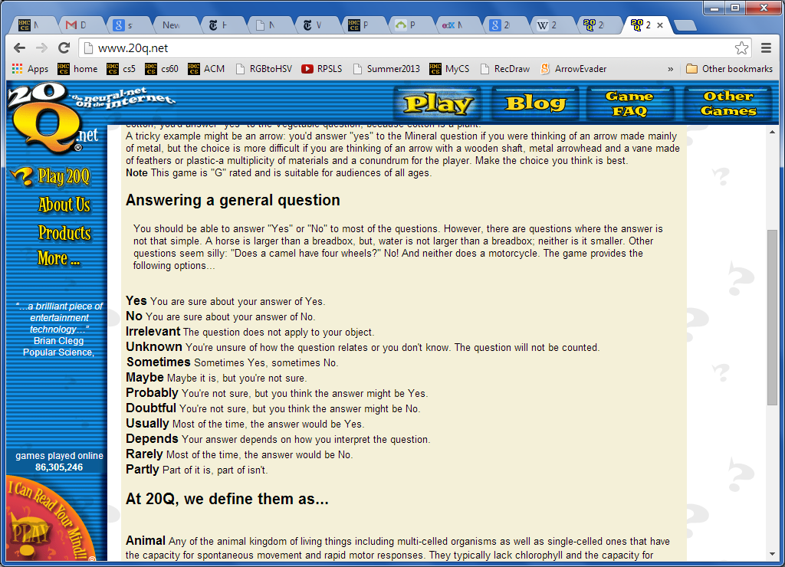

Slide 60
Lunch!
After lunch @ 1pm:
Why CS ~ a course-wide module

Slide 61
Why CS ~ a course-wide module

Slide 62
Why CS ~ Watson

Slide 63
Why CS ~ Watson

Slide 64
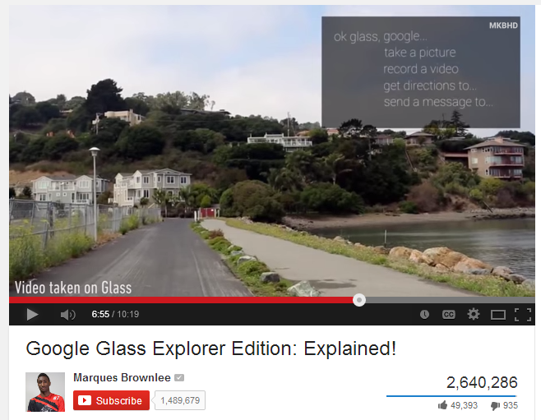
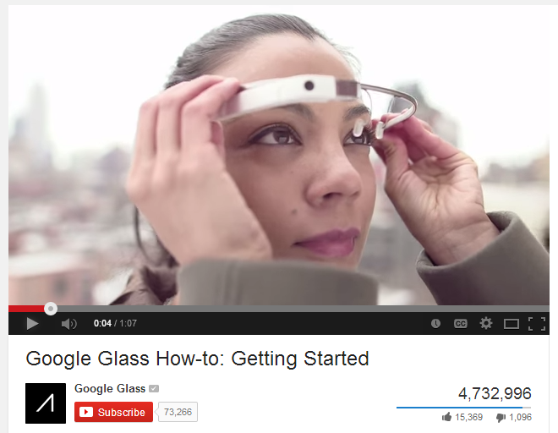
Why CS ~ each day we'll look at 1-2…
for now ~ Google Glass

Slide 65
Afternoon session
until 3pm: work on projects
@ 3pm: show off your work
everyone shows off a project Th afternoon…
then: team-based wrap-up survey/chat
and … scene!

Slide 66
An introduction to Computer Programming
Afternoon 1 ~ MyCS

Slide 67
Why program?

Slide 68
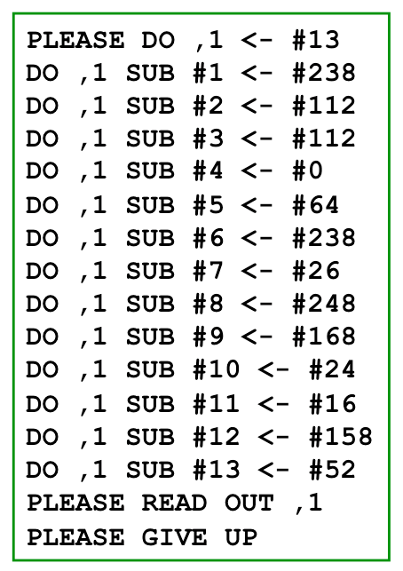
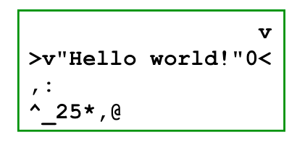
Programming
Programming/coding is the stereotypical CS activity.
But CS is really not about screenfuls of crazy text...
Intercal
Befunge
What popular programming languages have you used/heard of?
Notes:
create vs. consume

Slide 69
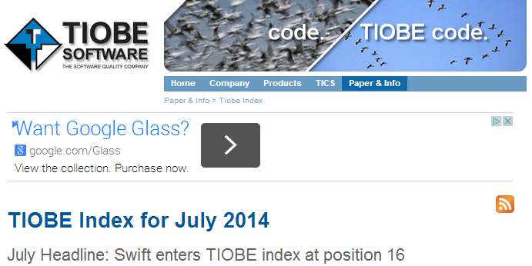
Programming languages

Slide 70
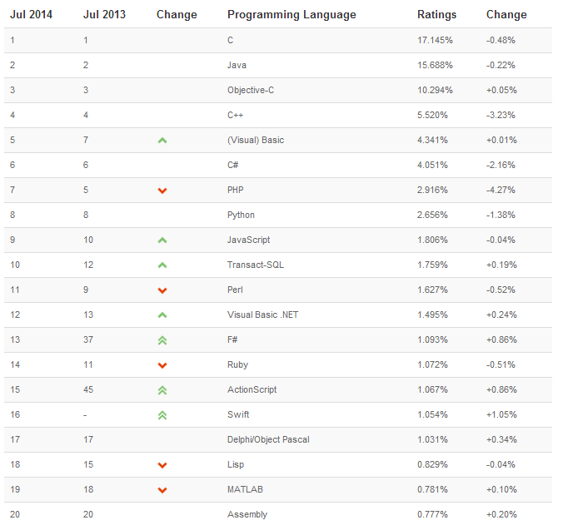
> 50% C-like langs
our first language
Apple's new lang.

Slide 71
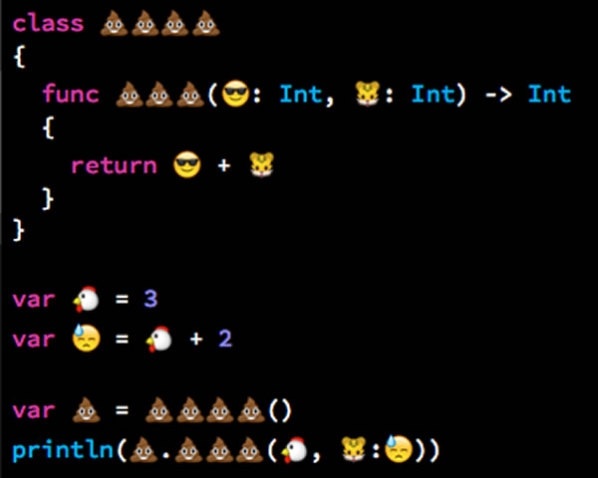
Programming languages
Always something new… !

Slide 72
Intro to Computer Programming
Here are two "Hello, World!" programs:
C++
Python
CS is fundamentally about problem-solving...
... programming is just its language

Slide 73
What does the future of programming look like?
Graphical languages are ever more popular in education and industry.

Slide 74
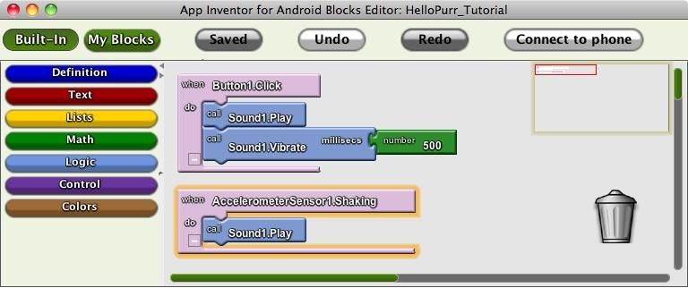
Graphical programming
Actions are the basic building blocks (literally!)...
The data can be simple.
The actions can be simple.
The combinations can be powerful!
Android Hello, World program in AppInventor

Slide 75
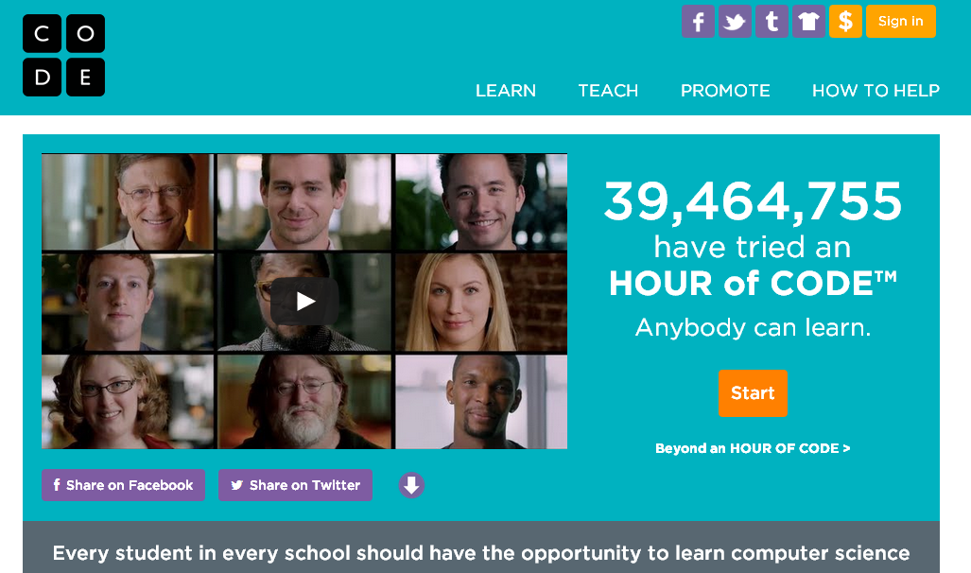
code.org

Slide 76
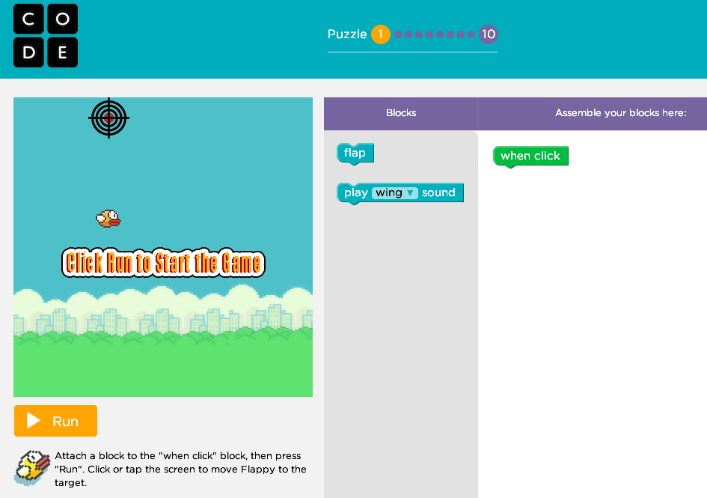
code.org/flappy

Slide 77
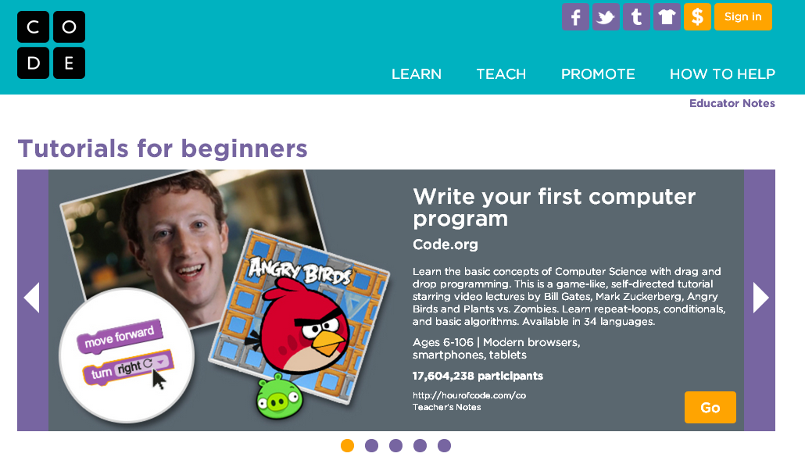
code.org/learn

Slide 78
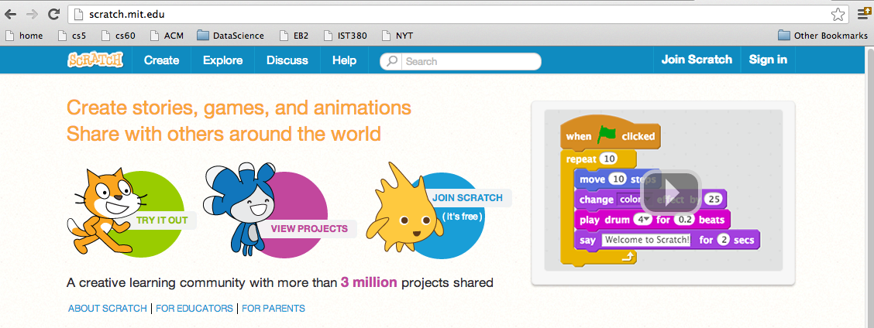
Scratch!
Developed at MIT, as with AppInventor
Lego-like blocks language
Now, entirely browser-based
Share + remix the community's projects
scratch.mit.edu

Slide 79
Scratch Lingo

Slide 80
A-Maze-ing Scratch:
Learning CS via mazes
(MyCS Unit 2)
Experienced Scratcher?
- ver. 2 of Scratch
- 100 mazes
- programming and CS !

Slide 81
Recommendation ~ try these mazes:
scratch.mit.edu/users/MyCS_Student/studios/
Studio 1: Try 1.1, 1.9, and 1.10.
Studio 2: Try 2.5, 2.8, and 2.10*
Studio 3: Try 3.1, 3.4, 3.7, and 3.10*
Studio 4: Try 4.2, 4.7, and 4.10*
Studio 5: Try 5.4, 5.6, 5.10*
Studio 6: Try 6.2, 6.5, 6.9, 6.10*
Studio 7: Try 7.2, 7.3, 7.6, 7.10*
Studio 8: Try 8.1, 8.2, 8.10*
Studios 9 and 10: *Try at your own risk!
want a challenge? see how few of the purple blocks you can use!

Slide 82
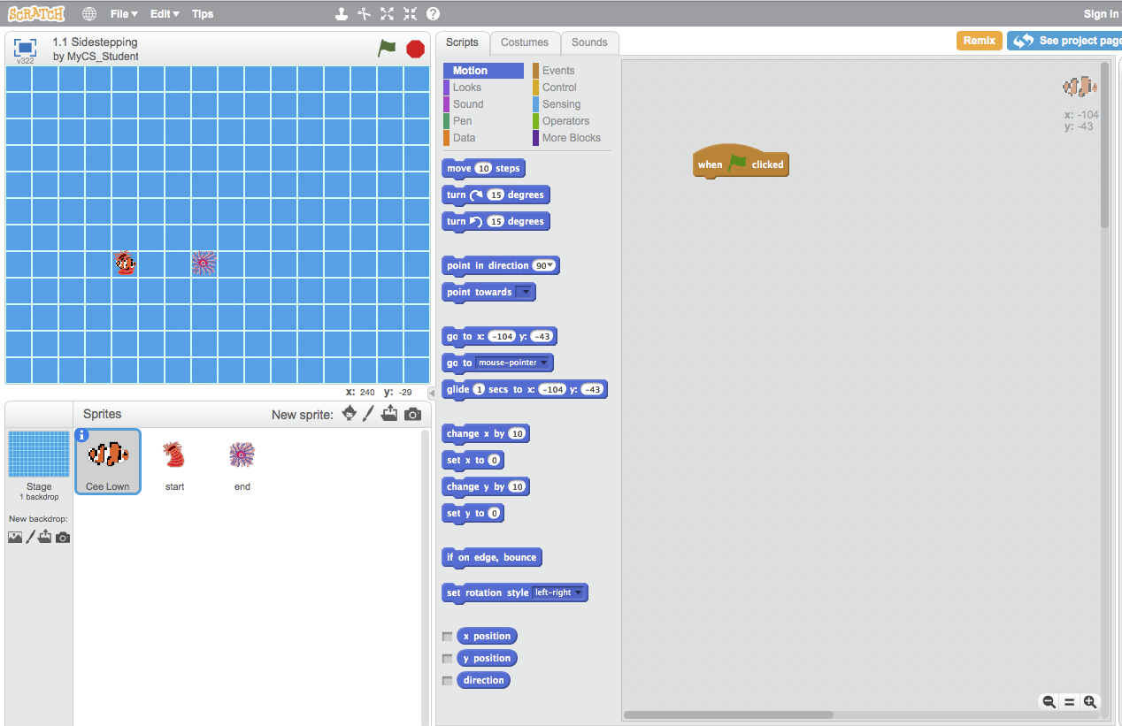
First Puzzle: Sidestepping
Click on 1.1 Sidestepping, then See Inside, and you'll see this:

Slide 83
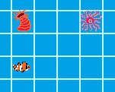
Let's meet our sprites!
Cee Lown, this World's character. The program's commands control him.
The Start: This is where the character begins
The End: Where the clownfish wants to go.
The world: our environment for this puzzle

Slide 84
Our goal...
The program blocks.
Our program
We need to write a program that gets our clownfish from the start to the finish.

Slide 85
Block programming
We need to move three squares to the right. So, we go to the More Blocks section and drag and drop blocks to make this
I'm feeling a bit blocky myself.

Slide 86
The repeat block
These are identical programs.
Each one moves left 6 times
Try solving the Ocean mazes using the repeat block

Slide 87
Studio 1 Ocean mazes...
Try (at least) Ocean mazes 1.9 + 1.10
How few purple blocks can you use?

Slide 88
Studio 2
Safari
Enemies!
(predators)
lead to using the WAIT block
2.5, 2.8, 2.10*

Slide 89
Studio 3
Fire
lead to the use of the IF/THEN/ELSE block
Teleporters
(portals)
3.1, 3.4, 3.7, 3.10*

Slide 90
Studio 4
Jungle
many possible teleports...
lead to using the repeat until block
4.2, 4.7, 4.10*

Slide 91
Studio 5
Ghosts
Multiple same-color exits
(for portals)
lead to the sprite-SENSING block
5.4, 5.6, 5.10*
Notes:
In this case, it's not color-SENSING... sprite-sensing?

Slide 92
Studio 6
Space
Using horizontal and vertical
positive and negative ~ mathematical coords
6.2, 6.5, 6.9, 6.10*

Slide 93
Studio 7
Arctic
Larger loops and Sesame!
more - and more sophisticated - practice with loops...
4.5, 4.7, 4.10*

Slide 94
Studio 8
Mech
using only turn and forward
~ basic robot control
8.1, 8.2, 8.10*

Slide 95
Recommendation ~ try these mazes:
scratch.mit.edu/users/MyCS_Student/studios/
Studio 1: Try 1.1, 1.9, and 1.10.
Studio 2: Try 2.5, 2.8, and 2.10*
Studio 3: Try 3.1, 3.4, 3.7, and 3.10*
Studio 4: Try 4.2, 4.7, and 4.10*
Studio 5: Try 5.4, 5.6, 5.10*
Studio 6: Try 6.2, 6.5, 6.9, 6.10*
Studio 7: Try 7.2, 7.3, 7.6, 7.10*
Studio 8: Try 8.1, 8.2, 8.10*
Studios 9 and 10: *Try at your own risk!
want a challenge? see how few of the purple blocks you can use!

Slide 96
Try it out!

Slide 97
Remixing projects ~ BYOM
In Scratch you can remix shared projects and make your own changes to them.

Slide 98
Sharing Projects
When you create something in Scratch you have the option to share it.
Try sharing your maze on your Scratch profile so that another group can try it!

Slide 99
Wrap-up
In groups of 2-4, go to our curriculum survey/chat
Have an HMCer or s/o else type the group's thoughts…
Have a great afternoon & see you tomorrow!

Slide 101
older/unusued slides

Slide 102
Create-your-own mazes
The MyCS_Student profile has templates so that students can make their own puzzles.
Add walls to create your own maze.
Move the sprites to new locations on the puzzle to make it more complex.
Get creative! Students can also repaint the sprites and backgrounds, or upload pictures.

Slide 103
Design for others...
Within the World00 - Template studio
Go to Part 1 Day 2 Template
Move sprites and edit the background so that
the maze requires 6 or fewer purple blocks!

Slide 104
For example...
Let's build this maze together.
How many purple blocks are needed to solve it?
here, the moving sprite has already taken two steps...

Slide 105
For example...
This maze requires three purple blocks to solve...
in this picture, one iteration of the loop has already run!

Slide 106
Scratch Projects
think of something you would like to build to demo, show off, or use in class…
ideas…
we'll all present our ideas on Friday…

Slide 107
Default: Unit 4: building a game…
Example…

Slide 108
Alternatives
Story
Music video (with music!)
Quiz
Demonstration of a concept

Slide 109
Tomorrow:
- Units 3 & 4
- Scratch Projects…
Mahalo!

Slide 111
Below are extra slides from old versions of the workshop...

Slide 112
Simulating humans is difficult!
So, let's try simpler life ~ cells

Slide 113
That seemed kind of complicated!
Yeah, I didn't follow any of that!
Never fear!
By the time the kids get to you, they will have solved many puzzles and this will be a piece of cake to them!
In fact, they will even have practice building their own mazes!
Which is, coincidentally, the subject of the next session!

Slide 114
The Game of Life...
White Blood Cell Chases Bacteria
http://www.youtube.com/watch?v=BNizygcJA9A
Can simpler cells still be "life"-like?

Slide 115
Simple Cells
1
2
3
4
5
6
= Living cell
A
= Empty space
B
B2
C
C3
D
A grid of cells depending on
(1) their rules (DNA)
(2) environment (neighbors)
E
F
How many live cells are in this grid?

Slide 116
Simple Cells
1
2
3
4
5
6
= Living cell
A
= Empty space
B
B2
Name
Is it live or empty?
C
C3
D
E
F

Slide 117
Neighbor cells
1
2
3
4
5
6
= a living cell
A
= empty space
B
C
C3
Living neighbors
Empty neighbors
D
C3
E
F
Cell C3 has 8 neighbors
How many of each?

Slide 118
Neighbor cells
1
2
3
4
5
6
= Living cell
A
A6
= Empty space
B
B2
C
C3
C4
# of living neighbors
D
A6
E
E2
E4
C4
F
E4
Each cell's future depends on its living neighbors
E2

Slide 119
Two rules
1
2
3
4
5
6
A living cell with 2 or 3 living neighbors survives.
Others die.
A
0n
B
2n
C
4n
4n
D
3n
4n
An empty cell with exactly 3 living neighbors comes to life. No others do.
E
2n
1n
F
BEFORE

Slide 120
Two rules
1
2
3
4
5
6
A
A living cell with 2 or 3 living neighbors survives. Others die.
B
C
D
An empty cell with exactly 3 living neighbors comes to life. No others do.
E
F
AFTER

Slide 121
Two rules
A living cell with 2 or 3 living neighbors survives. Others die.
An empty cell with exactly 3 living neighbors comes to life.
1
2
3
4
5
6
1
2
3
4
5
6
A
A
B
B
C
C
D
D
E
E
F
F
BEFORE
AFTER

Slide 122
Two rules
A living cell with 2 or 3 living neighbors survives. Others die.
An empty cell with exactly 3 living neighbors comes to life.
1
2
3
4
5
6
1
2
3
4
5
6
A
A
B
B
C
C
D
D
E
E
F
F
BEFORE
Fill in the next generation here.
Notes:
Print this slide.

Slide 123
Two rules
A living cell with 2 or 3 living neighbors survives. Others die.
An empty cell with exactly 3 living neighbors comes to life.
Only TWO survive,
1
2
3
4
5
6
1
2
3
4
5
6
and TWO are born.
A
A
B
B
C
C
D
D
E
E
F
F
BEFORE
Fill in the next generation here.

Slide 124
Two rules
A living cell with 2 or 3 living neighbors survives. Others die.
An empty cell with exactly 3 living neighbors comes to life.
1
2
3
4
5
6
1
2
3
4
5
6
A
A
B
B
C
C
D
D
E
E
F
F
BEFORE
AFTER
next...?

Slide 125
"The Game of Life"
John Conway, early '70s
http://www.ibiblio.org/lifepatterns/
Golly (downloadable)

Slide 126
Simple data
empty space
living cells
+
Basic rules
A living cell with 2 or 3 living neighbors survives. Others die.
An empty cell with exactly 3 living neighbors comes to life.
=
Complex behavior
"Game of Life"

Slide 127
Introductions
from the 1990's:
Matchmaking … ?!

Slide 128
From What is a computer? ...
tower vs. phone: same parts, different sizes
... to what's inside a computer?

Slide 129
Computer Disassembly
Day 1, Session 2
Notes:
The computer disassembly stuff can be moved to day 1

Slide 130
A computer at 30,000 feet...
Computer
INPUT
OUTPUT
Notes:
Change images to relate to Claremont

Slide 131
... at 20,000 feet
Inputs
the Net
Camera
Keyboard
Outputs
Mouse
Screen
Computer
Speakers
the Net
Notes:
Change images to relate to Claremont

Slide 132
... at 10,000 feet
INPUT
Controller (CPU)
Fast memory (RAM)
OUTPUT
Large, slow memory (Hard Disk)
Notes:
Change images to relate to Claremont

Slide 133
... at sea level?
What goes on inside a computer?
Notes:
Change images to relate to Claremont

Slide 134
Computer Disassembly
(1) Use a search engine to look up the parts of a computer - while taking it apart.
(2) Create a poster with the parts and (briefly) what each part does.
For example...

Slide 138
...you should get something like these computer entrails...

Slide 139
Dis'ed already?
... Go deeper!
Circuit-building with Logisim
Notes:
conservation of tools! First, we acknowledge them!

Slide 140
Stretch your legs...
dis~assembly
here
Logisim there
Notes:
conservation of tools! First, we acknowledge them!

Slide 141
Computers can seem like magic...
- not necessarily benign magic, at that
- unclear what's happening inside
- leads to anthropomorphizing
magician vs. wizard
but computers are the opposite of us humans...
~ because they're 100% understandable
How do we chip away at our defenses?
Notes:
conservation of tools! First, we acknowledge them!

Slide 142
1) Find these components in your computer
2) Remove and/or identify each
3) Label each with what it does on your poster
4) [optional] add two more part names that you can find...
5) Take a picture...
6) Reassemble!
Working memory (RAM)
Capacity/storage (hard drive)
Motherboard
Power supply
Cooling fan
Heat sink
Processor (CPU)
CD / DVD Drive
"Graphics" Card
LED
Heat Sink
Crystal oscillator
Transistor
Capacitor
or any expansion card
light-emitting diode
Part 1:
Part 2:
Notes:
Encourage use of search engines - don't stand there and answer them when they ask you what something is.

Slide 143
Other parts of computers that you won't find in the computer...
Speakers
Monitor
Network cable and port
Keyboard
Operating System
Mouse
Which one of these is not like the others?

Slide 144
How do these all fit together?
Suppose you're checking a friend's recent Facebook/Instagram posts, what order would these parts be involved?
___ Monitor showing updated status
___ Graphics Card
_1_ Touchscreen or keyboard
___ Working memory (RAM)
___ Processor (CPU)
___ Long-term capacity (Hard Drive)
___ Network wifi (or cable)

Slide 145
True or False?
If I'm running out of space on my computer, I need to get more memory.
If I get a computer with more memory, it will download faster.
The faster my processor is, the faster my computer will be.
The more space my computer has, the more programs it can run at once.
If I add another processor to this computer, it will run Minecraft with less lag.

Slide 146
CS, ECS, and MyCS
college
Computer Science
grades >12
AP Computer Science
high school
grades 11-12
Exploring Computer Science
grades 9-12
middle school
Middle-years Computer Science
grades ~4 -10+

Slide 147
Why MyCS?
from page 5...
ECS's Goal: to democratize CS
Everyone should have a chance to help author and understand the computation we use every day.

Slide 148
Why MyCS?
from page 5...
ECS's Goal: to democratize CS
Our Goal: expand CS's personal reach
Everyone should have a chance to help author and understand the computation we use every day.

Slide 149
Why MyCS?
from page 5...
ECS's Goal: to democratize CS
to "fun-ize" CS
Our Goal: expand CS's personal reach
Everyone should have a chance to help author and understand the computation we use every day.

Slide 150
A-Maze-ing Scratch:
now, even more twisty...
Day 1, Session 4

Slide 151
New Sprites!
Portal Enter: Walking onto here causes you to go to the...
...Portal Exit. You will randomly be sent to one of the exits in the puzzle.
The Villain: If you touch him, he will eat you!
Villain Start: If the Villain runs into an obstacle, he will restart back here.

Slide 152
Getting to Scratch
URL
Search for
MyCS_Student

Slide 153
Click Here...
...then scroll until...
...you can click here

Slide 154
Introductions
from the 1990's:
Matchmaking … ?!

Slide 155
Why CS ~ a course-wide module
IBM's Watson:
http://www.youtube.com/watch?v=lI-M7O_bRNg
Is Watson intelligent?

Slide 156
Can computers be intelligent?
IBM's Watson:
http://www.youtube.com/watch?v=lI-M7O_bRNg
Is Watson intelligent?

Slide 157
What would it mean for a machine to "be intelligent" ?
Alan Turing suggested an answer...

Slide 158
Turing Test
The Turing Test is a challenge to computers - or their software designers:
It states that a computer should be considered intelligent if it can produce interactions that a person honestly considers human.
Let's see if we're up to this challenge...
We'll decide as a group whether four "agents" are human or computer. We can chat with them, but we can't see them...
Notes:
We used a Google doc to implement an answering system, and also included Eliza as one source of answers. You need two people who can be out of the room to answer the questions remotely.
In 2012 we did four people, two humans, two chatbots
key things were:
-different fonts for each person since people copying from chatbot have little control over their font
-have everyone answer every question

Slide 159
Possible questions?
What movie did you most recently see?
Turing Test

Slide 160
Possible questions?
What movie did you most recently see?
What is the name of Bart Simpson's baby sister?
What do you think of Roald Dahl?
Are you a computer?
What is the next number in the sequence 3, 6, 9, 12, 15?
What is 2 X 78?
What is the square root of 2?
Add 34957 to 70764.
Do you like school?
Do you like dancing?
What day is it today?
What time is it?
How many days are there in February in a leap year?
How many days are there in a week?
For which country is the flag a red circle on a white background?
Do you like to read books?
What food do you like to eat?

Slide 161
Even Turing underestimated intelligence...
In 1950, Turing predicted that in 50 years, a computer would be the world's chess champion...
... and would thus also achieve intelligence !
Computers trade off raw processing power for what we might call "intelligence..."
As another example, try... Twenty Questions
Notes:
It would be nice to bring up 20Q again when we do Binary Search, since that's generally how it's implemented.

Slide 162
Paperless pdfs?

Slide 163
PB & J activity

Slide 164
Story Collaboration
Teams of 4-5 "scene animators"
(1) Decide on a story (or a part of one)
Example
Ideas:
(2) Choose characters
(3) Split story into one scene per person
(4) Create a 1-2 minute animation each
(5) Record the while story & show it off!

Slide 165
To do list
get other disassembly items
get posterboard
get 6 colors of post-its
what ARE the characteristics of/of not a comp.
get 9v connectors…
20Q

Slide 166
Making a scene from Scratch
Requirements:
(1) Make sure each scene includes one or more characters
(2) Choose or create an appropriate backdrop for your scene
(3) Make sure to use broadcasting for all cues (CONTROL blocks)
(4) Have at least 6 speech or thought bubbles (LOOKS blocks)
(5) Include at least two sound effects (SOUND blocks)
(6) There should be at least 6 motions in the scene (MOTION blocks)
Options:
costume changes, background changes, props, other characters only for your scene, your own audio files or images, custom sprites, use PEN blocks… there's no limit!

Slide 167
First, a small example
How to use broadcasting as cues to coordinate sprites

Slide 168
Go!
What story will you choose?

