Slide 1
Why Computer Science?
Welcome back!
CS is “good for you”
CS is important and interesting
CS is empowering and fun…
Glass sign-ups?
What’s even more important than this last one?

Slide 2
This week…
Glass sign-ups?
Welcome back!
Returners
Newcomers
MyCS
Mon.
Python programming
AppInventor
Tue.
AppInventor
Arduino, Circuits, and Robots
Wed.
Arduino, Circuits, and Robots
Python programming
Thu.
Morning – activities and demonstrations for the full group.
Afternoon everyone shows off one of the projects they built this week. primarily because we hope you will show it to your students…!
Fri.
No workshop on Friday.

Slide 3
Why Computer Science?
CS is “good for you”
CS is important and interesting
CS is empowering and fun…
What’s even more important than this last one?

Slide 4
Why Computer Science?
CS is “good for you”
CS is important and interesting
CS is empowering and fun…
Everybody's doing it!
Join in!

Slide 5
Data: the CS picture

Slide 6
Today…
Python
AppInv
MyCS (computer)
AppInv
Arduino
MyCS (data!)

Slide 7
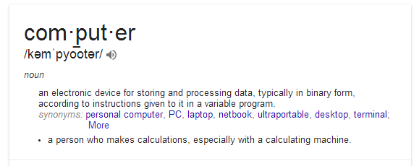
Yesterday we noted two things computers do:
(1) process data (arithmetic) (2) store/retrieve data
Amazingly, this is all that computers do!

Slide 8
Is this all that computers do?
Is this all that computers do?
(1) process data (arithmetic) (2) store/retrieve data
Let's see… Try listing some things we use computers for…

Slide 9
Data: it's what computers do!
We noted two things computers do:
(1) process data (arithmetic) (2) store/retrieve data
And this is the vast majority of computer work!
Rather than computers, they should be called datadogs.

Slide 10
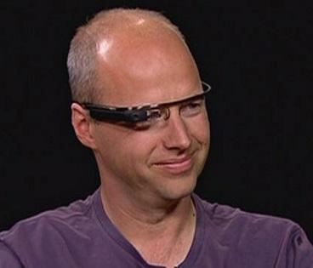
Data: a big example
Google Glass
84 years of HD: 8,000,000 GB
= 8 Petabytes
Concerns?
Notes:
Added a link to the work 'big'

Slide 11
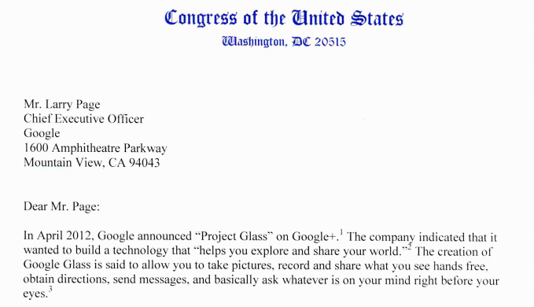
Data: a big example
Google Glass
5/16/13
84 years of HD: 8,000,000 GB

Slide 12
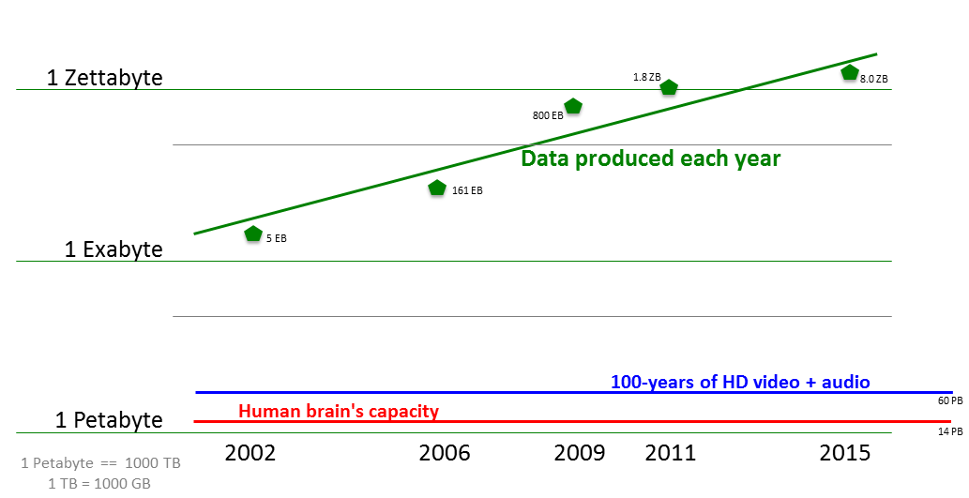
Data: the big picture
There's lots of it to work with!

Slide 13
Data: encoding and decoding
To work with data, it is always encoded: converted into a specific form by a set of rules.
Later, it can be decoded: changed back into its original form.

Slide 14
Encoding + Decoding!
One method of encoding a sentence is by having every letter correspond to a number.
For example:
AND 1 - 14 - 4
BUG .
19 - 09 - 07 - 14
Decoded data
Encoded data

Slide 15
Encoding + Decoding!
Or, we could shift every letter by one spot
A B, B C, C D, .....
For example:
ZOO APP
END
NVEE
Decoded data
Encoded data

Slide 16
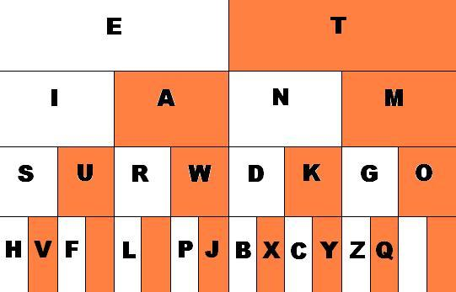
Another data encoding
Morse code encodes letters as dots and dashes
short sound: "dit"
long sound: "dah"
R
How does this chart represent Morse code?
What is the letter A in Morse code? What about the letter
?

Slide 17
Another data encoding
Morse code encodes letters as dots and dashes
short sound: "dit"
long sound: "dah"
white = dot
orange = dash
R
What is this word?
What is the encoding of SOS in Morse code? How about FOG?

Slide 18
Encoding + Decoding
Challenges

Slide 19
Your Mission
The following slides contain encoded sentences.
Decode each sentence!
Find the rules or pattern for each one.
Later, you will encode, instead of decode.
We will provide one example.
Then, you should create your own encoding…

Slide 20
25-15-21 19-15-12-22-5-4 20-8-5 6-9-18-19-20 15-14-5
Encoded Sentence:
Rules/Pattern
Decoded sentence
Every letter corresponds to a number.
A = 1, B = 2, C = 3, ...
See the table below:
(Use this space to work it out)

Slide 21
KVTU LFFQ TXJNNJOH
Encoded Sentence:
Rules/Pattern
Decoded sentence
Every letter is shifted by one.
A = B
B = C
C = D, ...
(Use this space to work it out)

Slide 22
REVELC SI SECNETNES GNISREVER
Encoded Sentence:
Rules/Pattern
Decoded sentence
(Use this space to work it out)
(Use this space to work it out)

Slide 23
SENTENCE WIT MISSIN LETTER AR CONFUSIN
Encoded Sentence:
Rules/Pattern
Decoded sentence
(Use this space to work it out)
(Use this space to work it out)

Slide 24
UOY ERA YAWFLAH ENOD
Encoded Sentence:
Rules/Pattern
Decoded sentence
(Use this space to work it out)
(Use this space to work it out)

Slide 25
VEREOYEN OLEVS OCPMTURE CSEICNE
Encoded Sentence:
Rules/Pattern
Decoded sentence
(Use this space to work it out)
(Use this space to work it out)

Slide 26
VOWOLS ORO OMPORTONT ON SONTONCOS
Encoded Sentence:
Rules/Pattern
Decoded sentence
Every vowel is now an “O” !
(Use this space to work it out)

Slide 27
IS IT CATS RAINING DOGS AND
Encoded Sentence:
Rules/Pattern
Decoded sentence
(Use this space to work it out)
(Use this space to work it out)

Slide 28
Morse Code
You will use these Morse Code rules to decode the next two secret messages.

Slide 29
Morse Code
Rules/Pattern
Encoded Sentence:
Decoded sentence
_ _ _ _ _ . _ . . . . .
_ . _ . _ _ _ _ . . . . . . . .
_ . _ . _ _ _ _ _ _ . _ . .
(Use this space to work it out)

Slide 30
Morse Code
Rules/Pattern
Encoded Sentence:
Decoded sentence
_ . _ . _ _ _ _ . _ _ . . _ .
. _ _ . . _ . _ . . . _ _ . .
_ _ _ _ . . . . _ . _ _
_ _ _ . . _ . . _ . . . _ .
. . . . . . . . . . _ . .
(Use this space to work it out)

Slide 31
PUPPIES ARE CUTE
Decoded sentence
Rules/Pattern
Encoded sentence
Pig Latin
If a word begins with a consonant:
the consonant is moved to the end
and an “ay” is added.
If not:
only “ay” is added.
Note: This time you are encoding the sentence.

Slide 32
Original (decoded) Sentence
something not too difficult…
Rules/Pattern
Encoded Sentence:
Now, invent your own code. Write your rules/pattern here:
Next, write your encoded secret message here:
Then, put it on the top of the next page + TRADE!

Slide 33
Trade this page with another team and try to decode each other's sentences!
Encoded Sentence:
… from the previous page
Rules/Pattern
Decoded sentence
(Use this space to work it out)
(Use this space to work it out)

Slide 34
The "digital age" ...
For computers, all data is ultimately represented as a set of numbers.
With binary, all numbers can be represented as a series 1's and 0's.

Slide 35
Binary is just another code!
0
1
2
3
4
5
6
7
8
9
10
…
decimal

Slide 36
Binary is just another code!
0
1
2
3
4
5
6
7
8
9
10
…
000
001
010
011
101
110
111
decimal
binary

Slide 37
Consider this much spam:
Why do we use 37 to encode this amount?
Notes:
intro to binary, cards (10 min)
#outline
need:
-4 decimal cards:
https://docs.google.com/open?id=0BxE1Rhkid9dVTUhuVzctQnhQdG8
-6 binary cards:
https://docs.google.com/open?id=0BxE1Rhkid9dVLWJnWk00cnlfZFk

Slide 38
3 7
tens
ones
3*10
The 3 means "three tens"
7*1
The 7 means "seven ones"
Together, they represent the total amount (what we call thirty-seven)
37
Notes:
intro to binary, cards (10 min)
#outline
need:
-4 decimal cards:
https://docs.google.com/open?id=0BxE1Rhkid9dVTUhuVzctQnhQdG8
-6 binary cards:
https://docs.google.com/open?id=0BxE1Rhkid9dVLWJnWk00cnlfZFk

Slide 39
Our numbers...
Decimal is based on the number 10.
4 3 7
hun- dreds
tens
ones
How is each column value getting larger?
Notes:
There was confusion over writing 22 like 1 12

Slide 40
3 7
tens
ones
In decimal, the columns increase x 10
In binary, the columns increase x 2
That's the difference!
1 0
twos
ones
in binary
Notes:
intro to binary, cards (10 min)
#outline
need:
-4 decimal cards:
https://docs.google.com/open?id=0BxE1Rhkid9dVTUhuVzctQnhQdG8
-6 binary cards:
https://docs.google.com/open?id=0BxE1Rhkid9dVLWJnWk00cnlfZFk

Slide 41
3 7
tens
ones
In decimal, the columns increase x 10
In binary, the columns increase x 2
That's the difference!
2
1 0
=
twos
ones
ones
in binary
in decimal
Notes:
intro to binary, cards (10 min)
#outline
need:
-4 decimal cards:
https://docs.google.com/open?id=0BxE1Rhkid9dVTUhuVzctQnhQdG8
-6 binary cards:
https://docs.google.com/open?id=0BxE1Rhkid9dVLWJnWk00cnlfZFk

Slide 42
Computers' numbers
Binary is based on the number 2.
1 0 1 0
fours
twos
ones
How is each column value getting larger?
What should this column value be?
Notes:
As an exercise, showing them how to count up in binary would be good - later in the lego building
exercise, some were skipping numbers as they counted up.
Additionally, mentioning the tally system (base 1!) would be good since they have likely used it before
but without realizing it is base 1

Slide 43
Decoding binary decimal
Suppose the computer holds this binary number:
1 1 0 1
eights
fours
twos
ones
Let's decode it into decimal:
Notes:
As an exercise, showing them how to count up in binary would be good - later in the lego building
exercise, some were skipping numbers as they counted up.
Additionally, mentioning the tally system (base 1!) would be good since they have likely used it before
but without realizing it is base 1

Slide 44
Practice
Binary
Decimal
twos
4s
ones
From binary to decimal:
101
1011
10000
101010
16s
4s
ones
32s
8s
twos
From decimal to binary:
14
33

Slide 45
Try these!
Binary
Decimal
From binary to decimal:
1001
110
11010
10101
From decimal to binary:
3
14
25
52

Slide 46
Acting out in binary…
We need 110 volunteers...
Don't worry -- you'll only have bit parts for this.
Notes:
As an exercise, showing them how to count up in binary would be good - later in the lego building
exercise, some were skipping numbers as they counted up.
We changed "five" into binary (101), it's funnier
Additionally, mentioning the tally system (base 1!) would be good since they have likely used it before
but without realizing it is base 1

Slide 47
Acting out in binary…
(1) Challenge the class!
have the "bits" create any number and the class has to figure out what it is
(2) Challenge the bits!
have the class suggest a number and challenge the "bits" to create it in binary
(3) Patterns in counting
have the cards count up + down and have the class find the patterns
(4) Even / Odd / More!
have everyone determine patterns in binary #s
Notes:
As an exercise, showing them how to count up in binary would be good - later in the lego building
exercise, some were skipping numbers as they counted up.
We changed "five" into binary (101), it's funnier
Additionally, mentioning the tally system (base 1!) would be good since they have likely used it before
but without realizing it is base 1

Slide 48
but why do computers use binary… ?

Slide 49
The problem is the number of digits!
37
How many different symbols can occupy each digit location in a number?
Notes:
intro to binary, cards (10 min)
#outline
need:
-4 decimal cards:
https://docs.google.com/open?id=0BxE1Rhkid9dVTUhuVzctQnhQdG8
-6 binary cards:
https://docs.google.com/open?id=0BxE1Rhkid9dVLWJnWk00cnlfZFk

Slide 50
The problem is the number of digits!
37
How many different symbols can occupy each digit location in a number?
07 17 27 37 47 57 67 77 87 97
There can be ten different digits!
Notes:
intro to binary, cards (10 min)
#outline
need:
-4 decimal cards:
https://docs.google.com/open?id=0BxE1Rhkid9dVTUhuVzctQnhQdG8
-6 binary cards:
https://docs.google.com/open?id=0BxE1Rhkid9dVLWJnWk00cnlfZFk

Slide 51
Ten symbols is too many!
A computer has to differentiate physically among all its possibilities.
0
1
2
3
4
5
6
7
8
9
ten symbols ~ ten different voltages
This is too difficult to replicate billions of times
engineering!
What digits are these?
Ouch!
Notes:
Number is 8237

Slide 52
Two symbols is easier!
A computer has to differentiate physically among all its possibilities.
0
1
2
3
4
5
6
7
8
9
ten symbols ~ ten different voltages
0
1
two symbols ~ two different voltages
What digits are these?
Easy!
Notes:
Number is 8237

Slide 53
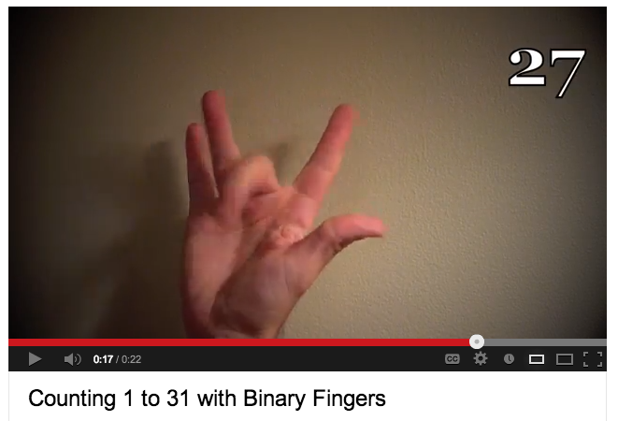
How high can you count
in binary on your fingers?
It's a lot higher than 10!
Some experts on YouTube... (http://www.youtube.com/watch?v=XKpWSKjdv4U)
Notes:
As an exercise, showing them how to count up in binary would be good - later in the lego building
exercise, some were skipping numbers as they counted up.
Additionally, mentioning the tally system (base 1!) would be good since they have likely used it before
but without realizing it is base 1

Slide 54
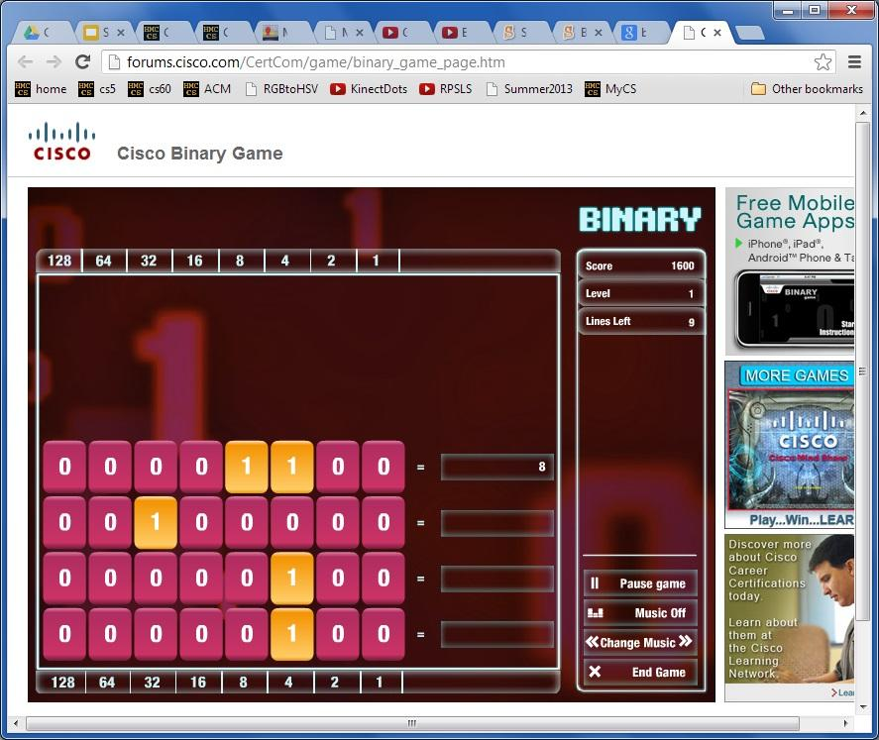
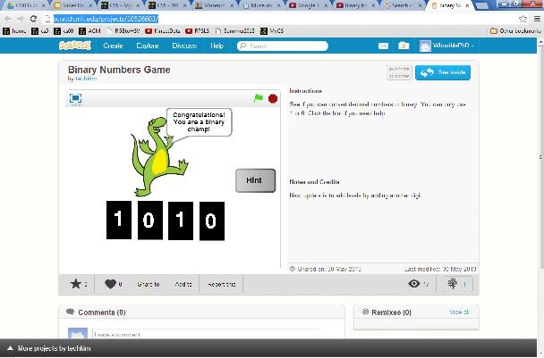
Other binary practice...
Cisco binary game
a Scratch binary game
Notes:
Put in links to the games

Slide 55
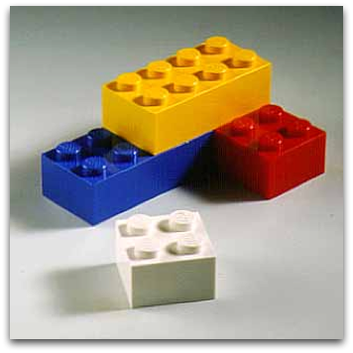
The "digital age" ...
For computers, all data is ultimately represented as 0s and 1s, in binary.
Could you encode a lego tower in binary... ?
Then, have someone else decode it back into the same Lego tower?

Slide 56
PB & J activity

Slide 57
PB & J activity

Slide 58
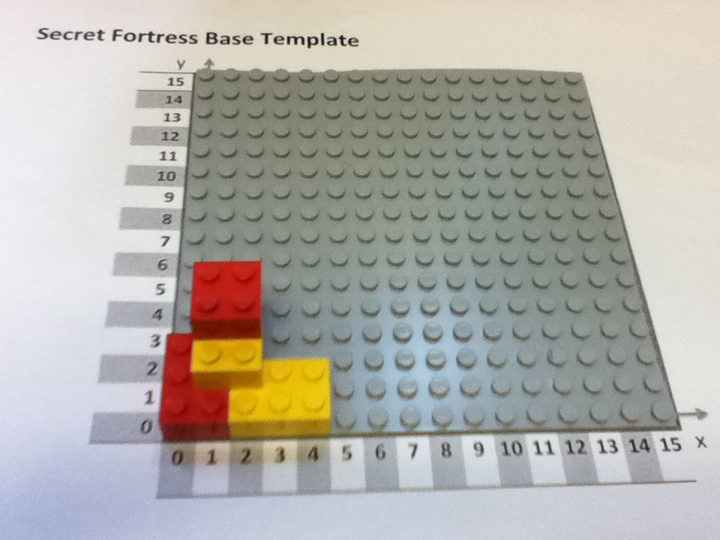
How could you tell someone how to build this tower – if they could not SEE it!

Slide 59
We definitely need to be able to describe positions of Legos!
Secret Fortress Base Template
y
15
14
13
12
11
10
9
8
7
6
5
4
3
2
1
0
0 | 1 | 2 | 3 | 4 | 5 | 6 | 7 | 8 | 9 | 10 | 11 | 12 | 13 | 14 | 15
x

Slide 60
Your Legend
Fill in the chart below with English and numeric instructions for your fortress.
Follow the sample line, which says “put the sample block, which is a red 2x4 block, horizontally, with its bottom left corner at the position given by the x-coordinate 6 and the y-coordinate 4.”
Then, fill in the legend to create an encoding for all the bricks you used.
For example, a 2x4 block might be represented with 010100, since 010 is 2 in binary, and 100 is 4 in binary.
Color
Red | 001
Let's go!
Brick Type
2 x 4 | 010100
Chart A. Your team's English Instructions
Block | Color | Brick Type | Orientation | X | Y
Sample | Red | 2x4 | Horizontal | 6 | 4
0 | Red | 2x3 | Vertical | 0 | 0
1 | Yellow | 2x3 | Horizontal | 2 | 0
2 | Yellow | 2x2 | Vertical | 1 | 1
3
4
5
6
7
8
Orientation
Horizontal | 00
Vertical | 01
Numbers
0 | 000
1 | 001
2 | 010
3 | 011
4 | 100
5 | 101
6 | 110
7 | 111

Slide 62
Your Legend
Now, we fill the legend…
Color
Red | 001
Copy the legend you created on the last page to this page.
Then, translate the instructions in Chart A to binary.
Converting information into binary allows a computer to store it and communicate it. Computers use an electric signal to represent the 1s and no signal to represent the 0s.
Brick Type
2 x 4 | 010100
Chart B. Your team's binary Instructions
Block | Color | Brick Type | Orientation | X | Y
Sample | 001 | 010100 | 00 | 110 | 100
0 | (Red) | (2x3) | Vertical | (0) | (0)
1 | (Yellow) | (2x3) | Horizontal | (2) | (0)
2 | (Yellow) | (2x3) | Vertical | (1) | (1)
3 | (Red) | (2x3) | Vertical | (1) | (2)
4
5
6
7
8
Orientation
Horizontal | 00
Vertical | 01
Numbers
0 | 000
1 | 001
2 | 010
3 | 011
4 | 100
5 | 101
6 | 110
7 | 111
& convert to binary…

Slide 63
Your Legend
Color
Red | 001
Yellow | 010
Copy the legend you created on the last page to this page.
Then, translate the instructions in Chart A to binary.
Converting information into binary allows a computer to store it and communicate it. Computers use an electric signal to represent the 1s and no signal to represent the 0s.
Brick Type
2 x 4 | 010100
2 x 3 | 010011
2 x 2 | 010010
Chart B. Your team's binary Instructions
Block | Color | Brick Type | Orientation | X | Y
Sample | 001 | 010100 | 00 | 110 | 100
0 | 001 (Red) | 010011 (2x3) | 01 Vertical | 000 (0) | 000 (0)
1 | 010 (Yellow) | 010011 (2x3) | 00 Horizontal | 010 (2) | 000 (0)
2 | 010 (Yellow) | 010010 (2x2) | 01 Vertical | 001 (1) | 001 (1)
3 | 001 (Red) | 010010 (2x2) | 01 Vertical | 001 (1) | 010 (2)
4
5
6
7
8
Orientation
Horizontal | 00
Vertical | 01
Numbers
0 | 000
1 | 001
2 | 010
3 | 011
4 | 100
5 | 101
6 | 110
7 | 111
My answer…

Slide 64
Your Legend
Color
Red | 001
Yellow | 010
Copy the legend you created on the last page to this page.
Then, translate the instructions in Chart A to binary.
Converting information into binary allows a computer to store it and communicate it. Computers use an electric signal to represent the 1s and no signal to represent the 0s.
Brick Type
2 x 4 | 010100
2 x 3 | 010011
2 x 2 | 010010
Chart B. Your team's binary Instructions
Block | Color | Brick Type | Orientation | X | Y
Sample | 001 | 010100 | 00 | 110 | 100
0 | 001 | 010011 | 01 | 000 | 000
1 | 010 | 010011 | 00 | 010 | 000
2 | 010 | 010010 | 01 | 001 | 001
3 | 001 | 010010 ( | 01 | 001 | 010
4
5
6
7
8
Orientation
Horizontal | 00
Vertical | 01
Numbers
0 | 000
1 | 001
2 | 010
3 | 011
4 | 100
5 | 101
6 | 110
7 | 111
just the bits!

Slide 65
Your Legend
Color
Red | 001
Yellow | 010
Copy the legend you created on the last page to this page.
Then, translate the instructions in Chart A to binary.
Converting information into binary allows a computer to store it and communicate it. Computers use an electric signal to represent the 1s and no signal to represent the 0s.
Differentiating delivery
Extra challenge: text one single line of bits
Usual: just swap binary pages (this one)
Simpler: just swap English pages (previous)
Brick Type
2 x 4 | 010100
2 x 3 | 010011
2 x 2 | 010010
Chart B. Your team's binary Instructions
Block | Color | Brick Type | Orientation | X | Y
Sample | 001 | 010100 | 00 | 110 | 100
0 | 001 | 010011 | 01 | 000 | 000
1 | 010 | 010011 | 00 | 010 | 000
2 | 010 | 010010 | 01 | 001 | 001
3 | 001 | 010010 | 01 | 001 | 010
4
5
6
7
8
Orientation
Horizontal | 00
Vertical | 01
Numbers
0 | 000
1 | 001
2 | 010
3 | 011
4 | 100
5 | 101
6 | 110
7 | 111
- swap bits -

Slide 66
Their Legend
Extra -- Transferring the bits!
If you send your instructions electronically, they have to be converted to a single line of 0s and 1s! For example, for these sample blocks,
Differentiating delivery!
Simpler: just swap binary pages.
Simplest: just swap English pages.
Color
Red | 001
Yellow | 010
Block | Color | Brick Type | Orientation | X | Y
0001 | 001 | 010100 | 00 | 110 | 100
0010 | 010 | 101101 | 01 | 111 | 100
Brick Type
2 x 4 | 010100
2 x 3 | 010011
2 x 2 | 010010
You would construct – and send – this line of 0s and 1s:
000100101010000110100001001010110101111100
Try it!
Write your binary instructions as a single line of 0s and 1s (it's OK to wrap):
__________________________________________________________________________________________________________________________________________________
Next, send a text or email to the other team with the bits of your tower.
Also, give them your legend or let them copy it…
Below, write down the other team's bits when they send them to you:
__________________________________________________________________________________________________________________________________________________
And copy their legend to the spots on this page.
00101001101000000010010011000100000100100100100100100101001001001010
Orientation
Horizontal | 00
Vertical | 01
Extra…
Numbers
0 | 000
1 | 001
2 | 010
3 | 011
4 | 100
5 | 101
6 | 110
7 | 111

Slide 67
Their Legend
Extra -- Transferring the bits!
If you send your instructions electronically, they have to be converted to a single line of 0s and 1s! For example, for these sample blocks,
Differentiating delivery!
Simpler: just swap binary pages.
Simplest: just swap English pages.
Color
Red | 001
Yellow | 010
Block | Color | Brick Type | Orientation | X | Y
0001 | 001 | 010100 | 00 | 110 | 100
0010 | 010 | 101101 | 01 | 111 | 100
Brick Type
2 x 4 | 010100
2 x 3 | 010011
2 x 2 | 010010
You would construct – and send – this line of 0s and 1s:
000100101010000110100001001010110101111100
Try it!
Write your binary instructions as a single line of 0s and 1s (it's OK to wrap):
__________________________________________________________________________________________________________________________________________________
Next, send a text or email to the other team with the bits of your tower.
Also, give them your legend or let them copy it…
Below, write down the other team's bits when they send them to you:
__________________________________________________________________________________________________________________________________________________
And copy their legend to the spots on this page.
00101001101000000010010011000100000100100100100100100101001001001010
Orientation
Horizontal | 00
Vertical | 01
Extra…
Numbers
0 | 000
1 | 001
2 | 010
3 | 011
4 | 100
5 | 101
6 | 110
7 | 111
01001001100001000001010011010100000010100100100001101001001001011001

Slide 68
Their Legend
Color
Red | 001
Yellow | 010
Make sure you have the other team's legend.
Then, make sure you have the other team's binary instructions.
If you swapped pages, you should be set.
If you transferred a single-line of 0s and 1s, you will need to make sure you have the correct bits in each spot!
Get the legend, too!
Now, we've swapped.
Brick Type
2 x 4 | 010100
2 x 3 | 010011
2 x 2 | 010010
Chart C. Other team's binary Instructions
Block | Color | Brick Type | Orientation | X | Y
Sample | 001 | 010100 | 00 | 110 | 100
0 | 010 | 010011 | 00 | 001 | 000
1 | 001 | 010011 | 01 | 010 | 000
2 | 001 | 010010 | 01 | 000 | 011
3 | 010 | 010010 | 01 | 011 | 001
4
5
6
7
8
Orientation
Horizontal | 00
Vertical | 01
Numbers
0 | 000
1 | 001
2 | 010
3 | 011
4 | 100
5 | 101
6 | 110
7 | 111
Try it from here…

Slide 69
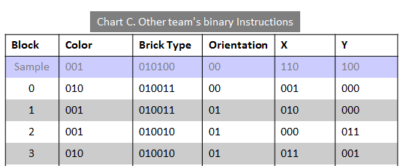
Their Legend
Color
Red | 001
Yellow | 010
Brick Type
2 x 4 | 010100
2 x 3 | 010011
2 x 2 | 010010
Translate the other team's instructions to English instructions.
Chart D. Other team's English Instructions
Block | Color | Brick Type | Orientation | X | Y
Sample | Red | 2x4 | Horizontal | 6 | 4
0 | Yellow | 2x3 | Horizontal | 1 | 0
1
2
3
4
5
6
7
8
Orientation
Horizontal | 00
Vertical | 01
Numbers
0 | 000
1 | 001
2 | 010
3 | 011
4 | 100
5 | 101
6 | 110
7 | 111
Decode…

Slide 70
Their Legend
Color
Red | 001
Yellow | 010
Translate the other team's instructions to English instructions.
Brick Type
2 x 4 | 010100
2 x 3 | 010011
2 x 2 | 010010
Chart D. Other team's English Instructions
Block | Color | Brick Type | Orientation | X | Y
Sample | Red | 2x4 | Horizontal | 6 | 4
0 | Yellow | 2x3 | Horizontal | 1 | 0
1 | Red | 2x3 | Vertical | 2 | 0
2 | Red | 2x2 | Vertical | 0 | 3
3 | Yellow | 2x2 | Vertical | 3 | 1
4
5
6
7
8
Orientation
Horizontal | 00
Vertical | 01
Numbers
0 | 000
1 | 001
2 | 010
3 | 011
4 | 100
5 | 101
6 | 110
7 | 111
My answers…

Slide 71
DECODED Fortress!
See if they match!
y
15
14
13
12
11
10
9
8
7
6
5
4
3
2
1
0
0 | 1 | 2 | 3 | 4 | 5 | 6 | 7 | 8 | 9 | 10 | 11 | 12 | 13 | 14 | 15
x

Slide 72
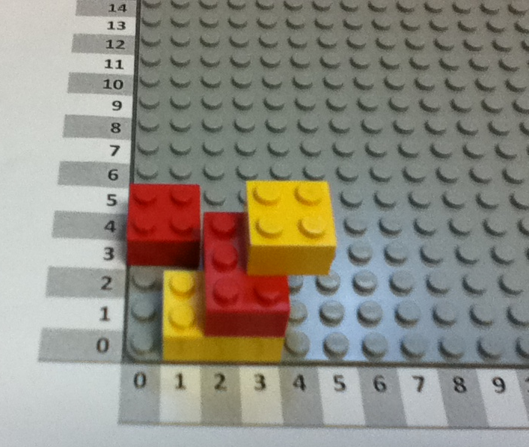
DECODED Fortress!
See if they match!

Slide 73
Bug tracker…
How many differences were they between the original and DECODED towers?
Find where the differences happened and make a mark for each location of these "bugs"
Translating from tower to English
Translating from English to binary
Transferring the bits
Translating from binary to English
Translating from English to tower
If you want to actually draw bugs, even better!

Slide 74
Secret Fortress Construction Challenge
You should have two identical LEGO block kits.
Set the extra kit aside, and use one kit to build a LEGO fortress:
Find a secluded spot to build your secret fortress. Don’t let anyone else see it!
Place your Lego baseplate on top of the template on page 2. Note the x and y axes are 0, as usual.
[First-timer advice] Keep your tower to the lower-left corner, where x and y are 7 or less
Write the English instructions for building your tower… (page 3)
Create a binary encoding (the legend) for each type and color of your Legos. (page 3)
Translate the English instructions to binary instructions for your tower! (page 4)
Be sure to copy over the legend, as well!
[Optional] Create a single line of 0s and 1s that you will send to the other team.
[Optional] Text or email that single line of 0s and 1s to the other team.
[Optional] Reassemble the other team's single line of 0s and 1s into binary instructions:
Swap! Make sure you have the chart of the other team's binary instructions…
Make sure you copy the other team's legend with their binary encoding
Convert their binary instructions back to English instructions using the legend.
Try to build their secret fortress!
When both teams are done, compare the fortresses you’ve created.
Were you successful? Why or why not?
Debug! If something went wrong, find where it went wrong -- which step of the process was it?!
Now, the real thing…
Pairs, pair up!

Slide 75
Don't show the other team your tower!
Secret Fortress Base Template
y
15
14
13
12
11
10
9
8
7
6
5
4
3
2
1
0
0 | 1 | 2 | 3 | 4 | 5 | 6 | 7 | 8 | 9 | 10 | 11 | 12 | 13 | 14 | 15
x

Slide 76
Your Legend
Fill in the chart below with English and numeric instructions for your fortress.
Follow the sample line, which says “put the sample block, which is a red 2x4 block, horizontally, with its bottom left corner at the position given by the x-coordinate 6 and the y-coordinate 4.”
Then, fill in the legend to create an encoding for all the bricks you used.
For example, a 2x4 block might be represented with 010100, since 010 is 2 in binary, and 100 is 4 in binary.
Color
Red | 001
Brick Type
2 x 4 | 010100
Chart A. Your team's English Instructions
Block | Color | Brick Type | Orientation | X | Y
Sample | Red | 2x4 | Horizontal | 6 | 4
0
1
2
3
4
5
6
7
8
Orientation
Horizontal | 00
Vertical | 01
Numbers
0 | 000
1 | 001
2 | 010
3 | 011
4 | 100
5 | 101
6 | 110
7 | 111

Slide 77
Your Legend
Color
Red | 001
Copy the legend you created on the last page to this page.
Then, translate the instructions in Chart A to binary.
Converting information into binary allows a computer to store it and communicate it. Computers use an electric signal to represent the 1s and no signal to represent the 0s.
Brick Type
2 x 4 | 010100
Chart B. Your team's binary Instructions
Block | Color | Brick Type | Orientation | X | Y
Sample | 001 | 010100 | 00 | 110 | 100
0
1
2
3
4
5
6
7
8
Orientation
Horizontal | 00
Vertical | 01
Numbers
0 | 000
1 | 001
2 | 010
3 | 011
4 | 100
5 | 101
6 | 110
7 | 111

Slide 78
Their Legend
Extra -- Transferring the bits!
If you send your instructions electronically, they have to be converted to a single line of 0s and 1s! For example, for these sample blocks,
Differentiating delivery!
Simpler: just swap binary pages.
Simplest: just swap English pages.
Color
Red | 001
Block | Color | Brick Type | Orientation | X | Y
0001 | 001 | 010100 | 00 | 110 | 100
0010 | 010 | 101101 | 01 | 111 | 100
Brick Type
2 x 4 | 010100
You would construct – and send – this line of 0s and 1s:
000100101010000110100001001010110101111100
Try it!
Write your binary instructions as a single line of 0s and 1s (it's OK to wrap):
__________________________________________________________________________________________________________________________________________________
Next, send a text or email to the other team with the bits of your tower.
Also, give them your legend or let them copy it…
Below, write down the other team's bits when they send them to you:
__________________________________________________________________________________________________________________________________________________
And copy their legend to the spots on this page.
Orientation
Horizontal | 00
Vertical | 01
Numbers
0 | 000
1 | 001
2 | 010
3 | 011
4 | 100
5 | 101
6 | 110
7 | 111

Slide 79
Their Legend
Color
Red | 001
Make sure you have the other team's legend.
Then, make sure you have the other team's binary instructions.
If you swapped pages, you should be set.
If you transferred a single-line of 0s and 1s, you will need to make sure you have the correct bits in each part of the code!
Brick Type
2 x 4 | 010100
Chart C. Other team's binary Instructions
Block | Color | Brick Type | Orientation | X | Y
Sample | 001 | 010100 | 00 | 110 | 100
0
1
2
3
4
5
6
7
8
Orientation
Horizontal | 00
Vertical | 01
Numbers
0 | 000
1 | 001
2 | 010
3 | 011
4 | 100
5 | 101
6 | 110
7 | 111

Slide 80
Their Legend
Color
Red | 001
Translate the other team's instructions to English instructions.
Brick Type
2 x 4 | 010100
Chart D. Other team's English Instructions
Block | Color | Brick Type | Orientation | X | Y
Sample | 001 | 010100 | 00 | 110 | 100
0
1
2
3
4
5
6
7
8
Orientation
Horizontal | 00
Vertical | 01
Numbers
0 | 000
1 | 001
2 | 010
3 | 011
4 | 100
5 | 101
6 | 110
7 | 111

Slide 81
DECODED Fortress!
See if they match!
y
15
14
13
12
11
10
9
8
7
6
5
4
3
2
1
0
0 | 1 | 2 | 3 | 4 | 5 | 6 | 7 | 8 | 9 | 10 | 11 | 12 | 13 | 14 | 15
x

Slide 82
Bug tracker…
How many differences were they between the original and DECODED towers?
Find where the differences happened and make a mark for each location of these "bugs"
Translating from tower to English
Translating from English to binary
Transferring the bits
Translating from binary to English
Translating from English to tower
If you want to actually draw bugs, even better!

Slide 83
Lunch!
After lunch @ 1pm:
Why CS: litter + language

Slide 84
Afternoon session
until 3pm: work on projects
@ 3pm: show off your work
everyone shows off a project Th afternoon…
then: team-based wrap-up survey/chat

Slide 85
Why CS ~ a course-wide module

Slide 86
Why CS ~ a course-wide module
Watson ~ a follow-up

Slide 87
Why CS ~ a course-wide module

Slide 88
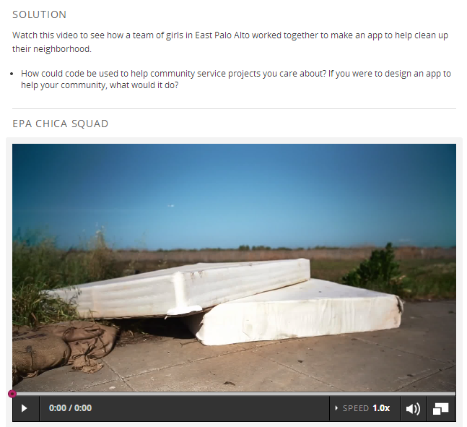

Slide 89
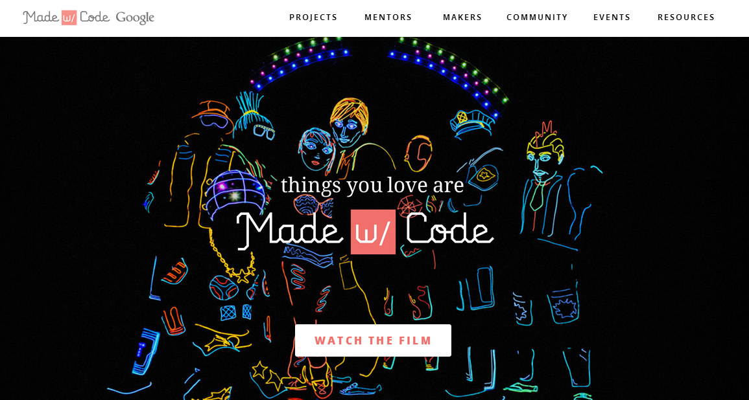
Why CS ~ a course-wide module
Made w/ Code: A Google effort aimed at women especially

Slide 90
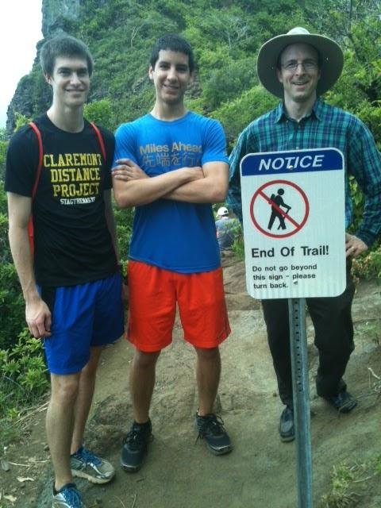
Human language is one data encoding
Human languages
ideas
encoding
words
decoding
ideas
The sign says not to go further.
La señal dice no ir más lejos.
Lots of different languages to use!

Slide 91
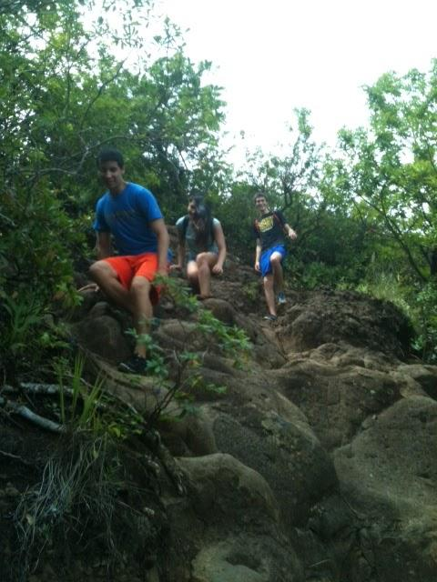
but the trail was too tempting to skip.
pero el camino era demasiado tentador para saltar.

Slide 92
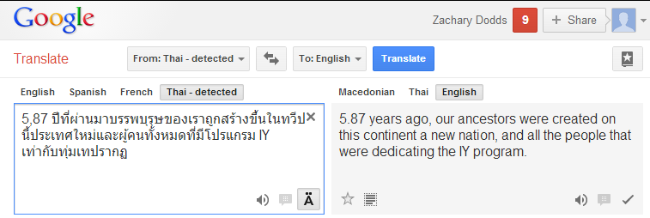
Language-encoding?
... using online translators ...
Anyone recognize this phrase, now 10 translations later?
not sure if this is an activity...

Slide 93
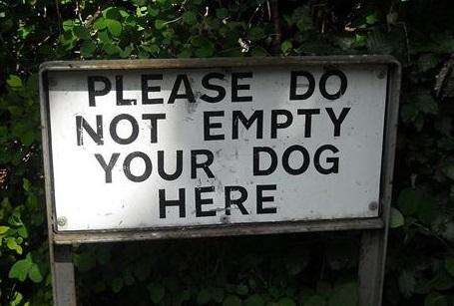
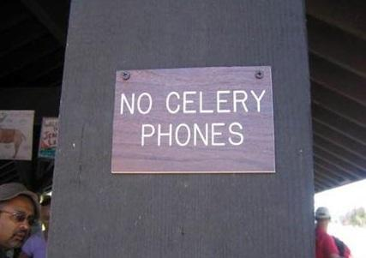
Translations...

Slide 94
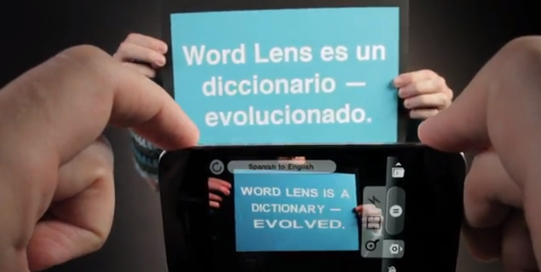
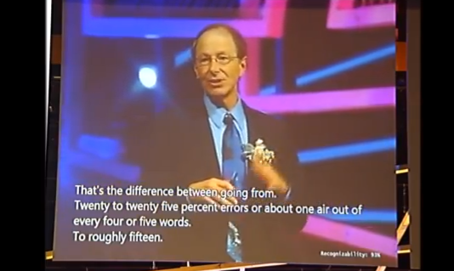
Automatic Translation Today...
WordLens
Microsoft Translation
Notes:
Added the links to the two videos (just click WordLens and Microsoft Translation

Slide 95
Too much Google translate...?
Carly Rae Jepson?
Notes:
Added the link to youtube on the word 'too much'

Slide 96
Afternoon session
until 3pm: work on projects
@ 3pm: show off your work
everyone shows off a project Th afternoon…
then: team-based wrap-up survey/chat

Slide 97
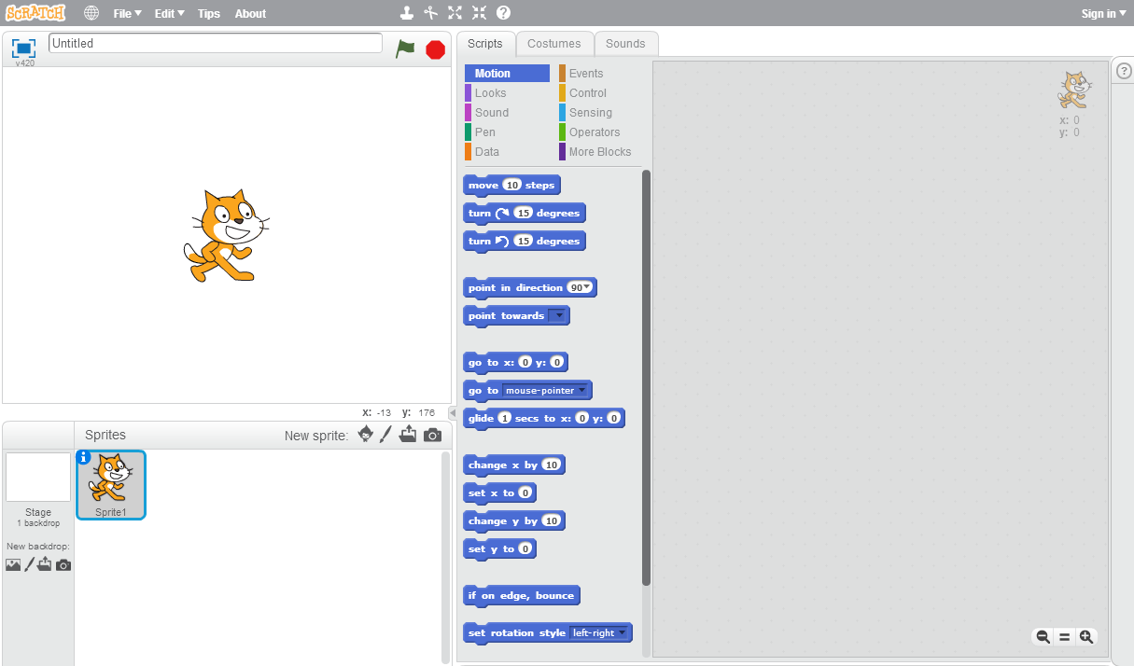
Unit 4: Making a scene with Scratch
"Scratch in its Natural State"

Slide 98
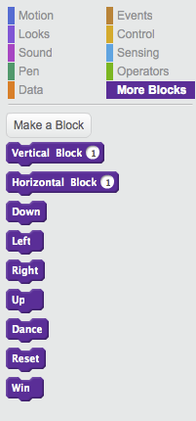
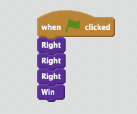
Block programming
We need to move three squares to the right. So, we go to the More Blocks section and drag and drop blocks to make this
I'm feeling a bit blocky myself.

Slide 99
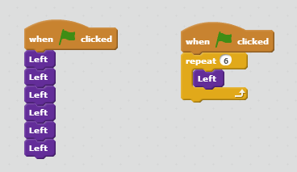
The repeat block
These are identical programs.
Each one moves left 6 times
Try solving the Ocean mazes using the repeat block

Slide 100
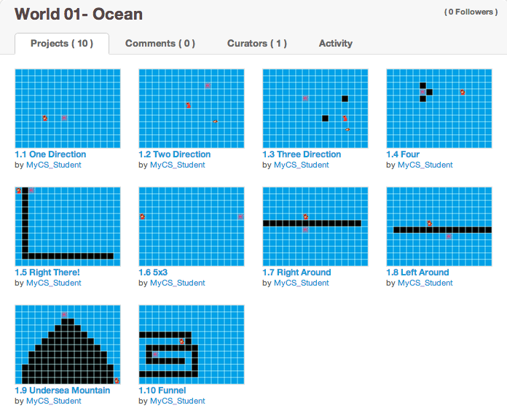
Studio 1 Ocean mazes...
Try (at least) Ocean mazes 1.9 + 1.10
How few purple blocks can you use?

Slide 101
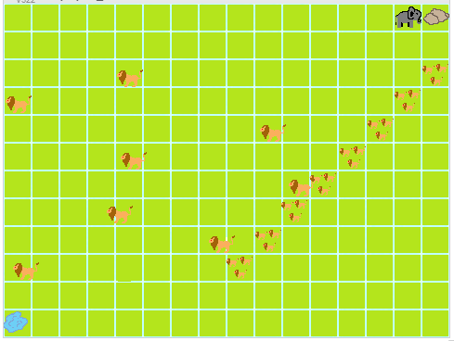
Studio 2
Safari
Enemies!
(predators)
lead to using the WAIT block
2.5, 2.8, 2.10*

Slide 102
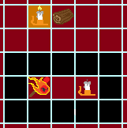
Studio 3
Fire
lead to the use of the IF/THEN/ELSE block
Teleporters
(portals)
3.1, 3.4, 3.7, 3.10*

Slide 103
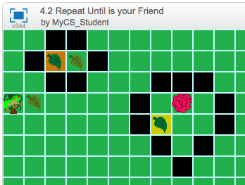
Studio 4
Jungle
many possible teleports...
lead to using the repeat until block
4.2, 4.7, 4.10*

Slide 104
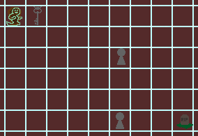
Studio 5
Ghosts
Multiple same-color exits
(for portals)
lead to the sprite-SENSING block
5.4, 5.6, 5.10*
Notes:
In this case, it's not color-SENSING... sprite-sensing?

Slide 105
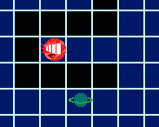
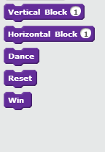
Studio 6
Space
Using horizontal and vertical
positive and negative ~ mathematical coords
6.2, 6.5, 6.9, 6.10*

Slide 106
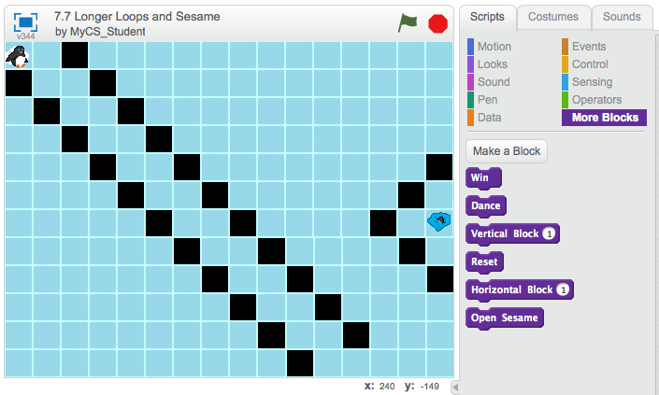
Studio 7
Arctic
Larger loops and Sesame!
more - and more sophisticated - practice with loops...
4.5, 4.7, 4.10*

Slide 107
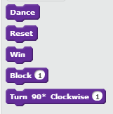
Studio 8
Mech
using only turn and forward
~ basic robot control
8.1, 8.2, 8.10*

Slide 108
Recommendation ~ try these mazes:
scratch.mit.edu/users/MyCS_Student/studios/
Studio 1: Try 1.1, 1.9, and 1.10.
Studio 2: Try 2.5, 2.8, and 2.10*
Studio 3: Try 3.1, 3.4, 3.7, and 3.10*
Studio 4: Try 4.2, 4.7, and 4.10*
Studio 5: Try 5.4, 5.6, 5.10*
Studio 6: Try 6.2, 6.5, 6.9, 6.10*
Studio 7: Try 7.2, 7.3, 7.6, 7.10*
Studio 8: Try 8.1, 8.2, 8.10*
Studios 9 and 10: *Try at your own risk!
want a challenge? see how few of the purple blocks you can use!

Slide 109
Unit 4: Making a scene with Scratch
Click the "Tips" button
"Scratch in its Natural State"

Slide 110
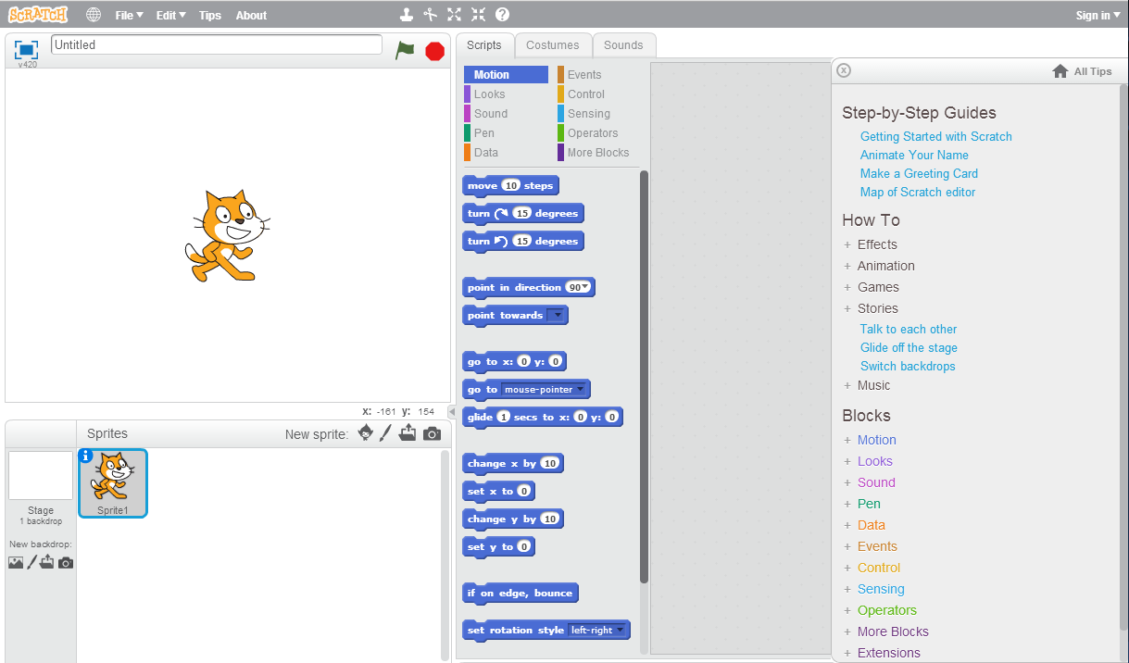
Unit 4: Making a scene with Scratch
First, work through the "Getting Started"
"Scratch in its Natural State"

Slide 111
Unit 4: Making a scene with Scratch
Then choose one of these three options to build:
Animate your name
Make a greeting card
Stories: talk to each other
"Scratch in its Natural State"

Slide 112
Try it out!

Slide 114
http://scratch.mit.edu/

Slide 118
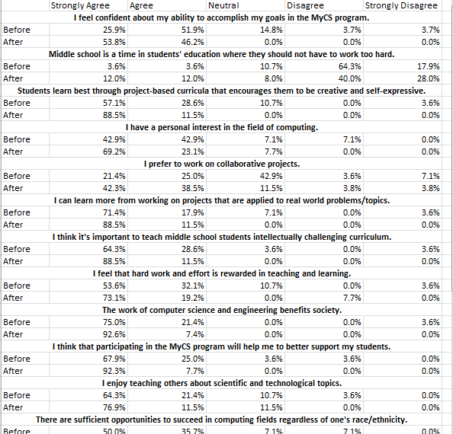
Lots of data…
n = 28 teachers

Slide 119
Lots of data…
n = 28 teachers

Slide 120
Mutual assessment…
How compelling was each topic?

Slide 121
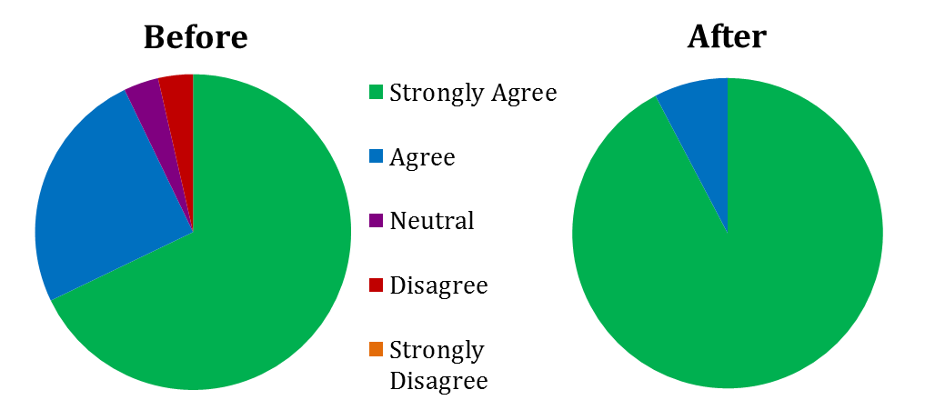
Teachers' feedback: MyCS
“I think that participating in the MyCS program will help me to better support my students.”
disagree
neutral
agree
strongly agree

Slide 122
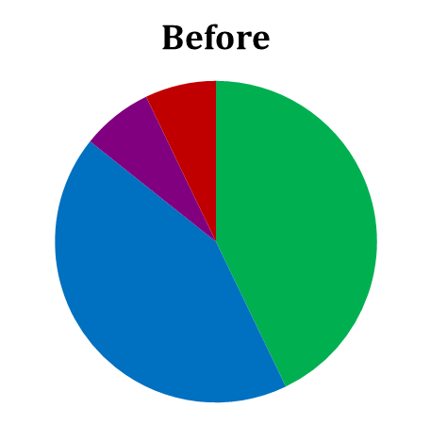
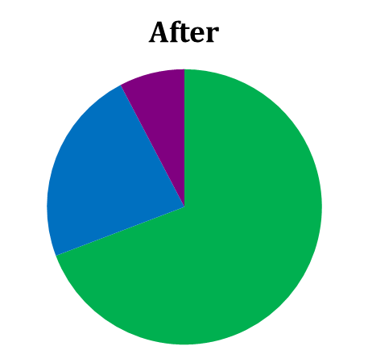
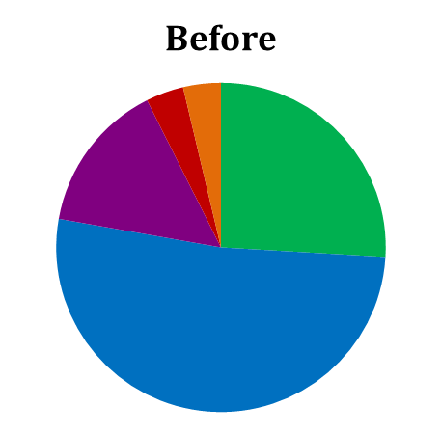
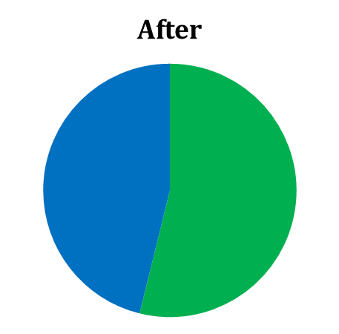
Teachers' feedback: self-efficacy
“I have a personal interest in the field of computing.”
“I feel confident about my ability to accomplish my goals with MyCS.”

Slide 123
Teachers' feedback: professional identity
“I prefer to work on collaborative projects.”
“I enjoy teaching others about scientific and technological topics.”
“Students learn best through project-based curricula that encourages them to be creative and self-expressive.”
Notes:
More time on “Students learn best”

Slide 124
MyCS MOOC
i.e., textbook+
Unify the curriculum + support our teachers
Offered as modules in existing classes
Pathway through the "creator gap":
from PLAY to PAUSE to POINT
Partner geography: Kauai, Pomona, …

Slide 125
MOOC,
complete
Lesson plans
Short videos
Explanations / illustrations
Instructions
Class activities
M.C. questions
Reflections /prompts
Notes:
Students! (name & year)

Slide 126
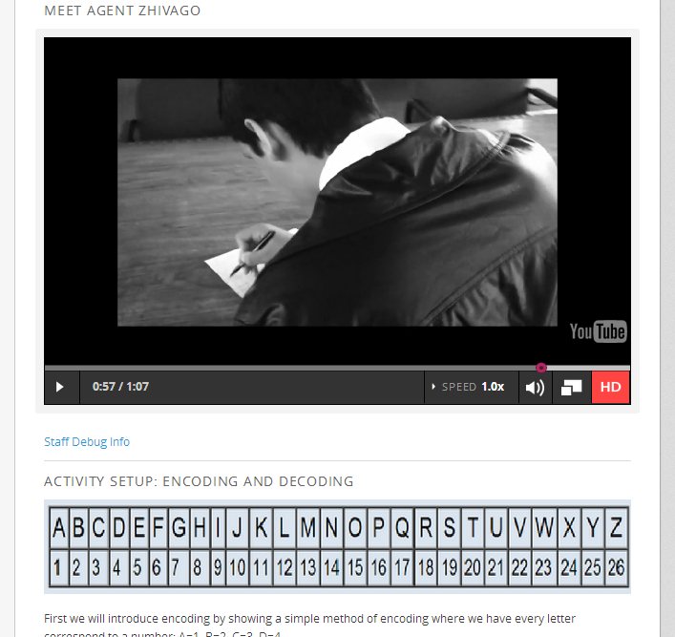
MOOC,
complete
Lesson plans
Short videos
Explanations / illustrations
Instructions
Class activities
M.C. questions
Reflections /prompts

Slide 127
MOOC,
complete
Lesson plans
Short videos
Explanations / illustrations
Instructions
Class activities
M.C. questions
Reflections /prompts

Slide 128
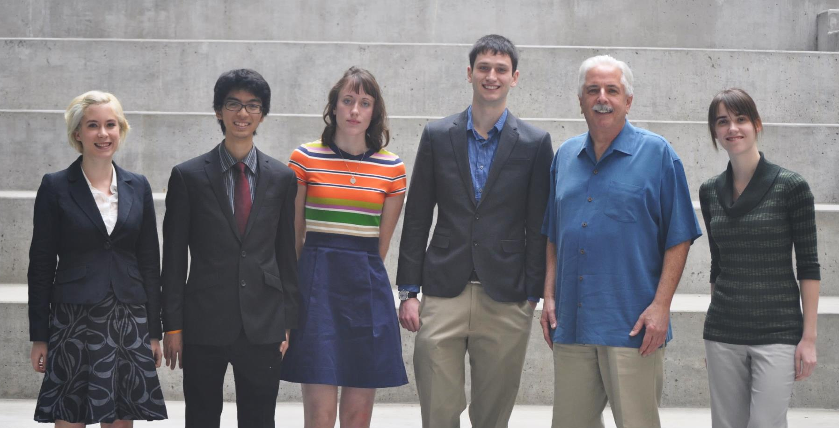
In-house team
How it's sold…

Slide 129
In-house team
How it feels…

Slide 130
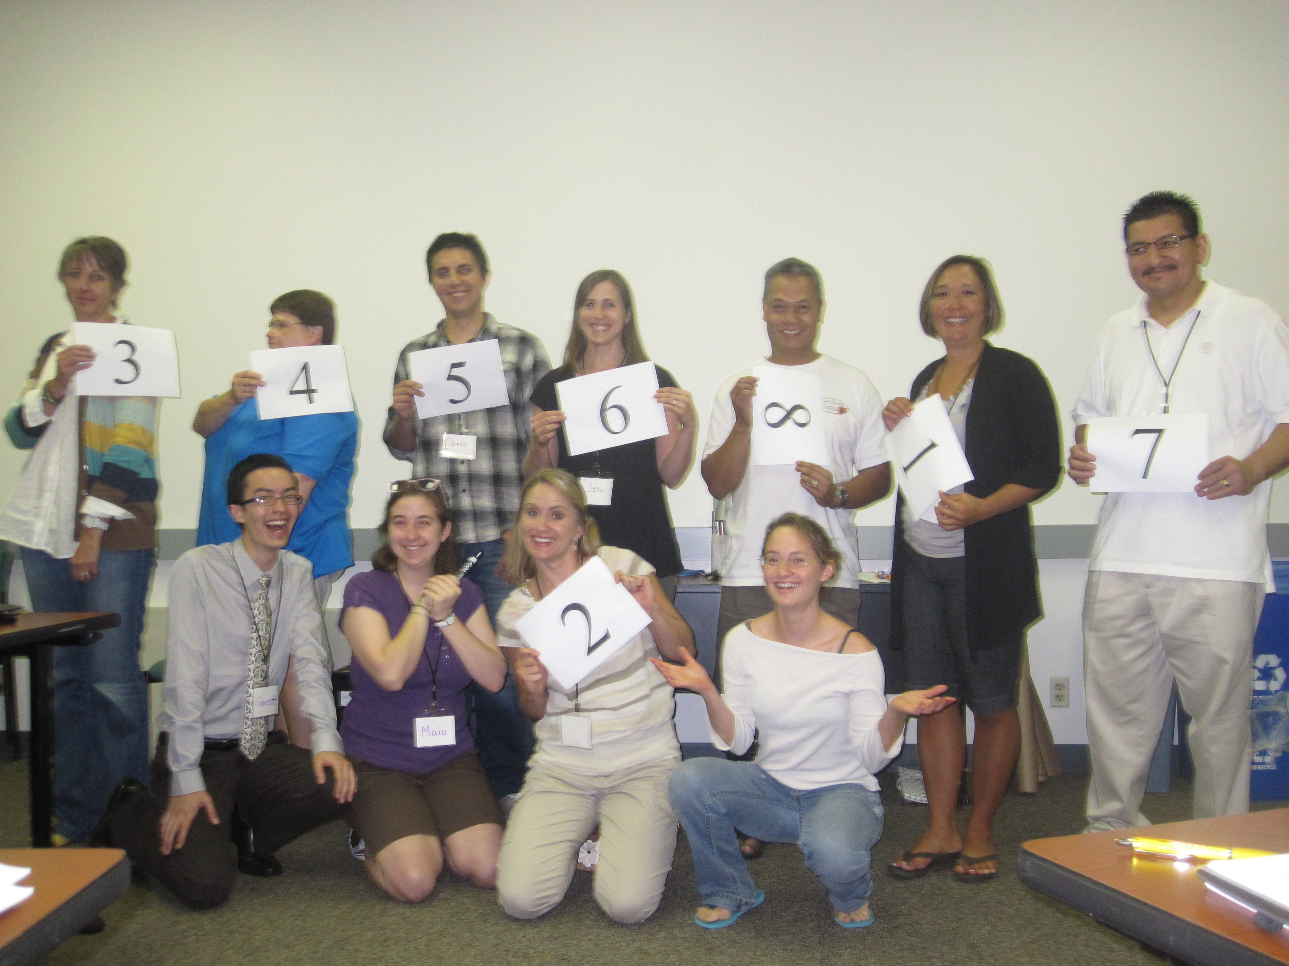
In building students' (computational) identities …
MyCS
… it's teachers who count.
is never complete
Notes:
MyCS is not complete – well, it is complete, but it's not DONE – we have no intention of ever calling it done. We're always looking out for new things that we can include in MyCS – but we want to give our partnering teachers a one-stop resource for the curriculum.
The feedback we get from teachers has and will keep on shaping the curriculum ----- and we are eager for anyone interested in a one-term middle-school CS course to use or remix MyCS for their purposes.
So, to end where we began, this work has been about how teachers relate to the MyCS curriculum, because teachers are the only real leverage available in _building a positive computational identity_ -- and that interpersonal essence is what we want to achieve with MyCS.

Slide 131
my women (left cols) vs. men (right cols)

Slide 132
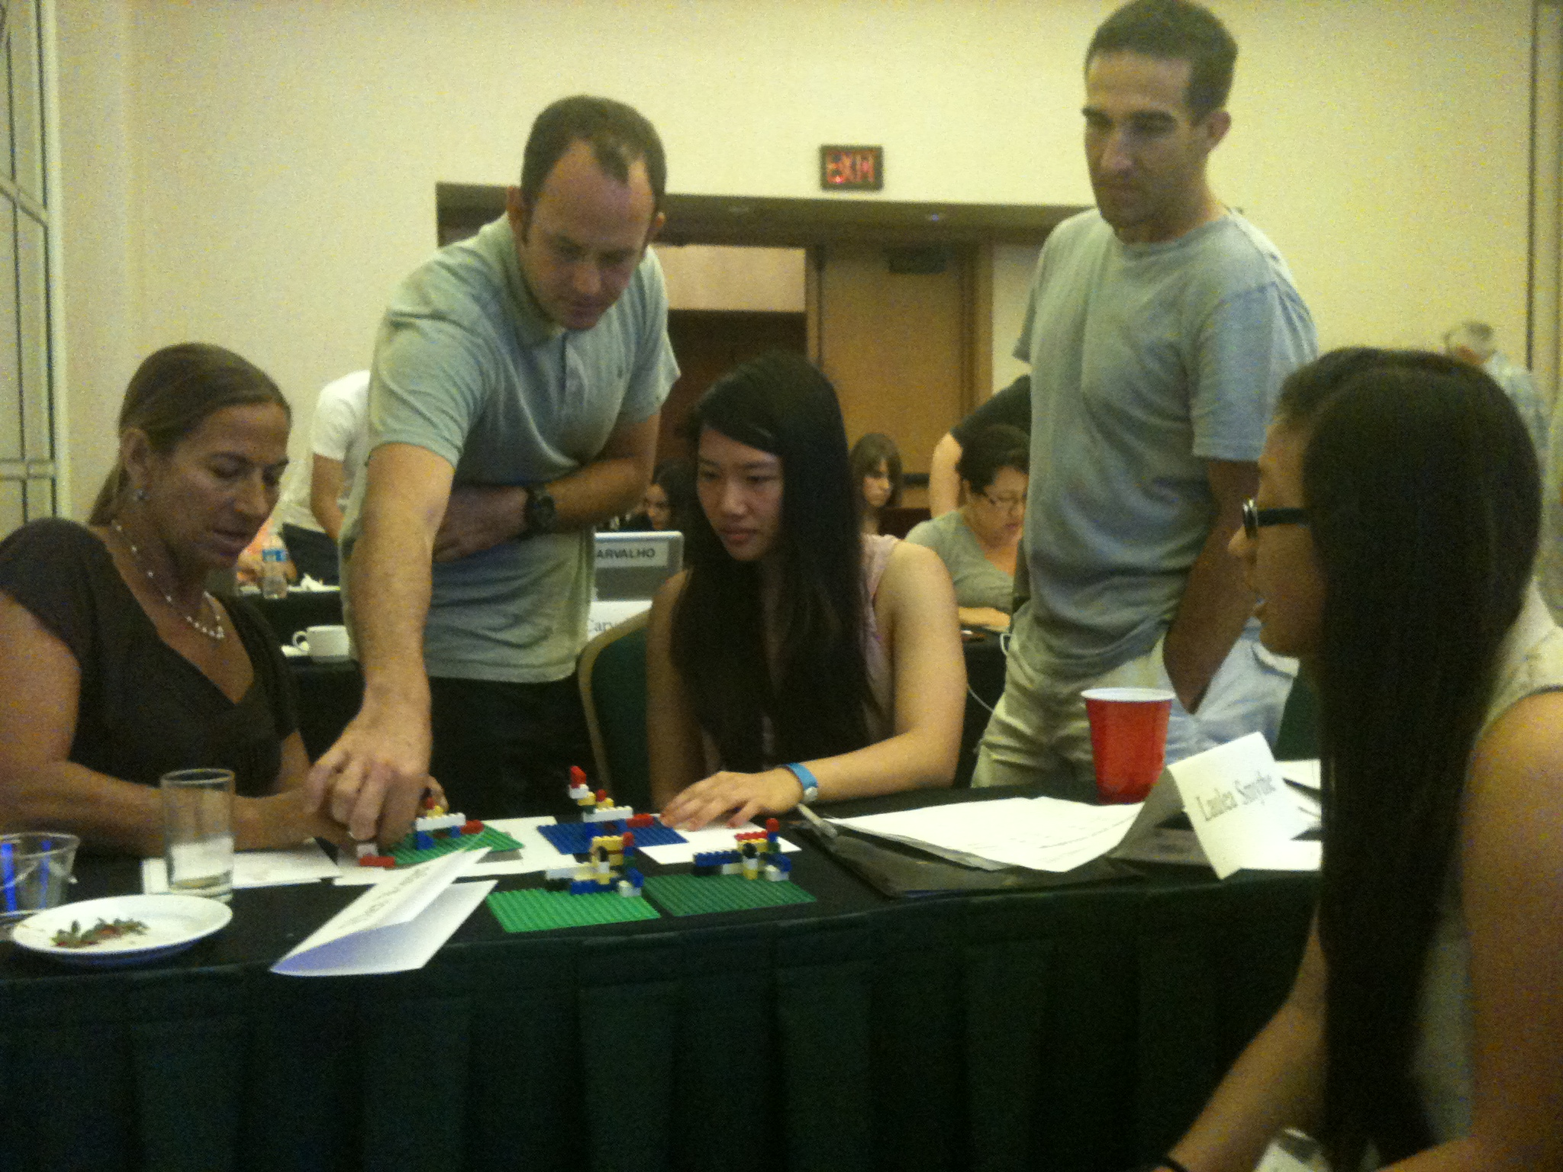
What have we learned?
Notes:
So, what have _we_ learned from and about the teachers we've worked with?
Well, this past summer we had a chance to bring Elly Schofield - a recent HMC alum - onto the project in order to help us with this teacher-feedback piece of the project…

Slide 133
Lots of data…
n = 28 teachers

Slide 134
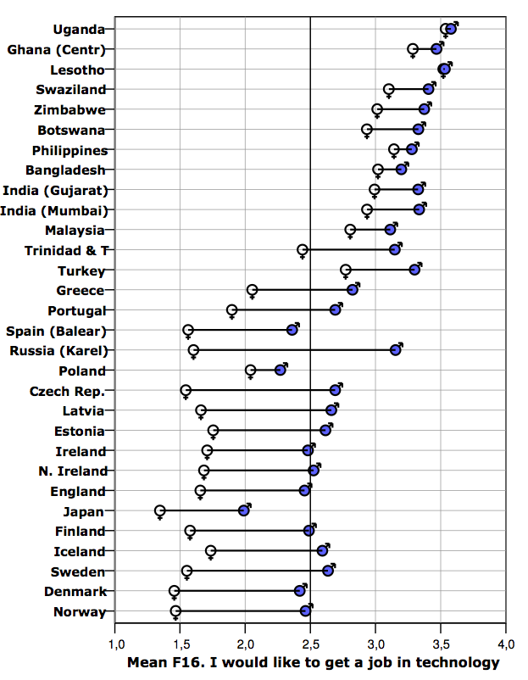
But
ROSE data
… building positive computational identity is difficult
"first-world problem"
useful isn't useful
Camilla Schreiner + Svein Sjoberg:
Notes:
Schreiner, Camilla & Sjøberg, Svein
… and in fact, as the joke goes – this really IS a first-world problem…!
What their data showed convincingly is that in first-world countries – being useful as a field – like computing – isn't actually a useful hook for young people – so, how do we reach this formative, middle-years age group?

Slide 135
Overheard @ CE21
I'd say middle-school teachers consider themselves "more about their students" …
… and high-school teachers consider themselves "more about their subjects."
teachers know how to hook their students…
many are seeking content confidence
Notes:
Well, at the middle-school panel of this year's CE 21 conference, a teacher made this interesting observation…
She said [[read]] .. at least each cohort relative to the other…
What this means is that we have an expert group at reaching middle-years students!!
But what those teachers _need_ is confidence in the content, that is, CS and computing.

Slide 136
Mutual assessment…

Slide 137
Teachers' feedback: MyCS
“I think that participating in the MyCS program will help me to better support my students.”
disagree
neutral
agree
strongly agree

Slide 138
Teachers' feedback: self-efficacy
“I have a personal interest in the field of computing.”
“I feel confident about my ability to accomplish my goals with MyCS.”

Slide 139
Teachers' feedback: professional identity
“I prefer to work on collaborative projects.”
“I enjoy teaching others about scientific and technological topics.”
“Students learn best through project-based curricula that encourages them to be creative and self-expressive.”

Slide 140
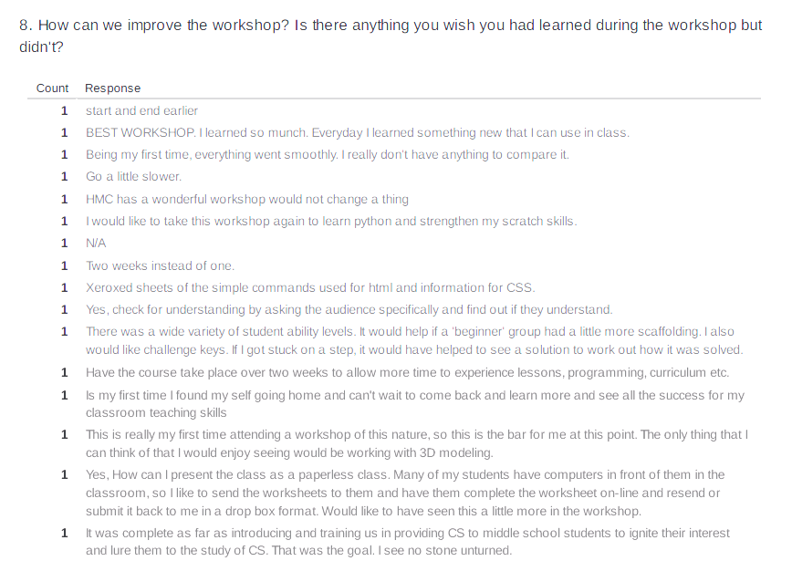
Teachers' feedback: what's missing?

Slide 141
MyCS MOOC
i.e., textbook+
unify the curriculum + support our teachers
easy to access ~ flexible to use
offered as modules in existing classes accessible pathway: PLAY to PAUSE to POINT
partner geography: Kauai, Pomona, …
The vision
online resource to help teachers bridge the "creator gap" in (CS) curricula

Slide 142
MOOC,
complete
Lesson plans
Short videos
Explanations / illustrations
Instructions
Class activities
M.C. questions
Reflections /prompts

Slide 143
MOOC,
complete
Lesson plans
Short videos
Explanations / illustrations
Instructions
Class activities
M.C. questions
Reflections /prompts

Slide 144
MOOC,
complete
Lesson plans
Short videos
Explanations / illustrations
Instructions
Class activities
M.C. questions
Reflections /prompts

Slide 145
In-house team
How it's sold…
EdX logo
Amazon EC2 logo
MuddX logo

Slide 146
In-house team
How it feels…
EdX logo
Amazon EC2 logo
MuddX logo

Slide 147
Teachers are CS's (esp. MyCS) vectors.
MOOCs are for teachers …
… and the teachers count.

Slide 148
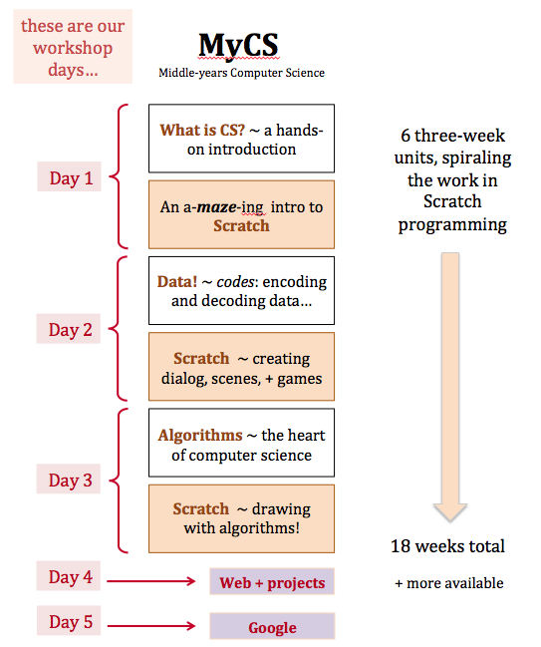
We do need to support teachers
with all that excellent material
18 weeks of day-by-day lesson plans

Slide 149
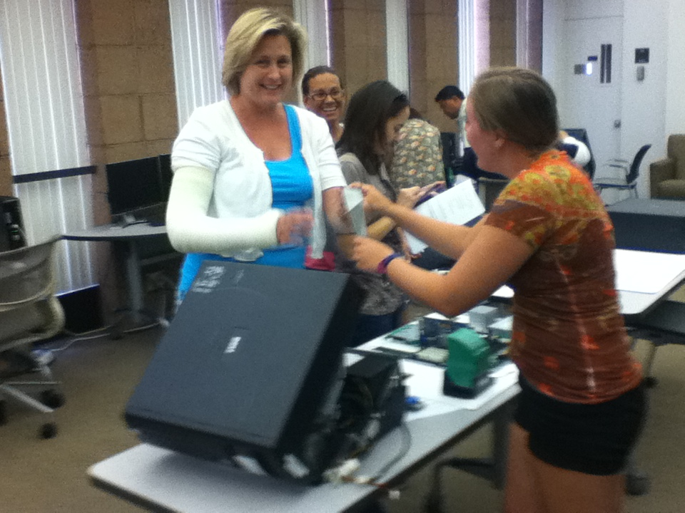
Our inspiration
(Maddy)

Slide 150
Our inspiration
(Maddy)

Slide 151
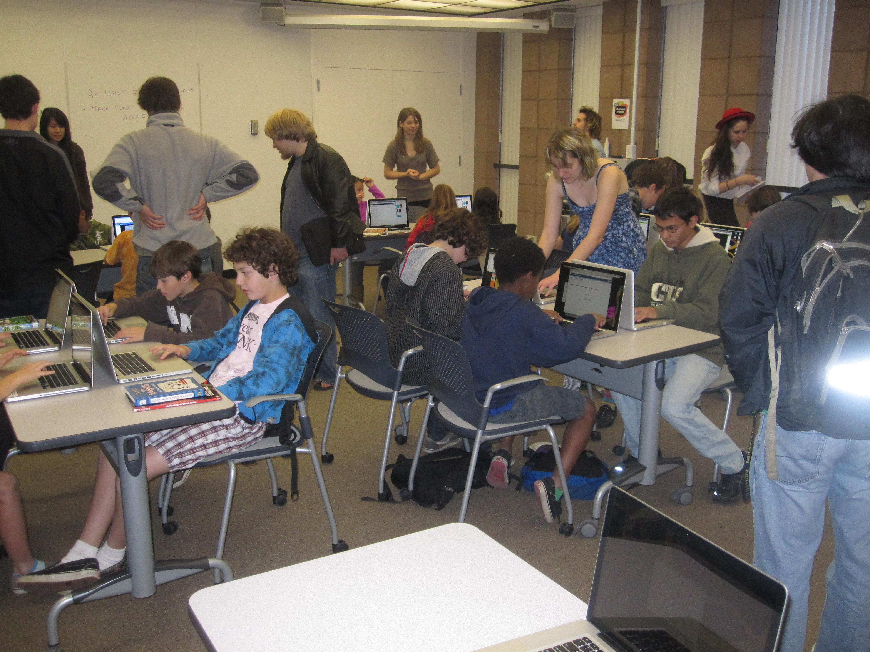
Initial attempts…
our students, ourselves

Slide 152
Initial attempts…
… we may need some teachers …

Slide 153
MyCS's curriculum
all here…
one semester of Scratch programming, punctuated by contextual activities
adaptations welcome…

Slide 154
MyCS MOOC
i.e., textbook+
Unify the curriculum + support our teachers
offered as modules in existing classes
accessible pathway:
PLAY to PAUSE to POINT
partner geography: Kauai, Pomona, …
online resource to help teachers bridge the "creator gap" in (CS) curricula

Slide 155
Open-ended Scratch…

Slide 156
Getting started…
Get the Scratch Cat to move…
Find the sprite editor and put some shorts (or other clothes) on the Cat…
Write a program to have the Cat trace the outline of the stage
Create a dance by going through the tutorial with the Scratch Cat…
Add more characters (sprites) from the library or your own to the dance!
Create music that goes with the Cat’s dance...
THEN – use the Pen blocks to trace the cat’s path
Create your own – perhaps either
(A) a dance-instruction tutorial or
(B) a scene involving 2 or more sprites

Slide 157
How computers work

Slide 158
Encoding with legos

Slide 159
More binary activities...
Christmas tree decoding
"beep" and "boop"
1
0
Claremont: CS Fridays ~ binary-encoded emails
Notes:
As an exercise, showing them how to count up in binary would be good - later in the lego building
exercise, some were skipping numbers as they counted up.
Additionally, mentioning the tally system (base 1!) would be good since they have likely used it before
but without realizing it is base 1

Slide 160
How computers work

Slide 161
See you Thursday!

Slide 163
Notes:
As an exercise, showing them how to count up in binary would be good - later in the lego building
exercise, some were skipping numbers as they counted up.
Additionally, mentioning the tally system (base 1!) would be good since they have likely used it before
but without realizing it is base 1

Slide 164
Lego encodings
y
Suppose we want to encode these blocks:
4
3
What characteristics of the blocks will we need to represent?
2
1
0
x
0
1
2
Notes:
This activity was great!
Consider letting the participants come up with their own encodings (don't give them x,y coords, color, orientation guides). Most teachers said that that is what they would like to do with their students.
Leave the 2nd table blank and do it as an example with them.

Slide 165
Lego encodings
y
Suppose we want to encode these blocks:
4
3
What characteristics of the blocks will we need to represents?
2
1
0
x
color | binary
White | 000
Blue | 001
color
0
1
2
brick type | binary
2X3 | 000
2X2 | 001
brick type
CODES
orientation | binary
horizontal | 000
vertical | 001
orientation
+ coordinates!
Notes:
This activity was great!
Consider letting the participants come up with their own encodings (don't give them x,y coords, color, orientation guides). Most teachers said that that is what they would like to do with their students.
Leave the 2nd table blank and do it as an example with them.

Slide 166
Lego encodings
y
Suppose we want to encode these blocks:
4
3
2
1
0
x
0
1
2
We now have this legend (or codes):
Legend/codes:
color | binary
White | 000
Blue | 001
brick type | binary
2X3 | 000
2X2 | 001
orientation | binary
horizontal | 000
vertical | 001
Notes:
This activity was great!
Consider letting the participants come up with their own encodings (don't give them x,y coords, color, orientation guides). Most teachers said that that is what they would like to do with their students.
Leave the 2nd table blank and do it as an example with them.

Slide 167
Lego encodings
y
Suppose we want to encode these blocks:
4
3
2
1
0
x
Next, we place their information in a table:
0
1
2
Color | Brick Type | Orientation | X-coordinate | Y-coordinate
White | 2x3 | vertical | 0 | 0
brick 1
let's use lower-left coordinates!
brick 2
Legend/codes:
color | binary
White | 000
Blue | 001
brick type | binary
2X3 | 000
2X2 | 001
orientation | binary
horizontal | 000
vertical | 001
Notes:
This activity was great!
Consider letting the participants come up with their own encodings (don't give them x,y coords, color, orientation guides). Most teachers said that that is what they would like to do with their students.
Leave the 2nd table blank and do it as an example with them.

Slide 168
Lego encodings
y
Suppose we want to encode these blocks:
4
Finally, we use our codes (legend) for binary:
3
Color | Brick Type | Orientation | X-coordinate | Y-coordinate
000 | 000 | 001 | 0000 | 0000
001
2
1
brick 1
0
x
brick 2
0
1
2
Color | Brick Type | Orientation | X-coordinate | Y-coordinate
White | 2x3 | vertical | 0 | 0
Blue | 2x2 | horiz. | 1 | 3
brick 1
brick 2
Legend/codes:
color | binary
White | 000
Blue | 001
brick type | binary
2X3 | 000
2X2 | 001
orientation | binary
horizontal | 000
vertical | 001
Notes:
This activity was great!
Consider letting the participants come up with their own encodings (don't give them x,y coords, color, orientation guides). Most teachers said that that is what they would like to do with their students.
Leave the 2nd table blank and do it as an example with them.

Slide 169
Lego encodings
y
4
Our encoding is complete!
3
Color | Brick Type | Orientation | X-coordinate | Y-coordinate
000 | 000 | 001 | 0000 | 0000
001 | 001 | 000 | 0001 | 0011
2
1
brick 1
0
x
brick 2
0
1
2
Color | Brick Type | Orientation | X-coordinate | Y-coordinate
White | 2x3 | vertical | 0 | 0
Blue | 2x2 | horiz. | 1 | 3
brick 1
brick 2
Legend/codes:
color | binary
White | 000
Blue | 001
brick type | binary
2X3 | 000
2X2 | 001
orientation | binary
horizontal | 000
vertical | 001
Notes:
This activity was great!
Consider letting the participants come up with their own encodings (don't give them x,y coords, color, orientation guides). Most teachers said that that is what they would like to do with their students.
Leave the 2nd table blank and do it as an example with them.

Slide 170
Let's decode!
Color | Brick Type | Orientation | X-coordinate | Y-coordinate
001 | 001 | 000 | 0000 | 0000
000 | 001 | 001 | 0011 | 0000
000 | 000 | 000 | 0001 | 0000
001 | 000 | 000 | 0001 | 0000
brick 1
brick 2
brick 3
brick 4
Legend/codes:
color | binary
White | 000
Blue | 001
brick type | binary
2X3 | 000
2X2 | 001
orientation | binary
horizontal | 000
vertical | 001

Slide 171
Building your own encoding
In pairs, build a Lego structure.
Then, create codes (a legend) for your legos.
Next, create an English encoding.
Finally, create a binary encoding.
But, do it all in ABSOLUTE SECRECY!
Then, swap with another group -- and see who can decode their tower most accurately!

Slide 172
Create your binary codes here...
you may need to define more orientations for tricky Lego shapes
color | binary
White | 000
Blue | 001
brick type | binary
2x3 | 000
2x2 | 001
orientation | binary
horizontal | 000
vertical | 001

Slide 173
Encode your Legos here... first English, then binary
Block | Color | Brick Type | Orentation | X-coordinate | Y-coordinate
0
1
2
3
4
5
6
7
8
9
10
11
12
13
14
15

Slide 174
Encode your Legos here... first English, then binary
Block | Color | Brick Type | Orentation | X-coordinate | Y-coordinate
0
1
2
3
4
5
6
7
8
9
10
11
12
13
14
15

Slide 175
Encode your Legos here... first English, then binary
Block | Color | Brick Type | Orentation | X-coordinate | Y-coordinate
0
1
2
3
4
5
6
7
8
9
10
11
12
13
14
15
Use one page for English, then use another for binary!

Slide 176
Prompts
agenda for Day 2's lunch
(1) We'd like to show you a "more carefully curated" version of these materials...
Saying "online" wouldn't convey muic...
Idea: leverage the trends in online education
(2) Your thoughts about online education?
(3) We'd love to get your feedback on usefulness...

Slide 177
Scratch Games
or
Python
Day 2, Sessions 3-4

Slide 178
Python resources
play!
tutor.

Slide 179
Games can seem complex...
yet they can also be a better place to start than general animations...
there's a human sprite
single focus of attention
very incremental

Slide 180
Key: step-by-step progress
create two games:
the first is scaffolded
the second is open-ended

Slide 181
Up, up, and away!
you'll need three more, too!
(1)
Choose a flying main character / hero
Add blocks like these so that you can move around with the 4 arrow keys:
swimming is just aquatic flying...
(2)

Slide 182
(3)
Make sure your hero can wrap around
-- at least from right to left:
add other wrapping as you see fit!

Slide 183
(4)
Create a second sprite ~ the goal!
~ something you want to reach
(5)
Create a third sprite ~ an "enemy"
~ something to avoid
(6)
Have your enemy move continuously:

Slide 184
(7)
When the enemy hits the hero, teleport the hero back to the start:
it's good to start there at the beginning, too

Slide 185
(8)
Customize! Add at least two of these:
(a) Add a changing score variable
(b) Add more enemies
(c) Have the enemies move randomly
(d) Add "power-up" sprites that change your hero's size, score, or speed
(e) Add portals that teleport your hero randomly
(f) Have the game end when a timer runs out.
(9)
Then, add two features of your own!
(g) Work with HMCers on these...

Slide 186
Game demonstrations...
...and code reviews

Slide 187
Other game ideas...
minigolf game
Pacman-type game
Asteroids
platformer (Mario)
get examples...
MEE's game
No limits... !
Mary Elise's game...

Slide 188
Thanks, everyone!
'til Wed. ...

Slide 190
Below are extra slides from old versions of the workshop...

Slide 191
Our game: Fly, fly again...
Use these blocks to write a script that makes it so that if you press the UP arrow, the helicopter goes up, but if you DON'T press the up arrow, the helicopter goes down (like gravity!)
Make sure to save when done!

Slide 192
Scratch:
Jokes - Plays - Music - Games
Day 2, Session 3

Slide 193
Scratch: many possibilities!
Robin: Class projects
Justin: Manzanar stagings
Notes:
Find Pomona teachers to show off their students' work, or delete this slide

Slide 194
Scratch: many possibilities!
Robin: Class projects
Justin: Manzanar stagings
as an expressive tool, CS is transformative...

Slide 195
Simple interaction
Knock-knock Joke in Scratch
Science Joke in Scratch
Using blocks like "wait ( ) secs" and "say [ ] for ( ) secs" you can create a conversation between two sprites.

Slide 198
Movement Practice
Can you make your sprite move in a triangle?
In a square?

Slide 199
Notes:
a lot of people figured this out before we showed them, so giving it to them sooner might be good
although, going over controls in image edit screen may be a good idea

Slide 200
Notes:
Consider changing the screen shot to the online version of scratch

Slide 202
Simple Stories
Find or create a Scratch sprite with multiple costumes, and give it some dialogue that involves a costume change.
"Who's on First" in Scratch
"Romeo and Juliet" in Scratch
Notes:
Free time to make a short script w/ changing costumes, maybe make the cat run (10 min)
#outline

Slide 203
But I want to be creative!
Costumes can be drawn in Scratch, or imported in.
Notes:
Creating your own costumes, importing images for costumes (5 min)
demo for each
#outline

Slide 204
Scratch storytelling
(1) Create a knock-knock joke in Scratch
(2) Choose a new sprite - move it in a triangle, then a square.
(3) Build a more elaborate, "staged play" that involves
costume changes
show and hide
movement of the sprites
Notes:
Free time to make a short script w/ changing costumes, maybe make the cat run (10 min)
#outline

Slide 205
Scratch: Music
Day 2, Session 4

Slide 209
Make a song!
Use notes, drums, and rests to create a short song.
When you are done, make sure to save your program -- saving to the desktop is OK
Then, have the other partner make a second song -- and play both songs for a nearby group!

Slide 210
Polyphonic Music
You can use multiple start tabs to create polyphonic music.
Broadcasting is also effective in starting other parts of music.
WARNING: Using too many start tabs can cause the parts to become offset.

Slide 211
Scratch: thoughts?
Could Scratch work as a medium for any other classes -- in the same spirit as ________ staging?
It's increasingly popular in colleges' CS1 courses... !
Notes:
Change "Justin's manzanar" to some other assignment done by a teacher in the current seminar

Slide 212
Thanks & see you tomorrow!
Day 1
Day 3
Tomorrow's plan
Day 4
Day 5

Slide 215
Song Improvements
Use repeats, tempo, and volume to make improvements to your songs or create a new one...
... either way, explore all of the tools!

Slide 224
Keyboard Challenge
Using "Keyboard" by MyCS_Student as a starting point, create a keyboard.
That is, make each key in a row of keys on your computer keyboard correspond to a note in a scale. Want more? Try different instruments!

Slide 227
Notes:
Not sure if this is available on the online version of scratch

Slide 228
Debugging Practice
Use the worksheet to practice debugging.

Slide 229
Numeric encodings
So, letters can be encoded as numbers...
Can all data be encoded as numbers?
sounds?
images?
everything?
Notes:
Added link to 'sounds' which goes to the song Kryptonite by 3 Doors Down

Slide 230
Lego encodings
y
Suppose we want to encode these blocks:
4
3
What characteristics of the blocks will we need to represent?
2
1
0
x
color | binary
red | 000
yellow | 001
color
0
1
2
brick type | binary
2X3 | 000
2X2 | 001
brick type
CODES
orientation | binary
horizontal | 000
vertical | 001
orientation
+ coordinates!
Notes:
This activity was great!
Consider letting the participants come up with their own encodings (don't give them x,y coords, color, orientation guides). Most teachers said that that is what they would like to do with their students.
Leave the 2nd table blank and do it as an example with them.

Slide 231
Lego encodings
y
Suppose we want to encode these blocks:
4
3
2
1
0
x
0
1
2
We now have this legend (or codes):
Legend/codes:
color | binary
White | 000
Blue | 001
brick type | binary
2X3 | 000
2X2 | 001
orientation | binary
horizontal | 000
vertical | 001
Notes:
This activity was great!
Consider letting the participants come up with their own encodings (don't give them x,y coords, color, orientation guides). Most teachers said that that is what they would like to do with their students.
Leave the 2nd table blank and do it as an example with them.

Slide 232
Lego encodings
y
Suppose we want to encode these blocks:
4
3
2
1
0
x
Next, we place their information in a table:
0
1
2
Color | Brick Type | Orientation | X-coordinate | Y-coordinate
White | 2x3 | vertical | 0 | 0
brick 1
let's use lower-left coordinates!
brick 2
Legend/codes:
color | binary
White | 000
Blue | 001
brick type | binary
2X3 | 000
2X2 | 001
orientation | binary
horizontal | 000
vertical | 001
Notes:
This activity was great!
Consider letting the participants come up with their own encodings (don't give them x,y coords, color, orientation guides). Most teachers said that that is what they would like to do with their students.
Leave the 2nd table blank and do it as an example with them.

Slide 233
Lego encodings
y
Suppose we want to encode these blocks:
4
Finally, we use our codes (legend) for binary:
3
Color | Brick Type | Orientation | X-coordinate | Y-coordinate
000 | 000 | 001 | 0000 | 0000
001
2
1
brick 1
0
x
brick 2
0
1
2
Color | Brick Type | Orientation | X-coordinate | Y-coordinate
White | 2x3 | vertical | 0 | 0
Blue | 2x2 | horiz. | 1 | 3
brick 1
brick 2
Legend/codes:
color | binary
White | 000
Blue | 001
brick type | binary
2X3 | 000
2X2 | 001
orientation | binary
horizontal | 000
vertical | 001
Notes:
This activity was great!
Consider letting the participants come up with their own encodings (don't give them x,y coords, color, orientation guides). Most teachers said that that is what they would like to do with their students.
Leave the 2nd table blank and do it as an example with them.

Slide 234
Lego encodings
y
4
Our encoding is complete!
3
Color | Brick Type | Orientation | X-coordinate | Y-coordinate
000 | 000 | 001 | 0000 | 0000
001 | 001 | 000 | 0001 | 0011
2
1
brick 1
0
x
brick 2
0
1
2
Color | Brick Type | Orientation | X-coordinate | Y-coordinate
White | 2x3 | vertical | 0 | 0
Blue | 2x2 | horiz. | 1 | 3
brick 1
brick 2
Legend/codes:
color | binary
White | 000
Blue | 001
brick type | binary
2X3 | 000
2X2 | 001
orientation | binary
horizontal | 000
vertical | 001
Notes:
This activity was great!
Consider letting the participants come up with their own encodings (don't give them x,y coords, color, orientation guides). Most teachers said that that is what they would like to do with their students.
Leave the 2nd table blank and do it as an example with them.

Slide 235
Scratch: thoughts?
Could Scratch be a compelling introduction to programming for middle-school students?

Slide 236
Poster-making: highlights

Slide 237
Poster-making: high-five-lights

Slide 238
Poster-making: highlights

Slide 239
Other posters: Thanks, Abi

Slide 240
Data: another big example
Google Glass
Google Cars
Google has a fleet of self-driving cars...
Sebastian Thrun

Slide 241
Data: another big example
Google Glass
Google Cars
They generate huge amounts of data!

Slide 242
Data: another big example
Google Glass
Google Cars
but it's potential is equally huge

Slide 243
the big picture
Fremont?

Slide 244
MyCS
Mon.
pictures…

Slide 245
Language-encoding?
... using online translators ...
Anyone recognize this phrase, now 10 translations later?
Four score and seven years ago our fathers brought forth on this continent, a new nation, conceived in Liberty, and dedicated to the proposition that all men are created equal.
not sure if this is an activity...

Slide 246
Translations...

Slide 247
Encoding + Decoding
Try some of these... Then, invent your own

Slide 248
Make-your-own code
Can others decode it?

Slide 249
Insights… (thank you!)
Scratch activities

