Slide 1
Problem Solving & Algorithms
Welcome back!
Google Glass
DUCK!
Google visit

Slide 2

This week…
Glass sign-ups?
Welcome back!
Returners
Newcomers
MyCS
Mon.
Python programming
AppInventor
Tue.
AppInventor
Arduino, Circuits, and Robots
Wed.
Arduino, Circuits, and Robots
Python programming
Thu.
Morning – activities and demonstrations for the full group.
Afternoon everyone shows off one of the projects they built this week. primarily because we hope you will show it to your students…!
Fri.
No workshop on Friday.

Slide 3
Algorithms... ?
An algorithm is a step-by-step process for solving problems

Slide 4
Algorithms... ?
enough detail that a even a computer could do it!
An algorithm is a step-by-step process for solving problems
not solving just one problem -- but a whole set of problems

Slide 5
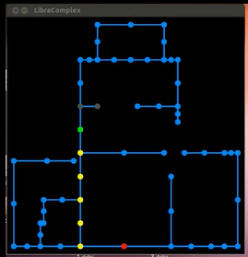
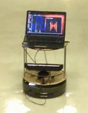
How do I get from A to B?
our map
our robot

Slide 6
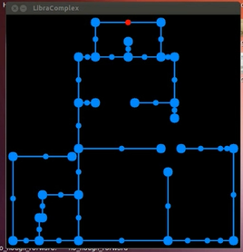
How do I get from A to B,
if I don't know where I am to start?

Slide 7
The CS view of the world...
?
Input
Output
Algorithm
CS's challenge
Once you start, you'll find algorithms everywhere!!

Slide 8



Two recent emails…
Which one is the more challenging algorithm?

Slide 9
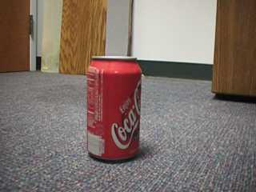
Where's the coke can?
Goal: a coke-can collecting robot…

Slide 10
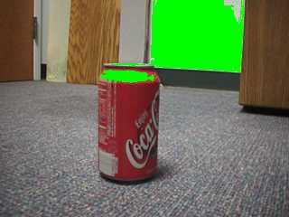
Where's the coke can?
red > 200
not good enough…

Slide 11
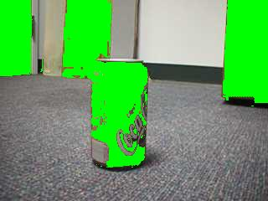
Where's the coke can?
| hue | < 25

Slide 12
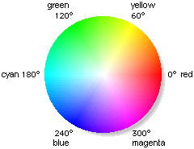
Hue and saturation
hue = 25°
hue = -25°

Slide 13
Where's the coke can?
| hue | < 25
not good enough…

Slide 14
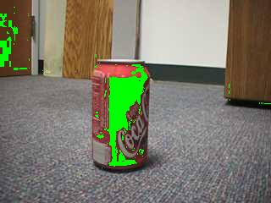
Where's the coke can?
| hue | < 25
saturation > 0.75

Slide 15
Hue and saturation
hue = 25°
sat > 0.75
sat < 0.75
hue = -25°

Slide 16
Where's the coke can?
Aargh!
| hue | < 25
saturation > 0.75
The door is still matched, too… why?

Slide 17
What's red?
Aargh!
| hue | < 25
Remarkably, this problem is, in a sense, our own fault…!
saturation > 0.75
The door is still matched, too… why?

Slide 18
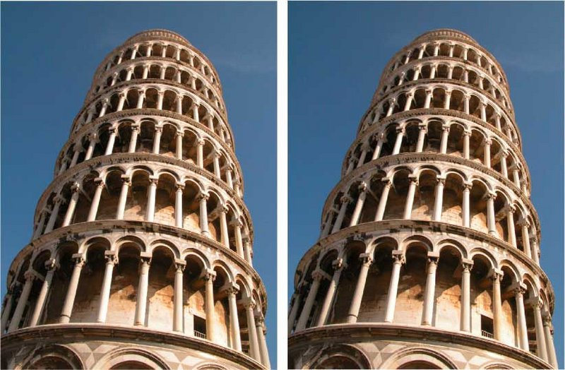

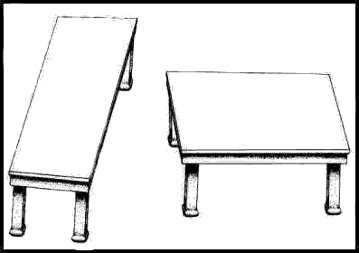
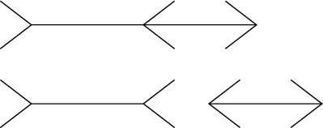
Quiz
Illusions? What algorithms is your brain doing to cause them? Why?
two tones
two towers
two tables
two segments

Slide 19
2 layers

Slide 20
2 layers

Slide 21
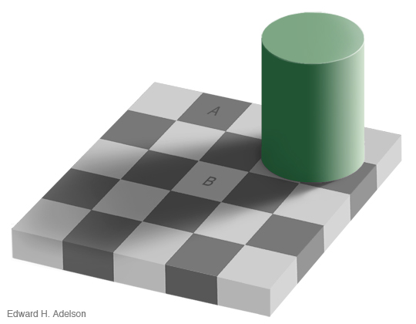
2 layers

Slide 25
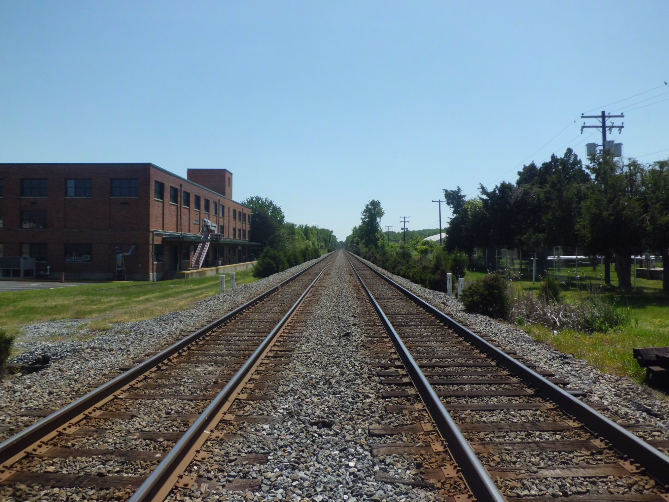
Are these lines parallel?

Slide 26
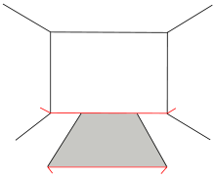

Slide 30
we don't always give our own vision system credit for everything it's doing…

Slide 31
we don't always give our own vision system credit for everything it's doing…

Slide 32
Quiz
Illusions? What computations is your brain doing to cause them?
Seeing is a much more challenging algorithm than it "appears"!

Slide 33
What's red?
Aargh!
| hue | < 25
saturation > 0.75
The door is still matched, too… why?

Slide 34
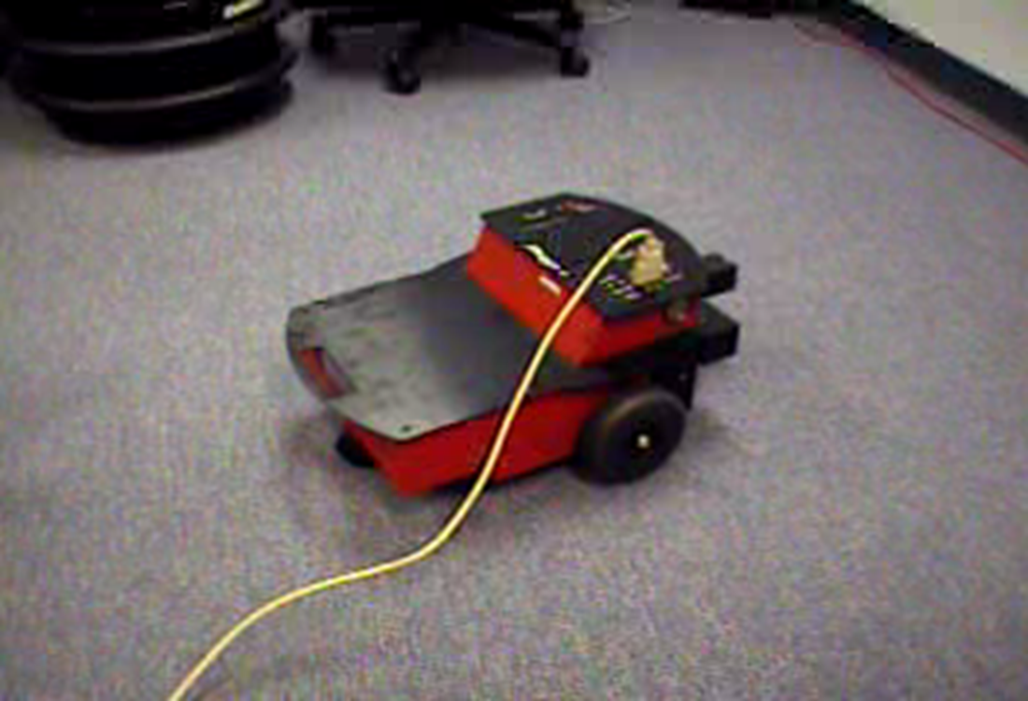
The coke-can collector: wall-avoidance

Slide 35
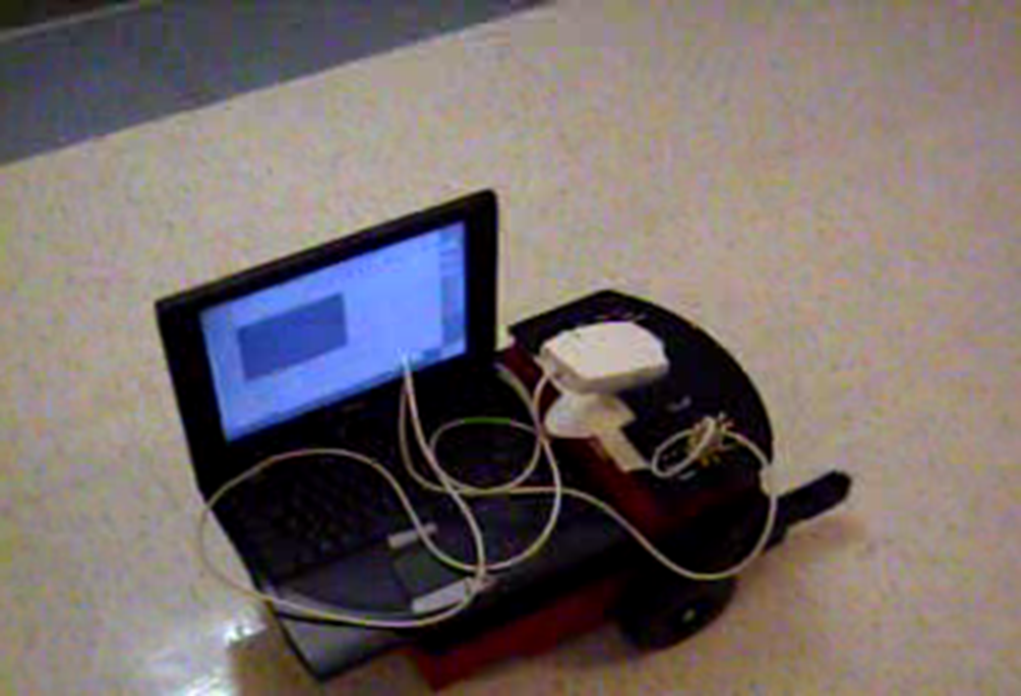
The coke-can collector: seeking…

Slide 36
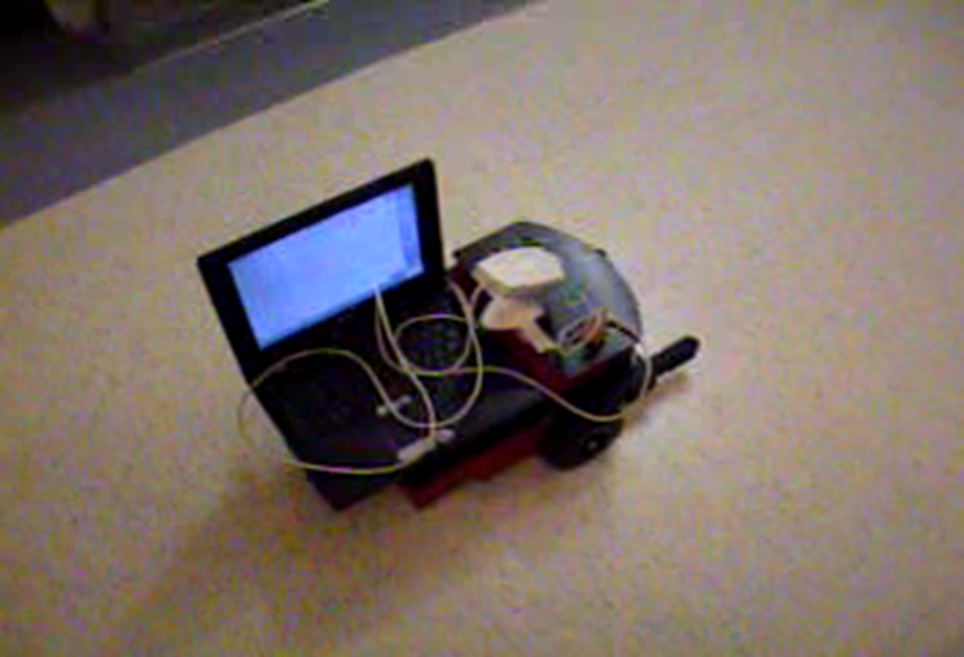
The coke-can collector: seeking…

Slide 37
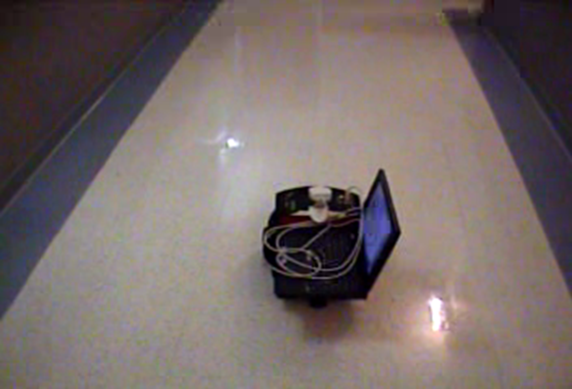
The coke-can collector: success!

Slide 38
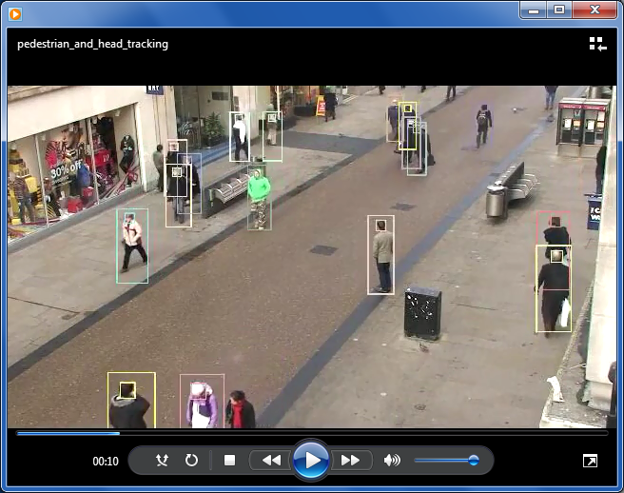
State of the "art" …
Actual output: contents
people, walking…

Slide 39
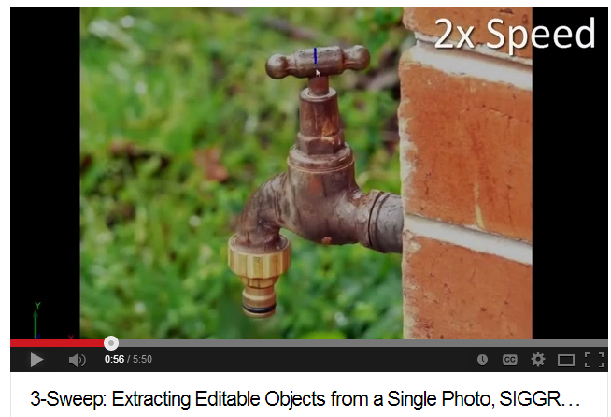
State of the "art" …
Actual output: models
a tap against a wall…

Slide 40
Algorithms are simply answers to
" How do I … "
-type questions.
It might be that we identify more with our (personal) algorithms than anything else!

Slide 41
The purpose of computing is insight, not numbers.
Algorithms are how we represent problem-solving insights.
An algorithm isn't a solution, it's a process for getting a solution.

Slide 42
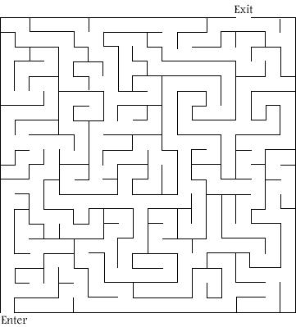
Problem-solving process
Here's a familiar problem.
How would you solve it? ~ that's the algorithm!
Notes:
[depending...] get a maze that does have a solution.

Slide 43
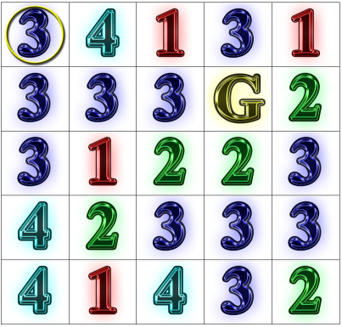
Algorithm ~ a problem-solving process
"rook-jumping maze"
What is the path from the ring to the G?
Notes:
This puzzle was great -- but it took a non-trivial amount of time to solve it.
-> but the time spent was good since it challenged them to find new ways
to think about it
they had to discuss different techniques to solve it like going backwards,
eliminating places that could never be used, etc.

Slide 44
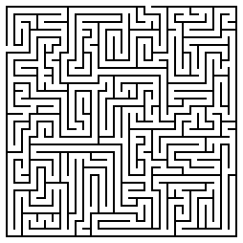
Problem Solving and Mazes
The Basic Maze:
Can you solve the maze on the left? Start at the entrance on the left, and try to exit out of the top.
As you work, make note of the steps and strategies you used to solve the maze below:
http://www.uefap.com/speaking/exercise/mazes/mazes.htm

Slide 45
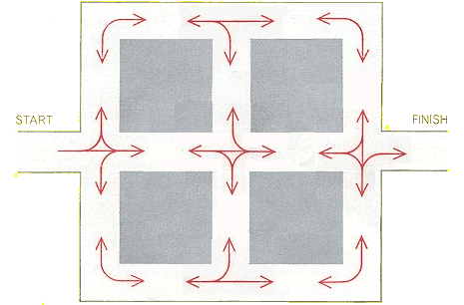
Name(s): _______________________
The Restricted Maze:
Travel along the white roads from start to finish. At each intersection, you must follow one of the red arrows. You may only travel in a certain direction only when there is an arrow that follows the same path. For example, You cannot make a right turn from the starting point.
http://www.logicmazes.com/
How is this maze different from the first one? What strategies did you use to solve it?

Slide 46
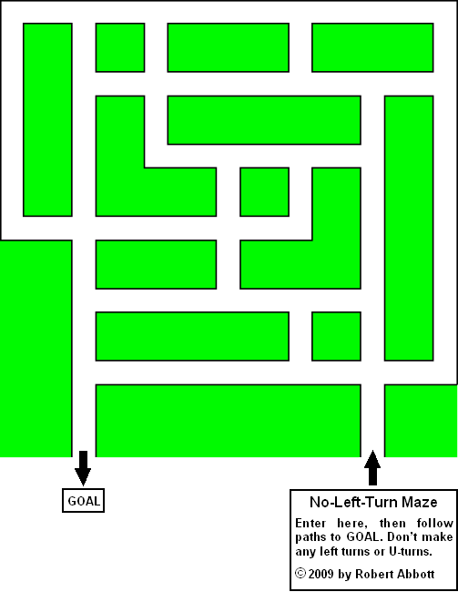
The No-Left-Turn Maze:
Can you solve this maze? Follow the path to get to the goal, but do NOT make any LEFT turns. At each intersection, you may only go straight or turn right.
How is this maze different?
What were some strategies you used to solve this maze?
http://www.logicmazes.com/

Slide 47
The Tilt Maze:
This maze is like the party favor toy: you are the circle (ball) and you want to get to the small square (the goal). When you choose a direction to go in, you must keep traveling in that direction until you hit one of the walls! You must travel in a straight line, and you can only change direction to move in if you’ve hit a wall.
How is this puzzle different from the first three? What new rules did you have to follow?
What strategies did you use to solve this maze?

Slide 48
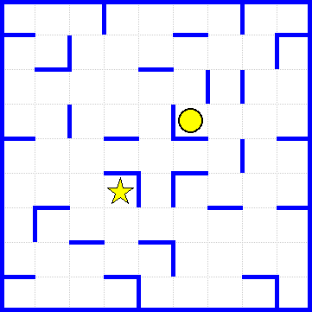
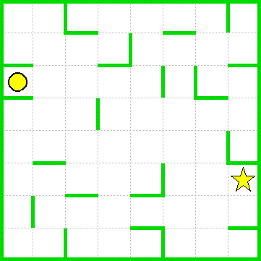
Bonus Mazes: If you finish early, work on these additional tilt-mazes below!

Slide 49
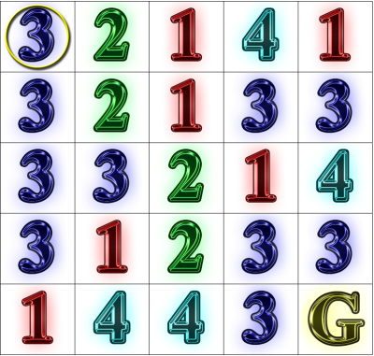
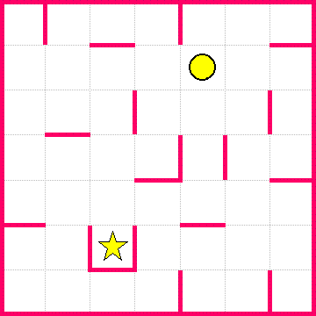
Another tilt and rook-jumping maze…

Slide 50
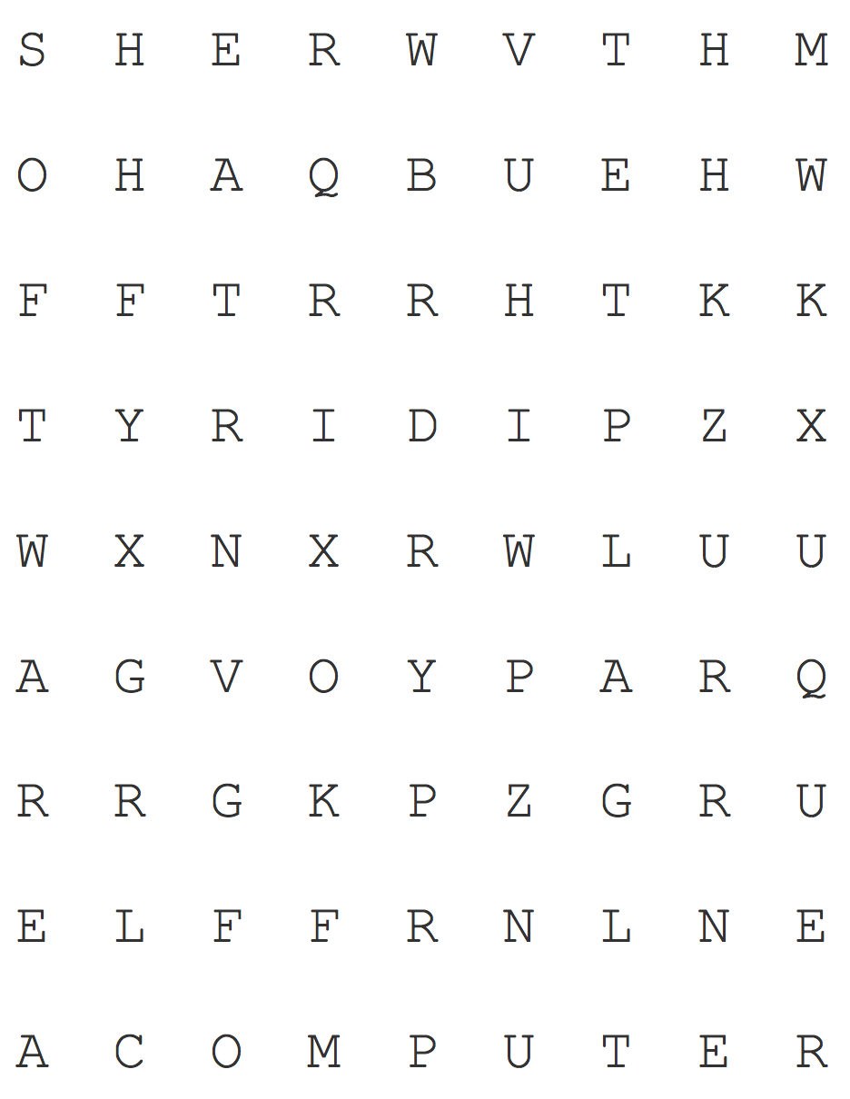
Solving Puzzles
Puzzle 1: Word Search
Find the following words:
Algorithm Software Hardware
Turing Computer
How did you solve the puzzle? Describe some of the steps you used to solve this particular word search.
Puzzle courtesy of http://puzzlemaker.discoveryeducation.com/

Slide 51

Now suppose you had to find 20 words in this puzzle, and then do 50 more like it—it would take a long time, and it probably wouldn’t be very fun, but you have an assistant who has a lot of free time and wants to help! However, your assistant has never done a word search before, and has no idea how to complete the puzzle!
In the space below, write a list of instructions for solving a word search that your assistant can follow!
Puzzle courtesy of http://puzzlemaker.discoveryeducation.com/

Slide 52
But does maze-solving have any real-life applications?

Slide 53
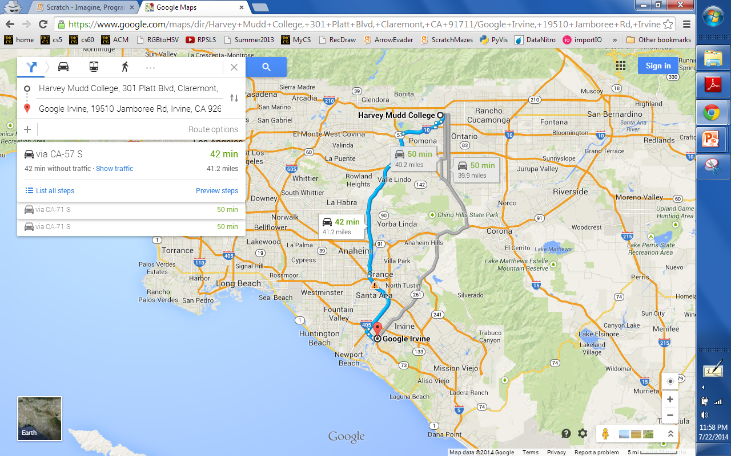
But does maze-solving have any real-life applications?

Slide 54
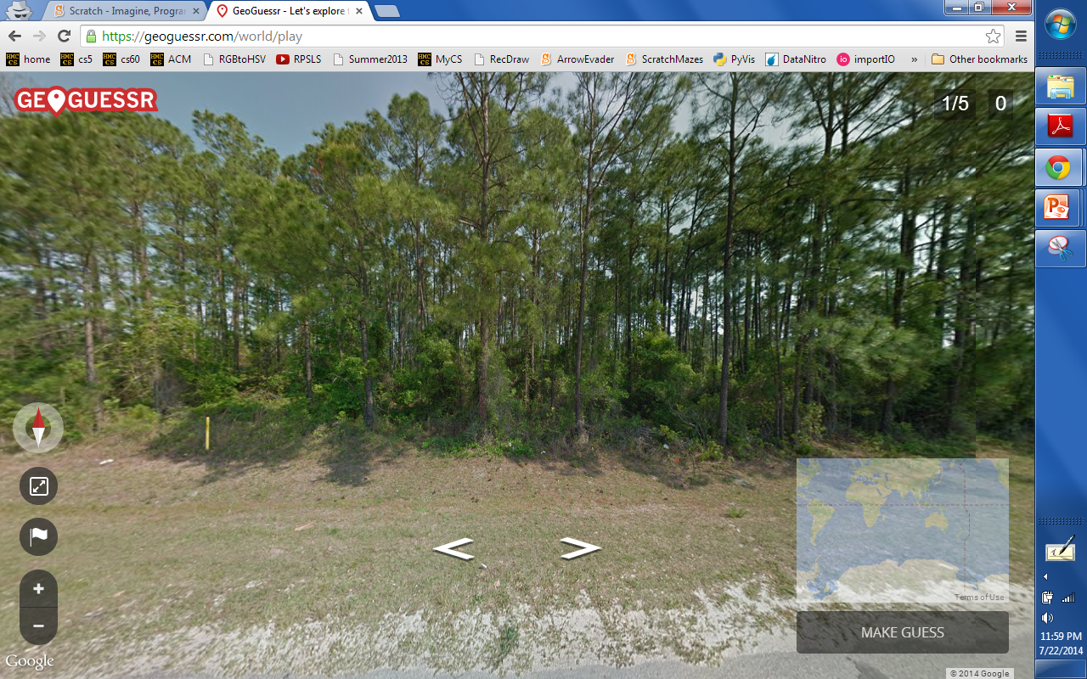
What if we didn't have a map?!
GeoGuessr ~ you're dropped in a random "street view" location and need to figure out where you are… . Once you have a guess, check how close you were!

Slide 55
Cup Robotics
An Introduction to Coding, Functions, and Parameters
activities only

Slide 56
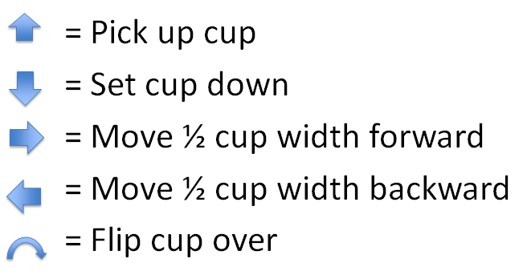
Try it!
1. Decode this stack:
Draw your stack here:

Slide 57
2. Encode this tower:
Try it!
0 1 2 3 4

Slide 58
Try it!
3. Try building your own tower and writing its code:
4. Exchange codes with a partner, build the stack, then draw it here:
Draw your stack here:

Slide 59
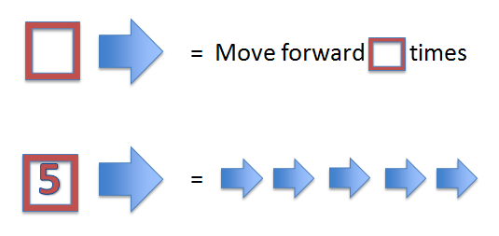
5. Decode this tower:
Try it!
2
2
4
4
6
6
5
5
2
2
Draw your stack here:

Slide 60
Try it!
6. Encode this tower:
0 1 2 3 4 5 6 7 8

Slide 61
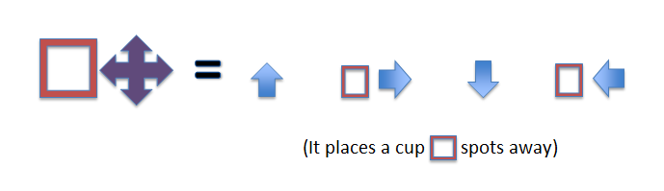
7. Decode this tower:
Try it!
2
4
3
Draw your stack here:

Slide 62
Try it!
8. Encode this tower:
Hint: use this “place cup” function!
0 1 2 3 4 5 6 7 8

Slide 63
Create your own function!
Bonus: Part 1
What’s the symbol for your function, and what does it do?
Give an example of a tower that can be made that uses your function
How would you represent your function using only arrows and functions we’ve already created?

Slide 64
Bonus: Part 2
2. Encode a tower that uses your new function at least twice.
3. Exchange codes with a partner, build the stack, then draw it here:
Draw your stack here:

Slide 65
Cup Robotics
An Introduction to Coding, Functions, and Parameters
overview, activities and answers

Slide 66
Motivation
Robots are cool
Robots need instructions
Robots need very clear instructions in a language they can understand
Let’s create a language for a cup tower building robot.

Slide 67
Our language (code)
= Pick up cup
= Set cup down
= Move ½ cup width forward
= Move ½ cup width backward
= Flip cup over

Slide 68
Let’s try our language!
(Example)
Consider this tower, we might
write this as:
0 1 2 3 4

Slide 69
Try it!
1. Decode this stack:
Draw your stack here:

Slide 70
2. Encode this tower:
Try it!
0 1 2 3 4

Slide 71
Let’s try our language! (Build)
Answer
Try building a tower by
Following these instructions
0 1 2 3 4

Slide 72
Now let’s encode!(Encode)
Answer
How would we write our
Robotic instructions?
0 1 2 3 4

Slide 73
Now, try designing your own!
Design a 3-5 cup tower
Encode the tower with the language
Trade codes with a partner
Build their tower using just their code
(no help!)
If the design and the tower are the same, awesome!
If there are some differences, try to figure out why that happened!

Slide 74
Try it!
3. Try building your own tower and writing its code:
4. Exchange codes with a partner, build the stack, then draw it here:
Draw your stack here:

Slide 75
How about this one?
This would take 328 arrows !!
It would be really hard to write, read, or fix if we make mistakes!
Do we have any patterns we can use?

Slide 76
Functions
A function is any process that we can repeat
Let’s use a function to make our language easier to write and understand!
Our new function:
= Move forward times
Example:
5
=

Slide 77
5. Decode this tower:
Try it!
2
2
4
4
6
6
5
5
2
2
Draw your stack here:

Slide 78
Try it!
6. Encode this tower:
0 1 2 3 4 5 6 7 8

Slide 79
Try making this tower!
Answer
2
2
4
4
6
6
5
5
2
2
0 1 2 3 4 5 6

Slide 80
Let’s use our new function!
Answer
Let’s encode this tower!
2
2
Easier to understand
Easier to write
We can build more interesting towers!
4
4
6
6
8
8

Slide 81
We can make any function!
What does this function do?
=
(It places a cup spots away)

Slide 82
7. Decode this tower:
Try it!
2
4
3
Draw your stack here:

Slide 83
Try it!
8. Encode this tower:
Hint: use this “place cup” function!
0 1 2 3 4 5 6 7 8

Slide 84
Step By Step
Answer
2
4
3
Step 1
2
Step 2
2
4
Step 3
2
4
3

Slide 85
Encoding with our new function
Answer
How would we encode this?
2
4
3
6
5
4

Slide 86
Make your own function!
Let’s re-visit this tower:
Do you see any patterns?
What would a useful function for this be?
How could we write this function?

Slide 87
The flipped tower function
Let’s make a function that makes a flipped tower some spaces away from the start
=
Let’s try using our new symbol!
=
2
4
0 1 2 3 4

Slide 88
Functions are powerful!
2
4
6
8
10
12
14
16
We went from a tower that needed 328 arrows, to one that just just uses 8 symbols!

Slide 89
Create your own function!
Bonus: Part 1
What’s the symbol for your function, and what does it do?
Give an example of a tower that can be made that uses your function
How would you represent your function using only arrows and functions we’ve already created?

Slide 90
Bonus: Part 2
2. Encode a tower that uses your new function at least twice.
3. Exchange codes with a partner, build the stack, then draw it here:
Draw your stack here:

Slide 91
(1) Searching
Two fundamental algorithms:
(2) Sorting

Slide 92
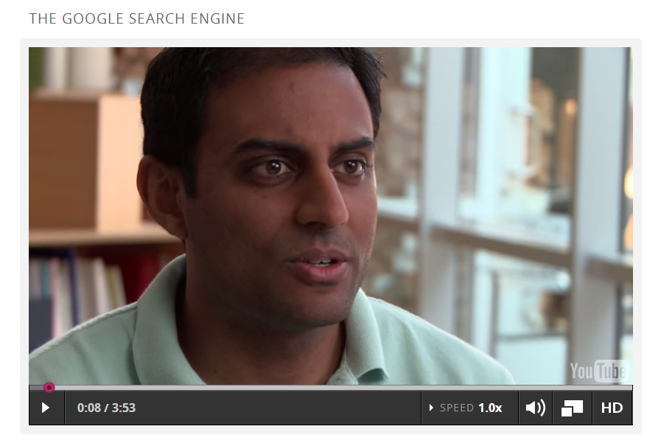
Why searching and sorting?

Slide 93
Searching for data…
Where's 42?
81
8246
82
5
365
199
42
12345
Unordered List
5
42
81
82
199
365
8246
12345
Ordered List

Slide 94
Searching!
42
4
3
17
99
100
844
1000000000
Where's 42?
Unordered List

Slide 95
Searching!
844
99
100
4
17
42
3
1000000000
Where's 42?
Unordered List

Slide 96
Searching!
0
42
46
47
81
365
9001
1000000
Where's 42?
Ordered List

Slide 97
Searching is MUCH faster in an ordered list!

Slide 98
How do we get the list sorted?
844
99
100
4
17
42
3
1000000000

Slide 99
How do we get the list sorted?
844
99
100
4
17
42
3
1000000000
This is deceptively easy because we "see" the answer automatically!

Slide 100
Step 1: Sorting people!
(1) Have 8 people hold numbered cards
(2) Act each algorithm + count comparisons
A. minsort
B. bubblesort
C. mergesort
# of comparisons
# of comparisons
# of comparisons
between each algorithm, mix up the cups again – or swap with a different team!

Slide 101
3 sort algorithms
A. minsort
Write a sentence on how each one works.
B. bubblesort
C. mergesort

Slide 102
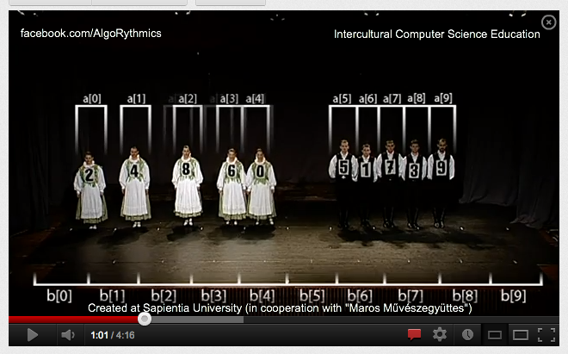
Sorting in dance…
look this up to see the many options...
http://www.youtube.com/watch?v=XaqR3G_NVoo

Slide 103
Step 2: Sorting cups…
(1) Teams make 8 cups with #s on post-its + swap
(2) Run each algorithm + count comparisons
A. minsort
B. bubblesort
C. mergesort
# of comparisons
# of comparisons
# of comparisons
between each algorithm, mix up the cups again – or swap with a different team!

Slide 104
Step 3: Comparing data
(1) Get ALL of the data from all of the teams.
A. minsort
B. bubblesort
C. mergesort
# of comparisons
# of comparisons
# of comparisons
find the average number of steps for each sorting algorithm – Which is fastest?

Slide 105
Is MergeSort for real? Let's see...

Slide 106
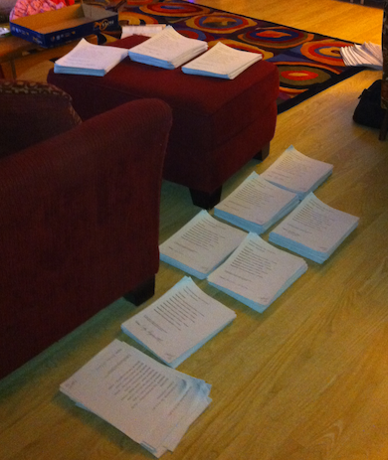
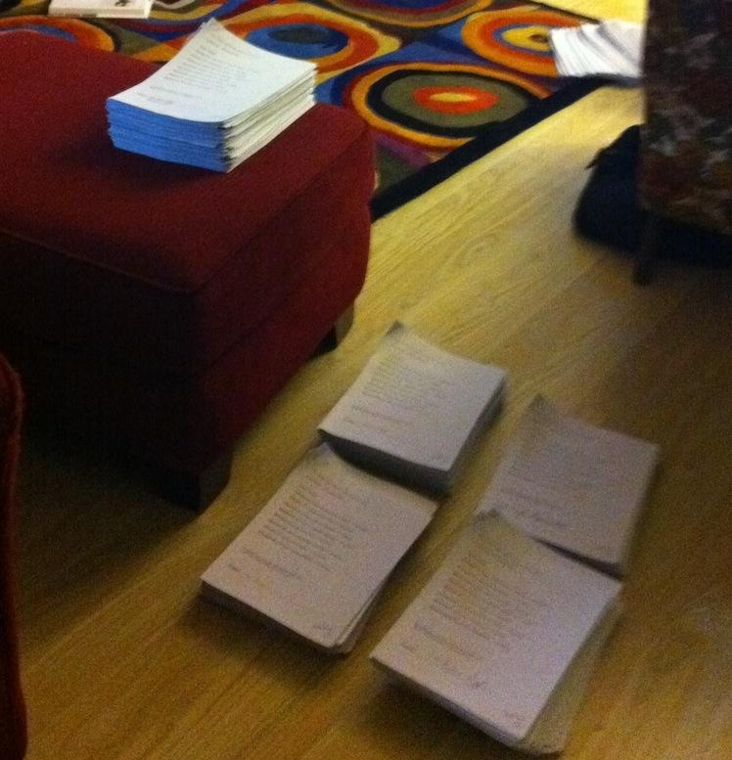
Is MergeSort for real? Let's see...
10 piles of 16
5 piles of 32

Slide 107
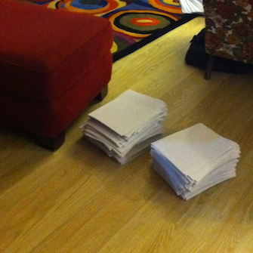
Is MergeSort for real? Let's see...
5 piles of 32
2 piles of 80

Slide 108
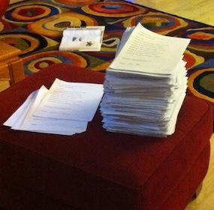
Is MergeSort for real? Let's see...
2 piles of 80
1 pile of 158
158?

Slide 109
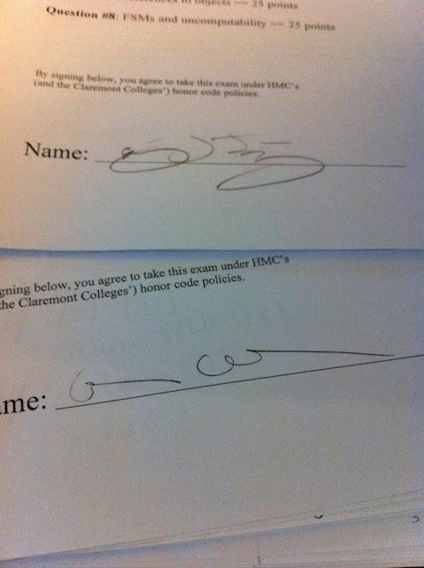
Is MergeSort for real? Yes!
2 piles of 80
1 pile of 158
Not sure who these people were....
158?

Slide 110


Sorting Activities from
Searching Algorithms
Sorting Algorithms
Sorting Networks

Slide 111
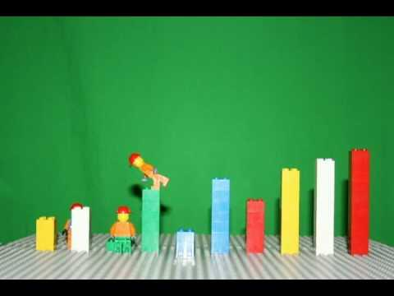
Lego Sorting
We've made this same method of sorting in Scratch
http://www.youtube.com/watch?v=MtcrEhrt_K0
Watch this sorting algorithm... can you describe how it works?

Slide 112
understanding > solving…
Notes:
Maybe make them play this instead of just explaining it. Make sure there is enough time allocated to this part.

Slide 113
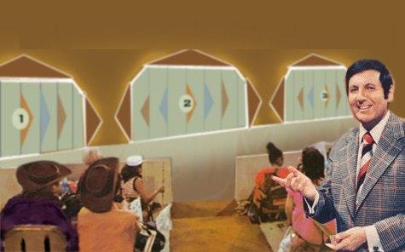
understanding > solving…
Recognize this game show?
http://www.youtube.com/watch?v=WKR6dNDvHYQ
Notes:
Maybe make them play this instead of just explaining it. Make sure there is enough time allocated to this part.

Slide 114
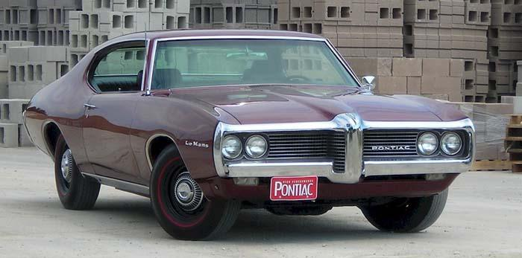
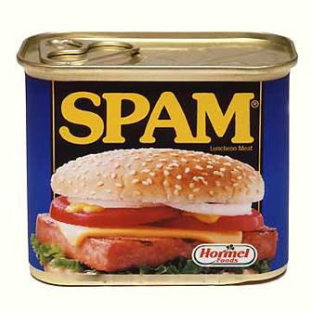
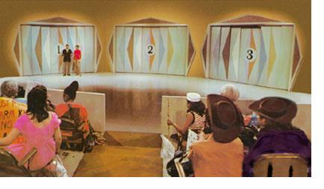
Let's Make a Deal...
Choose... Reveal... Switch or stay?
Let's Make a Deal is in Scratch too!

Slide 115
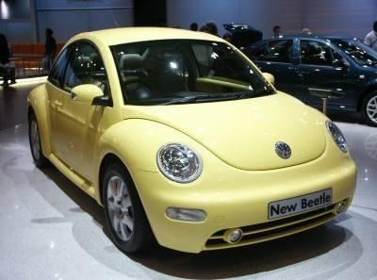
Let's Make a bigger Deal...
1
2
3
4
5
6
7
8
9
10
A
B
C
D
E
F
G
Notes:
original

Slide 116
Let's Make a bigger Deal...
1
2
3
4
5
6
7
8
9
10
A
B
C
D
E
F
G
Notes:
Next!

Slide 117
Take-home message
Understanding problems is the key to solving them -- and it's much more important than solving a particular one!
Computer Science is the science of analyzing (and solving) information-based problems.
Often, that means creating algorithms!
could these puzzles be made to work with your students?

Slide 118
"Seeing" the answer… ?
Are we running algorithms?

Slide 119
Creating a Scratch Game
in 7 steps…
with unlimited room for expansion + creativity!

Slide 120

Step 1: Choose a hero!
(1) Choose a main character or "hero" ...
(one that you will control)
choose one
upload from file
draw your own
take a new picture

Slide 121
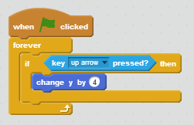
Step 2: Motion with the keyboard
(2a) Add this program to your hero sprite so that you can control it with the up arrow:
(2b) Add more blocks so that all arrow keys work appropriately. Where could you put them?

Slide 122
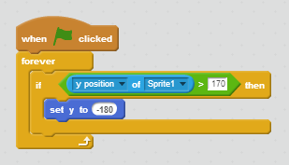
Step 3: Wrap master
(3a) Make sure your "hero" can wrap around the screen from top to bottom:
(3b) Add other wrapping as you see fit!

Slide 123

Step 4: Choose a goal.
(4) Create a second sprite ~ the goal!
(something you want the hero to reach)
the fearsome enemy
the goal
the hero
Place it on the other side of the scene.

Slide 124

Step 5: Choose an enemy.
(5a) Create a third sprite ~ an enemy!
(something you want the hero to avoid)
Place it in the middle of the scene, and
have the enemy move continuously:
This is a program within the enemy's scripts, not the hero's scripts.
(5b) Also, have your enemy wrap around the screen – use the hero's wrapping program as a guide.

Slide 125

Step 6: Reset if you collide!
(6a) For the hero sprite, when the hero hits the enemy, teleport the hero back to the hero's start:
(6b) It's good to have the hero start there at the beginning, too. Which block does that?

Slide 126
Step 7: Celebrate if you win!
(7a) For the hero sprite, when the hero hits the goal, celebrate.
For this, make another program very similar to the one handling the hero-enemy collisions!
Change the message and add a victory sound/song!
(7b) After celebrating, you should reset the hero…

Slide 127
The sky's the limit!
Now, add at least two of these features:
(a) Add a changing score variable (Data menu)
(b) Have the enemy move randomly (Operators)
(c) Add more enemies
(d) Add "power-ups" that change your hero's size, score, or speed
(e) Add portals to teleport the hero randomly
(f) Have the game end when a timer runs out.
(g) Have a second level that is more dificult.
And... at least two of your own ideas... !

Slide 129

Parallel Sorting
Follow the arrows...
At each merge point,
the higher # goes right
the lower # goes left
Which group can sort themselves more quickly?
Notes:
parallel sorting was quite popular with beryl and carling's group -> everyone was saying that their students would love it

Slide 130
Do we compute?
Your demonstrations game/scene/anything…
Your insights on CS + MyCS
Lunch…

Slide 131
We were here…
large cs5 from last fall…
data from HI Pomona HMC…

Slide 132
We were here…
CS ~ increasingly worthwhile

Slide 133

Linear vs. Binary Sorting!
How do they compare?
1) "Min Sort"
2) "Merge Sort"
How does this relate to dictionary-searching?

Slide 134
Sorting out sorting
Let's race three sorting algorithms
1) Act out minsort - count our comparisons: _____
2) Act out mergesort - count comparisons: _____
3) Try a parallel sort network - count: _____
Which one wins?
Notes:
worked better in smaller groups because everyone thinks they know where they need to go even though they don't
needs explicit instruction from person in charge -> could we put one of the teachers in charge so that somebody is learning as we try it out
parallel sorting networks are super popular, tied into mike's talk about parallelism that occurred in computer disassembly previously
need to show teachers how to make the sorting network for any number of numbers to sort
doing with 4 numbers or so vs. doing with 8 could reinforce how fast it can be doing comparisons in parallel
-> sorting networks are supposed to be /fast/ but have a lot of comparisons

Slide 135

An Infamous Equation
How long did it take you guys to learn the quadratic formula?
Did any of you learn songs?
Here's a way to use Scratch your kids might like

Slide 136

Min Sort
"Linear Sorting"
Idea: Search for the smallest element, then the second smallest, and so on...
More detail: Compare pairs of elements to find the smallest. Remove the smallest and place it at the end of the sorted list. Repeat until all elements are in the sorted list.

Slide 137
Merge Sort
"Binary Sorting"
Idea: Split repeatedly, then merge back!
More detail: Split in half repeatedly; when there are only two elements per list, they are easy to sort: just swap if needed!
Then, repeatedly merge two sorted lists by (1) comparing the first elements, and (2) placing the smaller element,
~ until all of the elements are sorted!

Slide 138
Sorting out sorting
Let's race three sorting algorithms
1) Act out minsort - count our comparisons: _____
2) Act out mergesort - count comparisons: _____
3) Try the parallel sorting network - count: _____
Which one wins?
Notes:
worked better in smaller groups because everyone thinks they know where they need to go even though they don't
needs explicit instruction from person in charge -> could we put one of the teachers in charge so that somebody is learning as we try it out
parallel sorting networks are super popular, tied into mike's talk about parallelism that occurred in computer disassembly previously
need to show teachers how to make the sorting network for any number of numbers to sort
doing with 4 numbers or so vs. doing with 8 could reinforce how fast it can be doing comparisons in parallel
-> sorting networks are supposed to be /fast/ but have a lot of comparisons

Slide 139
Other fun things students can make and play with in Scratch
Random Walk: applying randomness to a game
The Game of Life: Studying patterns and predicting possible outcomes
Using cloning in a Scratch game to shoot at villains
Using other types of controls to move your sprite
Solving simple Math Problems in Scratch

Slide 140
Algorithms everywhere
An algorithm is a process for solving problems.
... a couple inspired by the life sciences

Slide 141
Sorting and Searching
Day 3, Session 2

Slide 142

"Algorithm"
An algorithm is a process for solving problems.
Simply put, algorithms are what CS is about.

Slide 143
"Algorithm"
An algorithm is a process for solving problems.
The Nine Algorithms/Chapters:
(1) Ideas Computers Use Every Day
(2) Search Engine Indexing: Finding Needles in the World's Biggest Haystack
(3) PageRank: The algorithm that made Google
(4) Public Key Cryptography: Secrets on a Postcard
(5) Error-Correcting Codes: Mistakes That Fix Themselves
(6) Pattern Recognition: Learning from Experience
(7) Data Compression: Something for Nothing
(8) Databases: The Quest for Consistency
(9) Digital Signatures: Who Really Wrote This Software?
(10) What Is Computable?
(11) Conclusion: More Genius at Your Fingertips?

Slide 144
"Algorithm"
An algorithm is a process for solving problems.
Sorting
The Nine Algorithms/Chapters:
(1) Ideas Computers Use Every Day
(2) Search Engine Indexing: Finding Needles in the World's Biggest Haystack
(3) PageRank: The algorithm that made Google
(4) Public Key Cryptography: Secrets on a Postcard
(5) Error-Correcting Codes: Mistakes That Fix Themselves
(6) Pattern Recognition: Learning from Experience
(7) Data Compression: Something for Nothing
(8) Databases: The Quest for Consistency
(9) Digital Signatures: Who Really Wrote This Software?
(10) What Is Computable?
(11) Conclusion: More Genius at Your Fingertips?
Searching

Slide 145
Searching...
Seeking "spam"
Wubster's dictionary - not in order!
Webster's dictionary - in order
What algorithms can we use to find "spam"?
Notes:
This was cool.
Maybe actually print out a list of words in random order to stand in for "wubster's dictionary".

Slide 146
Linear Search (unsorted data)
Start at the first word.
"Is this the word we want?"
If it's not, go to the next word.
the algorithm
In the worst-case scenario, how many unsorted words would we have to look at before we get to the right one?
An example of a linear search in Scratch can be found here!

Slide 147
Binary Search (sorted data)
Can we find words faster if they're sorted?
If so, how?!?
Webster's Dictionary

Slide 148
Binary Search (sorted book)
the algorithm
Check the word in the middle.
If it's after our word, repeat with the 1st half.
If it's before our word, repeat with the 2nd half.
Seeking "spam" ...
mixplate
must be in here some-where

Slide 149
Binary Search (sorted book)
the algorithm
Check the word in the middle.
If it's after our word, repeat with the 1st half.
If it's before our word, repeat with the 2nd half.
Seeking "spam" ...
mixplate
here some-where
wusubi

Slide 150
Binary Search (sorted book)
the algorithm
Check the word in the middle.
If it's after our word, repeat with the 1st half.
If it's before our word, repeat with the 2nd half.
Seeking "spam" ...
mixplate
here some-where
soy sauce
wusubi

Slide 151
Binary Search (sorted book)
the algorithm
Check the word in the middle.
If it's after our word, repeat with the 1st half.
If it's before our word, repeat with the 2nd half.
Seeking "spam" ...
If our book has 32 words in it, how many do we look at before we definitely find the right one? 64? 1,000,000?
swordfish
An example of a binary search in Scratch can be found here!
Notes:
This was good.
Consider mentioning 20 Questions implementation.

Slide 152
Linear vs. Binary Search
With a large amount of sorted data, binary search is almost always more efficient.
But how do we get our data sorted?
Notes:
relate to Google: unordered search, need to sort
divide and conquer activity as example of binary search method (10 min)
with small boxes - like the santa video??
http://www.youtube.com/watch?v=wVPCT1VjySA&feature=player_embedded

Slide 153

Comparisons
The basic building-block of sorting is
comparing two items.
Consider these two numbers:
and
Which number is larger?
How can you tell?
110111001100100100010100111110101
110111001100100100010101111110101

Slide 154
Let's sort!
dukes
orange
feral burger
bbq
macademia
musubi
spam
coffee
Create 8 post-it notes with these words, one per note...

Slide 155
Let's sort!
First: In pairs, sort your items...!
Note: Computers can compare only two items at a time! The HMC students will help by saying what's smaller/larger...
Then: Sort again, counting the number of pairwise comparisons you make in order to ensure your items are sorted.
Challenge: describe a sorting algorithm that works for all possible cases!
Notes:
cans with pennies in them: 2,5,10,15,20,25,30,37 were the amounts
seemed to go over well

Slide 156
Your sorting algorithms:

Slide 157




Our game: Up, up, and away!
First, let's pair up -- so that each pair has both a teacher and an HMC student...

Slide 158

Problem-solving patterns
Q: How many breaks are needed to fully separate these pieces?
Brick-breaking challenge

Slide 159
Break it up...
# of breaks
# of pieces
1
2
3
4
12
B
N

Slide 160
Lunch Prompts: Scratch
(1) How would you imagine using Scratch with your students?
(2) What simple projects would you start with to get students comfortable?
(3) Would it be better for students to work in pairs or alone on Scratch projects?
(4) What other projects or curricular requirements could Scratch be used for?
Notes:
worked better in smaller groups because everyone thinks they know where they need to go even though they don't
needs explicit instruction from person in charge -> could we put one of the teachers in charge so that somebody is learning as we try it out
parallel sorting networks are super popular, tied into mike's talk about parallelism that occurred in computer disassembly previously
need to show teachers how to make the sorting network for any number of numbers to sort
doing with 4 numbers or so vs. doing with 8 could reinforce how fast it can be doing comparisons in parallel
-> sorting networks are supposed to be /fast/ but have a lot of comparisons

Slide 161
Is MergeSort for real? Let's see...

Slide 162
Is MergeSort for real? Let's see...
10 piles of 16
5 piles of 32

Slide 163
Is MergeSort for real? Let's see...
5 piles of 32
2 piles of 80

Slide 164
Is MergeSort for real? Let's see...
2 piles of 80
1 pile of 158
158?

Slide 165
Is MergeSort for real? Yes!
2 piles of 80
1 pile of 158
Not sure who these people were....
158?

Slide 166
Mergesort, in dance
look this up to see the many options...
http://www.youtube.com/watch?v=XaqR3G_NVoo

Slide 167
Sorting Activities from
Searching Algorithms
Sorting Algorithms
Sorting Networks

Slide 168

Our game: Fly, fly again...
Use these blocks to write a script that makes it so that if you press the UP arrow, the helicopter goes up, but if you DON'T press the up arrow, the helicopter goes down (like gravity!)
Make sure to save when done!

Slide 169


Butterfly Game
Create a two-toned background with a butterfly or a sprite of your choice "flying" in it. Use Scratch to change the costume of your sprite when it touches one of the colors.

Slide 170

Helicopter Game
Open Scratch and add the helicopter sprite.
It can be found in the "transportation" folder of sprites.
Notes:
helicopter game (15 min)

Slide 171
Helicopter Game
Change the background to have a start, an end, and some obstacles (color is key!).
Then, make sure that if the helicopter hits an obstacle, it resets back to the start.
You now have a playable game!
Notes:
create background -> copter starts somewhere, has to get to end, resets if hits obstacle
more helicopter game (20 min)

Slide 172
Scratch: Position
Day 3, Session 4

Slide 173


Slide 174


Slide 175


Want smooth motion?
Notes:
Should include glide block also here.
Experiment with drawing using coordinates, make shapes using corner coordinates, drawing challenges from worksheets (35 min)
worksheets:
http://www.cs.hmc.edu/~cs5grad/MyCS/2012_Curriculum/scratch_offline/day_15/worksheet.pdf
http://www.cs.hmc.edu/~cs5grad/MyCS/2012_Curriculum/scratch_offline/day_17/worksheet.pdf
#outline

Slide 176


Coordinate Practice
Review...
New...

Slide 177


Slide 178


Slide 179


Slide 180
Choose Your Challenges
Pick a challenge from the worksheets and implement it.

Slide 181
Scratch: Ifs and Elses

Slide 182

If Block
The "if" block can be found in the control tab.
The if block means, "IF this happens, THEN do this."
You can put blocks ON the if block and IN the if block.
Notes:
Sort of introduces earlier because people were excited about scratch and getting ahead of themselves

Slide 183

Sensing Blocks
Most of the blocks that fit ON the if block are sensing blocks, which can be found in the sensing tab.
Different sensing blocks can detect if a key is pressed, if the sprite is touching something, or if the sprite moves to a certain position.

Slide 184

Forever If
Usually, you don't want to just run the if block once, you want it to always be running.
To make it run forever you can either put it in a forever block or use the forever if block.
Notes:
This slide definitely needs to be shown -> some people missed it we think

Slide 185

Operators
In Scratch, operators let you connect other ideas together.
Many of these operators do things you have seen in math.
Notes:
operators (5 min)

Slide 186


Common Operators
Some operators let you compare values (like numbers).
Other operators let you combine other blocks.

Slide 187

Will the sprite say "Hello!" when you run this script?

Slide 188

What will the variable "X" be after you run this script?

Slide 189
Predict and Test
To get comfortable with operators, partner with the person sitting next to you and go through the worksheet.
Notes:
#outline
section should have printout:
http://www.cs.hmc.edu/~cs5grad/MyCS/2012_Curriculum/scratch_offline/day_26/worksheet.pdf

Slide 190


Slide 191


Slide 192


Slide 193


Slide 194


Slide 195

Broadcast Block
The broadcast block has a sprite send a signal.
You have to give each signal a name.
When another sprite hears that signal, it can start running a new script.
This can be helpful when you don't want one script to start until another script is finished.
Notes:
broadcasting and receiving (5 min)

Slide 196

Receiving a Broadcast Signal
To make a sprite listen for a signal, use the receive block, and choose which message to have it wait for.

Slide 197


Slide 198
Congratulations!
You've gone through an abridged version of the Scratch curriculum!
In the time remaining, team up with a partner and create a small project to show off your Scratch skills to everyone else.
Notes:
create your own project? (30 min)

Slide 199

Two envelopes...
Both envelopes have some money in them. You know that one envelope has double the amount in the other envelope.
Suppose you choose an envelope and you find M money in it. Say, $20.
Now you have the opportunity to trade. Should you?
Notes:
mindblowing.

Slide 200
More 1990's versions...

Slide 201


About face
Do we have face-detection algorithms ourselves?
Notes:
201

Slide 202


Holistic vs. part-based reasoning
Who are these folks?
If I were two faced, why would I be wearing this one?
- Abraham Lincoln
Notes:
Lincoln’s quote!
202

Slide 203
Holistic vs. part-based reasoning
It is more difficult to recognize distinct halves of faces, when aligned.
Holistic? Part-based?
Notes:
Lincoln’s quote!
203

Slide 204


Notes:
Lincoln’s quote!
204

Slide 205
Notes:
Lincoln’s quote!
205

Slide 206


Innate face detection?
Infants prefer the top image to the bottom one…
Evidence for the fusiform face area (FFA), a specialized face-detection module

Slide 207
Innate detection?
Infants prefer the top image to the bottom one…
But they also prefer the first row here:
Still debated as to whether infant preferences are for “faces” or “top-heavy” images

Slide 208


Learned recognition.
Infants prefer the top image to the bottom one…
Evidence for the fusiform face area (FFA), a specialized face-detection module

Slide 209

Peter Thompson 1980
Holistic? Part-based?

Slide 210
Peter Thompson 1980
Holistic? Part-based?

Slide 211


Peter Thompson 1980
Holistic? Part-based?

Slide 212

Parts!
Vector of normalized landmark coordinates (inter-landmark distances)
Slide credit: A. Efros

Slide 213


Parts clearly matter…

Slide 214

Parts clearly matter…

Slide 215

Parts clearly matter…
http://www.youtube.com/watch?v=m56F4EKN9hg

Slide 216

Some parts are more equal than others
The eyebrows turn out to be more important than the eyes…

Slide 217
Some parts are more equal than others
Nixon
Winona Ryder
The eyebrows turn out to be more important than the eyes…

Slide 218

Viola and Jones: Results
How is searching over many scales simplified?

Slide 219


Applications!
Smart cameras
Safety
auto focus,
red eye removal,
auto color correction
Lexus LS600 Driver Monitor System
smile!
Others?

Slide 220



Anonymization!
A Google maps' image over Chad
Opportunity!?
Notes:
opportunity: sell spots to actors!

Slide 221

Face replacement
Nayar et al. Columbia University, 2008
May be able to improve on blurring faces...

Slide 222

Face replacement
by replacing faces from a library of options...
Recognize either of these actors?

Slide 223
Face replacement
Gweneth Paltrow
Denzel Washington

Slide 224

First, create a large library...
Download images from the Internet and process them using a face detector
  Approximately 33,000 faces found
  Detector returns face pose (yaw, pitch, roll) and six fiducial points
  Sort faces according to yaw and pitch angles, and align to a common coordinate system using fiducial points

Slide 225


Algorithm, visualized

Slide 226
How well does it work?
Try it out…
Which of the two images is the original?

Slide 227





Which of these are real?

Slide 229
Face replacement results

Slide 230
Image de-Identification
Original
Notes:
Here is another example… The input image..

Slide 231

Image de-Identification
Replaced
Notes:
And the result of face de-identification

Slide 232



Limitations: Gender
Input
Candidate
Output
Notes:
Since our system does not currently enforce consistency for gender, it is possible for a female face to be replaced with a male one.

Slide 233

Limitations: Occlusion
Input
Candidate
Output
Notes:
Occlusion presents a significant problem to the current implementation of our system.
In this example, the input image is occluded by a hand which causes strong artifact in the result.

Slide 234

You are at a party with a total of 2, 3, 4, 10, or N people (including you)...
Q: How many handshakes do you need in order to greet everyone?
Q: How many handshakes are needed so everyone greets everyone?
# in group
# of h.shakes needed
# in group
# of h.shakes needed
2
2
3
3
10
10
N
N

Slide 235



Another algorithm example...
predicting your movie ratings…

Slide 236

The Netflix Prize
Bob Bell, winner of the "Netflix prize"
Napoleon Dynamite =
Batman Begins =
??
??
Finding Nemo =
Lord of the Rings =
??
??
Some films are difficult to predict… and others are easier!

Slide 237
Prediction errors...
(I don't know this guy)
Bob Bell, winner of the "Netflix prize"
Napoleon Dynamite =
Batman Begins =
1.22
.75
Finding Nemo =
Lord of the Rings =
.67
.42
These scores are the average error (in units of stars) for each film

Slide 238
The purpose of computing is insight, not numbers.
Algorithms are how we represent problem-solving insights.
An algorithm isn't a solution, it's a process for getting a solution.

Slide 239


Searching…
Artist
Take-home message: searching is fast when the data is in order (sorted)
Chef

Slide 240
Real Sorting
Artist's preferences?
Chef's preferences?
Other themes??

Slide 241
Trying things out…
mazes and puzzles
handshake challenge
[[ lesson survey / reflection ]]
searching
sorting
[[ survey: ways to make this work at any age? ]]

Slide 242
We were here…
Pictures of Lego towers!
Tetris ambiguity

Slide 243
Alg. examples
binary magic trick
emails
walls
text
computer vision – the ultimate algorithm!
Markov text generation

Slide 244
Alg. examples
finding a piece of data from a list!
improvise a Jazz melody
find a face – or a coke can
find your way through the halls
emails
walls
text
binary magic trick
computer vision – the ultimate algorithm!
Markov text generation

