Slide 1
Workshop schedule: Thursday
9-9:20 ~ Google logistics
CS curricula
9:20-10:20 ~ CS Teaching Tips project
10:20-11 ~ tour/demos
11-noon and 1-2:15 ~ project work
2:15-3 ~ demos / wrap-up survey
3pm ~ t-shirts and photo

Slide 2
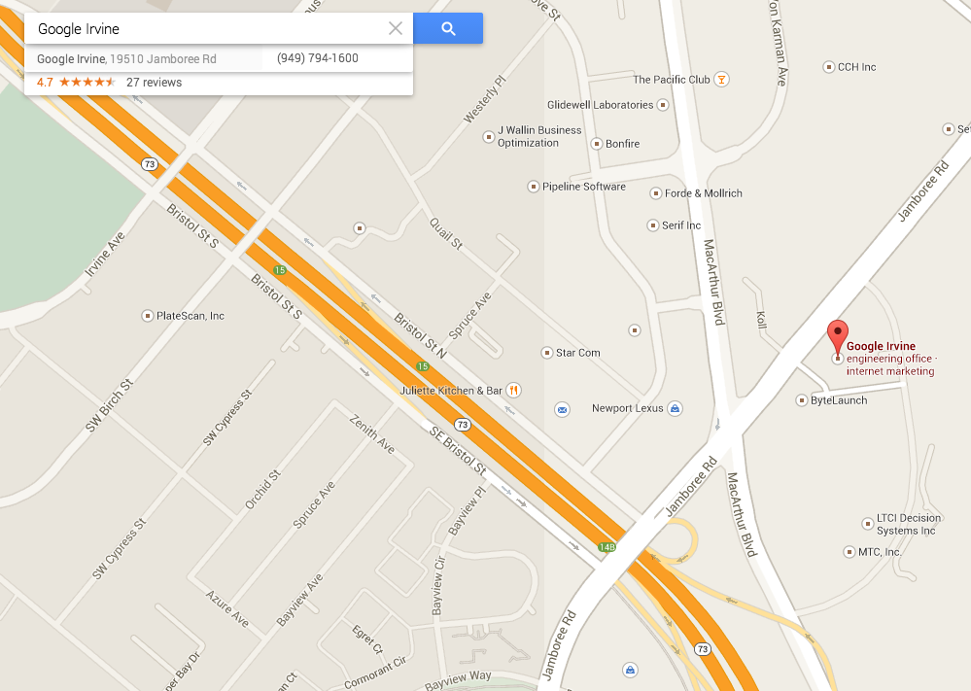
10:30am @ Google Irvine
Friday, July 25, 2014
HMC vehicles leaving ~9:45am

Slide 3
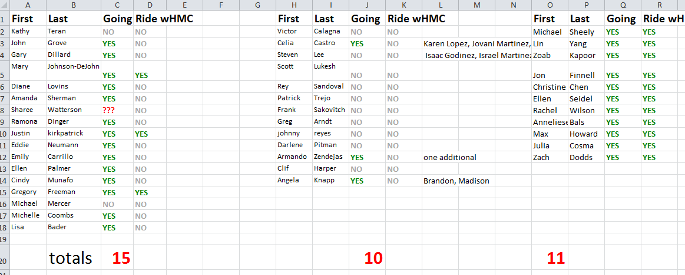
Google-visit planning…

Slide 4
We don't need more stuff…
though we're always happy for more!
Notes:
As a community, then, we don't need more material – certainly we're happy for more!
But there are amazing resources out there…
But for all of these wonderful resources, our partnering teachers tell us they want a one-stop curriculum tailored for them.

Slide 5
… we need more support
with all that excellent material
Notes:
[[read]]
So, what we can do is *support* teachers by organizing these resources in ways that work with their students.

Slide 6
MyCS
Six 3-week units, deployed depending on the teacher, subject, and school.
Broadening topics
Scratch programming
Units 4-6 (can) transition students into a more complete CS pipeline in high-school
Notes:
… and MyCS has evolved into an 18-week curriculum of day-by-day lesson plans.
It is really a scratch-programming course.
But, we borrowed an idea that has worked well in Introductory CS at Harvey Mudd, which is to give regular curricular breaks that offer students a rest from programming and a chance to hook into other facets/contexts in the discipline…
Now, the bottom half of MyCS is closely aligned with material from ScratchEd, ECS, and Colleen Lewis's Scratch curriculum, so to give you a sense of MyCS, I'll share one activity from each of the first three units:

Slide 7
CS curriculum opportunities
any-10
MyCS: Middle-years CS

Slide 8
CS curriculum opportunities
13+
CS through Python or …
12
AP CS A: Java programming
11
AP CS Principles: Beauty and Joy
10
ECS: Exploring CS
any-10
MyCS: Middle-years CS
grades

Slide 9
CS curriculum opportunities
CS through Python or …
code.org
13+
PLTW
Project Lead the Way
12
!!! AP CS A: Java programming
11
AP CS Principles: Beauty and Joy
10
ECS: Exploring CS
any-10
MyCS: Middle-years CS
grades

Slide 10
Workshop schedule: Thursday
9-9:20 ~ Google logistics
CS curricula
9:20-10:20 ~ CS Teaching Tips project
10:20-11 ~ tour/demos
11-noon and 1-2:15 ~ project work
2:15-3 ~ demos / wrap-up survey
3pm ~ t-shirts and photo

Slide 11
MyCS's pedagogy?

Slide 12
MyCS's pedagogy?
Harvey Mudd does have people thinking carefully about this…

Slide 13
Workshop schedule: Thursday
9-9:20 ~ Google logistics
CS curricula
9:20-10:20 ~ CS Teaching Tips project
10:20-11 ~ tour/demos
11-noon and 1-2:15 ~ project work
2:15-3 ~ demos / wrap-up survey
3pm ~ t-shirts and photo

Slide 14
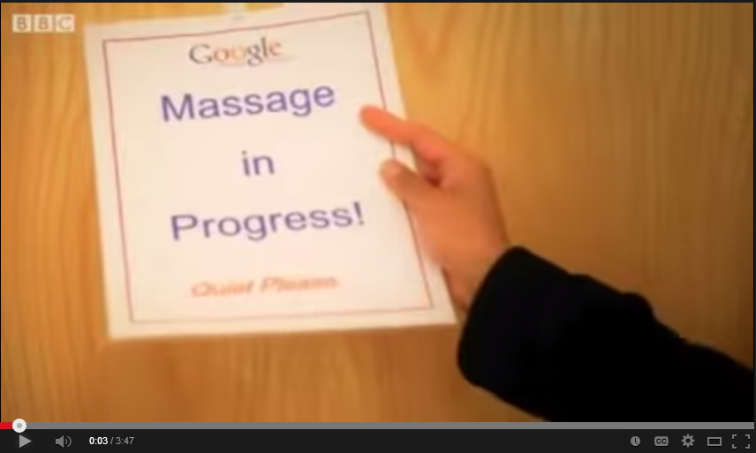
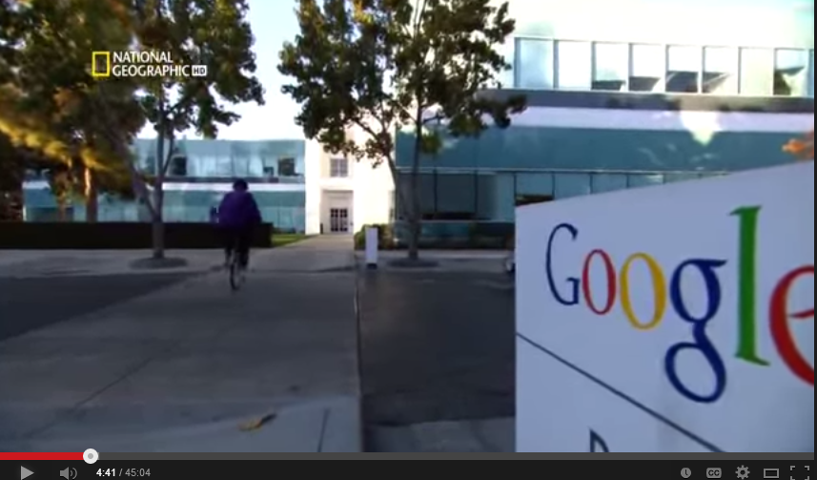
Google's aura?

Slide 15
Google's aura?
CS tourism?!

Slide 16
Workshop schedule: Thursday
9-9:20 ~ Google logistics
CS curricula
9:20-10:20 ~ CS Teaching Tips project
10:20-11 ~ tour/demos
11-noon and 1-2:15 ~ project work
2:15-3 ~ demos / wrap-up survey
3pm ~ t-shirts and photo

Slide 17
Mutual assessment…
How compelling was each topic?

Slide 18
Our goal
Computing is fun.
… building positive computational identity among middle-years students
I am good at computing.
Programming is hard.
I can become good at computing.
I'm interested in a computing career.
I like the challenge of computing.
Computer jobs are boring.
I'm interested in more computing.
Pre vs. post interest
Computing is something that people like me do.
Notes:
Read this…
and we have taken – verbatim – a number of prompts from surveys that Barb Erikson and Tom McKlin have used for the same age group – but in essence we're interested in getting students to identify with *computing* as at least a _potential_ part of who they are, perhaps best summarized by this last prompt, "computing is something that people like me do."

Slide 19
Data on the MyCS experience…

Slide 20
M-y women (left cols) vs. men (right cols)

Slide 21
C-y women (left cols) vs. men (right cols)

Slide 22
Thank you!
parting thoughts?
parting t-shirts!
photo!

Slide 24
We don't need more stuff…
though we're always happy for more!
Notes:
As a community, then, we don't need more material – certainly we're happy for more!
But there are amazing resources out there…
But for all of these wonderful resources, our partnering teachers tell us they want a one-stop curriculum tailored for them.

Slide 25
… we need more support
with all that excellent material
Notes:
[[read]]
So, what we can do is *support* teachers by organizing these resources in ways that work with their students.

Slide 26
MyCS
Six 3-week units, deployed depending on the teacher, subject, and school.
Broadening topics
Scratch programming
Units 4-6 (can) transition students into a more complete CS pipeline in high-school
Notes:
… and MyCS has evolved into an 18-week curriculum of day-by-day lesson plans.
It is really a scratch-programming course.
But, we borrowed an idea that has worked well in Introductory CS at Harvey Mudd, which is to give regular curricular breaks that offer students a rest from programming and a chance to hook into other facets/contexts in the discipline…
Now, the bottom half of MyCS is closely aligned with material from ScratchEd, ECS, and Colleen Lewis's Scratch curriculum, so to give you a sense of MyCS, I'll share one activity from each of the first three units:

