Slide 1
ACM Welcome!
Sep 11 Welcome! and DP problems ~ 6 problems
Sep 18 Lab session ~ 6 problems
Sep 25 Discussion session on graph problems ~ 6 problems
Oct 2 Lab session on graph problems ~ 6 problems
Oct 9 Scott Ellsworth on Google Irvine ~ 6 problems
Oct 16 Discussion session on maxflow problems ~ 6 problems
Oct 23 (9pm) Lab & local ACM qualifying contest ~ 6 problems
Oct 30 Discussion session on geometry problems ~ 6 problems
Nov 6 Lab session on geometry problems ~ 6 problems
Nov 10 (Sat.) ACM Regional contest (in Riverside...)
Nov 13 Final meeting
Job-fair thoughts?

Slide 2
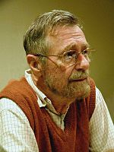
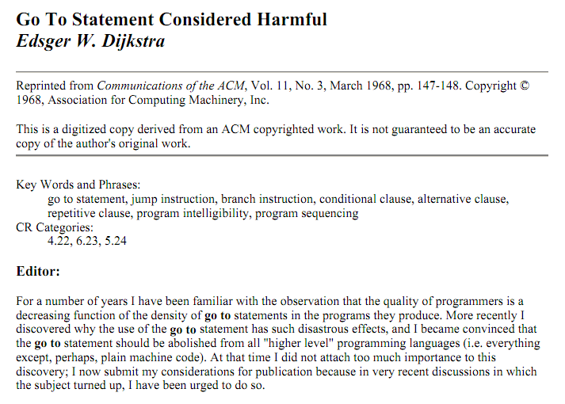
Past programmer: Dijkstra?
Computer science is no more about computers than astronomy is about telescopes.
Edsger Dijkstra
during the "structured programming" wars

Slide 3
Past programmer: Dijkstra?
Computer science is no more about computers than astronomy is about telescopes.
Edsger Dijkstra
during the "structured programming" wars
You probably know that arrogance, in computer science, is measured in nanodijkstras.
Alan Kay, keynote speech at OOPSLA 1997 [2]

Slide 5
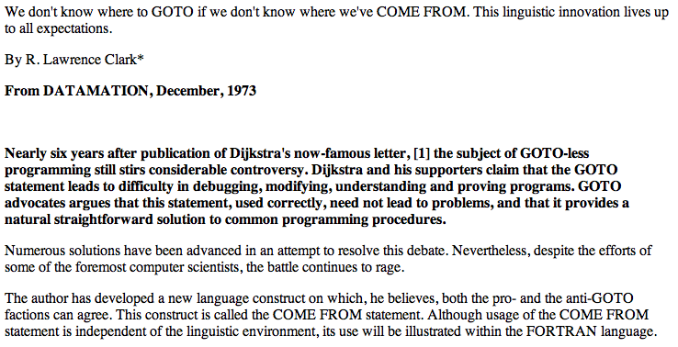

Slide 6
Geometry…
B
Turning direction: CW or CCW
(0,2)
A
Right-hand rule:
left turns are positive
right turns are negative
(1,1)
(0,0)
Convex hull
O
(2,0)
B'
applications: diameter
Monotone chains algorithm
Area and centroid

Slide 7
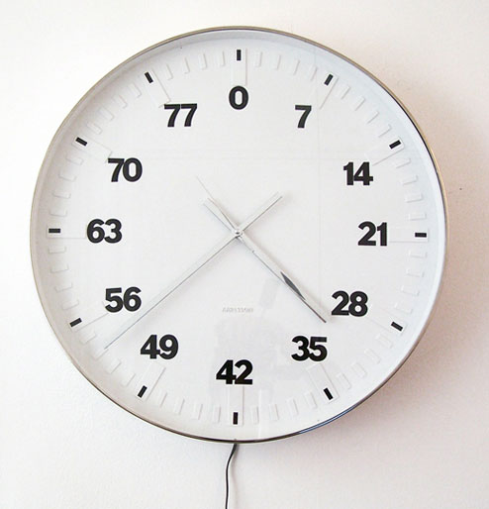
Turning direction
B
(0,2)
A
(1,1)
Bertrand Planes' Life Clock
(0,0)
A
O
B
O
(2,0)
def turningDirection( pt1, pt2, pt3 ):
""" returns 1 if pt1 -> pt2 -> pt3 is a CCW turn
returns -1 if pt1 -> pt2 -> pt3 is a CW turn
returns 0 if they are collinear
"""
x1, y1 = pt1; x2, y2 = pt2; x3, y3 = pt3;
# the signed magnitude of the cross product
CP = (x2-x1)*(y3-y1)-(y2-y1)*(x3-x1)
if CP > 0: return 1
if CP < 0: return -1
return 0
B'
x2*y3 – y2*x3
1*2 – 1*0
2
Notes:
PERL stories
- use in ACM
- creating scripts
- LTS, BOT

Slide 8
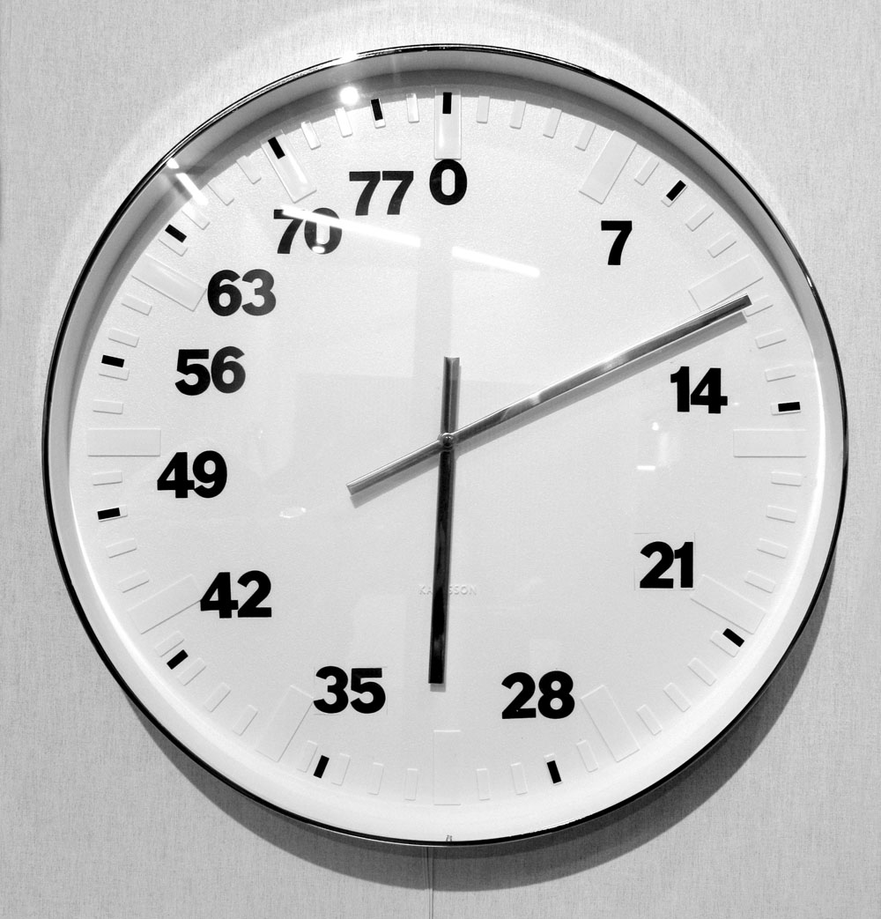
Turning direction
B
(0,2)
A
(1,1)
another version
(0,0)
O
(2,0)
def turningDirection( pt1, pt2, pt3 ):
""" returns 1 if pt1 -> pt2 -> pt3 is a CCW turn
returns -1 if pt1 -> pt2 -> pt3 is a CW turn
returns 0 if they are collinear
"""
x1, y1 = pt1; x2, y2 = pt2; x3, y3 = pt3;
# the signed magnitude of the cross product
CP = (x2-x1)*(y3-y1)-(y2-y1)*(x3-x1)
if CP > 0: return 1
if CP < 0: return -1
return 0
B'
Right-hand rule:
left turns positive
right turns negative
Notes:
PERL stories
- use in ACM
- creating scripts
- LTS, BOT

Slide 9
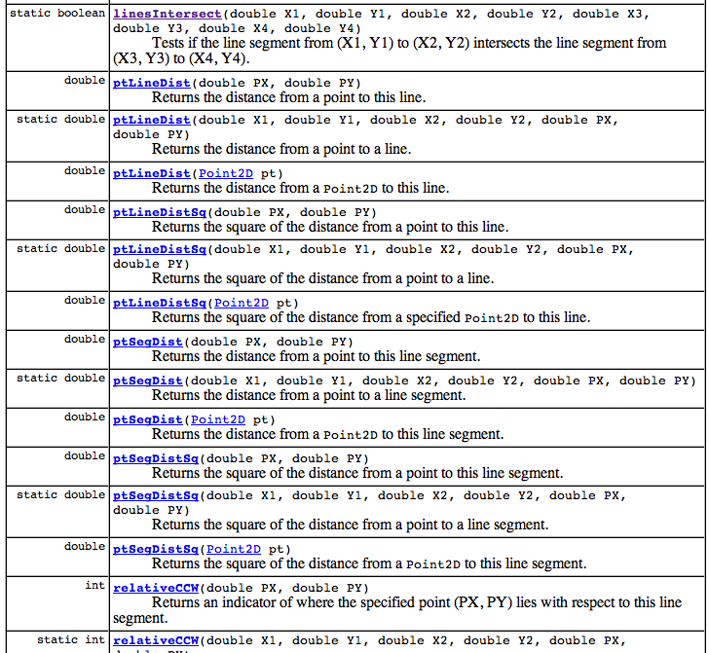
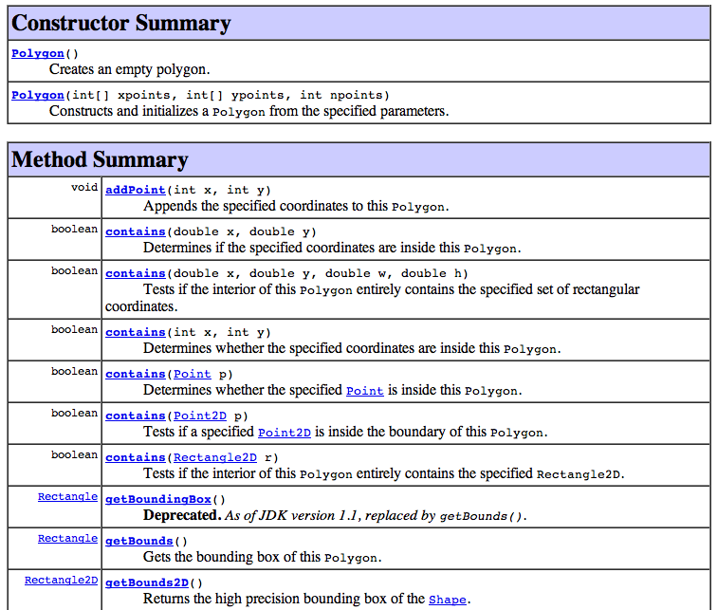
Geometric algorithms
Java has its advantages!
Line2d.linesIntersect(x1, y1, x2, y2, x3, y3, x4, y4);
Polygon().contains(x,y);
Line2D
Polygon
Notes:
PERL stories
- use in ACM
- creating scripts
- LTS, BOT

Slide 10
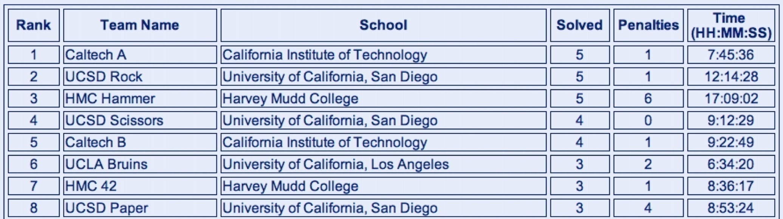
Problem #6: Find the area of a polygon, given its vertices.
Per-Problem Statistics
Problem Solved Submitted
1 3 60
2 11 72
3 3 12
4 0 0
5 19 58
6 7 10
7 10 64
Matt Beaumont, Dan Halperin, Jonah Cohen
contestwide
Monte Carlo geometry…
63 teams total, Fall 04 ACM Contest

Slide 11
Problem #6: Find the area of a polygon, given its vertices.
HMC Hammer
# Solved Runs Time
1 - 2 4:57:38
2 * 2 2:55:41
3 * 2 3:37:58
4 - 0 0:00:00
5 * 2 1:20:42
6 * 4 4:41:57
7 * 1 2:32:44
Per-Problem Statistics
Problem Solved Submitted
1 3 60
2 11 72
3 3 12
4 0 0
5 19 58
6 7 10
7 10 64
Matt Beaumont, Dan Halperin, Jonah Cohen
contestwide
Monte Carlo geometry…
63 teams total, Fall 04 ACM Contest

Slide 12
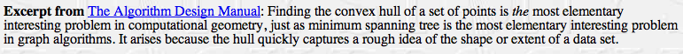
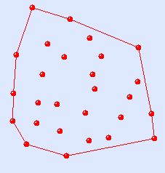
Convex Hull
Application: point-set diameter
What is the pair of points with the greatest separation among a collection in the plane?
the segments surrounding the exterior of a point set.
Notes:
PERL stories
- use in ACM
- creating scripts
- LTS, BOT

Slide 13
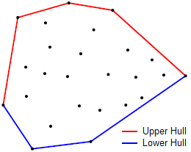
"Monotone-chain" Convex Hull
vertices of the smallest convex polygon containing all points
Note that, looking , all turns are left turns!
Notes:
PERL stories
- use in ACM
- creating scripts
- LTS, BOT

Slide 14
Monotone-chain Convex Hull
Let's find the "BOTTOM chain" for this set of points…
Start by sorting them by x-coordinate, then look for left turns.
Notes:
PERL stories
- use in ACM
- creating scripts
- LTS, BOT

Slide 15
Monotone-chain Convex Hull
Idea: find the upper hull and lower hull...
(Start-up) sort the point-list P by x-coordinate (then y)
Let P be all the points (sorted)
Let L=[] start the list of lower hull points…
(Lower hull)
for each point P[0]..P[i]..P[N]:
P[i]
while L[-2], L[-1], P[i] are not CCW:
remove L[-1]
append P[i] to L
(Upper hull)
same – but in reverse direction!
http://www.algorithmist.com/index.php/Monotone_Chain_Convex_Hull
Notes:
PERL stories
- use in ACM
- creating scripts
- LTS, BOT

Slide 16
Code...
def convex_hull(points):
"""
Input: an iterable sequence of (x, y) pairs representing the points.
Output: a list of vertices of the convex hull in counter-clockwise order,
starting from the vertex with the lexicographically smallest coordinates.
Implements Andrew's monotone chain algorithm. O(n log n) complexity.
"""
points = sorted(set(points))
if len(points) <= 1:
return points
def cross(o, a, b):
return (a[0] - o[0]) * (b[1] - o[1]) - (a[1] - o[1]) * (b[0] - o[0])
# Build lower hull
lower = []
for p in points:
while len(lower) >= 2 and cross(lower[-2], lower[-1], p) <= 0:
lower.pop()
lower.append(p)
# Build upper hull
upper = []
for p in reversed(points):
while len(upper) >= 2 and cross(upper[-2], upper[-1], p) <= 0:
upper.pop()
upper.append(p)
return lower[:-1] + upper[:-1]
# Example: convex hull of a 10-by-10 grid.
assert convex_hull([(i/10, i%10) for i in range(100)]) == [(0, 0), (9, 0), (9, 9), (0, 9)]
http://www.algorithmist.com/index.php/Monotone_Chain_Convex_Hull.py
Notes:
PERL stories
- use in ACM
- creating scripts
- LTS, BOT

Slide 17
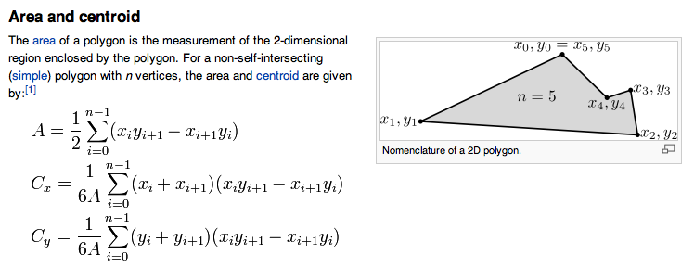
Area of any polygon... ?
without Monte Carlo!
(1,4)
(4,3)
(4,1)
P = (0,0)
Surveyor's Formula...
Idea: start from any point P: say, the origin
Compute the area of the triangles from P to each polygon edge...
Be sure to wrap all the way around...
Notes:
PERL stories
- use in ACM
- creating scripts
- LTS, BOT

Slide 18
Area of any polygon... ?
Idea: start from any point P ~ say, the origin
Compute the area of the triangles from P to each polygon edge...
Be sure to wrap all the way around...
Notes:
PERL stories
- use in ACM
- creating scripts
- LTS, BOT

Slide 19

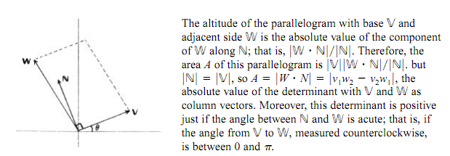
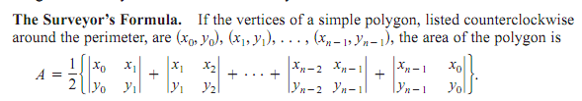
Proof of the surveyor's formula...
http://www.maa.org/pubs/Calc_articles/ma063.pdf

Slide 20
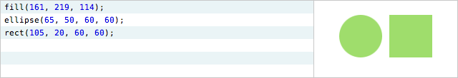
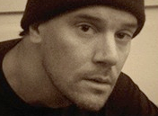
The future of programming…?
We need more dynamic tools to show code & data
"Try things out" is not really an optimal strategy!
http://worrydream.com/LearnableProgramming/
- Bret Victor

Slide 21

The future of programming…?
We need more dynamic tools to show code & data
imagine "trying out" the buttons on a microwave… !
http://worrydream.com/LearnableProgramming/
- Bret Victor

Slide 22
This week…
cavli
ship
goraft
moat
herd
start here!
Try things out!
Notes:
PERL stories
- use in ACM
- creating scripts
- LTS, BOT

Slide 23
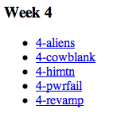
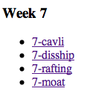
This week…
convex hull
binary search
binary search
Dijkstra!
Notes:
PERL stories
- use in ACM
- creating scripts
- LTS, BOT

Slide 24
Jotto!
Sophs
JRs
SRs
Elderly
Pomona
slate 1
slate 3
slate 2
slate 1
slate 3
flair 0
flair 0
flair 1
flair 2
flair 2
stems 1
stems 3
stems 1
stems 2
stems 2
loser 1
loser 2
loser 3
loser 2
loser 3
stone 1
stone 3
stone 1
stone 1
stone 2
guppy 2
guppy 1
guppy 0
guppy 1
guppy 0
This term's first class to guess another's word earns 1 problem...
This term's last class to have its word guessed earns 1 problem...
Notes:
PERL stories
- use in ACM
- creating scripts
- LTS, BOT

Slide 25
HMC-local contest...
Tuesday, October 18 9pm-1am
Top four (Java/C/C++)teams have the chance to go to the regionals at Riverside
Lab - and lab scoring - for everyone… (you need not stay all four hours!)

Slide 26
Geometric algorithms
Line Segment intersection…
All points on this line are
(xA,yA) + s(xB-xA,yB-yA)
(xB,yB)
dxA
dyA
(xi,yi)
(x2,y2)
(xA,yA)
(x1,y1)
All points on this line are
(x1,y1) + r(x2-x1,y2-y1)
dx1
dy1
dx1 dxA
dy1 dyA
r
s
=
xA - x1
yA - y1
Solving these equations finds the intersection via r and s.
Notes:
PERL stories
- use in ACM
- creating scripts
- LTS, BOT

Slide 27
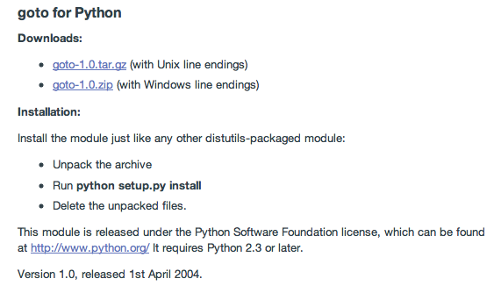
goto in Python…

Slide 28
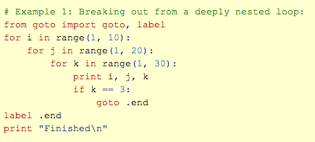
goto in Python…

Slide 29
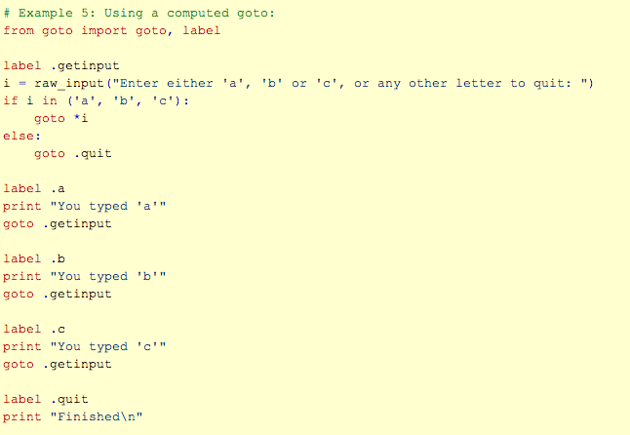
goto in Python…

Slide 30
Also this week: binary search
If a desired value is
difficult to compute but easy to check
1d (or broken into 1d subproblems)
then we can binary search across all the possible values for it, checking as we go... !
and
monotonic (true for all n < T or n > T)
and

Slide 31
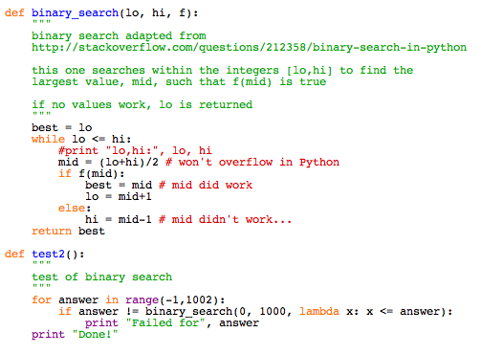
Also this week: binary search
Python example

Slide 32
Past programmer: Dijkstra?
APL is a mistake, carried through to perfection. It is the language of the future for the programming techniques of the past: it creates a new generation of coding bums.
Edsger Dijkstra
Computer science is no more about computers than astronomy is about telescopes.
Edsger Dijkstra
during the "structured programming" wars
You probably know that arrogance, in computer science, is measured in nanodijkstras.
Alan Kay, keynote speech at OOPSLA 1997 [2]

Slide 33
Last week: phoneline
# of telephone poles, N
Input
Output
# of edges available
4
5 7 1
1 2 5
3 1 4
2 4 8
3 2 3
5 2 9
3 4 7
4 5 6
# of cables you get for free
The smallest largest cable needed to connect #1 and #N
2
9
5
5
3
8
6
4
1
3
7
4
need to connect #1 and #N

Slide 34
Geometric algorithms
Line Segment intersection…
pt2 = (20,20)
pt5 = (40, 20)
pt3 = (10, 20)
pt1 = (10, 10)
pt4 = (20, 10)
Line segment #1 runs from (10, 10) to (20, 20)
Line segment #2 runs from (10, 20) to (20, 10)
Intersection result = (15.0, 15.0, 1, 0.5, 0.5)
Line segment #1 runs from (10, 10) to (10, 20)
Line segment #2 runs from (20, 20) to (20, 10)
Intersection result = (0, 0, 0, 0, 0)
Line segment #1 runs from (10, 10) to (20, 20)
Line segment #2 runs from (20, 10) to (40, 20)
Intersection result = (0.0, 0.0, 1, -1.0, -1.0)
Notes:
PERL stories
- use in ACM
- creating scripts
- LTS, BOT

Slide 35
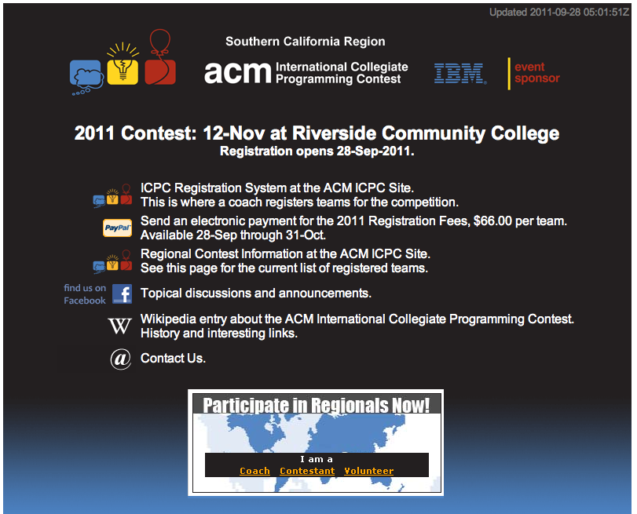
Regional contest...

Slide 37
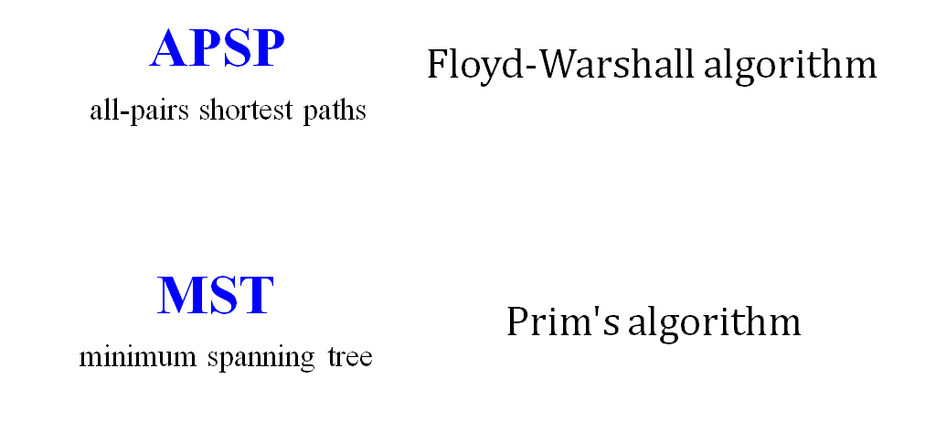
Today's algorithms…
Last Time...
This time!
SSSP
Dijkstra's algorithm
single-source shortest paths
Binary Search
Convex Hull

Slide 38
Dijkstra's shortest-paths algorithm
60
src
Single-source shortest paths to all vertices…
20
C
S
30
5
D
Maintain a list of Accessible [dist, node] pairs
21
Expand the closest node and Retire it…
E
10
B
1
Setup
Step 0
Step 1
Step 2
Step 3
Step 4
A = [
[0,S]
]
Accessible
Retired
R = [ ]

Slide 39
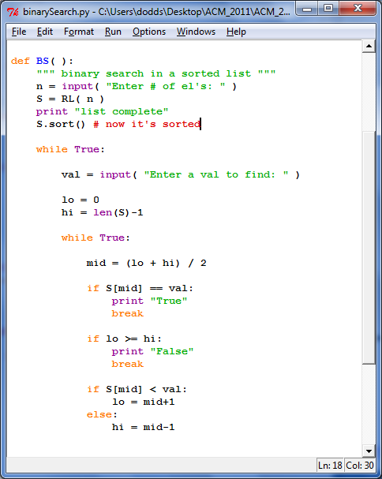
Binary search in a sorted list...
in Python
available on the ACM website

Slide 40
This week: aggr
Input
Output
3
5 3
1
2
8
4
9
Number of cows to house in the new barn…
The largest minimum spacing possible after placing the cows
Number of stalls in which cows can be placed
The locations of stalls
1
2
4
8
9

Slide 41
Jotto!
Sophs
JRs
SRs
Elderly
Pomona
slate 1
slate 3
slate 2
slate 1
slate 3
flair 0
flair 0
flair 1
flair 2
flair 2
stems 1
stems 3
stems 1
stems 2
stems 2
loser 1
loser 2
loser 3
loser 2
loser 3
stone 1
stone 3
stone 1
stone 1
stone 2
guppy 2
guppy 1
guppy 0
guppy 1
guppy 0
This term's first class to guess another's word earns 1 problem...
This term's last class to have its word guessed earns 1 problem...
Notes:
PERL stories
- use in ACM
- creating scripts
- LTS, BOT

Slide 42
Upcoming schedule...
Sep 6 Welcome! and DP problems ~ 5 problems
Sep 13 Lab session ~ 4 problems
Sep 20 Discussion session on graph problems ~ 4 problems
Sep 27 Lab session on graph problems ~ 4 problems
Oct 4 Discussion session on geometry problems ~ 4 problems
Oct 11 Lab session on geometry problems ~ 4 problems
Oct 18 Lab & local ACM qualifying contest ~ 6 problems
Oct 25 Discussion session on something new!! ~ 4 problems
Nov 1 Lab session ~ 4 problems
Nov 8 No meeting (organizing teams to Riverside...)
Nov 12 (Sat.) ACM Regional contest (in Riverside...)
Nov 15 Final meeting (may be a make-up lab if we miss one)
≥ 38 problems total
You may submit problems until the end of exams…

Slide 43
aggr in Python (in part)
# get the # of stalls (N) and cows (C)
S = []
for i in range(N):
S += [input()] # get the stalls' locations
S.sort() # sort them
lo = 0
hi = max(S)-min(S)+1
input

Slide 44
aggr in Python (in part)
# get the # of stalls (N) and cows (C)
S = []
for i in range(N):
S += [input()] # get the stalls' locations
S.sort() # sort them
lo = 0
hi = max(S)-min(S)+1
while True:
mid = (lo + hi)/2 # no overflow in Python, right?
if mid == hi or mid == lo: break
# does mid work?
if CHECKS_OUT( mid, C, S ):
lo = mid # worked! look higher (set lo to mid)
else:
hi = mid # did not work... look lower (set hi to mid)
print mid
input
binary search
still left to do?

Slide 45
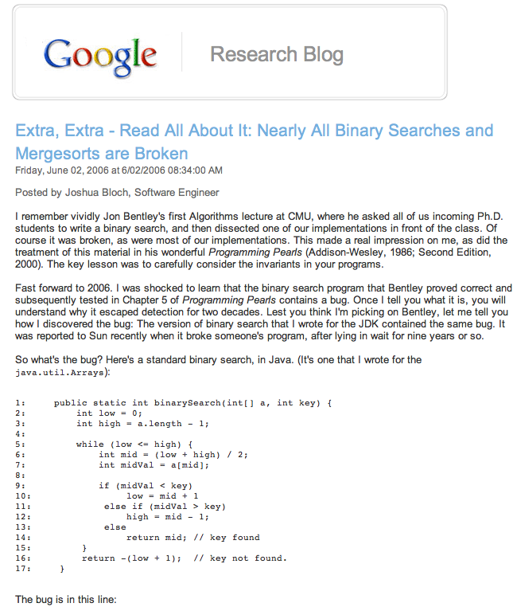

Slide 46
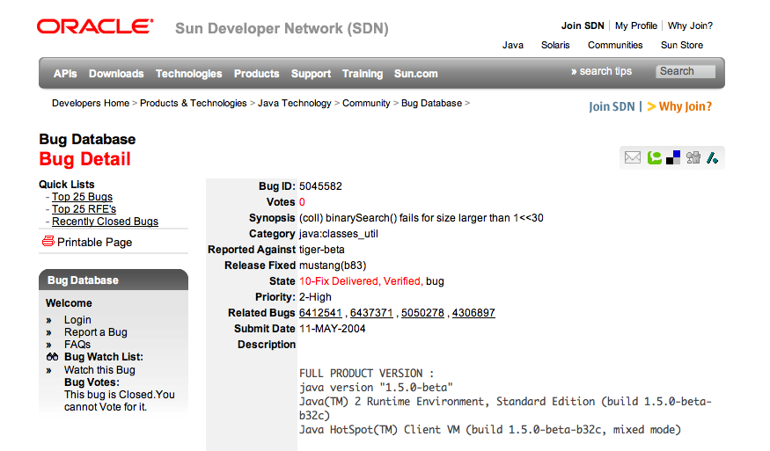
This bug went undetected in Java's libraries for years...

Slide 47
This week's problems…
phoneline
hunger
aggr
cowblank
btwr
this problem is only for those new to ACM...
but if you're returning, you can solve it
in web-form for credit: you should use HTML 5's
canvas object directly (or libraries that use it)
to draw the scenario and results...

Slide 48
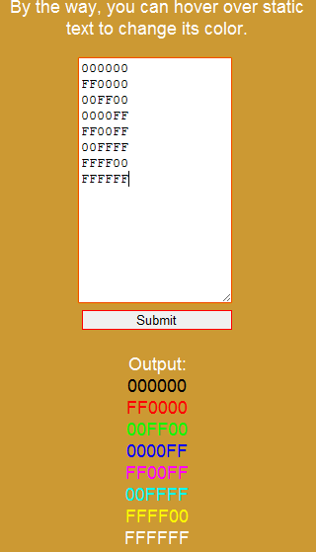
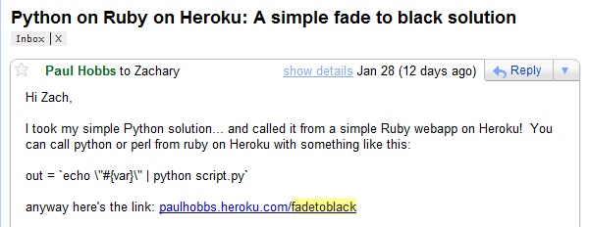
Web versions!
Web frameworks are welcome...
As are libraries, e.g., JQuery and its variants...
The locations of stalls
cows!
1
2
4
8
9
This week: HMTL 5 canvas objects

Slide 49
This week's problems…
phoneline
hunger
aggr
cowblank
btwr
this problem is only for those new to ACM...
but if you're returning, you can solve it
in web-form for credit: you should use HTML 5's
canvas object directly (or libraries that use it)
to draw the scenario and results...

Slide 50
This week: phoneline
# of telephone poles, N
Output
Input
# of edges available
4
5 7 1
1 2 5
3 1 4
2 4 8
3 2 3
5 2 9
3 4 7
4 5 6
# of cables you get for free
The minimium possible length of remaining largest cable needed to connect #1 and #N
2
9
5
5
3
8
6
4
1
3
7
4
#1 is connected to the phone network

Slide 51
MST
Minimum spanning tree: (Prim’s algorithm)
Start anywhere and repeatedly choose the next-smallest edge out from your current tree.

Slide 52
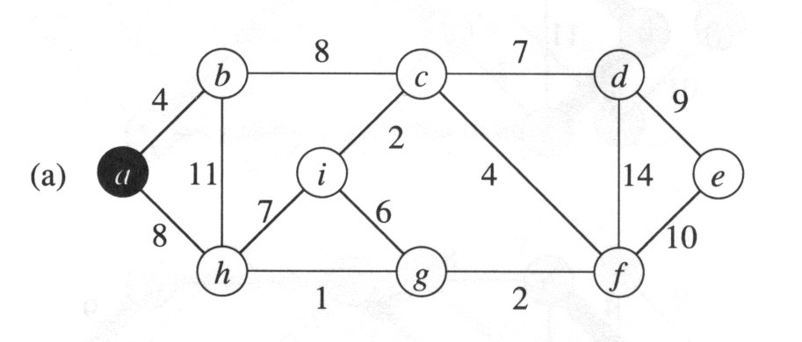
MST
Minimum spanning tree: (Prim’s algorithm)
Start anywhere and repeatedly choose the next-smallest edge out from your current tree.

Slide 53
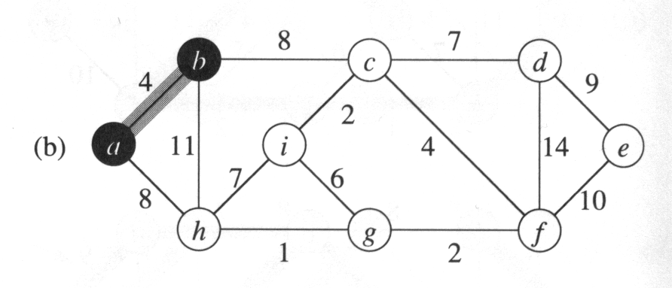
MST
Minimum spanning tree: (Prim’s algorithm)
Start anywhere and repeatedly choose the next-smallest edge out from your current tree.

Slide 54
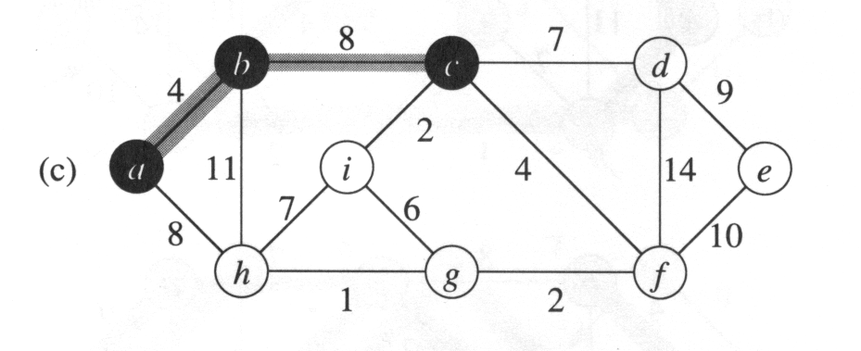
MST
Minimum spanning tree: (Prim’s algorithm)
Start anywhere and repeatedly choose the next-smallest edge out from your current tree.

Slide 55
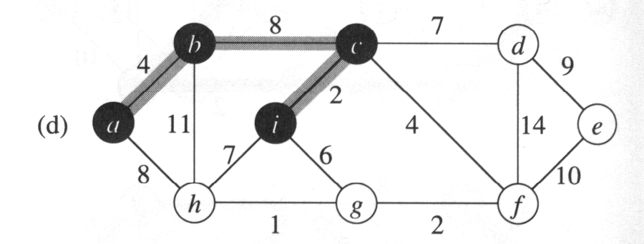
MST
Minimum spanning tree: (Prim’s algorithm)
Start anywhere and repeatedly choose the next-smallest edge out from your current tree.

Slide 56
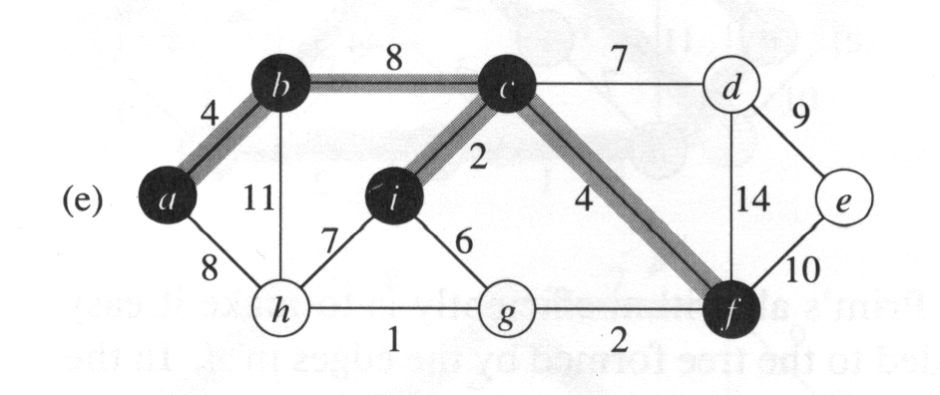
MST
Minimum spanning tree: (Prim’s algorithm)
Start anywhere and repeatedly choose the next-smallest edge out from your current tree.

Slide 57
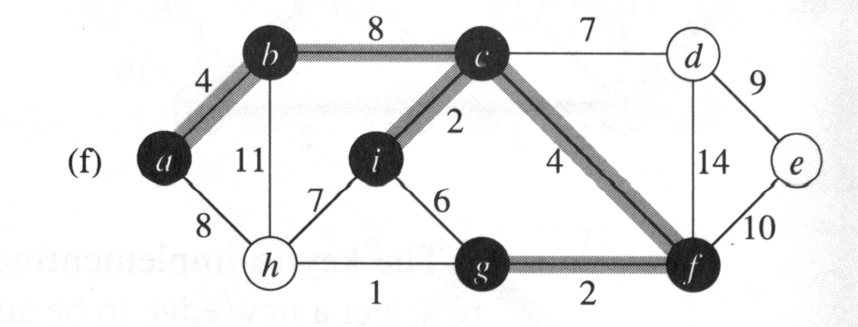
MST
Minimum spanning tree: (Prim’s algorithm)
Start anywhere and repeatedly choose the next-smallest edge out from your current tree.

Slide 58
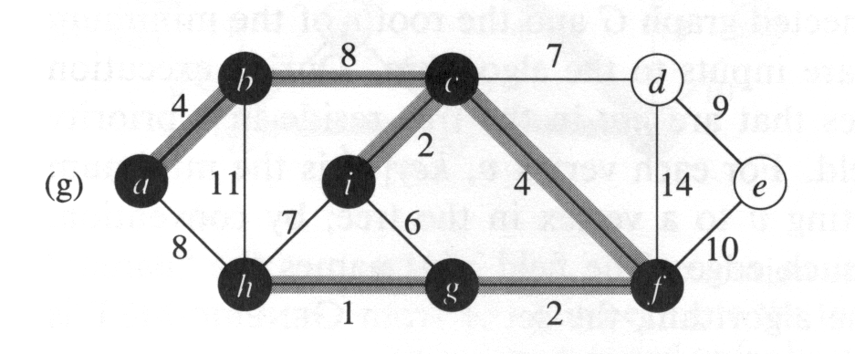
MST
Minimum spanning tree: (Prim’s algorithm)
Start anywhere and repeatedly choose the next-smallest edge out from your current tree.

Slide 59
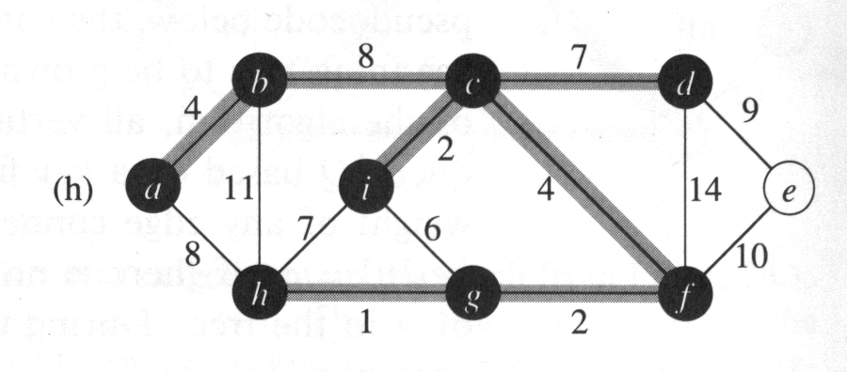
MST
Minimum spanning tree: (Prim’s algorithm)
Start anywhere and repeatedly choose the next-smallest edge out from your current tree.

Slide 60
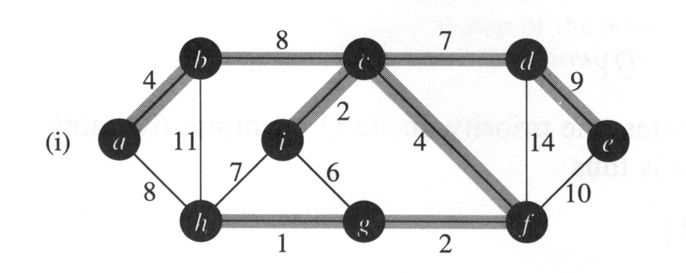
MST
Minimum spanning tree: (Prim’s algorithm)
Start anywhere and repeatedly choose the next-smallest edge out from your current tree.
Done!

Slide 61
Try this week's problems!
phoneline
hunger
aggr
cowblank
btwr
this problem is only for those new to ACM...
but if you're returning, you can solve it
in web-form for credit: you should use HTML 5's
canvas object directly (or libraries that use it)
to draw the scenario and results...

Slide 62
Jotto!
Frosh
Sophs
Jrs
Srs
audio 2
audio 1
audio 2
audio 1
graze 2
graze 3
graze 1
graze 1
alloy 2
alloy 1
alloy 1
alloy 1
fresh 1
fresh 2
fresh 1
fresh 2
armor 2
armor 2
armor 2
armor 1
brave 2
brave 3
brave 1
brave 1
This term's first class to guess another's word earns 1 problem...
This term's last class to have its word guessed earns 1 problem...
Notes:
PERL stories
- use in ACM
- creating scripts
- LTS, BOT

Slide 63
Last week: wifi
Input
Output
The # of test cases...
1.0
1
2 3
1
3
10
The smallest max distance achievable
The # of access points and the # of houses
Locations of the houses...
1
3
10

Slide 64
This week: city
# of people to house
Output
Input
cost per unit distance from (0,0)
194
10 20 3
11
22
33
maximum # of stories per building
The minimium cost to house the specified # of people
cost of 1st story
0dist
1dist
0dist
0dist
1dist
1dist
0dist
1dist
2dist
3dist
the central station where everyone works is at (0,0)
distances to it are considered to be |x|+|y|-1

Slide 65
This week: cowset
# of cows available, up to 34
Output
Input
minimum ID sum
5
3 -1 2
1
-2
3
maximum ID sum
The number of subsets whose IDs sum between min and max
ID # for 1st cow
ID # for 2nd cow
Try all subsets...?
ID # for 3rd cow
Farmer Ran is willing to play frisbee with any subset of cows whose IDs sum to any value between the min and max...

Slide 66
This week: cowset
# of cows available, up to 34
Output
Input
minimum ID sum
5
3 -1 2
1
-2
3
maximum ID sum
The number of subsets whose IDs sum between min and max
ID # for 1st cow
ID # for 2nd cow
Takes too long to try all subsets...!
How could Bin Search speed it up?
ID # for 3rd cow
Farmer Ran is willing to play frisbee with any subset of cows whose IDs sum to any value between the min and max...

Slide 67



Problem D from the 2009 World Finals in Stockholm:
Pipe Packing
Given a set of four wire diameters:
What is the minimum diameter of pipe that can contain all four wires?
(Constraint: pipes only come in millimeter sizes)

Slide 68
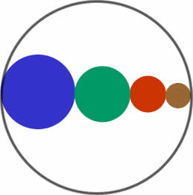
Intuition: Solve this problem by binary search
A lower bound:
sum of largest two wire-diameters
An upper bound: sum of all four wire-diameters
  Binary search between lower bound and upper bound
  Given a pipe diameter and four wire diameters, can you pack the wires inside the pipe?
  Choose the smallest integer pipe diameter that fits

Slide 69
Problem D from the 2009 World Finals in Stockholm:
Pipe Packing
Given a set of four wire diameters:
What is the minimum diameter of pipe that can contain all four wires?
(Constraint: pipes only come in millimeter sizes)

Slide 70
Intuition: Solve this problem by binary search
A lower bound:
sum of largest two wire-diameters
An upper bound: sum of all four wire-diameters
  Binary search between lower bound and upper bound
  Given a pipe diameter and four wire diameters, can you pack the wires inside the pipe?
  Choose the smallest integer pipe diameter that fits

Slide 71
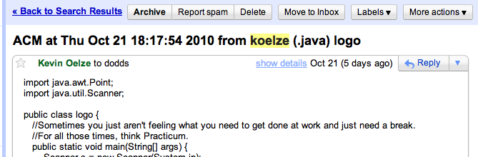
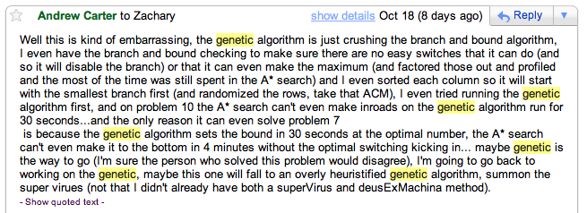
ACM this week!?

