Slide 1
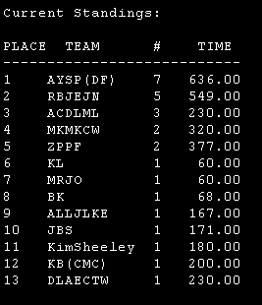

ACM today!
Today: BS!
Next 11/2: guest speaker...
On 11/9: final lab session
11/13: regionals
Nice work to everyone in the qualifiers and evening lab...
On 11/16: wrap-up

Slide 2
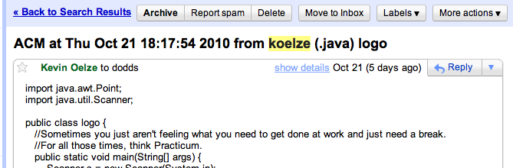
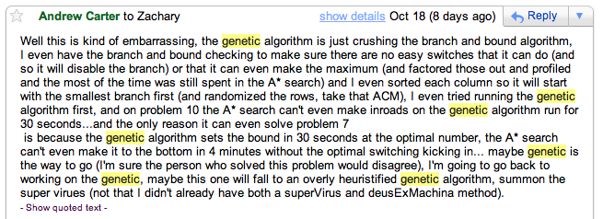
ACM this week!?

Slide 3

Next week
This talk is optional, but it should be good!
In addition, it's incentivized @ 2 problems...
It may count as a colloquium, too...

Slide 4
Jotto!
sophomores remain...
Sophs
Jrs
Srs
Profs
pluot 1
pluot 2
pluot 1
pluot 2
squid 2
squid 1
squid 0
squid 1
fails 2
fails 2
fails 0
fails 2
cache 1
cache 2
cache 3
cache 0
china 1
china 2
china 3
china 0
quail 1
quail 0
quail 2
quail 3
conch 0
conch 5
conch 0
conch 1
laugh ?
laugh 5
laugh x
laugh 2
Notes:
PERL stories
- use in ACM
- creating scripts
- LTS, BOT

Slide 5



Problem D from the 2009 World Finals in Stockholm: Pipe Packing
Given a set of four wire diameters:
What is the minimum diameter of pipe that can contain all four wires?
(Constraint: pipes only come in millimeter sizes)

Slide 6
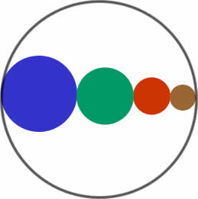
Intuition: Solve this problem by binary search
A lower bound: sum of largest two wire-diameters
An upper bound: sum of all four wire-diameters
Binary search between lower bound and upper bound
Given a pipe diameter and four wire diameters, can you pack the wires inside the pipe?
Choose the smallest integer pipe diameter that fits

Slide 7
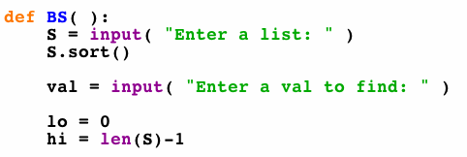
Binary search in a sorted list...
in Python
What's next... ?
we want to return True or False: is val in S?

Slide 8
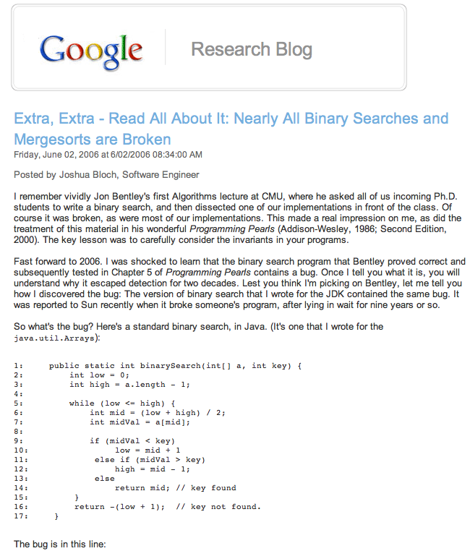

Slide 9
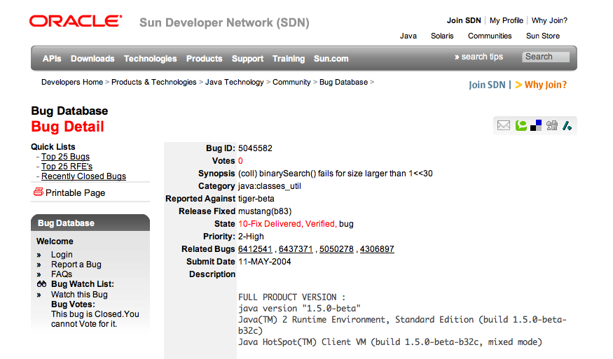
This bug went undetected in Java's libraries for years...

Slide 10
This week's problems…
palpath
city
aggr
cowset
flood2
These three are all examples of problems for which binary search might be a good technique…
could be used here, too...

Slide 11
Problem D from the 2009 World Finals in Stockholm: Pipe Packing
Given a set of four wire diameters:
What is the minimum diameter of pipe that can contain all four wires?
(Constraint: pipes only come in millimeter sizes)

Slide 12
Intuition: Solve this problem by binary search
A lower bound: sum of largest two wire-diameters
An upper bound: sum of all four wire-diameters
Binary search between lower bound and upper bound
Given a pipe diameter and four wire diameters, can you pack the wires inside the pipe?
Choose the smallest integer pipe diameter that fits

Slide 13
Binary search ?
If a desired value is
difficult to compute but easy to check
and
(what other criteria do we need here?)
then we can binary search across all the possible values for it, checking as we go... !

Slide 14
This week: aggr
Input
Output
3
5 3
1
2
8
4
9
Number of cows to house in the new barn…
The largest minimum spacing possible after placing the cows
Number of stalls in which cows can be placed
The locations of stalls
1
2
4
8
9

Slide 15
aggr in Python (in part)
# get the # of stalls (N) and cows (C)
S = []
for i in range(N):
S += [input()] # get the stalls' locations
S.sort() # sort them
lo = 0
hi = max(S)-min(S)+1
input

Slide 16
aggr in Python (in part)
# get the # of stalls (N) and cows (C)
S = []
for i in range(N):
S += [input()] # get the stalls' locations
S.sort() # sort them
lo = 0
hi = max(S)-min(S)+1
while True:
mid = (lo + hi)/2 # no overflow in Python, right?
if mid == hi or mid == lo: break
# does mid work?
if CHECKS_OUT( mid, C, S ):
lo = mid # worked! look higher (set lo to mid)
else:
hi = mid # did not work... look lower (set hi to mid)
print mid
input
binary search
still left to do?

Slide 17
Last week: wifi
Input
Output
The # of test cases...
1.0
1
2 3
1
3
10
The smallest max distance achievable
The # of access points and the # of houses
Locations of the houses...
1
3
10

Slide 18
This week: city
# of people to house
Output
Input
cost per unit distance from (0,0)
194
10 20 3
11
22
33
maximum # of stories per building
The minimium cost to house the specified # of people
cost of 1st story
0dist
1dist
0dist
0dist
1dist
1dist
0dist
1dist
2dist
3dist
the central station where everyone works is at (0,0)
distances to it are considered to be |x|+|y|-1

Slide 19
This week: cowset
# of cows available, up to 34
Output
Input
minimum ID sum
5
3 -1 2
1
-2
3
maximum ID sum
The number of subsets whose IDs sum between min and max
ID # for 1st cow
ID # for 2nd cow
Try all subsets...?
ID # for 3rd cow
Farmer Ran is willing to play frisbee with any subset of cows whose IDs sum to any value between the min and max...

Slide 20
This week: cowset
# of cows available, up to 34
Output
Input
minimum ID sum
5
3 -1 2
1
-2
3
maximum ID sum
The number of subsets whose IDs sum between min and max
ID # for 1st cow
ID # for 2nd cow
Takes too long to try all subsets...!
How could Bin Search speed it up?
ID # for 3rd cow
Farmer Ran is willing to play frisbee with any subset of cows whose IDs sum to any value between the min and max...

Slide 21
Try this week's problems!
Perhaps start with aggr...

