Slide 1
image processing
misc. techniqes

Slide 2
gamma correction (5 pts)
nxn median filter (5 pts)
nxn bilateral filter (8 pts)
nxn sobel operator (5 pts)
painterly filters (0-10 pts depending on difficulty and execution)

Slide 3
gamma correction
gamma correction corrects for non-linearity in crt displays.
for more info check wikipedia: http://en.wikipedia.org/wiki/Gamma_correction

Slide 4
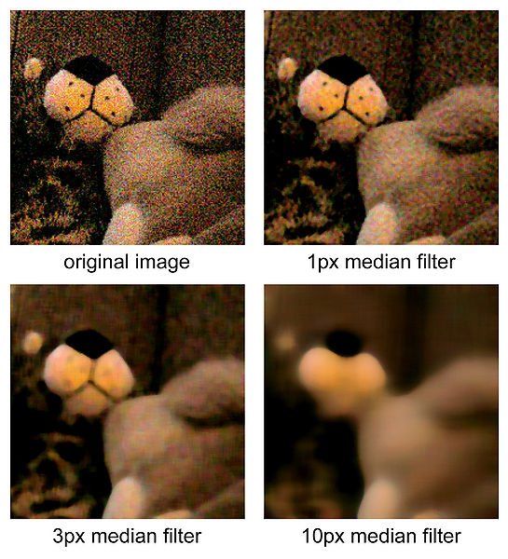
median filter
removes noise but preserves edges better than box or gaussian blur
algorithm: replace center of each nxn (n odd) windows by median pixel value in that window

Slide 5


bilateral filter
bilateral: gaussian blur modified to preserve edges; the gaussian weights are multiplied by an intensity factor. for more info check this link bilateral tutorial
not new
new
space weight
range weight
I

Slide 6
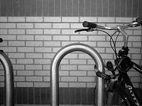
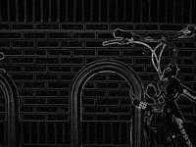
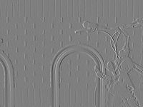
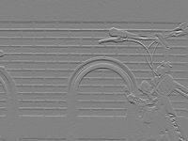
sobel operator
Improved edge detection:
Convolve with vertical and horizontal derivatives matrices
Compute final derivative:
(v_{x}² + v_{y}²)^{1/2} , where v_{x} and v_{y} are pixel values in in the two convolved images from step 1
-1 | 0 | 1
-2 | 0 | 2
-1 | 0 | 1
-1 | -2 | -1
0 | 0 | 0
1 | 2 | 1
original
sobel edges
derivates in horizontal and vertical directions

Slide 7


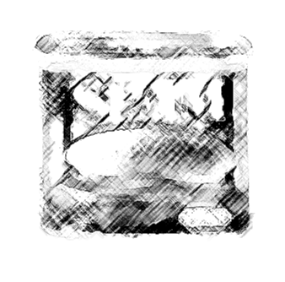
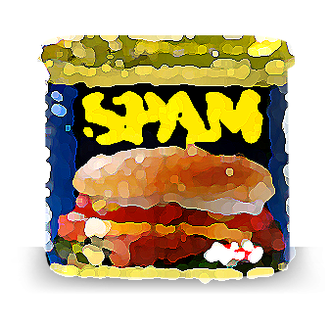
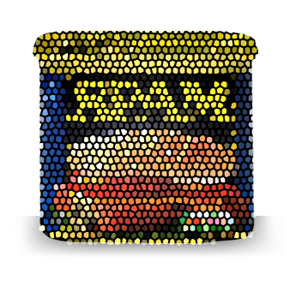
painterly filters
incorporates a range of techniques available in photoshop, gimp, etc.

