Slide 1
OpenGL Programming

Slide 2
Last time
Overview of pipeline
Lab:
Window set up
OpenGL state initialization
Callback functions

Slide 3
Window set up
OpenGL
(device independent)
hardware
GLUT
glutInitWindowSize(400, 400);
glutInit(&argc, argv);
glutInitDisplayMode(GLUT_DOUBLE | GLUT_RGB | GLUT_DEPTH);
glutCreateWindow(“My OPENGL APP");
buffers

Slide 4
Buffers
Front/back buffers
Depth buffer
Accumulation buffer
Stencil buffer
window width
window height

Slide 5
Buffers
Front/back buffers
pixel color:
RGBA or
indexed
displayed
drawing to
glutSwapBuffers()

Slide 6
Buffers
Front/back buffers
Depth buffer
pixel color:
RGBA or
indexed
distance from
projection plane
drawing to
depth

Slide 7
Buffers
Front/back buffers
Depth buffer
Accumulation buffer
Stencil buffer
more on these later

Slide 8
Last time
Overview of pipeline
Lab:
Window set up
OpenGL state initialization
Callback functions

Slide 9
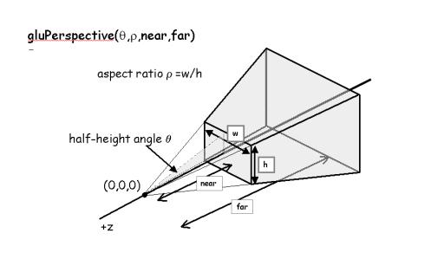
OpenGL state initialization
view volume/projection mode

Slide 10
OpenGL state initialization
view volume/projection mode
glClearColor (0,0,0,0)
background color (RGBA)

Slide 11
OpenGL state initialization
view volume/projection mode
glClearColor (0,0,0,0)
glEnable(GL_DEPTH_TEST)
sets up hidden surface removal

Slide 12
OpenGL state initialization
view volume/projection mode
glClearColor (0,0,0,0)
glEnable(GL_DEPTH_TEST)
more to come

Slide 13
Last time
Overview of pipeline
Lab:
Window set up
OpenGL state initialization
Callback functions

Slide 14
Call back functions
display
render scene
glClear(GL_COLOR_BUFFER_BIT | GL_DEPTH_BUFFER_BIT);
clear buffers
glMatrixMode(GL_MODELVIEW_MATRIX);
glLoadIdentity();
initalize modelview matrix
gluLookAt(0,0,0, 0,0,-1,0,1,1);
initalize viewpoint
draw scene

Slide 15
Call back functions
display
reshape
idle
mouse
keyboard
motion

Slide 16
Today
Lighting
Camera

