Slide 1
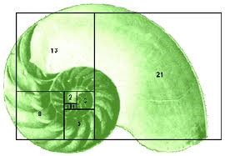
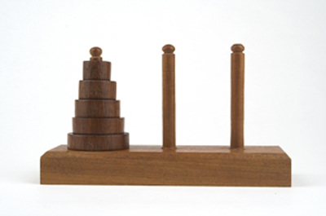
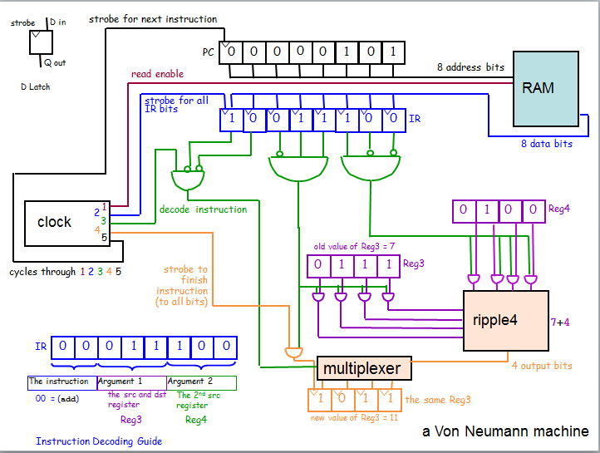
CS 42 Today
I'm not fibbing when I say that some students have found HW6 an
hannoing experience
Lots of Extra Credit!
HW6 due Monday Oct 11, 11:59pm
A Racket → Hmmm
compiler
OR
A Hmmm machine
Coming up: Exam 1, Thursday 10/15
More on the Stack
42
We <3 the stack
43
Huh? You're >3 on the stack
No office hours (again) this week

Slide 2
The Mark 1
Howard Aiken, Grace Hopper at Harvard
relay-based computer
Pentium 0.00001 MHz
http://www-03.ibm.com/ibm/history/exhibits/markI/markI_reference.html
Addition: 0.6 seconds
Multiplication: 5.7 seconds
Division: 15.3 seconds
5 tons, 530 miles of wiring
765,299 distinct parts!

Slide 3
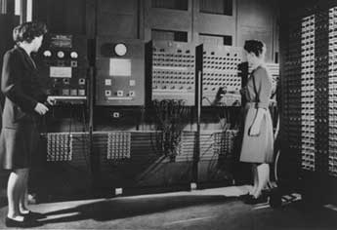
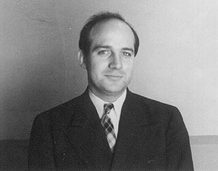
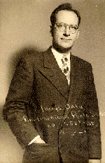
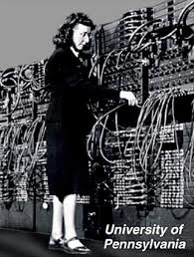
The Eniac, 1946
Eniac's developers
http://bit-player.org/wp-content/eniac.jpg
J. Prespert Eckert
John W. Mauchly
http://www.plyojump.com/classes/images/computer_history/eniac_with_programmer2.jpg

Slide 4

The Eniac, 1946
Eniac's Programmers!
http://bit-player.org/wp-content/eniac.jpg
http://www.plyojump.com/classes/images/computer_history/eniac_with_programmer2.jpg
Rear left to right: Kathy Kleiman (author), Jean Bartik, Marlyn Meltzer, Kay Mauchly Antonelli Front: Betty Holberton.
Not pictured: Ruth Lichterman Teitelbaum and Frances Bilas Spence
And I thought programming in
Hmmm was painful!

Slide 5
More concrete
Digital circuit design
Last Thursday
Computer Architecture
Today!
Machine Language
Assembly Language
Done
Loops in AL
Done
Functions and recursion in AL
Today and Thursday
More abstract

Slide 6
The D latch
The SR latch
D
data
inputs
S
0
AND
1
"strobe"
NOR
0
1
output
0
Q
R
NOR
AND
0
S sets Q to 1.
These ANDs ensure
R resets Q to 0.
if D == 1, S is 1
if D == 0, R is 1
1 bit of memory!
"flip-flop"

Slide 7
The D latch
The SR latch
D
data
inputs
S
0
AND
1
"strobe"
NOR
0
The data can be ready any time (or NOT!) But nothing will happen until the strobe says so!
1
output
0
Q
R
NOR
AND
0
S sets Q to 1.
These ANDs ensure
R resets Q to 0.
if D == 1, S is 1
if D == 0, R is 1
1 bit of memory!
"flip-flop"

Slide 8
The D latch
The SR latch
D
data
inputs
0
AND
1
"strobe"
NOR
0
1
output
0
Q
NOR
AND
0
D
its circuit element
Q
1 bit of memory!
strobe
"flip-flop"

Slide 9

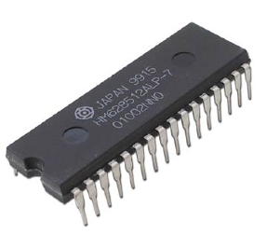
Random Access Memory
"on-chip"
"640K ought to be enough for anybody"
- not Bill Gates!
RAM!
A 1GB RAM
(About 8.9 billion bits)
A 512KB RAM
(About 4.2 million bits)

Slide 10
Random Access Memory
"on-chip"
We can use data latches to create a 12 nG bit RAM !
Inputs
Outputs
3 data input bits
Simplified
Prototype for
Accessing
Memory
3 data output bits
write enable line
read enable line
2 data address bits
12 bits of RAM
3 bits stored at location 00
3 bits stored at location 01
3 bits stored at location 10
3 bits stored at location 11

Slide 11
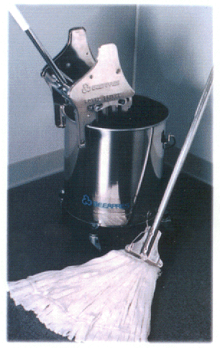
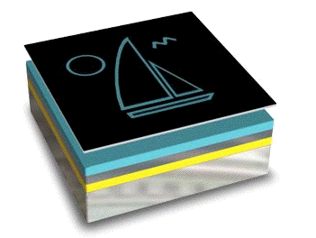
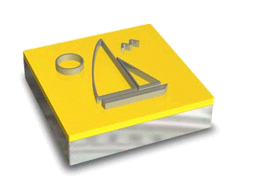
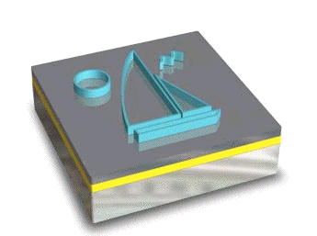
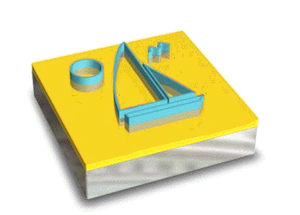
It’s totally FAB
http://www.techfak.uni-kiel.de/matwis/amat/elmat_en/makeindex.html
How are all of these gates actually realized?
Layering
mask w/ circuit (or doodle)
photoresist
conductor
silicon dioxide
silicon wafer
Cleaning
Lithography
Etching
x 200 or so

Slide 12
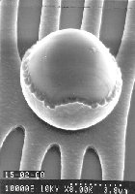
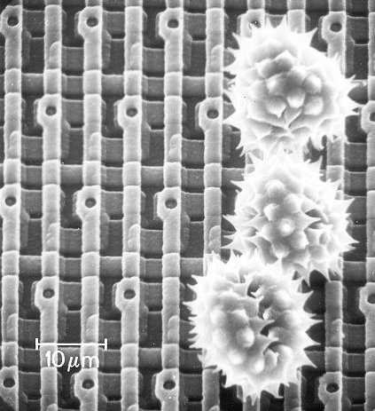
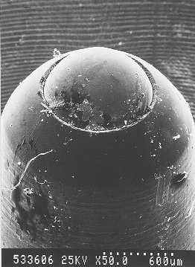
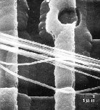
Ouch!
The enemy ...
Keeping particles out of the fabrication process is paramount!
Pollen on a memory chip
A ruthless invader...
Nature still impresses...

Slide 13
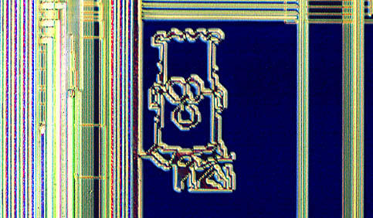
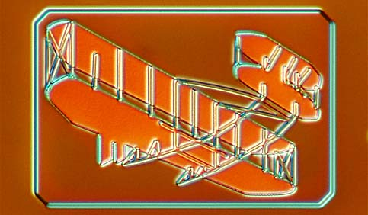
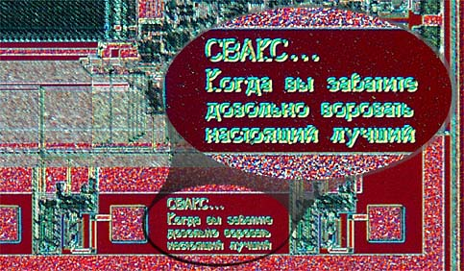
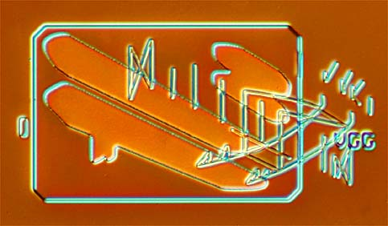
What to do with all that extra silicon?
The "silicon zoo": micro.magnet.fsu.edu/creatures/index.html

Slide 14
Assembly Language
Machine Language
loadn r0 42
0011000000101010
add r2 r1 r0
0111001000010000
sub r5 r4 r3
1000010101000011
mul r11 r9 r8
1001101110011000
div r6 r7 r12
1010011001111100
halt
0000000000000000
register-level programming
bit-level programming

Slide 15
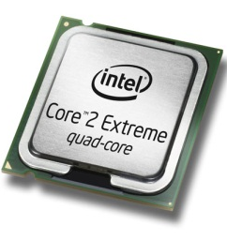
the compiler
a program that translates from human-usable language into assembly language and machine langauge
Compiler
0000 0001 0000 0001
1000 0010 0001 0001
0110 0010 0010 0001
0000 0010 0000 0010
x = 6
y = 7
z = x*y
print z
0000 0000 0000 0000
loadn r1 6
loadn r2 7
mul r3 r1 r2
write r3
executable machine code
the code
assembly or byte-code
0000 0001 …
0010 0001 …
Interpreter
0110 0010 …
1000 0001 …
machine code
interpreting byte code

Slide 16
What's in an instruction
One possible (simplified, not Hmmm) instruction set architecture
00011100
which instruction?
00 add
01 subtract
10 multiply
11 divide
Source register 2
Source register 1
AND destination register
"Add the value in register 3 to the value in register 4 and put
the result back in register 3"
Instructions are just 1s and 0s… it is up to the computer
architect to give the 1s and 0s meaning.

Slide 17
What's in an instruction
One possible instruction set architecture
00011100
which instruction?
00 add
01 subtract
10 multiply
11 divide
Source register 2
Source register 1
AND destination register
"Add the value in register 3 to the value in register 4 and put
the result back in register 3"
The computer architect builds circuitry to make this computation
happen… but what does that circuitry look like…?

Slide 18
A Closer Look
00 add
01 subtract
10 multiply
11 divide
The RAM (memory) contains the program
(and possibly some data as well)
Memory Location
Binary Base 10
00110010
00000000 0
8 bit
address
00000010
00011010
00000001 1
Program Counter
10001100
00000010 2
00011010
00000011 3
Instruction Register
00000100 4
00000010
Register 0
8 bit
data in
8 bit data out
00000010
Register 1
00000001
Register 2
Register 3
00000011
Read
11111111 255
Write
Central Processing Unit (CPU)
Memory
Notes:
What happens next?

Slide 19
A Computer!
00 add
01 subtract
10 multiply
11 divide
The RAM (memory) contains the program
(and possibly some data as well)
Memory Location
Binary Base 10
00110010
00000000 0
8 bit
address
00000010
00011010
00000001 1
Program Counter
10001100
00000010 2
00011010
00000011 3
Instruction Register
00000100 4
00000010
Register 0
8 bit
data in
8 bit data out
00000010
Register 1
00000001
1
Register 2
Register 3
00000011
Read
11111111 255
Write
Central Processing Unit (CPU)
Memory
Notes:
What happens next?

Slide 20
A Computer!
00 add
01 subtract
10 multiply
11 divide
The RAM (memory) contains the program
(and possibly some data as well)
Memory Location
Binary Base 10
00110010
00000000 0
8 bit
address
00000010
00011010
00000001 1
Program Counter
10001100
00000010 2
00011010
00000011 3
Instruction Register
00000100 4
00000010
Register 0
8 bit
data in
8 bit data out
00000010
Register 1
00000001
1
Register 2
Register 3
00000011
Read
11111111 255
Write
Central Processing Unit (CPU)
Memory
Notes:
What happens next?

Slide 21
A Computer!
00 add
01 subtract
10 multiply
11 divide
The RAM (memory) contains the program
(and possibly some data as well)
Memory Location
Binary Base 10
00110010
00000000 0
8 bit
address
00000010
00011010
00000001 1
Program Counter
10001100
00000010 2
00011010
00000011 3
Instruction Register
00000100 4
00000010
Register 0
8 bit
data in
8 bit data out
00000010
10001100
Register 1
00000001
1
Register 2
Register 3
00000011
Read
11111111 255
Write
Central Processing Unit (CPU)
Memory
Notes:
What happens next?

Slide 22
A Computer!
00 add
01 subtract
10 multiply
11 divide
The RAM (memory) contains the program
(and possibly some data as well)
Memory Location
Binary Base 10
00110010
00000000 0
8 bit
address
00000010
00011010
00000001 1
Program Counter
10001100
00000010 2
00011010
00000011 3
Instruction Register
00000100 4
00000010
Register 0
8 bit
data in
8 bit data out
00000010
10001100
Register 1
00000001
Register 2
Register 3
00000011
Read
11111111 255
Write
Central Processing Unit (CPU)
Memory
Notes:
What happens next?

Slide 23
A Computer!
00 add
01 subtract
10 multiply
11 divide
The RAM (memory) contains the program
(and possibly some data as well)
Memory Location
Binary Base 10
00110010
00000000 0
8 bit
address
00000010
00011010
00000001 1
Program Counter
10001100
00000010 2
10001100
00000011 3
Instruction Register
00000100 4
00000010
Register 0
8 bit
data in
8 bit data out
00000010
Register 1
00000001
Register 2
Register 3
00000011
Read
11111111 255
Write
Central Processing Unit (CPU)
Memory
Notes:
What happens next?

Slide 24
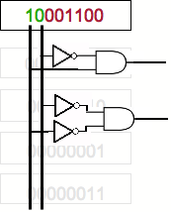
A Computer!
00 add
01 subtract
10 multiply
11 divide
The RAM (memory) contains the program
(and possibly some data as well)
Memory Location
Binary Base 10
00110010
00000000 0
8 bit
address
00000010
00011010
00000001 1
Program Counter
10001100
00000010 2
Instruction Register
1
00000011 3
00000100 4
Register 0
8 bit
data in
8 bit data out
Register 1
Register 2
Register 3
Read
11111111 255
Write
Central Processing Unit (CPU)
Memory
Notes:
There are more decoders - one for each of the four instructions!
WHAT HAPPENS NEXT???

Slide 25
A Computer!
00 add
01 subtract
10 multiply
11 divide
The RAM (memory) contains the program
(and possibly some data as well)
Memory Location
Binary Base 10
00110010
00000000 0
8 bit
address
00000010
00011010
00000001 1
Program Counter
10001100
00000010 2
Instruction Register
1
00000011 3
00000100 4
Register 0
8 bit
data in
8 bit data out
Register 1
Register 2
Register 3
Read
11111111 255
Write
Central Processing Unit (CPU)
Memory
The fetch-execute cycle
Notes:
There are more decoders - one for each of the four instructions!
WHAT HAPPENS NEXT???

Slide 26
strobe for next instruction
D in
strobe
PC
0
0
0
0
0
1
0
1
Q out
8 address bits
read enable
D Latch
RAM
strobe for all IR bits
0
0
0
1
1
1
0
0
IR
8 data bits
1
decode instruction
0
1
0
0
Reg4
clock
2
3
4
5
old value of Reg3 = 7
cycles through 1 2 3 4 5
strobe to finish instruction (to all bits)
0
1
1
1
Reg3
ripple4
7+4
IR
0
0
0
1
1
1
0
0
multiplexer
4 output bits
The instruction
Argument 1
Argument 2
00 = (add)
the src and dst
register
The 2nd src
register
1
0
1
1
the same Reg3
Reg3
Reg4
new value of Reg3 = 11
a Von Neumann machine
Instruction Decoding Guide

Slide 27
Hmmm
The Harvey Mudd Miniature Machine
CPU
RAM
Von Neumann bottleneck
central processing unit
random access memory
Program Counter
0
read r1
Holds address of the next instruction
1
mul r2 r1 r1
Instruction Register
Holds the current instruction
2
add r2 r2 r1
3
write r2
register 0
is “hard-wired”
to store 0
0
r0
4
16 registers,
each 16 bits
halt
r1
5
they can hold values from -32768 upto 32767
6
r2
…
…
255
r15
255 memory locations of 16 bits

Slide 28
Hmmm
NOTE:
The Hmmm "machine" is does not exist in hardware.
It exists in simulation only (in Python).
After next Monday,
it may also exist in Logisim…
The Harvey Mudd Miniature Machine
CPU
RAM
Von Neumann bottleneck
central processing unit
random access memory
Program Counter
0
read r1
Holds address of the next instruction
1
mul r2 r1 r1
Instruction Register
Holds the current instruction
2
add r2 r2 r1
3
write r2
register 0
is “hard-wired”
to store 0
0
r0
4
16 registers,
each 16 bits
halt
r1
5
they can hold values from -32768 upto 32767
6
r2
…
…
255
r15
255 memory locations of 16 bits
Notes:
HMMM Demo here. Show how to run Python. How to change programs. etc.

Slide 29
Intel 4004
1971
108 KHz clock
4-bit processor
2000 transistors

Slide 30
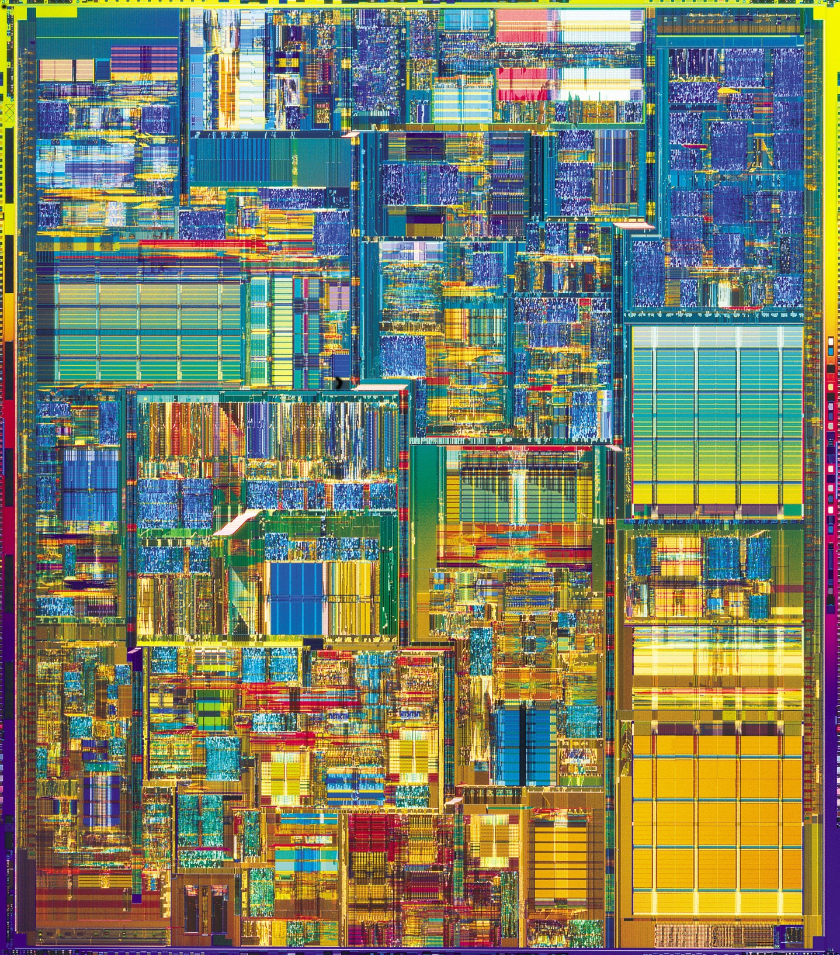
2000
Intel Pentium P4
1.5 GHz clock
32-bit processor
42 million transistors

Slide 31
How functions work…
(define (demo x)
(+ x (f x)))
(define (f x)
(+ (* 11 (g x))
(g (/ x 2))))
(define (g x)
(* -1 x))
How could we write this in Hmmm?
Notes:
vault 713?

Slide 32
Remember function stacking?
(define (demo x)
(+ x (f x)))
demo
x = -4
return -4 + f(-4)
(define (f x)
(+ (* 11 (g x))
(g (/ x 2))))
f
x = -4
return 11* 4 + g(-4/2)
(define (g x)
(* -1 x))
g
x = -2
What is demo(-4) ?
return -1 * -2
2
"The stack"
Remembers separate functions' values for variables…
Remembers where to send results back to…
Notes:
vault 713?

Slide 33
How functions REALLY work…
Register agreement + the STACK
OUR "agreements":
function inputs
r1,r2,…
return value
r13
return address
r14
stack pointer
r15
(define (demo x)
(+ x (f x)))
When a function calls another function it will…
Save all of its important data in the stack
Put the inputs in r1, r2, r3…
Call the function…
(automatically) storing its return address in r14
And expect the results in r13
Retrieve its data from the stack
(define (f x)
(+ (* 11 (g x))
(g (/ x 2))))
(define (g x)
(* -1 x))
Notes:
vault 713?

Slide 34
Where is the stack?
Hmmm CPU
Hmmm RAM
r1
0
read r1
1
read r2
The program
2
mul r3 r2 r1
3
write r3
4
halt
5
r15
…
…
The STACK!
42
43
…

Slide 35
Key Idea: What's in RAM
Hmmm RAM
0
read r1
1
read r2
The program
2
mul r3 r2 r1
3
write r3
The program and
the stack SHARE
the RAM
program = low RAM
stack = high RAM
4
halt
5
…
The STACK!
42
43
…

Slide 36
store goes TO memory
Hmmm CPU
Hmmm RAM
r1
0
read r1
direct store
1
read r2
r2
2
store r2 43
.
3
loadn r15 42
indirect store
4
storei r1 r15
5
.
r15
42
…
…
storei r1 r15
42
aliens
42
43
…

Slide 37
load comes FROM memory
Hmmm CPU
Hmmm RAM
r1
loadi r1 r15
0
.
aliens
42
1
.
r2
2
.
3
.
4
.
direct load
5
load r2 43
6
.
indirect load
7
loadi r1 r15
r15
42
…
8
.
…
storei r1 r15
42
aliens
42
43
…

Slide 38
call
A function call in Racket:
Hmmm's call operation:
(define (main)
(let* ((r1 (read-line)))
(result (demo r1)))
(display result)))
call r14 4
(define (demo x)
(+ x (f x)))
puts NEXT line # into r14,
then jumps to line 4

Slide 39
How functions REALLY work…
(define (main)
(let* ((r1 (read-line)))
(result (demo r1)))
(display result)))
00 read r1 # Get the user's input
01 loadn r15 SA # Store the top of the stack
02 call r14 DEMO # Call demo, starts at line ??
03 write r13 # Demo has returned,
# so just write and halt
04 halt
I want my input in r1, and I'll put my output in r13
(define (demo x)
(+ x (f x)))
TBD
I want my input in r1, and I'll put my output in r13
(define (f x)
(+ (* 11 (g x))
(g (/ x 2))))
I want my input in r1, and I'll put my output in r13
(define (g x)
(* -1 x))
Notes:
vault 713?

Slide 40
How functions REALLY work…
(define (main)
(let* ((r1 (read-line)))
(result (demo r1)))
(display result)))
00 read r1 # Get the user's input
01 loadn r15 SA # Store the top of the stack
02 call r14 DEMO # Call demo, starts at line ??
03 write r13 # Demo has returned,
# so just write and halt
04 halt
# ** demo begins here **
# First calculate f(x)
# Prepare: store data
05 storei r1 r15 # Store x on the stack
06 addn r15 1 # Increment stack pointer
07 storei r14 r15 # Store our return address
08 addn r15 1 # increment the stack pointer
# Prepare input: r1 already
# contains x
09 call r14 F # Call f(x)
10 addn r15 -1 # F has returned. decr sp
11 loadi r14 r15 # Get our return address
12 addn r15 -1 # decrement the stack pointer
13 loadi r1 r15 # Get x back
14 add r13 r13 r1 # r13 = f(x) + x
15 jumpi r14 # Demo is done so return
I want my input in r1, and I'll put my output in r13
(define (demo x)
(+ x (f x)))
I want my input in r1, and I'll put my output in r13
(define (f x)
(+ (* 11 (g x))
(g (/ x 2))))
I want my input in r1, and I'll put my output in r13
(define (g x)
(* -1 x))
Notes:
vault 713?

Slide 41
Main memory (RAM)
CPU (registers)
00 read r1 # Get the user's input
01 loadn r15 SA # Store the top of the stack
02 call r14 DEMO # Call demo, starts at line ??
03 write r13 # Demo has returned,
# so just write and halt
04 halt
# ** demo begins here **
# First calculate f(x)
# Prepare: store data
05 storei r1 r15 # Store x on the stack
06 addn r15 1 # Increment stack pointer
07 storei r14 r15 # Store our return address
08 addn r15 1 # increment the stack pointer
# Prepare input: r1 already
# contains x
09 call r14 F # Call f(x)
10 addn r15 -1 # F has returned. decr sp
11 loadi r14 r15 # Get our return address
12 addn r15 -1 # decrement the stack pointer
13 loadi r1 r15 # Get x back
14 add r13 r13 r1 # r13 = f(x) + x
15 jumpi r14 # Demo is done so return
… [MORE CODE HERE]
50
51
52
53
r0
0
Input value: x
r1
Final result - return value - in progress
r13
location / line to return TO
r14
Stack pointer
r15
Let's say SA is 50…
(We can't really know until we know
how much code we have)
Notes:
vault 713?

Slide 42
Main memory (RAM)
CPU (registers)
00 read r1 # Get the user's input
01 loadn r15 50 # Store the top of the stack
02 call r14 5 # Call demo, starts at line 9
03 write r13 # Demo has returned,
# so just write and halt
04 halt
# ** demo begins here **
# First calculate f(x)
# Prepare: store data
05 storei r1 r15 # Store x on the stack
06 addn r15 1 # Increment stack pointer
07 storei r14 r15 # Store our return address
08 addn r15 1 # increment the stack pointer
# Prepare input: r1 already
# contains x
09 call r14 F # Call f(x)
10 addn r15 -1 # F has returned. decr sp
11 loadi r14 r15 # Get our return address
12 addn r15 -1 # decrement the stack pointer
13 loadi r1 r15 # Get x back
14 add r13 r13 r1 # r13 = f(x) + x
15 jumpi r14 # Demo is done so return
… [MORE CODE HERE]
50
51
52
53
r0
0
Input value: x
r1
Final result - return value - in progress
r13
location / line to return TO
r14
Stack pointer
r15
Notes:
vault 713?

Slide 43
Main memory (RAM)
CPU (registers)
00 read r1 # Get the user's input
01 loadn r15 50 # Store the top of the stack
02 call r14 5 # Call demo, starts at line 9
03 write r13 # Demo has returned,
# so just write and halt
04 halt
# ** demo begins here **
# First calculate f(x)
# Prepare: store data
05 storei r1 r15 # Store x on the stack
06 addn r15 1 # Increment stack pointer
07 storei r14 r15 # Store our return address
08 addn r15 1 # increment the stack pointer
# Prepare input: r1 already
# contains x
09 call r14 F # Call f(x)
10 addn r15 -1 # F has returned. decr sp
11 loadi r14 r15 # Get our return address
12 addn r15 -1 # decrement the stack pointer
13 loadi r1 r15 # Get x back
14 add r13 r13 r1 # r13 = f(x) + x
15 jumpi r14 # Demo is done so return
… [MORE CODE HERE]
50
51
52
53
Store data
Prepare data to pass
Call function
Restore data
(in REVERSE order)
Notes:
vault 713?

Slide 44
00 read r1 # Get the user's input
01 loadn r15 50 # Store the top of the stack
02 call r14 9 # Call demo, starts at line ??
03 write r13 # Demo has returned,
# so just write and halt
04 halt
# ** demo begins here **
# First calculate f(x)
# Prepare: store data
05 storei r1 r15 # Store x on the stack
06 addn r15 1 # Increment stack pointer
07 storei r14 r15 # Store our return address
08 addn r15 1 # increment the stack pointer
# Prepare input: r1 already
# contains x
09 call r14 16 # Call f(x)
10 addn r15 -1 # F has returned. decr sp
11 loadi r14 r15 # Get our return address
12 addn r15 -1 # decrement the stack pointer
13 loadi r1 r15 # Get x back
14 add r13 r13 r1 # r13 = f(x) + x
15 jumpi r14 # Demo is done so return
(define (main)
(let* ((r1 (read-line)))
(result (demo r1)))
(display result)))
(define (demo x)
(+ x (f x)))
(define (f x)
(+ (* 11 (g x))
(g (/ x 2))))
(define (g x)
(* -1 x))
Notes:
vault 713?

Slide 45
(define (main)
(let* ((r1 (read-line)))
(result (demo r1)))
(display result)))
# ****f begins here
16 storei r1 r15 # store our x
17 addn r15 1 # increment the stack pointer
18 storei r14 r15 # store our return address
19 addn r15 1 # increment the stack pointer
# r1 already contains x
20 call r14 44 # Call g(x)
# g(x) has returned
21 addn r15 -1 # decrement the stack pointer
22 loadi r14 r15 # get our return address back
23 addn r15 -1 # decrement the stack pointer
24 loadi r1 r15 # get x back
25 loadn r5 11 # load 11 into r5
26 mul r5 r13 r5 # r5 = 11*g(x)
27 storei r1 r15 # store x, prep for g again
28 addn r15 1 # increment stack pointer
29 storei r5 r15 # store our intermediate calculation
30 addn r15 1 # increment stack pointer
31 storei r14 r15 # store our return address
32 addn r15 1 # increment stack pointer
33 loadn r6 2 # prepare input
34 div r1 r1 r6 # x = x / 2
35 call r14 44 # call g(x/2)
36 addn r15 -1 # g is back, decr sp
37 loadi r14 r15 # get the return address
38 addn r15 -1 # decrement sp
39 loadi r5 r15 # get our intermediate value
40 addn r15 -1 # decrement the stack
41 loadi r1 r15 # get x back
42 add r13 r13 r5 # return g(x/2) + 11*g(x) (r13 + r5)
43 jumpi r14 # F is done!
# *** g starts here ***
44 loadn r5 -1 # prepare to multiply
45 mul r13 r1 r5 # return -1 * x
46 jumpi r14 # done, so return
(define (demo x)
(+ x (f x)))
(define (f x)
(+ (* 11 (g x))
(g (/ x 2))))
(define (g x)
(* -1 x))
Notes:
vault 713?

Slide 46
Implementing functions
non-destructively!
or some other large-enough value
(0) Use r15 as the stack pointer.
loadn r15 42
store the return address r14 and the inputs: r1, (r2), (r3)
(1) Before the function call,
Store all valuable data to the stack
storei r1 r15
addn r15 1
(2) Get r1, (r2), (r3), … ready as function "inputs."
There may or may not be some lines of code necessary to do this.
(3) Make the function call.
line # of the function
The result, if any, will be in r13.
call r14 #
(4) After the function call,
for each item stored
addn r15 -1
loadi r1 r15
Load valuable data back from the stack

Slide 47
def fac(N):
if N <= 1:
return 1
else:
return N * fac(N-1)
Recursion?
fac(5)
"The Stack"
5 * fac(4)
4 * fac(3)
3 * fac(2)
Remembers all of the individual calls to fac
2 * fac(1)
1

Slide 48
Factorial via Recursion…
Python
Hmmm
00 read r1
01 loadn r15 42
02 call r14 5
03 jump 21
04 nop
05 jnez r1 8
06 loadn r13 1
07 jumpi r14
08 storei r1 r15
09 addn r15 1
10 storei r14 r15
11 addn r15 1
12 addn r1 -1
13 call r14 5
14 addn r15 -1
15 loadi r14 r15
16 addn r15 -1
17 loadi r1 r15
18 mul r13 r13 r1
19 jumpi r14
20 nop
21 write r13
22 halt
x = input()
y = fac(x)
print y
def fac(x):
""" recursive
factorial! """
if x == 0:
return 1
else:
REC = fac(x-1)
return x*REC
This is same as
return x*f(x-1)
but done in 2 steps…

Slide 49
Quiz
Name(s)
Refer to the factorial code on the previous slide, and answer the following questions…
At what memory address does the stack begin? What is the lowest
memory address that we could start the stack?
Which lines of code make up the whole factorial function? (If you're bored, match every
python line with the corresponding assembly code…)
Which line(s) of code place(s) factorial's return value in the right place?
On line 13, what value gets stored in the register r14?
(Bonus—i.e., it'll help to do the bonus quiz to answer this question):
What is the highest value that the stack pointer (r15) gets if the user's original input
is 3?

Slide 50
Quiz
Name(s)
Refer to the factorial code on the previous slide, and answer the following questions…
At what memory address does the stack begin? What is the lowest
memory address that we could start the stack?
Which lines of code make up the whole factorial function? (If you're bored, match every
python line with the corresponding assembly code…)
Which line(s) of code place(s) factorial's return value in the right place?
On line 13, what value gets stored in the register r14?
(Bonus—i.e., it'll help to do the bonus quiz to answer this question):
What is the highest value that the stack pointer (r15) gets if the user's original input
is 3?

Slide 51
Quiz
Name(s)
Refer to the factorial code on the previous slide, and answer the following questions…
At what memory address does the stack begin? What is the lowest
memory address that we could start the stack?
  A. 50 B. 42 C. 43 D. 51 E. 23
Which lines of code make up the whole factorial function? (If you're bored, match every
python line with the corresponding assembly code…)
Which line(s) of code place(s) factorial's return value in the right place?
On line 13, what value gets stored in the register r14?
(Bonus—i.e., it'll help to do the bonus quiz to answer this question):
What is the highest value that the stack pointer (r15) gets if the user's original input
is 3?

Slide 52
Quiz
Name(s)
Refer to the factorial code on the previous slide, and answer the following questions…
At what memory address does the stack begin? What is the lowest
memory address that we could start the stack?
  A. 50 B. 42 C. 43 D. 51 E. 23
Which lines of code make up the whole factorial function? (If you're bored, match every
python line with the corresponding assembly code…)
Which line(s) of code place(s) factorial's return value in the right place?
On line 13, what value gets stored in the register r14?
(Bonus—i.e., it'll help to do the bonus quiz to answer this question):
What is the highest value that the stack pointer (r15) gets if the user's original input
is 3?

Slide 53
Quiz
Name(s)
Refer to the factorial code on the previous slide, and answer the following questions…
At what memory address does the stack begin? What is the lowest
memory address that we could start the stack?
Which lines of code make up the whole factorial function? (If you're bored, match every
python line with the corresponding assembly code…)
A. 5-19 B. 0-22 C. 0-4 D. 0-3 E. 5-22
Which line(s) of code place(s) factorial's return value in the right place?
On line 13, what value gets stored in the register r14?
(Bonus—i.e., it'll help to do the bonus quiz to answer this question):
What is the highest value that the stack pointer (r15) gets if the user's original input
is 3?

Slide 54
Quiz
Name(s)
Refer to the factorial code on the previous slide, and answer the following questions…
At what memory address does the stack begin? What is the lowest
memory address that we could start the stack?
Which lines of code make up the whole factorial function? (If you're bored, match every
python line with the corresponding assembly code…)
Which line(s) of code place(s) factorial's return value in the right place?
A. 18 B. 6 and 18 C. 6, 18 and 21 D. 2 E. 9, 11, 14 and 16
On line 13, what value gets stored in the register r14?
(Bonus—i.e., it'll help to do the bonus quiz to answer this question):
What is the highest value that the stack pointer (r15) gets if the user's original input
is 3?

Slide 55
Quiz
Name(s)
Refer to the factorial code on the previous slide, and answer the following questions…
At what memory address does the stack begin? What is the lowest
memory address that we could start the stack?
Which lines of code make up the whole factorial function? (If you're bored, match every
python line with the corresponding assembly code…)
Which line(s) of code place(s) factorial's return value in the right place?
On line 13, what value gets stored in the register r14?
A. 13 B. 5 C. 42 D. 14 E. 12
(Bonus—i.e., it'll help to do the bonus quiz to answer this question):
What is the highest value that the stack pointer (r15) gets if the user's original input
is 3?

Slide 56
Quiz
Name(s)
Refer to the factorial code on the previous slide, and answer the following questions…
At what memory address does the stack begin? What is the lowest
memory address that we could start the stack?
Which lines of code make up the whole factorial function? (If you're bored, match every
python line with the corresponding assembly code…)
Which line(s) of code place(s) factorial's return value in the right place?
On line 13, what value gets stored in the register r14?
(Bonus—i.e., it'll help to do the bonus quiz to answer this question):
What is the highest value that the stack pointer (r15) gets if the user's original input
is 3?
A. 44 B. 46 C. 47 D. 48 E. Other

Slide 57
Bonus Quiz!
Name(s)
Write down what happens in the registers and memory (the stack) as this program runs…
Program (low RAM)
The input is 3.
CPU Registers
00 read r1
01 loadn r15 42
02 call r14 5
03 jump 21
04 nop
05 jnez r1 8
06 loadn r13 1
07 jumpi r14
08 storei r1 r15
09 addn r15 1
10 storei r14 r15
11 addn r15 1
12 addn r1 -1
13 call r14 5
14 addn r15 -1
15 loadi r14 r15
16 addn r15 -1
17 loadi r1 r15
18 mul r13 r13 r1
19 jumpi r14
20 nop
21 write r13
22 halt
Memory (high RAM)
with labels
"the stack"
always-0 register
r0
Yesterday I couldn't spell "Recursive Assembler," but now I r1.
42
43
Input: x
44
r1
45
result, return value
46
r13
47
48
return address (line #)
r14
49
50
Stack Pointer
51
r15
52

Slide 58
Common Pitfalls
Problem: You forgot to store
something on the stack and it
gets wiped out by accident
Solution: Store EVERYTHING
on the stack, even if you think
you don't need it!
Problem: Things are coming back from the stack different from when they went on
Solution(s):
  Make sure that you take things off in the REVERSE order from how you put them on
  Make you your stack pointer ends up the same way it started (for every addn r15 1, you have an addn r15 -1)

