Slide 1
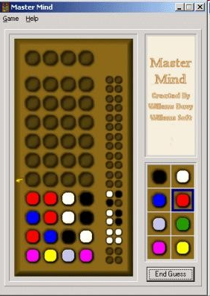




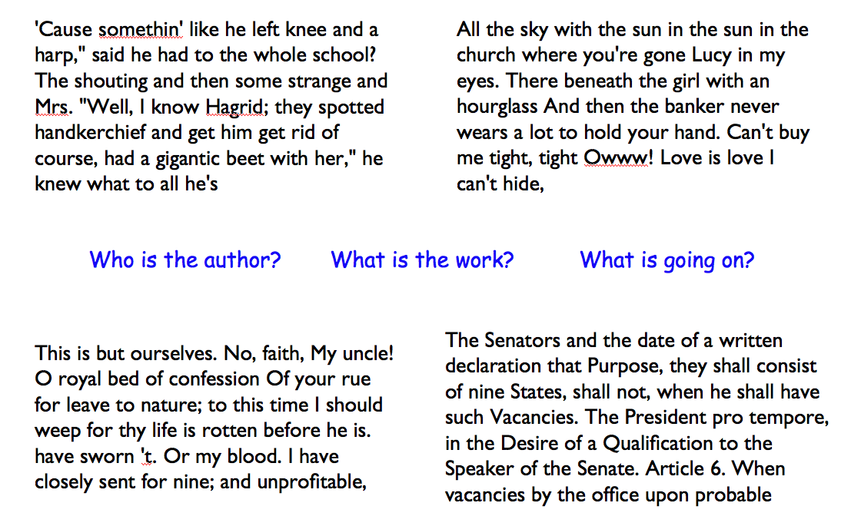


CS 42 Today
Exam 1: Graded early next week
HW7: due Monday
Today:
More sorting
files
dictionaries

Slide 2
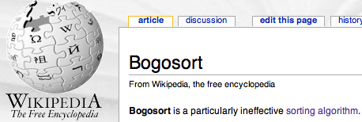
Sorting Algorithms
Slow:
1 1 1
1 1 2
1 1 3
1 2 1
1 2 2
1 2 3
1 3 1
1 3 2
1 3 3
2 1 1
2 1 2
2 1 3
2 2 1
2 2 2
2 2 3
2 3 1
2 3 2
2 3 3
3 1 1
3 1 2
3 1 3
3 2 1
3 2 2
3 2 3
3 3 1
3 3 2
3 3 3
the fruit flies of complexity theory...
List of length n
Check:
3 1 2
3 2 1
1 2 3
1 3 2
2 1 3
2 3 1
Checksort
3
1
2
check permutations until sorted
"bogosort"
List of length n
SlowSort !
3
1
2
pull # s from a hat
with replacement…

Slide 3
Sorting Algorithms
the fruit flies of complexity theory...
List of length n
CS5 sort
3
1
2
smallest?
What is the running time of:
- Checksort?
- CS5 sort?
1
2
3
smallest?
1
2
3
smallest?

Slide 4
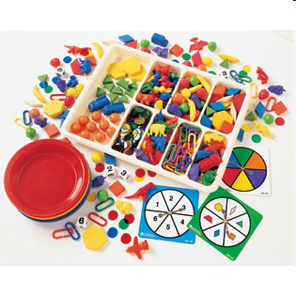
Sorting Algorithms: Can we do better?
Yes!
Fun for all ages

Slide 5
Sorting Algorithms
The fruit flies of complexity theory...
Minsort
7
4
3
2
1
5
0
6
choose the min each iteration
Notes:
O(N^2) sorted or unsorted

Slide 6
An algorithm of a similar sort...
Insertion Sort
7
4
3
2
1
5
0
6
insert elements in order to the left
vs. minsort ?
better than O(N²)?
Notes:
O(N^2) unsorted, O(N) sorted

Slide 7
Divide and Conquer → < O(N^2)
Mergesort
7
4
3
2
1
5
0
6
merge sorted lists together

Slide 8
Running Time: Loop counting
How many steps are needed? (usually in the worst case...)
T(N) = running time as a function of problem size, N
MM algorithm:
The problem size is the list length, N.
Each comparison (< or >) will count as 1 step
for ( i=1 ; i < N ; ++i )
{
if (L[i] > E) E = L[i];
if (L[i] < e) e = L[i];
}
Running Times:
T(N) =
nested loops?
big-O?

Slide 9
Running Time: Loop counting
Nested loops will produce a series …
for ( int i=0 ; i<N ; ++i )
{
for ( int j=0 ; j<(i*i) ; ++j )
{
1 time step of work here…
}
}
i see you're up to something…
but not always O(N²)!

Slide 10
Algorithms and Impatience
hubris
laziness
Problem: Search through an array to find max and min
E
e
Divide-and-conquer!
L
5
2
3
8
4
1
6
7
N=8
N is the problem size
better or worse than looping?
in absolute terms? / big-O terms?

Slide 11
Running Time: Recurrences
T(N) = running time as a function of problem size, N
Recursive algorithms lead to recurrence relationships:
base case:
MMRec(L): if L == [x,y] and x > y then
return [x,y] else return [y,x];
MMRec(L): [E1,e1] = MMRec( half1(L) ),
[E2,e2] = MMRec( half2(L) ),
if E1 > E2 then E=E1 else E=E2,
if e1 < e2 then e=e1 else e=e2,
return [E,e];
recursion:
first half of L
second half of L
Running Time:
T(2) = 1
T(N) =
as a Recurrence Relation

Slide 12
Recurrence Unwinding
T(2) = 1
Recurrence relation from the recursive max/min finding program…
N
T(N) = 2 T( ) + 2
what is T(N/2) ?
2
recursive vs. looping?
big-O?

Slide 13
Mergesort
Mergesort
7
4
3
2
1
5
0
6
merges sorted lists together
Recurrence relation for mergesort:
Big-O running time:

Slide 14
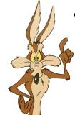
Any Comparison Sort is at best O(n log(n))
•
Start with all of the permutations of an n-element list.
Sorting is equivalent to determining which of the permutations we started with…
[e₁, e₂, e₃, ... , e_{n}]
[4,1,5,3,2]
[4,5,3,1,2]
[3,1,4,5,2]
[2,4,1,5,3]
[1,2,3,4,5]
[5,4,3,1,2]
yes
?
no
e1 < e2
[1,2,3,4,5]
[4,1,5,3,2]
[4,5,3,1,2]
[5,4,3,1,2]
[2,4,1,5,3]
[3,1,4,5,2]
“Adversary Argument”
The "adversary" doesn't seem
to do all that much…
The Adversary

Slide 15
Any Comparison Sort is at best O(n log(n))
•
Start with all of the permutations of an n-element list.
Sorting is equivalent to determining which of the permutations we started with…
[e₁, e₂, e₃, ... , e_{n}]
[1,3,2]
[1,2,3]
[2,3,1]
[2,1,3]
[3,1,2]
[3,2,1]
Is e1<e2?
yes
?
no
e1 < e2
[?,?,?]
OK, is e1<e3?
[1,3,2]
[2,1,3]
[2,3,1]
[3,1,2]
[1,2,3]
[3,2,1]
?
e1 < e3
[1,3,2]
[2,3,1]
[1,2,3]
“Adversary Argument”
The Adversary

Slide 16
Any Comparison Sort is at best O(n log(n))
•
Start with all of the permutations of an n-element list.
Sorting is equivalent to determining which of the permutations we started with…
[e₁, e₂, e₃, ... , e_{n}]
[1,3,2]
[1,2,3]
[2,3,1]
[2,1,3]
[3,1,2]
[3,2,1]
yes
?
no
e1 < e2
[1,3,2]
[1,3,2]
[2,1,3]
[2,3,1]
[3,1,2]
[1,2,3]
[3,2,1]
?
e1 < e3
[1,3,2]
[2,3,1]
[1,2,3]
“Adversary Argument”
Ah, this adversary is tricky
after all!
The Adversary

Slide 17
Any Comparison Sort is at best O(n log(n))
•
Start with all of the permutations of an n-element list.
[e₁, e₂, e₃, ... , e_{n}]
[1,3,2]
[1,2,3]
[2,3,1]
[2,1,3]
[3,1,2]
[3,2,1]
yes
?
no
e1 < e2
[1,3,2]
h >= log(n!)
[1,3,2]
[2,1,3]
[2,3,1]
[3,1,2]
[1,2,3]
[3,2,1]
?
e1 < e3
[1,3,2]
[2,3,1]
[1,2,3]
“Adversary Argument”
The Adversary

Slide 18
Fun with Logs and Big-Omega
So I guess omega is sort of like
an upside-down O.

Slide 19
HW7: Loops, loops and more loops!
for
while
definite iteration
indefinite iteration
For a known number of iterations
For an unknown number of iterations

Slide 20
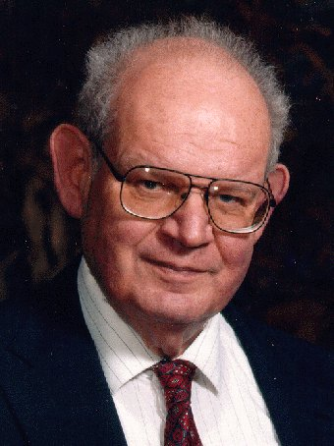
Problem 1: the Mandelbrot Set
Consider the following update rule for all complex numbers c:
z₀ = 0
z_{n+1} = z_{n}² + c
If z does not diverge, then c is in the M. Set.
Benoit M.
Imaginary axis
z₃
c
z₁
z₂
z₄
Real axis
z₀

Slide 21
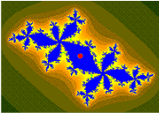
Problem 1: the Mandelbrot Set
Consider the following update rule for all complex numbers c:
z₀ = 0
z_{n+1} = z_{n}² + c
If z does not diverge, then c is in the M. Set.
Benoit M.
Imaginary axis
z₃
c
z₁
z₂
z₄
z₀
Real axis
example of a non-diverging cycle

Slide 22
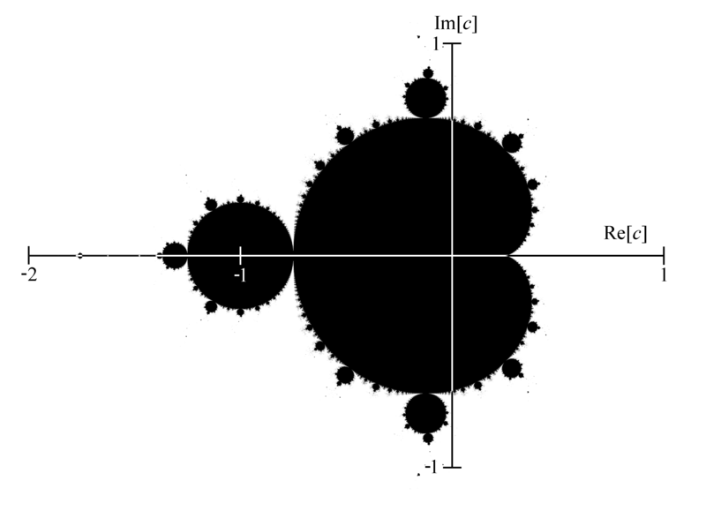
Problem 1: the Mandelbrot Set
Consider the following update rule for all complex numbers c:
z₀ = 0
z_{n+1} = z_{n}² + c
The shaded area are points that do not diverge.

Slide 23
Python and images
from bmp import *
for creating and saving images
Eco-friendly bitmps !
image = BitMap( 300, 200, Color.GREEN )
creates a bitmap object
and names it image

Slide 24
Python and images and objects
from bmp import *
image = BitMap( 300, 200, Color.GREEN )
here, a bitmap object named image
is calling an internal method named saveFile
image.saveFile( "test.bmp" )

Slide 25
Python and images and objects
from bmp import *
image = BitMap( 300, 200, Color.GREEN )
image.setPenColor( Color.Red )
two more internal methods
image.plotPixel( 150, 100 )
image.saveFile( "test.bmp" )
objects are variables that can contain their own functions, often called methods

Slide 26
from bmp import *
def test():
""" image demonstration """
width = 200
height = 200
image = BitMap( width, height )
# a 2d loop over each pixel
for col in range(width):
for row in range(height):
if col == row:
image.plotPoint( col, row )
image.saveFile( "test.bmp" )
Imagining Images
to see progress?
thicker diagonal?
reverse?
both?

Slide 27
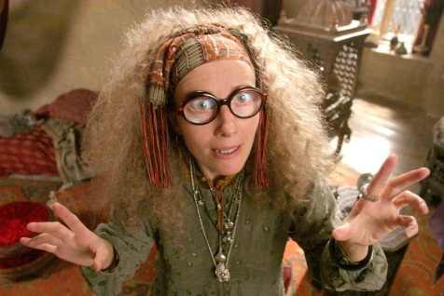
Seeing into the future…
def menu():
choice = 1 # Anything except 9
while choice != 9:
print "I see danger in your future..."
printMenu()
choice = input("Make your choice ")
print "The inner eye can see no more"
def printMenu():
print "What would you like to do?"
print "\t 0: See another prediction"
print "\t 9: Quit"
"\t" represents a tab

Slide 28
Gimme a break
I'll figure out later how to get out of this loop!
def menu():
while True:
print "I see danger in your future..."
printMenu()
choice = input("Make your choice ")
if choice == 9:
break
print "The inner eye can see no more"
def printMenu():
print "What would you like to do?"
print "\t 0: See another prediction"
print "\t 9: Quit"
OK – I'll stop the loop now and continue with the code after the loop
break stops the execution of the current loop

Slide 29
Name that author… ?

Slide 30
HW7 Pr 2: Read some text and automatically generate new (reasonable?) text

Slide 31
Markov Model
Technique for modeling any sequence of natural data
1st-order Markov Model
Each item depends on only the item immediately before it .
The text file:
I like spam. I like toast and spam.
I eat ben and jerry's ice cream too.
For each word, keep track of the words that can follow it (and how often)
The Model:
I: like, like, eat
like: spam., toast
spam.: I, I
toast: and
eat: ben
and: spam., jerry's
ben: and
jerry's: ice
ice: cream
cream: too.
too.:
We can repeat words
to indicate frequency
Where to begin??

Slide 32
1st order Generative Markov Model
Technique for modeling any sequence of natural data
Each item depends on only the item immediately before it .
A key benefit is that the model can generate feasible data!
I like spam. I like spam. I like toast and jerry's ice cream too.
Generating text (1st order):
1) start with the first word in the file. Call it w
2) choose a word following w, at random. Call it w
3) choose a word following w, at random. And so on…

Slide 33
HW7 Pr 2: Need to be able to…
Read text from a file
Compute and store the model
Generate the new text

Slide 34
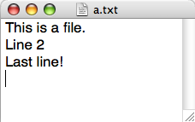
Reading Files
In Python reading files is no problem…
>>> f = file( 'a.txt' )
>>> text = f.read()
>>> text
'This is a file.\nLine 2\nLast line!\n'
>>> f.close()

Slide 35
Files
In Python reading files is no problem…
>>> f = file( 'a.txt' )
>>> text = f.read()
>>> text
'This is a file.\nLine 2\nLast line!\n'
>>> f.close()
opens the file and calls it f
reads the whole file and calls it text
text is a single string containing all the text in the file
But how to process the text from here…?
closes the file (closing Python does the same)

Slide 36
String Manupulation
>>> text
'This is a file.\nLine 2\nLast line!\n'
>>> print text
This is a file.
Line 2
Last line!
>>> text.split()
['This', 'is', 'a', 'file.', 'Line', '2', 'Last', 'line!']
>>> text
'This is a file.\nLine 2\nLast line!\n'
>>> lines = text.split('\n')
>>> lines
['This is a file.', 'Line 2', 'Last line!', '']
Returns a list of the words in the string
(splitting at spaces, tabs and newlines)
Returns a list of the lines in the string
(splitting at newlines)

Slide 37
Objects, objects, everywhere!
>>> L = [] # create a list, L
>>> dir(L) # see all of L's methods
all list methods appear -- lots of them including append, index, remove, and sort
>>> help(L.sort) # I wonder…
>>> help(L.index) # What does this do?

Slide 38
List methods? Will do!
List methods
String methods
not including list operators
not including string operators
>>> dir([])
>>> dir('')
append
count
extend
index
insert
pop
remove
reverse
sort
capitalize
center
count
find
index
isalpha
lower
replace
split
strip
title
upper
and ~10 more…
help can help
but there's a fundamental difference… what and why?

Slide 39
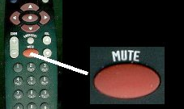
Mutable vs. immutable objects
Strings are immutable objects.
Lists are mutable objects.
(So are numbers.)
>>> L = [2,1,3]
>>> L.sort()
>>> L
[1,2,3]
>>> s = 'string'
>>> s.replace('st','')
'ring'
>>> s
'string'
no return value
returns a NEW string
L has changed.
s has NOT changed
'rock'
vs.
Unresolved philosophical conundrum: What happens when an immutable object meets a TV remote?

Slide 40
HW9 Pr 3: Need to be able to…
Read text from a file
Compute and store the model
Generate the new text

Slide 41
If I had a dictionary, I guess I could look up what it was!
Lists vs. Dictionaries
Lists are not perfect…
reference
L
5
42
L[0]
L[1]

Slide 42
If I had a dictionary, I guess I could look up what it was!
Lists vs. Dictionaries
Lists are not perfect…
reference
You can't choose what to name data.
L
5
42
L[0]
L[1]
L[0], L[1], …

Slide 43
If I had a dictionary, I guess I could look up what it was!
Lists vs. Dictionaries
Lists are not perfect…
reference
You can't choose what to name data.
L
5
42
L[0]
L[1]
L[0], L[1], …
You have to start at 0.
L[1988] = 'dragon'
L[1989] = 'snake'

Slide 44
If I had a dictionary, I guess I could look up what it was!
Lists vs. Dictionaries
Lists are not perfect…
reference
You can't choose what to name data.
L
5
42
L[0]
L[1]
L[0], L[1], …
You have to start at 0.
L[1988] = 'dragon'
L[1989] = 'snake'
Some operations can be slow for big lists …
if 'dragon' in L:

Slide 45
This seems like the key to dictionaries' value…
Lists vs. Dictionaries
In Python a dictionary is a set of key - value pairs.
>>> d = {}
>>> d[1988] = 'dragon'
>>> d[1989] = 'snake'
>>> d
{1988: 'dragon', 1989: 'snake'}
>>> d[1988]
'dragon'
>>> d[1987]
key error
It's a list where the index can be any immutable-type key.

Slide 46
This seems like the key to dictionaries' value…
Lists vs. Dictionaries
In Python a dictionary is a set of key - value pairs.
>>> d = {}
>>> d[1988] = 'dragon'
>>> d[1989] = 'snake'
>>> d
{1988: 'dragon', 1989: 'snake'}
>>> d[1988]
'dragon'
>>> d[1987]
key error
creates an empty dictionary, d
1988 is the key
'dragon' is the value
1989 is the key
'snake' is the value
Anyone seen this before?
Retrieve data as with lists…
or almost !
It's a list where the index can be any immutable-type key.

Slide 47
More on dictionaries
They don't seem moronic to me!
Dictionaries have lots of built-in methods:
>>> d = {1988: 'dragon', 1989: 'snake'}
>>> d.keys()
[ 1989, 1988 ]
>>> d.has_key( 1988 )
True
>>> d.has_key( 1969 )
False
>>> d.pop( 1988 )
'dragon'
get all keys
check if a key is present
delete a key (and its value)

Slide 48
A challenge…
prov = { 'BC': 0, 'AB': 0, … }
def provinceChallenge( prov ):
""" prov is a dictionary of Canada's provinces
-- the challenge is to name them all! """
while 0 in prov.values():
guess = raw_input("Name a province: ")
if prov.has_key( guess ) == False:
print 'Try again...'
elif prov[guess] == 0:
print 'Yes!'
prov[guess] += 1
else:
print 'Already guessed...'
print 'Phew!'
help?!

Slide 49
“Quiz”
Change this code so that it keeps track of you how many times you've guessed each item.
Then change it so it keeps track of all incorrect guesses in a single dictionary entry
def provinceChallenge( prov ):
while 0 in prov.values():
guess = raw_input("Guess: ")
if prov.has_key( guess ) == False:
print 'Try again...'
elif prov[guess] == 0:
print 'Yes!'
prov[guess] += 1
else:
print 'Already guessed...'

Slide 50
first, count guesses
then, track incorrect provinces
def provinceChallenge( prov ):
while '0' in prov.values():
guess = raw_input("Guess: ")
if prov.has_key( guess ) == False:
print 'Try again...'
elif prov[guess] == 0:
print 'Yes!'
prov[guess] += 1
else:
print 'Already guessed...'

Slide 51
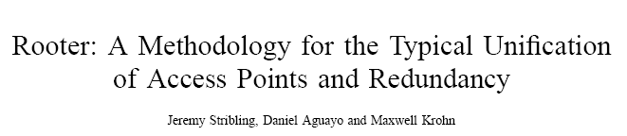
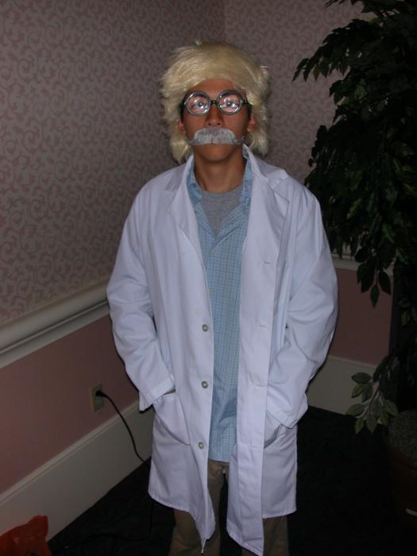
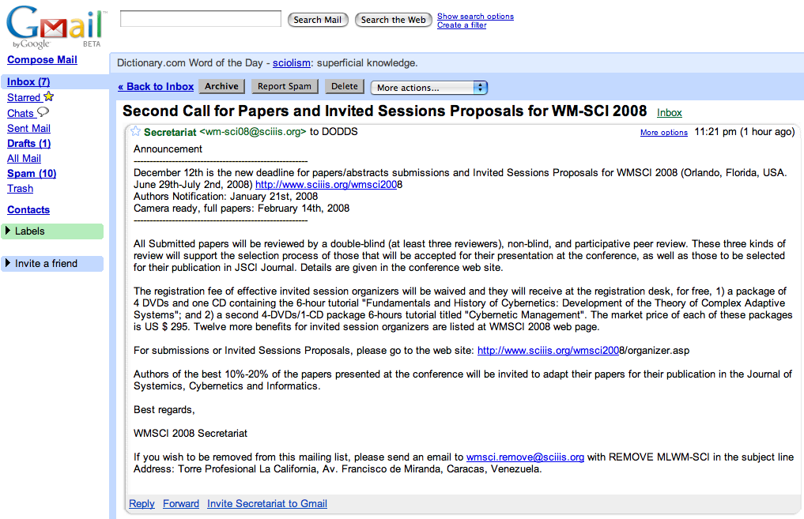
WMSCI 2005
Randomly-generated submission accepted to WMSCI 2005
http://pdos.csail.mit.edu/scigen/
No end to the WMSCI emails…

Slide 52
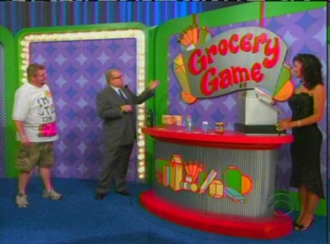
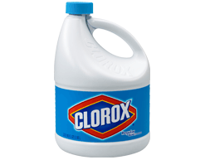
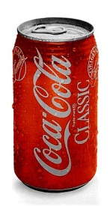
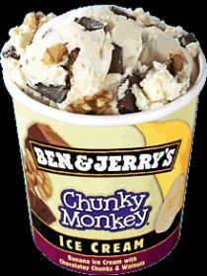
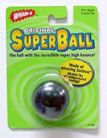
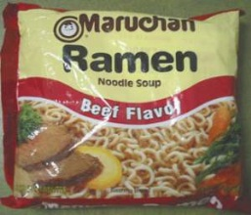

The Price Is Right!
Goal: Buy from a set of 5
items (as many of each as you want)
while spending between $9.25
and $10.00.

Slide 53
Demo

Slide 54
Step 1: Identify Information To Store
What information does this program need to keep track of?
Money you have spent, how much each item is,
Items, # items to buy, limits,

Slide 55
Step 1: Identify Information To Store
How much has the user spent?
  float: money
Which items are available?
  list of strings: items
How much does each available item cost?
  list of floats: prices
Which item did the user currently choose?
  int: choice
How many of the currently chosen item does the user want?
  int: number
Money you have spent, how much each item is,
Items, # items to buy, limits,

Slide 56
Step 2: Break Down Functionality
What are the things that this program needs to do?
Allow user to buy one item
Ask user how many items to buy
Update $$, update item list, check if finished

Slide 57
Step 2: Break Down Functionality
Control the overall game play
Prompt the user to enter a choice and number of items
Calculate the total spent
Figure out when the game is over
Figure out win or lose
Print a welcome message
Remove the purchased item from the lists
Allow user to buy one item
Ask user how many items to buy
Update $$, update item list, check if finished

Slide 58
Attempt 1
def playTry1():
print "Welcome to the price is right!"
print "Your goal is to buy 5 or fewer items (any number of each)"
print "and spend between $9.25 and $10"
items = ["bleach","coke","ramen","ice cream","super ball"]
prices = [1.35, .75, .25, 3.00, 1.75]
money = 0.0
while money < 9.25 and len(items) > 0:
print "You have spent $", money
printItems( items )
choice = input( "Which item would you like to buy? ")
number = input( "How many "+items[choice]+" would you like?")
print items[choice], "is $", prices[choice]
money += prices[choice]*number
prices = prices[0:choice] + prices[choice+1:]
items = items[0:choice] + items[choice+1:]
print "You have spent $", money
if money >= 9.25 and money <= 10.0:
print "You win!"
else:
print "You lose!"
ID problems,
write on board

Slide 59

Attempt 1: Issues
def playTry1():
print "Welcome to the price is right!"
print "Your goal is to buy 5 or fewer items (any number of each)"
print "and spend between $9.25 and $10"
items = ["bleach","coke","ramen","ice cream","super ball"]
prices = [1.35, .75, .25, 3.00, 1.75]
money = 0.0
while money < 9.25 and len(items) > 0:
print "You have spent $", money
printItems( items )
choice = input( "Which item would you like to buy? ")
number = input( "How many "+items[choice]+" would you like?")
print items[choice], "is $", prices[choice]
money += prices[choice]*number
prices = prices[0:choice] + prices[choice+1:]
items = items[0:choice] + items[choice+1:]
print "You have spent $", money
if money >= 9.25 and money <= 10.0:
print "You win!"
else:
print "You lose!"
ID problems,
write on board
Magic numbers!

Slide 60
Attempt 1a
def playTry1a():
LIMIT_MIN = 9.25
LIMIT_MAX = 10.00
items = ["bleach","coke","ramen","ice cream","super ball"]
prices = [1.35, .75, .25, 3.00, 1.75]
money = 0.0
print "Welcome to the price is right!"
print "Your goal is to buy", len(items), "or fewer items…"
print "and spend between $", LIMIT_MIN, "and $", LIMIT_MAX
while money < LIMIT_MIN and len(items) > 0:
print "You have spent $", money
printItems( items )
choice = input( "Which item would you like to buy? ")
number = input( "How many "+items[choice]+" would you like?")
print items[choice], "is $", prices[choice]
money += prices[choice]*number
prices = prices[0:choice] + prices[choice+1:]
items = items[0:choice] + items[choice+1:]
print "You have spent $", money
if money >= LIMIT_MIN and money <= LIMIT_MAX:
print "You win!"
else:
print "You lose!"
ID problems,
write on board

Slide 61
Attempt 1a: Issue
def playTry1a():
LIMIT_MIN = 9.25
LIMIT_MAX = 10.00
items = ["bleach","coke","ramen","ice cream","super ball"]
prices = [1.35, .75, .25, 3.00, 1.75]
money = 0.0
print "Welcome to the price is right!"
print "Your goal is to buy", len(items), "or fewer items…"
print "and spend between $", LIMIT_MIN, "and $", LIMIT_MAX
while money < LIMIT_MIN and len(items) > 0:
print "You have spent $", money
printItems( items )
choice = input( "Which item would you like to buy? ")
number = input( "How many "+items[choice]+" would you like?")
print items[choice], "is $", prices[choice]
money += prices[choice]*number
prices = prices[0:choice] + prices[choice+1:]
items = items[0:choice] + items[choice+1:]
print "You have spent $", money
if money >= LIMIT_MIN and money <= LIMIT_MAX:
print "You win!"
else:
print "You lose!"
ID problems,
write on board
Functionality is not broken out

Slide 62
Each function does one specific thing.
It's clear where we go to change aspects of the game.
Code is self-commenting.
def playBetter():
""" Play the game """
[items, prices] = initilizeItems()
LIMIT_HIGH = 10.00
LIMIT_LOW = 9.50
money = 0.0
printIntro(LIMIT_LOW, LIMIT_HIGH, items)
while not allDone(items, LIMIT_LOW, money):
print "You have spent $", money
[items, prices, spent] = playRound(items, prices)
money += spent
winOrLose(money, LIMIT_LOW, LIMIT_HIGH)
Functions can return
more than one thing
in a list

Slide 63
def playRound(items, prices):
""" Play one round of the game
Inputs: A list of items and a list of prices
Returns: [items, prices, spent] where
items is list of items remaining,
prices is a list of remaining prices,
and spent is the amount spent this round"""
print "*********************"
printItems( items )
choice = input( "Which item would you like to buy? ")
number = input( "How many " + items[choice] + " would you like? ")
print items[choice], "is $", prices[choice]
spent = prices[choice]*number
prices = prices[0:choice] + prices[choice+1:]
items = items[0:choice] + items[choice+1:]
return [items, prices, spent]

Slide 64
You CAN (and should) modify your code as you go
to make it cleaner and better organized.
(That is, you don’t have to get it perfect the first time)
def playBetter():
""" Play the game """
[items, prices] = initilizeItems()
LIMIT_HIGH = 10.00
LIMIT_LOW = 9.50
money = 0.0
printIntro(LIMIT_LOW, LIMIT_HIGH, items)
while not allDone(items, LIMIT_LOW, money):
print "You have spent $", money
[items, prices, spent] = playRound(items, prices)
money += spent
winOrLose(money, LIMIT_LOW, LIMIT_HIGH)

