Slide 1
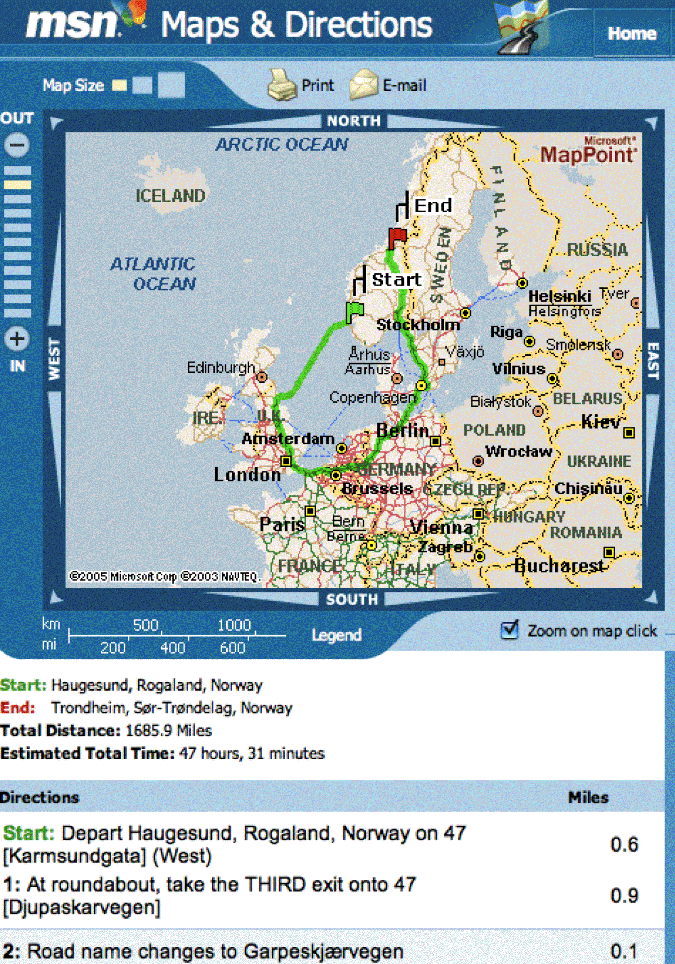
CS 42 Today
I wish this were a Stack!
the Queue ADT
back
front
Queue
for finding the shortest path…
…
08 storei r1 r15
09 addn r15 1
10 storei r14 r15
11 addn r15 1
12 addn r1 -1
13 call r14 5
14 addn r15 -1
15 loadi r14 r15
16 addn r15 -1
17 loadi r1 r15
…
A new look at
the HMMM stack
Hw #8: a better direction finder!
Yet another attempt to AI-ify a perfectly reasonable endeavor!

Slide 2
CS Exam 1
Nice job!!
If you didn't do as well as you hoped, please come talk to me about
strategies for improving on exam 2.

Slide 3
CS Exam 1: Humor
Two atoms are walking down the street when one says, "I've lost an electron!"
The other one turns and asks, "Are you sure?" The first one replies,
"I'm positive!"
Why is Python so lazy? It's written in IDLE! ☺
moo = oom = o(o(m)) = o(m) = m
(define (joke L)
(map (lambda (e) (* e (foldl + 0 L))) L))
O(funny) = O(fun^2y) = O(fuy n^2). We ignore coefficients, so
O(funny) = O(n^2)

Slide 4
CS Exam 1: Poetry
When push comes to pop
the stack point saves the day!
Racket looks like spam.
There once was a coder from Mudd.
But the Racket he wrote was a dud.
He tried to send spam
but it got out of hand—
Stack pointers—no leak, 'twas a flood!
Racket is stack pointer
Spam, because is was(?)
recursion too much.
The stack pointer is sad
No one uses him 'cuz they
use tail recursion

Slide 5
CS Exam 1: Dr. Racket in Hmmm
Define New Hmmm instruction: from x import y
01 from internet import Dr. Racket # gets Dr. Racket from the net
First implement Dr. Racket in Racket. Then compile to Hmmm.
In one line of code:
00 run_drracket #run drracket
In my modified Hmmm instruction set, the instruction run_drracket takes
the place of the add instruction and runs the dr racket programming env.
00 nop # This implements Dr. Racket
01 halt # but does not output the calculation to the screen. In fact, it
# optimizes Dr. Racket to be O(1)!

Slide 6
Divide and Conquer → < O(N^2)
Mergesort
7
4
3
2
1
5
0
6
merge sorted lists together

Slide 7
Running Time: Loop counting
How many steps are needed? (usually in the worst case...)
T(N) = running time as a function of problem size, N
MM algorithm:
The problem size is the list length, N.
Each comparison (< or >) will count as 1 step
for ( i=1 ; i < N ; ++i )
{
if (L[i] > E) E = L[i];
if (L[i] < e) e = L[i];
}
Running Times:
T(N) =
A. N B. 2N C. N^2 D. None of these
nested loops?
big-O?
Notes:
Clicker here.

Slide 8
Running Time: Loop counting
Nested loops will produce a series …
for ( int i=0 ; i<N ; ++i )
{
for ( int j=0 ; j<(i*i) ; ++j )
{
1 time step of work here…
}
}
i see you're up to something…
O(N) =
A. N B. 2N C. N^2 D. None of these

Slide 9
Algorithms and Impatience
hubris
laziness
Problem: Search through an array to find max and min
E
e
Divide-and-conquer!
L
5
2
3
8
4
1
6
7
N=8
N is the problem size
better or worse than looping?
in absolute terms? / big-O terms?

Slide 10
Running Time: Recurrences
T(N) = running time as a function of problem size, N
Recursive algorithms lead to recurrence relationships:
base case:
MMRec(L): if L == [x,y] and x > y then
return [x,y] else return [y,x];
MMRec(L): [E1,e1] = MMRec( half1(L) ),
[E2,e2] = MMRec( half2(L) ),
if E1 > E2 then E=E1 else E=E2,
if e1 < e2 then e=e1 else e=e2,
return [E,e];
recursion:
first half of L
second half of L
Running Time:
T(2) = 1
T(N) =
as a Recurrence Relation

Slide 11
Recurrence Unwinding
T(2) = 1
Recurrence relation from the recursive max/min finding program…
N
T(N) = 2 T( ) + 2
what is T(N/2) ?
2
recursive vs. looping?
big-O?

Slide 12
Mergesort
Mergesort
7
4
3
2
1
5
0
6
merges sorted lists together
Recurrence relation for mergesort:
T(2) = 1; T(N) = T(N/2) + N
T(2) = 1; T(N) = 2T(N/2) + 1
T(2) = N; T(N) = 4T(N/4) + N
T(2) = 1; T(N) = 2T(N/2) + N
T(2) = 1; T(N) = T(N) + N
Big-O running time:

Slide 13
Mergesort
Mergesort
7
4
3
2
1
5
0
6
merges sorted lists together
Recurrence relation for mergesort:
Big-O running time:

Slide 14
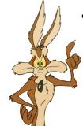
Any Comparison Sort is at best O(n log(n))
•
Start with all of the permutations of an n-element list.
Sorting is equivalent to determining which of the permutations we started with…
[e₁, e₂, e₃, ... , e_{n}]
[4,1,5,3,2]
[4,5,3,1,2]
[3,1,4,5,2]
[2,4,1,5,3]
[1,2,3,4,5]
[5,4,3,1,2]
yes
?
no
e1 < e2
[1,2,3,4,5]
[4,1,5,3,2]
[4,5,3,1,2]
[5,4,3,1,2]
[2,4,1,5,3]
[3,1,4,5,2]
“Adversary Argument”
The "adversary" doesn't seem
to do all that much…
The Adversary

Slide 15
Any Comparison Sort is at best O(n log(n))
•
Start with all of the permutations of an n-element list.
Sorting is equivalent to determining which of the permutations we started with…
[e₁, e₂, e₃, ... , e_{n}]
[1,3,2]
[1,2,3]
[2,3,1]
[2,1,3]
[3,1,2]
[3,2,1]
Is e1<e2?
yes
?
no
e1 < e2
[?,?,?]
OK, is e1<e3?
[1,3,2]
[2,1,3]
[2,3,1]
[3,1,2]
[1,2,3]
[3,2,1]
?
e1 < e3
[1,3,2]
[2,3,1]
[1,2,3]
“Adversary Argument”
The Adversary

Slide 16
Any Comparison Sort is at best O(n log(n))
•
Start with all of the permutations of an n-element list.
Sorting is equivalent to determining which of the permutations we started with…
[e₁, e₂, e₃, ... , e_{n}]
[1,3,2]
[1,2,3]
[2,3,1]
[2,1,3]
[3,1,2]
[3,2,1]
yes
?
no
e1 < e2
[1,3,2]
[1,3,2]
[2,1,3]
[2,3,1]
[3,1,2]
[1,2,3]
[3,2,1]
?
e1 < e3
[1,3,2]
[2,3,1]
[1,2,3]
“Adversary Argument”
Ah, this adversary is tricky
after all!
The Adversary

Slide 17
Any Comparison Sort is at best O(n log(n))
•
Start with all of the permutations of an n-element list.
[e₁, e₂, e₃, ... , e_{n}]
[1,3,2]
[1,2,3]
[2,3,1]
[2,1,3]
[3,1,2]
[3,2,1]
yes
?
no
e1 < e2
[1,3,2]
h >= log(n!)
[1,3,2]
[2,1,3]
[2,3,1]
[3,1,2]
[1,2,3]
[3,2,1]
?
e1 < e3
[1,3,2]
[2,3,1]
[1,2,3]
“Adversary Argument”
The Adversary

Slide 18
Fun with Logs and Big-Omega
So I guess omega is sort of like
an upside-down O.

Slide 19
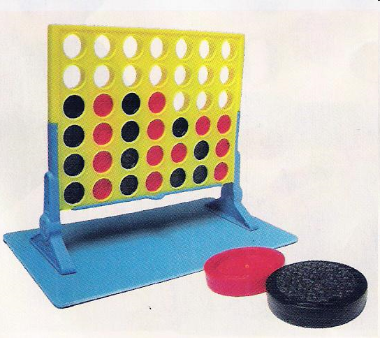
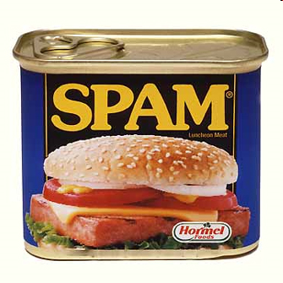
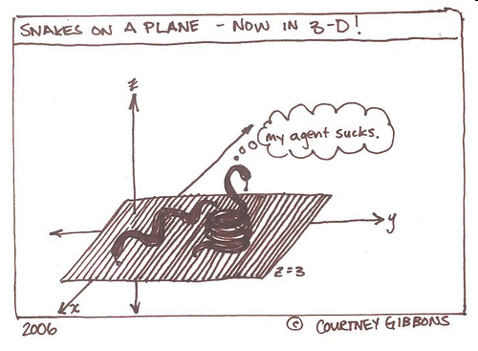
Objects, Objects Everywhere
Spam!
Connect 4!
Spam lists? Not going to cut it.
Geometric Objects!
And much more…

Slide 20

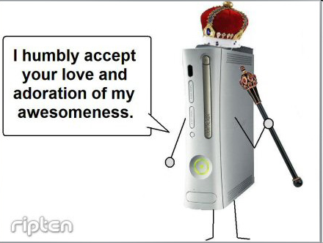
OOP: Where Data is King

Slide 21
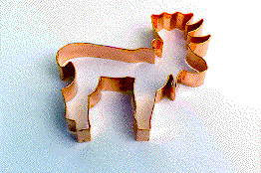

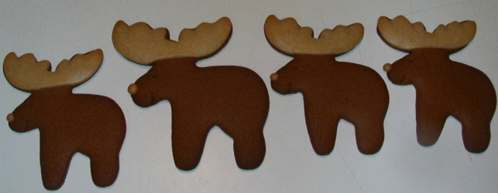
User-Defined Classes & Objects
A user-defined object is a data structure where:
(1) Its data elements have names chosen by the programmer.
(2) Data elements are chosen & organized by the programmer
(3) An object can have behaviors built-in by the programmer.
usually called "methods"
(1) A class is a type of variable.
(2) An object (instance) is one such variable.
There will typically be MANY objects of a single class.

Slide 22
Python is Object Oriented
Objects are Python's abstraction for data. All data in a Python program is represented by objects or by relations between objects. (In a sense, and in conformance to Von Neumann's model of a ``stored program computer,'' code is also represented by objects.)
--Python Reference Manual
Some are mutable, e.g.
Others are not, e.g.
list
dictionary
user-defined classes
string
tuple
numbers
bool
Consequences?

Slide 23
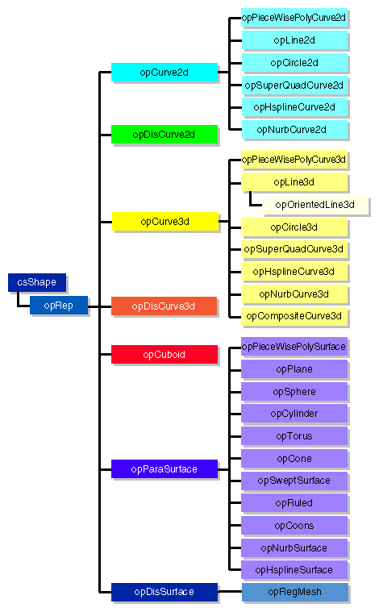
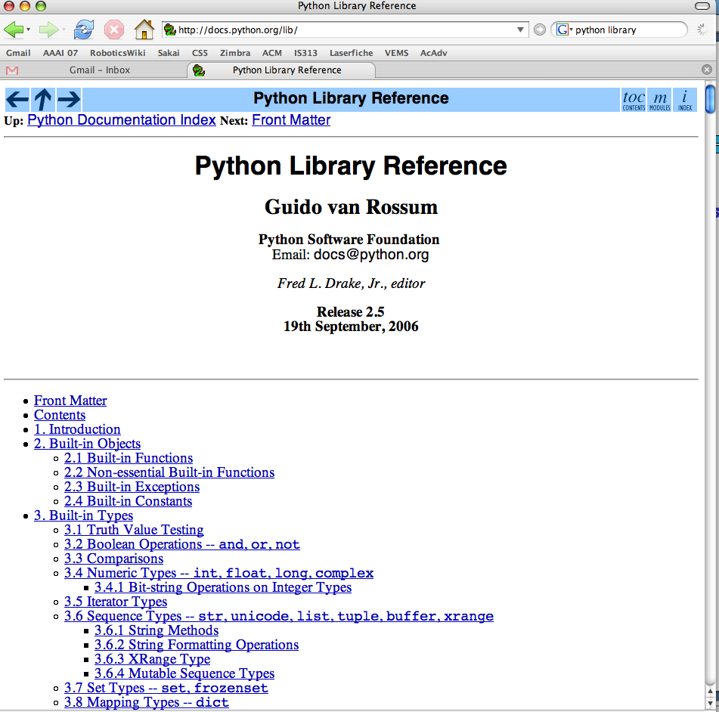
Examples…
Graphics libraries
Python's class libraries…
Do reference libraries have library references?
http://docs.python.org/lib/

Slide 24
Using objects and classes:
A particularly complex example…
>>> z = 3 + 4j
>>> dir(z)
all of the data members and methods of the complex class (and thus the object z !)
>>> z.imag
4.0
>>> z.conjugate()
3-4j
a data member of all objects of class complex
its value for this object, z
a method (function) within all objects of class complex
its return value for this object, z

Slide 25
The Point of Python: defining objects and classes

Slide 26
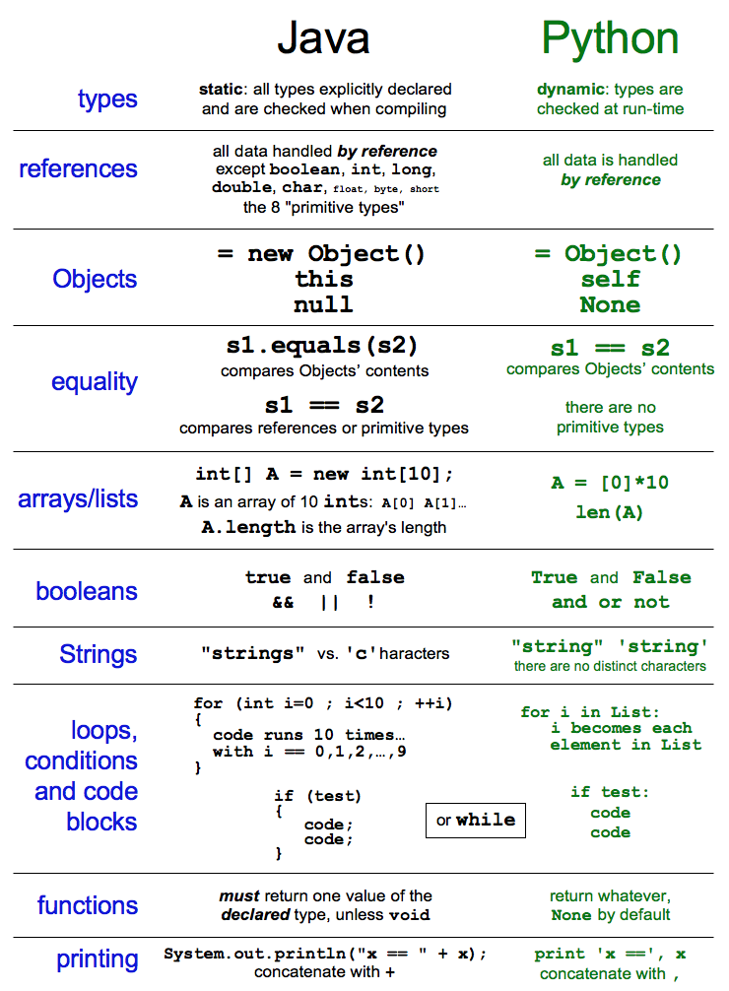
The Point of Python: defining objects and classes
syntax and idiosyncrasies
memory model and management
stack
Any more stack and I'm in a heap of trouble!
heap

Slide 27
A Point class
The Point of Python: objects and classes
class Point(object):
def __init__(self, x=0.0, y=0.0):
self.x = x
self.y = y
def main():
d = 42.0
p = Point(d, 42.0)
q = Point(p.x, 42)
Python sure is proud of its self!
Constructors are giving me a HEAP of trouble!
Draw a picture of the data at the end of main

Slide 28
The point of Point another main method for Point.py
The Point of Python: objects and classes
class Point(object):
def __init__(self, x=0.0, y=0.0):
self.x = x
self.y = y
def main():
p1 = Point(0.0, 0.0)
p2 = Point(42.0, 42.0)
p1 = p2
p1.x = 60.0
print "p2.x is", p2.x
It will print: p2.x is ____
A. 42.0 B. 60.0 C. 0.0
Draw a picture of the data at the end of main. What will be printed?

Slide 29
The Point of Java: objects and classes
class Point(object):
def __init__(self, x=0.0, y=0.0):
self.x = x
self.y = y
def main():
p1 = Point(0.0, 0.0)
p2 = Point(0.0, 0.0)
if p1 == p2:
print "Equally valid points!"
else:
print "They’re not equal!"
This code will print:
A. "Equally valid points!" B. "They are not equal!"

Slide 30
class Point(object):
def __init__(self, x=0.0, y=0.0):
self.x = x
self.y = y
def __eq__(self, p2):
return self.x == p2.x and self.y == p2.y
def main():
p1 = Point(0.0, 0.0)
p2 = Point(0.0, 0.0)
if p1 == p2:
print "Equally valid points!"
else:
print "They’re not equal!"

Slide 31
class Point(object):
def __init__(self, x=0.0, y=0.0):
self.x = x
self.y = y
def __eq__(self, p2):
return self.x == p2.x and self.y == p2.y
def main():
p1 = Point(0.0, 0.0)
p2 = Point(0.0, 0.0)
if p1 is p2:
print "Equally valid points!"
else:
print "They’re not equal!"
This code will print:
A. "Equally valid points!" B. "They are not equal!"

Slide 32
class Point(object):
def __init__(self, x=0.0, y=0.0):
self.x = x
self.y = y
def __eq__(self, p2):
return self.x == p2.x and self.y == p2.y
def main():
p1 = Point(0.0, 0.0)
p2 = Point(0.0, 0.0)
if p1 == (0.0, 0.0):
print "Equally valid points!"
else:
print "They’re not equal!"
This code will print:
A. "Equally valid points!" B. "They are not equal!" C. None of the above

Slide 33
class Point(object):
def __init__(self, x=0.0, y=0.0):
self.x = x
self.y = y
def __eq__(self, p2):
if type(p2) != type(self):
return False
return self.x == p2.x and self.y == p2.y
def main():
p1 = Point(0.0, 0.0)
p2 = Point(0.0, 0.0)
if p1 == (0.0, 0.0):
print "Equally valid points!"
else:
print "They’re not equal!"
print p1

Slide 34
class Point(object):
def __init__(self, x=0.0, y=0.0):
self.x = x
self.y = y
def __eq__(self, p2):
if type(p2) != type(self):
return False
return self.x == p2.x and self.y == p2.y
def __repr__(self):
s = "(" + str(self.x) + "," + str(self.y) + ")"
return s
def main():
p1 = Point(0.0, 0.0)
p2 = Point(0.0, 0.0)
if p1 == (0.0, 0.0):
print "Equally valid points!"
else:
print "They’re not equal!"
print p1

Slide 35

Problem 1: Spamsweeper!
Demo!
Ideas for data design? (don't peek ahead)

Slide 36
Spamsweeper!
Demo!
A Boardcell
(boolean) mined
(boolean) exposed
(int) neighborcount
mined = False
neighborcount = 2
mined = True
neighborcount = 3
A Gameboard

Slide 37
Automatic Exposure
3
0
0
1
1
neighbor count
0
0
1
exposed?
true
false
1
1
2
1
If player
chooses this,
how much
should be
exposed?
3
2
0
2
0

Slide 38
Automatic Exposure
3
0
0
1
1
neighbor count
0
0
1
exposed?
true
false
1
1
2
1
7
8
3
2
0
6
1
5
2
2
0
4
3

Slide 39
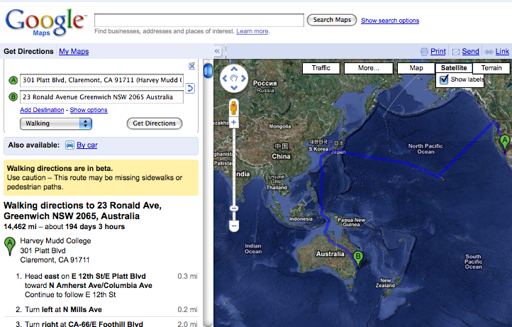
Direction Finding!

Slide 40
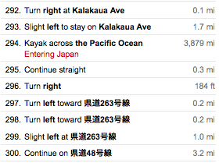
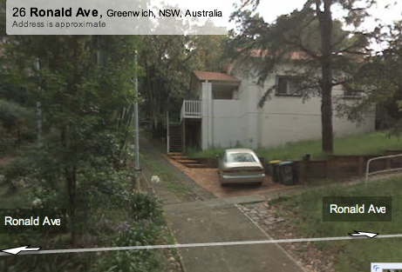

Slide 41
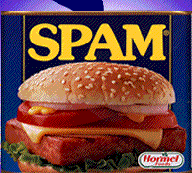
Problem 3: Search for Spam!
This maze looks kinda easy to me…
Notes:
I don’t know if this really works...

Slide 42


Stacks: an Abstract Data Type
do a little example
push 1
push 2
push 3
int x = pop()?
“Last-In-First-Out” (LIFO)
supported operations:
push( o )
pop()
empty()
(also can include peek())
Add Data: Red
Remove Data: Blue
Key Concept: "ABSTRACT" means we promise to fulfill a behavioral contract, but the Stack user doesn't know how
Why don’t you need to specify which
element you want?

Slide 43
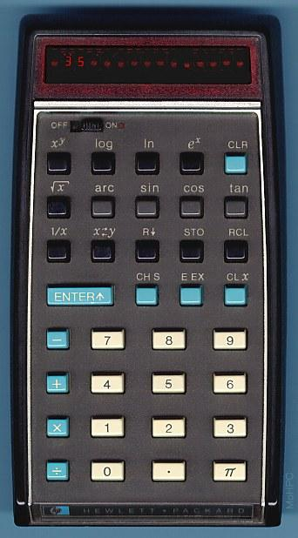
Stacks
Last In, First Out (LIFO)
def main():
S = Stack()
S.push('sleep')
S.push('innertube waterpolo')
S.push('do CS 42 assignment!')
print S
midnight = S.pop()
print "It's midnight! Time to", midnight
push - inserts an item at the front
pop - removes the item at the front

Slide 44
ADT = Many
possible
implementations
S = Stack()
S.push("Sleep")
S.push("IWP");
S.push("CS42");
S.push("Dinner!");
S.pop();
Stacks,
in pictures with lists
after these 6 lines of code…
name: S
class: Stack
name: data
"Sleep"
"IWP"
"CS42"
"Dinner!"
0
1
2
3
topIndex 2
name: topIndex
type: int
we're stoked and stacked!

Slide 45
ADT = Many
possible
implementations
Stack S = Stack()
S.push("Sleep")
S.push("IWP")
S.push("CS42")
S.push("Dinner!")
S.pop()
Stacks,
in pictures with linked lists
after these 6 lines of code…
name: S
class: Stack
name: top
type: StackCell
name: ?
type: StackCell
name: ?
type: StackCell
n: data
n: next
n: data
n: next
n: data
n: next
"CS42"
"IWP"
"Sleep"
None
name: <none>
class: StackCell
n: data
t: Object
n: next
t: StackCell
"Dinner!"
we're stoked and stacked!

Slide 46
Stacks,
class StackCell(object):
def __init__(self, data):
self.data = data
self.next = None
def __repr__(self):
return str(self.data)
class Stack(object):
def __init__(self):
self.top = None
in code

Slide 47
"Quiz"
Complete the linked-list implementation of a Stack.
class Stack(object):
def pop(self):
def push(self, data):
def empty(self):
write pop()
write push(Object data)
extra: repr
def __repr__(self):
}
write empty()

