Slide 1
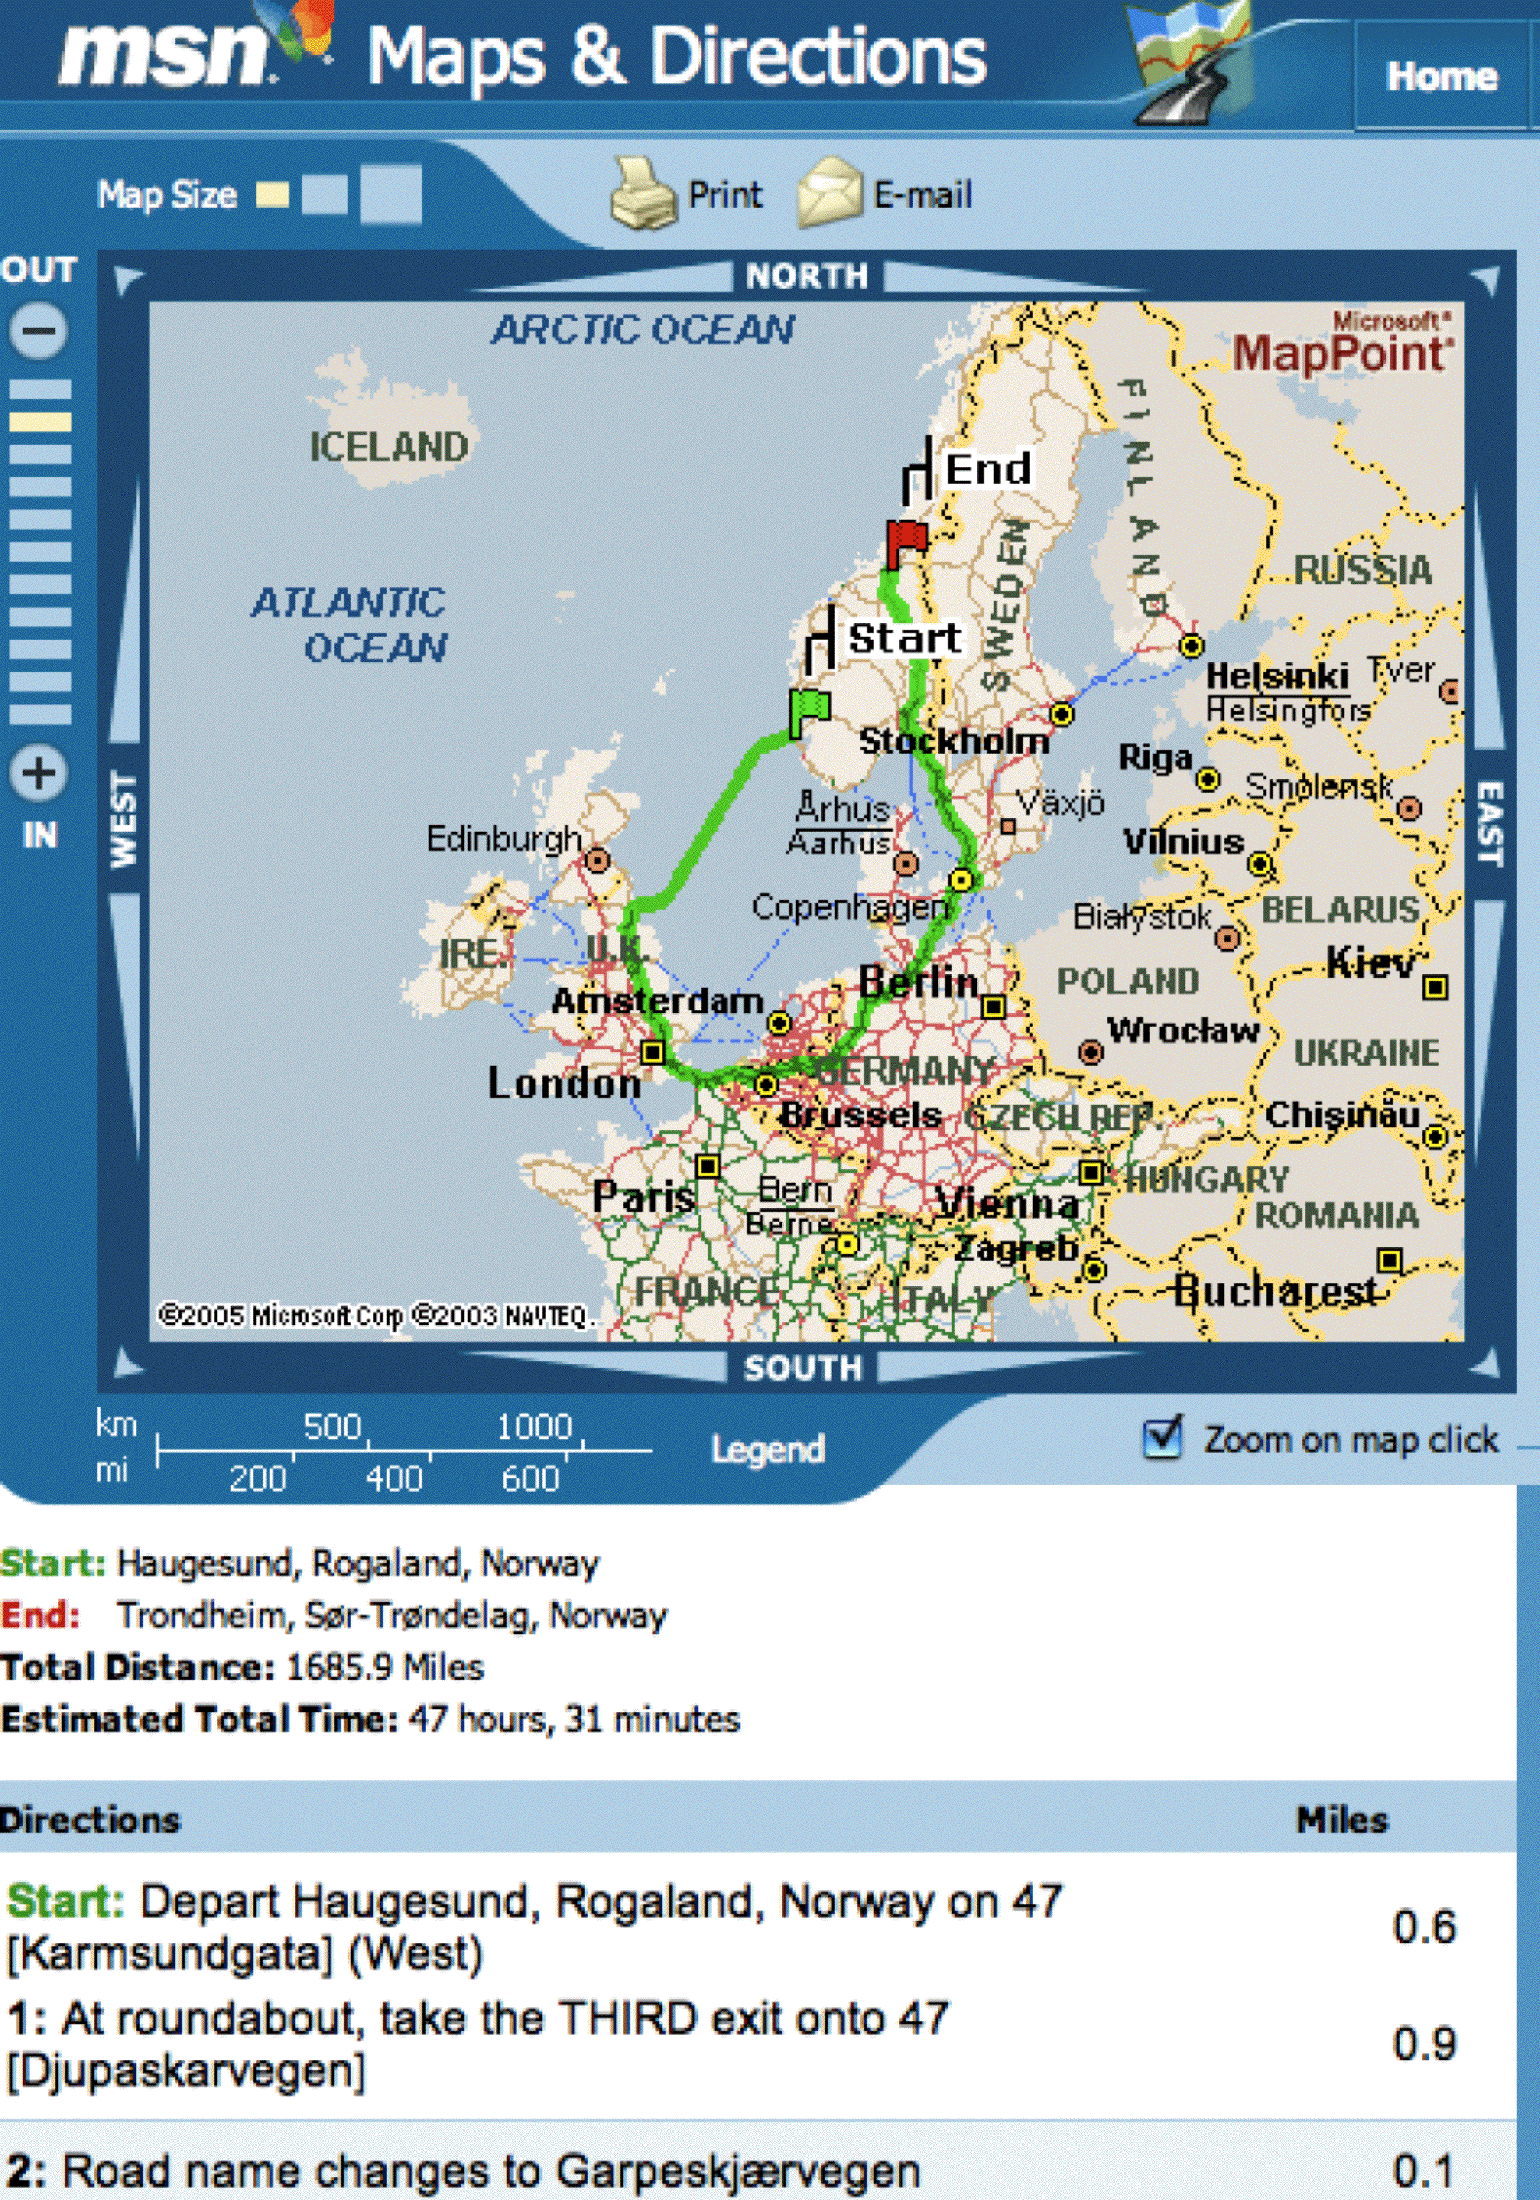
CS 42 Today
I wish this were a Stack!
the Queue ADT
back
front
Queue
for finding the shortest path…
…
08 storei r1 r15
09 addn r15 1
10 storei r14 r15
11 addn r15 1
12 addn r1 -1
13 call r14 5
14 addn r15 -1
15 loadi r14 r15
16 addn r15 -1
17 loadi r1 r15
…
A new look at
the HMMM stack
Hw #8: a better direction finder!
Yet another attempt to AI-ify a perfectly reasonable endeavor!

Slide 2
class Point(object):
def __init__(self, x=0.0, y=0.0):
self.x = x
self.y = y
def __eq__(self, p2):
return self.x == p2.x and self.y == p2.y
def main():
p1 = Point(0.0, 0.0)
p2 = Point(0.0, 0.0)
if p1 == (0.0, 0.0):
print "Equally valid points!"
else:
print "They’re not equal!"
This code will print:
A. "Equally valid points!" B. "They are not equal!" C. None of the above

Slide 3
class Point(object):
def __init__(self, x=0.0, y=0.0):
self.x = x
self.y = y
def __eq__(self, p2):
if type(p2) != type(self):
return False
return self.x == p2.x and self.y == p2.y
def main():
p1 = Point(0.0, 0.0)
p2 = Point(0.0, 0.0)
if p1 == (0.0, 0.0):
print "Equally valid points!"
else:
print "They’re not equal!"
print p1

Slide 4
class Point(object):
def __init__(self, x=0.0, y=0.0):
self.x = x
self.y = y
def __eq__(self, p2):
if type(p2) != type(self):
return False
return self.x == p2.x and self.y == p2.y
def __repr__(self):
s = "(" + str(self.x) + "," + str(self.y) + ")"
return s
def main():
p1 = Point(0.0, 0.0)
p2 = Point(0.0, 0.0)
if p1 == (0.0, 0.0):
print "Equally valid points!"
else:
print "They’re not equal!"
print p1

Slide 5

Spamsweeper!
Demo!
A Boardcell
(boolean) mined
(boolean) exposed
(int) neighborcount
mined = False
neighborcount = 2
mined = True
neighborcount = 3
A Gameboard

Slide 6
Automatic Exposure
3
0
0
1
1
neighbor count
0
0
1
exposed?
true
false
1
1
2
1
If player
chooses this,
how much
should be
exposed?
3
2
0
2
0

Slide 7
Automatic Exposure
3
0
0
1
1
neighbor count
0
0
1
exposed?
true
false
1
1
2
1
7
8
3
2
0
6
1
5
2
2
0
4
3

Slide 8
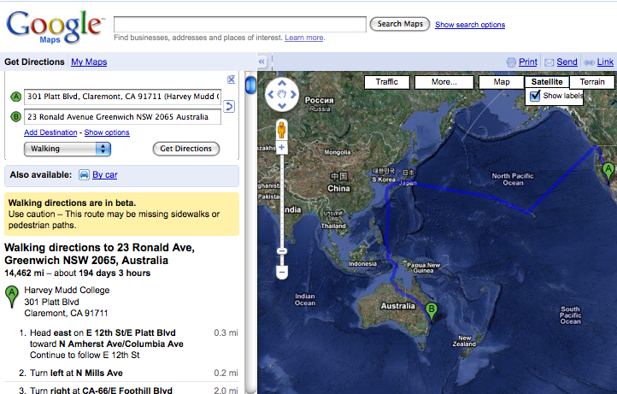
Direction Finding!

Slide 9
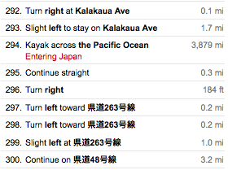
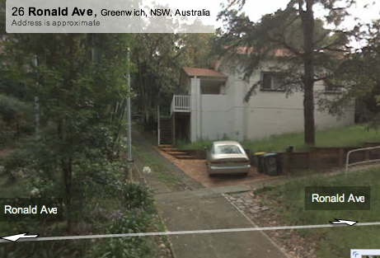

Slide 10

Problem 3: Search for Spam!
This maze looks kinda easy to me…
Notes:
I don’t know if this really works...

Slide 11


Stacks: an Abstract Data Type
do a little example
push 1
push 2
push 3
int x = pop()?
“Last-In-First-Out” (LIFO)
supported operations:
  push( o )
  pop()
  empty()
  (also can include peek())
Add Data: Red
Remove Data: Blue
Key Concept: "ABSTRACT" means we
promise to fulfill a behavioral contract,
but the Stack user doesn't know how
Why don’t you need to specify which
element you want?

Slide 12
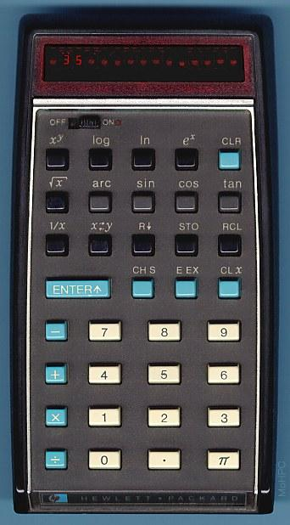
Stacks
Last In, First Out (LIFO)
def main():
S = Stack()
S.push('sleep')
S.push('innertube waterpolo')
S.push('do CS 42 assignment!')
print S
midnight = S.pop()
print "It's midnight! Time to", midnight
push - inserts an item at the front
pop - removes the item at the front

Slide 13
ADT = Many
possible
implementations
S = Stack()
S.push("Sleep")
S.push("IWP")
S.push("CS42")
S.push("Dinner!")
S.pop()
Stacks,
in pictures
with lists
after these 6 lines of code…
name: S
class: Stack
name: data
"Sleep"
"IWP"
"CS42"
"Dinner!"
0
1
2
3
topIndex 2
name: topIndex
type: int
we're stoked and stacked!

Slide 14
ADT = Many
possible
implementations
Stack S = Stack()
S.push("Sleep")
S.push("IWP")
S.push("CS42")
S.push("Dinner!")
S.pop()
Stacks,
in pictures
with linked lists
after these 6 lines of code…
name: S
class: Stack
name: top
type: StackCell
name: ?
type: StackCell
name: ?
type: StackCell
n: data
n: next
n: data
n: next
n: data
n: next
"CS42"
"IWP"
"Sleep"
None
name: <none>
class: StackCell
n: data
n: next
"Dinner!"
we're stoked and stacked!

Slide 15
Stacks,
class StackCell(object):
def __init__(self, data):
self.data = data
self.next = None
def __repr__(self):
return str(self.data)
class Stack(object):
def __init__(self):
self.top = None
in code

Slide 16
"Quiz"
Complete the linked-list implementation of a Stack.
class Stack(object):
def pop(self):
def push(self, data):
def empty(self):
write pop()
write push(Object data)
extra: repr
def __repr__(self):
}
write empty()

Slide 17
Search for Spam!
col
col
col
col
col
col
0
1
2
3
4
5
row
class MazeCell(object):
''' A class to support Maze
containing one cell of the maze '''
def __init__(self, row, col, contents):
self.row = row
self.col = col
self.contents = contents
self.visited = False
self.parent = None
def __repr__(self):
return "[" + str(self.row) + "," +\
str(self.col) + "," + \
self.contents + "]"
0
row
1
E
C
B
L
row
2
F
A
K
row
3
J
row
4
G
H
I
row
5
Here are the available characters:
‘S’ = Start Spam Seeking
‘*’ = Wall!
‘D’ = Delectible Dinner Destination
‘ ’ = Open Space

Slide 18
Depth-first search (DFS)
Pseudocode
Create an empty Stack
mark starting MazeCell as visited
push starting MazeCell onto our Stack
while ( the stack’s not empty )
current = pop the stack
for each of current’s neighbors
if ( it’s not visited or wall )
mark it (neighbor) as visited
set its parent to current MazeCell
push it onto the stack
E
C
B
L
4
F
A
K
3
2
D
S
1
J
G
H
I
This is deep…
‘S’ = Start Spam Seeking
‘D’ = Delectible Dinner Destination
Notes:
I don’t know if this really works...

Slide 19
Depth-first search (DFS)
Pseudocode
Create an empty Stack
mark starting MazeCell as visited
push starting MazeCell onto our Stack
while ( the stack’s not empty )
current = pop the stack
for each of current’s neighbors
if ( it’s not visited or wall )
mark it (neighbor) as visited
set its parent to current MazeCell
push it onto the stack
E
C
B
L
F
A
K
4
D
S
J
3
2
G
H
I
1
This is deep…
Notes:
I don’t know if this really works...

Slide 20
4
Recursive DFS, No Stack Required?
3
2
1
SEWN
col
col
col
col
col
col
DFS Pseudocode
0
1
2
3
4
5
row
if current == destination return (success)
if current is visited or a wall return (fail)
mark current as visisted
for each of current's neighbors (s, e, n, w):
set its parent to current
call DFS (neighbor)
Note: if any neighbor is successful, then
search is successful
0
row
1
E
C
B
L
row
2
F
A
K
row
D
S
3
J
row
4
G
H
I
row
5
‘S’ = Start Spam Seeking
‘D’ = Delectible Dinner Destination

Slide 21
Stack vs. Queue ADT
* Stack Contract
(object) pop()
push(data)
(bool) empty()
* Queue Contract
(object) dequeue()
enqueue(data)
(bool) empty()
in
in
out
42
42
7
…
60
7
…
60
out
Stack
Queue
How will switching to a Queue change our search procedure?

Slide 22
Breadth-first search (BFS)
is it really search at all?
Pseudocode
Create a Queue of MazeCells
mark starting MazeCell as visited
push starting MazeCell onto our Queue
while ( the queue’s nonempty )
cur = dequeue the queue
for each of cur’s neighbors
if ( it’s not visited or wall )
mark it (neighbor) as visited
set its parent to current MazeCell
enqueue it onto the queue
4
D
3
2
S
1
This is qt…
‘S’ = Start Spam Seeking
‘D’ = Delectible Dinner Destination
Notes:
I don’t know if this really works...

Slide 23
Breadth-first search (BFS)
is it really search at all?
Pseudocode
E
Create a Queue of MazeCells
mark starting MazeCell as visited
push starting MazeCell onto our Queue
while ( the queue’s nonempty )
cur = dequeue the queue
for each of cur’s neighbors
if ( it’s not visited or wall )
mark it (neighbor) as visited
set its parent to current MazeCell
enqueue it onto the queue
C
B
L
F
A
K
D
S
J
4
3
2
G
H
I
1
This is qt…
Notes:
I don’t know if this really works...

Slide 24
Amazed by details?
col
col
col
col
col
col
0
1
2
3
4
5
class Maze(object):
# USE THESE RATHER THAN MAGIC VALUES!
WALL = '*';
EMPTY = ' ';
START = 'S';
DESTINATION = 'D';
FOOTSTEP = 'o';
def __init__(self, filename):
self.maze = None
self.rows = 0
self.columns = 0
self.loadMazeFromFile(filename)
def findMazeCell(self, charToFind):
for r in range(self.rows):
for c in range(self.columns):
if self.maze[r][c].contents ==
charToFind:
return self.maze[r][c]
def BFS(self, start, dest):
# To be implemented by you!
row
0
row
1
row
2
row
'D'
'S'
3
row
4
row
5
Hw8, part 3: implement breadth-first search

Slide 25


Three views of Qs
Desmond Llewelyn
in main…
Ball = Queue()
Ball.enqueue(“Y”)
Ball.enqueue(“C”)
Ball.enqueue(“U”)
s = Ball.dequeue()
Hw8, part 2: implement and benchmark 3 different queues

Slide 26
Queue Code
/* making the most of one’s comments…
* - Jim Norwood HMC ‘03
*/
class Queue(object):
# helper class: QCell!
# see StackCell for a model
# I 1 2 C F D Q S M T
def isEmpty(self):
return self.front == None
# I 1 A v M T Q
def __init__(self):
self.front = None
self.back = None
# enqueue, dequeue, peek, empty, __repr__
example code…
in main…
Ball = Queue()
Ball.enqueue(“Y”)
Ball.enqueue(“C”)
Ball.enqueue(“U”)
s = Ball.dequeue();

Slide 27
"Q"uiz
back
(QCell)
front
(QCell)
Draw the results of each of these lines of code…
Bert = Queue()
Bert.enqueue("U") (1)
Bert.enqueue("C") (2)
Bert.dequeue() (3)
Bert.dequeue() (4)
back
(QCell)
front
(QCell)
back
(QCell)
front
(QCell)
Here is a picture of a QCell…
QCell object
data
next
"IWP"
back
(QCell)
front
(QCell)
we're right on queue!

Slide 28
Thoughts on Maze
What kinds of objects will your Queue hold?
How would your program know if there is no solution ?
How would you fill in the path from 'D' to 'S' ?
One data member of the Maze class is maze
maze is a 2 dimensional list (nested list of lists) of MazeCells
How do you get the neighbors of a particular cell?
We're positive about this…

