Slide 1

Today in CS 42
HW9 (due Monday): Last Python
Python graphics with
tkinter
class App:
def __init__(self, master):
frame = Frame(master)
frame.pack()
self.button = Button(frame, text="QUIT", fg="red", command=frame.quit)
self.button.pack(side=LEFT)
self.hi_there = Button(frame, text="Hello", command=self.say_hi)
self.hi_there.pack(side=LEFT)
def say_hi(self):
print "hi there, everyone!"
Event-driven programming
and the return of
functions as first-class
citizens
Messages from the grutors:
Hours: Thurs 8-9pm,
Fri (Prof. A's office hours): 11-12, 2-3:15
Sat 3-4pm, Sun 3-5, 7-11, Mon 8pm-12am
PLEASE READ ASSIGNMENT INSTRUCTIONS CAREFULLY

Slide 2
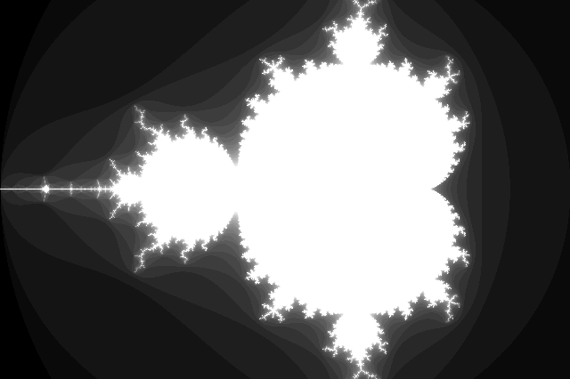
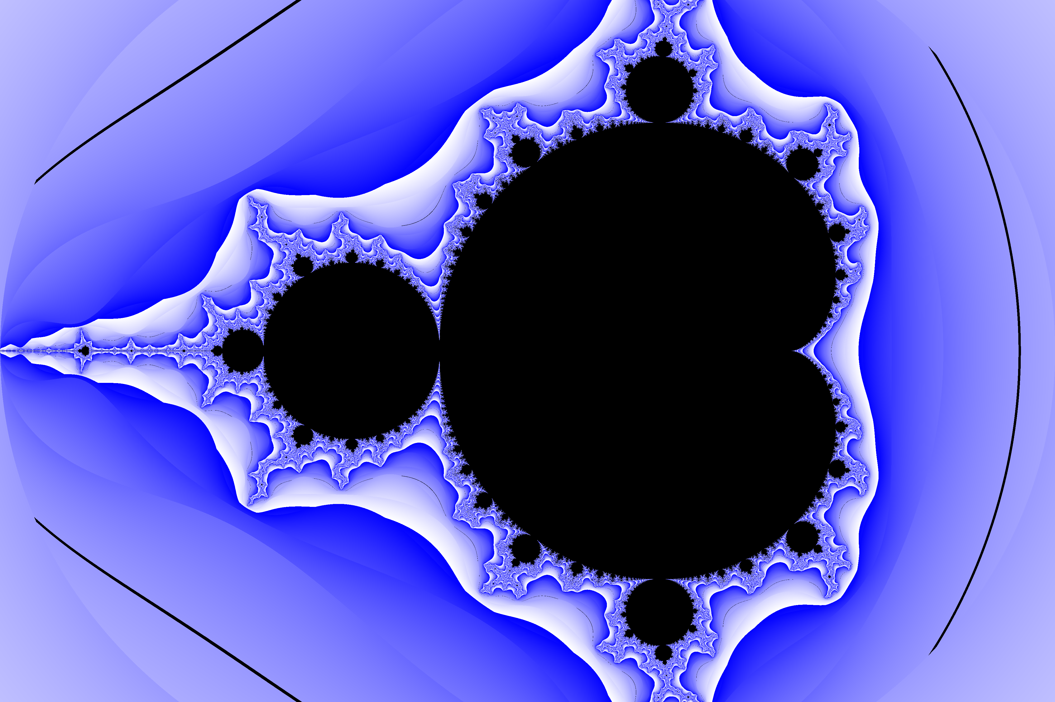
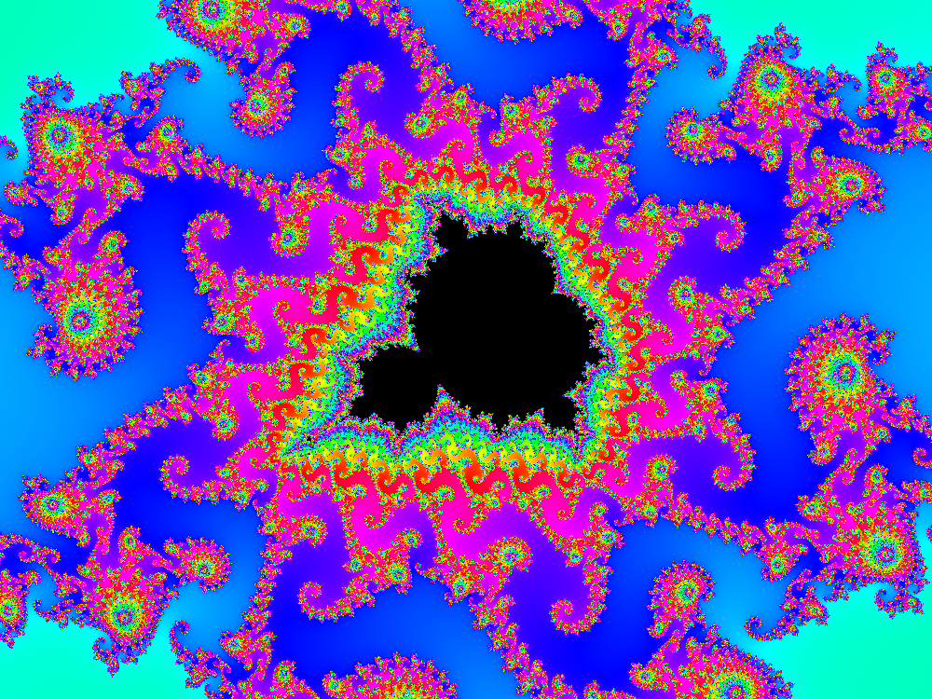

Mset hall of fame
Spencer Alves
Patrick Meehan
Jacob Bandes-Storch
Ben Huppe

Slide 3
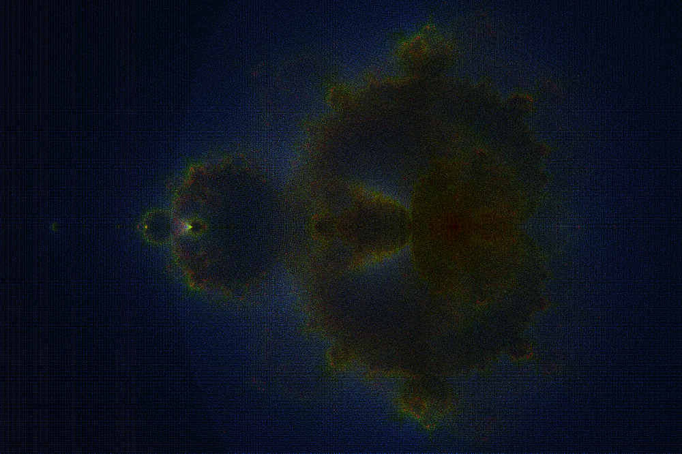
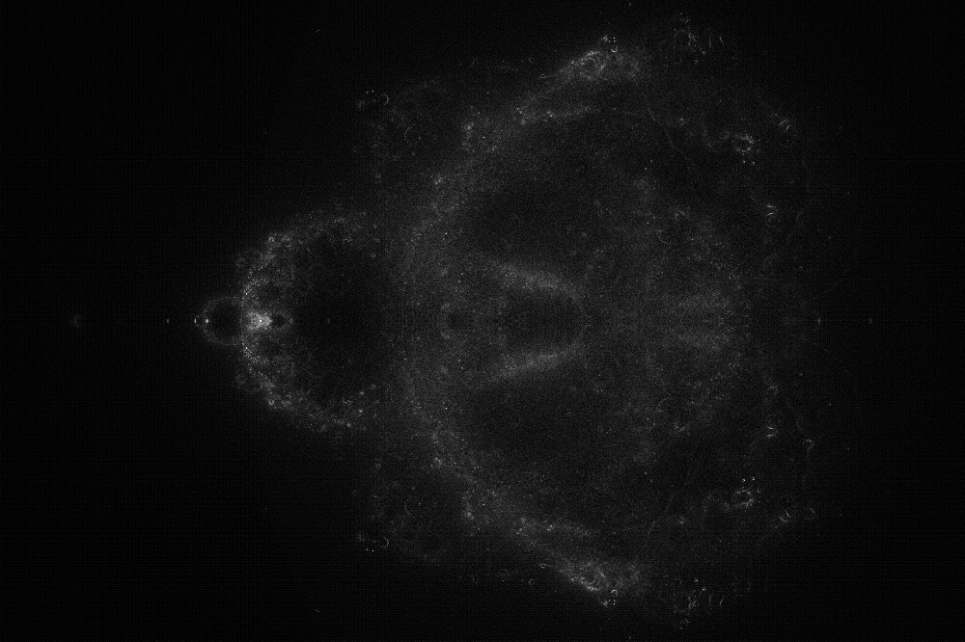
Mset hall of fame
Jacob Bandes-Storch

Slide 4
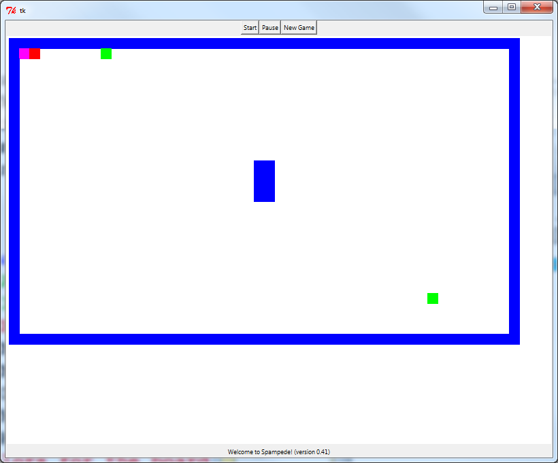
Designing a GUI in Python
import Tkinter
tk = Tkinter
Responding to user input
Game play
GUI layout
+ drawing
the game board

Slide 5
Designing a GUI in Python
GUI layout
Buttons
Canvas
Label

Slide 6
Overview
import Tkinter
tk = Tkinter
def main():
''' Start the game. '''
root = tk.Tk() # Create the main window
app = Spampede(root) # Create a Spampede object
root.mainloop() # Give the main window control

Slide 7
Laying out the Window
class Spampede(object):
''' A class that implements the game of Spampede
using the tkinter library.'''
PADDING = 5 # The space between the edge of the
# canvas and the board
WIDTH = 800 # The width of the gameboard
HEIGHT = 600 # The height of the gameboard
# Game colors
BGCOLOR = "white"

Slide 8
Laying out the Window
def __init__(self, master):
''' Initialize the Spampede application '''
frame = tk.Frame(master) # Create the main frame
frame.pack() # Pack it into the master window
buttonFrame = tk.Frame(frame) # Create a frame for buttons
buttonFrame.pack(side=tk.TOP) # Put that frame at the top of
# the main frame
startb = tk.Button(buttonFrame, text="Start", command=self._go)
startb.pack(side=tk.LEFT)
pauseb = tk.Button(buttonFrame, text="Pause", command=self._pause)
pauseb.pack(side=tk.LEFT)
resetb = tk.Button(buttonFrame, text="New Game", command=self._reset)
resetb.pack(side=tk.LEFT)
self.canvas = tk.Canvas(frame, width=self.WIDTH, height=self.HEIGHT,
bg=self.BGCOLOR)
self.canvas.pack(fill=tk.BOTH)
self.message = "Welcome to Spampede v0.42!"
self.messageLabel = tk.Label(frame, text=self.message)
self.messageLabel.pack(side=tk.BOTTOM)

Slide 9
Frames, Buttons, Canvases, oh my!
import Tkinter
tk = Tkinter
# More code here not shown…
# then, in __init__:
buttonFrame = tk.Frame(frame) # Create a frame for buttons
buttonFrame.pack(side=tk.TOP) # Put that frame at the top of
# the main frame
startb = tk.Button(buttonFrame, text="Start", command=self._go)
startb.pack(side=tk.LEFT)
And put this new frame in the main frame
using tkinter (which we've named tk)
Create a new Frame object to hold the buttons
and put it in the button frame
Create a new Button to be the start button
and set some of its attributes
pack?
attributes?

Slide 10
Attributes of graphical objects
import Tkinter
tk = Tkinter
# More code here not shown…
# then, in __init__:
buttonFrame = tk.Frame(frame) # Create a frame for buttons
buttonFrame.pack(side=tk.TOP) # Put that frame at the top of
# the main frame
startb = tk.Button(buttonFrame, text="Start", command=self._go)
startb.pack(side=tk.LEFT)
But how do you know what you can specify here?
Answer: Look it up.
A widget's parent is always the first argument
http://effbot.org/tkinterbook/button.htm
you can also change attributes later using config, e.g.
self.messageLabel.config(text=self.message)

Slide 11
The pack geometry manager
import Tkinter
tk = Tkinter
# More code here not shown…
# then, in __init__:
buttonFrame = tk.Frame(frame) # Create a frame for buttons
buttonFrame.pack(side=tk.TOP) # Put that frame at the top of
# the main frame
startb = tk.Button(buttonFrame, text="Start", command=self._go)
startb.pack(side=tk.LEFT)
pack tells tkinter to show the item in the frame.
Optional arguments: side (values: TOP, BOTTOM, LEFT, RIGHT, CENTER)
fill (values: X, Y, BOTH) – see canvas for example
There are other geometry managers (e.g., grid), but pack is the simplest.
http://effbot.org/tkinterbook/pack.htm

Slide 12
The Canvas hosts the game
# Create the canvas object and save it. This is where you will
# draw all of the components of the gameboard.
self.canvas = tk.Canvas(frame, width=self.WIDTH,
height=self.HEIGHT, bg=self.BGCOLOR)
self.canvas.pack(fill=tk.BOTH)
Try it! Download the Spampede starter file
and play around with it. Change attributes
of objects, add buttons, etc. Or create your
own new GUI from scratch.

Slide 13
Game control overview
_keyPressed()
1. _updateCentipede()
Application run
6. after…
2. _updateSpam()
cycle()
__init__()
_reset()
5. _cycleNum+=1
3. _drawEnvironment()
4. _displayMessage()

Slide 14
Game control details
def _reset(self):
''' This is the function that will run when the user
presses the New Game button. Resets the game.'''
#set up the maze here
self.theMaze = SpamMaze()
#You may also want to initialize the pede's direction here
#and to other initializations that need to happen each time
# a new game is started.
self.currentColor = "green"
self._drawEnvironment()
self._displayMessage()
_keyPressed()
1. _updateCentipede()
Application run
6. after…
2. _updateSpam()
cycle()
__init__()
_reset()
5. _cycleNum+=1
3. _drawEnvironment()
4. _displayMessage()

Slide 15
Game control details
def _cycle(self):
''' This is the main "loop" that controls the gameplay. '''
if self.running:
self._updateCentipede() # update the Spampede deque
self._updateSpam() # update the Spam deque
self._drawEnvironment() # draw things to buffer
self._displayMessage() # display messages
self.cycleNum += 1 # add a cycle
# Wait a little while and then cycle again.
self.canvas.after(self.sleepTime, self._cycle)
_keyPressed()
1. _updateCentipede()
Application run
6. after…
2. _updateSpam()
cycle()
__init__()
_reset()
5. _cycleNum+=1
3. _drawEnvironment()
4. _displayMessage()

Slide 16
Game control details
# You might use this method to move the centipede one square
# Also, this method can check if the centipede runs
# into a can of spam, a wall, itself, etc. and act appropriately.
def _updateCentipede(self):
''' Update the centipede. You don't have to do this
every cycle if you want a slower game. '''
return
# You might use this method to add/delete spam cans periodically
def _updateSpam(self):
''' Possibly add or remove spam. You won't want to do this
every cycle. '''
return
_keyPressed()
1. _updateCentipede()
Application run
6. after…
2. _updateSpam()
cycle()
__init__()
_reset()
5. _cycleNum+=1
3. _drawEnvironment()
4. _displayMessage()

Slide 17
Game control details
def _drawEnvironment(self):
''' Draw the state of the game on the board.
Note that (0,0) is in the top left corner of the board
and +y is down.'''
self._clear()
r3 = self.canvas.create_rectangle(40,50,100,100)
self.canvas.itemconfig(r3, fill="red")
r2 = self.canvas.create_rectangle(250, 100, 350, 200,
fill=self.currentColor)
if (self.cycleNum+1) % 42 == 0:
self.currentColor = "magenta"
_keyPressed()
1. _updateCentipede()
Application run
6. after…
2. _updateSpam()
cycle()
__init__()
_reset()
5. _cycleNum+=1
3. _drawEnvironment()
4. _displayMessage()
Issues?

Slide 18
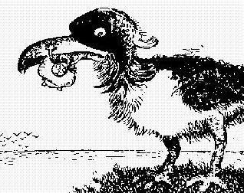
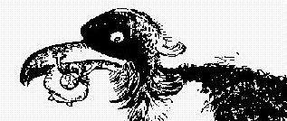
Double Buffering
avoiding flicker…
individual drawing commands
Off screen buffer
Screen
raster copy
Gustav Verbeek
fillRect ...
screen
image
but fast to copy
possibly slow to draw…

Slide 19
Double Buffering
avoiding flicker…
individual drawing commands
Off screen buffer
Screen
raster copy
Gustav Verbeek
fillRect ...
screen
image
but fast to copy
possibly slow to draw…
Python automatically
updates all at once
_drawEnvironment()
_displayMessage()

Slide 20
Game control details
def _displayMessage(self):
''' Display a text message to the user.'''
self.messageLabel.config(text=self.message)
_keyPressed()
1. _updateCentipede()
Application run
6. after…
2. _updateSpam()
cycle()
__init__()
_reset()
5. _cycleNum+=1
3. _drawEnvironment()
4. _displayMessage()

Slide 21
Event-driven programming
import Tkinter
tk = Tkinter
def main():
''' Start the game. '''
root = tk.Tk() # Create the main window
app = Spampede(root) # Create a Spampede object
root.mainloop() # Give the main window control
_keyPressed()
1. _updateCentipede()
Application run
6. after…
2. _updateSpam()
cycle()
__init__()
_reset()
5. _cycleNum+=1
3. _drawEnvironment()
4. _displayMessage()

Slide 22
Event-driven programming
import Tkinter
tk = Tkinter
def main():
''' Start the game. '''
root = tk.Tk()
app = Spampede(root)
root.mainloop()
The program is literally
looping idly waiting for
something to happen…

Slide 23
Event-driven programming
import Tkinter
tk = Tkinter
def main():
''' Start the game. '''
root = tk.Tk()
app = Spampede(root)
root.mainloop()
The program is literally
looping idly waiting for
something to happen…
events are registered to
callback code when they
happen.

Slide 24
Event-driven programming
buttonFrame.pack(side=tk.TOP) # Put that frame at the top of
# the main frame
startb = tk.Button(buttonFrame, text="Start", command=self._go)
Passing the function in as an argument will
register it to be called whenever a click event
happens on this button

Slide 25
Event-driven programming
startb = tk.Button(buttonFrame, text="Start", command=self._go)
startb.pack(side=tk.LEFT)
pauseb = tk.Button(buttonFrame, text="Pause", command=self._pause)
pauseb.pack(side=tk.LEFT)
resetb = tk.Button(buttonFrame, text="New Game", command=self._reset)
resetb.pack(side=tk.LEFT)
self.canvas = tk.Canvas(frame, width=self.WIDTH, height=self.HEIGHT,
bg=self.BGCOLOR)
self.canvas.pack(fill=tk.BOTH)
self.message = "Welcome to Spampede v0.42!"
self.messageLabel = tk.Label(frame, text=self.message)
self.messageLabel.pack(side=tk.BOTTOM)
# Capture all keystroke events. Handle them with the self._keyPressed
# function, which you will need to add to.
master.bind_all("<Key>", self._keyPressed)

Slide 26
Event-handlers
def _go(self):
''' This is the function that will run when the user presses the
Start button. (Re)Starts the game.'''
self.running = True
self._cycle()
def _pause(self):
''' This is the function that will run when the user presses the
Pause button. Pauses the game.'''
self.running = False

Slide 27
Event-handlers and after
def _cycle(self):
''' This is the main "loop" that controls the gameplay. '''
while self.running:
self._updateCentipede() # update the Spampede deque
self._updateSpam() # update the Spam deque
self._drawEnvironment() # draw things to buffer
self._displayMessage() # display messages
self.cycleNum += 1 # add a cycle
Assuming all helpers were written correctly,
what would this code do?
Correctly play the game
Move the pede but not allow the user to control it
Move the pede and allow the user to control it, but not allow
the user to stop the game
Cause the main window to "hang"

Slide 28
Event-handlers and after
def _cycle(self):
''' This is the main "loop" that controls the gameplay. '''
if self.running:
self._updateCentipede() # update the Spampede deque
self._updateSpam() # update the Spam deque
self._drawEnvironment() # draw things to buffer
self._displayMessage() # display messages
self.cycleNum += 1 # add a cycle
# Wait a little while and then cycle again.
self.canvas.after(self.sleepTime, self._cycle)
after schedules an event to occur at least self.sleepTime
milliseconds in the future.

Slide 29
IDLE and TkInter
import Tkinter
tk = Tkinter
def main():
''' Start the game. '''
root = tk.Tk() # Create the main window
app = Spampede(root) # Create a Spampede object
root.mainloop() # Give the main window control
IDLE is written in TkInter! So why does this cause a problem…?

Slide 30
“Quiz”
Code Treasure Hunt!
1) Where is the code that is drawing the small red square?
2) What do the first four arguments to create_recatangle(int,int,int,int) mean?
3) What is the point of the PADDING member variable?
4) What keypress(es) lead to drawing the large square dark blue?
Which keypress is incorrectly reported on the screen?
5) What code draws the text of the latest keypress onto the screen?
6) What's your favorite color?
7) How long does it take for the large square to return to magenta color?
8) What happens in the code when "Pause" and "Go" are pressed?
Where/how does sleepTime determine the speed of the applet's updates?

Slide 31
Hw 9 ~ overall planning
1) Do the Maze and SpamMaze parts of the assignment first…
2) Make sure you can change, and test Spampede.py
self.theMaze
3) Get a bird's-eye view of the code…
self.dir
the current direction the snake is heading
(doesn't exist yet)
4) Write _drawEnvironment (and test…)
5) Write _updatePede and _keyPressed (and test…)
one direction at a time…
6) Build up to reversing and AI (note that AI is almost completely implemented by multiBFS)
Notes:
(9) update is being called when the window is made visible, etc…

