Slide 1
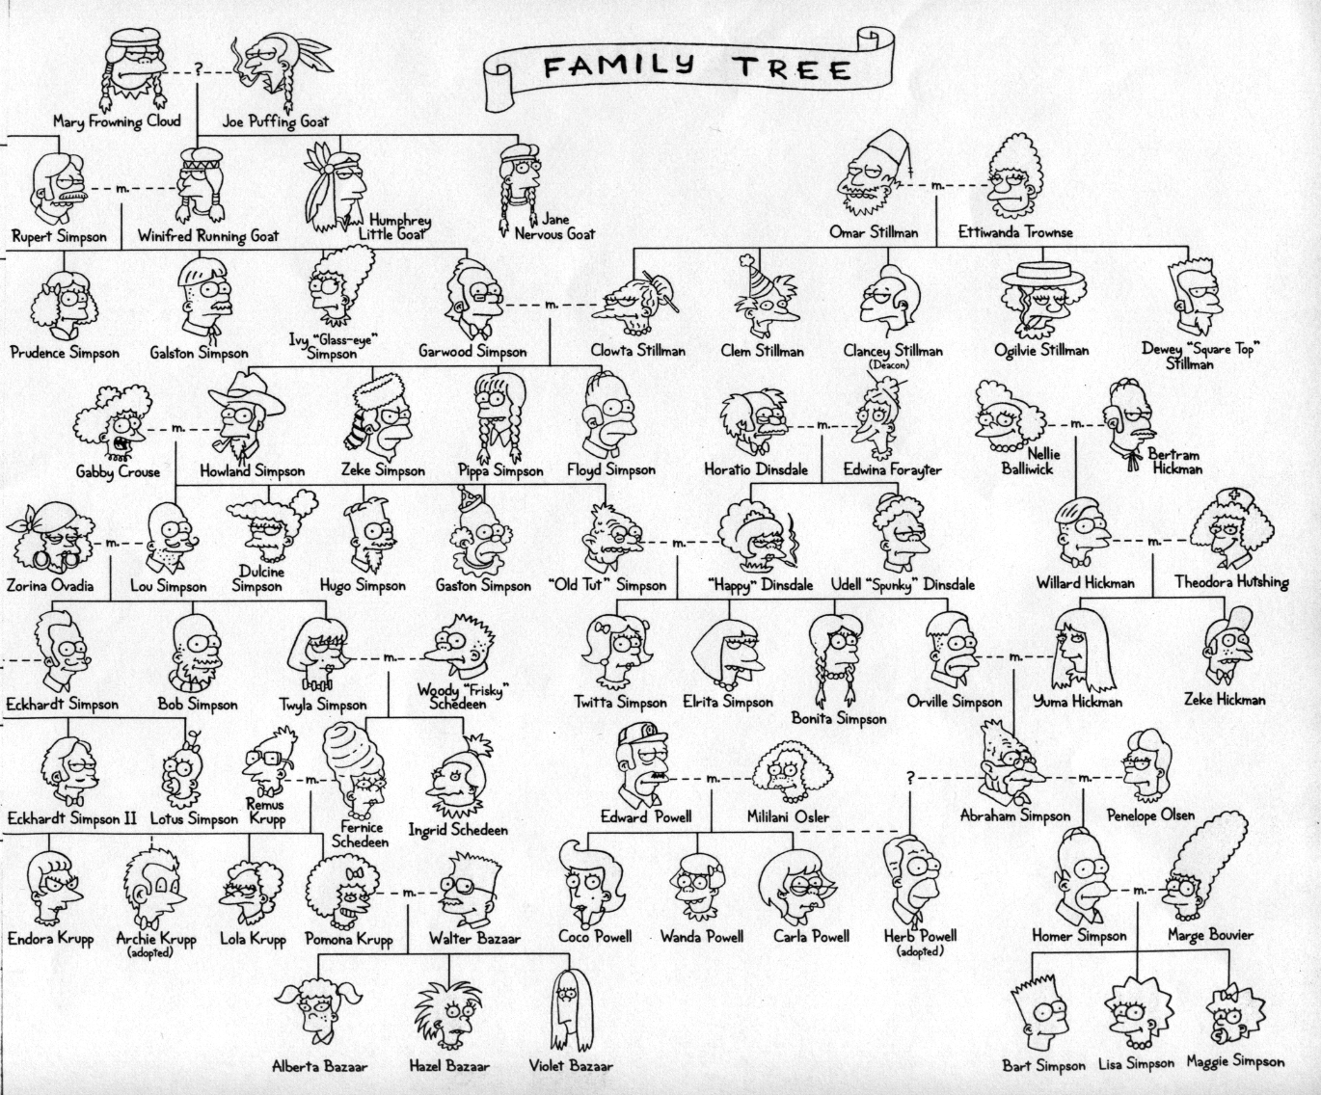

Today in CS 42
yes
Hw #10: Prolog
Coming up…
Monday 11/15: HW10 (Prolog intro)
Thursday 11/18: Midterm #2
Monday 11/22: NO HW DUE
Thursday 11/25: Thanksgiving
Tuesday 11/30: HW 11 (Prolog games)
Matt Groening's family?

Slide 2
Feedback on Feedback: Most important
Uses of various forms of programming/various languages/learning new languages quickly
Program design/helper functions/good variable names
Debugging skills/testing
Python
Assembly in Hmmm
Hardware/software interface
Lists and recursion/graphs and trees/ADTs
CS has interesting problems to solve
Python docstrings
The number 42
Still recursion/tail recursion
Big-O

Slide 3
Review: Tail Recursion and Hmmm
(define (tower N)
(tower-tr N 2))
(define (tower-tr N A)
(if (= N 0)
A
(power A (tower-tr (- N 1) A))))
Is this a tail recursive function?
Yes
No
Not sure

Slide 4
Review: Tail Recursion and Hmmm
(define (power-tr b n A)
(if (= n 0)
A
(power-tr b (- n 1) (* A b))))
42 jeqz r2 46
43 addn r2 -1
44 mul r3 r3 r1
45 jump 42
46 mov r13 r3
47 jumpi r14
42 jeqz r2 51
43 addn r2 -1
44 mul r3 r3 r1
45 storei r14 r15
46 addn r15 1
47 call r14 42
48 addn r15 -1
49 loadi r14 r15
50 jumpi r14
51 mov r13 r3
52 jumpi r14
Which is a "faithful" implementation of the Racket code above in HMMM?
left side only
right side only
both
neither

Slide 5
Big O comparison
Please do not try these at home!
Problem
Find the maximum element in a list
8
42
9
0
First, verify the < operator with 2,000 known comparisons (1 < 2 )
paranoid algorithm
Second, look at each list element, compare it with the current max
-- Replace the current max if necessary.
As you do this, make each comparison 1,000 times just to “be sure”
You have a minimum-element finder already.
code reuse algorithm
All elements start unmarked.
Find the smallest unmarked element and mark it.
Repeat, keeping track of the last element marked each time.
When they’re all marked, return the last element marked.

Slide 6
The Big Picture on “Big Oh”
O (“Big Oh”) compares running times for algorithms
time
f
paranoid algorithm
f ∈ O(g)
g ∉ O(f)
g
code reuse algorithm
input size (N)
O(g)
set of all functions dominated by g
O(f)
set of all functions dominated by f

Slide 7
The Formal Definition of Big-O
f(n) is O(g(n)) if there exists constants c and n₀ s.t.
f(n) ≤ c*g(n) for all n ≥ n₀
time
f
paranoid algorithm
f ∈ O(g)
g ∉ O(f)
g
code reuse algorithm
input size (N)

Slide 8
Big O in practice
big-Oh = hand-waving math!
Ignore everything but the dominant term
even there, ignore the constant
420n² + 3n³ - 201
17 + 300 + 0.5log(n)
√n
117 2^{n}
+
+ 1700
n 3^{n}
Big-Oh is simply an upper bound, but in general we want the BEST upper bound…

Slide 9
Review: Big-O
What is Big-O running time of the following mystery function? (and what does it do?)
(define (mystery N)
(reverse (mystery-help N)))
(define (mystery-help N)
(cond
((= N 0) '())
((= 1 (modulo N 2)) (cons 1 (mystery-help (/ (- N 1) 2))))
(else (cons 0 (mystery-help (/ N 2))))))
A. O(log N) B. O(N) C. O(N log N) D. All of these E. None of these

Slide 10
Midterm #2
In class, Thursday Nov 18
You may bring 1 8.5x11 sheet with handwritten notes (both sides)
Everything up through simple Prolog (HW10) even if we only saw it in class including topics from before midterm 1
Short reviews over the next two lectures More review problems posted online this week

Slide 11
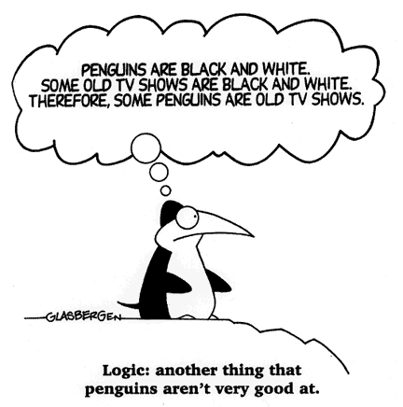
And now, for something completely different…

Slide 12
Taxonomy of Programming Models
Programming
What mood am I in today?
Declarative
Programming
Imperative
Programming
Logic Programming
Functional Programming
Object-Oriented
Programming
Low-level Programming
Prolog
Racket
Pyhon
JFlap
simply describe the problem - and I'll solve it!
algorithms via functions
data structures
more abstraction away from the machine
closer to the machine

Slide 13
Prolog: yes !
prolog is very definitive!
Prolog's data ~ similar to Racket's
[3.14,42,spam,‘+’,“hi”].
floating point
symbols
strings
integers
characters
is that Python syntax?
But -- Prolog has only 1 algorithm!
The idea:
Provide data and relationships to describe the world.
Ask questions! function evaluation vs. inference…
Prolog's goal is to answer all your questions!
So buy now! http://www.swi-prolog.org/

Slide 14
Prolog: yes !
Prolog's data ~ similar to Racket's
[3.14,42,spam,‘+’,“hi”].
floating point
symbols
strings
integers
characters
But -- Prolog has only 1 algorithm!
The idea:
Provide data and relationships to describe the world.
Ask questions! function evaluation vs. inference…
Caution!
There is not now, and never will be, a programming language in which it is the least bit difficult to write bad programs.
- Lawrence Flon

Slide 15
Prolog: Just the Facts!
%% Here is a comment in Prolog
/* this is also a comment */
chocolate. %% “chocolate” is a fact. A good one too!
good(spam). %% a debatable fact, but now prolog thinks so
good(42). %% no one can deny this…
better(tofu, spam). %% “tofu” is better than spam
better(chocolate, tofu). %% “chocolate” is better than “tofu”
better(money, chocolate). %% “money” is better than “chocolate”
%% Does prolog know that money is better than spam? Does prolog even
%% know what spam is???
Predicate, or fact. Defined to be true.
You must write your facts and rules in a file!

Slide 16
Prolog: Just the Facts!
%% Here is a comment in Prolog
/* this is also a comment */
chocolate. %% “chocolate” is a fact. A good one too!
good(spam). %% a debatable fact, but now prolog thinks so
good(42). %% no one can deny this…
better(tofu, spam). %% “tofu” is better than spam
better(chocolate, tofu). %% “chocolate” is better than “tofu”
better(money, chocolate). %% “money” is better than “chocolate”
%% Does prolog know that money is better than spam? Does prolog even
%% know what spam is??? NO!
Predicate, or fact. Defined to be true.
beats(X, Y) :- better(X, Y).
beats(X, Y) :- better(X, Z), beats(Z, Y).
Ask, what does it mean to “beat” something
Rules, variables have to be in caps.

Slide 17
Prolog can be alien…
prolog seems reasonable to me!
To run: pl
or
swipl
To exit: halt.
To (re)load a file: [file]. or reconsult(‘file.pl’).
[user]. lets you type facts
The Prolog environment is for queries only! Use your favorite editor to change files…
Windows's swipl has an editor built-in.
parent(homer,bart).
parent(homer,lisa).
parent(marge,bart).
parent(marge,lisa).
child(A,B) :- parent(B,A).
?: parent(homer,lisa).
yes
?: parent(X,bart).
X = homer ;
X = marge ;
no
FACTS
TEST
GENERATE
RULES
some facts and rules from the file part1.pl
queries within the Prolog environment

Slide 18
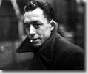
Prolog syntax is the stranger
The idea:
Provide data/relationships that describe the world. Then ask questions.
you mean L’Étranger…
variables start with a capital letter
colon-hyphen means “IF”
Relationships:
mother(X, Y) :- parent(X, Y), female(X).
child(X, Y) :- parent(Y, X).
ancestor(X, Y) :- parent(X, Y).
ancestor(X, Y) :- parent(X, Z), ancestor(Z, Y).
commas mean “AND”
predicates and constants start with a lowercase letter
these relationships are predicates not functions. They have a value, but they do not return a value!
recursion welcome!
multiple rules express “OR”
; also means “OR”

Slide 19
/*
* the parent predicate
*/
parent(olf, skug).
parent(helga, skug).
parent(skug, esmerelda).
parent(skugerina, esmerelda).
parent(esmerelda, klotho).
parent(gemini, klotho).
parent(esmerelda, atropos).
parent(gemini, atropos).
parent(esmerelda, lachesis).
parent(gemini, lachesis).
parent(olf, homericus).
parent(helga, homericus).
parent(ug, matilda).
parent(uggette, matilda).
parent(homericus, homer).
parent(matilda, homer).
parent(homericus, gomer).
parent(matilda, gomer).
parent(homer, bart).
parent(marge, bart).
parent(homer, lisa).
parent(marge, lisa).
parent(homer, maggie).
parent(marge, maggie).
parent(john, marge).
parent(jackie, marge).
parent(john, selma).
parent(jackie, selma).
parent(john, patty).
parent(jackie, patty).
parent(john, glum).
parent(jackie, glum).
parent(glum, millhouse).
parent(cher, millhouse).
parent(glum, wentworth).
parent(cher, wentworth).
/*
* the age predicate
*/
age(helga, 97).
age(olf, 99).
age(uggette, 93).
age(ug, 92).
age(matilda, 65).
age(homericus, 76).
age(skugerina, 101).
age(skug, 78).
age(esmerelda, 55).
age(gemini, 54).
age(klotho, 20).
age(atropos, 19).
age(lachesis, 18).
age(marge, 35).
age(homer, 38).
age(lisa, 8).
age(maggie, 1).
age(bart, 10).
age(gomer, 41).
age(john, 62).
age(jackie, 59).
age(patty, 38).
age(selma, 38).
age(glum, 27).
age(cher, 44).
age(millhouse, 8).
age(wentworth, 8).
File part1.pl
/*
* the female predicate
*/
female(helga).
female(esmerelda).
female(skugerina).
female(uggette).
female(matilda).
female(marge).
female(jackie).
female(selma).
female(patty).
female(cher).
female(lisa).
female(maggie).
female(klotho).
female(atropos).
female(lachesis).
/*
* the male predicate
*/
male(olf).
male(skug).
male(homericus).
male(ug).
male(homer).
male(gomer).
male(gemini).
male(john).
male(glum).
male(bart).
male(millhouse).
male(wentworth).
/*
* Here are three rules about families
*/
child(X, Y) :- parent(Y, X).
mother(X, Y) :- female(X), parent(X, Y).
anc(X, Y) :- parent(X, Y).
anc(X, Y) :- parent(Z, Y), anc(X, Z).

Slide 20
A more complete picture ...
99
97
92
93
olf
helga
ug
uggette
101
78
76
65
62
59
skugerina
skug
homericus
matilda
john
jackie
54
55
41
38
35
38
38
27
44
gemini
esmerelda
gomer
homer
marge
selma
patty
glum
cher
20
18
19
10
1
8
8
8
klotho
lachesis
atropos
bart
maggie
lisa
millhouse
terpsichore

Slide 21
The idea:
Provide data/relationships that describe the world. Then ask questions.
Questions:
child(lisa,marge).
parent(marge,X).
Is Lisa a child of Marge?
Who has Marge as a parent?
Is Ug a parent of Bart?
Who are the ancestors of Lisa?
Who are uggette's descendants?
Who is who's parent?
Who are John's grandchildren?

Slide 22
“Quiz”
Try it out!
Write these three family-relationship predicates in prolog:
sibs(X,Y)
true if X and Y are siblings
aunt(A,N)
true if A is N’s aunt
rel(X,Y)
true if X and Y are related (by blood)

Slide 23
“Quiz”
Try it out!
Are these definitions correct? A. Yes B. No
sibs(X,Y)
true if X and Y are siblings
sibs( X, Y ) :- parent(A,X), parent(A,Y).
aunt(A,N)
true if A is N’s aunt
aunt( X, Y ) :- parent( Q, N ), sibs( Q, A ), female( A ).
rel(X,Y)
true if X and Y are related (by blood)
rel( X, Y ) :- anc( Z, X ), anc( Z, Y ).

Slide 24
What's wrong here?
sibs(X, Y) :- parent (A,X), parent (A,Y), X\==Y.
Nothing is wrong…

Slide 25
What's wrong here?
sibs(X, Y) :- parent (A,X), parent (A,Y), X\==Y.
Nothing IS wrong…

Slide 26
setof
?- setof(A,aunt(A,bart),S).
?- setof(N,aunt(marge,N),S).
setof(R, p(R), S)
is true when S is the set (list) of Rs that satisfy predicate p.

Slide 27
trace. / notrace.
Maybe this should be Prolog == DFS?
Prolog is DFS
spy(female).
nospyall.
Who are Bart’s aunts?
aunt(A,bart)
aunt(A,N) :- parent(P,N), sibling(A,P), female(A).
N = bart
parent(P,N)
is there a parent?
other parents?
parent(homer,bart)
parent(marge,bart)
YES N = bart
YES N = bart
P = homer
P = marge
backtrack!
sibling(A,P)
is there a sibling?
other siblings?
is there a sibling?
other siblings?
sibling(gomer,homer)
NO
sibling(glum, marge)
sibling(selma, marge)
YES N = bart
YES N = bart
YES N = bart
P = homer
P = marge
P = marge
A = gomer
A = glum
A = selma
backtrack!
backtrack!
female(A)
female(gomer) ?
female(glum) ?
female(selma)
NO (fails)
NO
SUCCESS
YES!

Slide 28
Negation in Prolog?
How could you write oldest(X) ?
oldest(X) :- AX > AY, age(X,AX), age(Y,AY).
On the query oldest(X)…
This will work correctly
This will cause Prolog to run into an infinite loop
This will find one of more values for X, but not the correct value
This will find many values for X, one of which will be the correct value (the others will be wrong)
This will cause an error

Slide 29
Negation in Prolog?
How could you write oldest(X) ?
oldest(X) :- age(X,AX), age(Y,AY), AX > AY.
On the query oldest(X)…
This will work correctly
This will cause Prolog to run into an infinite loop
This will find one or more values for X, but not the correct value
This will find many values for X, one of which will be the correct value (the others will be wrong)
This will cause an error

Slide 30
Negation in Prolog?
How could you write oldest(X) ?
oldest(X) :- age(X,AX), age(Y,AY), AX > AY.
Why doesn't this work?
notoldest(X) :- age(X,AX), age(Y,AY), AX < AY.
oldest(X) :- \+notoldest(X).
Will this work? A. Yes B. No C. only if X is bound
Need for #4, hasFirstGC

Slide 31
Math in Prolog?
Racket: no side effects (assignments changing variables) -- new data is created & returned.
Python: you can choose to use side effects, or return new data as needed
Prolog: everything is done via side effects, there are no return values!
This goes wrong in THREE places (in Prolog)!
What are they?
fac(X) :- X * fac(X-1).
Notes:
write fac!

Slide 32
Math in Prolog?
Racket: no side effects (assignments changing variables) -- new data is created & returned.
Python: you can choose to use side effects, or return new data as needed
Prolog: everything is done via side effects, there are no return values!
fac(0, 1). fac(N, Ans) :- M is N-1, fac(M, Ans2), Ans is Ans2 * N.
! rules!
Notes:
write fac!

Slide 33
Prolog Lists
Inference on structure, instead of a database.
Test
Generate
member(3, [1,2,3,4,5]).
Yes
member(E, [1,2,3,4,5]).
E = 1 ;
E = 2 ;
E = 3 ;
E = 4 ;
E = 5 ;
No
member(6, [1,2,3,4,5]).
No
both variable?

Slide 34
Prolog’s key difference...
Remember, prolog does not have return values!
member( e, L )
in Racket/Python, this returns a boolean
member( E, L )
in prolog, this can be tested (yes/no) OR it can bind values to E or L !
true when E is a member of L and false otherwise
Writing the member predicate:
member( E, )
member( E, )

Slide 35
when in Prolog…
This is bound to cause problems…
Equals Aren't!
positive
negative
Binding
=
\=
2-sided!
the = operator is also called "unification"
Structure
==
\==
Math!
is
no need for this!
the right-hand side MUST have values, not unbound variables
Prolog knows arithmetic, not algebra!

Slide 36
Not all equals are created equal!
Yes (A), No (B) or error (C)
[X,a] = [b,Y].
X = [Y].
X = [X].
X = 5+2.
X \= Y.
X=3, Y=2, X \= Y.
Binding
1+2 == 1+2.
1+2 == 2+1.
[1,X] == [1,X].
[1,2] == [1,X].
X \== Y.
X=3, Y=3, X \== Y.
Structure
X is 5+2.
X is Y+3.
Y = 6, X is Y*7.
1+2 =:= 2+1.
X = 3, Y < X
Math

Slide 37
Not all equals are created equal!
[X,a] = [b,Y]. <-- yes, binds X to b and Y to a
X = [Y]. <-- yes, binds X to [Y]
X = [X]. <-- quite literally hours of fun!
X = 5+2. <-- yes, but X is 5+2, not 7
X \= Y. <-- NO, because X CAN unify with Y.
X=3, Y=2, X \= Y. <-- YES, they can not be unified
Binding
1+2 == 1+2. <-- yes, the same structure
1+2 == 2+1. <-- no, NOT the same structure!
[1,X] == [1,X]. <-- yes
[1,2] == [1,X]. <-- no, although OK with =
X \== Y. <-- YES, they have different names!
X=3, Y=3, X \== Y. <-- NO, it uses the values!
Structure
X is 5+2. <-- yes, now X is 7
X is Y+3. <-- error: Y is unbound
Y = 6, X is Y*7. <-- yes, X is bound to 42
1+2 =:= 2+1. <-- yes – this op. evals both sides!!
X = 3, Y < X <-- error: Y is unbound
Math

Slide 38
_ "Don't cares" _
How does prolog say "I might think about caring in the indefinite future?"
Prolog let's you say "I don't care!"
We never used R … it's a singleton.
mem( E, [E|R] ).
mem( E, [F|R] ) :- mem(E, R).
We never used F either!
The underscore _ is a place holder:
mem( E, [E|_] ).
mem( E, [_|R] ) :- mem(E, R).
Let me underscore that _ has no value!

Slide 39
Old friends, prolog style…
(both are built-in, too!)
length( L, N )
append( L, M, Both )
nnodes( BST, N )
Short. Sweet!

Slide 40
Careful… Bound vs. Unbound
len([], 0).
len([_|R], N) :- len(R,N2), N2 is N-1.
When will Prolog not like this definition?
fac(0, 1). fac(N, Ans) :- fac(M, Ans2), M is N-1, M >= 0, Ans is Ans2 * N.
When will Prolog not like this definition?

Slide 41
lastof( E, L )
true if Eis the last element of the list L
Quiz
lastof( E, )
lastof( E, )
reverse( L, Rev )
true if Rev is the reverse of the list L
treefind( E, BST )
true if E is a node found in BST (a bin. search tree)
Extra!
kid( Par, Graph, K )
true if K is a child of Par in graph Graph (list of edges)
kid( a, [ [a,b], [b,c], [a,c] ], K ).
K = b ;
K = c ;
No
No kidding!

Slide 42
lastof( E, L )
true if Eis the last element of the list L
Quiz
lastof( E, )
Many times [] is not the base case!
lastof( E, )
reverse( L, Rev )
true if Rev is the reverse of the list L
test vs. generate: var and nonvar
treefind( E, BST )
true if E is a node found in BST (a bin. search tree)
trees and graphs are OK, too!
Extra!
kid( P, Graph, K )
true if K is a child of P in graph Graph (list of edges)
kid( a, [ [a,b], [b,c], [a,c] ], K ).
K = b ;
K = c ;
No
No kidding!

Slide 43
var and nonvar
reverse( L, Rev ) :- var(L), var(Rev),
write( 'If you insist…' ), nl,
L = [42], Rev = [42].
reverse( L, Rev ) :- var(L), nonvar(Rev),
reverse(Rev, L).
Alternatively, try randomly permute predicates until something works !
reverse( [], [] ).
and the recursive case from the quiz…
which might not work!

Slide 44
HW 8 (part 1): Prolog as family…
grandparent( GP, GK )
Lines of code?
cousins( C1, C2 )
hasYS( X )
true iff X has a younger sister…
true iff Parent has child who is the oldest grandchild of one of Parent's parents!
hasFirstGC( Parent )

Slide 45
HW 8 (part 2): Prolog & friends…
removeOne( E, L, NewL )
NewL is L with an E removed.
< 15 lines
TOTAL
count( E, L, N )
There are exactly N Es in L.
find( Pattern, Target, Index )
The list Pattern is found in the list Target at location Index.
depth( BST, Depth )
The binary tree BST has a depth (or height) of Depth.
insert( E, BST, NewBST )
NewBST is BST with E appropriately inserted.
I think we've been down this PATH before?!!
path( A, B, Graph, Path )
Path is a path from A to B in Graph, a list of [src,dst] edges.

