Slide 1
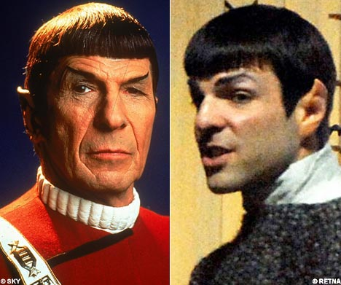

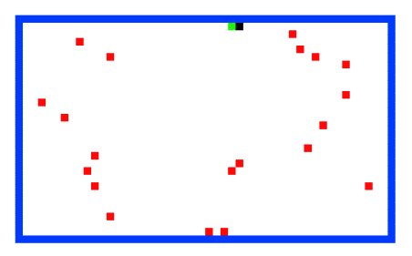

Puzzles!
Problem #1: logic puzzle
Assignment 11: four prolog puzzles…
Due after Thanksgiving (but not too far after)
The new generation of logical thinkers…
Line count:
30 lines
15 lines
15 lines
30 lines
#1
#2
#3
#4
Problem #2: 24
Keeping the CS 42 ecosystem balanced…
Problem #3: Towers of Hanoi
Problem #4: the island of knights and knaves…
Notes:
Zachary Quinto -- Spock

Slide 2
Fun and Games!
2
1
Goal: Assign a distinct digit (0-9) to each
letter to produce a valid sum (M!=0)
S E N D
+ M O R E
-------------
M O N E Y
3
A valid solution?
S =
E =
N =
D =
M =
O =
R =
Y =
A valid solution?
S =
E =
N =
D =
M =
O =
R =
Y =
1
0
2
3
5
4
9
8
9
0
0
0
1
0
0
0

Slide 3
digits([0, 1, 2, 3, 4, 5, 6, 7, 8, 9]).
% element( A, X, Y ) says A is an element of X, residue Y
sum( A, B, C, Sum, Carry ) :-
solution( [S, E, N, D, M, O, R, Y] ) :-
digits( Digits ),
element( D, Digits, D1 ), /* D E Y column */
element( E, D1, D2 ),
sum(D, E, 0, Y, C1 ),
element( Y, D2, D3),
/* N R E column */
/* E O N column */
/* S M O column */
/* M != 0 */
ELEMENT EXAMPLES!
element( 3, [2, 1, 3, 4],
[2, 1, 4] ) ?
element( 3, [2, 1, 3, 4],
[2, 1, 3, 4]
Sum is (A + B + C) mod 10,
Carry is (A + B + C) // 10.
sum(6, 8, 0, 4, 1)
6
1 8 0
--
4
element( N, D3, D4 ),
element( R, D4, D5 ),
sum( N, R, C1, E, C2 ),
element(O, D5, D6),
sum(E, O, C2, N, C3),
element(S, D6, D7),
element(M, D7, _),
sum( S, M, C3, O, M),
M =\= 0.
money.pl by Robert Keller

Slide 4
24 (Problem #2)
4
7
4
7
Can you combine these numbers into 24 with the operations + - * ÷ ?
2
1
Each operation may be used any number of times.
2
1
A two-dot card from the "official" 24 game: 24game.com

Slide 5
24 (Problem #2)
4
7
4
7
Can you combine these numbers into 24 with the operations + - * ÷ ?
2
1
Each operation may be used any number of times.
2
1
solve( [‘+’,‘-’,‘*’,‘/’], [1,2,4,7], 24, Tree ).
operators available: (use any number of times)
values:
(use each exactly once)
arithmetic tree
final answer
Tree = [*, [+, 1, [-,7,2]], 4]

Slide 6
Searching to the end…
be sure there is an end!
setof( Tree, solve( [‘+’,‘-’,‘*’,‘/’], [1,2,4,7], 24, Tree ) , S).
variable whose values you want to collect into a set
the set
predicate that you would like to satisfy…
setof( Tree, solve( [‘+’,‘-’,‘*’,‘/’], [5,1,155,11], 24, Tree ) , S).
a much smaller example…
setof( N, T^solve( [‘+’,‘-’,‘*’,‘/’], [4,4,4,4], N, T ) , S).
a surprisingly well-studied problem!
T^ ~ there exists a T

Slide 7
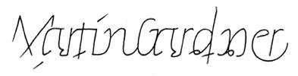

For four 4’s ...
0 = 4 + 4 - 4 - 4
1 = 44 / 44
2 = 4
...
8 = sqrt( .4 ) * ( 4 + 4 + 4 )
...
19 = ???
20 = 4! + 4 - 4 - 4
Allowed Operations
4/(4+4)
+
-
*
/
sqrt
.
!
concat
power
Ask around…

Slide 8
24 (Hint) (Problem #2)
solve( base case ).
solve( Ops, Values, Sol, Tree ) :-
Tree = [ Op, Left, Right ],
... .
What’s the problem?
Tree, Op, Left, Right
could all be anything!
Why won't this work?
What do you mean? It will work!
You can't unify a variable with a list
You need to use the == operator instead of =
All of Tree, Op, Left and Right may be unbound, which will cause a problem
You need to instead write [ Op, Left, Right ] = Tree
How does this help?
We can pin down solid values of Tree
If you want another hint, see the hidden slide on the web

Slide 9
solve
What is the base case?
What is the recursive case?
solve( Ops, Values, Sol, Tree ) :-
Set up: Ops and Values will have values; Sol and Tree may not…
Tree = [ Op, Left, Right ].
Use split !
Other constraints, perhaps…
solve( [‘+’,‘-’,‘*’,‘/’], [1,2,4,7], 24, Tree ).
Tree = [*,[+,1,[-,7,2]],4]
operators available: (use any number of times)
values:
(use each exactly once)
arithmetic tree
Each operation may be used any number of times.
final answer

Slide 10
eval
Tree-evaluation code provided:
Notice the base case!
eval(R, R) :- number(R).
eval(['+', A, B], R) :- eval(A, AR), eval(B, BR), R is AR + BR.
eval(['*', A, B], R) :- eval(A, AR), eval(B, BR), R is AR * BR.
eval(['-', A, B], R) :- eval(A, AR), eval(B, BR), R is AR - BR.
eval(['/', A, B], R) :- eval(A, AR), eval(B, BR), BR\==0, R is AR // BR.
the tree
It also checks nonvar(A) and nonvar(B)
resulting value

Slide 11
The alien, the spampede, and the spam!
Goal: Get back to the dorms with the spam, the spampede, and the three-eyed alien.
Constraints: Can’t carry more than one thing and can’t leave two things alone if one would eat the other…
Mudder
West
East

Slide 12
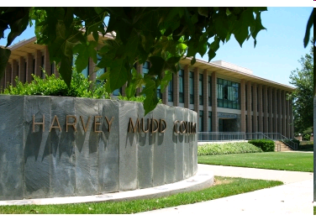
West Side
East Side
Mudder takes spampede east
Mudder goes west
Mudder takes alien east
Mudder takes spampede west
Mudder takes spam east
Mudder goes west
Mudder takes spampede east
How to formulate in Prolog?

Slide 13
The BIG Idea
initial configuration
[ [mudder, alien, spampede, spam], [] ]
[ [alien, spam], [mudder, spampede] ] ]
[ [], [mudder, alien, spampede, spam] ]
final configuration
solve( [[mudder,alien,spampede,spam],[]],
[mudder_takes_spampede_east, mudder_goes_west, ...] ).
yes.
Mudder_takes_spampede_east
. . .

Slide 14
The alien, the spampede, and the spam…
Configuration ~ a list of two sorted lists
[ [ mudder, alien, spampede, spam ], [ ] ]
West
East
one possible configuration
What constraints do we have?

Slide 15
The alien, the spampede, and the spam…
Configuration ~ a list of two sorted lists
[ [ mudder, alien, spampede, spam ], [ ] ]
West
East
C
Constraints ~ describing the puzzle
%% This checks each List (side) of a configuration. How?!
ok(L) :- sorted(L), (member(mudder, L) ; \+predatorprey(L)).
predatorprey(L) :- member(alien, L), member(spampede, L).
predatorprey(L) :- member(spampede, L), member(spam, L).
%% The final configuration is defined here.
final([ [], [mudder, alien, spampede, spam] ]).
L can be the West or the East side of a configuration

Slide 16
The alien, the spampede, and the spam…
Constraints ~ describe and select the moves:
describes a valid move
from this "before" configuration
to this "after" configuration
via this action
valid([Wb, Eb], mudder_goes_east, [Wa, Ea]) :-
How do we generate Wa and Ea ? What constraints do we need to check?

Slide 17
The alien, the spampede, and the spam…
Constraints ~ describe and select the moves:
describes a valid move
from this "before" configuration
to this "after" configuration
via this action
valid([Wb, Eb], mudder_goes_east, [Wa, Ea]) :-
perm([mudder|Eb],Ea),
perm(Wb,[mudder|Wa]),
ok(Wa),
ok(Ea).
uses perm to generate the resulting configuration
makes sure that they're sorted and safe from predators!
How Muddery different possible moves are there?

Slide 18
The alien, the spampede, and the spam…
solve ~ general-purpose puzzle-solving!
Wasn't there 42-dimensional configuration-space search in CS 5?
configuration-space search!
need to specify a starting configuration
Ask Prolog to generate a list of moves that results in the final configuration…
solve( StartConfig, ListOfMoves )
base case?

Slide 19
The alien, the spampede, and the spam…
solve ~ general-purpose puzzle-solving!
Prolog's configuration-space search:
%% what it means for a list of moves to solve the puzzle...
%% C is a configuration.
solve(C, []) :- final(C). %% Done! (base case)
solve(C, [Move | RoM]) :- %% Move ~ next move to make
[W, E] = C, %% C is the [ West, East ] pair
ok(W), ok(E), %% is everything in order?
valid(C, Move, NewC), %% selects a valid Move !
solve(NewC, RoM). %% solve the rest of the puzzle...
Doesn't this solve ALL problems !?!
How does it do?

Slide 20
The alien, the spampede, and the spam…
Aargh! It doesn't work!!
solve ~ general-purpose puzzle-solving!
Prolog's configuration-space search:
%% what it means for a list of moves to solve the puzzle...
%% C is a configuration.
solve(C, []) :- final(C). %% Done!
solve(C, [Move | RoM]) :- %% Move ~ next move to make
[W, E] = C, %% C is the [ West, East ] pair
ok(W), ok(E), %% is everything in order?
valid(C, Move, NewC), %% select a valid Move !
solve(NewC, RoM). %% solve the rest of the puzzle...
Doesn't this solve ALL problems !?!
How does it do?

Slide 21
dynamic predicates
:- dynamic marked/1.
declares marked to be a dynamic rule ~ iy can be changed an the fly…
add
assert( marked(42) ).
places marked(42) into the program's current database of facts.
marked( X )
will now produce at least one binding: X = 42
retract( marked(42) ).
removes marked(42) from the program's current database of facts.
remove
removes all of marked's rules from the program's current facts.
retractall( marked(_) ).

Slide 22
The alien, the spampede, and the spam…
Prolog's configuration-space search, with dynamic marking of configurations along the way…
:- dynamic marked/1.
solve(C, []) :- final(C). %% Done!
solve(C, [Move | RoM]) :- %% Move ~ next move to make
[W, E] = C, %% C is the [ West, East ] pair
ok(W), ok(E), %% is everything in order?
\+marked(C), %% "if" we haven't visited this C
assert(marked(C)), %% we mark it
valid(C, Move, NewC), %% select a valid Move !
solve(NewC, RoM). %% solve the rest of the puzzle...
Let's try it (twice)!
Why keep the list in sorted order?

Slide 23
Towers of Hanoi
Goal: Get all of the disks from Peg 1 to Peg 3.
Constraints: You may not place a smaller disk onto a larger one.
Peg 1
Peg 2
Peg 3
solve( [[1,2,3,4],[],[]], M ).
This could get Hanoi’ing!
Use spam.pl as a starting point…

Slide 24
Is the answer to this question the same as the answer to the question "Is there a CS42 assignment due after break?"?
NO!
No homework??

Slide 25
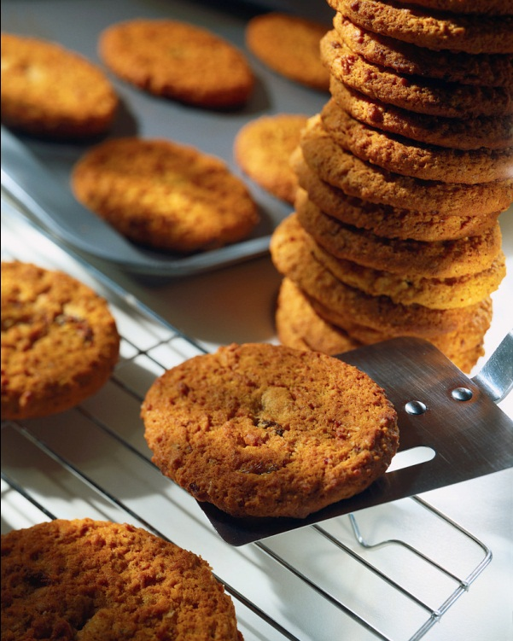
If there is no homework this week
THEN
Prof. Alvarado brought cookies today
And cookies too??

Slide 26
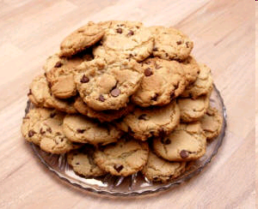
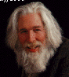


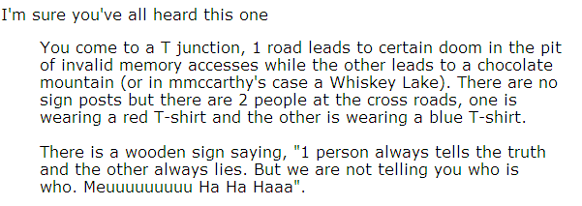
Truth-telling vs. Lying?
Raymond Smullian
Putting the logic into logic programming…

Slide 27

Truth-telling vs. Lying?
Raymond Smullian
Putting the logic into logic programming…

Slide 28
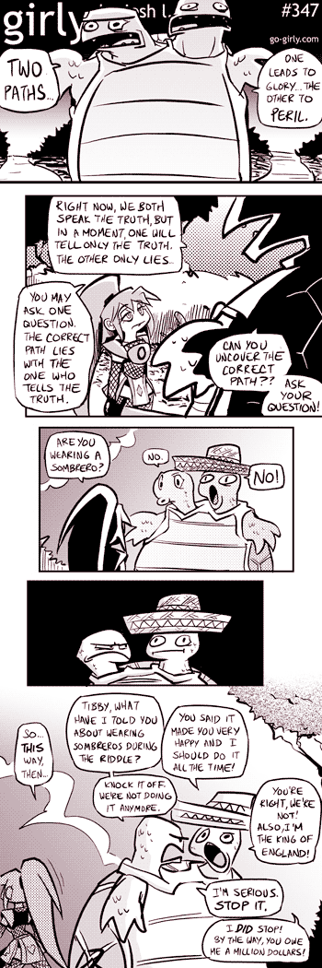
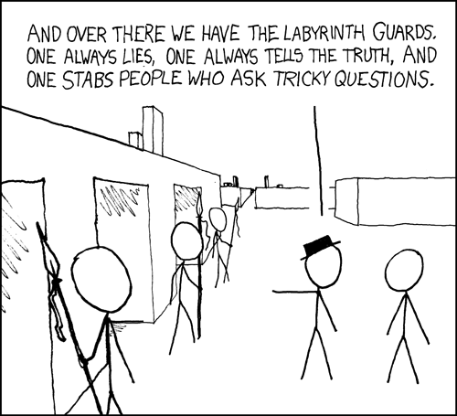
Truth-telling?
xkcd
Labyrinth, 1986
girly

Slide 29
The Liar Paradox
All HMC profs are liars
I always lie
I am lying right now (i.e. This sentence is false)

Slide 30
Curry's Paradox
If everyone in CS42 gets an A on all their homework and exams, then everyone in CS42 gets an A.

Slide 31
Curry's Paradox
If everyone in CS42 gets an A on all their homework and exams, then everyone in CS42 gets an A.
If this sentence is true, then everyone in CS42 gets an A.

Slide 32
Curry's Paradox
X
Y
X: If this sentence is true, then everyone in CS42 gets an A.
1. X → X
rule of assumption, also called restatement of premise or of hypothesis
2. X → (X → Y)
substitute right side of 1, since X = X → Y
3. X → Y
from 2 by contraction
4. X
substitute 3, since X = X → Y
5. Y
from 4 and 3 by modus ponens
http://en.wikipedia.org/wiki/Curry%27s_paradox

Slide 33
Logic is everywhere…
asks A, "What type are you?"
But particularly on the Island of knights and knaves…
A, B, and C are each a knight or knave:
<mumbles>
A
"A said that she is a knave"
B
"Don't believe B, he's lying!"
C

Slide 34
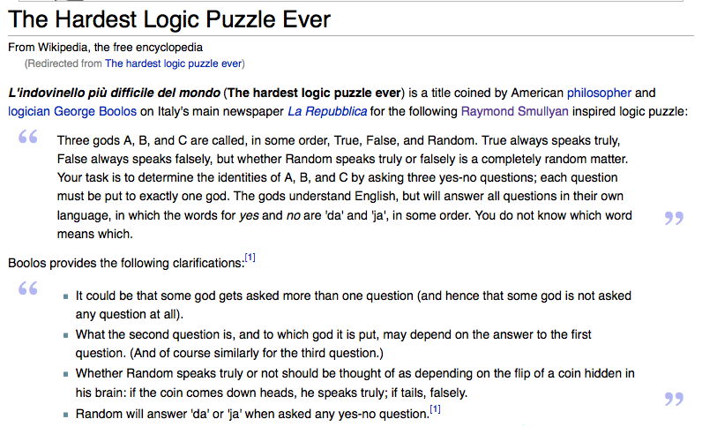

Slide 35
Logical functions are all computation
All logical functions from 2 bits of input to 1 bit of output
Inputs
Outputs
Function number
x
y
0
1
2
3
4
5
6
7
8
9
10
11
12
13
14
15
0
0
0
0
0
0
0
0
0
0
1
1
1
1
1
1
1
1
0
1
0
0
0
0
1
1
1
1
0
0
0
0
1
1
1
1
1
0
0
0
1
1
0
0
1
1
0
0
1
1
0
0
1
1
1
1
0
1
0
1
0
1
0
1
0
1
0
1
0
1
0
1
9?
13?
and what are their names?
Which of these are familiar?
How many logical functions are there…
From n bits to 1 bit ?
From n bits to m bits ?

Slide 36
Evaluating logical statements
Truth tables for two less familiar logical operators:
iff
ifthen
Inputs
Output
Inputs
Output
x
y
[iff, x, y]
x
y
[ifthen, x, y]
0
0
1
0
0
1
0
1
0
0
1
1
1
0
0
1
0
0
1
1
1
1
1
1
Do we need these?
This one I blame the mathematicians for…

Slide 37
Evaluating logical statements
All statements in predicate logic can be classified as
t/f expressions that may include variables
tautology
true, regardless of the values of any variables
satisfiable
if it can be made true (or it's already true)
unsatisfiable
if it can not be made true regardless of the values of any variables

Slide 38

Evaluating logical statements
All statements in predicate logic can be classified as
t/f expressions that may include variables
tautology
true, regardless of the values of any variables
satisfiable
if it can be made true (or it's already true)
unsatisfiable
if it can not be made true regardless of the values of any variables
http://xkcd.com/703/

Slide 39
Evaluating logical statements
All statements in predicate logic can be classified as
t/f expressions that may include variables
tautology
true, regardless of the values of any variables
Examples:
t
[or, v1, [not v1]]
Statements like these give variables a bad name!
satisfiable
if it can be made true (or it's already true)
Examples:
v42
[or, v1, v2]
plus all of the tautologies
unsatisfiable
if it can not be made true regardless of the values of any variables
Examples:
f
[and, v1, [not v1]]

Slide 40
Evaluating logical statements
What kinds of statements are these four?
Predicate logic representation
v1
1
Hw#11's Prolog representation
false iff false
[iff, f, f]
v1 iff (not v1)
[iff, 1, [not, 1]]
if v1 then (if v2 then v1)
[ifthen, 1, [ifthen, 2, 1]]
tautology
true, regardless of the values of any variables
satisfiable
if it can be made true (or it's already true)
unsatisfiable
if it can not be made true regardless of the values of any variables

Slide 41
Evaluating logical statements
v1 (v2 v1)
What islanders could make this statement?
implies
implies
If <mumble #1> then [if <mumble #2> then <mumble #1>]

Slide 42
Boole/Shannon expansion
v1 (v2 v1)
v1 (v2 v1)
What islanders could make this statement?
implies
implies
[ifthen, 1, [ifthen, 2, 1]]
[ifthen, t, [ifthen, m2, t]]
[ifthen, f, [ifthen, m2, f]]
Choose a variable.
Replace it both ways!

Slide 43
Boole/Shannon expansion
m1 (m2 m1)
v1 (v2 v1)
What islanders could make this statement?
implies
implies
[ifthen, m1, [ifthen, m2, m1]]
[ifthen, t, [ifthen, m2, t]]
[ifthen, f, [ifthen, m2, f]]
[ifthen, t, [ifthen, t, t]]
[ifthen, f, [ifthen, t, f]]
[ifthen, t, [ifthen, f, t]]
[ifthen, f, [ifthen, f, f]]
Recurse!!
What's the base case?

Slide 44
Boole/Shannon expansion
m1 (m2 m1)
What islanders could make this statement?
implies
implies
[ifthen, m1, [ifthen, m2, m1]]
[ifthen, t, [ifthen, m2, t]]
[ifthen, f, [ifthen, m2, f]]
[ifthen, t, [ifthen, t, t]]
[ifthen, f, [ifthen, t, f]]
[ifthen, t, [ifthen, f, t]]
[ifthen, f, [ifthen, f, f]]
t
t
t
t
Recursively ~ via Boole/Shannon expansion
tautology!

Slide 45
hw 11, problem #4
Your id predicate should determine who could have spoken a particular expression.
id( Expr, Speaker ).
knight
This could be
knave
This will be a fully-instantiated parse tree of logical operators, truth literals, and integers representing logical variables.
human
Your id predicate should be able to both check and generate appropriate types…
id( t, Who ).
id( [ifthen, f, 1], Who ).
Examples
id( [and, 2, [not, 2]], Who ).

Slide 46
Consider logical parse trees that use the operators: or, and, iff, ifthen, and not.
I guess you'd call these prological expressions
Quiz
f
1
[or, 1, t]
[and,1,[not,1]]
Here are four possible trees
noVars( Tree )
Write these two predicates
getVar( Tree, N )
noVars should be true when Tree has no (logical) variables. It does not need to generate Tree, only check it.
getVar should be true when Tree does have a (logical) variable. It should bind N to an integer that represents one such (logical) variable.
noVars( f ).
Base Cases
noVars( t ).
How many recursive cases?
How could noVars make getVar more efficient?

Slide 47
hw 11, problem #4
Using your predicates from the Quiz, come up with an approach to this problem.
id( Expr, Speaker ).
knight
This could be
knave
This will be a fully-instantiated parse tree of logical operators, truth literals, and integers representing logical variables.
human
Your id predicate should be able to both check and generate appropriate types…

