Slide 1
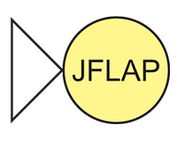
CS 42 today
Hw 11: Prolog puzzles (due Tonight!)
Hw 12: Languages (due Monday 12/6)
Grutoring hours: Tonight! 8-12
What would all possible computations look like?
( 01* | 10 )*
Even I wouldn't call this expression "regular."
And, in particular, do they look like this?
Notes:
1

Slide 2
Exam 2 Results
Again, nice job!
Mean: 84%, Median: 90%
But, a wider spread…
Notes:
2

Slide 3
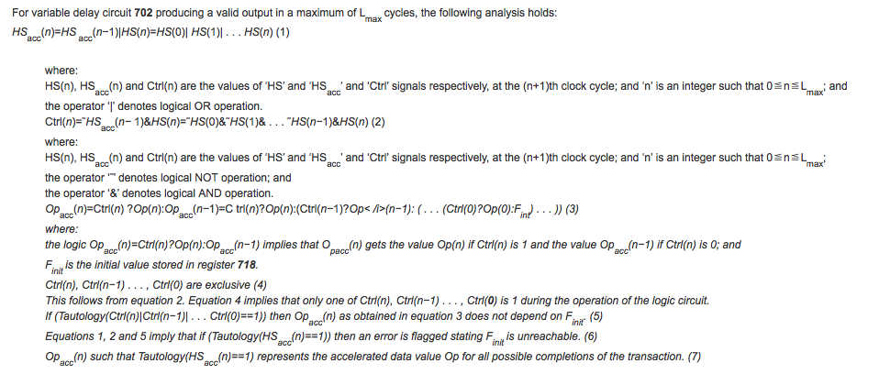
tautologies ~ circuit simplification…
a subroutine for minimizing circuit complexity…

Slide 4
A more theoretical application
x or y = y or x
Definition of a Boolean Algebra
(x or y) or z = x or (y or z)
!(!x or y) or !(!x or !y) = x
What’s this?
Definition of a Robbins Algebra
!(!(x or y) or !(x or !y)) = x
Herbert Robbins (1933)
Are these equivalent structures?

Slide 5
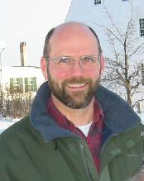

Axioms of Boolean Algebra
x or y = y or x
Definition of a Boolean Algebra
(x or y) or z = x or (y or z)
!(!x or y) or !(!x or !y) = x
What’s this?
Yes!
Definition of a Robbins Algebra
!(!(x or y) or !(x or !y) = x
Herbert Robbins (1933)
William McCune, Argonne National Lab
6/96

Slide 6
Robbins algebras are Boolean
----- EQP 0.9, June 1996 -----
The job began on eyas09.mcs.anl.gov, Wed Oct 2 12:25:37 1996
UNIT CONFLICT from 17666 and 2 at 678232.20 seconds.
---------------- PROOF ----------------
2 (wt=7) [] -(n(x + y) = n(x)).
3 (wt=13) [] n(n(n(x) + y) + n(x + y)) = y.
5 (wt=18) [para(3,3)] n(n(n(x + y) + n(x) + y) + y) = n(x + y).
6 (wt=19) [para(3,3)] n(n(n(n(x) + y) + x + y) + y) = n(n(x) + y).
24 (wt=21) [para(6,3)] n(n(n(n(x) + y) + x + y + y) + n(n(x) + y)) = y.
47 (wt=29) [para(24,3)] n(n(n(n(n(x) + y) + x + y + y) + n(n(x) + y) + z) + n(y + z)) = z.
48 (wt=27) [para(24,3)] n(n(n(n(x) + y) + n(n(x) + y) + x + y + y) + y) = n(n(x) + y).
146 (wt=29) [para(48,3)] n(n(n(n(x) + y) + n(n(x) + y) + x + y + y + y) + n(n(x) + y)) = y.
250 (wt=34) [para(47,3)] n(n(n(n(n(x) + y) + x + y + y) + n(n(x) + y) + n(y + z) + z) + z) = n(y + z).
996 (wt=42) [para(250,3)] n(n(n(n(n(n(x) + y) + x + y + y) + n(n(x) + y) + n(y + z) + z) + z + u) + n(n(y + z) + u)) = u.
16379 (wt=21) [para(5,996),demod([3])] n(n(n(n(x) + x) + x + x + x) + x) = n(n(x) + x).
16387 (wt=29) [para(16379,3)] n(n(n(n(n(x) + x) + x + x + x) + x + y) + n(n(n(x) + x) + y)) = y.
16388 (wt=23) [para(16379,3)] n(n(n(n(x) + x) + x + x + x + x) + n(n(x) + x)) = x.
16393 (wt=29) [para(16388,3)] n(n(n(n(x) + x) + n(n(x) + x) + x + x + x + x) + x) = n(n(x) + x).
16426 (wt=37) [para(16393,3)] n(n(n(n(n(x) + x) + n(n(x) + x) + x + x + x + x) + x + y) + n(n(n(x) + x) + y)) = y.
17547 (wt=60) [para(146,16387)] n(n(n(n(n(x) + x) + n(n(x) + x) + x + x + x + x) + n(n(n(x) + x) + x + x + x) + x) + x)
= n(n(n(x) + x) + n(n(x) + x) + x + x + x + x).
17666 (wt=33) [para(24,16426),demod([17547])] n(n(n(x) + x) + n(n(x) + x) + x + x + x + x) = n(n(n(x) + x) + x + x + x).
------------ end of proof -------------
EQP’s output… has since been hand-checked!

Slide 7
Map Coloring: 1852-1976
colorMap([A,B,C,D,E,F,G],Colors) :-
setColors(Colors),
next(A,B,Colors),
next(A,C,Colors),
next(A,D,Colors),
next(A,E,Colors),
next(B,C,Colors),
next(B,D,Colors),
next(B,E,Colors),
next(B,F,Colors),
next(B,G,Colors),
next(C,E,Colors),
next(D,E,Colors),
next(D,F,Colors),
next(E,G,Colors),
next(F,G,Colors).
setColors([ocher,puce,taupe,zaffer]).
next(X,Y,Colors) :-
The Map
This is your brain on Prolog… any questions?
F
B
G
D
A
C
E
Is this similar to any other data structures we’ve seen?

Slide 8
Map Coloring: 1852-1976
colorMap([A,B,C,D,E,F,G],Colors) :-
setColors(Colors),
next(A,B,Colors),
next(A,C,Colors),
next(A,D,Colors),
next(A,E,Colors),
next(B,C,Colors),
next(B,D,Colors),
next(B,E,Colors),
next(B,F,Colors),
next(B,G,Colors),
next(C,E,Colors),
next(D,E,Colors),
next(D,F,Colors),
next(E,G,Colors),
next(F,G,Colors).
setColors([ocher,puce,taupe,zaffer]).
next(X,Y,Colors) :-
The Graph
F
•
•
B
G
•
•
D
•
A
C
•
•
E
Not just any graph!

Slide 9

Map Coloring: 1852-1976
1852: Francis Guthrie conjectures that all maps can be 4-colored.
1879: A. B. Kempe’s “Proof”.
1890: Heawood’s Discovery and proof for all maps with =< 5 regions
1922: Franklin: proof that all maps with =< 25 regions
1925: Errera: proof that all maps with =< 26 regions
1940: Winn: proof that all maps with =< 36 regions
1970: Ore & Stemple: proof that all maps with =< 40 regions
1 region/decade!
1976: Appel & Haken & machine: proof that all maps are 4-colorable

Slide 10

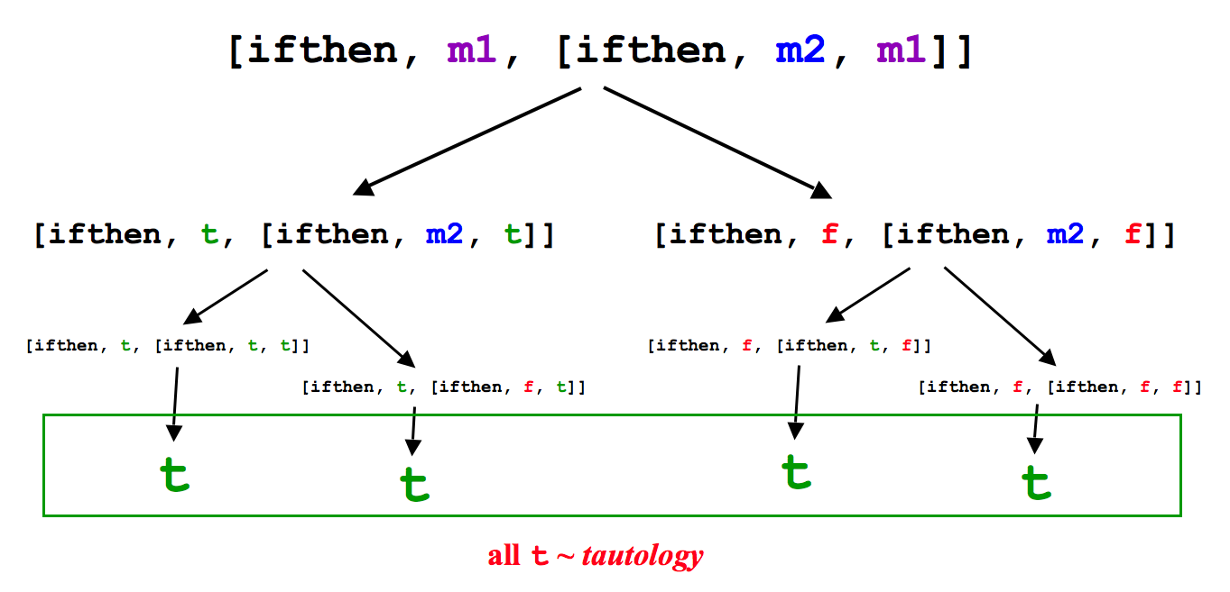
The lie detector
Reminder of the algorithm for evaluating logical expressions:
id( Expr, Speaker ).
You will need a number of helper rules…
Key subroutines
getVar
subst
Use recursion!
If not working, go to
No - I've been framed! I'm really a knight!
Hmmm, I'm still unsatisfied.
Notes:
10

Slide 11
The lie detector: efficiency
Suppose that Expr has N distinct logical variables.
What is the big-O run time of the tautology checker?
Is it any faster to check satisfiability or unsatisfiability?
Can we do better? polynomial, perhaps?
Notes:
11

Slide 12
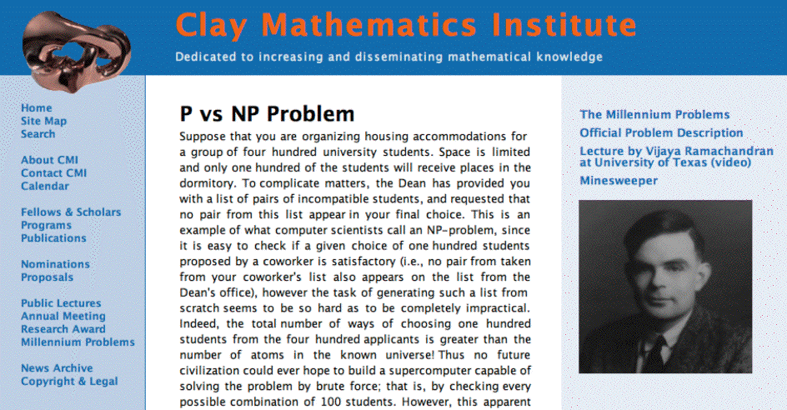

20
The 2 dollar question…
"Difficult" problems are, in fact, difficult.
"Difficult" problems are, in fact, easy.
No.
Yes!!
Is there a polynomial-time algorithm for satisfiability-checking?
Notes:
12

Slide 13
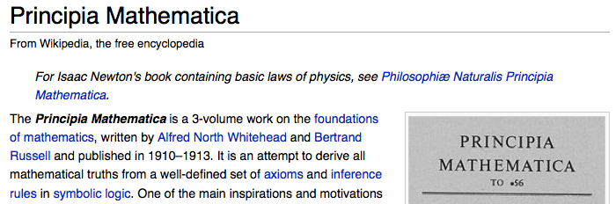
Automating mathematics?
A long-time dream…
Assumed that all mathematics could be represented – and generated – by boolean functions… ?
… and set out to do it!

Slide 14
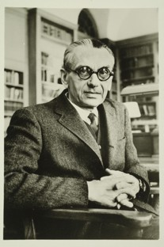
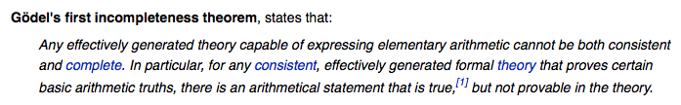
Automating mathematics?
A long-time dream…
No!
"shattered" by Kurt Godel
Algorithm or program

Slide 15
So, what can be accomplished via logical functions?
(boolean)
Any computation at all...
… but not anything at all…
encode a problem with bits and it becomes one of computing logical functions
as Godel (and Smullyan!) showed...
What does it mean to be computable?
If something is computable, how efficiently can it be computed?
big-O
Names for these fields…
Notes:
15

Slide 16
So, what can be accomplished via logical functions?
or "boolean"
Any computation at all...
… but not anything at all…
encode a problem with bits and it becomes one of computing logical functions
as Godel (and Smullyan!) showed...
Computability
What does it mean to be computable?
Theocomp
What can and can't we compute?
Complexity
If something is computable, how efficiently can it be computed?
…and how well?
big-O
Notes:
16

Slide 17
Taxonomy of Computational Models
Programming
Where is this "machine"?
Declarative
Programming
Imperative
Programming
Logic Programming
Functional Programming
Object-Oriented
Programming
Low-level Programming
Prolog
Racket
Python
JFlap
leveraging one algorithm
creating algorithms
creating data structures
creating computation
-- and algorithms, too
more abstraction away from the machine
closer to the machine

Slide 18
Taxonomy of Computational Models
Programming
Declarative
Programming
Imperative
Programming
Logic Programming
Functional Programming
Object-Oriented
Programming
Low-level Programming
Prolog
Racket
Python
the machine
JFlap
leveraging one algorithm
creating algorithms
creating data structures
creating computation
-- and algorithms, too
more abstraction away from the machine
closer to the machine
run over by the machine

Slide 19
One idea of low-level programming
main:
pushl %ebp
movl %esp, %ebp
subl $24, %esp
andl $-16, %esp
movl $0, %eax
subl %eax, %esp
movl $42, -4(%ebp)
movl $7, -8(%ebp)
movl -4(%ebp), %eax
movl %eax, -12(%ebp)
movl -8(%ebp), %eax
movl %eax, -4(%ebp)
movl -12(%ebp), %eax
movl %eax, -8(%ebp)
subl $4, %esp
pushl -8(%ebp)
pushl -4(%ebp)
pushl $.LC0
call printf
addl $16, %esp
leave
ret
main:
!#PROLOGUE# 0
save %sp, -128, %sp
!#PROLOGUE# 1
mov 42, %g1
st %g1, [%fp-20]
mov 7, %g1
st %g1, [%fp-24]
ld [%fp-20], %g1
st %g1, [%fp-28]
ld [%fp-24], %g1
st %g1, [%fp-20]
ld [%fp-28], %g1
st %g1, [%fp-24]
sethi %hi(.LLC0), %g1
or %g1, %lo(.LLC0), %o0
ld [%fp-20], %o1
ld [%fp-24], %o2
call printf, 0
nop
mov %g1, %i0
ret
restore
main:
pushl %ebp
movl %esp, %ebp
subl $8, %esp
andl $-16, %esp
movl $0, %eax
subl %eax, %esp
movl $42, -4(%ebp)
movl $7, -8(%ebp)
movl -8(%ebp), %edx
leal -4(%ebp), %eax
xorl %edx, (%eax)
movl -4(%ebp), %edx
leal -8(%ebp), %eax
xorl %edx, (%eax)
movl -8(%ebp), %edx
leal -4(%ebp), %eax
xorl %edx, (%eax)
subl $4, %esp
pushl -8(%ebp)
pushl -4(%ebp)
pushl $.LC0
call printf
addl $16, %esp
leave
ret
main:
!#PROLOGUE# 0
save %sp, -120, %sp
!#PROLOGUE# 1
mov 42, %g1
st %g1, [%fp-20]
mov 7, %g1
st %g1, [%fp-24]
ld [%fp-20], %o5
ld [%fp-24], %g1
xor %o5, %g1, %g1
mov %g1, %o5
st %o5, [%fp-20]
ld [%fp-24], %g1
xor %g1, %o5, %g1
mov %g1, %o5
st %o5, [%fp-24]
ld [%fp-20], %g1
xor %g1, %o5, %g1
st %g1, [%fp-20]
sethi %hi(.LLC0), %g1
or %g1, %lo(.LLC0), %o0
ld [%fp-20], %o1
ld [%fp-24], %o2
call printf, 0
nop
mov %g1, %i0
ret
restore
Intel: PC
UltraSparc: Turing
Intel: PC
lots of machine-dependent details -- is it worth it?
UltraSparc: Turing

Slide 20
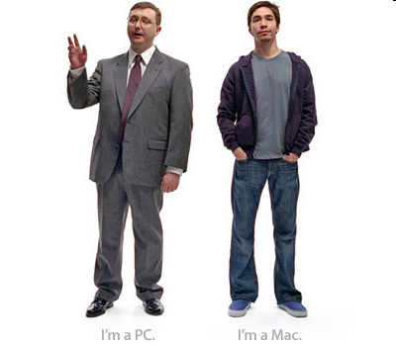
What can a computer do?

Slide 21
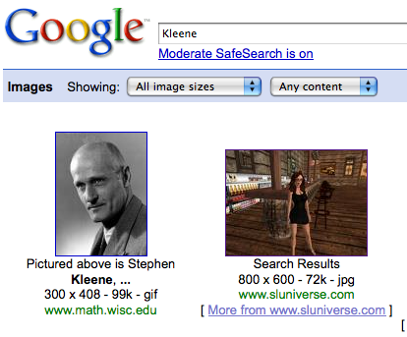
Computable Sets
Computation ~ logical functions
consider only 1 bit of output (combine these to get more)
Computation simply separates its inputs!
Kleene, 1950's
inputs yielding "true"
inputs yielding "false"
do we need both of these?

Slide 22
Computable Sets
Computation ~ logical functions
consider only 1 bit of output (combine these to get more)
Computation simply separates its inputs!
Kleene, 1950's
inputs yielding "true"
inputs yielding "false"
One of these is enough to describe a particular computation.
a formal language
is a set of inputs selected by a computation
from function to structure…

Slide 23
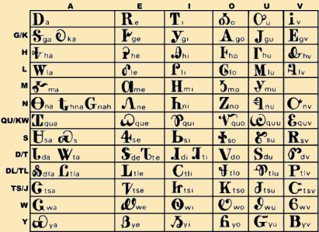
Formal languages
example alphabets
Choose an alphabet
(a set of input characters)
ASCII
{a,b,…,z}
{0,1}
Consider all sets of the alphabet's finite-length strings.
∅
1
10
100
101010
do the sets themselves have to be finite?
{ }

Slide 24
Formal languages
example alphabets
Choose an alphabet
(a set of input characters)
ASCII
{a,b,…,z}
{0,1}
Consider all sets of the alphabet's finite-length strings.
∅
1
10
100
1
10
100
1000
…
λ
0
1
00
01
10
11
000
…
101010
{ }
Are all of these computable by some program?
Choose your data representation…
Choose your algorithm…
Choose your language…
Choose your computer…
Choose your OS…

Slide 25
Formal languages
example alphabets
Choose an alphabet
(a set of input characters)
ASCII
{a,b,…,z}
{0,1}
Consider all sets of the alphabet's finite-length strings.
∅
1
10
100
1
10
100
1000
…
λ
0
1
00
01
10
11
000
…
101010
{ }
Are all of these computable by some program?
NO !

Slide 26
Languages > Programs
There are as many programs as integers…
λ
0
1
00
01
10
11
000
…
There are as many languages as real numbers…
If you "choose" a language at random, what is its probability of being computable?

Slide 27
Computable Languages = "Regular" Languages
(Deterministic Finite Automata)
"A language is regular
if and only if there if a DFA
that accepts it"
DFAs
=
=
Regular
Languages
"A language is regular
if and only if it can be
represented with a
regular expression"
"A language is regular
if and only if there if an
NFA that accepts it"
Regular
Expressions
NFAs
=
(Nondeterministic Finite Automata)
We will learn about all three and prove that they are all equivalent

Slide 28
A model of computation: DFAs
DFA or “Finite State Machine”
Deterministic
(Deterministic Finite Automaton)
Every state has one transition for every possible character.
0
0
1
Finite
Machine 1
q0
q1
key resource is memory
1
start state
transition
final (accepting) state
“input funnel”
“where to go”
double circled
Example Inputs:
What strings are accepted?

Slide 29
DFAs or FSMs
Deterministic
0
Every state has one transition for every possible character.
1
q1
Machine 2
q0
0
1
q2
0,1
“language accepted by Machine 2”
L(Machine 2) =

Slide 30
DFA Examples
What DFA accepts L = { w | w is a binary # that’s even }
What DFA accepts L = { w | w does not contain the substring 101 }
binary even numbers are sort of cheating…

Slide 31
DFA Examples
What DFA accepts L = { w | w is a binary # that’s even }
A common sentiment:
I understood the last two examples,
but I have no idea where to start here
What DFA accepts L = { w | w does not contain the substring 101 }
binary even numbers are sort of cheating…

Slide 32
DFA Examples
What DFA accepts L = { w | w is a binary # that’s even }
"ok, so I know I need a start state"
binary even numbers are sort of cheating…

Slide 33
DFA Examples
What DFA accepts L = { w | w is a binary # that’s even }
"now… an even number has to end with a 0. So 10 should be
accepted, but 1 should not."
q0
binary even numbers are sort of cheating…

Slide 34
DFA Examples
What DFA accepts L = { w | w is a binary # that’s even }
"OK, so far so good… but now I need to accept 100 too, and reject 11."
q0
1
q1
0
q2
binary even numbers are sort of cheating…

Slide 35
DFA Examples
What DFA accepts L = { w | w is a binary # that’s even }
"Hmmm… maybe I should reconsider..."
q0
1
q1
0
q2
0
q3
1
q4
binary even numbers are sort of cheating…

Slide 36
DFA Examples
What DFA accepts L = { w | w is a binary # that’s even }
"Well, maybe if I just fill in the missing transitions…"
q0
1
q1
0
q2
binary even numbers are sort of cheating…

Slide 37
DFA Examples
What DFA accepts L = { w | w is a binary # that’s even }
"Well, maybe if I just fill in the missing transitions…"
q1 = "The last thing I saw was a 1"
q0
1
q1
0
q2
q0 = "I've seen nothing"
q2 = "The last thing I saw was a 0"
binary even numbers are sort of cheating…

Slide 38
DFA Examples
What DFA accepts L = { w | w is a binary # that’s even }
"Well, maybe if I just fill in the missing transitions…"
q1 = "The last thing I saw was a 1"
q0
1
q1
0
q2
q0 = "I've seen nothing"
q2 = "The last thing I saw was a 0"
binary even numbers are sort of cheating…

Slide 39
DFA Examples
What DFA accepts L = { w | w does not contain the substring 101 }

Slide 40
(1) Draw a DFA that accepts
L = { w | w’s third character is a 1}
How do we know if we have the most efficient machine?

Slide 41
(2) (Watch out!) Draw a DFA accepting
L = { w | w’s third-to-last character (from the right) is a 1}
Extra Credit: do your solutions use the minimum possible number of states?

Slide 42
The Size of a DFA
How do we know when our DFA is as small as possible?
1
q1
0
1
1
1
q1
0
q2
q0
1
0
q2
0
0

Slide 43
When is a DFA as small as possible
Intuitively, a DFA is as small as it possibly can be if taking away a state would necessarily lead to a change in the language it accepts.
How can we prove this?

Slide 44
String soulmates…
Distinguishing between in and out of the language
Start with a language
L = { w | w’s third character is a 1}
example strings in L
example strings NOT in L
001
1010
11100010
011111111
λ
11
0101010
110111011110
Meet our four string couples for today…
w₁ = 011…
w₁ = 011…
w₁ = 01…
w₁ = 0…
w₂ = 111…
w₂ = 110…
w₂ = 10…
w₂ = 10…
Couple #1
Couple #2
Couple #3
Couple #4
Are the fates of these couples’ strings the same or different?
both accepted? both rejected? or might they have different outcomes?
indistinguishable
distinguishable

Slide 45
String matchmaking
Definition 1: Two strings w₁ and w₂ are distinguishable with respect to language L if…
Definition 2: A set S = {w₁, w₂, …} is pairwise distinguishable with respect to language L if…
There exists z s.t.
w1z in L
W2z not in L or vice versa
There exists a z such that w₁z is in L and w₂z is not in L.
wi and wj are distinguishable for all
i not= j.
w_{i} and w_{j} are distinguishable with respect to L for all i != j.

Slide 46
Distinguishability Practice
Explain notation
L = {0^{i}1^{j} | i is even, j is odd}
Are the following distinguishable w.r.t. L?
00, 0
0000, 00
010, 1
λ, 001

Slide 47
The Distinguishability Theorem
If there is a pairwise distinguishable set of N strings for a language L, then a DFA accepting L must have ≥ N states.
Intuition: If two strings are distinguishable, then they have to go
“separate ways” in the DFA on the same input. Thus they need to be
in different states at then end of their input.
Proof: by contradiction
Assume there exists a DFA M with n-1 states.
By the pigeonhole principle, at least two of the inputs must end up in the
Same state at the end of their input.
Call this state qbad. wi and wj are the two words that end in qbad.
wiz should accept and wjz should reject. But since qbad does not know the
Difference between wi and wj, it has no choice but to allow z to pass
Through the exact same states until z runs out.

Slide 48
XX1 revisited
Using the distinguishability theorem, prove that a DFA to recognize
L₁ = {w | w has a 1 in the third symbol from the left}
must have at least 5 states

Slide 49
1XX revisited
Using the distinguishability theorem, prove that a DFA to recognize
L₂ = {w | w has a 1 in the third symbol from the right}
must have at least 8 states

Slide 50
Assume we have a DFA M with N-1 states that recognizes L.
We will prove that M cannot actually exist (it does not actually recognize L).
wi
q_{s}
q_{end}
M
q_{bad}
wj
z
Consider the set of pairwise distinguishable strings.
Because there are N of these, two of them MUST end in the same state
after being processed by M. Call this state q_{bad}. Call the strings
w_{i} and w_{j}
Because w_{i} and w_{j} are pairwise distinguishable, there must exists some z
such that w_{i}z is in L and w_{j}z is not in L, or vice versa.
However, because M is deterministic, beginning in state q_{bad}, z will always
transition to the same state, q_{end}, which must either accept or
reject both w_{i}z and w_{j}z. So M does not recognize L.

Slide 51
All languages are not Regular Languages
A language L is regular if there is a DFA that accepts it.
L = { w | w’s third character is a 1}
L = { w | w’s third-to-last character (from the right) is a 1}
L = { w | w is a binary # that’s divisible by 3 }
How could we prove that
L = { 0^{n}1^{n} | n ≥ 0}
is not regular?

Slide 52
Regular Languages
A language L is regular if there is a DFA that accepts it.
L = { w | w’s third character is a 1}
L = { w | w’s third-to-last character (from the right) is a 1}
L = { w | w is a binary # that’s divisible by 3 }
How could we prove that
L = { 0^{n}1^{n} | n ≥ 0}
is not regular?
If there is an infinite pairwise distinguishable set of strings (w.r.t. L), it must be that L is not regular!
The Nonregular Language Theorem

Slide 53
The Nonregular Language Theorem
Consider the language
L = { 0^{n}1^{n} | n ≥ 0}
example strings
To show it’s not regular…
λ
01
0011
000111
00001111
0000011111
DFA’s can’t do everything!
Maybe a better model can?

Slide 54
Using the Nonregular Language Theorem
Is L = {ww | w is a string of 0s and 1s} regular?
Is L = {0^{n^2} | n >= 0} regular?

