Slide 1
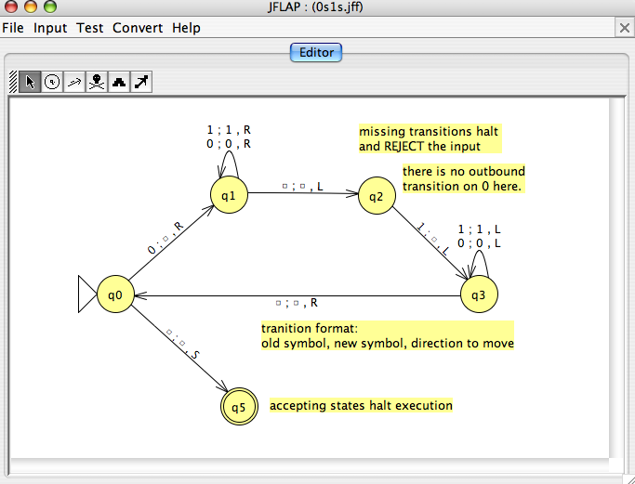
HW 12 due Dec. 6
Today in CS 42
JFLAP!
Models of computation
Regular Expressions
Nondeterministic Finite Automata
all have equivalent expressive power
Deterministic Finite Automata
strictly more powerful than DFAs
Turing Machines
How to prove some languages are not regular

Slide 2
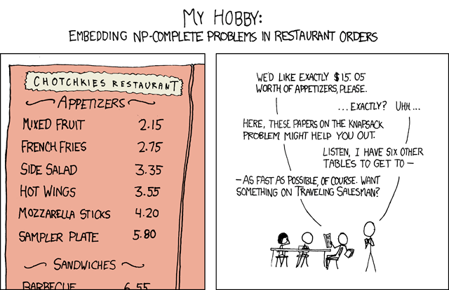

Slide 3
the HMC DFA
actually, this isn’t a DFA…
work
this is a λ-transition
sleep
HMC
bored
have fun
normal
life
born
not enough?
ITR
Gautam Thatte
Mira Stoilova

Slide 4
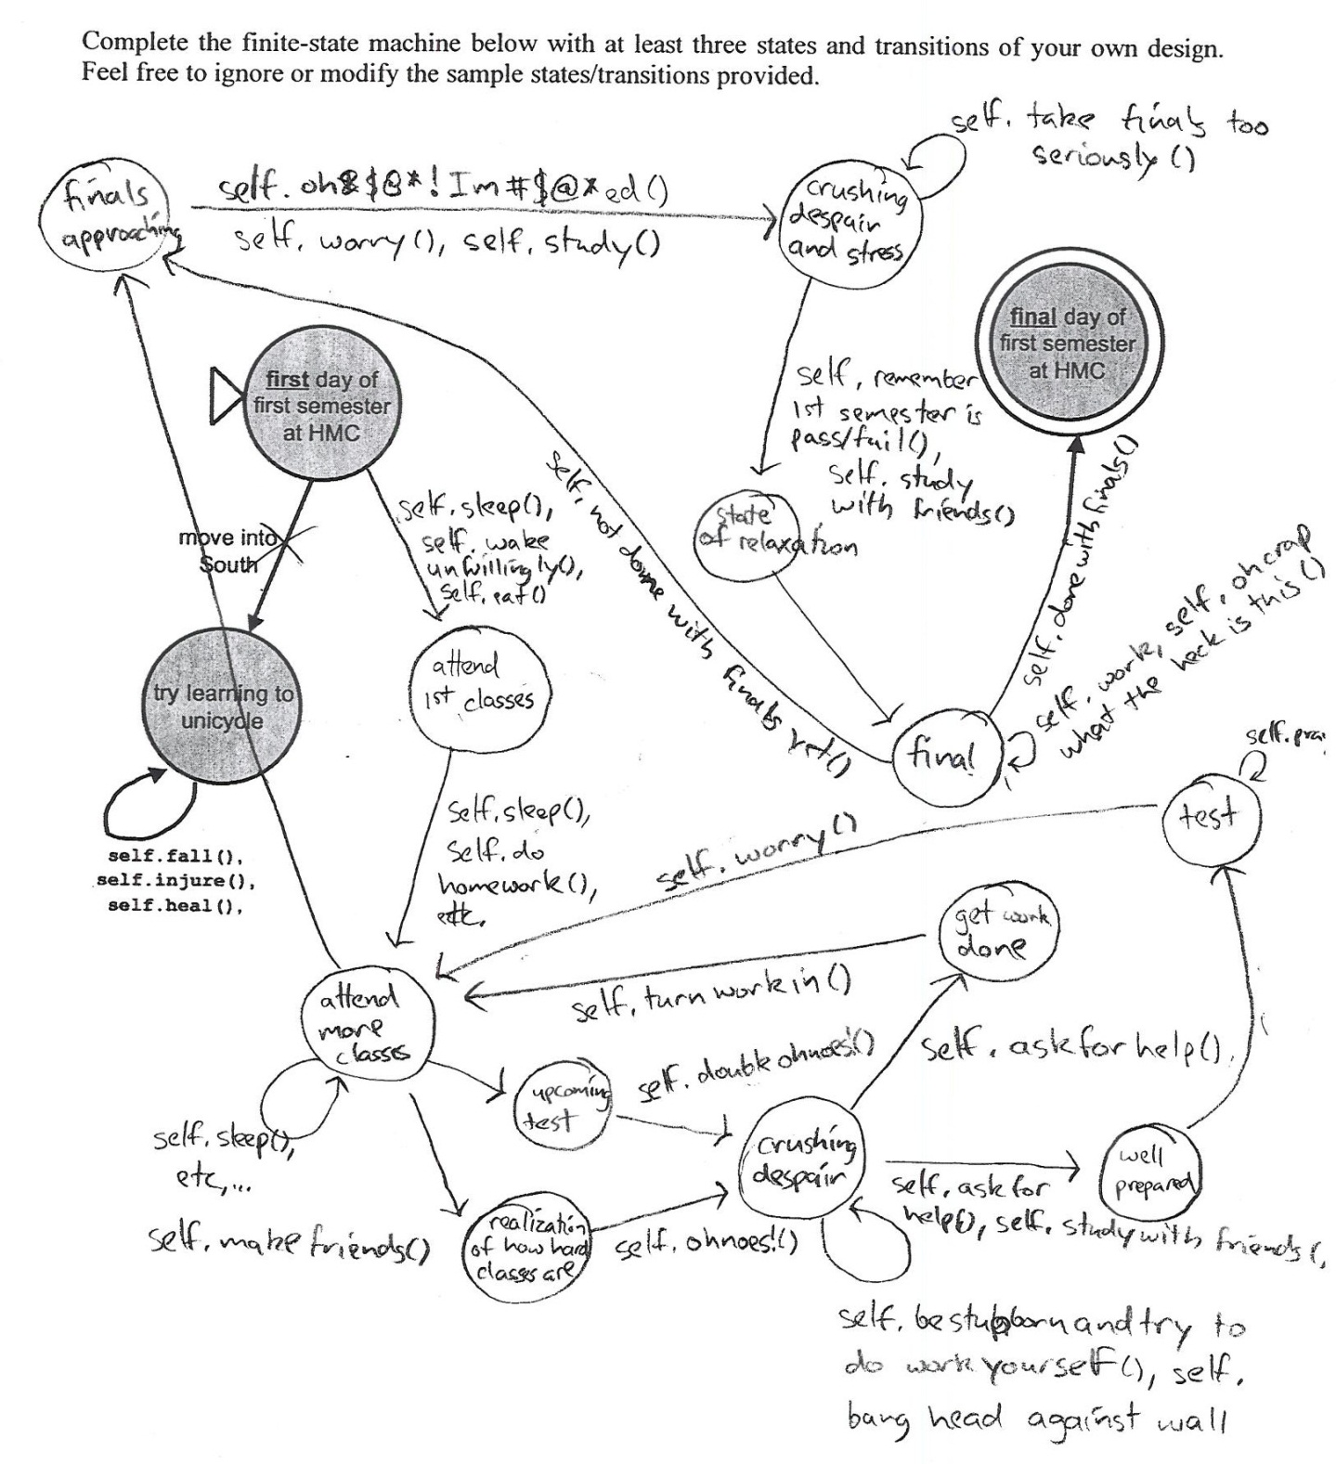
Another HMC DFA
not sure whose this is…

Slide 5
The Distinguishability Theorem
If there is a pairwise distinguishable set of N strings for a language L, then a DFA accepting L must have ≥ N states.
Intuition: If two strings are distinguishable, then they have to go
“separate ways” in the DFA on the same input. Thus they need to be
in different states at then end of their input.
Proof: by contradiction
Assume there exists a DFA M with n-1 states.
By the pigeonhole principle, at least two of the inputs must end up in the
Same state at the end of their input.
Call this state qbad. wi and wj are the two words that end in qbad.
wiz should accept and wjz should reject. But since qbad does not know the
Difference between wi and wj, it has no choice but to allow z to pass
Through the exact same states until z runs out.

Slide 6
XX1 revisited
Using the distinguishability theorem, prove that a DFA to recognize
L₁ = {w | w has a 1 in the third symbol from the left}
must have at least 5 states

Slide 7
1XX revisited
Using the distinguishability theorem, prove that a DFA to recognize
L₂ = {w | w has a 1 in the third symbol from the right}
must have at least 8 states

Slide 8
Assume we have a DFA M with N-1 states that recognizes L.
We will prove that M cannot actually exist (it does not actually recognize L).
wi
q_{s}
q_{end}
M
q_{bad}
wj
z
Consider the set of pairwise distinguishable strings.
Because there are N of these, two of them MUST end in the same state
after being processed by M. Call this state q_{bad}. Call the strings
w_{i} and w_{j}
Because w_{i} and w_{j} are pairwise distinguishable, there must exists some z
such that w_{i}z is in L and w_{j}z is not in L, or vice versa.
However, because M is deterministic, beginning in state q_{bad}, z will always
transition to the same state, q_{end}, which must either accept or
reject both w_{i}z and w_{j}z. So M does not recognize L.

Slide 9
RLs: Equivalent Representations
(Deterministic Finite Automata)
DFAs
=
=
Regular
Languages
Regular
Expressions
NFAs
=
(Nondeterministic Finite Automata)
We'll only prove regexp->NFA->DFA, not the other way
So NFAs and regexps are NO MORE POWERFUL than DFAs

Slide 10
DFAs + parallel universes = NFAs
NFAs
(Nondeterministic Finite Automata)
States may have any number (0,1,2,…) of transitions on a single character. They may also teleport on a transition with no character at all!
q1
1
λ
q0
λ
q2
0

Slide 11
DFAs + parallel universes = NFAs
NFAs
(Nondeterministic Finite Automata)
States may have any number (0,1,2,…) of transitions on a single character. They may also teleport on a transition with no character at all!
q1
1
1
q0
1
q2
0
L = { w | w’s third character from the right is a 1} (revisited)

Slide 12
NFAs ←→ DFAs
How do we prove that there exists an NFA to recognize a language L if and only if there exists a DFA to recognize L?
Mechanical “recipe” for converting from
a NFA to an DFA:
Enumerate the combinations of states in the
NFA (including an empty set)
Connect configurations according
to how states are “activated” in the NFA
Accept states are those containing at
least one accept state from DFA

Slide 13
NFAs ←→ DFAs
How do we prove that there exists an NFA to recognize a language L if and only if there exists a DFA to recognize L?
Part 1: Prove the forward "if" direction: There exists an NFA to recognize
L if there exists a DFA to recognize it.
Mechanical “recipe” for converting from
a NFA to an DFA:
Enumerate the combinations of states in the
NFA (including an empty set)
Connect configurations according
to how states are “activated” in the NFA
Accept states are those containing at
least one accept state from DFA
Part 2: Prove the backward "and only if" direction:
There exists an NFA to recognize L only if there exists a DFA to recognize it.
That is, if we have an NFA for L, there must also be a DFA for the same L.
q₀
0
1
q₁
q₂
0
1

Slide 14
RLs: Equivalent Representations
(Deterministic Finite Automata)
DFAs
=
=
Regular
Languages
Regular
Expressions
NFAs
=
(Nondeterministic Finite Automata)
We'll only prove regexp->NFA->DFA, not the other way
So NFAs and regexps are NO MORE POWERFUL than DFAs

Slide 15
Kleene's computer: Regular Expressions
a "simple" description for those sets that are computable …
A regex describes a formal language, a set of (binary) inputs for which a logical function outputs True
regex
10
(10)*
1* | 10*
L = { w | w is zero or more 1's or w is a single 1 followed by zero or more 0's
its language
{ 10 }
{λ, 10, 1010, 101010, … }
Ouch!
A regular expression is composed of three operations:
Kleene Star a* “0 or more a’s”
high precedence
concatenation ab “a then b”
union a | b “a or b”
low precedence
where a and b can be any bit strings - or regular expressions
base case
recursively defined !
Notes:
15
http://www.cs.duke.edu/csed/jflap/new/DOCS/gui.regular.EditorPane.html
The Regular Expression EditorThe editor for a regular expression is essentially just a single text field. Operators in a regular expression are the Kleene star (*), the ``or'' operator (+), parentheses are also usable, and concatenation is accomplished by making symbols adjacent.In HaikuTo make expressions for this program to work with, type them in the field.Adjacent symbols imply concatenation. No symbol is used.Many or nothing, Asterisk (*) is the Kleine star. What precedes repeats.Additionally, if you want an "or" symbol the plus (+) should be used.Screaming nothingness, exclamations (!) are special. They act as lambda.Formatting errors will be reported to you when you choose actions. The Regular Expression EditorThe editor for a regular expression is essentially just a single text field. Operators in a regular expression are the Kleene star (*), the ``or'' operator (+), parentheses are also usable, and concatenation is accomplished by making symbols adjacent.In HaikuTo make expressions for this program to work with, type them in the field.Adjacent symbols imply concatenation. No symbol is used.Many or nothing, Asterisk (*) is the Kleine star. What precedes repeats.Additionally, if you want an "or" symbol the plus (+) should be used.Screaming nothingness, exclamations (!) are special. They act as lambda.Formatting errors will be reported to you when you choose actions.

Slide 16
Regular Expression Example
Haiku?
A regular expression is composed of three string operations:
“Kleene Star” a* “0 or more a’s”
high precedence
concatenation ab “a then b”
union a | b “a or b”
low precedence
A regular expression defines a regular language!
(0|1)(0|1)1(0|1)*
L = { w | w’s third character is a 1}
0*10*
L = { w | w is a binary number whose value is a power of two }
within 1 of

Slide 17
Regular Expressions → NFAs
We need to show how (e)NFAs can represent regular expressions
(We’ve already shown how DFAs can represent NFAs):
How should we approach this proof?
Use these machines to mechanically construct (01)*

Slide 18
Regular Expressions → NFAs
We need to show how (e)NFAs can represent regular expressions
(We’ve already shown how DFAs can represent NFAs):
Base regexp: 0, 1
ab
a*
a+b
Use these machines to mechanically construct (01)*

Slide 19
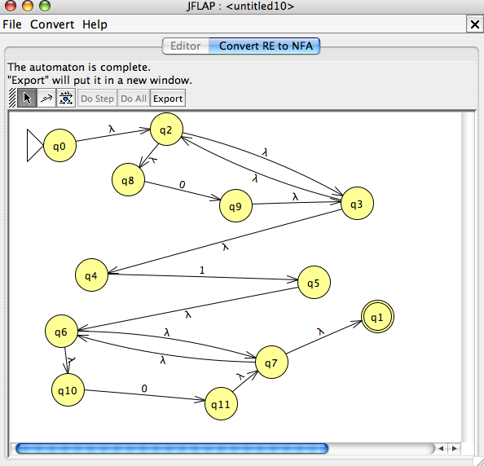
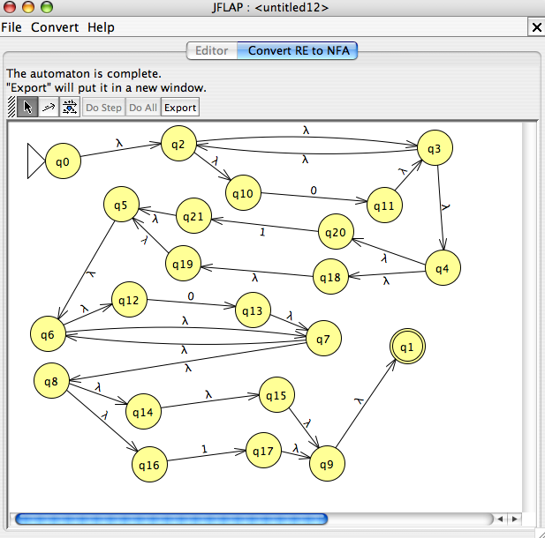
RegEx NFA DFA
This conversion is provided by JFLAP…
0*10*
L = { w | w is a binary number whose value is a power of two }
within 1 of
0*(λ|1)0*(λ|1)

Slide 20
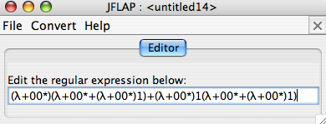
RegEx NFA DFA
This conversion is provided by JFLAP…
0*10*
L = { w | w is a binary number whose value is a power of two }
within 1 of
0*(λ|1)0*(λ|1)
JFLAP will go from DFA → RegEx, too.
Entropy wins again!
this doesn't look right…

Slide 21
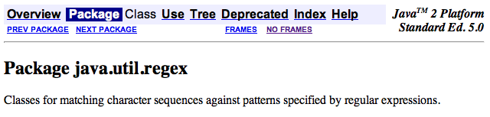
Regexes in practice…
Almost all languages have a regex library…
Unix’s egrep does a line-by-line search for a regex:
egrep 'hh'
egrep 'y.*y'
egrep '(xq|hq)'
egrep '^y.*y$'
/usr/share/dict/words
symbol for start of a line
symbol for end of a line
symbol for any character, a shortcut for (a|b|c|…|z|0|1|…|9|…)
good for crosswords !
VOWEL
U
VOWEL
not always obvious …
egrep '^(0|1(01*0)*1)(0|1(01*0)*1)*$' binStr
Notes:
21

Slide 22
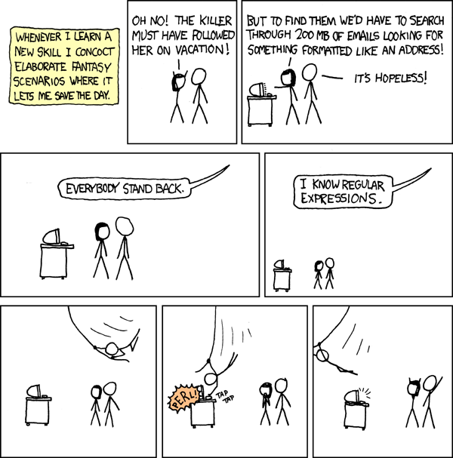
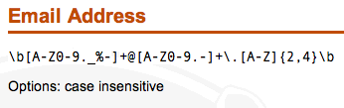
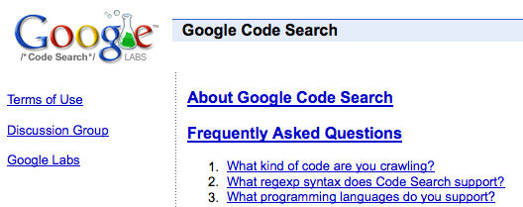
REs to the rescue!
practical extraction and report language
PERL
www.regular-expressions.info/regexbuddy/email.html
but how does regular expression matching actually work?
Notes:
22
Pimp my Ride from MTV - Corona is where the garage is…
MTV + SciFi -- twilight zone…

Slide 23
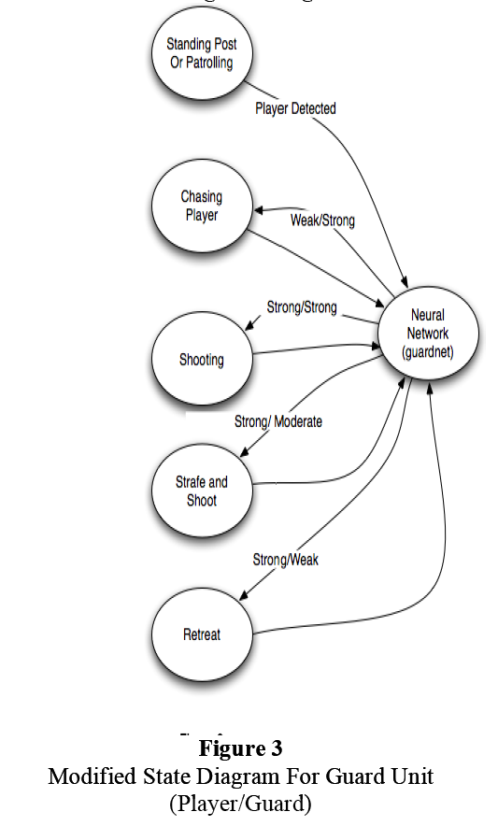
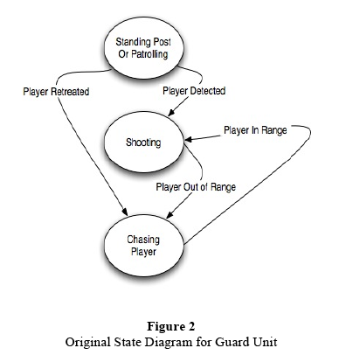
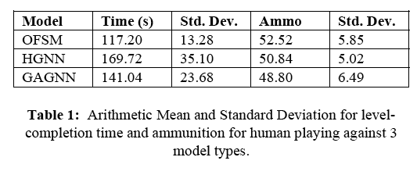
FSM applications…
http://www.gameai.com/statemachines.html
Game AI
original finite state machine
human-guided neural network
genetic-algorithm-guided neural network
Notes:
Ask for the game: Wolfenstein 3d - really the first first-person shooter 1992
by id software: Doom, in 1993, Quake in 1996,
ammo == ammo remaining at the end of the level…

Slide 24
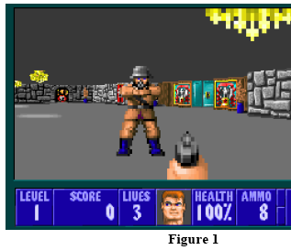
FSM applications…
http://www.gameai.com/statemachines.html
Game AI
Notes:
Ask for the game: Wolfenstein 3d - really the first first-person shooter 1992
by id software: Doom, in 1993, Quake in 1996,

Slide 25
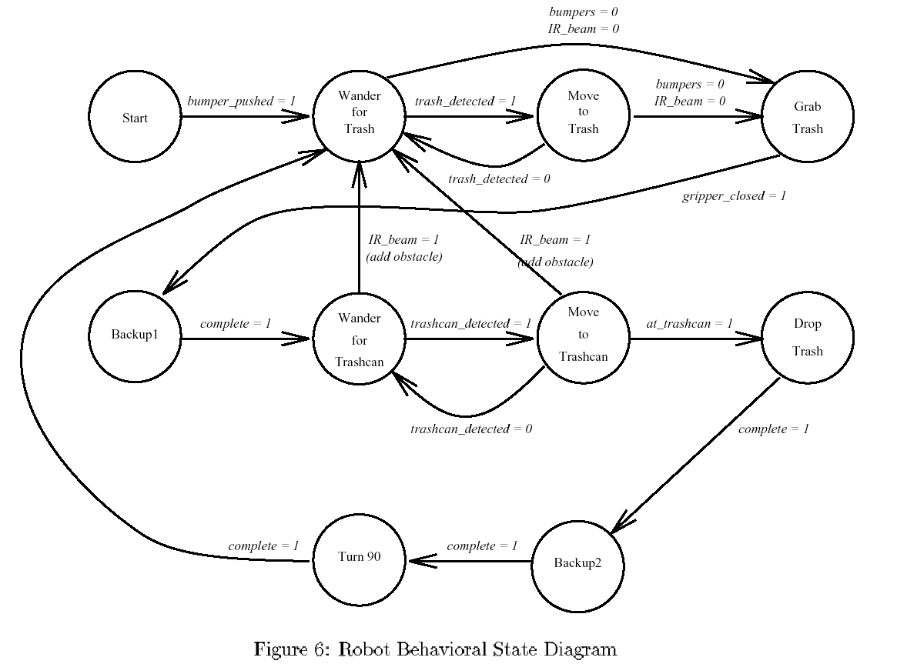
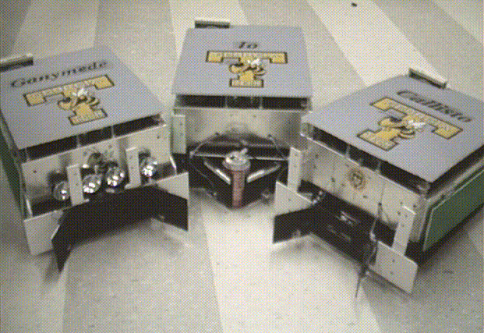
GA Tech’s FSM for trash pick-up

Slide 26
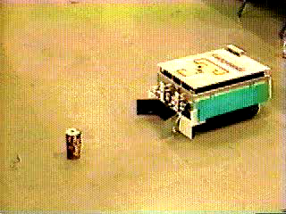
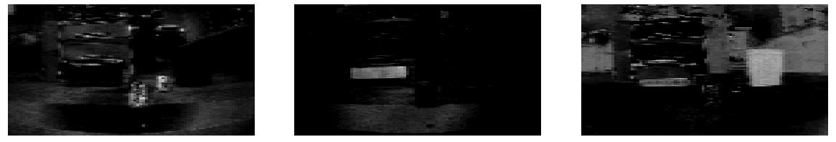
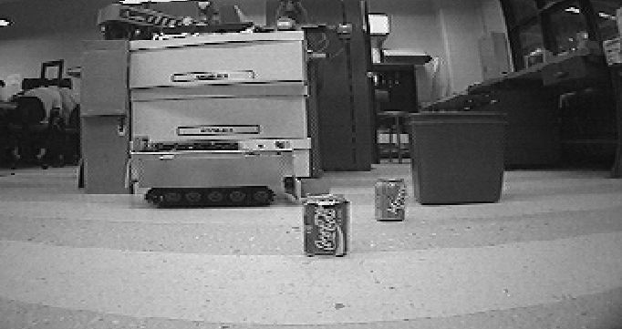
AAAI 1994 champions
Office-cleaning event
Georgia Tech

Slide 27
What can DFA's do?
Is it possible to build a DFA accepting this language?
L = { w | w is a binary number that is divisible by 7 }

Slide 28
What can DFA's do?
Is it possible to build a DFA accepting this language?
L = { w | w is a binary number that is divisible by 7 }
This is problem 6 on this week's HW…
Suppose you're on the accepting state and the next input bit is a 0… ?

Slide 29
Regular Languages
A language L is regular if there is a DFA that accepts it.
L = { w | w is a binary number whose value is a power of two }
L = { w | the third and third-to-last digits of w are identical }
L = { w | w is a binary number that’s divisible by 7 }
L = { 0^{k}1^{k} | k ≥ 0}
Everyone O^{k} with this?
Are any of these languages too complex for a DFA to accept ?

Slide 30
Regular Languages
A language L is regular if there is a DFA that accepts it.
or NFA
or RegEx
L = { w | w is a binary number whose value is a power of two }
All regular
L = { w | the third and third-to-last digits of w are identical }
L = { w | w is a binary number that’s divisible by 7 }
L = { 0^{k}1^{k} | k ≥ 0}
Nonregular !
How could we prove that
L = { 0^{k}1^{k} | k ≥ 0}
is not regular?

Slide 31
Regular Languages
A language L is regular if there is a DFA that accepts it.
L = { w | w’s third character is a 1}
L = { w | w’s third-to-last character (from the right) is a 1}
L = { w | w is a binary # that’s divisible by 3 }
How could we prove that
L = { 0^{n}1^{n} | n ≥ 0}
is not regular?
If there is an infinite pairwise distinguishable set of strings (w.r.t. L), it must be that L is not regular!
The Nonregular Language Theorem

Slide 32
The Nonregular Language Theorem
Consider the language
L = { 0^{n}1^{n} | n ≥ 0}
example strings
To show it’s not regular…
λ
01
0011
000111
00001111
0000011111
DFA’s can’t do everything!
Maybe a better model can?

Slide 33
Using the Nonregular Language Theorem
Is L = {ww | w is a string of 0s and 1s} regular?
Is L = {0^{n^2} | n >= 0} regular?

Slide 34
The question…
So, how powerful are DFAs ?
Can they compute anything at all?
NO
No! For example, the language { 0^{k}1^{k} | k ≥ 0 } is not regular.
Can they emulate normal I/O behavior?
Yes
Yes… via large compositions (each handles 1 bit)
Can they do anything a desktop machine can?
?

Slide 35
Computability
not complexity
DFAs
"can't count"
ww
What about
these languages?
FSMs
can compute regular languages
Machines
that halt
on input w
0^{n}1^{n}
!
these all compute the SAME languages !
NFAs
though not necessarily as efficiently…
RegEx's
are computationally equivalent to DFAs!
Notes:
plan on board….

Slide 36
An Impossible Program?
(define (impossible L)
(help1 L 0))
(define (help1 L n)
(cond
((null? L) (= n 0))
((equal? (first L) 0) (help1 (rest L) (+ n 1)))
(else (help2 L n))))
(define (help2 L n)
(cond
((null? L) (= n 0))
((equal? (first L) 1) (help2 (rest L) (- n 1)))
(else #f)))
Notes:
plan on board….

Slide 37
Computability
not complexity
DFAs
TMs
"can't count"
TMs count!
FSMs
Turing Machines
can compute regular languages
strictly more powerful than DFAs
!
these all compute the SAME languages !
NFAs
though not necessarily as efficiently…
RegEx's
are computationally equivalent to DFAs!
Notes:
plan on board….

Slide 38
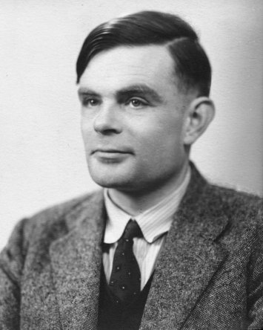
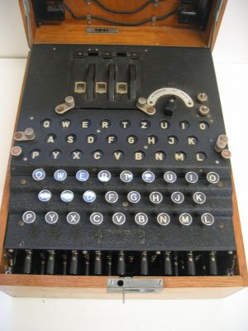
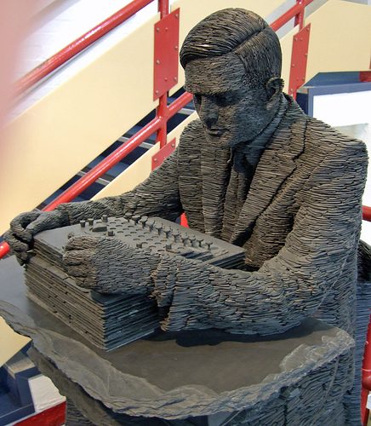
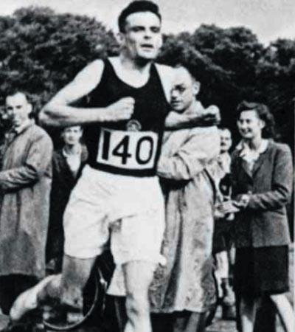
Alan Turing
AI !
WWII
Enigma machine ~ The axis's encryption engine
2007
Bletchley Park
1946

Slide 39
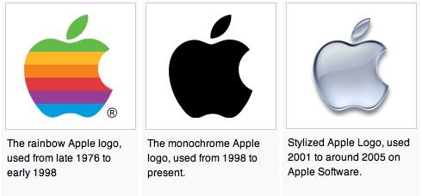
Alan Turing
AI !
WWII
Enigma machine ~ The axis's encryption engine
too neat, perhaps…?
2007
Bletchley Park
1946

Slide 40
Turing Machines…
Turing: “Logical Computing Machines”
A simple model of universal computation.
Starts on the leftmost character
The tape: an unbounded amount of memory. Consists of cells, each containing exactly one character characters (e.g. 0, 1, or  (blank))
Read/write head for the tape
The control: a finite amount of memory, the control states -- some are accepting, some are not.
Ability to move left and right
The control state
The symbol now under the head
The symbols to the right of the head
The symbols to the left of the head
The complete state of a TM is determined by:

Slide 41
JFLAP's Turing Machines

Slide 42
block set tools
JFLAP's Turing Machines
States control the TM’s execution
Left == char. read on the tape
Middle == char. written to the tape
Right == direction to move (LRS)
Blank
Accepting states halt computation immediately!

Slide 43
Turing Machines…
Turing: “Logical Computing Machines”
Problem: Accepting the nonregular language { 0^{k}1^{k} | k ≥ 0 }
0
0
0
1
1
1
Every Turing machine is/has a program: (see previous slide for this program!)
Assume that the turing machine's read/write head starts at the left of the input.
Halting convention #1: if a transition is unspecified, then the TM halts in the current state.
Halting convention #2: if a TM goes into an accepting state, it accepts and does no more work.

Slide 44
Turing Machine “Quiz”
Problem: Sketch a turing machine that accepts (000)*
Turing machines are also capable of deciding regular languages!
Reg. Expr.!

