Slide 1
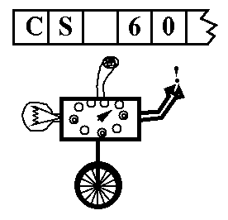
Today in CS42
(Deterministic Finite Automata)
DFAs
=
Regular Languages
=
Turing machines
Regular Expressions
NFAs
=
(Nondeterministic Finite Automata)
Halt Checkers
Yes, P halts on w
P, w
output
The Halt Checker Program
No, P doesn’t halt on input w.
Homework 13 due
Friday, Dec 10, 11:59pm
input

Slide 2

Computability
FSMs
DFAs
TMs
"can't count"
TMs count!
Turing Machines
can compute regular languages
strictly more powerful than DFAs
PDAs
!
NFAs
Is anything in the middle? ~ CS 81
RegEx's
Yes, but we're going to look elsewhere
are computationally equivalent to DFAs!
What about "real" computation?
Notes:
Pimp my Ride from MTV - Corona is where the garage is…
MTV + SciFi -- twilight zone…

Slide 3

From theory to practice...
Are real computers better modeled by a DFA or a TM ?
?
qs
1
q1
0
1
1
0
0
q0
q2
0
1

Slide 4

From theory to practice...
Are real computers better modeled by a DFA or a TM ?
?
qs
1
q1
0
1
The same reason why statistical mechanics (statmech) is important:
1
0
0
q0
q2
0
1

Slide 5
Can TMs compute everything?
Python
Scheme
Java
Prolog
JFLAP
Other TMs ?!
Could a Turing machine emulate

Slide 6
Can TMs compute everything?
“Two thumbs way up!”
Church/Turing Hypothesis
“The Turing Machine is as good as it gets”
-- Alonzo "Ebert" Church and Alan "Roeper" Turing
But
“A woeful disappointment”
“Missing most of what I’d hope for”
-- Georg “Can’t” Cantor
How many functions of bits can be computed by TMs?
where the input and output are both bitstrings (integers, strings)…

Slide 7
Can TMs compute everything?
“Two thumbs way up!”
Church/Turing Hypothesis
“The Turing Machine is as good as it gets”
-- Alonzo Church and Alan Turing
But
“A woeful disappointment”
“Missing most of what I’d hope for”
-- Georg Cantor
Most functions from N to N aren’t computable!

Slide 8

The Halting Problem
P is an input program.
w is the data on which P will be tested.
Yes, P halts on w
P, w
output
The Halt Checker Program
input
No, P doesn’t halt on input w.

Slide 9
Set Cardinality
What is the size (cardinality) of the following sets?
{ 42, 65, 1, 7 }
{ 800, 2, 76, 99, 101, 222 }

Slide 10

Set Cardinality
Georg Cantor
1845 - 1918
What is the cardinality of these sets?
{ 1, 2, 3, 4, … }
{ 2, 4, 6, 8, … }
Which set is bigger?

Slide 11
Countable Infinity
A set is countably infinite if there is a one-to-one mapping between
the members of the set and the counting (natural) numbers.
(Two sets that are both countably infinite have the same cadinality)
Prove that the rational numbers are countably infinite

Slide 12
Are all infinite sets countable?
Are the real numbers [0, 1) countably infinite?

Slide 13
Can TMs compute everything?
“Two thumbs way up!”
Church/Turing Hypothesis
“The Turing Machine is as good as it gets”
-- Alonzo "Ebert" Church and Alan "Roeper" Turing
But
“A woeful disappointment”
“Missing most of what I’d hope for”
-- Georg Cantor
Why?
The set of Turing machines is countably infinite = N.
Can you imagine a way to enumerate (count) all turing machines?
The set of functions from N to N is uncountably infinite.
⇒
100%
Most functions from N to N aren’t computable!
how does this help me ?

Slide 14
A Strategy* for CS Programming HW**
or “How to succeed in CS 70 without programming at all !”
For each programming assignment, note that the desired program’s behavior can be rephrased as a function from the integers N to the integers N by encoding the input and output appropriately.
1
2
Point out that with 100% probability a function chosen from the set of all functions from N to N is not computable by any program at all.
3
Proceed to your choice of (A) the mountains or (B) the beach.
4
Consult fine print for disclaimers.
* Please do not cite Prof. Alvarado when using this strategy
** This strategy not applicable for CS 42 assignments.
what's one?

Slide 15
The TM Halting Problem
An example uncomputable or undecidable function (program)
P is an input program, i.e., a turing machine, encoded suitably.
w is P's input data.
Yes, P halts on w
P, w
output
The Halt Checker Program
input
No, P doesn’t halt on input w.
Note that this blue halt checker is not allowed to run forever.
is it obvious that the HaltChecker is uncomputable?
just run P on w!
Notes:
inf. loop checker!!

Slide 16
The DFA Halting Problem
Is it possible to create a program that decides if a DFA halts for a given input?
Yes, D halts on w
D, w
output
The DFA Halt Checker Program
input
No, D doesn’t halt on input w.
Note that this blue halt checker is not allowed to run forever.
Is there a program that outputs the correct answer to this question?

Slide 17
The TM Halting Problem
An example uncomputable or undecidable function (program)
P is an input program, i.e., a turing machine, encoded suitably.
w is P's input data.
Yes, P halts on w
P, w
output
The Halt Checker Program
input
No, P doesn’t halt on input w.
Note that this blue halt checker is not allowed to run forever.
I thought we were taking about functions of integers!
Weird things ! Are these OK?
The blue program takes two inputs, one of which is a program!
examples?
The blue program can call P and P(w) any time it wants – it may not finish!
We can’t just call P(w) and return yes if it finishes, since P(w) might loop.
Hooray!! The above line proves that the H.C. can not exist!
How can we prove the Halt Checker program impossible?
Show that it creates a contradiction!
Notes:
program and function and formal language (set of integers/bitstrings) are all the same thing!

Slide 18
The Halting Problem
Suppose that our Halt-checker exists:
Yes, P halts on w
P, w
Halt
Checker
No, P doesn’t halt on input w.
Our plan
Since we can assume that a HC exists,
use HC as a subroutine
that creates an impossibility.
proof by contradiction!

Slide 19
The Halting Problem
Suppose that our Halt-checker exists:
Yes, P halts on w
P, w
Halt
Checker
No, P doesn’t halt on input w.
We build this machine/program:
Cant. Machine: C
Key idea:
P
You can build whatever kind of program you want in here!
our CM's output is (sometimes) 42
our CM's input is a program P.
42
All usual computational techniques are OK
and you can use H.C. as a subroutine!
looking for a contradiction…

Slide 20

The Halting Problem
Suppose that our Halt-checker exists:
Yes, P halts on w
P, w
Halt
Checker
No, P doesn’t halt on input w.
We build this machine/program:
Cant. Machine: C
if "Yes," then run
while (true);
P
P, P
Halt
Checker
our CM's output is (sometimes) 42
our CM's input is a program P.
Duplicate P and use as both inputs to a halt checker.
if "No," halt and return 42.
42
Claim: The Cant. Machine can't exist!
Hey! That's my tie!
Proof: Does C(C) halt?
If it does, it doesn't.
If it doesn't, it does!

Slide 21
The Halting Problem is uncomputable...
Now we know that
Yes, P halts on w
P, w
Halt
Checker
No, P doesn’t halt on input w.
can’t exist.
This makes it easier to show other programs can’t exist either!
Rather than inventing some clever contradiction, we can reach one simply by building a Halt Checker, HC!
Notes:
elementary proof: Mary Cartwright -- simplest proof, asked as a problem on an examination at Cambridge University… ~ 1947 (Girton College within Cambridge)

Slide 22
Undecidability of the Halting Problem
To show the Halting Problem can't be algorithmically solved, We use diagonalization, a proof method that's evolved Where Turing Machines are asked to run in modes of simulation, On codes that represent themselves, an auto-copulation. Suppose a TM we'll call Halt, with input that's a code Of another machine M, and in addition is showed An input x to M, whence Halt says (and it's always right) Whether M did halt on x. (But how? Divine insight?) Let TM D, with input that's the code of machine A Use Halt to find if A will halt on its own code, then say, ``If the answer's `no' I'll output 1, else fight the urge To give another answer''-- better then that D diverge. Rather than recount the proof's denouement, we'll be prudent, And leave the rest to you, dear reader, the ever-able student. When Halt is given the code of D, it simply cannot know If D does halt on its own code--but that's for you to show. The trick is to diagonalize--D changed the bit returned By Halt, thus contradicts its work, as its output is spurned. No matter how a TM solves the Halting Problem, see, Diagonalization makes a counter-example. Q.E.D.
Harry Mairson
http://www.cs.brandeis.edu/~mairson/poems/node5.html

Slide 23
"Proof" that the Halt Machine Cannot Exist
The Halt Checker Program
Yes, P halts on w
P, w
run P on w
If P halts return true
output
input
No, P doesn’t halt on input w.
Note that this blue halt checker is not allowed to run forever.
We show that a halt checker cannot exist by contradiction.
We build a program named HC, which takes a program P and a string w as input, as follows:
HC(P,w):
(1) Run P on w.
(2) If P halts, return true.
Since P might run forever on w, we have no way of knowing whether P will eventually halt, or whether P will run forever. Thus HC(P,w) might run forever. But since HC is required to halt, this creates a contradiction.
The only assumption we have made is that the halt checker exists, all other steps are legal, therefore this contradiction proves that the halt checker cannot exist.
Notes:
program and function and formal language (set of integers/bitstrings) are all the same thing!

Slide 24
The no-input halting problem
or blank-tape
P is a program that takes no input (a turing machine with a blank tape)
Yes, P halts on λ
P
λ-Halt Checker
output
input
No, P does not halt on λ
Claim: The λ-Halt Checker can not exist.
Proof: Reduction from the Halt Checker problem.
i.e., we build a haltchecker from a λ-Halt Checker!
Shouldn't that be reduction to the halting problem?

Slide 25
The no-input halting problem
or blank-tape
P is a program that takes no input (a turing machine with a blank tape)
Yes, P halts on λ
P
λ-Halt Checker
output
input
No, P does not halt on λ
HC
P, w
Plan: Build a H.C. machine!
Yes
HC's input is a program P and input string w.
using any programming we want, plus our presumed no-input halt-checker.
No

Slide 26
The no-input halting problem
or blank-tape
P is a program that takes no input (a turing machine with a blank tape)
Yes, P halts on λ
P
λ-Halt Checker
output
input
No, P does not halt on λ
HC
(1) Transform inputs
(2) Run the newly created TM
(3) Transform outputs
P, w
Plan: Build a H.C. machine!
Yes
HC's input is a program P and input string w.
using any programming we want, plus our presumed no-input halt-checker.
No

Slide 27
The no-input halting problem
or blank-tape
P is a program that takes no input (a turing machine with a blank tape)
Yes, P halts on λ
P
λ-Halt Checker
output
input
No, P does not halt on λ
HC
(1) Transform inputs
(2) Run the newly created TM
(3) Transform outputs
Create a no-input Turing Machine that
(1) writes w onto the blank tape
(2) runs P on the tape when finished writing w
Call this machine P_{w}
P, w
if "Yes," then output "Yes"
Yes
P_{w}
λ-Halt Checker
HC's input is a program P and input string w.
if "No," then output "No"
No
Are all these steps finite?
Claim: The λ-Halt Checker can't exist.
Proof: Assume it does, we've shown we can build a (regular) halt checker!

Slide 28
We show that a blank-tape-halt-checker can not exist by reduction from the Halting Problem.
Assume that a blank-tape-halt-checker BT(P) does exist.
We build a program named HC, which takes a program P and a string w as input, as follows:
HC(P,w):
(1) Build a Turing Machine that takes no inputs. It first writes the string w
to its blank tape, and then runs P on that tape. Call this no-input
turing machine TM. Note that TM effectively runs P on w.
(2) Call our blank-tape-halt-checker on this TM: BT( TM )
(3) If BT(TM) reports that TM halts, halt and output "Yes"
(4) If BT(TM) reports that TM does not halt, halt and output "No"
As long as BT exists, this constructed HC is a legitimate program. All of the steps are computable -- writing a single, known string to a blank tape, running a turing machine's program, and conditional-checking.
However, note that HC(P,w) is a halt checker!
(A) If P halts on w, HC(P,w) returns "Yes"
(because TM will halt on no input, so BT(TM) returns "Yes")
(B) If P does not halt on w, HC(P,w) returns "No"
(because TM will not halt on no input, so BT(TM) returns "No")
Since a halt-checker can not exist, we have reached a contradiction. Thus, our original assumption that the blank-tape-halt-checker exists was false. A blank-tape-halt-checker also can not exist.
(1) Setup
Write-up
(2) Describe new machine
(3) Demonstrate contradiction

Slide 29
"Quiz": (part 1) All-input halting is uncomputable.
P is an input program. Assume that it returns a boolean “yes” or “no” (or runs forever) on its inputs
Yes, P halts on all inputs
Halt Checker for ALL Inputs
HCAI
P
output
input
No, P does not halt on all inputs
Claim: The all-input halt checker can not exist!
Proof: Reduction from the Halt Checker problem.
i.e., assume HCAI exists. Build a halt-checking machine from it.
Halt-checking machine, HC
P, w
Yes
HC's input is a program P and input string w.
No

Slide 30
"Quiz": (part 2) the CS 60 grading problem...
P1,P2 are input programs: they either return a value or not -- they might not halt -- on the various inputs they take.
Yes, P1 and P2 always agree
P1,P2
Autograder
output
input
No, P1 and P2 do not always agree.
Claim: Autograder, too, can not exist!
Proof: Reduction from the Halt Checker problem.
i.e., we build a halt checker from it!

Slide 31
What about DFA auto-grading?
D1,D2 are input DFAs.
Yes, D1 and D2 agree on all inputs
D1, D2
Autograder for DFAs
output
input
No, D1 and D2 do not always agree.
Is the Autograder for DFAs possible or not?

Slide 32
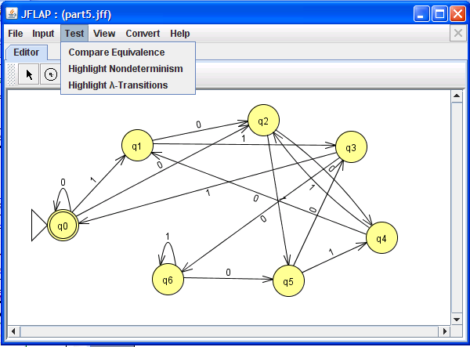
What about DFA auto-grading?

Slide 33
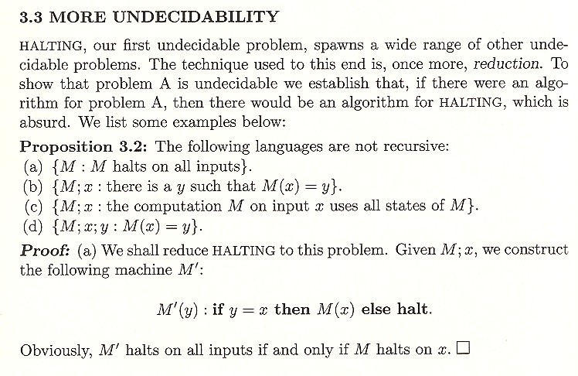
Shorter write-ups are welcome!
P
w
from Computational Complexity, by UCSD's Christos Papadimitriou

Slide 34
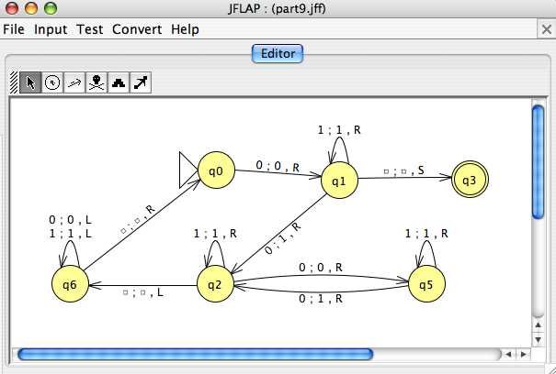
HW #13, Problem 1
The POTDT
power-of-two-decider-tester
P is an input program or turing machine
Yes, P accepts 0
2^{n}
P
POTDT
output
2^{n}
input
No, P does not accept 0
an example of an INPUT to the POTDT which produces an output of Yes

Slide 35
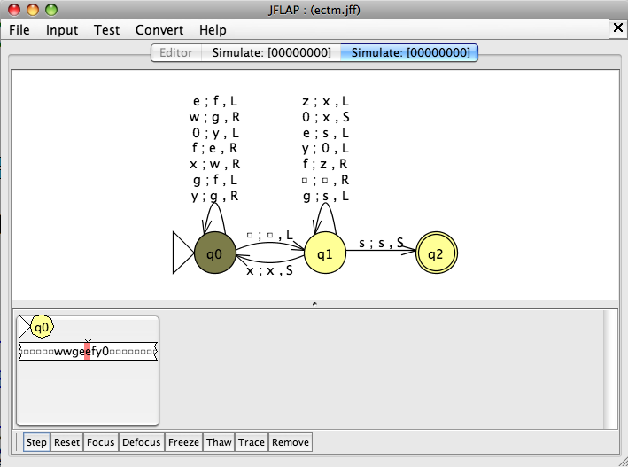
HW #13, Problem 1
The POTDT
power-of-two-decider-tester
P is an input program or turing machine
Yes, P accepts 0
2^{n}
P
POTDT
output
2^{n}
input
No, P does not accept 0
another example of an INPUT to the POTDT which produces an output of Yes

Slide 36
The Reg. Language Checker…
P is an input program.
Assume that it returns
a boolean “yes” or “no.”
Yes, P accepts a regular language
P
Regular Language Checker
output
input
No, P does not accept a regular language.
Why is there no string w specified here?
An example of an INPUT to the Regularity Checker which produces an output of No ?
HW #13, Problem 2

Slide 37
The Reg. Language Checker…
P is an input program.
Assume that it returns
a boolean “yes” or “no.”
Yes, P accepts a regular language
P
Regular Language Checker
output
input
No, P does not accept a regular language.
Why is there no string w specified here?
An example of an INPUT to the Regularity Checker which produces an output of No ?
HW #13, Problem 2
basic message: anything about program behavior is uncomputable! (also called undecidable)

Slide 38
Rice's theorem
Every nontrivial property of programs is uncomputable.
Turing machines
undecidable
functions
recursive
…
extra credit
Proof:
…
see CS 142 / Math 167, computability theory
Consequence:
programming can't be automated!
or, at least, reasoning about programs…
Finding the shortest program outputting any integer n.
Examples:
Finding the largest possible output for a given size program.
Hilbert’s 10th problem!

Slide 39
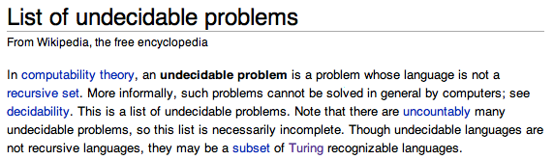
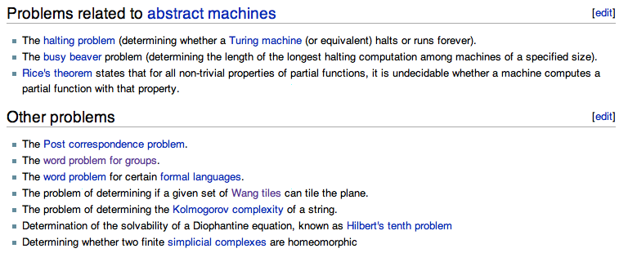
Real uncomputable problems?
Wikipedia humor?
Notes:
The tiles can't rotate…

Slide 40
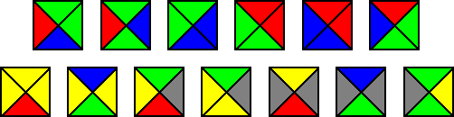
Other uncomputable problems?
The Bill Gates' flooring problem…
A record-breaking set of non-rotating 13 Wang tiles discovered in 1996
Given a set of template tiles, can you cover the plane with them?
Constraint: you need to match edge-colors when placing tiles…
Notes:
The tiles can't rotate…

Slide 41
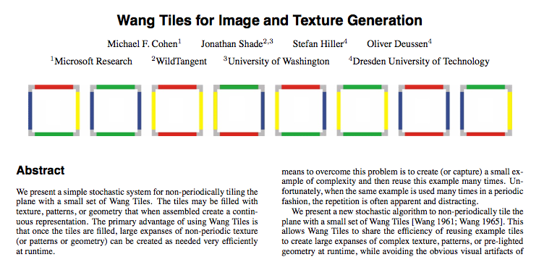
Other uncomputable problems?
You never know what will be useful!
SIGGRAPH 2003

Slide 42

Wang tiles, applied
texture synthesis…

Slide 43
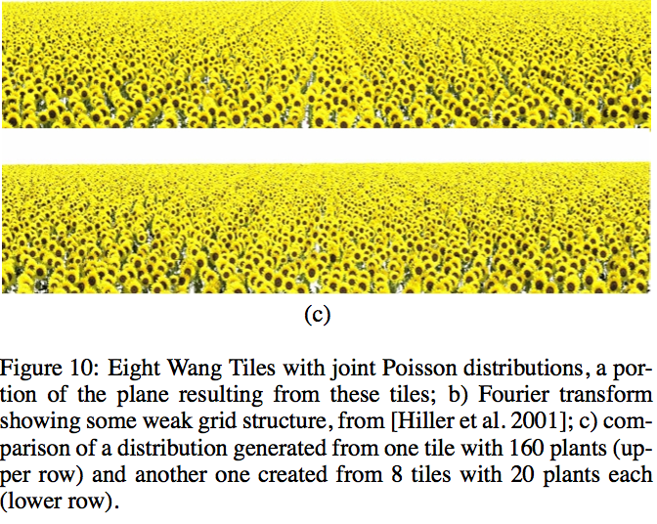
Wang tiles, applied
Perhaps from regular-tiling expressions?
artifacts from regular tiling:
vs. more natural result from aperiodic Wang tilings:

