Slide 1
What about DFA auto-grading?
D1,D2 are input DFAs.
Yes, D1 and D2 agree on all inputs
D1, D2
Autograder for DFAs
output
input
No, D1 and D2 do not always agree.
Is the Autograder for DFAs possible or not?

Slide 2
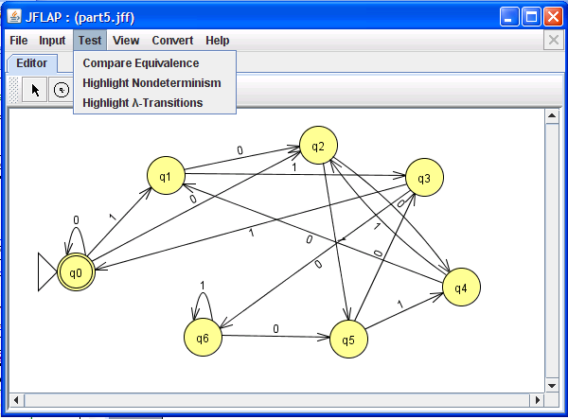
What about DFA auto-grading?

Slide 3
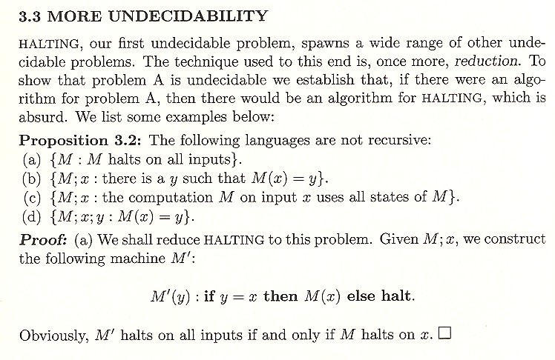
Shorter write-ups are welcome!
P
w
from Computational Complexity, by UCSD's Christos Papadimitriou

Slide 4
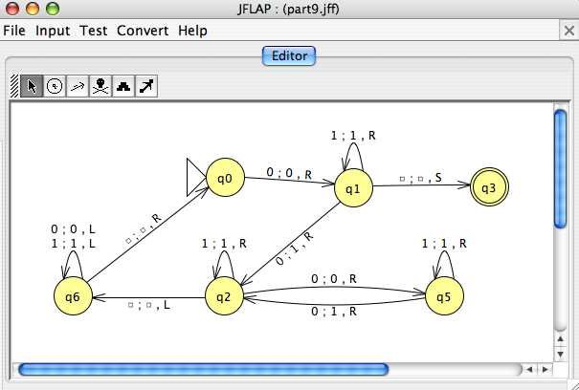
HW #13, Problem 1
The POTDT
power-of-two-decider-tester
P is an input program or turing machine
Yes, P accepts 0
2^{n}
P
POTDT
output
2^{n}
input
No, P does not accept 0
an example of an INPUT to the POTDT which produces an output of Yes

Slide 5
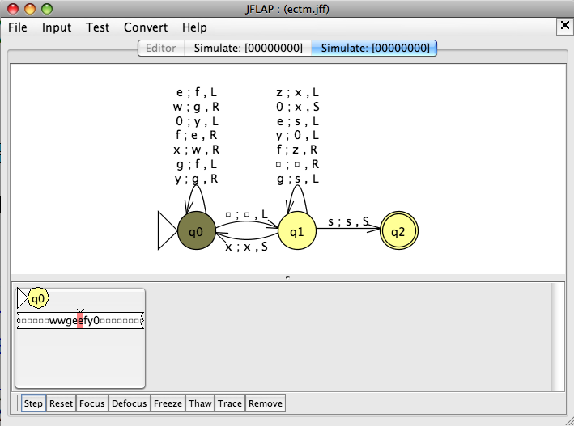
HW #13, Problem 1
The POTDT
power-of-two-decider-tester
P is an input program or turing machine
Yes, P accepts 0
2^{n}
P
POTDT
output
2^{n}
input
No, P does not accept 0
another example of an INPUT to the POTDT which produces an output of Yes

Slide 6
The Reg. Language Checker…
P is an input program.
Assume that it returns
a boolean “yes” or “no.”
Yes, P accepts a regular language
P
Regular Language Checker
output
input
No, P does not accept a regular language.
Why is there no string w specified here?
An example of an INPUT to the Regularity Checker which produces an output of No ?
HW #13, Problem 2

Slide 7
The Reg. Language Checker…
P is an input program.
Assume that it returns
a boolean “yes” or “no.”
Yes, P accepts a regular language
P
Regular Language Checker
output
input
No, P does not accept a regular language.
Why is there no string w specified here?
An example of an INPUT to the Regularity Checker which produces an output of No ?
HW #13, Problem 2
basic message: anything about program behavior is uncomputable! (also called undecidable)

Slide 8
Rice's theorem
Every nontrivial property of programs is uncomputable.
Turing machines
undecidable
functions
recursive
…
extra credit
Proof:
…
see CS 142 / Math 167, computability theory
Consequence:
programming can't be automated!
or, at least, reasoning about programs…
Finding the shortest program outputting any integer n.
Examples:
Finding the largest possible output for a given size program.
Hilbert’s 10th problem!

Slide 9
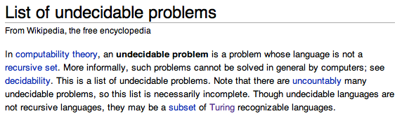
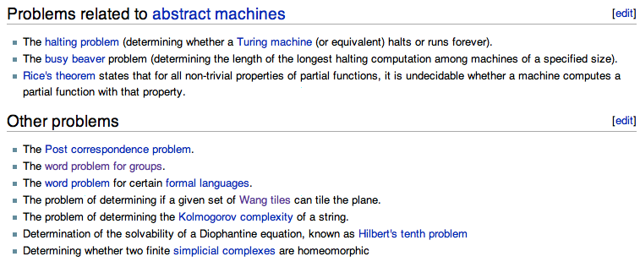
Real uncomputable problems?
Wikipedia humor?
Notes:
The tiles can't rotate…

Slide 10
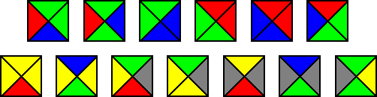
Other uncomputable problems?
The Bill Gates' flooring problem…
A record-breaking set of non-rotating 13 Wang tiles discovered in 1996
Given a set of template tiles, can you cover the plane with them?
Constraint: you need to match edge-colors when placing tiles…
Notes:
The tiles can't rotate…

Slide 11
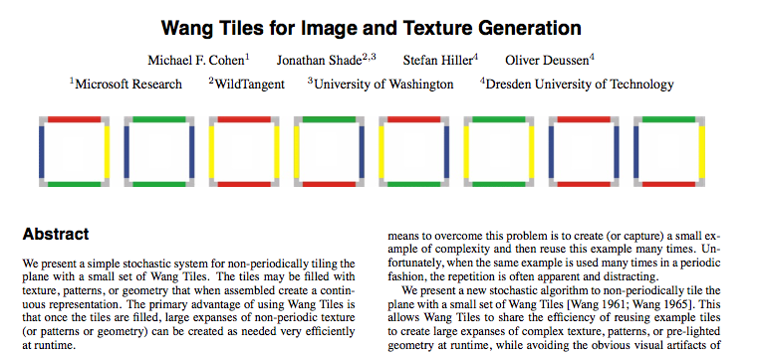
Other uncomputable problems?
You never know what will be useful!
SIGGRAPH 2003

Slide 12
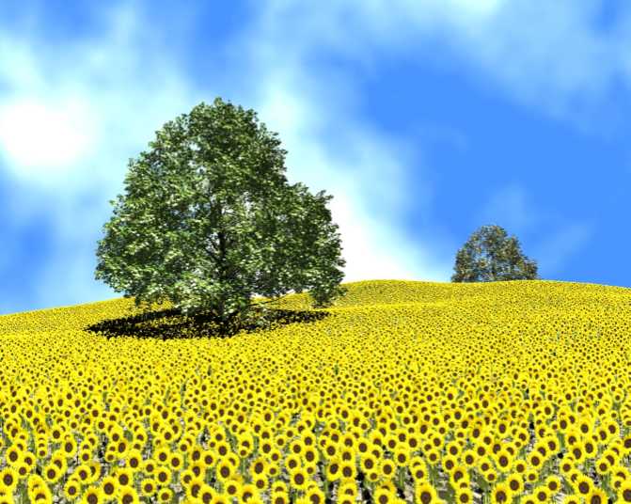
Wang tiles, applied
texture synthesis…

Slide 13
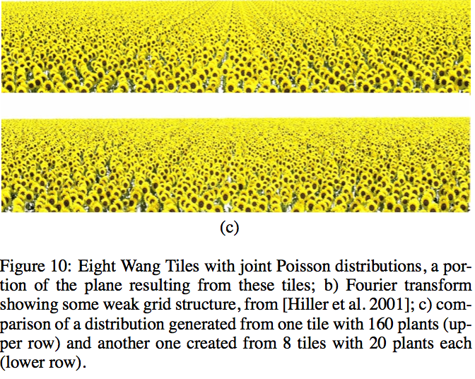
Wang tiles, applied
Perhaps from regular-tiling expressions?
artifacts from regular tiling:
vs. more natural result from aperiodic Wang tilings:

Slide 14
The HP and the Twin Prime Conjecture
Q: How powerful IS the halting problem?
A: If we had a program to decide it, we could answer many of the biggest OPEN QUESTIONS in mathematics!
There are infinitely many primes p such that p + 2 is also prime.
function findTwinPrimeAbove(int N)
int p = N
while True
if p is prime and p + 2 is prime
return
else
p = p + 1

Slide 15
The HP and the Twin Prime Conjecture
Q: How powerful IS the halting problem?
A: If we had a program to decide it, we could answer many of the biggest OPEN QUESTIONS in mathematics!
There are infinitely many primes p such that p + 2 is also prime.
function findTwinPrimeAbove(int N)
int p = N
while True
if p is prime and p + 2 is prime
return
else
p = p + 1
function findAllTwinPrimes
int N = 0
while True
if HaltCheck(findTwinPrimeAbove( N ))
// there are twin primes above N
N = N + 1
else return // there are not twin primes above N

Slide 16
The HP and the Twin Prime Conjecture
Q: How powerful IS the halting problem?
A: If we had a program to decide it, we could answer many of the biggest OPEN QUESTIONS in mathematics!
There are infinitely many primes p such that p + 2 is also prime.
function findTwinPrimeAbove(int N)
int p = N
while True
if p is prime and p + 2 is prime
return
else
p = p + 1
function inifinitelyManyTwinPrimes
return !HaltCheck(findAllTwinPrimes())
function findAllTwinPrimes
int N = 0
while True
if HaltCheck(findTwinPrimeAbove( N ))
// there are twin primes above N
N = N + 1
else return // there are not twin primes above N

Slide 17
The End of CS (42)
CS
useful
creative
I've never liked the term "computer science." The main reason I don't like it is that there's no such thing. Computer science is a grab bag of tenuously related areas thrown together by an accident of history, like Yugoslavia.
- Paul Graham, Hackers and Painters

Slide 18
Final Exam
3-hour exam. Tuesday 2-5pm. TG 201
On the semester’s material, with an attempt at bridging different topics.
You may use two double-sided pages of notes (similar to before)…
Exam topics are available on the CS 42 website.
Some practice problems will be posted too!
Free 5 points EXTRA CREDIT for filling out this survey before (or immediately after) the exam!
http://www.surveymonkey.com/s/JCMJS7Z
Notes:
extra credit for joining the spring cs talks…

Slide 19
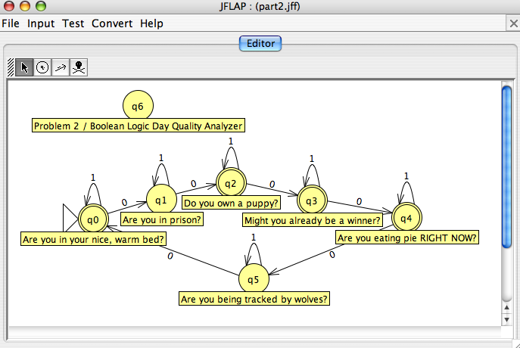
Creative approaches…

Slide 20
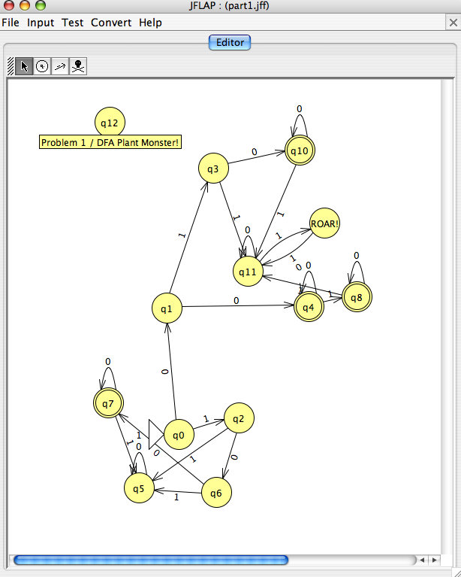

Slide 21
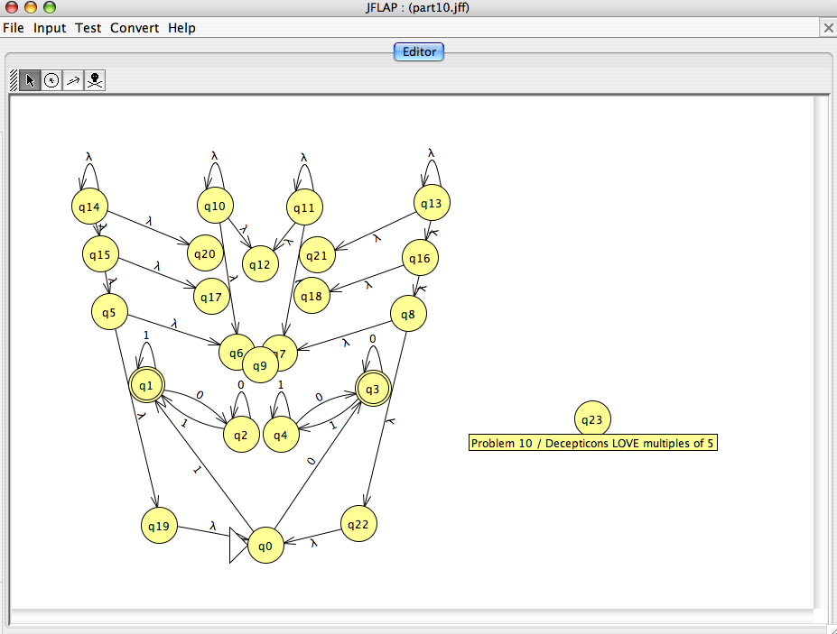
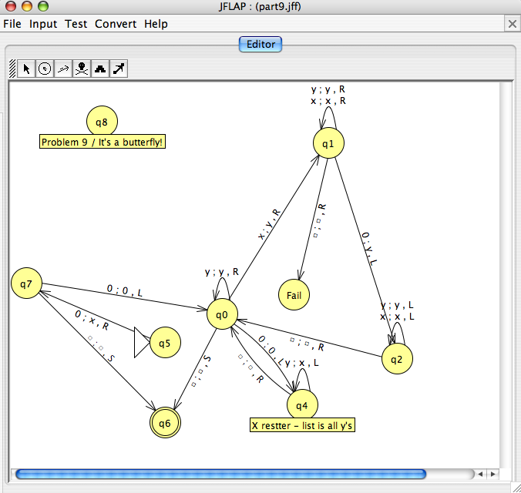

Slide 22
Creative approaches…
best layout

Slide 23

IOCCC “best layout ever”
#define/**/X
char*d="X0[!4cM,!"
"4cK`*!4cJc(!4cHg&!4c$j”
"8f'!&~]9e)!'|:d+!)rAc-!*m*"
":d/!4c(b4e0!1r2e2!/t0e4!-y-c6!"
"+|,c6!)f$b(h*c6!(d'b(i)d5!(b*a'`&c”
")c5!'b+`&b'c)c4!&b-_$c'd*c3!&a.h'd+"
"d1!%a/g'e+e0!%b-g(d.d/!&c*h'd1d-!(d%g)"
"d4d+!*l,d7d)!,h-d;c'!.b0c>d%!A`Dc$![7)35E"
"!'1cA,,!2kE`*!-s@d(!(k(f//g&!)f.e5'f(!+a+)"
"f%2g*!?f5f,!=f-*e/!<d6e1!9e0'f3!6f)-g5!4d*b"
"+e6!0f%k)d7!+~^'c7!)z/d-+!'n%a0(d5!%c1a+/d4"
"!2)c9e2!9b;e1!8b>e/! 7cAd-!5fAe+!7fBe(!"
"8hBd&!:iAd$![7S,Q0!1 bF 7!1b?'_6!1c,8b4"
"!2b*a,*d3!2n4f2!${4 f. '!%y4e5!&f%"
"d-^-d7!4c+b)d9!4c-a 'd :!/i('`&d"
";!+l'a+d<!)l*b(d=!' m- a &d>!&d'"
"`0_&c?!$dAc@!$cBc@!$ b < ^&d$`"
":!$d9_&l++^$!%f3a' n1 _ $ !&"
"f/c(o/_%!(f+c)q*c %! * f &d+"
"f$s&!-n,d)n(!0i- c- k) ! 3d"
"/b0h*!H`7a,![7* i] 5 4 71"
"[=ohr&o*t*q*`*d *v *r ; 02"
"7*~=h./}tcrsth &t : r 9b"
"].,b-725-.t--// #r [ < t8-"
"752793? <.~;b ].t--+r / # 53"
"7-r[/9~X .v90 <6/<.v;-52/={ k goh"
"./}q; u vto hr `.i*$engt$ $ ,b"
";$/ =t ;v; 6 =`it.`;7=` : ,b-"
"725 = / o`. .d ;b]`--[/+ 55/ }o"
"`.d : - ?5 / }o`.' v/i]q - "
"-[; 5 2 =` it . o;53- . "
"v96 <7 / =o : d =o"
"--/i ]q-- [; h. / = "
"i]q--[ ;v 9h ./ < - "
"52={cj u c&` i t . o ; "
"?4=o:d= o-- / i ]q - "
"-[;54={ cj uc& i]q - -"
"[;76=i]q[;6 =vsr u.i / ={"
"=),BihY_gha ,)\0 " , o [
3217];int i, r,w,f , b ,x ,
p;n(){return r <X X X X X
768?d[X(143+ X r++ + *d ) %
768]:r>2659 ? 59: ( x = d
[(r++-768)% X 947 + 768] ) ?
x^(p?6:0):(p = 34 X X X )
;}s(){for(x= n (); ( x^ ( p
?6:0))==32;x= n () ) ;return x ; }
void/**/main X () { r = p
=0;w=sprintf (X X X X X X o
,"char*d="); for ( f=1;f < * d
+143;)if(33-( b=d [ f++ X ] )
){if(b<93){if X(! p ) o
[w++]=34;for X(i = 35 +
(p?0:1);i<b; i++ ) o
[w++]=s();o[ w++ ]
=p?s():34;} else X
{for(i=92; i<b; i
++)o[w++]= 32;} }
else o [w++ ]
=10;o [
w]=0 ;
puts(o);}
Saitou Hajime
char*d="X0[!4cM,""!4cK`*!4cJc(!4cHg&!4c$j8f'!&~]9e)!'|:d+!)rAc-""!*m*:d/!4c(b"
"4e0!1r2e2!/t0" "e4!-y-c6!+|,c6!)f$b(h*c6!(d'b(i)d5""!(b*a'`&c)c5!'b+`&b"
"'c)c4!&b-_$c'" "d*c3!&a.h'd+d1!%a/g'e+e0!%b""-g(" "d.d/!&c*h'd1d-!(d%"
"g)d4d+!*l,d7d" ")!,h-d;c""'!.b0c>d%!A`Dc$![7)3" "5E!'1cA,,!2kE`*!"
"-s@d(!(k(f//g&" "!)f.e5" "'f(!+a+)""f%2g*!" "?f5f,!=f-*e/!<d"
"6e1!9e0'f3!6f)" "-g5!4d*b+e6!0f%k" ")d7!+~^'c7!)z/"
"" "d-+!'n%a0(d5!%c1" "a+/d4!2)c9""e2!"
"9" "b;e1!8b>e/!7cAd-" "!5fAe+!7fBe(!8hBd"
"&!" ":" "iAd$![7S," "Q0!1bF7!1" "b?'_6!1c,8b4!2b*a,*"
"d3!2n4f2!${4f.'!" "%y4e5!&" "f%d-^" "-d7!4c+b)d9!4c-a'd:!/"
"i('`&d;!+l'a+d<!" ")l*b(d=!'" "m-a" "&d>!&d'`0_&c?!$dAc@!$c"
"Bc@!$b<^&d$" "`:!$""d9_" "&l" "++^$!%f3a'n1_$!&f/c(o/_"
"%!(f+c)" "q*c" "%!*f&d+" "f$s&!-n,d)n(!0i-c-k)!3d/"
"b0h*!" "H`7a,!" "[7*i" "]5471[=ohr&o*t*q*`*d*v*r;"
"027" "*~=h./}tc" "rs" "th&t:r9b].,b-725-.t--//#r["
"<t" "8-7" "52793?<.~;b]" ".t" "--+r/#537-r[/9~X.v90<6/<.v;"
"" "-52/={kgoh./}q;uvtohr`.i*$eng" "t$$,b;$/=t;v;6=`it.`;7=`:,b-"
"" "725=/o`..d;b]`--[/+55/}o`.d:-?" "5/}o`.'v/i]q--[;52=`it.o;53-"
"" ".v96<7/=o:d=o--/i]q--[;h" "./" "" "=i]q--[;v9h./<-52={cju"
"" "c&`it.o;?4=o:d=o--/i]" "q-" "-[;54={""cjuc&i]" ""
"q" "--[;76=i]q[;6=v" "sru" ".i/={=),BihY_" ""
"gh" "a,)",o[3217] ;int i ,r,w,f,b,p,t= 641
,x;n() {return r <t?d[(* d+143+(r ++)
)%t]:r>+ 1341 ?59:(x=d[ (r ++-t
)%351+t])?x ^(p?6:0):( p=+34); }main(
){w=sprintf(o, "char""*d=" );r=p=0;for (f=1;f<
*d+143;)if((b=d[f ++])-33){if(b <+93){if(!p)o[ w++]=34;
for(i=35+(p?0:1);i<b;i++)o[w++]=n();o[ w++]=p?n():+34;}else for(i=92;i
<b;i++)o[w++]=32;}else o[w++]=10;o[w]=0;puts(o);};/*Don_Yang*/;;;;;;;;;;;;;;;;
Mrs. Ples, 1947
zan
dhyang.c 2000 winner -- best layout
(best layout ever)

Slide 24
The one-semester CS major:
CS 42
CS 70 : C++ & data structures
CS 81 : Logic for CS
CS105 : Systems
CS121 : LSD
CS131 : Prog. Languages
CS140 : Algorithms
CS142 : Theory
CS151 : Artificial Intelligence
CS132 : Compilers
CS155 : Graphics
Python/Object-Or. programming
Lists, Stacks, Queues, Deques
BFS + DFS: graphs and trees
Spampede, Inheritance
Racket, functional progr.
Parsing and Grammars
Prolog and Boolean Logic
Computability and TMs
DFAs, NFAs, and Reg. Exps
Big-O program analysis
REQUIRED
3 ELECTIVES
among many others...

Slide 25
The one-semester CS major:
CS 42
CS 70 : C++ & data structures
CS 81 : Logic for CS
CS105 : Systems
CS121 : LSD
CS131 : Prog. Languages
CS140 : Algorithms
CS142 : Theory
CS151 : Artificial Intelligence
CS132 : Compilers
CS155 : Graphics
Python/Object-Or. programming
Lists, Stacks, Queues, Deques
BFS + DFS: graphs and trees
Spampede, Inheritance
Racket, functional progr.
Parsing and Grammars
Prolog and Boolean Logic
Computability and TMs
DFAs, NFAs, and Reg. Exps
Big-O program analysis
REQUIRED
3 ELECTIVES
among many others...

Slide 26
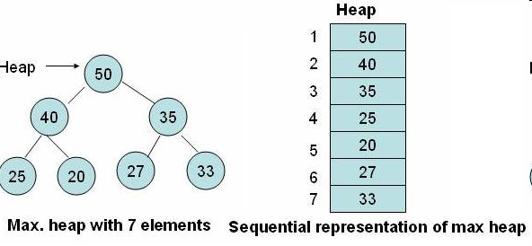
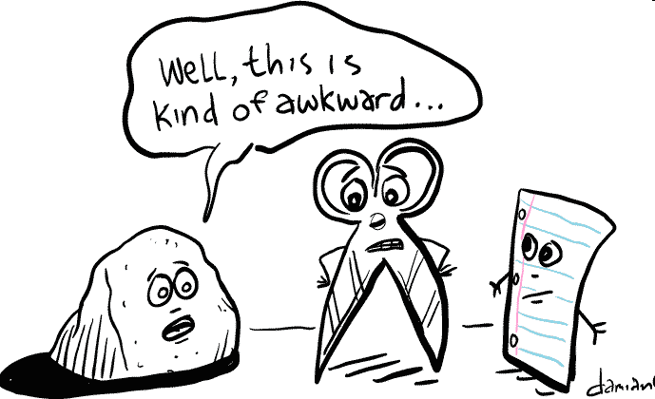
If you liked Stacks and Queues…
You'll LOVE CS70
C++

Slide 27

If you liked Prolog/TMs…
You'll LOVE CS81
Rice's Theorem—Proved!
New kinds of logic!
a. ∀x (p(x) → q(x)) → ((∀x p(x)) → (∀x q(x)))
b. ∀x (p(x) → q(x)) → ((∃x p(x)) → (∃x q(x)))
c. ∃x (p(x) → ∀x p(x))
d. ((∃x p(x)) → (∀x q(x))) → (∀x (p(x) → q(x)))

Slide 28
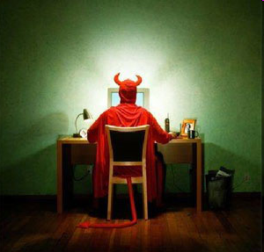
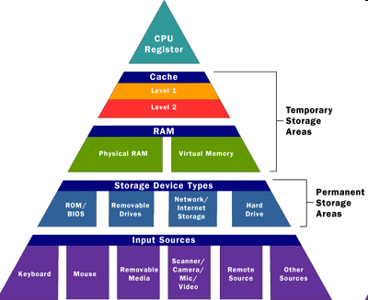
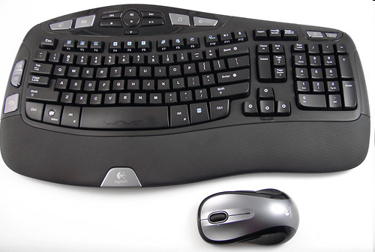
If you liked Computer Architecture/Hmmm
You'll LOVE CS105

Slide 29
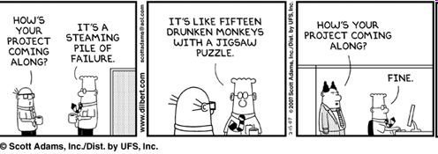
If you liked Spampede
You'll LOVE CS121

Slide 30
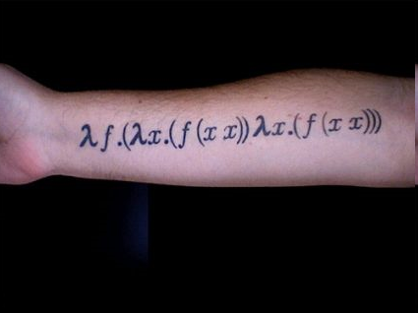
If you liked Racket
You'll LOVE CS131
Haskell
ML
Other crazy
programming languages
Lambda Calculus

Slide 31
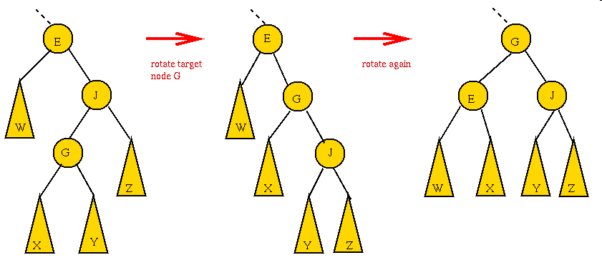
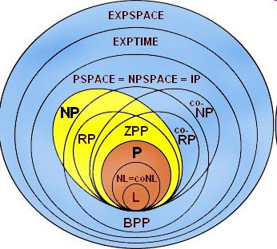
If you liked Searching and Sorting
You'll LOVE CS140

Slide 32
And there's more!
CS151: Artificial Intelligence
CS152: Neural Nets
CS153: Computer Vision
CS154: Robotics
CS158: Machine learning
CS141: Advanced Algorithms
CS142: Complexity Theory
CS143: Applied Algorithms
CS144: Scientific Computing
CS147: Systems Analysis
CS156: Parallel Computing
CS125: Computer Networks
CS132: Compilers
CS133: Databases
CS134: Operating Systems
CS135: File Systems
CS136: Advanced Architecture
CS124: UI Design
CS157: Computer Animation
CS155 Computer Graphics

Slide 33
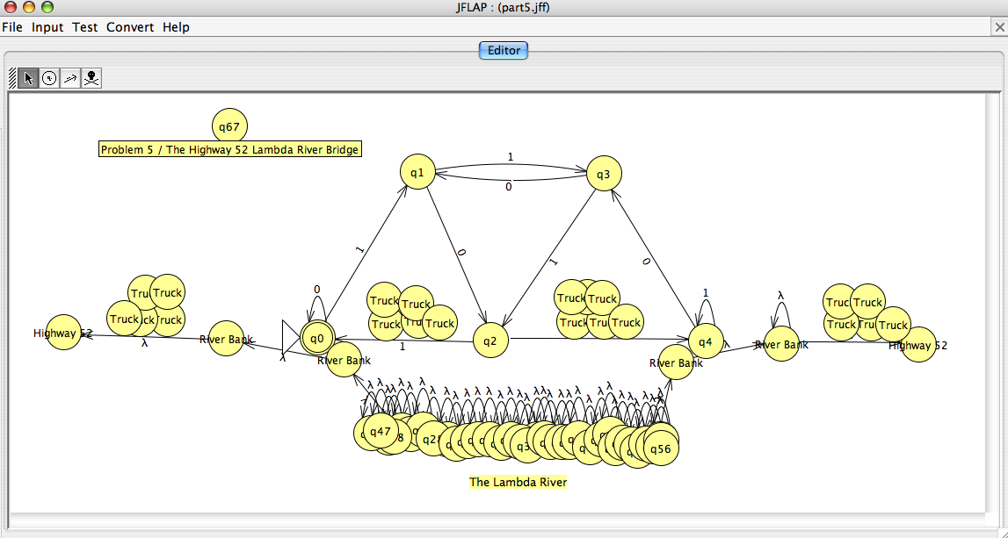
CS 42 as the lambda river
or the bridge. You decide…

Slide 34
Reflection
What was your favorite idea from CS42?
What was the most important idea from CS42?
What was the most confusing idea from CS42?

Slide 35
Favorite idea

Slide 36
Most important idea

Slide 37
Most confusing

Slide 38
Review problems

