Slide 1

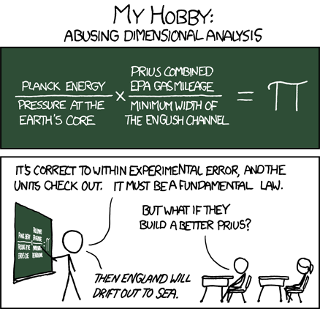
C
S
4
2
Last week:
Trees and higher-order functions
This week!
Trees' tangled cousins: Graphs
Homework #3
due Monday, 9/20 by 11:59 pm
tutors will be around all week
office hours: Friday 11-12, 2-3:15
starting early is the key to
CS 42 (and life) happiness
http://xkcd.com/687/
I <3 Prii

Slide 2

Hw 3's trees!
The game of 20 Questions
What is the tree here?
Notes:
I don’t know if this really works...

Slide 3
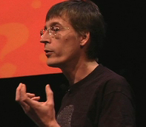

Hw 3's trees!
The game of 20 Questions
What is the tree here?
Is it bigger than a breadbox?
no
yes
Robin Burgener
gelconference.com/07/robin.html
spam
a computer scientist

Slide 4
How are things going?
The pace of lectures is:
  Way too slow
  A little too slow
  Just about right
  A little too fast
  Way too fast

Slide 5
How are things going?
The amount of homework is:
  Way too much! Help!
  A little too much, but I'm (barely) managing
  Just about right
  Not quite enough, but I can live with that
  Not nearly enough, I want more!

Slide 6
How are things going?
How much time did you spend on HW2?
  less than 5 hours
  5-7 hours
  7-10 hours
  10-15 hours
  more than 15 hours

Slide 7
How are things going?
Did you get help from the grutors or Prof. Alvarado?
  No, I didn't need it
  No, I wanted to, but forgot about grutoring hours
  No, I wanted to, but I couldn't make it to any of the grutoring hours
  Yes

Slide 8
Written Feedback
What is the most important thing you have learned so far?
What are you still confused about?
What is one thing that is helping you learn in this class?
What is one thing that I can do to help your learning improve?

Slide 9
Another Tree Example?
Brad Pitt
Fight
Club
Sleepers
Edward Norton
Kevin Bacon
Novocaine
The Gift
Chelcie Ross
Cate Blanchett
The “Oracle of Bacon” at oracleofbacon.org/
Notes:
I don’t know if this really works...

Slide 10
Undirected Graphs
Brad Pitt
Bill Clinton
Fight
Club
Sleepers
Edward Norton
Kevin Bacon
Novocaine
The Gift
Chelcie Ross
Cate Blanchett
Model relationships in which all connections are two-way.
The “Oracle of Bacon” at oracleofbacon.org/

Slide 11
Graph’s Anatomy
A directed graph models a general set of connection relationships.
node
node
node…
C
N
C
1
2
edge
How might it differ from a tree ?
Roots ?
Y
Leaves ?
edge
Parents
“fan-in”
E
edge…
Children ?
L
U
Cycles ?
Representation?
I
Notes:
I don’t know if this really works...

Slide 12
Data Abstraction
The one and only building block:
( )
Quantity List
'(fortnight (14.0 (day) () ) )
Binary Search Tree
'(42 (2 () ()) (50 (45 () ()) ()))
Graph??

Slide 13
Graphical programming
(define Gu '( (c1 n) (c1 y) (n y)
(c2 n) (c2 y) (y e)
(e u) (u i) (i l)
(l e) (c1 s) ) )
C
N
C
1
2
VS.
S
Y
(define Gu '( (c1 (n y s))
(n (y))
(c2 (n y))
(s ())
(y (e))
(e (u))
(l (e))
(u (i))
(i (l)) ) )
E
L
U
I

Slide 14
Graphical programming
(define Gu '( (c1 n) (c1 y) (n y)
(c2 n) (c2 y) (y e)
(e u) (u i) (i l)
(l e) (c1 s) ) )
C
N
C
1
2
; function nodes returns
; a list of nodes in G
(define (nodes G)
S
Y
E
L
U
I
Node-based?
Notes:
I don’t know if this really works...

Slide 15
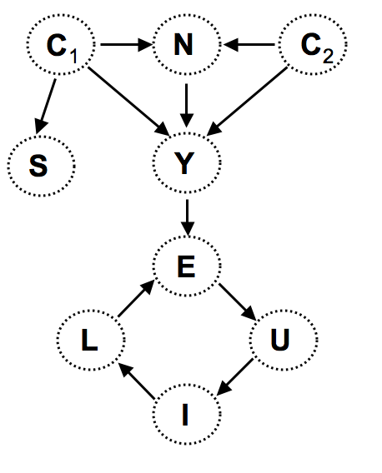
Graphical programming
(define Gu '( (c1 n) (c1 y) (n y)
(c2 n) (c2 y) (y e)
(e u) (u i) (i l)
(l e) (c1 s) ) )
already written…
How to extract the children of a particular node, n in G?
nodes
(define (kids n G)
Notes:
I don’t know if this really works...

Slide 16
Graphical programming
(define Gu '( (c1 n) (c1 y) (n y)
(c2 n) (c2 y) (y e)
(e u) (u i) (i l)
(l e) (c1 s) ) )
already written…
How about the parents?
nodes
(define (parents n G)
kids
and the roots?
Notes:
I don’t know if this really works...

Slide 17
Try it out…
(define Gu '( (c1 n) (c1 y) (n y)
(c2 n) (c2 y) (y e)
(e u) (u i) (i l)
(l e) (c1 s) ) )
This function returns #t if node gp is a grandparent of node gk, else #f.
(define (gkid gp gk G)
This function returns #t if node b can be reached by any path from node a, else #f.
(define (reach a b G)
Thought experiment: How could you determine if a graph contains a cycle or not?
Notes:
I don’t know if this really works...

Slide 18
reach
(define Gu '( (c1 n) (c1 y) (n y)
(c2 n) (c2 y) (y e)
(e u) (u i) (i l)
(l e) (c1 s) ) )
This function returns #t if node b can be reached by any path from node a, else #f.
(reach 'c1 'e Gu)
Notes:
I don’t know if this really works...

Slide 19
reach
(define Gu '( (c1 n) (c1 y) (n y)
(c2 n) (c2 y) (y e)
(e u) (u i) (i l)
(l e) (c1 s) ) )
This function returns #t if node b can be reached by any path from node a, else #f.
(define (reach a b G)
(reach-help b (list (list a)) G))
(define (reach-help dst path-list G)
(if (null? path-list)
#f
(let ((active-path (first path-list))
(remaining-paths (rest path-list)))
; If active path contains the destination, return #t
; Otherwise, expand the active path by one node for
; each edge, ignoring any paths with cycles, creating
; a list of 0 or more new paths.
; append this new list of paths onto the remaining
; paths and recurse.
; At least one helper function (to build the list
; of new paths) is recommended.
Notes:
I don’t know if this really works...

Slide 20
reach
(define Gu '( (c1 n) (c1 y) (n y)
(c2 n) (c2 y) (y e)
(e u) (u i) (i l)
(l e) (c1 s) ) )
This function returns #t if node b can be reached by any path from node a, else #f.
(define (reach a b G)
(reach-help b (list (list a)) G))
(define (reach-help dst path-list G)
(if (null? path-list)
#f
(let ((active-path (first path-list))
(remaining-paths (rest path-list)))
Notes:
I don’t know if this really works...

Slide 21
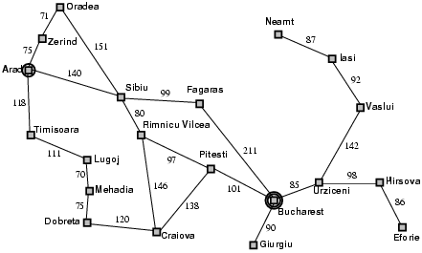
More Graph Algorithms
Find the shortest path from Bucharest to Arad

Slide 22
Best First Search
Intuition: explore from the node closest to the source that has not yet been explored

Slide 23
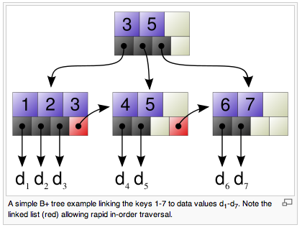

Trees: benefits!
fast storage and retrieval of data
File systems and databases tend to use trees with higher branching factors and advantageous block sizes. For example, a B+ tree.
wikipedia, B+ trees

Slide 24
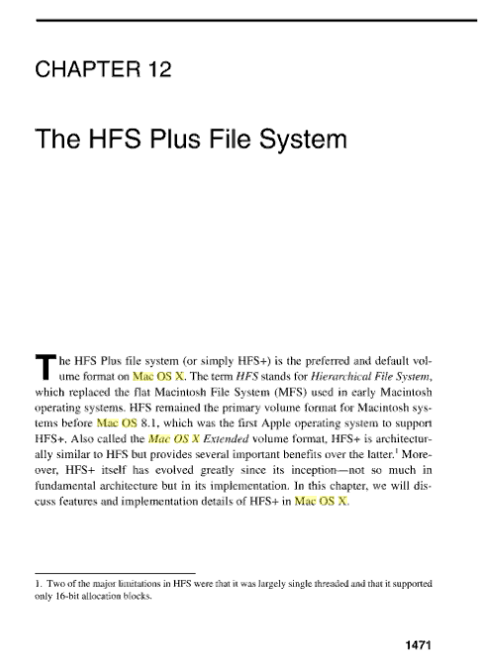
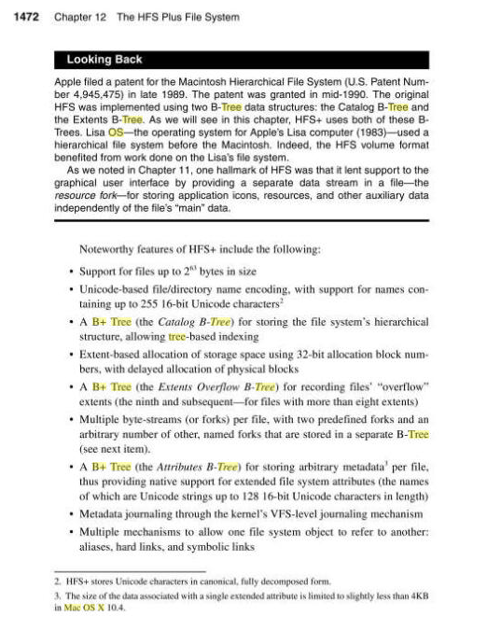
Macs, too

Slide 25
Side-note: Big - O
summarizes the “order” of work
Count the number of steps (in the worst case), then…
ignore constant coefficients
ignore all but the biggest term
N - 1
O(N)
is
2N² + 5N
O(N²)
is
2N² + 4N³
O( )
is
key to comparing programs and problems!

Slide 26
Trees: Not so fast…
Worst-case?
Average-case?
42
20
100
find
12
21
211
35
insert
25
39
delete
Notes:
I don’t know if this really works...

Slide 27
Lopsided trees
Suppose elements are being inserted into a binary tree.
At each decision point 99% of elements are larger and sort to the right.
How tall is such an N-node tree?
Notes:
I don’t know if this really works...

Slide 28
Trees are fast
find
insert
delete
For any constant left/right split-ratio of the data, all operations on trees are O(logN).
What if the data conspire against you -- and create an O(N) path?
Notes:
I don’t know if this really works...

Slide 29
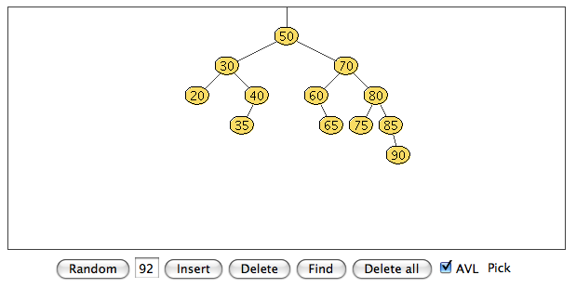
Trees are fast
find
For any constant left/right split-ratio of the data, all operations on trees are O(logN).
insert
delete
The solution: self-balancing trees.
AVL tree
Adelson-Velskii and Landis, An algorithm for the organization of information, 1960
http://www.csi.uottawa.ca/~stan/csi2514/applets/avl/BT.html
What if the data conspire against you -- and create an O(N) path?
Notes:
I don’t know if this really works...

