Slide 1
Today in CS 42
From Unicalc to Unilang: The anatomy of a programming language
the Parser and Evaluator and Tokenizer, too!
Tips for CS42 success (from your Grutors):
Nice job on HW1
Cut and paste the template file for future files.
Keep the lines short. <80 characters.
read instructions carefully.
Use let statements. Use helper functions.
Header comments, even for helper functions.
What? You mean I have to read for this class? What kind of a CS class is this?
Today + HW4:
Building an interpreted language (Racket)
Time = Money
Knowledge = Power
Power =
HW5 + HW6:
Assembly language and
Circuits (NOT Racket)
Work Time
Thursday, 10/14:
Midterm 1

Slide 2
Feedback feedback
Most important thing:
How to think/plan before starting to code
Recursion
How to use lambda
How to use a new/LISP-like language
Always use the new functions learned during lecture
Commenting is really helpful!
Thinking functionally
Higher-order functions/tail recursion
(not (equal? 'stuck 'failure))

Slide 3
Confusions/questions
Answers provided now (or shortly):
How much commenting/testing do we need?
Big-O
42
How Racket knows when to return something
Questions we'll get to later in the class
What racket does better than Python
How to approach a problem in Racket vs. other languages

Slide 4
Confusions/questions
Come see me for help with:
How to use lambda
Using recursion to modify trees
Tail recursion
Higher-order functions
Binary search trees
lotto solution
let and let* statements
Questions we may never know the answer to
Why does Racket use so many parentheses?
Why Unicalc "hates" one of you.
Why the grading site breaks when I do X

Slide 5
Suggestions
Things I will do (in the future if not now):
Try to limit tangential questions
Discuss naming conventions and readability
Compare problem solving in Racket to other languages
Give an overview of what's coming
Provide a reference card for Racket functions
Hints for the homework (come see me)
More examples
Move to another language
Other ideas (and reasons why they might not always be implemented)
Starting points or templates for functions
Slow lectures down

Slide 6
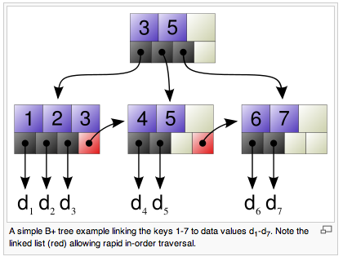

Trees: benefits!
fast storage and retrieval of data
File systems and databases tend to use trees with higher branching factors and advantageous block sizes. For example, a B+ tree.
wikipedia, B+ trees

Slide 7
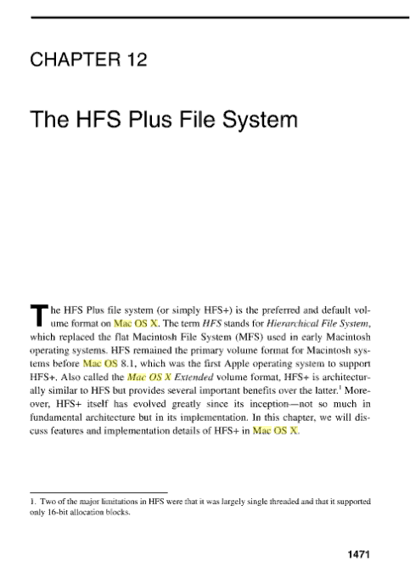
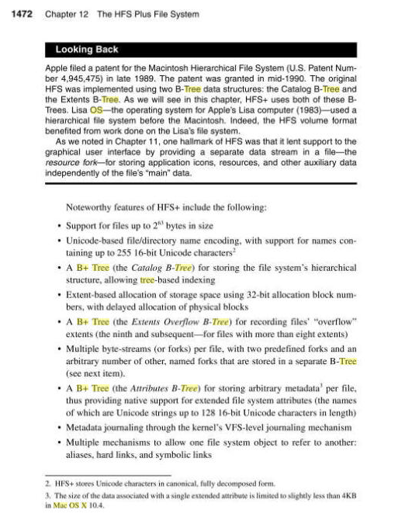
Macs, too

Slide 8
Side-note: Big - O
summarizes the “order” of work
Count the number of steps (in the worst case), then…
ignore constant coefficients
ignore all but the biggest term
N - 1
O(N)
is
2N² + 5N
O(N²)
is
2N² + 4N³
O( )
is
key to comparing programs and problems!

Slide 9
Trees: Not so fast…
Worst-case?
Average-case?
42
20
100
find
12
21
211
35
insert
25
39
delete

Slide 10
Lopsided trees
Suppose elements are being inserted into a binary tree.
At each decision point 99% of elements are larger and sort to the right.
How tall is such an N-node tree?

Slide 11
Trees are fast
find
insert
delete
For any constant left/right split-ratio of the data, all operations on trees are O(logN).
What if the data conspire against you -- and create an O(N) path?

Slide 12
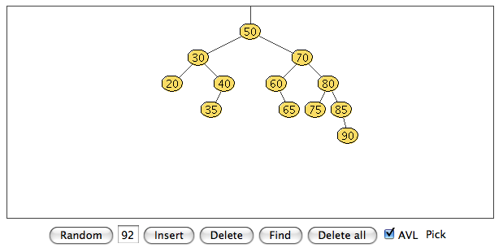
Trees are fast
find
For any constant left/right split-ratio of the data, all operations on trees are O(logN).
insert
delete
The solution: self-balancing trees.
AVL tree
Adelson-Velskii and Landis, An algorithm for the organization of information, 1960
http://www.csi.uottawa.ca/~stan/csi2514/applets/avl/BT.html
What if the data conspire against you -- and create an O(N) path?

Slide 13
The Racket language
>> (load "unicalc-db.rkt")
>> (multiply '(2.0 (kg) (second)) '(3.0 (meter) (second))) (6.0 ("kg" "meter") ("second" "second"))
>> (divide '(12.5 (meter) (second)) '(0.5 (meter) ()))
(25.0 () ("second"))

Slide 14
The Racket language
>> (load "unicalc-db.rkt")
>> (multiply '(2.0 (kg) (second)) '(3.0 (meter) (second))) (6.0 ("kg" "meter") ("second" "second"))
>> (divide '(12.5 (meter) (second)) '(0.5 (meter) ()))
(25.0 () ("second"))
Top 3 complaints about unicalc (in Racket)
3. Too many parentheses
2. Why the crazy order??
1. We don't use it enough in CS42!

Slide 15
The Racket language
>> (load "unicalc-db.rkt")
>> (multiply '(2.0 (kg) (second)) '(3.0 (meter) (second))) (6.0 ("kg" "meter") ("second" "second"))
>> (divide '(12.5 (meter) (second)) '(0.5 (meter) ()))
(25.0 () ("second"))
Top 3 complaints about unicalc (in Racket)
3. Too many parentheses
2. Why the crazy order??
1. We don't use it enough in CS42!

Slide 16
The unicalc language
An example interaction…
> v = vinit + a*t
> vinit = 3.0 +- 0.2 foot / second
> a = 3.0 meter /second second
> a
3.0 meter / second second
> t = 1 +- 0.04 minute
> v
180.91 +- 7.20 meter / second
> a = 3.0 foot / second second
> a
3.00 foot / second second
> %a
0.91 meter / second second
It looks like a normal interaction to me!

Slide 17
The minimath language
> (read-eval-print)
5 + 4
9
5 * 5
25
5 + 3 * 2
11
(5 + 3) * 2
16
x = 4
x * 2
8
An example interaction…
This looks simple!
What are the pieces?
decompose this…

Slide 18
The minimath language
> (read-eval-print)
5 + 4
9
5 * 5
25
5 + 3 * 2
11
(5 + 3) * 2
16
x = 4
x * 2
8
Input:
Output:
Challenges:

Slide 19
Stages of an Interpreter
Lexical Analyzer
Tokenizer
AKA
Parser
Evaluator
Environment
Printer

Slide 20
Stages of an Interpreter: Minimath
Tokenizer
"5 + 3 * 2"
Parser
5
+
3
*
2
Evaluator
symbol +
number 5
subexp
Environment
symbol *
number 3
number 2
Printer
number 11.0
"11.0"

Slide 21
Stages of an Interpreter: Racket
Tokenizer
"(average 4 (+ 5 5))"
Parser
(
average
4
(
+
5
5
)
)
Evaluator
symbol average
number 4
subexp
Environment
symbol +
number 5
number 5
Printer
number 7
"7"

Slide 22
Your own language…
string input
Tokenizer
list tokens
Parser
list parseTree
Evaluator
Uncertain QL result
Printer
Printed result
a great opportunity for the glottally challenged!

Slide 23
Getting the Symbols
Tokenizer
String input
Tokenizer
list tokens
"5+3*2"
["5", "+", "3", "*", "2"]
"5plus3times2"
["5", "plus", "3", "times", "2"]
"fiveplusthreetimestwo"
["five", "plus", "three", "times", "two"]

Slide 24
Java vs. Python
Tokenizer
while ( true )
{
print( "CS 60 4ever!" );
}
while
(
true
)
{
print
(
"
CS
60
4ever!
"
)
;
}
while true:
print "CS 60 4ever!"
while
true
:
\n
\t
print
"
CS
60
4ever!
"

Slide 25

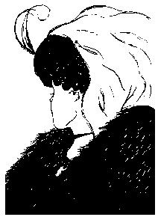
Tokenizing examples
expression
tokens
code
(+ (- 3.4) 45.4)
speech
/th sc y/
e
e
inumbrage
text
atonementionlyingravenspecksoftheartsseekindimagesinamementogodigatherscarletnotestendangerslaysherelapses
images

Slide 26
Tokenizing implemented
tokenizer.rkt

Slide 27
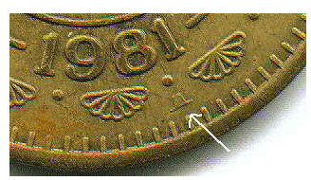
Tokens don't grow on trees…
but trees grow from them!
z = x+y*m
code
< z, =, x, +, y, *, m >
tokens
parse tree
=
z
+
x
y
++

Slide 28
Understanding a sentence
He gave her food
He gave food
her

Slide 29
Understanding a sentence
He gave her cat food
He gave food
He gave food
her
cat
cat
her

Slide 30
Understanding a sentence (or not…)
Food cat gave he.

Slide 31
Understanding a sentence
"5 + 3 * 2"
"5 2 + * 3"
?
(5 + 3) * 2
5 + (3 * 2)
error

Slide 32
Grammars
Grammar: A set of rules that determines legal expressions in a language.
the starting rule or “production”
Example:
S V S
V
+
"sum"
V
0
1
…
9
"value"
nonterminal or auxiliary symbol
each nonterminal symbol represents a “syntactic category”
S = “I want to be a sum.”
V = “I want to be a value.”
terminal symbols -- things that appear in the expression to be parsed
alphabet = { +, 0, 1, …, 9 }

Slide 33
Grammars
Grammar: A set of rules that determines legal expressions in a language.
the starting rule or “production”
A parser takes in tokens and generates a parse tree
Example:
S V S
V
+
"sum"
V
0
1
…
9
"value"
nonterminal or auxiliary symbol
each nonterminal symbol represents a “syntactic category”
Token list: '( 4 + 5 )
S = “I want to be a sum.”
V = “I want to be a value.”
terminal symbols -- things that appear in the expression to be parsed
Input “4 + 5”
alphabet = { +, 0, 1, …, 9 }

Slide 34
Grammars
Grammar: A set of rules that determines legal expressions in a language.
the starting rule or “production”
the parse tree for "4+5"
Example:
S V S
+
V
S
"sum"
V
V
+
S
0
1
…
9
"value"
4
V
nonterminal or auxiliary symbol
5
each nonterminal symbol represents a “syntactic category”
Parse tree: '( + 4 5)
Token list: '( 4 + 5 )
S = “I want to be a sum.”
V = “I want to be a value.”
terminal symbols -- things that appear in the expression to be parsed
Input “4 + 5”
alphabet = { +, 0, 1, …, 9 }

Slide 35
Ambiguous Grammars
Grammar: A set of rules that determines legal expressions in a language.
the starting rule or “production”
one parse tree for "4+5+6"
Example:
S S S
V
+
S
"sum"
V
S
+
S
0
1
…
9
"value"
S
+
S
V
V
V
6
4
5
is there another?

Slide 36
When it really matters
Grammar: A set of rules that determines legal expressions in a language.
the starting rule or “production”
Example:
E E E
E E
V
+
*
"expression"
V
0
1
…
9
"value"
E
E
"4+5*6"
E
*
E
E
+
E
E
+
E
V
V
E
*
E
V
V
6
V
V
4
4
5
5
6

Slide 37
Synthesizing Sentences
start here
S
V
+
S
V
-
S
V
S
V
0
1
…
9
The grammar decides how things get parsed and thus what they mean!
What is the parse tree for
8 - 4 + 5
?
end at tokens
as a list?

Slide 38
Synthesizing Sentences
8 - 4 + 5
S
V
+
S
V
-
S
V
V
0
1
…
9

Slide 39
Quiz
Root of the parse tree:
P
Starting symbol
P
S
*
P
S
/
P
S
"product"
S
V
+
S
V
-
S
V
"sum"
V
0
1
…
9
"value"
1
Above, create the parse tree for the expression
7 * 3 + 9 / 2
What would this parse tree evaluate to?
2
How could you correct this grammar to represent the usual mathematical meaning of this expression?
(Note: Consider THIS expression only).
What rule could you add that would enable the use of parentheses ( and ) for grouping terms?
3

Slide 40
Quiz
Option A
P
V
*
P
V
/
P
V
+
S
V
-
S
V
V
0
1
…
9
Option B
S
P
+
S
P
-
S
P
Option C
P
V
*
P
V
/
P
V
S
D
+
S
D
D
P
-
S
P
V
0
1
…
9
P
Q
*
P
Q
Q
V
/
Q
V
V
Option D: None of the above
0
1
…
9
2
How could you correct this grammar to represent the usual mathematical meaning of this expression? (Note: Consider THIS expression only).

Slide 41
Quiz
list form of the parse tree:
(* 7(/ (+ 3 9) 2))
Starting symbol
Root of the parse tree:
P
P
S
*
P
S
/
P
S
S
P
*
"product"
S
V
+
S
V
-
S
V
V
S
P
/
"sum"
V
0
1
…
9
V
+
S
S
"value"
V
V
1
Above is this grammar's parse tree for
7 3 9 2
What would this parse tree evaluate to?
Closer to the starting symbol
2
How could you correct this grammar to represent the usual mathematical meaning of this expression? (Note: Consider THIS expression only).
-- implies --
lower precedence
What rule could you add that would enable the use of parentheses ( and ) for grouping terms?
change the right-hand-side Vs to Us and then add
3
U
P
V
(
)

Slide 42
A Parsing Algorithm
P
S
*
P
S
/
P
S
"product"
S
V
+
S
V
-
S
V
"sum"
V
0
1
…
9
"value"
Tokens (8 - 4 + 5)
What is the parse tree for
8 - 4 + 5
?

Slide 43
A Parsing Algorithm
P
S
*
P
S
/
P
S
tokens: '(8 * 4 + 5)
P: "I start with an S, so ask S to parse"
"product"
tokens: '(8 * 4 + 5)
S
V
+
S
V
-
S
V
S: "I start with a V, so ask V to parse"
"sum"
tokens: '(8 * 4 + 5)
V: "I am a number, so I'll consume the first token as a number."
V
0
1
…
9
"value"
tokens: '(* 4 + 5)
P
S: "Now that I have a V, I expect a "+", "-" or nothing.
I see a "*", so I guess I'm just a value.
S
P
tokens: '(* 4 + 5)
*
P: "Now that I have an S, I expect a "*", "/" or nothing.
I see a "*" so I consume it and ask P to parse again.
V
S
tokens: '(4 + 5)
P: "I start with an S, so ask S to parse…"
V
+
S
V
8
4
5

Slide 44
Recursive Descent
S
P
+
S
P
"sum"
P
N
*
P
N
Recursive descent parsing:
"product"
each nonterminal has its own function
N
any Double
need to maintain a token list (or array)
"number"
String
"12+15 * 2"
Token List
( 12 + 15 * 2 )
Parse Tree
'(+ 12 (* 15 2)))

Slide 45
I → varname = E | # varname | varname
E → S | Val
S → P + S | P - S | P
P → Pow * P | Pow / P | Pow
Pow → Sub^Amt | Sub
Sub → ( S ) | varname | Amt
Val → Amt +- Amt UL | Amt UL
Amt → number | - number
UL → Units / Units | Units
Units → ε | unitname Units
A grammar for the Unicalc language

Slide 46
I → varname = E | # varname | varname
E → S | Val
S → P + S | P - S | P
P → Pow * P | Pow / P | Pow
Pow → Sub^Amt | Sub
Sub → ( S ) | varname | Amt
Val → Amt +- Amt UL | Amt UL
Amt → number | - number
UL → Units / Units | Units
Units → ε | unitname Units
(= varname E)
(# varname)
varname
Parse Trees
S
Val
(+ P S)
(- P S)
P
(* Pow P)
(/ Pow P)
Pow
(^ Sub Amt)
Sub
S
varname
Amt
UQL
UQL (with 0 error)
number
-1*number
(Units Units)
(Units ())
()
(unitname {Units*})

Slide 47
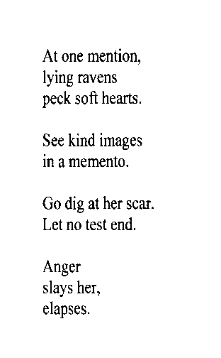
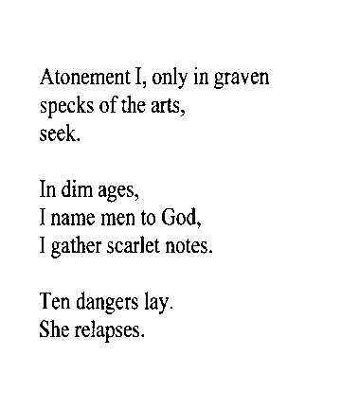
inumbrage
atonementionlyingravenspecksoftheartsseekindimagesinamementogodigatherscarletnotestendangerslaysherelapses
inumbrage
inumbrage
atonementionlyingravenspecksoftheartsseekindimagesinamementogodigatherscarletnotestendangerslaysherelapses
atonementionlyingravenspecksoftheartsseekindimagesinamementogodigatherscarletnotestendangerslaysherelapses
- Mike Maguire

