Slide 1
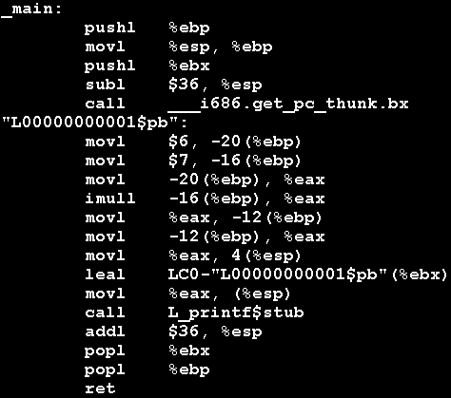
Hmmm… What is this all about?
CS 42 Today
Racket
How computers dream
Harvey
mudd
miniature
machine
Hmmm…
PC: Program Counter
IR: Instruction Register
RAM
registers
1-bit memory: flip-flops
arithmetic
bitwise functions
Office hours Friday 11-12, 2-3:15
Next Thursday (9/30): Class in Galileo Edwards
logic gates
our path…
transistors / switches

Slide 2
Stages of an Interpreter
Lexical Analyzer
Tokenizer
AKA
Parser
Evaluator
Environment
Printer

Slide 3
Evaluation!
S
P
S
P
+
"sum"
P
N
*
P
N
The final step in our language's implementation…
"product"
N
number
"number"
String
"12+15 * 2"
Token List
'( 12 + 15 * 2 )
IMPORTANT: This looks
like a Racket expression,
but it is NOT!! (It's just a
list of symbols)
Parse Tree
'(+ 12 (* 15 2))
Evaluation
42
How is this going to work?

Slide 4
;; File: minimath-eval.rkt
;; Author: Christine Alvarado
;; A file that implements an evaluator for a simple math language
(load "minimath-parser.rkt")
;; Function: read-eval-print
;; The main read-eval-print loop
;; input: none
;; output: the quit expression, when the user quits
;; description: Reads in an expression from the user, parses
;; that expression and prints the parse tree, then repeats
(define (read-eval-print)
(begin
(prompt)
(let* ( (expression (read-line)) )
(if (equal? expression quit-expr)
expression ;; exit
(begin
;; Parse and eval the expression
(let* ((parsed (parse expression)))
(minimath-display-pt parsed)
(if (outcome parsed)
(minimath-display
(minimath-eval (second parsed)))))
;; Then repeat the loop
(read-eval-print))))))

Slide 5
;; Function: minimath-display-pt
;; input:
;; parsed - the output of the parse function
;; output - none
;; prints the parse tree for the user.
(define (minimath-display-pt parsed)
(if (first parsed)
(begin
(display syntax-tree-label)
(display (second parsed))
(newline))
(begin
(display "Parse error: ")
(display parsed))))
;; Function: minimath-display
;; input:
;; expr - the expression to display
;; output - none
(define (minimath-display expr)
(begin (display result-label)
(display expr)))

Slide 6
;; The main evaluation function for the minimath language
;; Note: avoid eval, which is a built-in
(define (minimath-eval parse-tree)
(cond
((sum? parse-tree) (+ (minimath-eval (second parse-tree))
(minimath-eval (third parse-tree))))
((product? parse-tree) (* (minimath-eval (second parse-tree))
(minimath-eval (third parse-tree))))
;; no need to eval a number, number? is built-in
((number? parse-tree) parse-tree)
(else (list 'error "unrecognized expression" parse-tree))))
;; Is the expression a sum? (a list that starts with a plus)
(define (sum? expr)
(and (list? expr) (begins-with? add-char expr)))
;; Is the expression a product? (a list that starts with times)
(define (product? expr)
(and (list? expr) (begins-with? multiply-char expr)))

Slide 7
What about variables?
> (read-eval-print) > w = 4.53 +- 0.02 m syntax tree: (= w ((4.53 0.02) (m) ())) environment: ((w ((4.53 0.02) (m) ())))
> w syntax tree: w environment((w ((4.53 0.02) (m) ()))) 4.53+-0.02 m

Slide 8
What about variables?
> (read-eval-print) > w = 4.53 +- 0.02 m syntax tree: (= w ((4.53 0.02) (m) ())) environment: ((w ((4.53 0.02) (m) ())))
> w syntax tree: w environment((w ((4.53 0.02) (m) ()))) 4.53+-0.02 m
;; Evaluate the current expression in the global environment
(define (unicalc-eval parse-tree)
(cond
((quant-list? parse-tree) parse-tree)
((variable? parse-tree) (uc-eval-variable parse-tree))
(else (list 'error "unrecognized expression" exp))))

Slide 9
;; This is the global database of mappings from
;; variable names to values
(define global-env '())
;; store a new named value in the global environment
;; input: a name and a value
;; output: void
;; modifies the global environment to contain the new binding
(define (save-definition! name val)
(set! global-env (cons (list name val) global-env)))
;; function: lookup
;; input: a variable name
;; Output: the value of a variable in the given environment.
;; If the variable is unbound, an error value is returned.
(define (lookup var)
(let (
(found (assoc var global-env))
)
(if found
(second found)
(list 'error "unbound variable" var))))

Slide 10
What about variables?
How could you modify the evaluator (and the language)
to handle parameters (i.e. local scope)?
;; Evaluate the current expression in the global environment
(define (unicalc-eval parse-tree)
(cond
((quant-list? parse-tree) parse-tree)
((variable? parse-tree) (uc-eval-variable parse-tree))
(else (list 'error "unrecognized expression" exp))))

Slide 11
Taxonomy of Programming Models
Programming
Whew! Goodbye Racket!
Declarative
Programming
Imperative
Programming
Logic
Programming
Functional Programming
Object-Oriented
Programming
Low-level Programming
Prolog
Racket
Python
Hmmm
algorithms via circuitry
more abstraction away from the machine
closer to the machine

Slide 12
What's in a computer?

Slide 13
What's in a computer?
Data Processing
The CPU
(Central
Processing
Unit)
Data Storage
Memory, Disk

Slide 14
And when you look closer

Slide 15
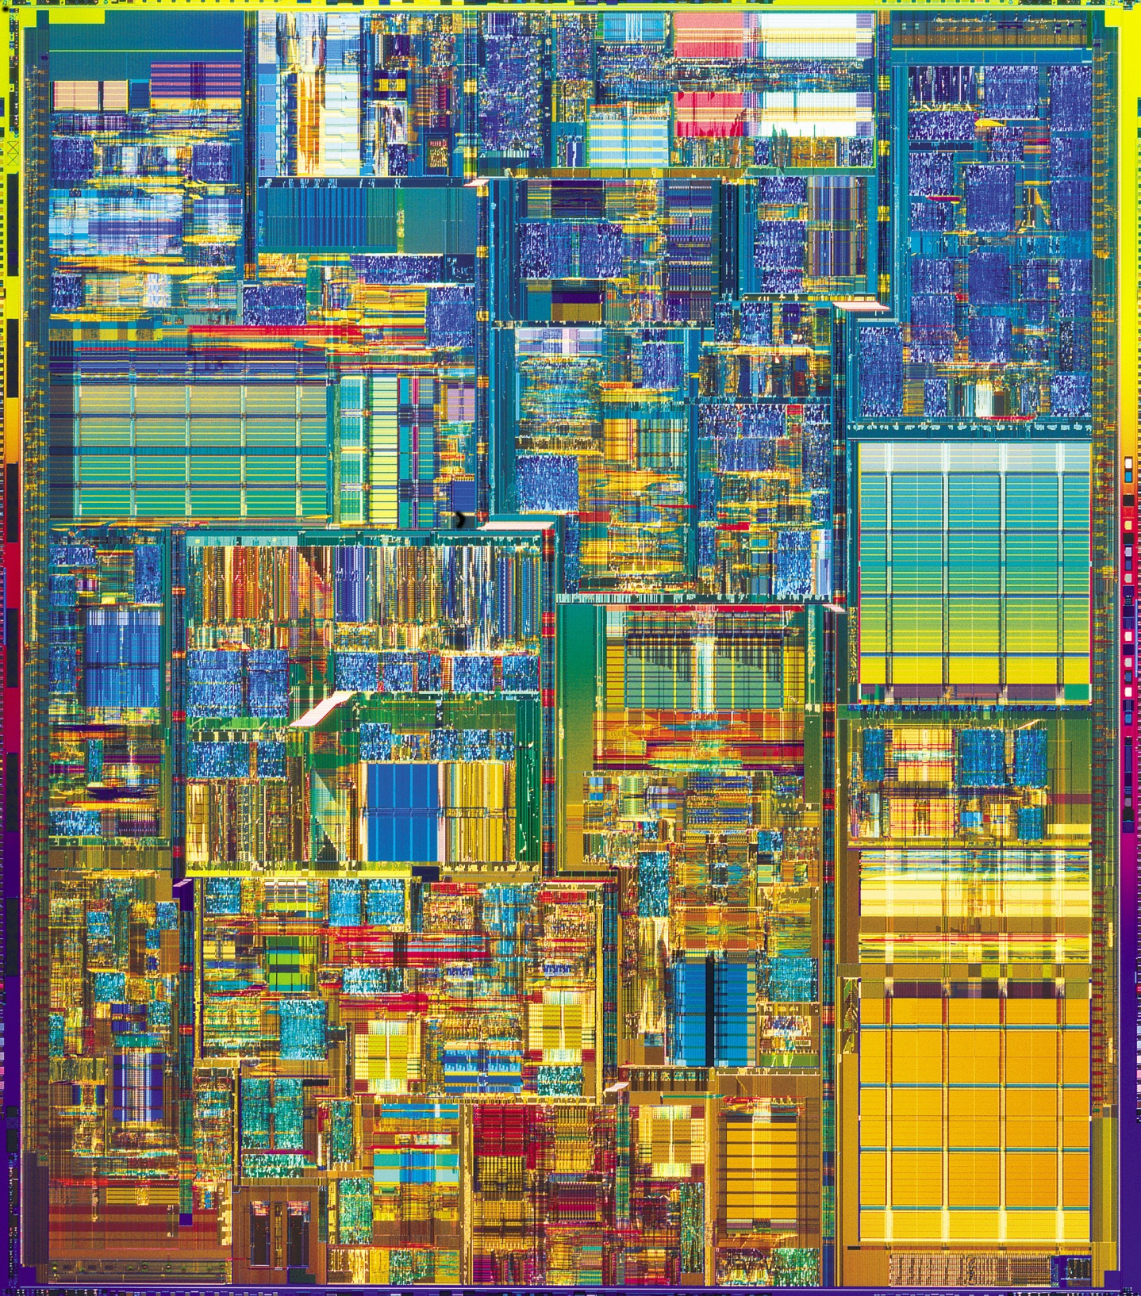
Or even
closer?

Slide 16
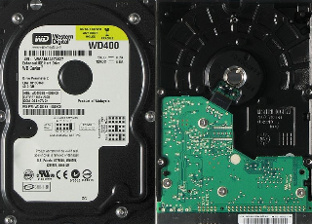
Computer Organization
CPU
Main Memory
(RAM)
Disk Drive
Central Processing Unit
An 8-bit register: 8 flip-flops
D
Q
D
Q
D
Q
D
Q
D
Q
D
Q
D
Q
D
Q
s
s
s
s
s
s
s
s
~50 Registers of 8-32 bits each
8 billion bits
800 billion bits (or more)
1 billion bytes
100 billion bytes (or more)
Price
~$100
~$100
~$100
Time
1 clock cycle
100 cycles
10⁷ cycles
10⁻⁹ sec
10⁻⁷ sec
10⁻² sec
If “cycle”
= 1 min
1 min
1.5 hours
19 YEARS

Slide 17
Von Neumann Architecture
Will the real von Neumann please stand up?
instructions executed here
programs stored here
CPU
RAM
Von Neumann bottleneck
central processing unit
random access memory
A few, fast registers + arithmetic
“Slow” memory no computation

Slide 18
Von Neumann Architecture
instructions executed here
programs stored here
CPU
RAM
Von Neumann bottleneck
central processing unit
random access memory
0
read r1
1
mul r2 r1 r1
Programs are stored in memory in machine language (1s and 0s)
2
add r2 r2 r1
3
write r2
4
halt
5
6
…
255
255 total memory locations

Slide 19
Von Neumann Architecture
instructions executed here
programs stored here
CPU
RAM
Von Neumann bottleneck
central processing unit
random access memory
0
read r1
1
mul r2 r1 r1
Each instruction is transferred (in order) to the CPU to be executed
2
add r2 r2 r1
3
write r2
4
halt
5
6
…
255
255 total memory locations

Slide 20
Von Neumann Architecture
instructions executed here
programs stored here
CPU
RAM
Von Neumann bottleneck
central processing unit
random access memory
0
read r1
Assembly language is human-readable machine language
1
mul r2 r1 r1
2
add r2 r2 r1
3
write r2
4
halt
5
6
…
255
255 total memory locations

Slide 21
The BIG IDEA
Instructions are simple functions for the computer to perform
move some data (between registers and/or memory)
Add some numbers
Go back to a previous instruction
Etc.
We can represent functions in logic
Truth tables, algebra, logic gates
We ENCODE instructions as sequences of 0s and 1s…
…Then we can build HARDWARE to execute these instructions
The instructions are just INPUTS to LOGIC FUNCTIONS!
(The output is the RESULT of executing the instruction)

Slide 22
More concrete
Digital circuit design
how to turn functions into hardware
collections of circuits that can perform
all the needed functions to manipulate data
Computer Architecture
sequences of 1s and 0s that drive the
hardware to perform the necessary functions
Machine Language
Assembly Language
A translation of the 1s and 0s
into something human-readable
Loops in AL
how to use AL to do stuff that's useful
to humans
Functions and recursion in AL
More abstract

Slide 23
More concrete
Digital circuit design
Tuesday + Thursday
Computer Architecture
Tues 10/4
Machine Language
Assembly Language
Today + Tuesday
Loops in AL
Tues 10/4
Functions and recursion in AL
Thurs 10/6
More abstract

Slide 24
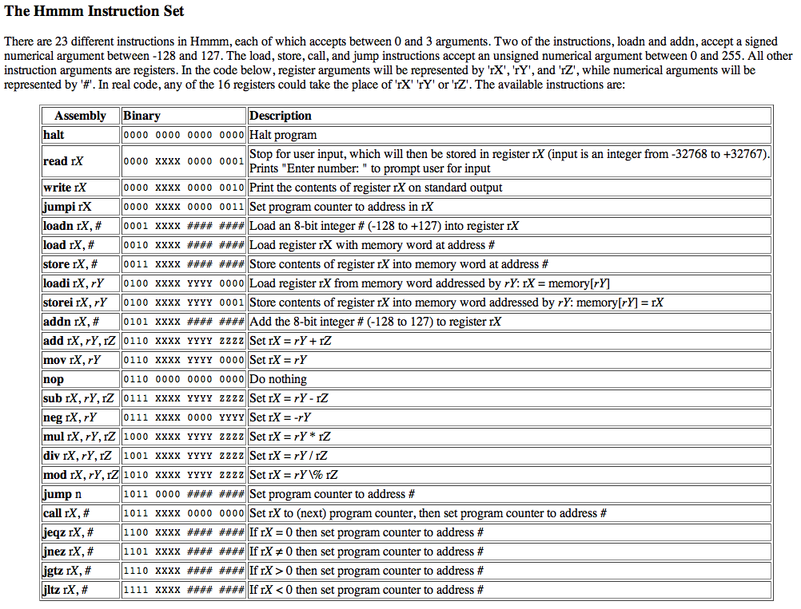
Hmmm Quick Reference

Slide 25
Hmmm
The Harvey Mudd Miniature Machine
CPU
RAM
Von Neumann bottleneck
central processing unit
random access memory
Program Counter
0
read r1
Holds address of the next instruction
1
mul r2 r1 r1
Instruction Register
Holds the current instruction
2
add r2 r2 r1
3
write r2
register 0
is “hard-wired”
to store 0
0
r0
4
16 registers,
each 16 bits
halt
r1
5
they can hold values from -32768 upto 32767
6
r2
…
…
255
r15
255 memory locations of 16 bits

Slide 26
Hmmm
NOTE:
The Hmmm "machine" is does not exist in hardware.
It exists in simulation only (in Python).
We'll see it in action next time.
The Harvey Mudd Miniature Machine
CPU
RAM
Von Neumann bottleneck
central processing unit
random access memory
Program Counter
0
read r1
Holds address of the next instruction
1
mul r2 r1 r1
Instruction Register
Holds the current instruction
2
add r2 r2 r1
3
write r2
register 0
is “hard-wired”
to store 0
0
r0
4
16 registers,
each 16 bits
halt
r1
5
they can hold values from -32768 upto 32767
6
r2
…
…
255
r15
255 memory locations of 16 bits

Slide 27
Hmmm
The Harvey Mudd Miniature Machine
CPU
RAM
Von Neumann bottleneck
central processing unit
random access memory
Program Counter
0
read r1
Holds address of the next instruction
1
mul r2 r1 r1
Instruction Register
Holds the current instruction
2
add r2 r2 r1
3
write r2
register 0
is “hard-wired”
to store 0
0
r0
4
16 registers,
each 16 bits
halt
r1
5
they can hold values from -32768 upto 32767
6
r2
…
…
255
r15
255 memory locations of 16 bits

Slide 28
Hmmm: the fetch - execute cycle
CPU
Initially 0
RAM
central processing unit
random access memory
Program Counter
0
read r1
0
Holds address of the next instruction
1
mul r2 r1 r1
Instruction Register
Holds the current instruction
add r2 r2 r1
0
register 0
is “hard-wired”
to store 0
2
r0
3
write r2
r1
halt
General-purpose register r1
4
r2
General-purpose register r2

Slide 29
Assembly Language
register-level programming
add r2 r2 r2
reg2 = reg2 + reg2
crazy, perhaps, but used ALL the time
sub r2 r1 r4
reg2 = reg1 - reg4
mul r7 r6 r2
reg7 = reg6 * reg2
div r1 r1 r1
reg1 = reg1 / reg1
INTEGER division - no remainders
loadn r1 42
you can replace 42 with anything from -128 to 127
reg1 = 42
addn r1 -1
reg1 = reg1 - 1
a shortcut
read r0
read from keyboard and write to screen
Each of these instructions (and many more) get implemented for a particular processor and particular machine… .
write r0

Slide 30
Is this enough?
Could we implement Racket using Hmmm Assembly?
read r1
0
1
mul r2 r1 r1
add r2 r2 r1
2
3
write r2
halt
4
fetch-execute cycle

Slide 31
It's not enough!
Could we implement Racket using our Hmmm Assembly Language so far?
It's all too linear!
"straight-line code"
read r1
0
1
mul r2 r1 r1
add r2 r2 r1
2
3
write r2
jump!
halt
4

Slide 32
Hmmm, Let's jump !
CPU
RAM
central processing unit
random access memory
Program Counter
loadn r1 42
0
Holds address of the next instruction
1
write r1
Instruction Register
Holds the current instruction
addn r1 1
0
register 0
is “hard-wired”
to store 0
2
r0
3
jump 1
r1
General-purpose register r1
halt
4
r2
Replace 1 with 2? with r1?
General-purpose register r2

Slide 33
jumps
Unconditional jump
GOTO
jump 42
replaces the PC (program counter) with 42.
"jump to line number 42"
Conditional jumps
IF
jeqz r1 #
IF r1 == 0 THEN jump to line number #
jgtz r1 #
IF r1 > 0 THEN jump to the location in #
jltz r1 #
IF r1 < 0 THEN jump to the location in #
jnez r1 #
IF r1 != 0 THEN jump to the location in #
Indirect jump
jumpi r1
Jump to the line # stored in reg1!

Slide 34
jgtz
Gesundheit!
CPU
RAM
central processing unit
random access memory
Program Counter
0
read r1
Holds address of the next instruction
1
jgtz r1 7
Instruction Register
2
loadn r2 -1
3
mul r1 r1 r2
Holds the current instruction
nop, nop, whose there?
4
nop
r1
5
nop
General-purpose register r1
6
nop
7
write r1
r2
8
halt
General-purpose register r2
What is this code computing about its input?

Slide 35
Worksheet
Follow this assembly-language program from top to bottom. Use r1 = 42 and r2 = 5.
Write an assembly-language program that reads one integer as keyboard input. Then, the program should compute the factorial of that input and write it out. You may assume without checking that the input will be a positive integer.
1
2
Registers - CPU
Memory - RAM
0
read r1
Memory - RAM
r0
0
1
read r2
Registers - CPU
0
r1
2
sub r3 r2 r1
0
1
r0
3
nop
2
r2
r1
4
jltz r3 7
3
r3
r2
4
5
write r1
r4
6
jump 8
r3
5
7
write r2
6
halt
r4
7
8
9
r5
8
9
(1) What does this program compute in general?
(2) How could you change this program so that, if the original two inputs were equal, it asked the user for new inputs?
10
Hint: Take in an input. Next, set up a “result” register starting with 1 in it. Then modify the “result” until it’s right!

Slide 36
1
Follow this assembly-language program from top to bottom. Use r1 = 42 and r2 = 5.
Memory - RAM
Registers - CPU
read r1
0
r0
0
1
read r2
2
sub r3 r2 r1
r1
3
nop
4
jltz r3 7
5
write r1
r2
6
jump 8
7
write r2
r3
8
halt
9
(1) What does this program compute in general?
(2) How could you change this program so that, if the original two inputs were equal, it asked the user for new inputs?

Slide 37
2
Write an assembly-language program that reads one integer as keyboard input. Then, the program should compute the factorial of that input and write it out. You may assume without checking that the input will be a positive integer.
factorial
plan

Slide 38
Program Counter
Factorial
Instruction Register
Hmmm CPU
Hmmm RAM
0
read r1
input
r0
0
1
loadn r13 1
initialize result to 1
Input value: x
2
jeqz r1 6
r1
3
mul r13 r13 r1
loop
Final result - in progress
4
addn r1 -1
r13
5
jump 2
6
write r13
output
7
halt
.
.

