Slide 1
Image Processing Fun

Slide 2
Today
Fun
Fun
Fun
Fun
Fun
Fun
Fun

Slide 3
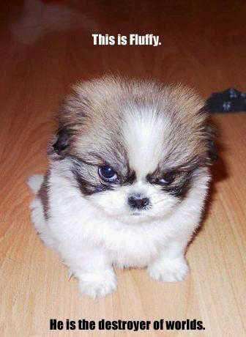
Step 1
Find an image

Slide 4
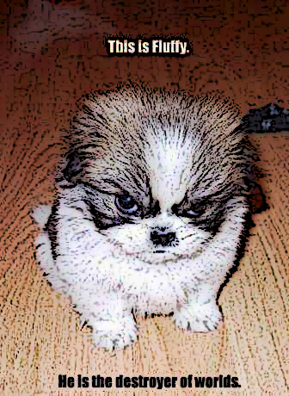
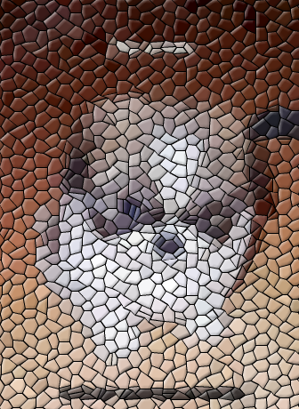
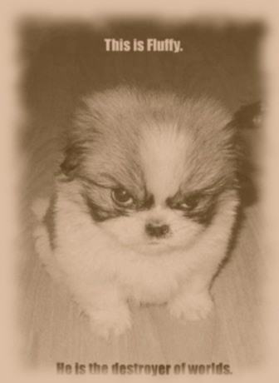
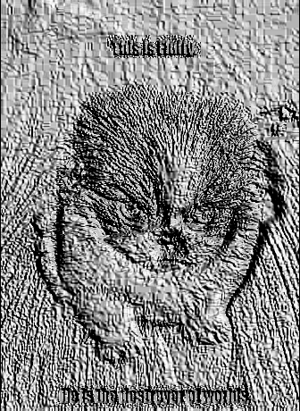
Step 2
Mess with it

Slide 5
Step 3
Analyze results
shrink
smudge boundaries
reduce contrast
decrease blue/green

Slide 6
Step 4
Plan a “fun filter” for project 1

Slide 7
Meanwhile
I’ll take your pictures for next Tuesday’s morphing lab

