Slide 1
CS155 Computer Graphics
Lecture 1: Introduction

Slide 2
Overview
What is computer graphics?
What is it good for?
What is this class about?
Grading
Policies
Administrative matters
Lab 0

Slide 3
What is computer graphics?
Computer graphics is the study of creating images with a computer
  Image Processing
  Modeling
  Rendering
  Animation

Slide 4
Image Processing
Analyze
Correct
Enhance
Synthesize

Slide 5
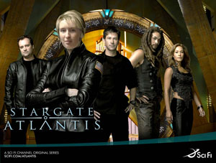
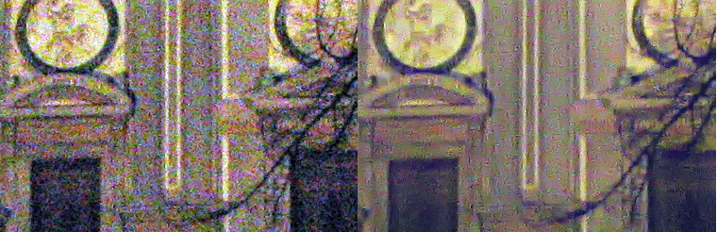
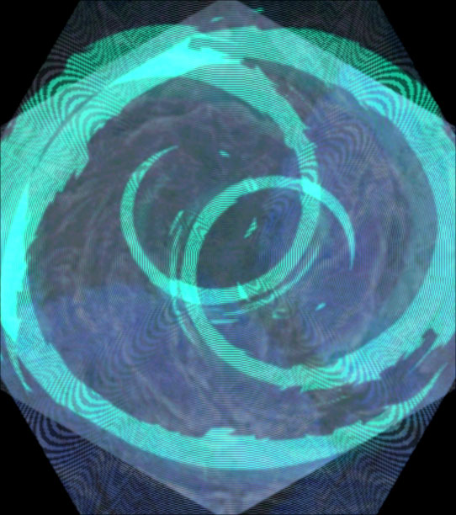
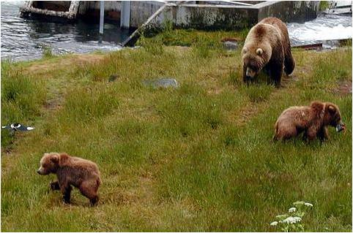
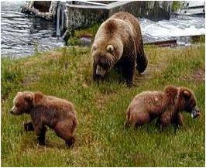
Image Processing Examples
Denoising (Portilla 2004)
Compositing (Gragg 2009)
Seam Carving (Avidan/Shamir 2007)
Misc. effects (Fujimoto 2009)

Slide 6
Modeling
Representation of shape, lighting, material properties, etc.
Creation of models
Manipulation of models

Slide 7
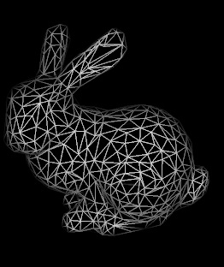

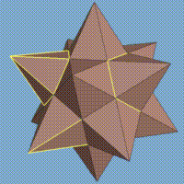
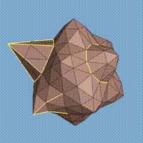
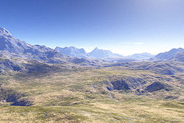
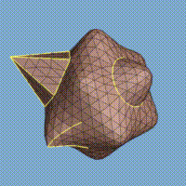
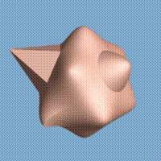
Modeling Examples
Standford’s Michealangelo project
Stanford bunny wireframe
Fractal landscape
Subdivision surfaces

Slide 8
Rendering
Creating an image of a “virtual” scene.
pipeline
ray tracing

Slide 9
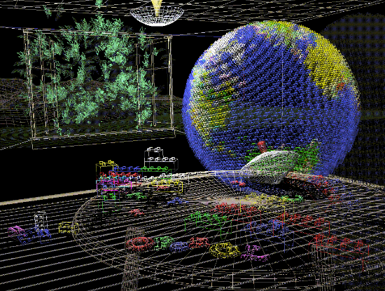
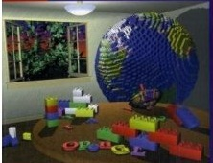
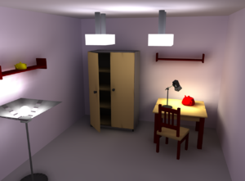

Render examples
OpenGL
radiosity renderer based on OpenGL
ray tracing

Slide 10
Animation
Making it move
  Key frame
  Kinematics
  Path planning
  Physical simulation
  etc.

Slide 11


Animation Examples
Luxo Jr.
cloth simulation
(youTube raven67854)

Slide 12
Overview
What is computer graphics?
What is it good for?
What is this class about?
Grading
Policies
Administrative matters
Lab 0
✓

Slide 13
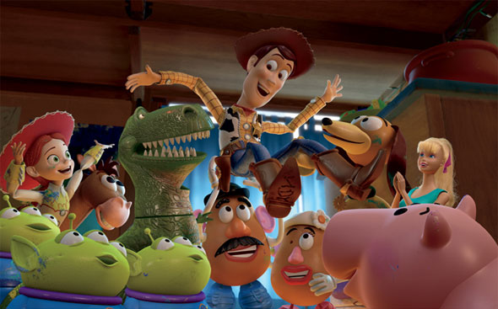
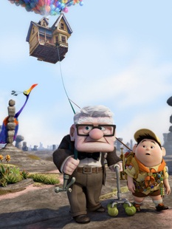

Entertainment

Slide 14
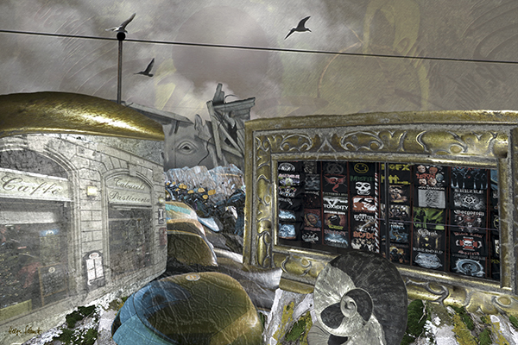
Art
Helga Schmitt Pullach at MOCA, Brooklyn

Slide 15
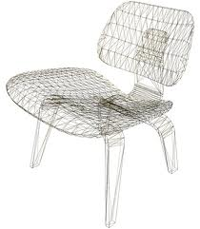
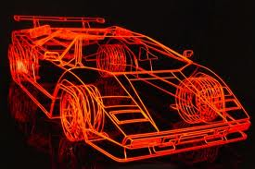
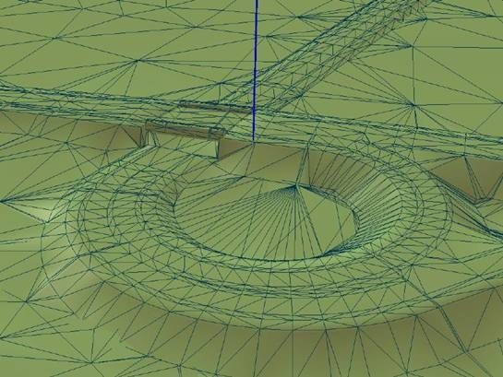
Computer aided design

Slide 16
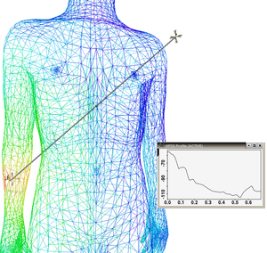
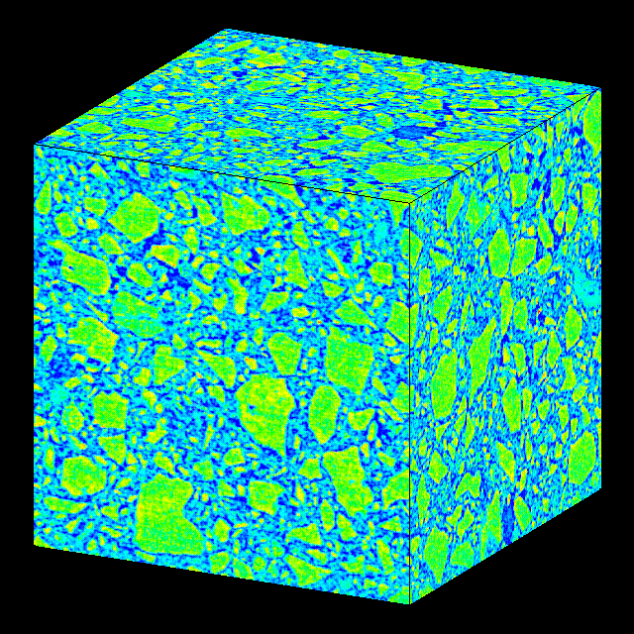
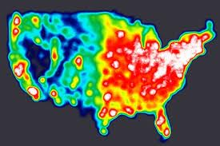
Scientific visualization

Slide 17

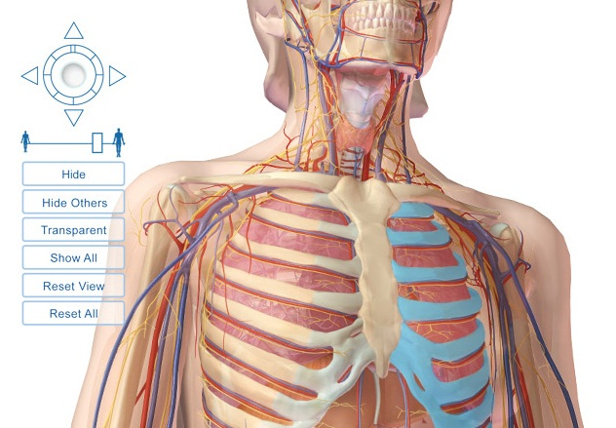
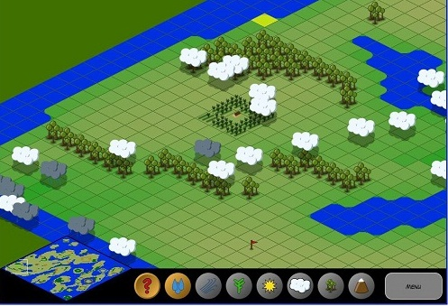
Education and Training

Slide 18
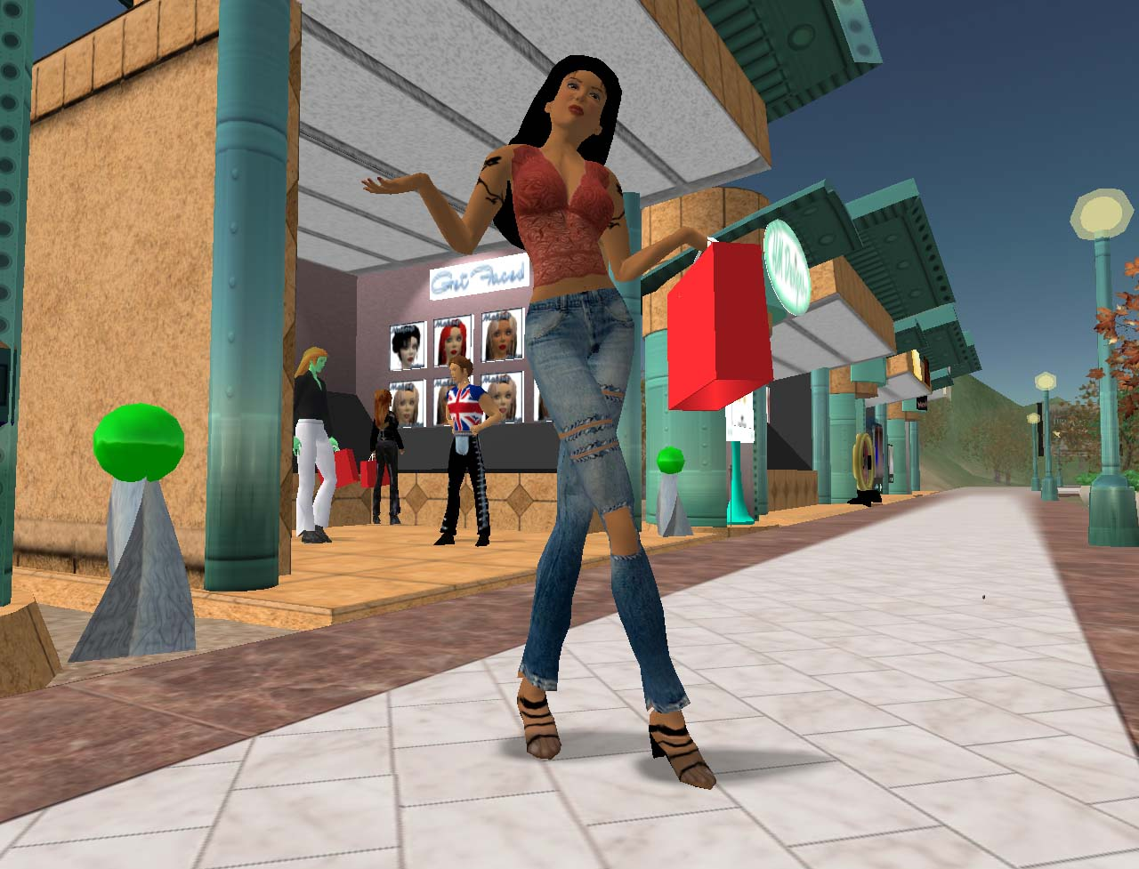
e-commerce

Slide 19
Overview
What is computer graphics?
What is it good for?
What is this class about?
Grading
Policies
Administrative matters
Lab 0
✓
✓

Slide 20
Course overview
Images
Ray tracing
Pipeline rendering
Introduction to Modeling
Misc. topics

Slide 21
Projects
Image Processor
Ray Tracer
OpenGL application
Final project

Slide 22
Overview
What is computer graphics?
What is it good for?
What is this class about?
Grading
Policies
Administrative matters
Lab 0
✓
✓
✓

Slide 23
Grades
20% Image processor
25% Ray tracer
20% OpenGL modeling tool
25% Final project
10% Labs/class participation

Slide 24
Grades
A 96-100
A- 91-95
B+ 87-90
B 84-86
B- 81-83
C+ 77-80
C 74-76
C- 71-73
D+ 67-70
D 64-66

Slide 25
Overview
What is computer graphics?
What is it good for?
What is this class about?
Grading
Policies
Administrative matters
Lab 0
✓
✓
✓
✓

Slide 26
Policies
When to start
Late days
How to submit
Honor code

Slide 27
When to start
As soon as it is assigned
But no earlier*
*Projects, labs, etc. are subject to change until the time they are assigned in class

Slide 28
Late days
Two late days for each project
Extend intermediate or final deadlines
Bank them
No extensions beyond Dec. 12
Lose 10% per day after the deadline + extensions

Slide 29
Submissions
Projects:
  Zipped folder containing
    visual studio project folder with source code (no object/executable code)
    project write up
    images, movies, etc.
  Attach to your wiki page
  Note: Must run on Learning Studio machines!!
Labs: self-reporting on wiki

Slide 30
Honor code
Use the skeleton code provided
Do not use code from other sources unless explicit permission is obtained
You may discuss problems with classmates but you may not view or use their code!

Slide 31
Overview
What is computer graphics?
What is this class about?
What is it good for?
Grading
Policies
Administrative matters
Lab 0
✓
✓
✓
✓
✓

Slide 32
Administrative
Office hours
  M&W 2:30-4:00
  by appointment (no Fridays)
Web page: www.cs.hmc.edu/courses/2010/fall/cs155
wiki: see course web page for link
Accounts
  charlie
  knuth
  wiki

Slide 33
Overview
What is computer graphic?
What is it good for?
What is this class about?
Grading
Policies
Administrative matters
Lab 0
✓
✓
✓
✓
✓
✓

