Slide 1
OpenGL tricks

Slide 2
textures
transparency
reflections
shadows
billboards
bump mapping

Slide 3
textures
transparency
reflections
shadows
billboards
bump mapping
You know how textures work, just need to learn the API.
Basics provided in texture tutorial.

Slide 4
Transparency basics
Reminder of pipeline principles
Specifying alpha
Setting up blending
The order of it all…

Slide 5
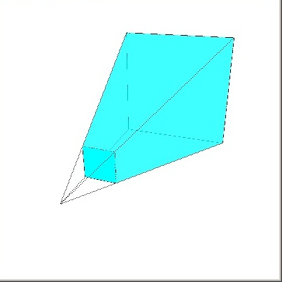
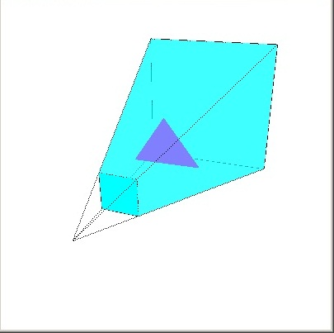
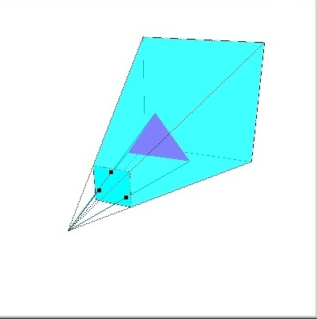

Pipeline rendering overview
state:
view volume,
viewport transform
etc.
define triangle
project vertices
render to frame buffer
YOU
Pipeline System

Slide 6
Depth Buffering
frame buffer
depth buffer
-∞
depth in 3d space

Slide 7
Depth Buffering
frame buffer
depth buffer
Red pixels drawn provided they pass the depth test.

Slide 8
Depth Buffering
frame buffer
depth buffer
Red triangle in front of blue.
Red triangle behind blue.
or something else

Slide 9
Blending
frame buffer
depth buffer
Red triangle in front of blue.
Red triangle behind blue.
We can make red triangle semi-transparent.

Slide 10
Setting up blending parameters
//set alpha of red triangle to
// .5,.5,.5
glEnable(GL_BLENDING);
glBlendFunc(sfactor,dfactor);
// draw red triangle
glDisable(GL_BLENDING)
GL_ZERO,
GL_ONE,
GL_SRC_COLOR,
GL_ONE_MINUS_SRC_COLOR,
GL_DST_COLOR,
GL_ONE_MINUS_DST_COLOR,
GL_SRC_ALPHA,
GL_ONE_MINUS_SRC_ALPHA,
GL_DST_ALPHA,
GL_ONE_MINUS_DST_ALPHA,
GL_CONSTANT_COLOR,
GL_ONE_MINUS_CONSTANT_COLOR,
GL_CONSTANT_ALPHA,
GL_ONE_MINUS_CONSTANT_ALPHA,
GL_SRC_ALPHA_SATURATE

Slide 11
Setting up blending parameters
//set alpha of red triangle to
// .5,.5,.5
glEnable(GL_BLENDING);
glBlendFunc(GL_SRC_ALPHA, ONE_MINUS_SRC_ALPHA);
// draw red triangle
glDisable(GL_BLENDING)
if pixel passes depth test
replace c_{d} with .5 c_{S} + .5 c_{d}
c_{s} is color of source (the red triangle)
c_{d} is color of destination (the frame buffer)

Slide 12
Order matters
frame buffer
depth buffer

Slide 13
Blending
frame buffer
depth buffer
Red triangle in front of blue.
Red triangle behind blue.

Slide 14
textures
transparency
reflections
mirror
shadows
billboards
bump mapping
Order matters! Blending lab further illustrates!

Slide 15
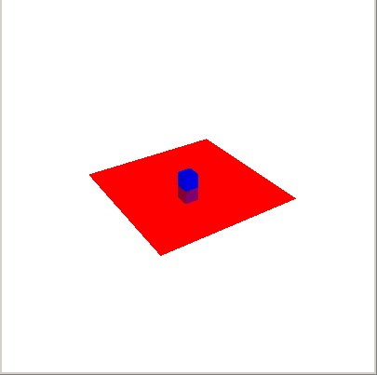
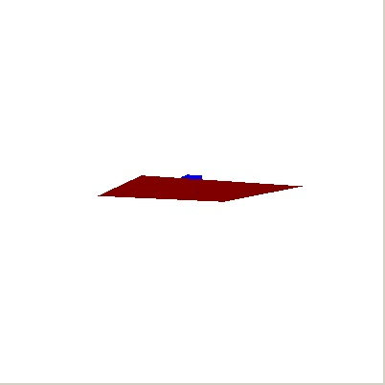
Reflections

Slide 16

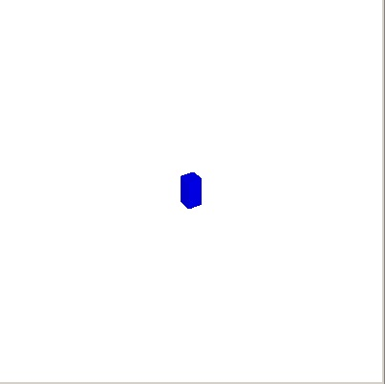
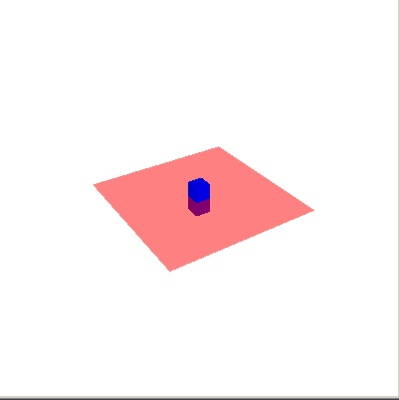
Take 1
cube
cube and reflected cube
cube, reflected cube, and
blended floor
Problem 1: semi-transparent floor

Slide 17
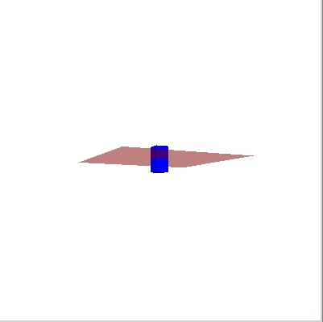
Take 1
cube
cube and reflected cube
cube, reflected cube, and
blended floor
Problem 2

Slide 18



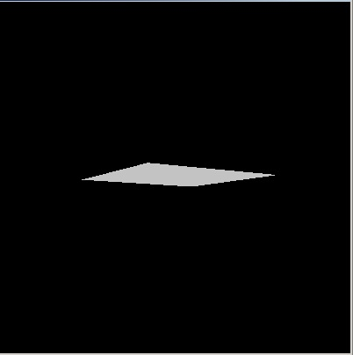
Stencil buffer
top view
3 values:
no floor
top of floor
bottom of floor
bottom view

Slide 19
Step 1: draw floor into stencil buffer
top view
bottom view
frame Buffer
depth Buffer
stencilBuffer

Slide 20

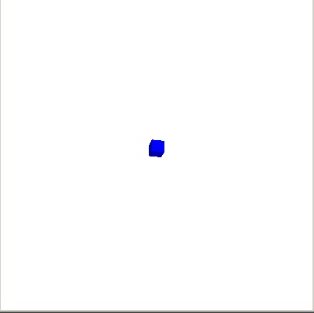
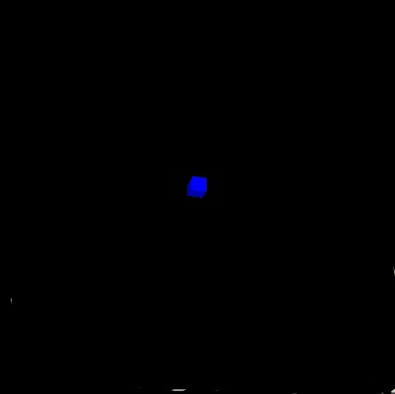
Step 2: draw cube in frame/depth buffers
top view
bottom view
frame Buffer
depth Buffer
stencilBuffer

Slide 21

Step 3: draw reflected cube in frame/depth buffers on top floor pixels
top view
bottom view
frame Buffer
depth Buffer
stencilBuffer

Slide 22
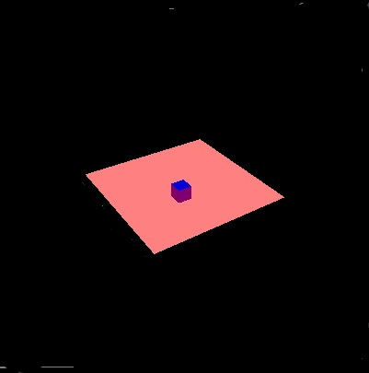
Step 3: draw reflected cube in frame/depth/stencil buffers on top floor pixels
top view
bottom view
frame Buffer
depth Buffer
stencilBuffer

Slide 23
Step 4: draw floor, blending when on reflected cube pixel
top view
bottom view
frame Buffer
stencilBuffer

Slide 24
textures
transparency
reflections
mirror
shadows
billboards
bump mapping
Use stencil buffer

