Slide 1
Pipeline rendering

Slide 2
Pipeline vs. Ray tracing
OpenGL, DirectX
Pipeline: Fast, low quality
Ray tracing: Slow, high quality
A little clunky by today’s standards

Slide 3
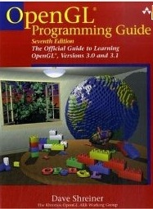
Pipeline
principles
API
(OpenGL)
lecture
labs, proj3, a little lecture
“The Red Book” (online)

Slide 4
Pipeline Program Overview
Call back functions (event driven)
DISPLAY
RESHAPE
WINDOW
INITIALIZE
PIPELINE “STATE”
KEYBOARD
MOUSE
OTHER EVENTS

Slide 5
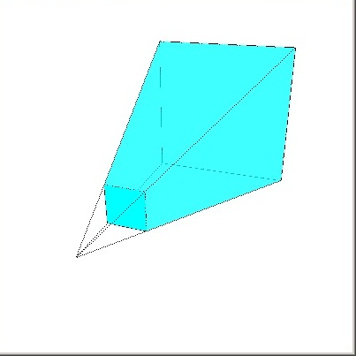
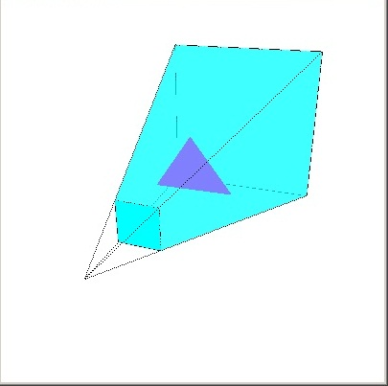
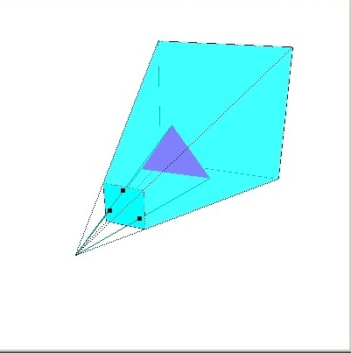
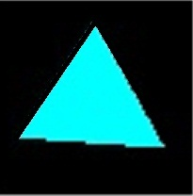
Pipeline rendering overview
state:
projection transform
etc.
define triangle
project vertices
render to frame buffer
YOU
Pipeline System

Slide 6
view volume: frustum
view window
viewpoint
far
(0,0,0)
near
+z
frustum centerline aligned with z axis

Slide 7
Defining the view volume
Example:
glMatrixMode(GL_PROJECTION);
glLoadIdentity();
gluPerspective(θ, ρ, near, far);
w= ρh
θ
h = 2*near*tan(θ)
near
(0,0,0)
far

Slide 8
OpenGL state
Projection matrix
Modelview matrix
Current matrix
gluPerspective(θ, ρ, near, far) multiplies
current matrix by the appropriate projection
transform
To keep things straight make the Modelview matrix your default
Example:
glMatrixMode(GL_PROJECTION);
glLoadIdentity();
gluPerspective(θ, ρ, near, far);
glMatrixMode(GL_MODELVIEW);

Slide 9
Pipeline rendering overview
state:
projection transform,
model/view transform
viewport transform
etc.
define triangle
project vertices
render to frame buffer
YOU
Pipeline System

Slide 10
Display (define triangle)
glBegin(GL_TRIANGLE);
glVertex3f(0,0,-5);
glVertex3f(1,0,-5);
glVertex3f(0,1,-5);
glEnd();
3 float values (x,y,z)

Slide 11
Display (define triangle)
glBegin(GL_TRIANGLE);
glVertex3f(0,0,-5);
glVertex3f(1,0,-5);
glVertex3f(0,1,-5);
glEnd();
VERTICES TRANSFORMED BY
MODELVIEW MATRIX

Slide 12
Display (define triangle)
glRotatef(20,0,1,0)
glBegin(GL_TRIANGLE);
glVertex3f(0,0,-5);
glVertex3f(1,0,-5);
glVertex3f(0,1,-5);
glEnd();
VERTICES TRANSFORMED BY
MODELVIEW MATRIX

Slide 13
Pipeline state
Projection matrix
Modelview matrix
Current matrix
Several functions create a matrix M and replace the current matrix C with C*M.
gluPerspective
glRotate
glTranslate
glScale
gluLookAt

Slide 14
viewpoint
viewpoint is FIXED at origin
we can transform the world to
simulate other viewpoints
gluLookAt(…)
viewpoint
(0,0,0)
+z

Slide 15
Pipeline rendering overview
state:
view volume,
modeling/viewing transforms
etc.
define triangle
project vertices
render to frame buffer
YOU
Pipeline System

Slide 16
viewport transformation
projected vertices in world
coordinates
vertices in display window coordinates
user can resize display window

Slide 17
viewport transformation
display window set by end user
view window

Slide 18
viewport transformation
display window set by end-user
view window
glViewport(0,0,width,height)
typically set in reshape function

Slide 19
Pipeline rendering overview
state:
view volume,
modeling/viewing transforms
viewport transform
etc.
define triangle
project vertices
render to frame buffer
YOU
Pipeline System

Slide 20
Pipeline rendering overview
state:
view volume,
modeling/viewing transforms
viewport transform
etc.
define triangle
project vertices
render to frame buffer
YOU
Pipeline System

Slide 21
Display (define triangle)
glColor3f(0,0,1);
glRotatef(20,0,1,0)
glBegin(GL_TRIANGLE);
glVertex3f(0,0,-5);
glVertex3f(1,0,-5);
glVertex3f(0,1,-5);
glEnd();

Slide 22
Pipeline rendering overview
state:
view volume,
modeling/viewing transforms
viewport transform
color info
etc.
define triangle
project vertices
render to frame buffer
YOU
Pipeline System

Slide 23
Pipeline Program Overview
Call back functions (event driven)
DISPLAY
draw scene
RESHAPE
WINDOW
viewport xfm
INITIALIZE
PIPELINE “STATE”
KEYBOARD
MOUSE
Projection matrix
Modelview matrix
Current matrix
Viewport transform
Color info
OTHER EVENTS

Slide 24
Clipping

