Slide 1
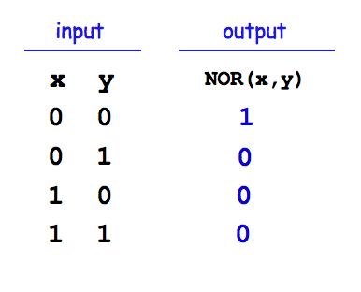
Take a look at this circuit.
If S is 1, what will Q be?
What happens if S becomes 0?
input
output
S
Q
NOR
feedback loop
Reminders
NOR outputs 1 only if both inputs are 0
NOR outputs 0 if either inputs is 1
NOR's Truth Table

Slide 2
The SR latch
Is it currently stable or oscillating?
input
S
0
1
NOR
What will happen if input S is set to 1?
0
Follow how the signals will change…
1
output
input
0
Q
R
NOR
What will happen if input S is then set back to 0?
0
Which signals will change?
What will happen if input R is then set to 1?
how do R and S affect Q in general?
How could we change this circuit to ensure S and R are not simultaneously 1?
NOR's Truth Table

Slide 3
The SR latch
input
S
NOR
output
Q
input
NOR
R

Slide 4
Sequential Logic: Logic that "remembers"
input
S
NOR
time
S R Q
1 0
0 0
0 1
0 0
input
NOR
output
R
Q

Slide 5
The SR latch
input
S
0
1
NOR
0
1
output
input
0
Q
R
NOR
0
How could we change this circuit to ensure S and R are not simultaneously 1?

Slide 6
The D latch
The SR latch
D
data
inputs
S
0
AND
1
"strobe"
NOR
0
tells when to remember the data!
1
output
0
Q
R
NOR
AND
0
mutually exclusive ANDs
How we might change this circuit to ensure S and R are not simultaneously 1!

Slide 7
The D latch
The SR latch
D
data
inputs
S
0
AND
1
"strobe"
NOR
0
1
output
0
Q
R
NOR
AND
0
S sets Q to 1.
R resets Q to 0.
1 bit of memory!
"flip-flop"

Slide 8
The D latch
The SR latch
D
data
inputs
S
0
AND
1
"strobe"
NOR
0
1
output
0
Q
R
NOR
AND
0
S sets Q to 1.
These ANDs ensure
R resets Q to 0.
if D == 1, S is 1
if D == 0, R is 1
1 bit of memory!
"flip-flop"

Slide 9
The D latch
The SR latch
D
data
inputs
S
0
AND
1
"strobe"
NOR
0
The data can be ready any time (or NOT!) But nothing will happen until the strobe says so!
1
output
0
Q
R
NOR
AND
0
S sets Q to 1.
These ANDs ensure
R resets Q to 0.
if D == 1, S is 1
if D == 0, R is 1
1 bit of memory!
"flip-flop"

Slide 10
The D latch
The SR latch
D
data
inputs
0
AND
1
"strobe"
NOR
0
1
output
0
Q
NOR
AND
0
D
its circuit element
Q
1 bit of memory!
strobe
"flip-flop"

Slide 11

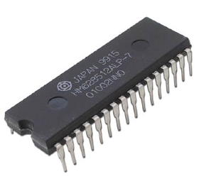
Random Access Memory
"on-chip"
"640K ought to be enough for anybody"
- not Bill Gates!
RAM!
A 1GB RAM
(About 8.9 billion bits)
A 512KB RAM
(About 4.2 million bits)

Slide 12
Random Access Memory
"on-chip"
We can use data latches to create a 12 nG bit RAM !
Inputs
Outputs
3 data input bits
Simplified
Prototype for
Accessing
Memory
3 data output bits
write enable line
read enable line
2 data address bits
12 bits of RAM
3 bits stored at location 00
3 bits stored at location 01
3 bits stored at location 10
3 bits stored at location 11

