Slide 1
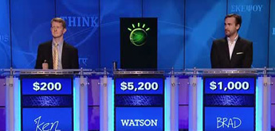
Thinking like prolog...
He was a bank clerk in the Yukon before he published “Songs of a Sourdough” in 1907
We required a language in which we could conveniently express pattern matching rules... and could execute these rules very efficiently. We found that Prolog was the ideal choice...
The Prolog intro hw (#8) is due next Mon.
~30 lines of code (instead of 300+)
lemma(1, "he"). partOfSpeech(1,pronoun). lemma(2, "publish"). partOfSpeech(2,verb). lemma(3, "Songs of a Sourdough"). partOfSpeech(3,noun). subject(2,1). object(2,3).
Next week: take-home midterm on Wednesday (see review topics!)

Slide 2
Where Watson could get its answer...
"Songs of a Sourdough" by Robert W. Service
authorOf(Author,Composition) :- composition(Composition), argument(Composition,Preposition), lemma(Preposition, "by"), objectOfPreposition(Preposition,Author), author(Author).
... when Robert Service wrote "Songs of a Sourdough"
authorOf(Author,Composition) :- createVerb(Verb), subject(Verb,Author), author(Author), object(Verb,Composition), composition(Composition).
createVerb(Verb) :-
partOfSpeech(Verb,verb), lemma(Verb,VerbLemma),
member(VerbLemma,
["write",
"publish",
...]).

Slide 3
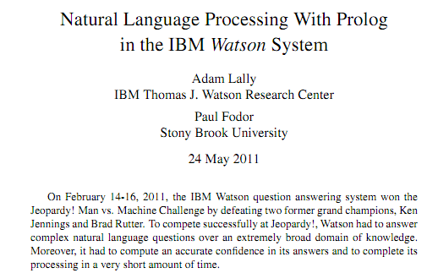
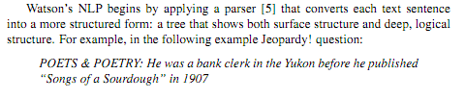
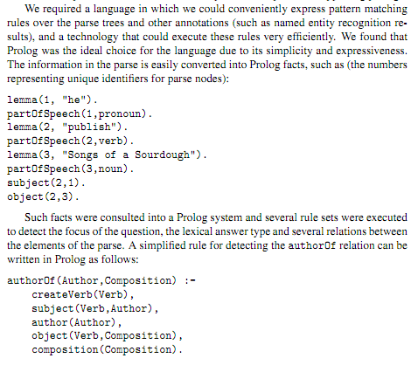
www.cs.nmsu.edu/ALP/2011/03/natural-language-processing-with-prolog-in-the-ibm-watson-system/

Slide 4
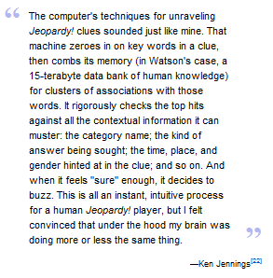
www.cs.nmsu.edu/ALP/2011/03/natural-language-processing-with-prolog-in-the-ibm-watson-system/

Slide 5
The Prolog progression...
Prolog is crazy.
Who would ever invent such a thing?
Week 1:
Week 2:
Week 3:
Notes:
secret strategy: randomly reorder things until it works!!

Slide 6
The Prolog progression...
Prolog is crazy.
Who would ever invent such a thing?
Week 1:
Prolog is crazy.
... though not as bad as before...
Week 2:
Week 3:
Notes:
secret strategy: randomly reorder things until it works!!

Slide 7
The Prolog progression...
Prolog is crazy.
Who would ever invent such a thing?
Week 1:
Prolog is crazy.
... though not as bad as before...
Week 2:
Prolog is crazy.
... and now so am I
Week 3:
but what if you started off that way?
because it makes sense!
Notes:
secret strategy: randomly reorder things until it works!!

Slide 8
Prolog ?!
(1) Base case (usually no constraint clauses at all!)
mem(E, [E|_]).
mem(E, [_|R]) :- mem(E, R).
Key idea: You are describing the constraints that make a relationship - a Prolog predicate - true.
(2) Recursion first! (when possible)
an element
a list
(3) Arithmetic next (RHS must be bound)
len([], 0).
len([_|R], N) :- len(R, M), N is M+1.
list
its length
(4) Negation last (all vars must be bound)
Notes:
secret strategy: randomly reorder things until it works!!

Slide 9
Prolog patterns
(1) Base case (usually no constraint clauses at all!)
mem(E, [E|_]).
mem(E, [_|R]) :- mem(E, R).
(2) Recursion first! (when possible)
an element
a list
(3) Arithmetic next (RHS must be bound)
len([], 0).
len([_|R], N) :- len(R, M), N is M+1.
list
its length
(4) Negation last (all vars must be bound)
Notes:
secret strategy: randomly reorder things until it works!!

Slide 10
Prolog patterns
(1) Base case
app([], M, M).
app([F|R], M, [F|A]) :- app(R, M, A).
left list
right list
final list
(2) Recurse
rev([], []).
rev([F|R], Rev) :- rev(R, RoR),
app(RoR, [F], Rev).
a list
its reverse
reverse of the rest
(3) Other constraints
Notes:
secret strategy: randomly reorder things until it works!!

Slide 11
Prolog patterns
(1) Base case
(2) Recurse
min( , ).
min(
min(
(3) Other constraints
Example: min( [6,7,5,42], 5 )
a list
its min
num42( , ).
num42(
num42(
a list
its number of 42s
Example: num42( [42,3,42,42], 3 )
Notes:
secret strategy: randomly reorder things until it works!!

Slide 12

Sorting out Prolog… by sorting in Prolog!
Practice with how prolog thinks...
rem1(E,L,NewL)
true if NewL is L without one of its Es
E must be present in L!
inorder( L )
true if L's elements are inorder (ascending)
perm(L,P)
true if P is a permutation of L
sort(L,S)
It can be tough to get perm right!
S is L, sorted

Slide 13
Don't hand these in!
rem1(E, [E|R], R).
rem1(E, [F|R], [F|NewR]) :-
inorder( ).
inorder( ).
inorder(
Hint: you may want two base cases
perm([], []).
perm([F|R], P) :-
Hint: recurse and then use something else on this page
Extra! There are at least TWO ways to write sort... Both use predicates we've just written!
sort(
sort(
Notes:
secret strategy: randomly reorder things until it works!!

Slide 14
Sorting out Prolog… by sorting in Prolog!
Practice with how prolog thinks...
sort(
sort(
Extra! There are at least TWO ways to write sort... What are they?
What are their big-O runtimes?
sort(
sort(
Notes:
secret strategy: randomly reorder things until it works!!

Slide 15
Trees and graphs work, too!
42
tree1( [42,[5,[],[]],[60,[],[]]] )
5
60
bst
# of nodes
nnodes([], 0).
nnodes([Root,L,R], N) :- nnodes(L,NoL),
nnodes(R,NoR),
N is NoL + NoR + 1.
treemin(
treemin(
binary search tree
its minimum element
Notes:
secret strategy: randomly reorder things until it works!!

Slide 16
Trees and graphs work, too!
a
graph1( [[a,b],[b,c],[a,c]] )
b
c
graph as a list of edges
# of edges
numedges([], 0).
numedges(G, N) :- length( G, N ).
kid(P,K,Graph) :-
parent
child (kid)
graph as list of edges
Notes:
secret strategy: randomly reorder things until it works!!

Slide 17
HW 8 (part 2): Prolog & friends…
removeOne( E, L, NewL )
NewL is L with an E removed.
less than 15-20 lines
count( E, L, N )
There are exactly N Es in L.
TOTAL
find( Pattern, Target, Index )
The list Pattern is found in the list Target at location Index.
depth( BST, Depth )
The binary tree BST has a depth (or height) of Depth.
insert( E, BST, NewBST )
NewBST is BST with E appropriately inserted.
I think we've been down this PATH before?!!
path( A, B, Graph, Path )
Path is a path from A to B in Graph, a list of [src,dst] edges.

Slide 18

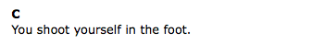

Slide 19
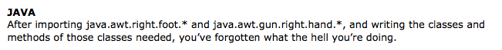
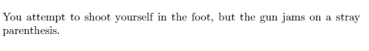
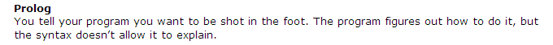
LISP/Scheme/Racket

Slide 20

LISP/Scheme/Racket

Slide 21
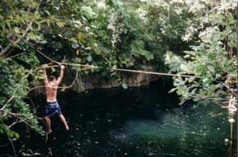
Where we're headed…
Week 9: Mar 28…
Prolog puzzles...
Week 10: Apr 4…
Prolog adventure!
Week 11: Apr 11…
"Theocomp" ~ formal models of computation
DFA, NFA, Regexes,
Week 12: Apr 18…
More on DFA, NFA, Regular expressions, also Turing Machines, reduction-style uncomputability, algorithm analysis
Week 14: Apr 25…
algorithm analysis: unwinding recurrences, loop-counting, sorting, big-O, algorithm speed challenge…
Not to mention some very cool computer science constructs with suggestively cool (maybe?) names, like quantum computing, NP-completeness, linear median finding, and sub-cubic matrix multiplication!
Oxford comma

Slide 22
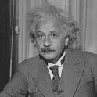
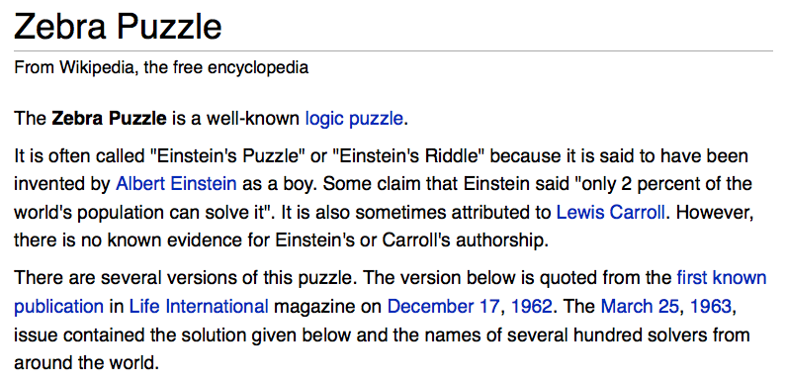
There are five houses:
The nationalities are norwegian, brit, swede, dane, german
The pets are dog, bird, zebra, cat, horse
The cigars are pallmall, winfield, dunhill, rothmans, marlboro
The beverages are tea, coffee, milk, water, beer
The house colors are red, green, yellow, blue, white
We know that
1) The Norwegian lives in the first house.
2) The person living in the center house drinks milk.
3) The Brit lives in a red house.
4) The Swede keeps dogs as pets.
5) The Dane drinks tea.
6) The Green house is next to, and on the left of the White house.
7) The owner of the Green house drinks coffee.
8) The person who smokes Pall Mall rears birds.
9) The owner of the Yellow house smokes Dunhill.
10) The man who smokes Marlboro lives next to the one who keeps cats.
11) The man who keeps horses lives next to the man who smokes Dunhill.
12) The man who smokes Winfields drinks beer.
13) The German smokes Rothmans.
14) The red house is to the right of the blue.
15) The Norwegian doesn't live by the red, white, or green houses
Who owns the zebra?
Prolog ~ representation!
Einstein's Zebra puzzle: a logic challenge

Slide 23
There are five houses:
The nationalities are norwegian, brit, swede, dane, german
The pets are dog, bird, zebra, cat, horse
The cigars are pallmall, winfield, dunhill, rothmans, marlboro
The beverages are tea, coffee, milk, water, beer
The house colors are red, green, yellow, blue, white
We know 15 things…
1) The Norwegian lives in the first house.
Who owns the zebra?
Einstein's Zebra puzzle: a logic challenge
~ 1900
(plus fourteen more constraints)
The setup
nation, pet, cigar, beverage, house color
nation, pet, cigar, beverage, house color
nation, pet, cigar, beverage, house color
nation, pet, cigar, beverage, house color
nation, pet, cigar, beverage, house color

Slide 24
There are five houses:
The nationalities are norwegian, brit, swede, dane, german
The pets are dog, bird, zebra, cat, horse
The cigars are pallmall, winfield, dunhill, rothmans, marlboro
The beverages are tea, coffee, milk, water, beer
The house colors are red, green, yellow, blue, white
We know that
1) The Norwegian lives in the first house.
2) The person living in the center house drinks milk.
3) The Brit lives in a red house.
4) The Swede keeps dogs as pets.
5) The Dane drinks tea.
6) The Green house is next to, and on the left of the White house.
7) The owner of the Green house drinks coffee.
8) The person who smokes Pall Mall rears birds.
9) The owner of the Yellow house smokes Dunhill.
10) The man who smokes Marlboro lives next to the one who keeps cats.
11) The man who keeps horses lives next to the man who smokes Dunhill.
12) The man who smokes Winfields drinks beer.
13) The German smokes Rothmans.
14) The red house is to the right of the blue.
15) The Norwegian doesn't live by the red, white, or green houses
Who owns the zebra?
Einstein's Zebra puzzle: a logic challenge
The full puzzle

Slide 25
There are five houses:
The nationalities are norwegian, brit, swede, dane, german
The pets are dog, bird, zebra, cat, horse
The cigars are pallmall, winfield, dunhill, rothmans, marlboro
The beverages are tea, coffee, milk, water, beer
The house colors are red, green, yellow, blue, white
We know that
1) The Norwegian lives in the first house.
2) The person living in the center house drinks milk.
3) The Brit lives in a red house.
4) The Swede keeps dogs as pets.
5) The Dane drinks tea.
6) The Green house is next to, and on the left of the White house.
7) The owner of the Green house drinks coffee.
8) The person who smokes Pall Mall rears birds.
9) The owner of the Yellow house smokes Dunhill.
10) The man who smokes Marlboro lives next to the one who keeps cats.
11) The man who keeps horses lives next to the man who smokes Dunhill.
12) The man who smokes Winfields drinks beer.
13) The German smokes Rothmans.
14) The red house is to the right of the blue.
15) The Norwegian doesn't live by the red, white, or green houses
Who owns the zebra?
Einstein's Zebra puzzle: a logic challenge
(0) How do we represent the puzzle state?
(1) What relationships do we need?
(2) How do we encode the constraints?

Slide 26
Zebra-puzzle representation
A list H reflects the houses' spatial order
with the five items that each house has…
pet
cigar
beverage
nation
house color
H = [[norwegian, _, _, _, _], _, [_, _, _, milk, _], _, _]
House 1
House 3
House 2
Houses 4+5
1) The Norwegian lives in the first house.
2) The person living in the center house drinks milk.

Slide 27
Zebra-puzzle representation
A list H reflecting the houses' spatial order
with the five items that each house has…
pet
cigar
beverage
nation
house color
H = [[norwegian, _, _, _, _], _, [_, _, _, milk, _], _, _]
House 1
House 3
House 2
Houses 4+5
Let's try this constraint:
7) The owner of the Green house drinks coffee.
Hint: use member and H

Slide 28
Zebra-puzzle constraints
% What does this say about L and R?
% lr( HouseL, HouseR, HouseList )
lr(L, R, [L, R | _ ]).
lr(L, R, [ _ | Rest]) :- lr(L, R, Rest).
% … and then X and Y?
% mystery( HouseA, HouseB, HouseList )
mystery(X, Y, List) :- lr(X, Y, List).
mystery(X, Y, List) :- lr(Y, X, List).
Helpers...
List will be H

Slide 29
Zebra-puzzle constraints
% left-to-right adjacency
lr(L, R, [L, R | _ ]).
lr(L, R, [ _ | Rest]) :- lr(L, R, Rest).
% adjacency (unordered)
nextTo(X, Y, List) :- lr(X, Y, List).
nextTo(X, Y, List) :- lr(Y, X, List).
Helpers...
List will be H
Try this constraint:
15) The Norwegian does not live by the red house.
Hint: use one of the above predicates -- and H
Where should this predicate go?

Slide 30
Got bindings?
houses( [H1, H2, H3, H4, H5 ] ) :-
H1 = [ N1, P1, S1, B1, C1 ],
H2 = [ N2, P2, S2, B2, C2 ],
H3 = [ N3, P3, S3, B3, C3 ],
H4 = [ N4, P4, S4, B4, C4 ],
H5 = [ N5, P5, S5, B5, C5 ],
perm( [N1,N2,N3,N4,N5], [norwegian, brit, swede, dane, german] ),
perm( [P1,P2,P3,P4,P5], [dog, bird, zebra, cat, horse] ),
perm( [S1,S2,S3,S4,S5], [pallmall, winfield, dunhill, rothmans, marlboro] ),
perm( [B1,B2,B3,B4,B5], [tea, coffee, milk, water, beer] ),
perm( [C1,C2,C3,C4,C5], [red, green, yellow, blue, white] ).
Question1: What does this houses predicate do?
Question2: How many binding-possibilities will prolog try here?
the order of its predicates can dramatically affect the speed of Prolog's search!
perm == permutation

Slide 31
Zebra-puzzle output
solve :-
einstein( [ H1, H2, H3, H4, H5 ] ),
write( ' first house: '), write(H1), nl,
write( 'second house: '), write(H2), nl,
write( ' third house: '), write(H3), nl,
write( 'fourth house: '), write(H4), nl,
write( ' fifth house: '), write(H5), nl.
A zero-argument predicate!
and its output:
?- solve.
first house: [norwegian, cat, dunhill, water, yellow]
second house: [dane, horse, marlboro, tea, blue]
third house: [brit, bird, pallmall, milk, red]
fourth house: [german, zebra, rothmans, coffee, green]
fifth house: [swede, dog, winfield, beer, white]
true

Slide 32
The Mystery of the Spamwarts Express
Five "people" are traveling home in adjacent train seats for break…
Seat 1
Seat 2
Seat 3
Seat 4
Seat 5
Names = [algird, bruno, collette, dino, edwina].
Each has a different name.
Schools = [pomona, pitzer, hmc, cmc, scripps].
Each is from a different Claremont College.
Snacks = [jots, chocolate, donuts, pez, spam].
Each has brought a different snack.
1) Dino and Bruno sat in the end seats.
2) Algird sat next to the student from HMC.
3) Collette sat next to friends with chocolate and donuts.
4) The HMC student brought spam as a snack and sat in the middle seat.
5) Chocolate was immediately to the left of pez.
6) Bruno, Dino, and Algird do not go to Scripps.
7) The Pomona student sat between the one with jots and the one with spam.
8) Dino did not sit next to the person with donuts.
9) The CMC student did not sit next to Edwina.
9 hints are available

Slide 33

24 (Problem #2)
4
7
4
7
Can you combine these numbers into 24 with the operations + - * ÷ ?
2
1
Each operation may be used any number of times.
2
1
A two-dot card from the "official" 24 game: 24game.com

Slide 34
24 (Problem #2)
4
7
4
7
Can you combine these numbers into 24 with the operations + - * ÷ ?
2
1
Each operation may be used any number of times.
2
1
solve( [‘+’,‘-’,‘*’,‘/’], [1,2,4,7], 24, Tree ).
operators available: (use any number of times)
values:
(use each exactly once)
arithmetic tree
final answer
Tree = [*, [+, 1, [-,7,2]], 4]

Slide 35
Searching to the end…
be sure there is an end!
setof( Tree, solve( [‘+’,‘-’,‘*’,‘/’], [1,2,4,7], 24, Tree ) , S).
variable whose values you want to collect into a set
the set
predicate that you would like to satisfy…
setof( Tree, solve( [‘+’,‘-’,‘*’,‘/’], [5,1,155,11], 24, Tree ) , S).
a much smaller example…
notice the splitting!
[2,8,22,424] ~ 42
[4,4,4,4] ~ 42
setof( N, T^solve( [‘+’,‘-’,‘*’,‘/’], [4,4,4,4], N, T ) , S).
a surprisingly well-studied problem!
T^ ~ there exists a T

Slide 36
solve( [‘+’,‘-’,‘*’,‘/’], [1,2,4,7], 24, Tree ).
Each operation may be used any number of times.
operators available: (use any number of times)
values:
(use each exactly once)
arithmetic tree
final answer
Tree = [*,[+,1,[-,7,2]],4]
solve
What is the base case?
solve(
What is the recursive case?
solve( Ops, Values, Ans, Tree ) :-
Set up: Ops and Values will have values; Tree may not (20pts); or Ans (5pts); …
How to create Left and Right here?
What about Op ?
What helper predicates will be needed?
Tree = [ Op, Left, Right ].
Leave until the end.

Slide 37
eval
Tree-evaluation code provided:
Notice the base case!
eval(R, R) :- number(R).
eval(['+', A, B], R) :- eval(A, AR), eval(B, BR), R is AR + BR.
eval(['*', A, B], R) :- eval(A, AR), eval(B, BR), R is AR * BR.
eval(['-', A, B], R) :- eval(A, AR), eval(B, BR), R is AR - BR.
eval(['/', A, B], R) :- eval(A, AR), eval(B, BR), BR\==0, R is AR // BR.
the tree
also checks nonvar(A) and nonvar(B)
resulting value
This eval can both test and generate resulting values, R.

Slide 38
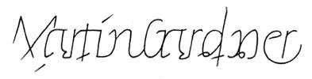
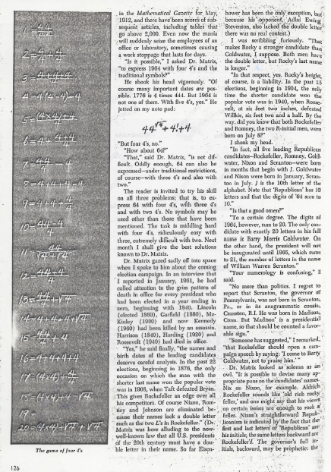
Allowed Operations
For four 4’s ...
+
-
*
/
sqrt
.
!
concat
power
0 = 4 + 4 - 4 - 4
1 = 44 / 44
2 = 4
...
8 = sqrt( .4 ) * ( 4 + 4 + 4 )
...
19 = ???
20 = 4! + 4 - 4 - 4
4/(4+4)
Ask around…

Slide 39
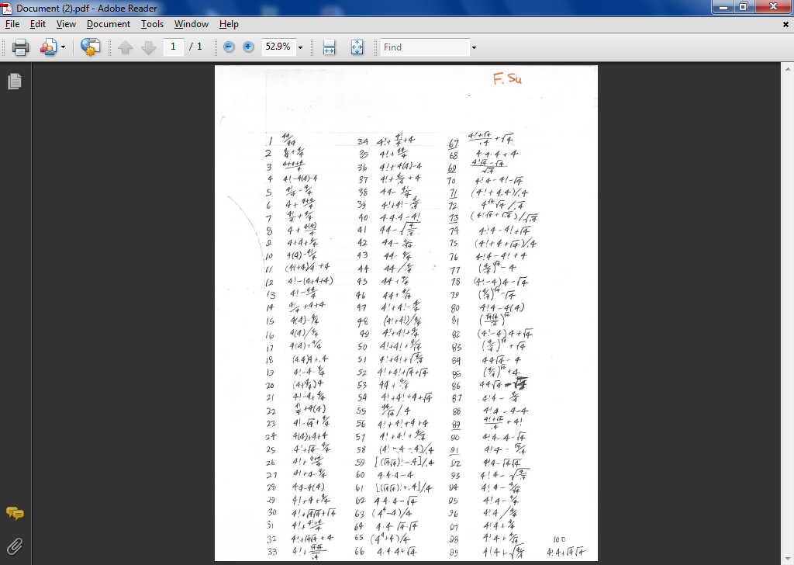

Slide 41
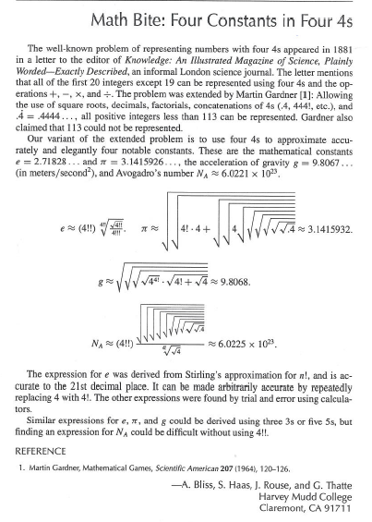
Using Prolog initially written in CS 60!

Slide 42
More puzzles next Monday
Good luck with Prolog this week(end)...

Slide 43
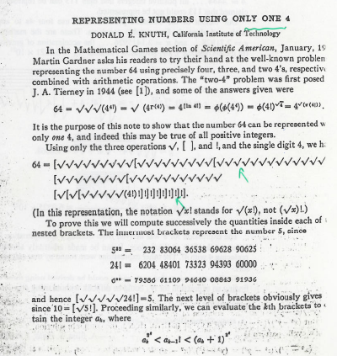

Slide 44
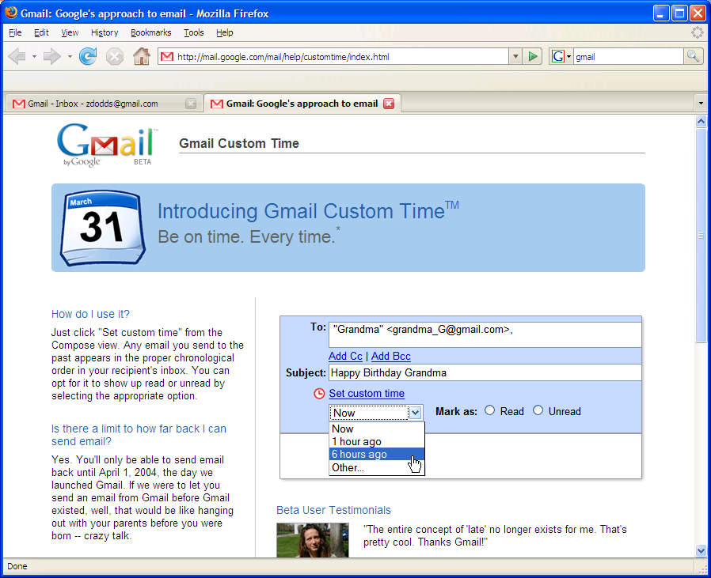
More puzzles next time!
in honor of Apr. 1, I'll be disguised as Jack Ma on Friday…

Slide 45
removeOne( 42, L, [5,6,7])
removeOne( E, L, NewL )
removeOne(E,[E|R],R).
E must be present
removeOne(E,[F|R],[F|R2]) :- removeOne(E,R,R2).
removeAll( 42, L, [5,6,7])
removeAll( E, L, NewL )
removeAll(E,[],[]).
E need not be present...
removeAll(E,[E|R],X) :-
removeAll(E,[F|R],[F|X]) :-
uniq( [7,6,5,6,7,7,5], UList)
uniq( List, UList )
uniq([],[]).
uniq([F|R],[F|X]) :-

Slide 46
sorted( L )
Define sorted(L). Assume L contains only integers.
Quiz
You'll want 2 base cases and one recursive case…
Don't hand this in...
sorted(
sorted(
Prolog pandemonium!
sorted(
perm( L, P )
Write perm(L,P) to generate permutations P of a list L.
Hint: Use recursion and removeOne
perm( [ ], [ ] ).
perm( [F|R], P ) :-
sort( L, S )
Write sort(L,S), which "sorts" L into S.
Hint: Use the previous two predicates – in only one rule!
What is the big-O running time for this sorting algorithm?
sort( L, S ) :-
split( L, S1, S2 )
Write split(L,S1,S2) that splits a list L into all possible subsets S1 and S2.
so that L = S1 ∪ S2.
union, not concatenation
split( L, S1, S2 ) :-
Hint: Only 1 rule needed! You'll want to use a built-in helper predicate and something on this page...
speaking of split…

Slide 47
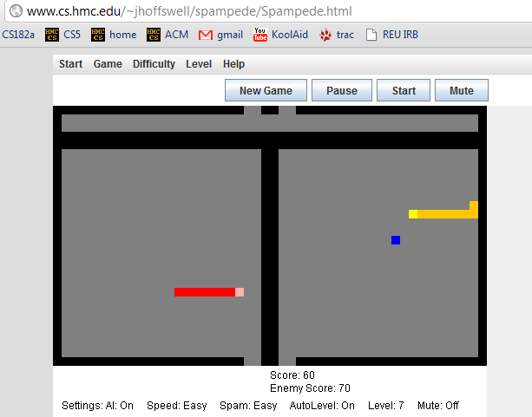
Applet examples
- Jane H.

Slide 48
lastof( E, L )
Take-home messages
lastof( E, )
Many times [] is not the base case!
lastof( E, )
reverse( L, Rev )
true if Rev is the reverse of the list L
reverse( , ).
test vs. generate: var and nonvar
reverse( [F|R], Rev ) :-
treefind( E, BST )
true if E is a node found in BST (a bin. search tree)
trees and graphs are OK, too!
Extra!
kid( P, Graph, K )
true if K is a child of P in graph Graph (list of edges)
kid( a, [ [a,b], [b,c], [a,c] ], K ).
K = b ;
K = c ;
No
No kidding!

Slide 49
var and nonvar
reverse( L, Rev ) :- var(L), var(Rev),
write( 'If you insist…' ), nl,
L = [42], Rev = [42].
reverse( L, Rev ) :- var(L), nonvar(Rev),
reverse(Rev, L).
Alternatively, try randomly permute predicates until something works !
reverse( [], [] ).
and the recursive case from the quiz…
which might not work!

Slide 50
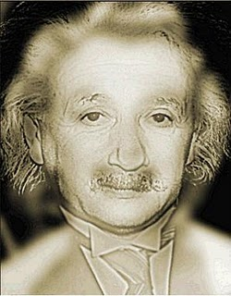
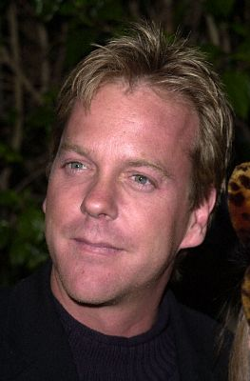
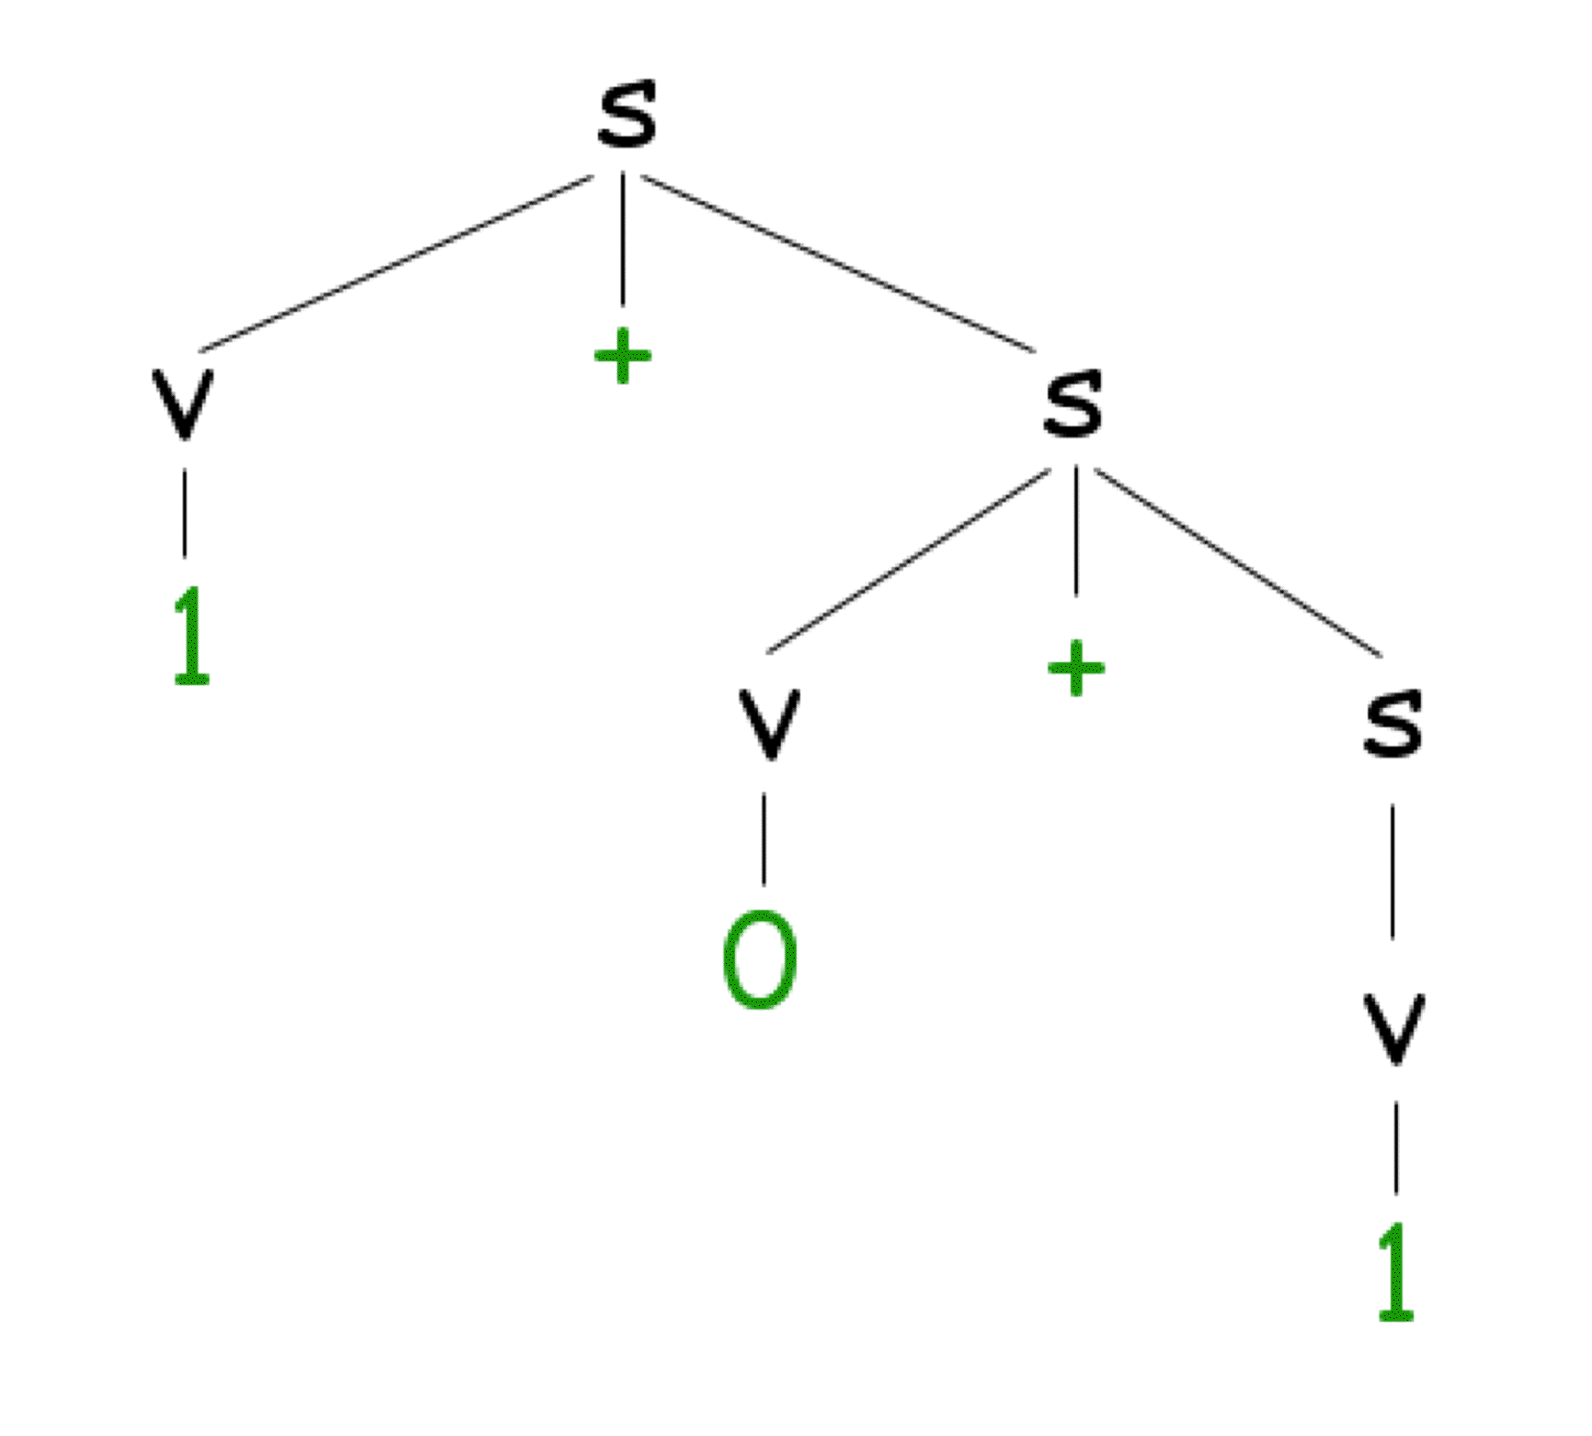
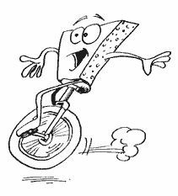
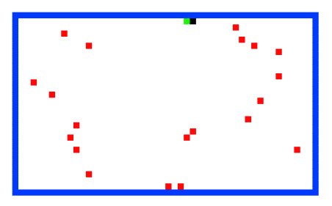
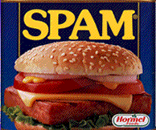
CS 60 Today
Problem #1: an Einsteinian logic puzzle...
Applet grading...!
Hw 9:
prolog puzzles, parsing, paths less traveled…
These two look fairly puzzling to me!
Prolog comma
~ due Mon. April 4
Tutors will be available W, Th, F, S, Sun.
X.
Office hours ~ Sun. afternoon, 2-4 @ LAC
the answer?
Line count:
~30 lines
~15 clauses
~15 lines
~8 clauses
seems like a good trend!
#1
#2
#3
#4
more rules
more structure
Problem #2: 24
Problem #3: The rivercrossing puzzle…
Problem #4: parsing ANY grammar…
Mudder
Alien
Spampede
Spam
parse([s],[1,+,0,+,1]).

Slide 51
Lists and trees, prolog style…
(length and append are built-in, but we'll write them here, too)
length( L, N )
length( [], 0 ).
length( [F|R], N ) :- length(R,M), N is M+1.
append( L, M, Both )
base case
append(
rec case
append(
BST = [ 42, [10,[],[]], [60,[],[]] ], for example
Short. Sweet!
nnodes( BST, N )
base case
nnodes(
rec case
nnodes( [Root,L,R], N ) :-

Slide 52
lastof( E, L )
Try it…
true if Eis the last element of the list L
lastof( E, )
lastof( E, )
reverse( L, Rev )
true if Rev is the reverse of the list L
reverse( , ).
reverse( [F|R], Rev ) :-
Hint: use reverse (recursively) and append.
treefind( E, BST )
true if E is a node found in BST (a bin. search tree) otherwise, false
Extra!
kid( Par, Graph, K )
true if K is a child of Par in graph Graph (list of edges)
kid( a, [ [a,b], [b,c], [a,c] ], K ).
K = b ;
K = c ;
No
No kidding!

Slide 53
Midterm feedback…
Don't put your name
We'd love to know any thoughts you have about CS60 thus far in the term… in particular, how you feel about the time and effort you find CS60 requires:
Where we've been...…
On average how much time per week do you spend on CS60 – outside of class time?
How does CS60's workload compare to other classes you're taking this term?
How would you judge the pace of CS60?
much lighter
about the same
much heavier
much too slow
about right
much too fast
What is something you'd keep about CS60 …?
& something you'd change about / get rid of / add to CS60 …?
Racket/Scheme
Java
Prolog
Rank each language we've used from 0 (disliked it) to 10 (loved it):
Other thoughts are optional, but 142% welcome.
Would you like the class to use clickers?
Possibilities:
Would you like exams to be actual coding?
Other concerns?

Slide 54
Prolog is uniq !
uniq( List, UList )
uniq([],[])
uniq([F|R],[F|X])
removeAll( E, L, NewL )
will
rA( _ ,
rA( E ,[E|R],
rA( E ,[F|R],
removeOne( E, L, NewL )
removeOne(E,[E|R],R).
removeOne(E,[F|R],[F|R2]) :- removeOne(E,R,R2).

Slide 55
Zebra-puzzle representation
A list H reflecting the houses' spatial order
containing the five items that each house has…
pet
cigar
beverage
nation
house color
H = [[norwegian, _, _, _, _], _, [_, _, _, milk, _], _, _]
House 1
House 3
House 2
Houses 4+5
Try this constraint:
7) The owner of the Green house drinks coffee.
Hint: use member and H

Slide 56
sorted( L )
Define sorted(L). Assume L contains only integers.
Quiz
You'll want 2 base cases and one recursive case…
Prolog pandemonium!
perm( L, P )
Write perm(L,P) to generate permutations P of a list L.
Use removeOne(E,L,NewL)
perm( [ ], [ ] ).
perm( [F|R], P ) :-
sort( L, S )
Write sort(L,S), which "sorts" L into S.
What is the big-O running time for this sorting algorithm?
Hint: Use the previous two predicates!
split( L, S1, S2 )
Write split(L,S1,S2) that splits a list L into subsets S1 and S2.
so that L = S1 ∪ S2.
not concatenation
speaking of split…

Slide 57
Zebra-puzzle constraints
% left-to-right adjacency
lr(L, R, [L, R | _ ]).
lr(L, R, [ _ | Rest]) :- lr(L, R, Rest).
% adjacency (unordered)
nextTo(X, Y, List) :- lr(X, Y, List).
nextTo(X, Y, List) :- lr(Y, X, List).
Creating some helpers:
List will be H
Try this constraint:
15) The Norwegian does not live by the red house.
Where should this predicate go?

Slide 58
Applet #1

Slide 59
24 (Problem #2)
4
7
4
7
Can you combine these numbers into 24 with the operations + - * ÷ ?
2
1
Each operation may be used any number of times.
2
1
A two-dot card from the "official" 24 game: 24game.com

Slide 60
24 (Problem #2)
4
7
4
7
Can you combine these numbers into 24 with the operations + - * ÷ ?
2
1
Each operation may be used any number of times.
2
1
solve( [‘+’,‘-’,‘*’,‘/’], [1,2,4,7], 24, Tree ).
operators available: (use any number of times)
values:
(use each exactly once)
arithmetic tree
final answer
Tree = [*, [+, 1, [-,7,2]], 4]

Slide 61
24 (Problem #2)
4
7
4
7
Can you combine these numbers into 24 with the operations + - * ÷ ?
2
1
Each operation may be used any number of times.
2
1
solve( [‘+’,‘-’,‘*’,‘/’], [1,2,4,7], 24, Tree ).
operators available: (use any number of times)
values:
(use each exactly once)
arithmetic tree
final answer
Tree = [*,[+,1,[-,7,2]],4]
Suggestion on solve -- use the following as a rough template:
solve(base case).
solve( Ops, Values, Sol, Tree ) :-
… , % don’t start with Tree = [ Op, Left, Right ] (why?)
predicates that create an appropriate Tree,
… ,
Tree = [ Op, Left, Right ]. % may also have more predicates after…

Slide 62
Searching to the end…
be sure there is an end!
setof( Tree, solve( [‘+’,‘-’,‘*’,‘/’], [1,2,4,7], 24, Tree ) , S).
variable whose values you want to collect into a set
the set
predicate that you would like to satisfy…
setof( Tree, solve( [‘+’,‘-’,‘*’,‘/’], [5,1,155,11], 24, Tree ) , S).
a much smaller example…
[2,8,22,424] ~ 42
[4,4,4,4] ~ 42
setof( N, T^solve( [‘+’,‘-’,‘*’,‘/’], [4,4,4,4], N, T ) , S).
a surprisingly well-studied problem!
T^ ~ there exists a T

Slide 63

For four 4’s ...
0 = 4 + 4 - 4 - 4
1 = 44 / 44
2 = 4
...
8 = sqrt( .4 ) * ( 4 + 4 + 4 )
...
19 = ???
20 = 4! + 4 - 4 - 4
Allowed Operations
4/(4+4)
+
-
*
/
sqrt
.
!
concat
power
A problem surprisingly well-studied…

Slide 64
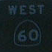
The alien, the spampede, and the spam!
Goal: Get back to the dorms with the spam, the spampede, and the three-eyed alien.
Constraints: Can’t carry more than one thing and can’t leave two things alone if one would eat the other…
Heading to the polls…!
Mudder
West
East

Slide 65
Towers of Hanoi
Goal: Get all of the disks from Peg 1 to Peg 3.
Constraints: You may not place a smaller disk onto a larger one.
Peg 1
Peg 2
Peg 3
solve( [[1,2,3,4],[],[]], M ).
This could get Hanoi’ing!
Use spam.pl as a starting point…

Slide 66
Parsing in Prolog
I refuse to write more than one parser!
%% file: g0.pl
%% A grammar must specify variables, terminals, and rules.
variable(s). %% grammar variables, NOT prolog variables!
variable(v).
terminal(0). %% grammar terminals, NOT prolog constants…
terminal(1).
terminal(+). %% actually, all of these are prolog constants
%% Here are the rules for this grammar: [LHS, RHS]
%% s -> v + s | v
%% v -> 0 | 1
rule(s, [v, +, s]).
rule(s, [v]).
rule(v, [0]).
rule(v, [1]).
A grammar expressed in prolog.
this is the file g0.pl
you’ll write the file part5.pl
parse([s], [1,+,0,+,1]).
yes
Your parse predicate should work for any reasonable grammar!
parse([s], [1,0,+,1]).
no
and we will ONLY test with fully-instantiated lists…

Slide 67
Parsing in Prolog
A derivation tree…
Sentential Forms
s
s
v
+
s
v + s
1 + s
1
+
v
s
1 + v + s
0
v
1 + 0 + s
1
1 + 0 + v
1 + 0 + 1

Slide 68
And I thought parse was just a good jotto word!
Parsing in Prolog
An example of how prolog might think about this…
parse([s], [1,+,0,+,1]).
parse([v,+,s], [1,+,0,+,1]).
parse([1,+,s], [1,+,0,+,1]).
parse([+,s], [+,0,+,1]).
parse([s], [0,+,1]).
parse([v,+,s], [0,+,1]).
parse([0,+,s], [0,+,1]).
parse([+,s], [+,1]).
parse([s], [1]).
parse([v], [1]).
parse([1], [1]).
parse([], []).
yes
What are the key decisions being made here?

Slide 69
And I thought parse was just a good jotto word!
Parse ~ Jotto?

Slide 70
Towers of Hanoi, briefly
The Towers of Hanoi puzzle was first published in 1883 by French mathematician Edouard Lucas.
class hanoi
{
public static void main(String[] args)
{
int n = Integer.parseInt(args[0]); // # of disks
int x = 0; // move number
int to = 0; // peg to move to
int from = 0; // peg to move from
for (x=1 ; x < (1<<n) ; ++x)
System.out.println("Move " + x +
": from peg " + ((x&x-1)%3) +
" to peg " + (((x|x-1)+1)%3));
}
}
Can be done recursively AND without recursion.

Slide 71
Math in Prolog
Rex: there are no side effects (assignments) new data is created and returned.
Java: you have a choice to use side effects, or return new data as needed
Prolog: everything is done via side effects, there are no return values!
Math without return values ?
factorial rules!
fac(X,N)
! does rule!

Slide 72
Sorting in Prolog? mysort
%% sort is built-in, so we’ll write mysort:
mysort(L,S) :- perm(L,S), sorted(S).
%% sorted checks if a list is sorted...
sorted([]).
sorted([_]).
sorted([F,S|R]) :-
%% perm can generate all permutations of L
%% it does not work in right-to-left, however
This is mysort of programming!
what do we need here?

Slide 73
Sorting in Prolog? mysort
%% sort is built-in, so we’ll write mysort:
mysort(L,S) :- perm(L,S), sorted(S).
%% sorted checks if a list is sorted...
sorted([]).
sorted([_]).
sorted([F,S|R]) :-
%% perm can generate all permutations of L
%% it does not work in right-to-left, however
perm([],[]).
perm(L, [F|R]) :-
app(BeforeF, [F|AfterF], L), %% split L around F
app(BeforeF, AfterF, PermR), %% recombine all except F
perm(PermR, R). %% PermR is bound, so we're OK
This is mysort of programming!
what do we need here?

Slide 74
Listing with Prolog
%% member is not built in to prolog...
member(X, [X|R]).
member(X, [F|R]) :- member(X, R).
%% length is built-in, so we will write len
%% just to illuistrate how it might be written
len([], 0).
len([_|R], L) :- len(R, L2), L is L2+1.
%% append is built-in, so we will write app
%% again just to see how it might be done
app([], L, L).
app([F|R], L, [F|A]) :- app(R, L, A).
Why might Prolog complain here?
Does order matter here?
I should underscore the importance of this!
See! Prolog is friendly!

Slide 75
“Quiz” #2
Mathematics with Prolog
Write a predicate fac that finds factorials…
How many arguments will fac need?
Write a predicate sum that finds the sum of two values…
How many arguments will sum need?
Will your predicates always work?

Slide 76
Unhappy Prolog
len([], 0).
len([_|R], L) :- len(R,L2), L2 is L-1.
When will Prolog not like these definitions?
sum(X, Y, Z) :- Z is X + Y.
any ideas?

Slide 77
More flexible sums…
digits([0,1,2,3,4,5,6,7,8,9]).
sum(X,Y,Z) :-
digits(D),
member(X,D),
member(Y,D),
Z is X+Y.
sum(X,Y,Z) :-
D = [0,1,2,3,4,5,6,7,8,9],
member(X,D),
member(Y,D),
Z is X+Y.
better?

Slide 78
More flexible sums…
sum(X,Y,Z) :-
D = [0,1,2,3,4,5,6,7,8,9],
member(X,D),
member(Y,D),
Z is X+Y.
digits([0,1,2,3,4,5,6,7,8,9]).
sum(X,Y,Z) :-
digits(D),
member(X,D),
member(Y,D),
Z is X+Y.
better solution? Use var, nonvar
sum(X,Y,Z) :- nonvar(Y), nonvar(Z), X is Z-Y.
sum(X,Y,Z) :- nonvar(X), nonvar(Z), Y is Z-X.
sum(X,Y,Z) :- nonvar(X), nonvar(Y), Z is X+Y.
It’s possible to make sum generate ALL integer solutions even when X, Y, and Z are all variables…
How many of these rules will sum(2,2,4) and sum(2,2,5) finish?

Slide 79
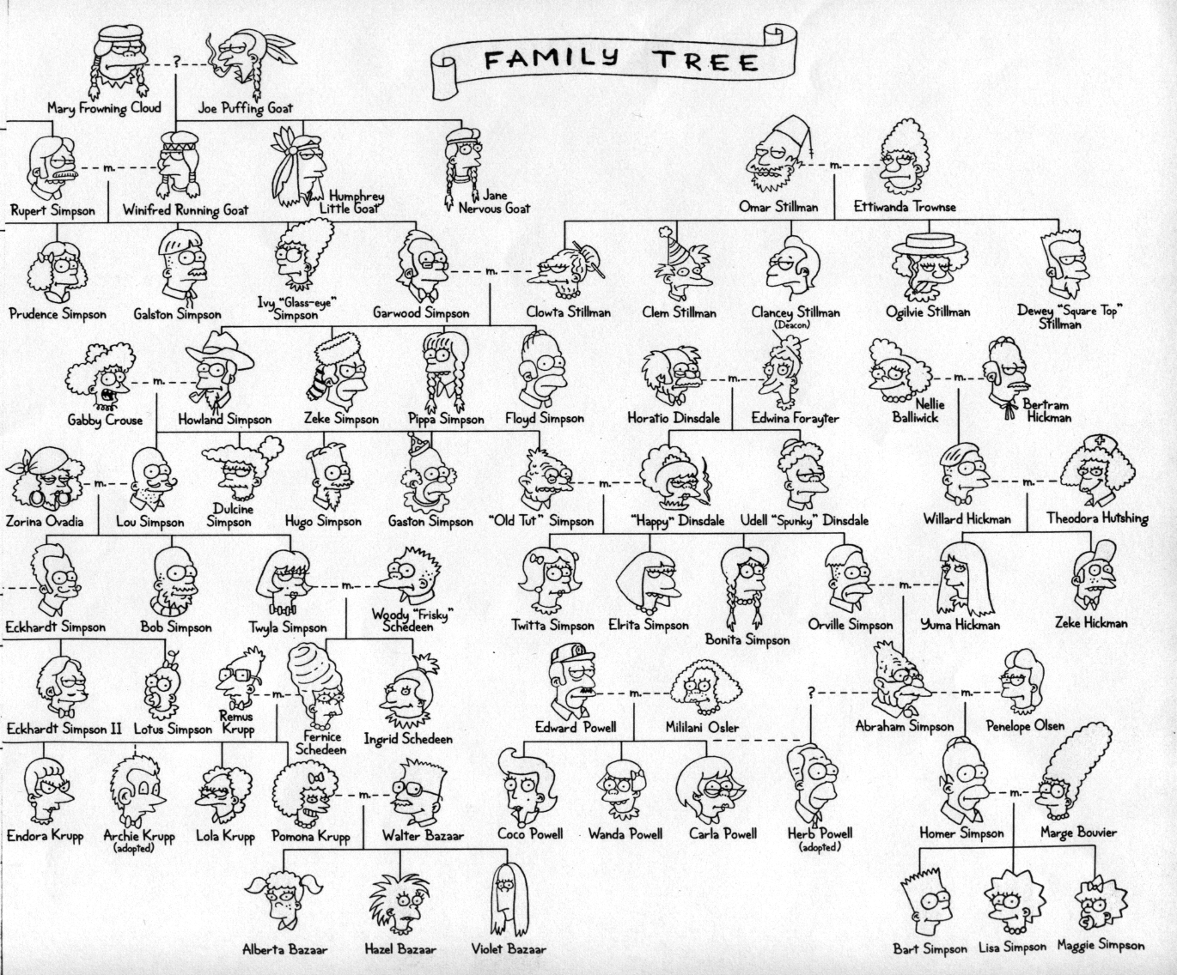
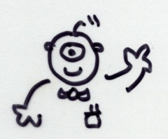
Welcome back to CS 60!
CS 60 Then and Now:
Weeks 1-4: Java
Weeks 5-8: Rex
Weeks 10-15:
Prolog, ISCAL, JFLAP, and more!
Guest-appearing this week …
Keeping the CS 60 ecosystem balanced…
This makes me appreciate my own family reunions…

Slide 80
The idea:
Provide data/relationships that describe the world. Then ask questions.
Questions:
child(lisa,marge).
parent(marge,X).
Is Lisa a child of Marge?
Who has Marge as a parent?
Is Ug a parent of Bart?
Who are the ancestors of Lisa?
Who are uggette's descendants?
Who is who's parent?
Who are John's grandchildren?

Slide 81
Prolog lists…
unifies L with [1, 2, 3]
Prolog has a more Python-like list syntax than Scheme:
L = [ 1, 2, 3 ].
== comparison (structural -- no arithmetic!)
\==
=:= arithmetic comparison with both-sided evaluation
=\=
2 not-equals
3 == 3. <-- yes
1+2 == 1+2. <-- yes
1+2 == 2+1. <-- no
1+2 =:= 2+1. <-- yes
[1,X] == [1,X]. <-- yes
[1,2] == [1,X]. <-- no
[1,2] = [1,X]. <-- yes, X is bound to 2

Slide 82
Math in Prolog
General operators/rules
Example
Notes
comparing for equality: == X == Y
arithmetic assignment: is X is Y+42
pattern matching (lists): = [F|R] = L
inequalities: < > =< >= \==
does not bind X or Y --
they must be bound
binds X ; Y must be bound
binds F and R
L must already be bound
read(X)
write(X)
nl
reads keyboard input into X
writes X to the screen
writes a newline “\n” to the screen
Input / Output

Slide 83
Towers of Hanoi
Goal: Get all of the disks from Peg 1 to Peg 3.
Constraints: You may not place a smaller disk onto a larger one.
Peg 1
Peg 2
Peg 3

Slide 84
Einstein's Zebra puzzle…
length( L, N )
append( L, M, Both )
Short. Sweet!

Slide 85
Exam notes, pr. 5
A function is tail recursive if it does no computational work after the recursive call.
Tail recursive functions can be implemented as loops and thus save the time of building the function-call stack.
def fac(N):
if N < 2: return 1
else: return N * fac(N-1)
No tail recursion
def fac(N): return facTail(N,1)
def facTail(N,A):
if N < 2: return A
else: return facTail(N-1,N*A)
With tail recursion

Slide 86
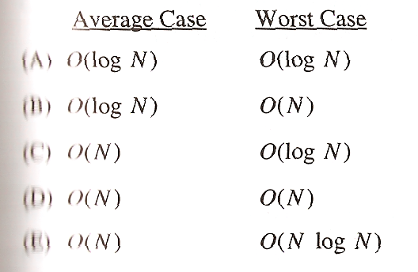
Exam notes, ex. cr.
There once was an alien named Sam
who ate 42 punds of spam
it was all during lunch
and it made quite a crunch
next time please do not eat the can!
Emily
Limericks?
Multiple-choice problem:
most difficult problem on the AP computer science exam!
< 10% of students answered it correctly…

Slide 87
Poetic programming
There once was an alien named Sam
who ate 42 punds of spam
it was all during lunch
and it made quite a crunch
next time please do not eat the can!
Emily
Alex Y
There once was an elf who loved spam
He devised a scheme to cook it in a pan.
At the age of 42
he made java for me and you
And never once said, Oh Damn!
An Alien named 42-PAM
desired a quick train trip for spam
said alien, "Let's go!"
but prolog said No
So the alien rode alone on the tram.
Camille

Slide 88
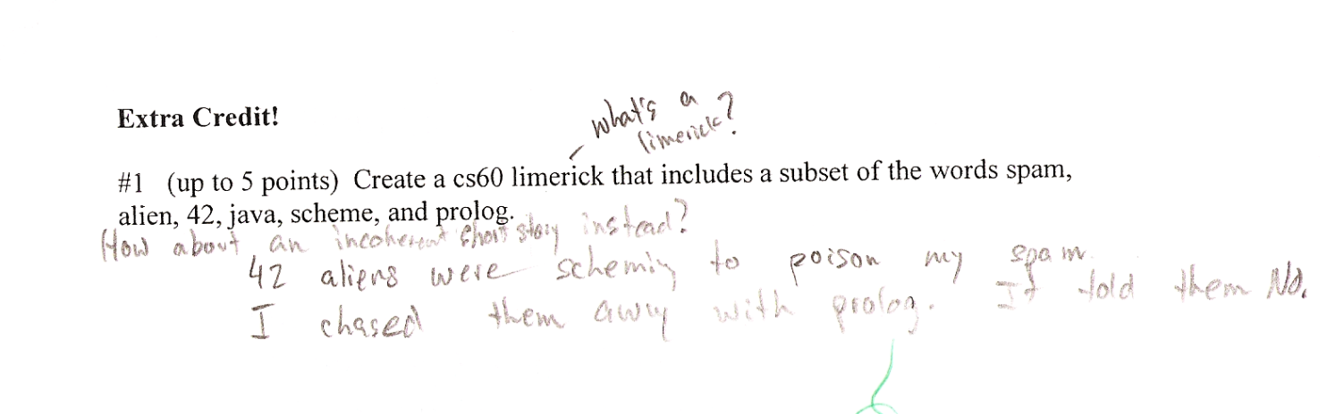
Poetic programming
There once was an alien named Sam
who ate 42 punds of spam
it was all during lunch
and it made quite a crunch
next time please do not eat the can!
Emily
Alex Y
There once was an elf who loved spam
He devised a scheme to cook it in a pan.
At the age of 42
he made java for me and you
And never once said, Oh Damn!
An Alien named 42-PAM
desired a quick train trip for spam
said alien, "Let's go!"
but prolog said No
So the alien rode alone on the tram.
Camille
Andrew X.

Slide 89
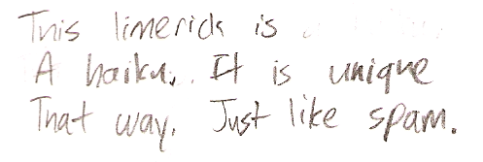
Poetic programming
There once was an alien named Sam
who ate 42 punds of spam
it was all during lunch
and it made quite a crunch
next time please do not eat the can!
Emily
Skye B.
Alex Y
There once was an elf who loved spam
He devised a scheme to cook it in a pan.
At the age of 42
he made java for me and you
And never once said, Oh Damn!
An Alien named 42-PAM
desired a quick train trip for spam
said alien, "Let's go!"
but prolog said No
So the alien rode alone on the tram.
Camille
Andrew X.

Slide 90
Where we're headed…
Week 9: Nov 4…
Prolog puzzles.
Week 10: Nov 11…
Prolog adventure!
Week 11: Nov 18…
"Theocomp" ~ formal models of computation
Week 12: Nov 25…
DFA, NFA, Regular Expressions, indistinguishability and minimum # of states
Week 13: Dec 2…
Implementing DFAs via sequential logic, Turing Machines, uncomputability, algorithm analysis
Week 14: Dec 9…
algorithm analysis: unwinding recurrences, loop-counting, sorting, big-O, algorithm speed challenge…
Not to mention some very cool computer science constructs with suggestively cool (maybe?) names, like quantum computing, NP-completeness, linear median finding, and sub-cubic matrix multiplication!
Oxford comma

Slide 91
The Mystery of the Spamwarts Express
Five people are traveling home in adjacent train seats for Thanksgiving break…
Seat 1
Seat 2
Seat 3
Seat 4
Seat 5
Names = [algird, bruno, collette, dino, edwina].
Each has a different name.
Schools = [pomona, pitzer, hmc, cmc, scripps].
Each is from a different Claremont College.
Snacks = [jots, chocolate, donuts, pez, spam].
Each has brought a different snack.
Dino and Bruno sat in the end seats (that is, seats 1 and 5, but which student sat in which of these seats is still unknown).
2) Algird sat next to the student from HMC.
3) Collette sat next to friends with chocolate and donuts.
4) The HMC student brought spam as a snack and sat in the middle seat.
5) Chocolate was immediately to the left of pez.
6) Bruno, Dino, and Algird do not go to Scripps.
7) The Pomona student sat between the person with jots and spam.
8) Dino did not sit next to the person with donuts.
9) The CMC student did not sit next to Edwina.
9 hints are available

Slide 92
There are five houses:
The nationalities are norwegian, brit, swede, dane, german
The pets are dog, bird, zebra, cat, horse
The cigars are pallmall, winfield, dunhill, rothmans, marlboro
The beverages are tea, coffee, milk, water, beer
The house colors are red, green, yellow, blue, white
We know that
1) The Norwegian lives in the first house.
2) The person living in the center house drinks milk.
3) The Brit lives in a red house.
4) The Swede keeps dogs as pets.
5) The Dane drinks tea.
6) The Green house is next to, and on the left of the White house.
7) The owner of the Green house drinks coffee.
8) The person who smokes Pall Mall rears birds.
9) The owner of the Yellow house smokes Dunhill.
10) The man who smokes Marlboro lives next to the one who keeps cats.
11) The man who keeps horses lives next to the man who smokes Dunhill.
12) The man who smokes Winfields drinks beer.
13) The German smokes Rothmans.
14) The red house is to the right of the blue.
15) The Norwegian doesn't live by the red, white, or green houses
Who owns the zebra?
Einstein's Zebra puzzle: a logic challenge
(0) How do we represent the puzzle state?
(1) What relationships do we need?
(2) How do we encode the constraints?

