Slide 1
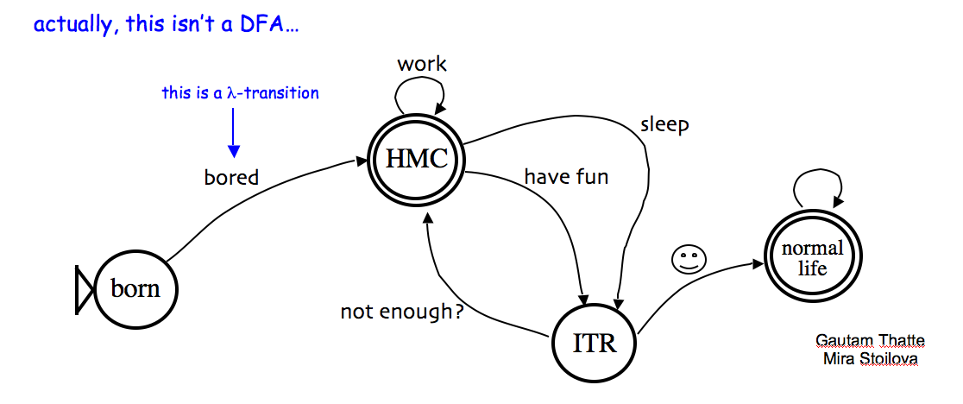
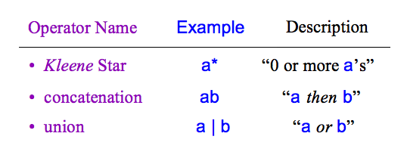
HW 11 due Nov. 21st
Today in CS 60
Weekend adventures?
JFLAP!
in Prolog
Computation without a computer…
Regular Expressions
"simplest" structural model of computation…
(0|1(01*0)*1)(0|1(01*0)*1)*
Deterministic Finite Automaton
Finite State Machine
"simplest" procedural model of computation…
What can be computed.
How it can be computed.
Notes:
regexen?

Slide 2
This week's key ideas:
(1) Not every (boolean) function can be computed.
(2) So, what can be computed?
Last time
Answer #1: Regular expressions
Finite-state machines (FSMs)
Answer #2:
This time
Deterministic Finite Automata (DFAs)
Turing machines (TMs)
Next time
Answer #3:
Notes:
regexen?

Slide 3
A Kleene answer: Regular Expressions
a structural description for those sets that are computable …
A regular expression is composed of three operations:
Kleene Star a* “0 or more a’s”
high precedence
concatenation ab “a then b”
union a | b “a or b”
low precedence
where a and b can be any bit strings - or regular expressions
base case
recursively defined !
Notes:
3
http://www.cs.duke.edu/csed/jflap/new/DOCS/gui.regular.EditorPane.html
The Regular Expression EditorThe editor for a regular expression is essentially just a single text field. Operators in a regular expression are the Kleene star (*), the ``or'' operator (+), parentheses are also usable, and concatenation is accomplished by making symbols adjacent.In HaikuTo make expressions for this program to work with, type them in the field.Adjacent symbols imply concatenation. No symbol is used.Many or nothing, Asterisk (*) is the Kleine star. What precedes repeats.Additionally, if you want an "or" symbol the plus (+) should be used.Screaming nothingness, exclamations (!) are special. They act as lambda.Formatting errors will be reported to you when you choose actions. The Regular Expression EditorThe editor for a regular expression is essentially just a single text field. Operators in a regular expression are the Kleene star (*), the ``or'' operator (+), parentheses are also usable, and concatenation is accomplished by making symbols adjacent.In HaikuTo make expressions for this program to work with, type them in the field.Adjacent symbols imply concatenation. No symbol is used.Many or nothing, Asterisk (*) is the Kleine star. What precedes repeats.Additionally, if you want an "or" symbol the plus (+) should be used.Screaming nothingness, exclamations (!) are special. They act as lambda.Formatting errors will be reported to you when you choose actions.

Slide 4
CS 60 programming languages
Programming
Declarative
Programming
Imperative
Programming
Logic Programming
Functional Programming
Object-Oriented
Programming
Low-level Programming
Prolog
Scheme
Java
the (real) machine
JFlap
leveraging one algorithm
creating algorithms
creating data structures
creating computation
more abstraction away from the machine
closer to the machine
No machine at all!

Slide 5
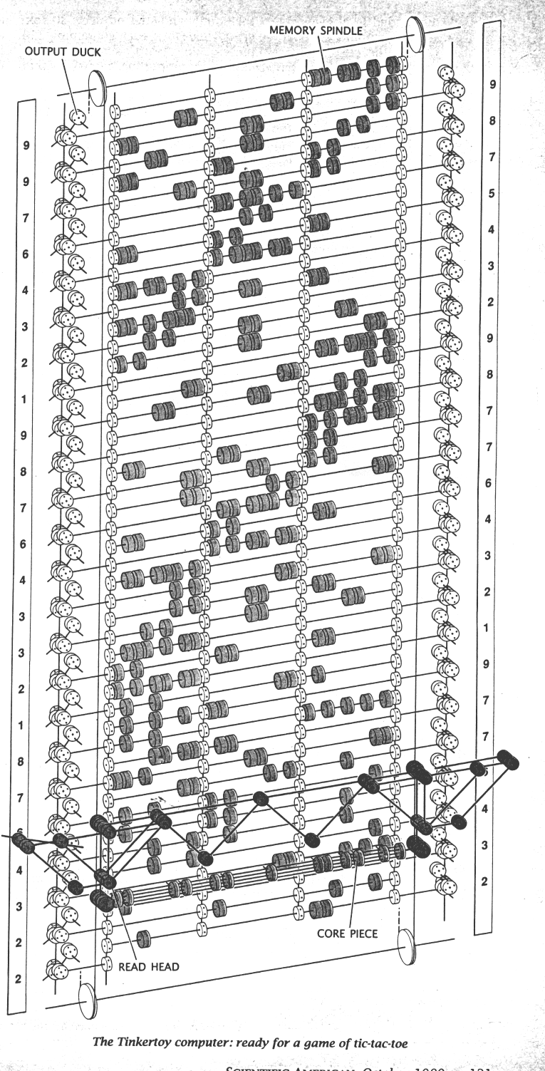

Machines without any machine?
Quantum computation
http://www.quantiki.org/
Molecular computation
http://www.arstechnica.com/reviews/2q00/dna/dna-1.html
Parallel computers
Integrated circuits
Electromechanical computation
Water-based computation
Tinkertoy computation
We want to capture the fundamental processes of all of these machines...

Slide 6
All procedural computation...
Input: a string of bits
01
A string is a sequence of legal characters:
0011
characters from some alphabet, such as {0,1}
000111
Output: a bit
three example strings
Is the string is accepted (1) or rejected (0) ?
A Computer: accepts or rejects strings, looking one bit at a time.
Each machine accepts a particular language, or set of strings
{ 01, 0011, 000111 }
{ w | w contains the substring 01 }
{ w | w is 0^{k} followed by 1^{k} }
This is O^{k} by me!

Slide 7
Our computational model: DFAs ~ FSMs
no s needed?
DFA or “Finite State Machine”
Deterministic
(Deterministic Finite Automaton)
Every state has one transition for every possible character.
0
0
1
Finite
q0
q1
key resource is memory
1
start state
transition
final (accepting) state
“input funnel”
“where to go”
double circled
00101
Example Inputs:
100011
What strings does this FSM accept?

Slide 8
What is each state saying?
DFAs or FSMs
Deterministic
0
Every state has one transition for every possible character.
1
q1
Machine 2
q0
0
1
q2
0,1
L is the language accepted by Machine 2
L =
To be Deterministic, a DFA must
have a 0-edge and a 1-edge from every state
accept all strings in L and reject all strings not in L

Slide 9
Creating DFAs
What DFA accepts L = { w | the # of 1s in w is divisible by 4 } ?
The set of all bit strings containing 0, 4, 8, ... '1's
Common thoughts...
I understood the last couple of examples, but am not sure where to start here...

Slide 10
Creating DFAs
What DFA accepts L = { w | the # of 1s in w is divisible by 4 } ?
The set of all bit strings containing 0, 4, 8, ... '1's
(1) Name a couple of strings accepted by this DFA…
(2) Name a couple of strings rejected by this DFA…
(3) What will the states mean ?
(4) Sketch…
JFLAP !

Slide 11
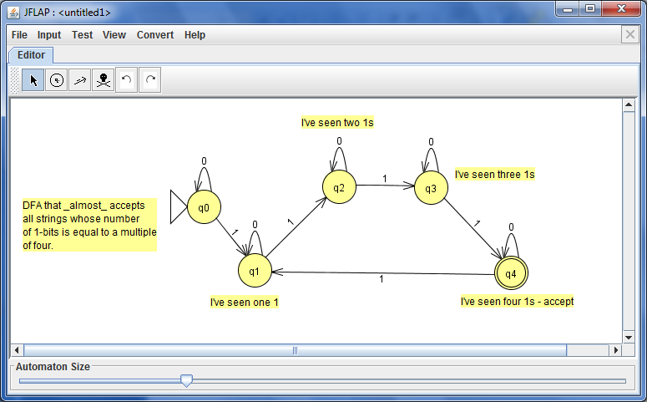

JFLAP !
tool choices
states
comments or notes
There's a bug here ! Plus, it can be done in only 4 states!
Plus, this reminds me of the NyanCat...

Slide 12
DFA "Quiz"
(2) Draw a DFA accepting the language
L = { w | w is a binary # that's a power of two }
initial 0s are OK
(1) Draw a DFA accepting
only 0s are not OK
the empty string λ is not OK
L = { w | w is the string 10 }
0010
1
10000
…
10
(3) Draw a DFA accepting
(4) Draw a DFA accepting
L = { w | w is a binary # that’s divisible by 4 }
L = { w | the first and last bit of w are the same }
initial 0s are OK
the empty string λ is OK
the empty string λ is OK
101
00
0010
0
1
λ
…
01000
0
λ
10100
…
Extra! use the minimum possible number of states in your four solutions…

Slide 13
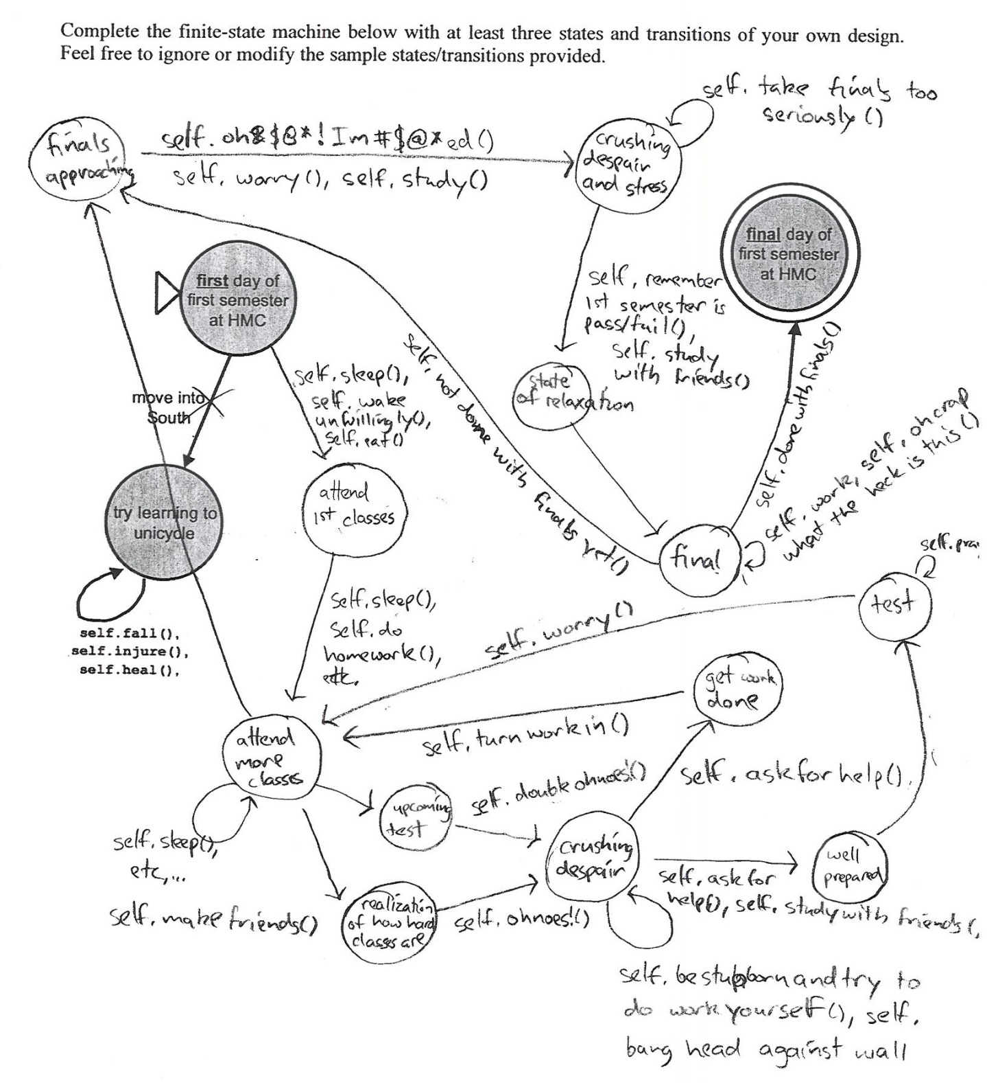
An HMC DFA
not sure whose this is…

Slide 14
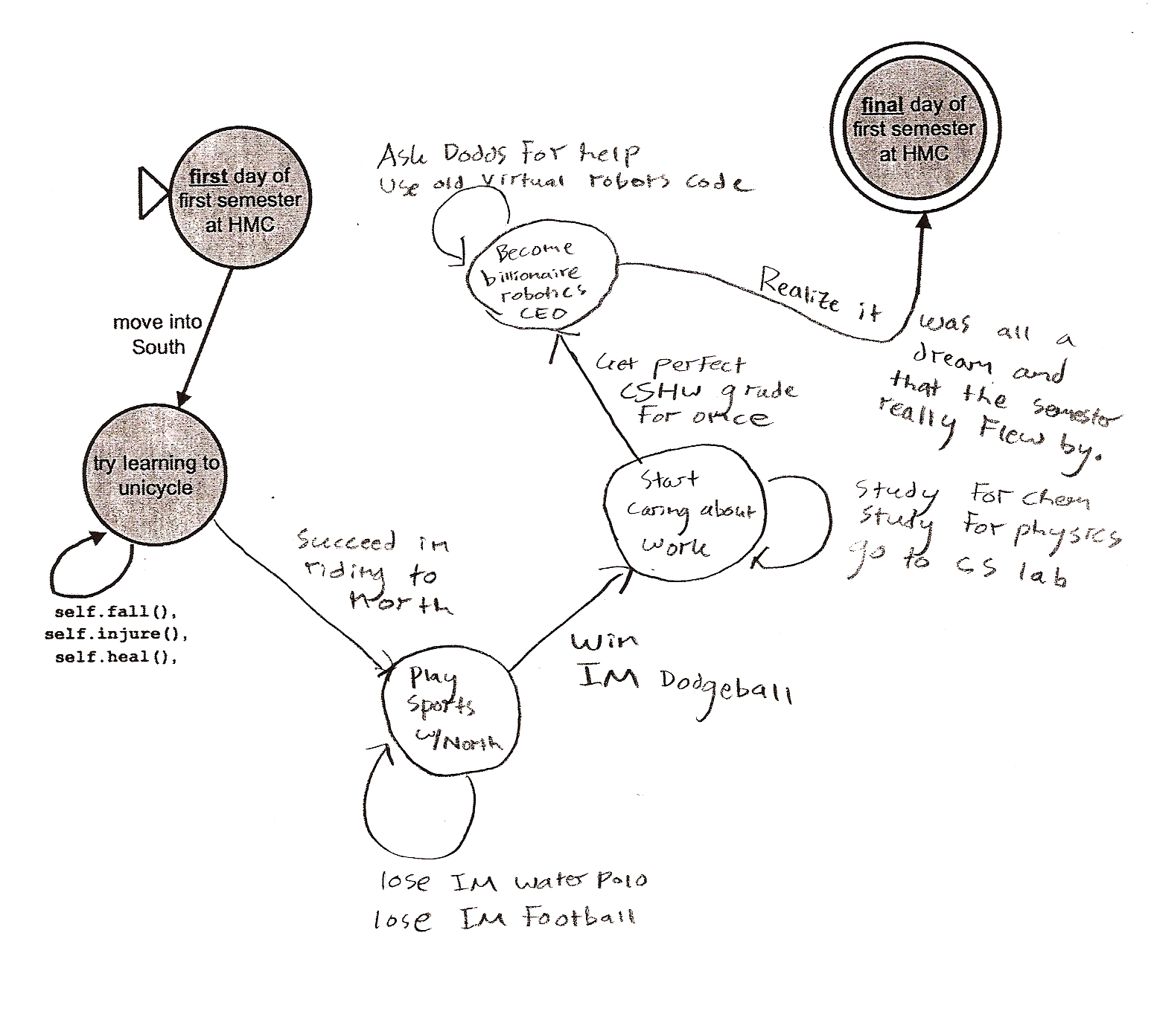
Yet another HMC DFA
I think it was all a dream…

Slide 15
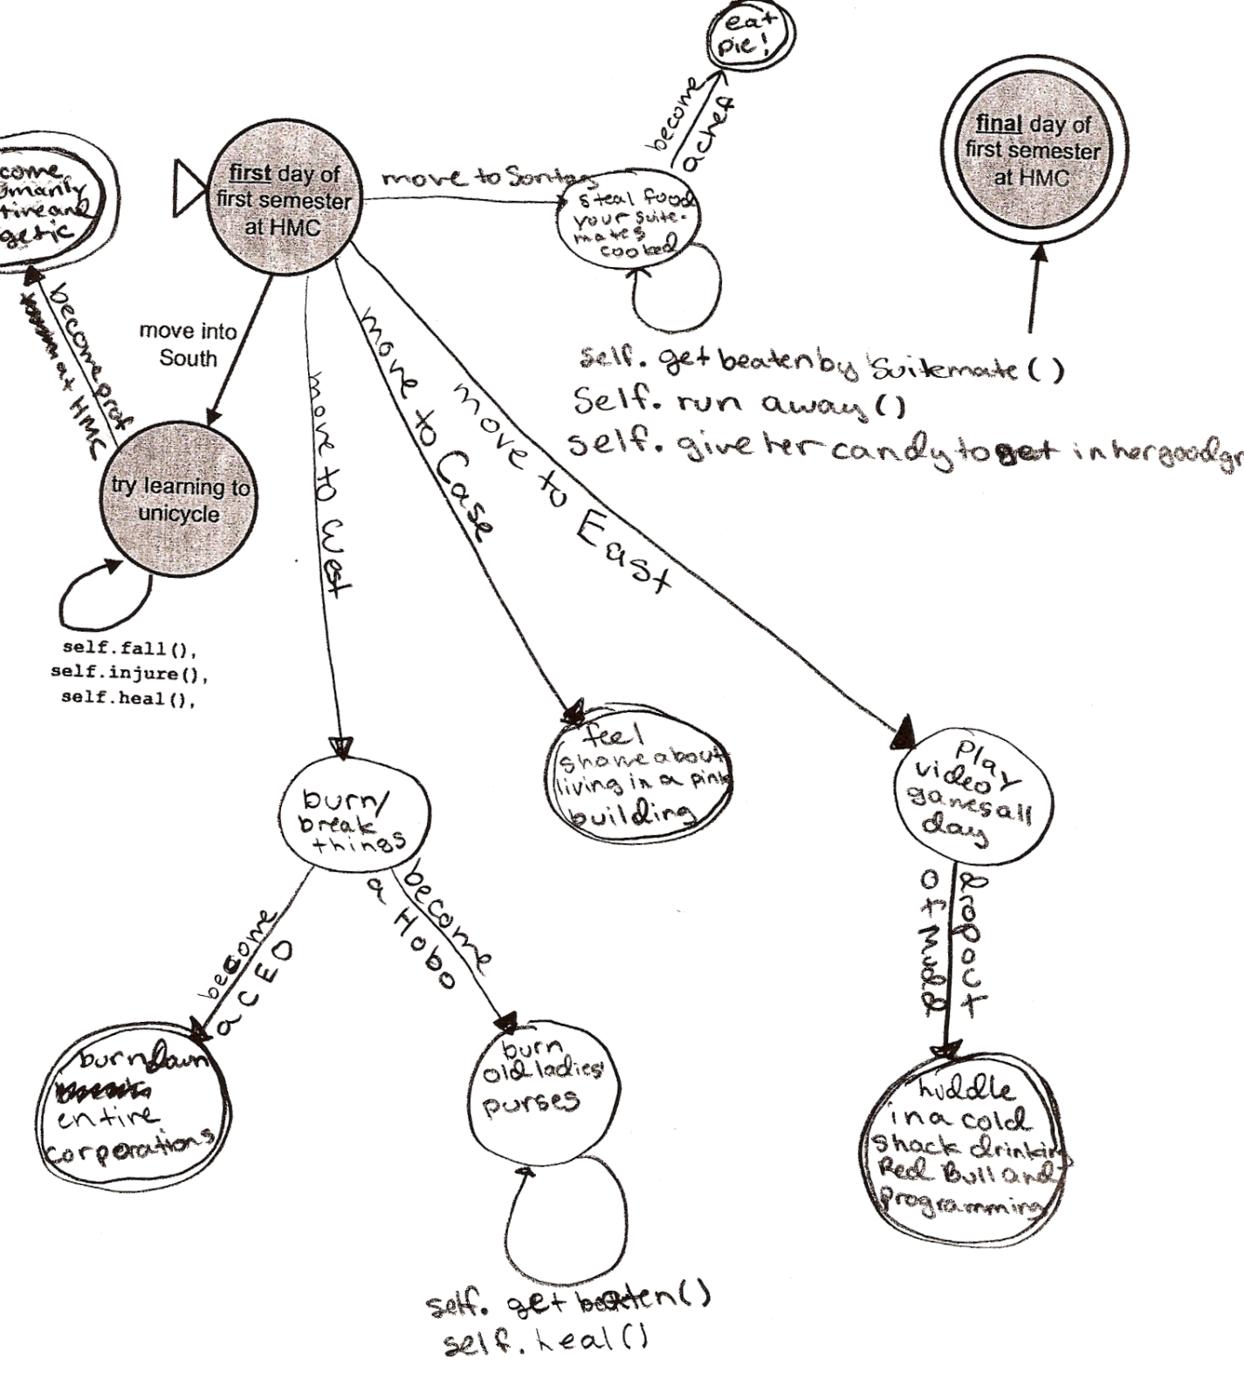
Yet another HMC DFA
don't trust dorm stereotypes…

Slide 16
Minimal states
Like Rhode Island?
Start with a language
L = { w | w is a binary number whose value is a power of two }
initial 0s are OK
example strings in L
example strings NOT in L
only 0s are not OK
the empty string λ is not OK
001
1000
1
010000000
λ
11
0101010
0000
How few states does a DFA for this language need?
How can we prove it?

Slide 17
Minimal machines
Basic idea:
State == Fate
when a string lands in a particular state, that state fully determines what will happen to it as additional characters are added
I wonder what CA's fate is?
A FSM has more states than needed if strings in two different states have the same fate.

Slide 18
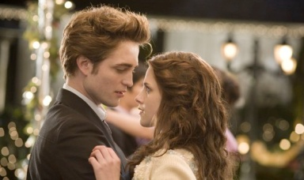
No soul required!
String soulmates…
Start with a language
L = { w | w is a binary number whose value is a power of two }
w₁ = λ …
w₁ = 100…
w₁ = 11…
w₁ = 11…
w₂ = 1…
w₂ = 1…
w₂ = 101…
w₂ = 10…
Couple #1
Couple #2
Couple #3
Couple #4
Meet our four string couples for today
Are the fates of these couples' strings the same or different in L?
both accepted? both rejected? or might they have different outcomes?
indistinguishable
distinguishable
Notes:
from twilight: Bella Swan and Edward Cullen

Slide 19
String matchmaking
Given a language, L,
they might have different outcomes
Two strings w₁ , w₂ are distinguishable w.r.t. L if
(with respect to)
∃ z such that w₁ z ∈ L and w₂ z ∉ L (or vice versa).
"there exists"
think of z as a "suffix" for w₁ and w₂
How about L = { w | w is a binary number whose value is a power of two } ?

Slide 20
String matchmaking
Given a language, L,
they might have different outcomes
Two strings w₁ , w₂ are distinguishable w.r.t. L if
(with respect to)
∃ z such that w₁ z ∈ L and w₂ z ∉ L (or vice versa).
"there exists"
think of z as a "suffix" for w₁ and w₂
each pair could have different fates
A set of strings {w₁,w₂,w₃,…} is pairwise distinguishable if
∀ w_{i} , w_{j} with i ≠ j , w_{i} and w_{j} are distinguishable.
"for all"
How does this help?

Slide 21
The Distinguishability Theorem
Distinguishable pairs must reside in different states.
Thus, given a language L, if you can show a pairwise distinguishable set of N strings
then L's DFA must have ≥ N states.
How about L = { w | w is a binary number whose value is a power of two } ?

Slide 22
a word from our sponsor…
Applications ?

Slide 23
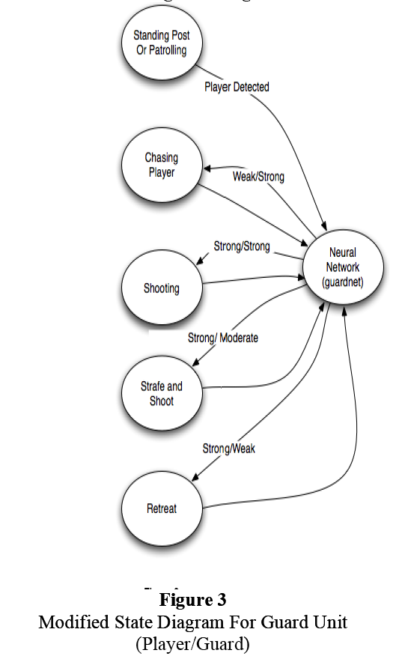
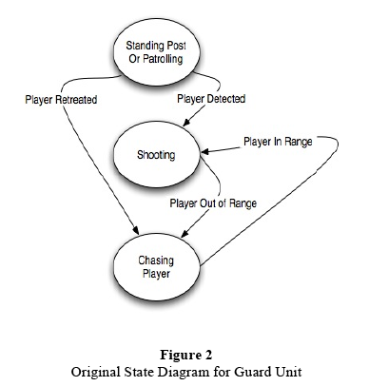
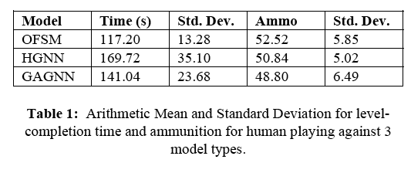
FSM applications…
http://www.gameai.com/statemachines.html
Game AI
original finite state machine
human-guided neural network
genetic-algorithm-guided neural network
Notes:
Ask for the game: Wolfenstein 3d - really the first first-person shooter 1992
by id software: Doom, in 1993, Quake in 1996,
ammo == ammo remaining at the end of the level…

Slide 24
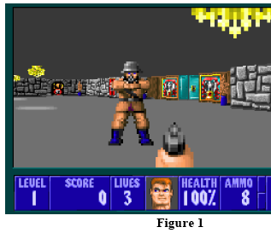
FSM applications…
http://www.gameai.com/statemachines.html
Game AI
Notes:
Ask for the game: Wolfenstein 3d - really the first first-person shooter 1992
by id software: Doom, in 1993, Quake in 1996,

Slide 25
Regular Languages
A language L is regular if there is a DFA that accepts it.
L = { w | w is a binary number whose value is a power of two }
L = { w | the third and third-to-last digits of w are identical }
L = { w | w is a binary number that’s divisible by 7 }
L = { 0^{k}1^{k} | k ≥ 0}
Everyone O^{k} with this?
Are any of these languages too complex for a DFA to accept ?

Slide 26
What can DFA's do?
Is it possible to build a DFA accepting this language?
L = { w | w is a binary number that is divisible by 7 }
Accept
Reject
0
111
1110
10101
11100
100011
101010
...
all others

Slide 27
What can DFA's do?
Is it possible to build a DFA accepting this language?
L = { w | w is a binary number that is divisible by 7 }
Accept
Reject
0
111
1110
10101
11100
100011
101010
...
all others
This is problem 6 on this week's HW…
Suppose you're on the accepting state and the next input bit is a 0… ?

Slide 28
Regular Languages
A language L is regular if there is a DFA that accepts it.
L = { w | w is a binary number whose value is a power of two }
All regular
L = { w | the third and third-to-last digits of w are identical }
L = { w | w is a binary number that’s divisible by 7 }
L = { 0^{k}1^{k} | k ≥ 0}
Nonregular !
How could we prove that
L = { 0^{k}1^{k} | k ≥ 0}
is not regular?

Slide 29
Regular Languages
A language L is regular if there is a DFA that accepts it.
L = { w | w is a binary number whose value is a power of two }
All regular
L = { w | the third and third-to-last digits of w are identical }
L = { w | w is a binary number that’s divisible by 7 }
L = { 0^{k}1^{k} | k ≥ 0}
Nonregular !
How could we prove that
L = { 0^{k}1^{k} | k ≥ 0}
is not regular?
If there is an infinite pairwise distinguishable set of strings (w.r.t. L), it must be that L is not regular!
The Nonregular Language Theorem
Myhill-Nerode theorem

Slide 30
Proving a language nonregular
L = { 0^{k}1^{k} | k ≥ 0}
is a non-regular language !
We need to show an infinite set of pairwise distinguishable strings:

Slide 31
Proving a language nonregular
Show L = {ww | w is a string of 0s and 1s} is nonregular:
Show L = {0^{n^2} | n >= 0} is nonregular:

Slide 32
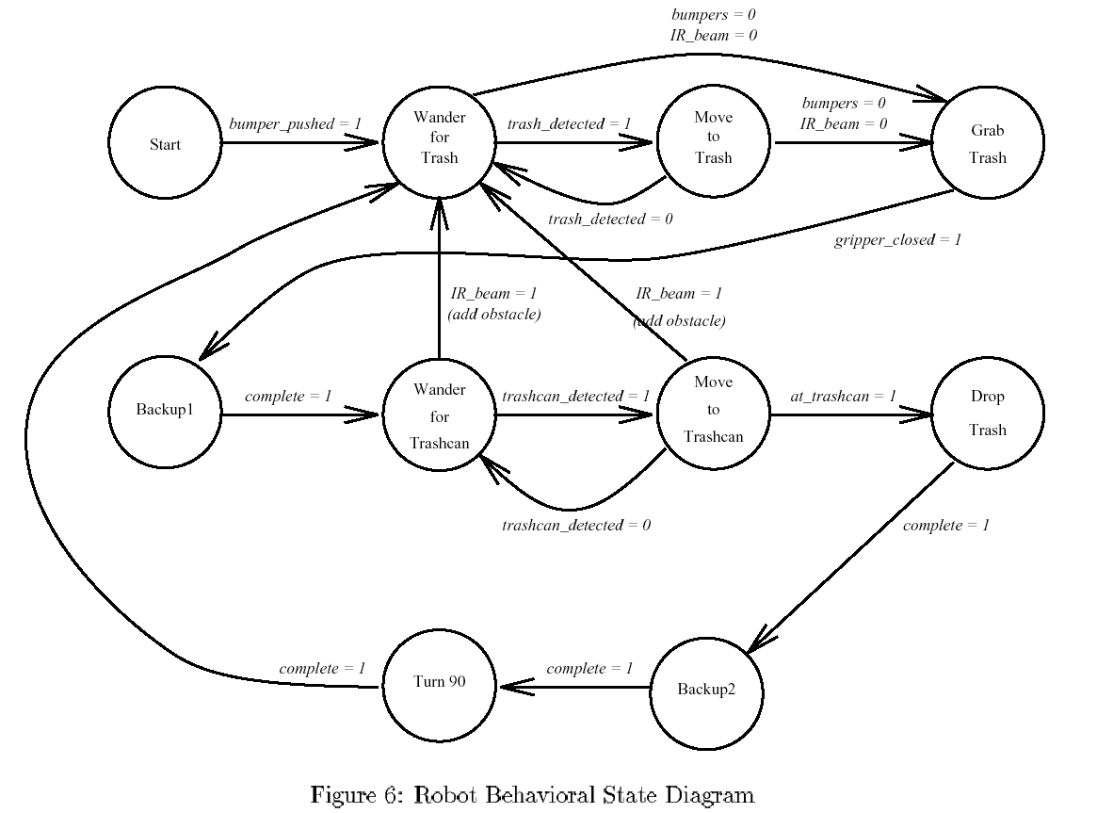
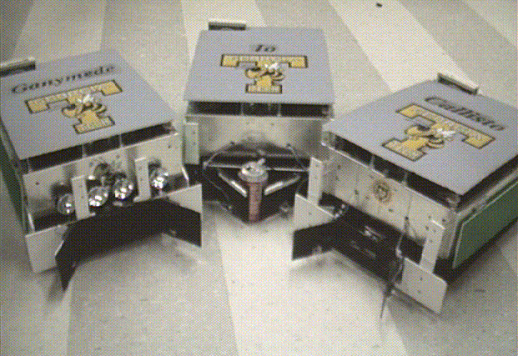
GA Tech’s FSM for trash pick-up

Slide 33
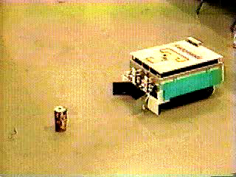
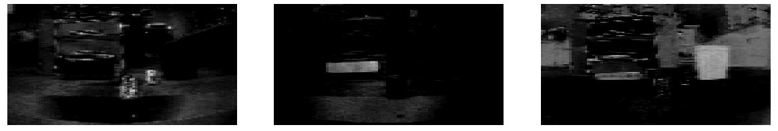
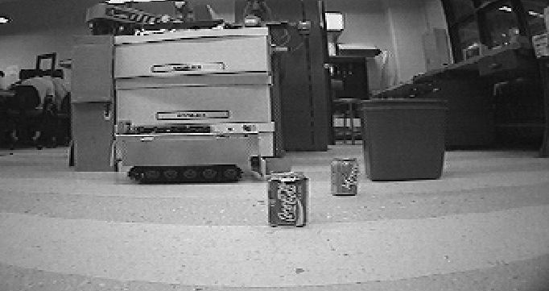
AAAI 1994 champions
Office-cleaning event
Georgia Tech

Slide 34
you
See
Wed!
Notes:
34
http://www.cs.duke.edu/csed/jflap/new/DOCS/gui.regular.EditorPane.html
The Regular Expression EditorThe editor for a regular expression is essentially just a single text field. Operators in a regular expression are the Kleene star (*), the ``or'' operator (+), parentheses are also usable, and concatenation is accomplished by making symbols adjacent.In HaikuTo make expressions for this program to work with, type them in the field.Adjacent symbols imply concatenation. No symbol is used.Many or nothing, Asterisk (*) is the Kleine star. What precedes repeats.Additionally, if you want an "or" symbol the plus (+) should be used.Screaming nothingness, exclamations (!) are special. They act as lambda.Formatting errors will be reported to you when you choose actions. The Regular Expression EditorThe editor for a regular expression is essentially just a single text field. Operators in a regular expression are the Kleene star (*), the ``or'' operator (+), parentheses are also usable, and concatenation is accomplished by making symbols adjacent.In HaikuTo make expressions for this program to work with, type them in the field.Adjacent symbols imply concatenation. No symbol is used.Many or nothing, Asterisk (*) is the Kleine star. What precedes repeats.Additionally, if you want an "or" symbol the plus (+) should be used.Screaming nothingness, exclamations (!) are special. They act as lambda.Formatting errors will be reported to you when you choose actions.

Slide 35
Kleene's answer: Regular Expressions
looking for a simple description for those sets that are computable …
Examples:
10
matches the string 10, which is the language
{ 10 }
or
L = { w | w is 10 }
(10)*
1* | 10*
A regular expression is composed of three operations:
Kleene Star a* “0 or more a’s”
high precedence
concatenation ab “a then b”
union a | b “a or b”
low precedence
where a and b can be any bit strings - or regular expressions
base case
recursively defined !
Notes:
35
http://www.cs.duke.edu/csed/jflap/new/DOCS/gui.regular.EditorPane.html
The Regular Expression EditorThe editor for a regular expression is essentially just a single text field. Operators in a regular expression are the Kleene star (*), the ``or'' operator (+), parentheses are also usable, and concatenation is accomplished by making symbols adjacent.In HaikuTo make expressions for this program to work with, type them in the field.Adjacent symbols imply concatenation. No symbol is used.Many or nothing, Asterisk (*) is the Kleine star. What precedes repeats.Additionally, if you want an "or" symbol the plus (+) should be used.Screaming nothingness, exclamations (!) are special. They act as lambda.Formatting errors will be reported to you when you choose actions. The Regular Expression EditorThe editor for a regular expression is essentially just a single text field. Operators in a regular expression are the Kleene star (*), the ``or'' operator (+), parentheses are also usable, and concatenation is accomplished by making symbols adjacent.In HaikuTo make expressions for this program to work with, type them in the field.Adjacent symbols imply concatenation. No symbol is used.Many or nothing, Asterisk (*) is the Kleine star. What precedes repeats.Additionally, if you want an "or" symbol the plus (+) should be used.Screaming nothingness, exclamations (!) are special. They act as lambda.Formatting errors will be reported to you when you choose actions.

Slide 36
Computations-as-sets
example alphabets
Choose an alphabet
(a set of input characters)
ASCII
{a,b,…,z}
{0,1}
Consider all sets of the alphabet's finite-length strings.
∅
1
10
100
1
10
100
1000
…
λ
0
1
00
01
10
11
000
…
101010
{ }
Is there a static, structural description of computation?

Slide 37
Quiz
Regular (?) expressions
Operator Name
Example
Description
Kleene Star a* “0 or more a’s”
concatenation ab “a then b”
union a | b “a or b”
L = { w | w contains a 0 }
L = { w | w’s second-to-last character is a 1 }
L = { w | every 1 in w has a 0 after it }
L = { w | w’s first and last bits are the same }
Description of a formal language
Equivalent regular expression
Is there an equivalent regular expression to this one that avoids the nested * operators?
( 01* | 10 )*
Can every reg. expression avoid nested *'s ?
Notes:
37
http://www.cs.duke.edu/csed/jflap/new/DOCS/gui.regular.EditorPane.html
The Regular Expression EditorThe editor for a regular expression is essentially just a single text field. Operators in a regular expression are the Kleene star (*), the ``or'' operator (+), parentheses are also usable, and concatenation is accomplished by making symbols adjacent.In HaikuTo make expressions for this program to work with, type them in the field.Adjacent symbols imply concatenation. No symbol is used.Many or nothing, Asterisk (*) is the Kleine star. What precedes repeats.Additionally, if you want an "or" symbol the plus (+) should be used.Screaming nothingness, exclamations (!) are special. They act as lambda.Formatting errors will be reported to you when you choose actions. The Regular Expression EditorThe editor for a regular expression is essentially just a single text field. Operators in a regular expression are the Kleene star (*), the ``or'' operator (+), parentheses are also usable, and concatenation is accomplished by making symbols adjacent.In HaikuTo make expressions for this program to work with, type them in the field.Adjacent symbols imply concatenation. No symbol is used.Many or nothing, Asterisk (*) is the Kleine star. What precedes repeats.Additionally, if you want an "or" symbol the plus (+) should be used.Screaming nothingness, exclamations (!) are special. They act as lambda.Formatting errors will be reported to you when you choose actions.

Slide 38
Grammars
Regular grammars
Context-free grammars
S
1A
λ
S
1A
λ
A
0S
A
0S
A
1AA
at most one nonterminal on the right and it must be at the far right end
may have many nonterminals and terminals on the right…
only one nonterminal on the left of each rule
are regular grammars the same as finite state machines?
only one nonterminal on the left of each rule

Slide 39
Real assembly languages are messy…
each of these programs swaps the values of two variables (what are those values?)
main:
pushl %ebp
movl %esp, %ebp
subl $24, %esp
andl $-16, %esp
movl $0, %eax
subl %eax, %esp
movl $42, -4(%ebp)
movl $7, -8(%ebp)
movl -4(%ebp), %eax
movl %eax, -12(%ebp)
movl -8(%ebp), %eax
movl %eax, -4(%ebp)
movl -12(%ebp), %eax
movl %eax, -8(%ebp)
subl $4, %esp
pushl -8(%ebp)
pushl -4(%ebp)
pushl $.LC0
call printf
addl $16, %esp
leave
ret
main:
!#PROLOGUE# 0
save %sp, -128, %sp
!#PROLOGUE# 1
mov 42, %g1
st %g1, [%fp-20]
mov 7, %g1
st %g1, [%fp-24]
ld [%fp-20], %g1
st %g1, [%fp-28]
ld [%fp-24], %g1
st %g1, [%fp-20]
ld [%fp-28], %g1
st %g1, [%fp-24]
sethi %hi(.LLC0), %g1
or %g1, %lo(.LLC0), %o0
ld [%fp-20], %o1
ld [%fp-24], %o2
call printf, 0
nop
mov %g1, %i0
ret
restore
main:
pushl %ebp
movl %esp, %ebp
subl $8, %esp
andl $-16, %esp
movl $0, %eax
subl %eax, %esp
movl $42, -4(%ebp)
movl $7, -8(%ebp)
movl -8(%ebp), %edx
leal -4(%ebp), %eax
xorl %edx, (%eax)
movl -4(%ebp), %edx
leal -8(%ebp), %eax
xorl %edx, (%eax)
movl -8(%ebp), %edx
leal -4(%ebp), %eax
xorl %edx, (%eax)
subl $4, %esp
pushl -8(%ebp)
pushl -4(%ebp)
pushl $.LC0
call printf
addl $16, %esp
leave
ret
main:
!#PROLOGUE# 0
save %sp, -120, %sp
!#PROLOGUE# 1
mov 42, %g1
st %g1, [%fp-20]
mov 7, %g1
st %g1, [%fp-24]
ld [%fp-20], %o5
ld [%fp-24], %g1
xor %o5, %g1, %g1
mov %g1, %o5
st %o5, [%fp-20]
ld [%fp-24], %g1
xor %g1, %o5, %g1
mov %g1, %o5
st %o5, [%fp-24]
ld [%fp-20], %g1
xor %g1, %o5, %g1
st %g1, [%fp-20]
sethi %hi(.LLC0), %g1
or %g1, %lo(.LLC0), %o0
ld [%fp-20], %o1
ld [%fp-24], %o2
call printf, 0
nop
mov %g1, %i0
ret
restore
Intel: PC
Sun UltraSparc
with a temporary variable
Intel: PC
only worry about these details on a need-to-know basis…
using the XOR trick
Sun UltraSparc

Slide 40
Grammars ~ production machines
Regular grammars
Context-free grammars
S
1A
λ
S
1A
λ
more than 1 possibility with each step!
A
0S
A
0S
A
1AA
at most one nonterminal on the right and it must be at the far right end
may have many nonterminals and terminals on the right…
only one nonterminal on the left of each rule
only one nonterminal on the left of each rule

Slide 41
Creating DFAs
What DFA accepts L = { w | the # of 1s in w is divisible by 4 } ?
is defined to be the set of all strings, w, such that the number of 1s in w is divisible by 4.
the language is named L
Remember: we're only worried about strings of 0s and 1s.
(1) Name a couple of strings accepted by this DFA…
(2) Name a couple of strings rejected by this DFA…
(3) What will the states mean ?
(4) Sketch…
JFLAP

Slide 42
Kleene's answer: Regular Expressions
looking for a simple description for those sets that are computable …
Examples:
10
matches the string 10, which is the language
{ 10 }
or
L = { w | w is 10 }
(10)*
1* | 10*
A regular expression is composed of three operations:
Kleene Star a* “0 or more a’s”
high precedence
concatenation ab “a then b”
union a | b “a or b”
low precedence
where a and b can be any bit strings - or regular expressions
base case
recursively defined !
Notes:
42
http://www.cs.duke.edu/csed/jflap/new/DOCS/gui.regular.EditorPane.html
The Regular Expression EditorThe editor for a regular expression is essentially just a single text field. Operators in a regular expression are the Kleene star (*), the ``or'' operator (+), parentheses are also usable, and concatenation is accomplished by making symbols adjacent.In HaikuTo make expressions for this program to work with, type them in the field.Adjacent symbols imply concatenation. No symbol is used.Many or nothing, Asterisk (*) is the Kleine star. What precedes repeats.Additionally, if you want an "or" symbol the plus (+) should be used.Screaming nothingness, exclamations (!) are special. They act as lambda.Formatting errors will be reported to you when you choose actions. The Regular Expression EditorThe editor for a regular expression is essentially just a single text field. Operators in a regular expression are the Kleene star (*), the ``or'' operator (+), parentheses are also usable, and concatenation is accomplished by making symbols adjacent.In HaikuTo make expressions for this program to work with, type them in the field.Adjacent symbols imply concatenation. No symbol is used.Many or nothing, Asterisk (*) is the Kleine star. What precedes repeats.Additionally, if you want an "or" symbol the plus (+) should be used.Screaming nothingness, exclamations (!) are special. They act as lambda.Formatting errors will be reported to you when you choose actions.

Slide 43
Quiz
Regular (?) expressions
Operator Name
Example
Description
Kleene Star a* “0 or more a’s”
concatenation ab “a then b”
union a | b “a or b”
L = { w | w contains a 0 }
L = { w | w’s second-to-last character is a 1 }
L = { w | every 1 in w has a 0 after it }
L = { w | w’s first and last bits are the same }
Description of a formal language
Equivalent regular expression
Is there an equivalent regular expression to this one that avoids the nested * operators?
( 01* | 10 )*
Can every reg. expression avoid nested *'s ?
Other operators can be used with regular expressions, such as
a+
1 or more as
strings not matching a
~a
Write these operators in terms of the original three…
Notes:
43
http://www.cs.duke.edu/csed/jflap/new/DOCS/gui.regular.EditorPane.html
The Regular Expression EditorThe editor for a regular expression is essentially just a single text field. Operators in a regular expression are the Kleene star (*), the ``or'' operator (+), parentheses are also usable, and concatenation is accomplished by making symbols adjacent.In HaikuTo make expressions for this program to work with, type them in the field.Adjacent symbols imply concatenation. No symbol is used.Many or nothing, Asterisk (*) is the Kleine star. What precedes repeats.Additionally, if you want an "or" symbol the plus (+) should be used.Screaming nothingness, exclamations (!) are special. They act as lambda.Formatting errors will be reported to you when you choose actions. The Regular Expression EditorThe editor for a regular expression is essentially just a single text field. Operators in a regular expression are the Kleene star (*), the ``or'' operator (+), parentheses are also usable, and concatenation is accomplished by making symbols adjacent.In HaikuTo make expressions for this program to work with, type them in the field.Adjacent symbols imply concatenation. No symbol is used.Many or nothing, Asterisk (*) is the Kleine star. What precedes repeats.Additionally, if you want an "or" symbol the plus (+) should be used.Screaming nothingness, exclamations (!) are special. They act as lambda.Formatting errors will be reported to you when you choose actions.

Slide 44
Kleene's computer: Regular Expressions
a "simple" description for those sets that are computable …
A regex describes a formal language, a set of (binary) inputs for which a logical function outputs True
regex
10
(10)*
1* | 10*
L = { w | w is zero or more 1's or w is a single 1 followed by zero or more 0's
its language
{ 10 }
{λ, 10, 1010, 101010, … }
Ouch!
A regular expression is composed of three operations:
Kleene Star a* “0 or more a’s”
high precedence
concatenation ab “a then b”
union a | b “a or b”
low precedence
where a and b can be any bit strings - or regular expressions
base case
recursively defined !
Notes:
44
http://www.cs.duke.edu/csed/jflap/new/DOCS/gui.regular.EditorPane.html
The Regular Expression EditorThe editor for a regular expression is essentially just a single text field. Operators in a regular expression are the Kleene star (*), the ``or'' operator (+), parentheses are also usable, and concatenation is accomplished by making symbols adjacent.In HaikuTo make expressions for this program to work with, type them in the field.Adjacent symbols imply concatenation. No symbol is used.Many or nothing, Asterisk (*) is the Kleine star. What precedes repeats.Additionally, if you want an "or" symbol the plus (+) should be used.Screaming nothingness, exclamations (!) are special. They act as lambda.Formatting errors will be reported to you when you choose actions. The Regular Expression EditorThe editor for a regular expression is essentially just a single text field. Operators in a regular expression are the Kleene star (*), the ``or'' operator (+), parentheses are also usable, and concatenation is accomplished by making symbols adjacent.In HaikuTo make expressions for this program to work with, type them in the field.Adjacent symbols imply concatenation. No symbol is used.Many or nothing, Asterisk (*) is the Kleine star. What precedes repeats.Additionally, if you want an "or" symbol the plus (+) should be used.Screaming nothingness, exclamations (!) are special. They act as lambda.Formatting errors will be reported to you when you choose actions.

Slide 45
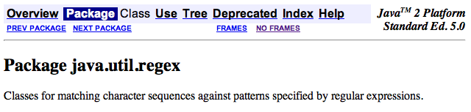
Regexes in practice…
Almost all languages have a regex library…
Unix’s egrep does a line-by-line search for a regex:
egrep 'hh'
egrep 'y.*y'
egrep '(xq|hq)'
egrep '^y.*y$'
/usr/share/dict/words
symbol for start of a line
symbol for end of a line
symbol for any character, a shortcut for (a|b|c|…|z|0|1|…|9|…)
good for crosswords !
VOWEL
U
VOWEL
not always obvious …
egrep '^(0|1(01*0)*1)(0|1(01*0)*1)*$' binStr
Notes:
45

Slide 46

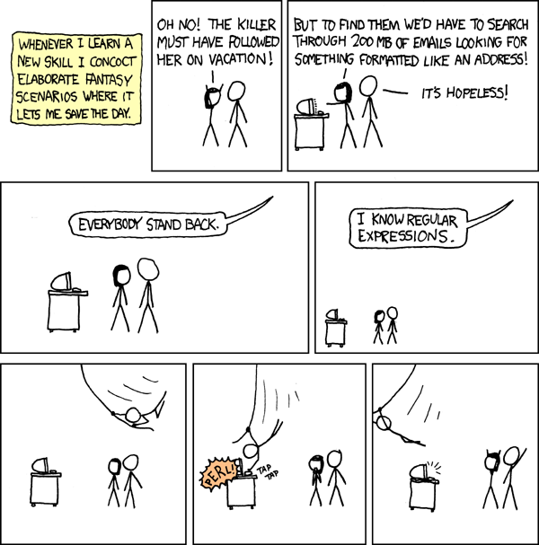
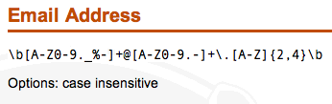
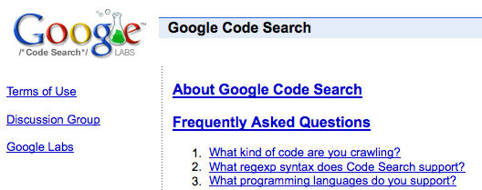
xkcd to the rescue, perhaps?
REs to the rescue!
practical extraction and report language
PERL
www.regular-expressions.info/regexbuddy/email.html
but how does regular expression matching actually work?
Notes:
46
Pimp my Ride from MTV - Corona is where the garage is…
MTV + SciFi -- twilight zone…

Slide 47
See you Wednesday!
You walk west
You are in a dark cave.
There is water dripping from the stalactites.
The only light is from the way you came.
You can just barely make out a sign that says
"Here there be dragons"
You see a dragon
?- look(dragon).
___====-_ _-====___
_--~~~#####// \\#####~~~--_
_-~##########// ( ) \\##########~-_
-############// :\^^/: \\############-
_~############// (@::@) \\############~
~#############(( \\// ))#############~
-###############\\ (^^) //###############-
-#################\\ / "" \ //#################-
-###################\\/ \//###################-
_#/:##########/\######( /\ )######/\##########:\#_
:/ :#/\#/\#/\/ \#/\##\ : : /##/\#/ \/\#/\#/\#: \:
" :/ V V " V \#\: : : :/#/ V " V V \: "
" " " " \ : : : : / " " " "
You are in a hallway with dull grey wallpaper.
There is really not much to describe...
There is a door to the south and to the west.
You see a wibstr_dictionary
Yes
?- look(wibstr_dictionary).
Brought to you by the AAAA, the
American Association Against Acronyms.
You are in a giant pantry, or is it a giant's pantry?
There is a door to the west.
You see a forty_two_cans_of_spam
You see a spork
?- take( spork ).
You now have the spork
?- take( forty_two_cans_of_spam ).
You now have the forty_two_cans_of_spam
?- eat( forty_two_cans_of_spam ).
You greedily shovel all 42 cans of spam down your throat.
Your stomach explodes, but you died happy. You just won THE GAME.
You are in a giant pantry, or is it a giant's pantry?
There is a door to the west.
You see a forty_two_cans_of_spam
You see a spork
?- take( forty_two_cans_of_spam ).
You now have the forty_two_cans_of_spam
?- eat( forty_two_cans_of_spam ).
You eat the spam, cans and all. You choke on the metal and die.
You just lost the game.
Losing.
Winning!
The line between winning and losing can be very thin indeed!

Slide 48
Regexes in practice…
Haiku?
Almost all languages have a regex library…
Unix’s egrep does a line-by-line search for a regex:
egrep 'hh'
egrep 'y.*y'
egrep '(xq|hq)'
egrep '^y.*y$'
/usr/share/dict/words
Haiku
symbol for start of a line
symbol for end of a line
symbol for any character, a shortcut for (a|b|c|…|z|0|1|…|9|…)
good for crosswords !
VOWEL
U
VOWEL
not always obvious …
egrep '^(0|1(01*0)*1)(0|1(01*0)*1)*$' binStr
Notes:
48

Slide 49
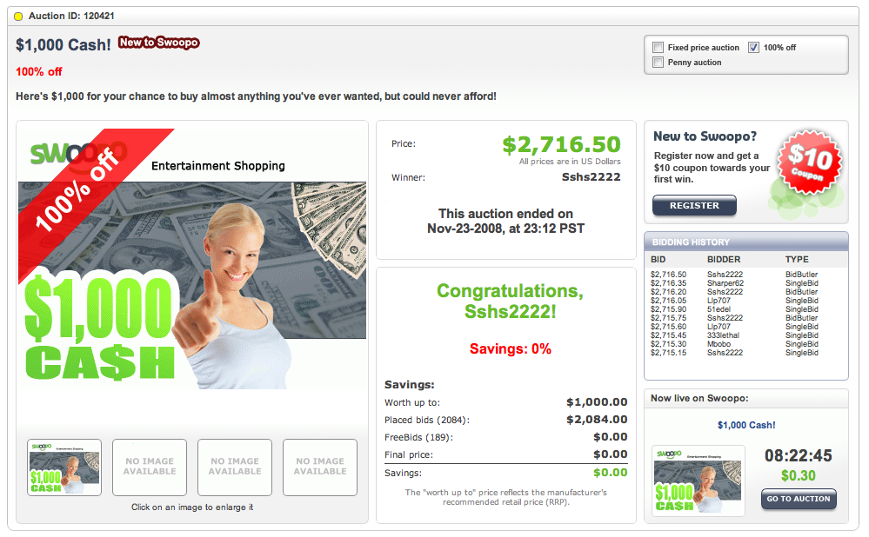
entertainment shopping?

Slide 50
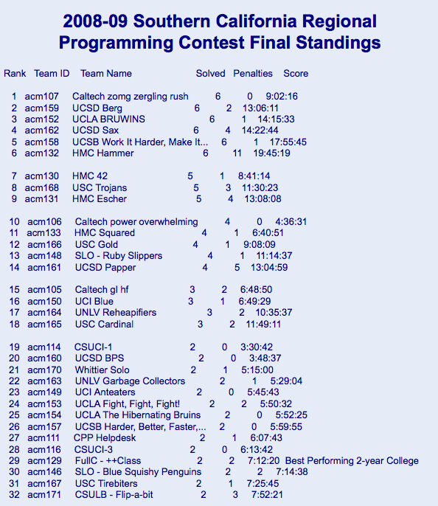
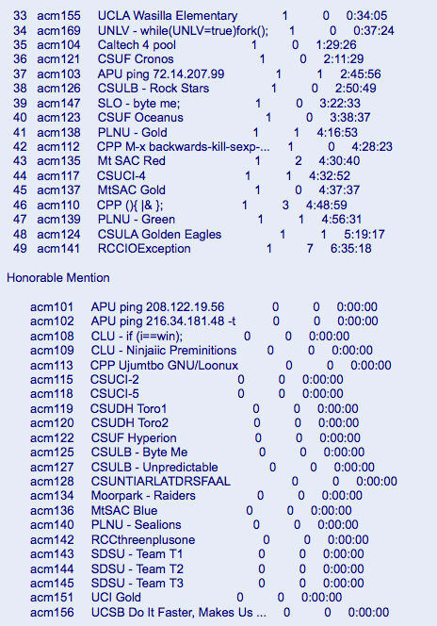
This weekend's ACM regional programming contest
Aaron Pribadi, Stuart Persteiner, and Daniel Lubarov
Anak Yodpinyanee + Jason GarretGlaser
Kevin Oelze, Andrew Hunter, and Kwang Ketcham
Marquis Wang, Josh Ehrlich, and Daniel Fielder
Notes:
50

Slide 51
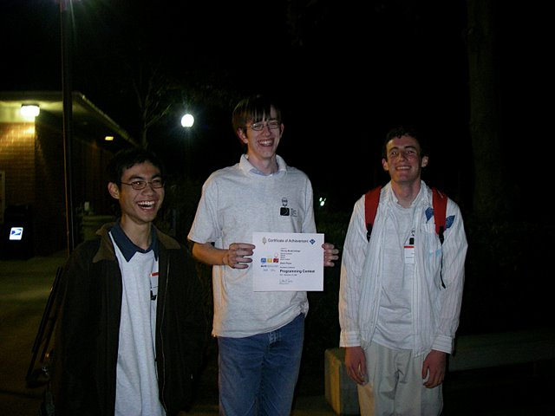
This weekend's ACM regional programming contest
Aaron Pribadi, Stuart Persteiner, and Daniel Lubarov
Anak Yodpinyanee + Jason GarretGlaser
Kevin Oelze, Andrew Hunter, and Kwang Ketcham
Marquis Wang, Josh Ehrlich, and Daniel Fielder
The contest seemed to be channeling CS 60…
Notes:
51

Slide 52
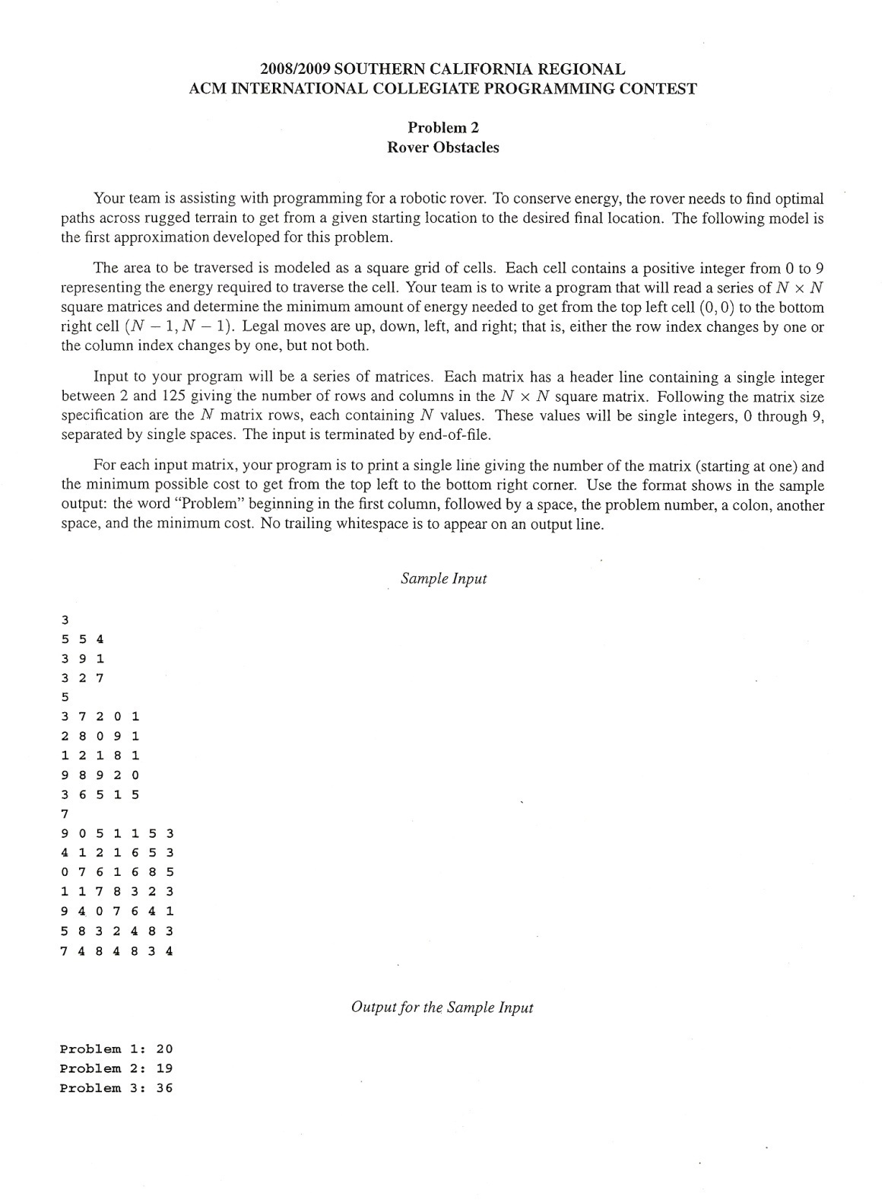

ACM regionals ~ CS 60?
From corner to corner as cheaply as possible…
Notes:
52

Slide 53
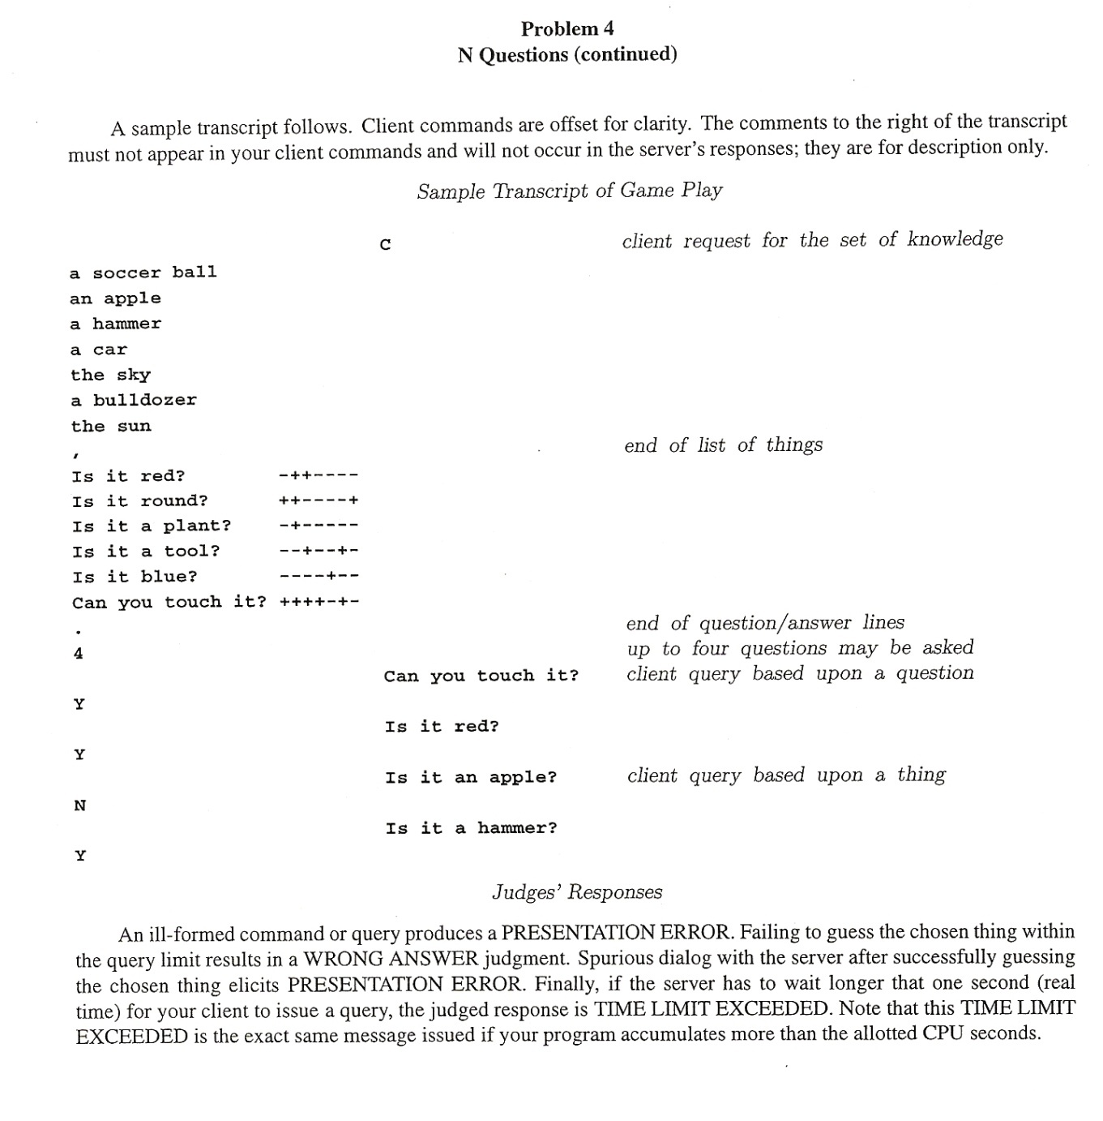
ACM regionals ~ CS 60?
20 questions: given objects, given questions, and given the answers to the questions (!), Identify the object in the specified number of questions…
Notes:
53

Slide 54
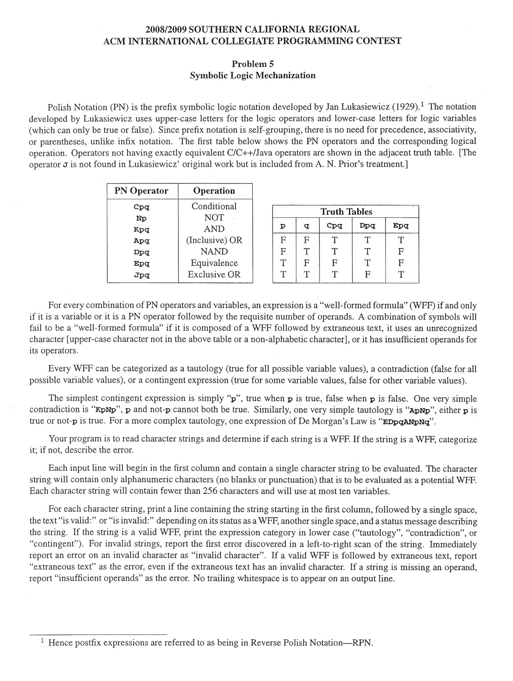
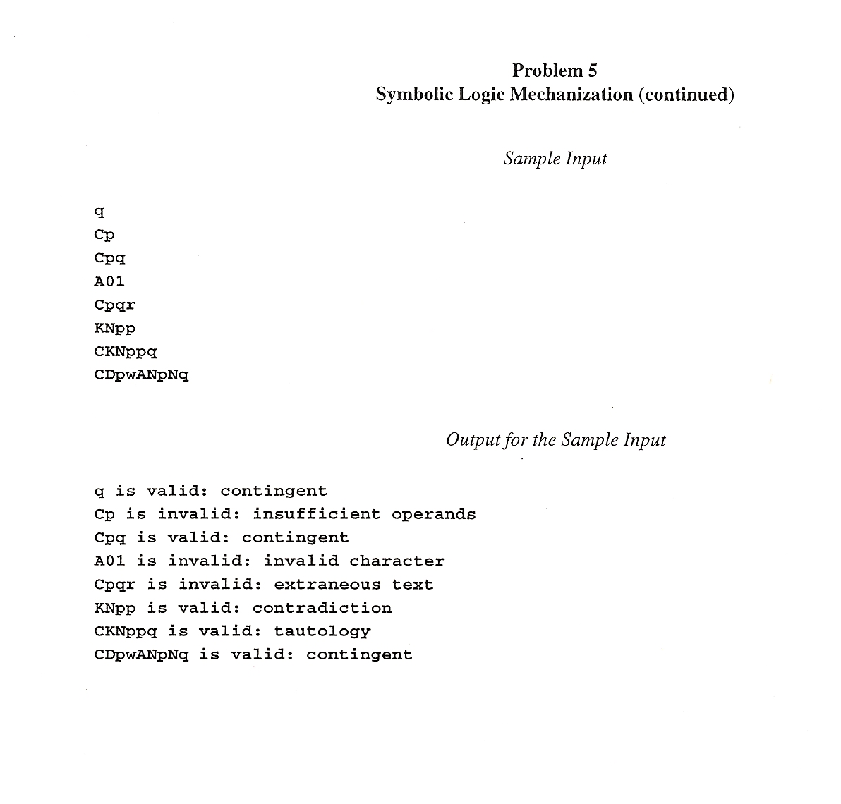
ACM regionals ~ CS 60?
Tautology checking (and parsing!)
( no Prolog permitted )
Notes:
54

Slide 55
See you on Wednesday!
Wednesday, April 16 for some
Wednesday, September 3 for others, perhaps…

Slide 56
There's something irregular about this theorem's name…
The Nonregular Language Theorem
Consider the language
L = { 0^{n}1^{n} | n ≥ 0}
example strings in L
To show it’s not regular…
λ
01
0011
000111
00001111
0000011111
Does the same set work for these languages?
L = palindromes
L = { w | w has the same # of 1s and 0s }

Slide 57
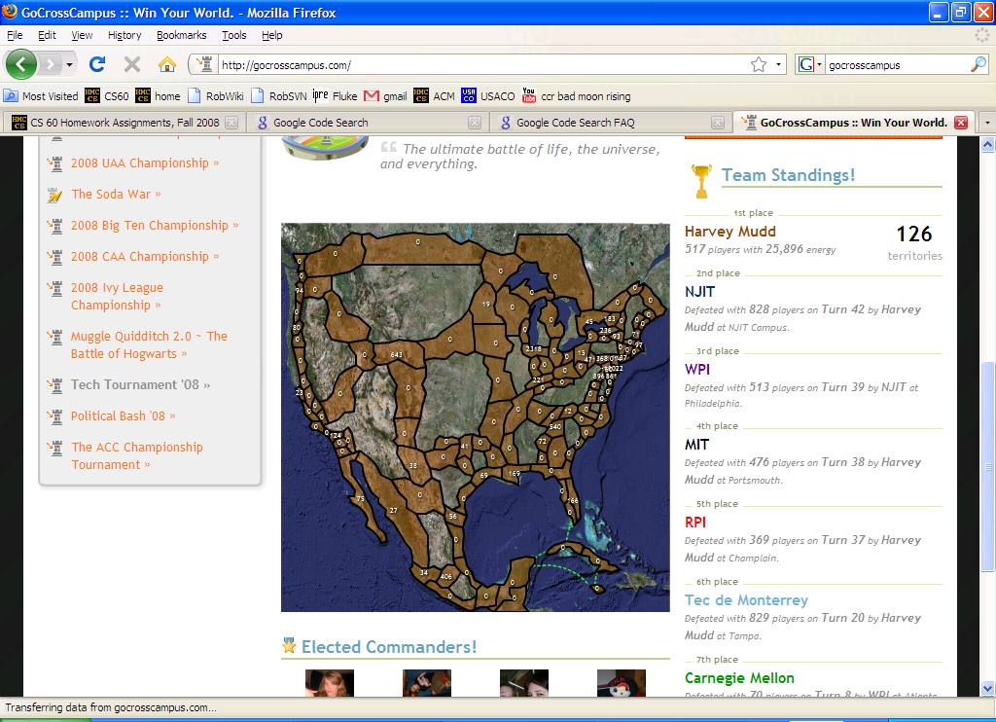
Notes:
regexen?

Slide 58
The question…
How powerful are DFAs ?
Can they emulate normal I/O behavior?
Can they do anything a desktop machine can?
Can they compute anything at all?
computing with parallel universes…
Next Time:

Slide 59
See you on Wednesday!
Wednesday, April 16 for some
Wednesday, September 3 for others, perhaps…

Slide 60
GA Tech’s FSM for trash pick-up

Slide 61
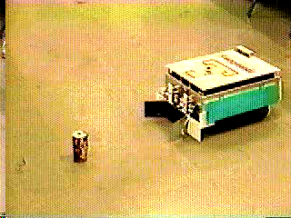
AAAI 1994 champions
Office-cleaning event
Georgia Tech

Slide 62
FSM applications…
http://www.gameai.com/statemachines.html
Game AI
original finite state machine
human-guided neural network
genetic-algorithm-guided neural network
Notes:
Ask for the game: Wolfenstein 3d - really the first first-person shooter 1992
by id software: Doom, in 1993, Quake in 1996,
ammo == ammo remaining at the end of the level…

Slide 63
FSM applications…
http://www.gameai.com/statemachines.html
Game AI
Notes:
Ask for the game: Wolfenstein 3d - really the first first-person shooter 1992
by id software: Doom, in 1993, Quake in 1996,

Slide 64
The question…
How powerful are DFAs ?
Can they emulate normal I/O behavior?
Can they do anything a desktop machine can?
Can they compute anything at all?
computing with parallel universes…
Next Time:
the DFA - DNA connection: string sequencing!

Slide 65
Soulmate strings…
Start with a language
L = { w | w’s third-from-left character is a 1}
example strings in L
example strings NOT in L
001
1010
11100010
011111111
λ
11
0101010
110111011110
Meet our three string couples for today…
Couple #1
Couple #2
Couple #3
w₁ = 011…
w₁ = 011…
w₁ = 01…
w₂ = 111…
w₂ = 110…
w₂ = 10…
Are the fates of these string couples the same or different?
both accepted? both rejected? or might they have different outcomes?
indistinguishable
distinguishable

Slide 66
String matchmaking
Given a language, L,
they might have different outcomes
Two strings w₁ , w₂ are distinguishable (w.r.t. L) if
∃z such that w₁ z ∈ L and w₂ z ∉ L (or vice versa).
A set of strings {w₁,w₂,w₃,…} is pairwise distinguishable if
∀ w_{i} ,w_{j} with i ≠ j , w_{i} and w_{j} are distinguishable, as above.
What if there are 42 of them?

Slide 67
The Distinguishability Theorem
If there is a pairwise distinguishable set of N strings for a language L, then a DFA accepting L must have ≥ N states.

Slide 68
The Distinguishability Theorem
If there is a pairwise distinguishable set of N strings for a language L, then a DFA accepting L must have ≥ N states.
How could we prove that this language's DFA requires 4 states?
L = { w | w is a binary # that’s divisible by 4 }

Slide 69
The question…
How powerful are DFAs ?
Can they emulate normal I/O behavior?
Can they do anything a desktop machine can?
Can they compute anything at all?
computing with parallel universes…
Next Time:
the DFA - DNA connection: string sequencing!

Slide 70
GA Tech’s FSM for trash pick-up

Slide 71
AAAI 1994 champions
Office-cleaning event
Georgia Tech

Slide 72
FSM applications…
http://www.gameai.com/statemachines.html
Game AI
original finite state machine
human-guided neural network
genetic-algorithm-guided neural network
Notes:
Ask for the game: Wolfenstein 3d - really the first first-person shooter 1992
by id software: Doom, in 1993, Quake in 1996,
ammo == ammo remaining at the end of the level…

Slide 73
FSM applications…
http://www.gameai.com/statemachines.html
Game AI
Notes:
Ask for the game: Wolfenstein 3d - really the first first-person shooter 1992
by id software: Doom, in 1993, Quake in 1996,

Slide 74
A really big DFA…
What DFA accepts this language?
L = { 0^{n}1^{n} | n ≥ 0}
example strings
λ
01
0011
000111
00001111
0000011111

Slide 75
Regular Languages
A language L is regular if there is a DFA that accepts it.
L = { w | w’s third character is a 1}
L = { w | w’s third-to-last character (from the right) is a 1}
L = { w | w is a binary # that’s divisible by 3 }
How could we prove that
L = { 0^{n}1^{n} | n ≥ 0}
is not regular?
If there is an infinite pairwise distinguishable set of strings (wrt L), it must be that L is not regular!

Slide 76
The Nonregular Language Theorem
Consider the language
L = { 0^{n}1^{n} | n ≥ 0}
example strings
λ
01
0011
000111
00001111
0000011111

Slide 77
DFA “Quiz”
(1) Draw a DFA that accepts
L = { w | w’s third character is a 1}
Extra Credit: do your solutions use the minimum possible number of states?
(2) (Watch out!) Draw a DFA accepting
L = { w | w’s third-to-last character (from the right) is a 1}

Slide 78
(1) How many states must a DFA for
L = { w | w’s third character is a 1}
have?
Extra Credit: do your solutions use the minimum possible number of states?
(2) How many states must a DFA for this language have?
L = { w | w’s third-to-last character (from the right) is a 1}

Slide 79
DFA “Quiz”
(1) Draw a DFA that accepts
L = { w | w’s third character is a 1}
Extra Credit: do your solutions use the minimum possible number of states?
(2) (Watch out!) Draw a DFA accepting
L = { w | w’s third-to-last character (from the right) is a 1}

Slide 80
q000
q001
q010
q011
q100
q101
q110
q111
0
qλ
1
q0
q1
0
1
0
1
q00
q01
q10
q11
0
1
0
1
0
1
0
1
q000
q001
q010
q011
q100
q101
q110
q111
0
qλ
1
q0
q1
0
1
0
1
q00
q01
q10
q11
0
1
0
1
0
1
0
1
q000
q001
q010
q011
q100
q101
q110
q111
plus a “few” more transitions...

Slide 81
Adding nondeterminism to DFAs
(nondeterministic finite automaton)
NFA
States can have any number of transitions for a single character. (zero, one, more...)
q1
1
1
Is this possible ??
q0
1
q2
0
L = { w | w’s third character from the right is a 1} (revisited)

Slide 82
NFAs vs. DFAs
What NFA accepts L = { w | w ends with 011 or 110} ?

Slide 83
Regular Languages
A regular language is a set of strings defined by three operations:
concatenation ab “a then b”
high precedence
“Kleene Star” a* “0 or more a’s”
union a | b “a or b”
low precedence
A regular expression defines a regular language:
(0|1)(0|1)1(0|1)* all (binary) strings whose third bit is 1
(1|0)*1(0|1)(0|1) all strings whose third-to-last bit is 1
01*0
all strings in which each 1 is followed by a 0

Slide 84
emacs
Perl
vi ...
Regular Expressions
Unix’s grep or egrep
does a line-by-line search for a regexp:
egrep ’hh’ /usr/dict/words
egrep ’y.*y’ /usr/dict/words
egrep ’^y.*y$’ /usr/dict/words
egrep ’(xq|hq)’ /usr/dict/words
good for crosswords
A
T or S
A
not always obvious !
egrep ’^(0|1(01*0)*1)(0|1(01*0)*1)*$’
Regular Expressions = DFAs = NFAs

Slide 85
DFAs to Regular Expressions
What reg. exp. is equivalent to this FA?
Is it deterministic or nondeterministic?
0
0
1
q0
q1
1

Slide 86
DFAs and Regular Expressions
DFA accepting { w | w is a binary number divisible by 3 } :

Slide 87
A slide about λ ...
nothing
S λ
S ( S )
S S S
E T + T
T V * V
V
a
b
c
d
e
…
z
Derivation Tree of ( )(( )) ?
Derivation Tree of n+m∗y

Slide 88
Other Machines
Classifier: maps each state to some category
Why no final states ?
0
0
q0/all 0
1
qs/none
1
q2/mix
0,1
0
q1/all 1
1
outputs a symbol at EACH STATE

Slide 89
Other Machines
Transducer: maps each transition to some output character
input
records the path taken
0/0
output
start
saw 0
0/0
1/0
0/1
1/1
saw 1
1/0
outputs a symbol at EACH TRANSITION

Slide 90
qs
0
0
“none”
acceptor
q0
0
0
q0
1
0,1
qs
qs
q2
“all 0”
acceptor
1
0
qs
1
q1
q1
“mix”
acceptor
1
“all 1”
acceptor
1

Slide 91
0
0
start
qb/0
qB/1
0
1
Equivalent
Classifier
0
1
1
0
1
qc/0
1
qC/1

Slide 92
qs
1
q1
0
1
1
0
0
q0
q2
0
1

Slide 93
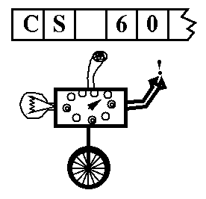
Real Machines don’t just accept their input
Turing machine (TM): a simple model of universal computation.
The tape: an unbounded amount of memory. Consists of cells, each containing exactly one of an alphabet ∑ of characters (e.g. 0, 1, _ (blank))
Read/write head for the tape
The control: a finite amount of memory, the control states. Defines control functions.
The complete state of a TM is determined by:
The control state
The symbol now under the head
The symbols to the right of the head
The symbols to the left of the head
Ability to move left and right

Slide 94
Polyglot Sorting
minsort([],[]).
minsort(U, [F|R] ) :- member(F,U), remove(F,U,N), minsort(N,R), less(F,R).
less(F,[A|R]) :- F =< A, less(F,R). less(F,[ ]).
swapsort2([ ]) => [ ];
swapsort2([ x ]) => [x];
swapsort2([f,s | r]) => f < s ? [ f | swapsort2([ s|r ]) ]: [ s, f | swapsort2( r ) ] ;
mergesort (see one possible solution in /cs/cs60/as/a10)
A true polyglot ...
/***/
class//
hello// /*
{ public static void main(String[] arg) {
System.out.println("\nHello from Java.\n");
// */ /***/ p(0). p(hello-from-prolog). /*
// */ /***/ hello :- p(A), write(A). /*
} } // */ %; hello = "\nHello from Rex.";

Slide 95
AS 11 due Fri. @ midnight
Today
Fall 00 Lec 24
Machines, machines, machines...
DFAs (Deterministic Finite Automata) { = FSMs }
NFAs (Nondeterministic Finite Automata)
Turing Machines = universal computing
other types of computing: DNA Quantum
... and Problems
P
NP
EXP
UNDECIDABLE
NP complete
halting
satisfiability
tiling
searching
knapsack
equivalence of “super” regular expressions
sorting
factoring
theorem proving
graph coloring
traveling salesperson

Slide 96
NFAs vs. DFAs
What NFA accepts L = { w | w ends with 011 or 110} ?
True or False?
For any DFA, there is some NFA that accepts the same language?
For any NFA, there is some DFA that accepts the same language?
Languages accepted by FAs are called regular.

Slide 97
Today
In search of an O(1) sorting algorithm...
CS: The science of difficulty
Assignment 11: Finite State Machines (Due Fri., 12/1)
?
P ≠ NP
also called
DFA: “Deterministic Finite Automata”
Mudd
do HW
skip HW
Summer
HW
HW
skip HW
do HW
The Mudd DFA
Thursday
Tuesday
Thursday
5/14 or 5/17
Turing Machines
Real Machines! (circuits)
Machine Language
Final Exam

Slide 98
Quicksort
Another Divide and Conquer technique
List of length n
Quick Sort
5
3
2
6
4
1
3
7
partition and swap

Slide 99
Quicksort
“Divide and Conquer”
List of length n
Quick Sort
5
3
2
6
4
1
3
7
partition and swap
3
3
2
1
4
6
5
7
3
3
2
1
4
6
5
7
1
2
3
3
4
5
6
7
...
Can we do better than O(n*log(n)) ?

Slide 100
O(n) Sorting
Can we do better than O( n*log(n) ) ?
Yes, but we have to make assumptions about the data...
Counting Sort
List of length n
or
5
3
2
6
4
1
3
7
Bucket Sort
Suppose we know each item is between 1 and 10.

Slide 101
O(n) Sorting
Radix Sort
start with LSD & continue from there...
5
101
3
011
FOR
2
010
BOX
6
110
FOX
4
100
BAR
1
001
FAR
3
011
7
111
Can we do better than O(n)?

Slide 102
Seeking O(1) sorting !
Punchcard sort
radix sort with 1 operation per digit
List of length n
5
101
3
011
2
010
6
110
List of any length!
4
100
Spaghettisort
1
001
...
need a big, flat surface and a lot of pasta
3
011
7
111

Slide 103

Any Comparison Sort is at best O(n log(n))
•
Start with all of the permutations of a list with n elements.
[e1, e2, e3, ... , en]
Key Fact
n
n
( )
2
n
[4,1,5,3,2]
2
< n! <
n
[4,5,3,1,2]
[3,1,4,5,2]
[2,4,1,5,3]
[1,2,3,4,5]
[5,4,3,1,2]
yes
?
no
e1 < e2
[1,2,3,4,5]
[4,1,5,3,2]
[4,5,3,1,2]
[5,4,3,1,2]
[2,4,1,5,3]
[3,1,4,5,2]
“Adversary Argument”
The Adversary

Slide 104



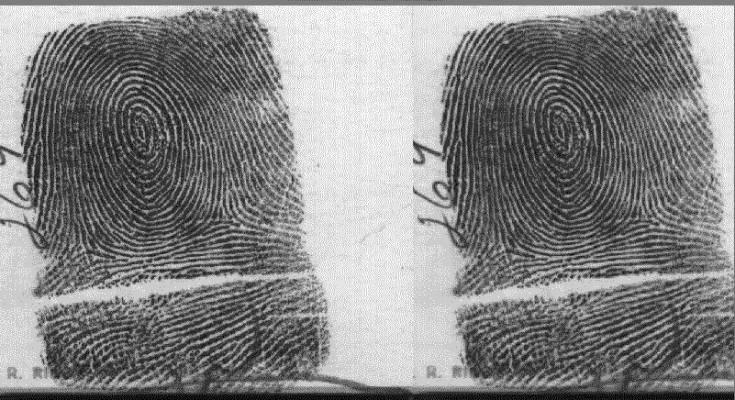
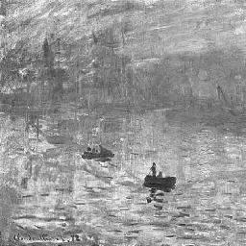
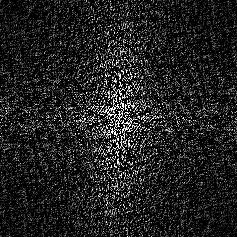
Fast Algorithms Us
Fast fourier transform / MIT’s FFTW
N-body interactions, particle simulations
Image and audio compression

Slide 105
“Big Oh” + Tractable Problems
Order
n
n
n!
Intractable Problems (Exponential)
n
2
3
n
2
n
Tractable Problems (Polynomial)
n log(n)
n
√n
Problem-solving strategy:
log(n)
No Problems!
Push a problem as far down the hierarchy as possible, then worry about constants... .
1

Slide 106
What assumptions are allowed?
Testing for satisfiability (SAT)
(x+y) * (x+y’) * (x’+y’)
Deterministic Algorithm
Nondeterministic Algorithm
Each algorithm step has a specified following step.
An algorithm step may have several choices of following steps.
Deterministic Algorithm:
Nondeterministic Algorithm:
Let x = false (0).
Recurse to determine SAT.
Let x = true (1).
Recurse to determine SAT.
If either was satisfiable,
return 1 else return 0.
Choose x = true and false (1 and 0).
Recurse to determine SAT.
If any choice succeeded,
return 1 else return 0.

Slide 107
Deterministic Computing
“step-by-step”
x = true;
y = true;
z=1
unsatisfiable
z=0
unsatisfiable
y = false;
z=1
unsatisfiable
z=0
unsatisfiable
14 steps...
x = false;
y = true;
z=1
unsatisfiable
z=0
tautology
y = false;
z=1
unsatisfiable
z=0
unsatisfiable

Slide 108
Nondeterminism
parallel-universe computing

Slide 109
This weekend's ACM regional programming contest
Aaron Pribadi, Stuart Persteiner, and Daniel Lubarov
Anak Yodpinyanee + Jason GarretGlaser
Kevin Oelze, Andrew Hunter, and Kwang Ketcham
Marquis Wang, Josh Ehrlich, and Daniel Fielder
Notes:
109

Slide 110
This weekend's ACM regional programming contest
Aaron Pribadi, Stuart Persteiner, and Daniel Lubarov
Anak Yodpinyanee + Jason GarretGlaser
Kevin Oelze, Andrew Hunter, and Kwang Ketcham
Marquis Wang, Josh Ehrlich, and Daniel Fielder
The contest seemed to be channeling CS 60…
Notes:
110

Slide 111
ACM regionals ~ CS 60?
From corner to corner as cheaply as possible…
Notes:
111

Slide 112
ACM regionals ~ CS 60?
20 questions: given objects, given questions, and given the answers to the questions (!), Identify the object in the specified number of questions…
Notes:
112

Slide 113
ACM regionals ~ CS 60?
Tautology checking (and parsing!)
( no Prolog permitted )
Notes:
113

Slide 114
Nondeterminism
“computing with parallel universes”
x = true;
x = false;
y = true;
y = false;
y = true;
y = false;
z=1
z=0
z=1
z=0
z=1
z=0
z=1
z=0
3 steps!
U
U
U
U
U
T
U
U

Slide 115
Extra Credit
P
vs.
NP
Set of problems solvable by deterministic algorithms in polynomial time.
Set of problems solvable by nondeterministic algorithms in polynomial time.
searching
sorting
Fourier Transform
chess, checkers, go, ...
SAT (satisfiability)
Bin Packing
Knapsack problem
factoring
TSP

Slide 116
More efficient?
The results of compiling into two different machine languages…
.LLC0:
.asciz "x is %d and y is %d.\n"
.section ".text"
.align 4
.global main
.type main, #function
.proc 04
main:
!#PROLOGUE# 0
save %sp, -128, %sp
!#PROLOGUE# 1
mov 42, %g1
st %g1, [%fp-20]
mov 7, %g1
st %g1, [%fp-24]
ld [%fp-20], %g1
st %g1, [%fp-28]
ld [%fp-24], %g1
st %g1, [%fp-20]
ld [%fp-28], %g1
st %g1, [%fp-24]
sethi %hi(.LLC0), %g1
or %g1, %lo(.LLC0), %o0
ld [%fp-20], %o1
ld [%fp-24], %o2
call printf, 0
nop
mov %g1, %i0
ret
restore
.LC0:
.string "x is %d and y is %d.\n"
.text
.globl main
.type main,@function
main:
pushl %ebp
movl %esp, %ebp
subl $24, %esp
andl $-16, %esp
movl $0, %eax
subl %eax, %esp
movl $42, -4(%ebp)
movl $7, -8(%ebp)
movl -4(%ebp), %eax
movl %eax, -12(%ebp)
movl -8(%ebp), %eax
movl %eax, -4(%ebp)
movl -12(%ebp), %eax
movl %eax, -8(%ebp)
subl $4, %esp
pushl -8(%ebp)
pushl -4(%ebp)
pushl $.LC0
call printf
addl $16, %esp
leave
ret
main:
!#PROLOGUE# 0
save %sp, -120, %sp
!#PROLOGUE# 1
mov 42, %g1
st %g1, [%fp-20]
mov 7, %g1
st %g1, [%fp-24]
ld [%fp-20], %o5
ld [%fp-24], %g1
xor %o5, %g1, %g1
mov %g1, %o5
st %o5, [%fp-20]
ld [%fp-24], %g1
xor %g1, %o5, %g1
mov %g1, %o5
st %o5, [%fp-24]
ld [%fp-20], %g1
xor %g1, %o5, %g1
st %g1, [%fp-20]
sethi %hi(.LLC0), %g1
or %g1, %lo(.LLC0), %o0
ld [%fp-20], %o1
ld [%fp-24], %o2
call printf, 0
nop
mov %g1, %i0
ret
restore
main:
pushl %ebp
movl %esp, %ebp
subl $8, %esp
andl $-16, %esp
movl $0, %eax
subl %eax, %esp
movl $42, -4(%ebp)
movl $7, -8(%ebp)
movl -8(%ebp), %edx
leal -4(%ebp), %eax
xorl %edx, (%eax)
movl -4(%ebp), %edx
leal -8(%ebp), %eax
xorl %edx, (%eax)
movl -8(%ebp), %edx
leal -4(%ebp), %eax
xorl %edx, (%eax)
subl $4, %esp
pushl -8(%ebp)
pushl -4(%ebp)
pushl $.LC0
call printf
addl $16, %esp
leave
ret
lots of machine-dependent details!

Slide 117
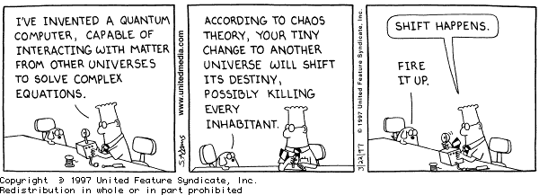
Computation, without the machine!
http://www.cs.caltech.edu/~westside/quantum-intro.html

Slide 118
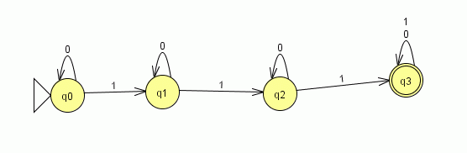
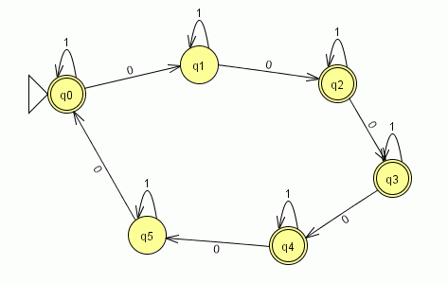
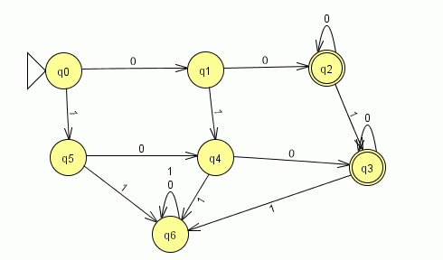
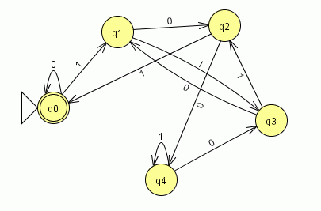
part1
part2
part3
part5

Slide 119
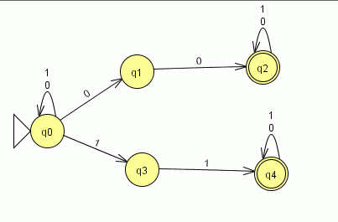
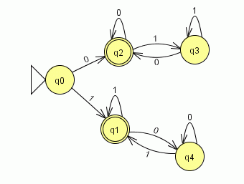
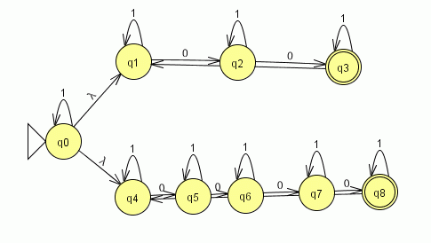
part6
part10
part7

