Slide 1
Project Management

Slide 2
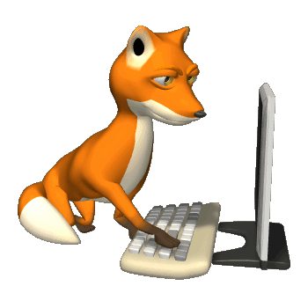

Predictors of Success
It’s all about team talent
small project

Slide 3
Predictors of Success
It’s all about methodology
large project
We use agile!

Slide 4
Today: Project management
Forming teams
Partitioning/scheduling work
Monitoring progress
Dealing with problems
Agile: small, self-organizing teams
Goal stack, risk analysis, estimation
Team meetings, wiki updates, tickets
Postmortem, slippages

Slide 5
Estimation
Work break down
Time tracking
Analysis

Slide 6
Work break down
1-2 hour tasks

Slide 7
Work break down dependencies

Slide 8
Work break down dependencies and time estimates
+.5 hour
+1 hour
1.5 hours
+2 hours
+2 hours
2 hours
+.5 hour
1 hour

Slide 9
Schedule and assign
+.5 hour
+1 hour
1.5 hours
+2 hours
+2 hours
2 hours
+.5 hour
eric: due tues.
yoyoz: due wed.
BE WARY of DEPENDENCIES
1 hour
fiona: due tues.

Slide 10
Wed. AM
ERIC spend 10 hours and isn’t done
+.5 hour
+1 hour
1.5 hours
+2 hours
+2 hours
2 hours
+.5 hour
eric: due tues.
yoyoz: due wed.
BE WARY of DEPENDENCIES
1 hour
fiona: due tues.

Slide 11
Estimation
Estimate
Track
Compare estimates/actual
Learn from your lessons!
No really!
If your estimates are half of actual in week n, then double your estimates for week n+1

Slide 12
More practices
Define “done”
Add feature x
Add feature x, fully debugged
Add feature x, fully debugged, augment test plan
Add feature x, fully debugged, augment test plan and UML

Slide 13
More practices
Define “done”
Timebox
Allow time X and no more

Slide 14
More practices
Define “done”
Timebox
Allow time X and no more

Slide 15
More practices
Define “done”
Timebox
Don’t add slack to estimates
Parkinson’s law: Work expands so as to fill the time available for its completion.

Slide 16
More practices
Define “done”
Timebox
Don’t add slack to estimates
Parkinson’s law: Work expands so as to fill the time available for its completion.

Slide 17
More practices
Define “done”
Timebox
Don’t add slack to estimates
Avoid crunch times

Slide 18
More practices
Define “done”
Timebox
Don’t add slack to estimates
Avoid sustained overtime (crunch time)

