Slide 1
CS 182 today: facing the future
Schedule
Today: faces
T 4/19: 3d vision
Th 4/21: robot navigation
T 4/26: no meeting
Th 4/28: project demos
F 4/29: Claremont robotics competition
S 5/8: project write-ups due
S 5/8: final assignment also due

Slide 2
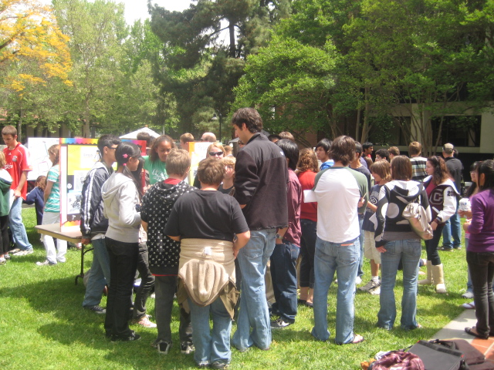
CS 182 final assignment
On one topic from the course's 2nd half:
Option #1: motion-planning problems
Option #2: Claremont robotics judging
Friday, 4/29
Either 11am-12:30 (poster judging)
or 12:30-2:00pm (competition judging)
Option #3: SLAM visualization & evaluation
Option #4: ROS: Willow Garage's Robot Operating system
Option #5: Face recognition via Eigenfaces

Slide 4
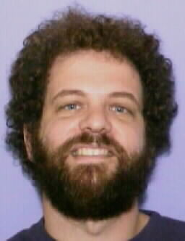
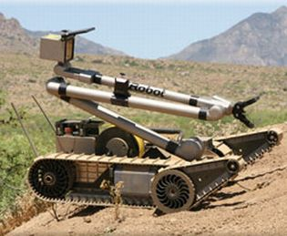

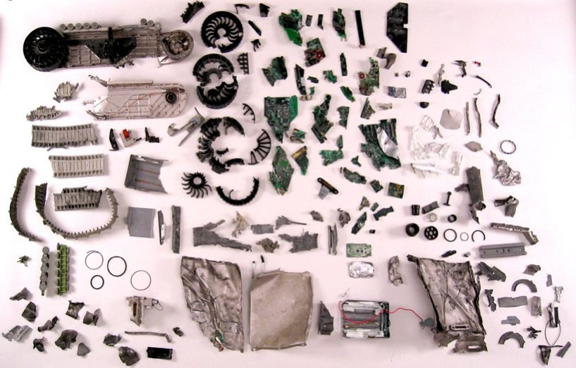
Insights from TePRA...
Gill Pratt, DARPA
iRobot & DARPA's PackBot
look familiar?
Colin Angle, iRobot
failure!

Slide 5
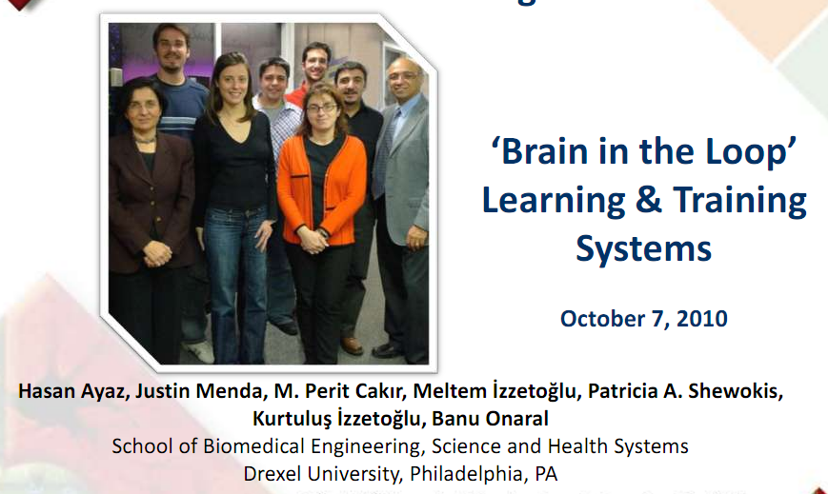
Gill Pratt, DARPA

Slide 6
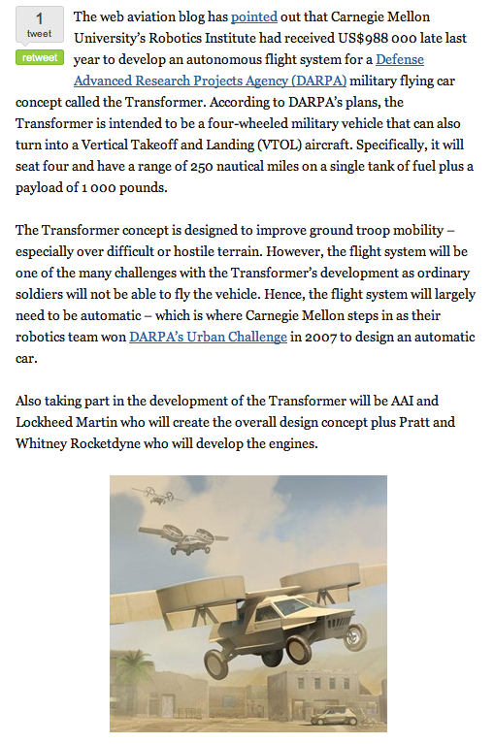
Gill Pratt, DARPA
Flying cars... for real!

Slide 7
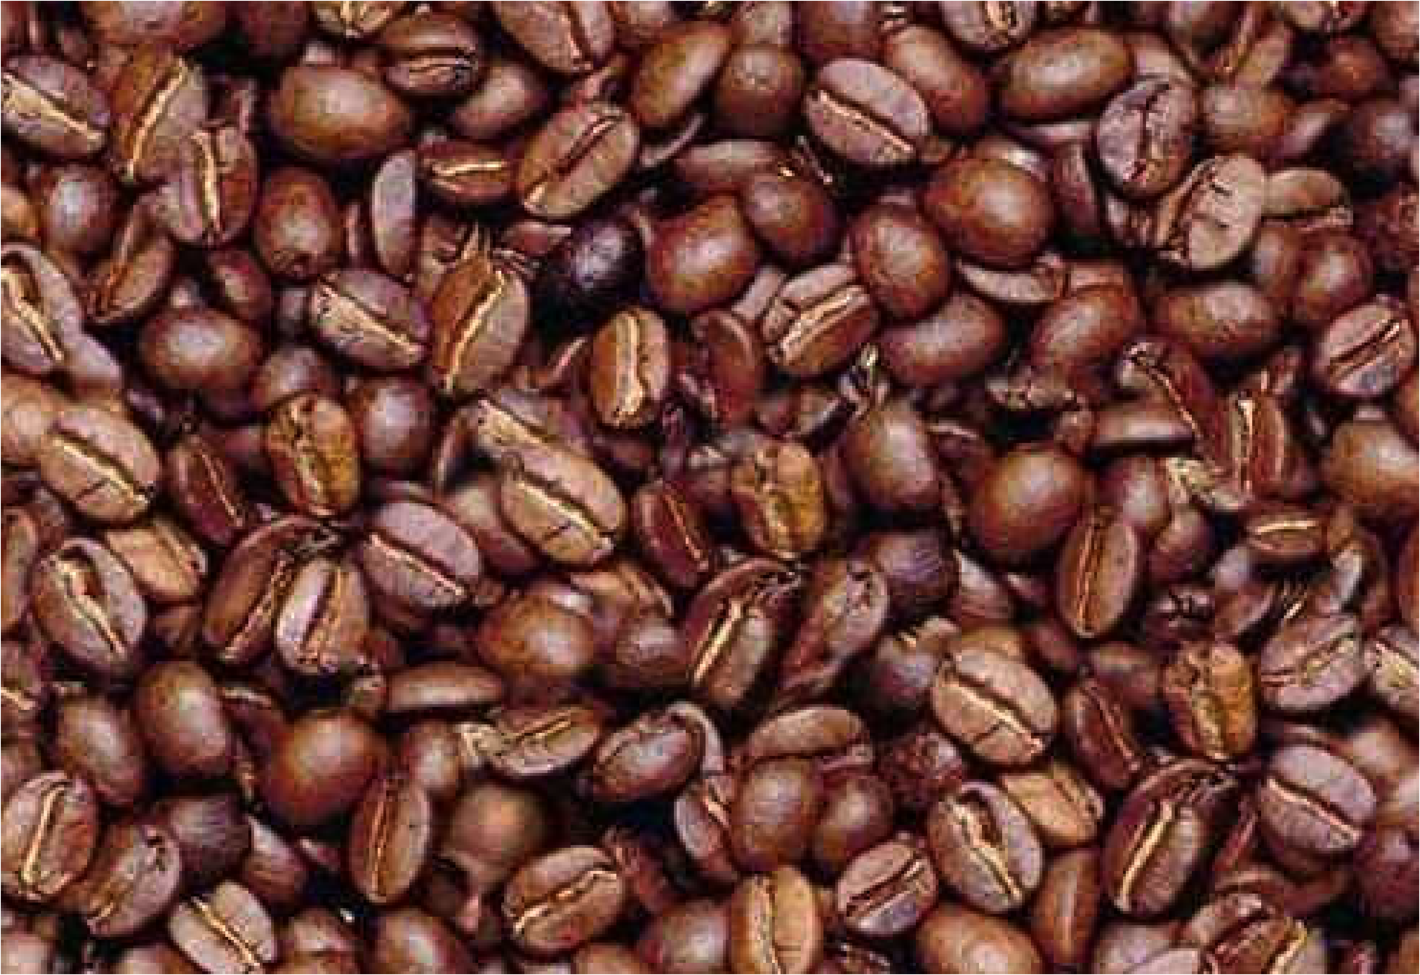
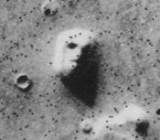
About face
Real and artificial algorithms specialized for handling images of faces…
Are our approaches top-down or bottom-up?
Notes:
7

Slide 8
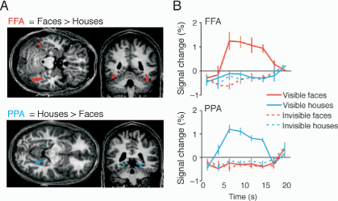
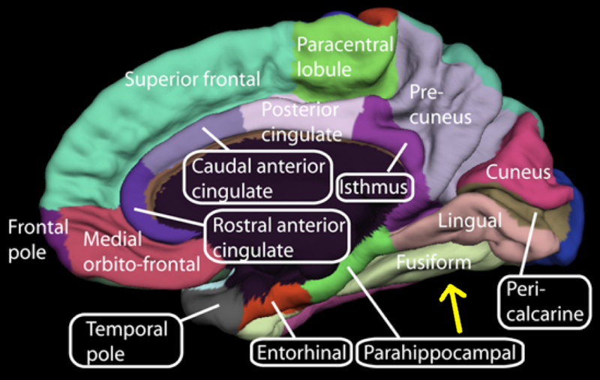
Real facial recognition
How wired are we for recognizing faces?
Unresolved:
How are we wired for recognizing faces?
FFA = Fusiform Face Area
parahippocampal place area (PPA)
Notes:
8

Slide 9
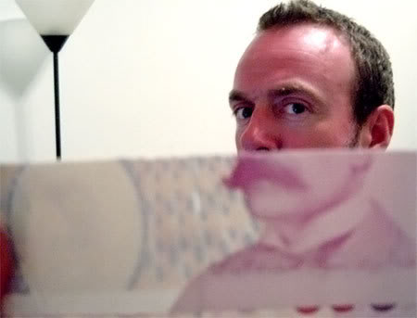

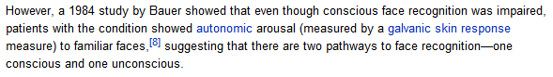
Face-blindness
Facing the future of faces...
Parents with prosopagnosia can go to the day-care center, and if their kid has changed clothes while there, the
parents have no clue who their child is, while the people working there think, `What is wrong with this parent?' "
Face-blind individuals can see faces perfectly well -- the eyes, nose, and mouth -- but seem to have trouble processing what they see and placing it into memory to be recalled again.
Opposite condition: Capgras delusion
in which one recognizes faces, but believe they are imposters!
Vision may be non-monolithic ~ despite appearances...

Slide 10
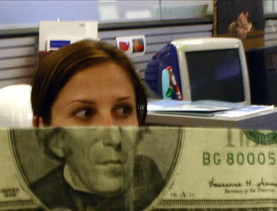
Face-blindness
Facing the future of faces...
Parents with prosopagnosia can go to the day-care center, and if their kid has changed clothes while there, the
parents have no clue who their child is, while the people working there think, `What is wrong with this parent?' "
Face-blind individuals can see faces perfectly well -- the eyes, nose, and mouth -- but seem to have trouble processing what they see and placing it into memory to be recalled again.
Opposite condition: Capgras delusion
in which one recognizes faces, but believe they are imposters!
Vision may be non-monolithic ~ despite appearances...

Slide 11
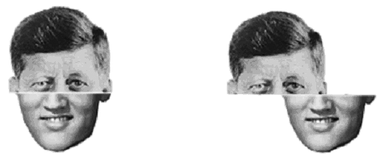
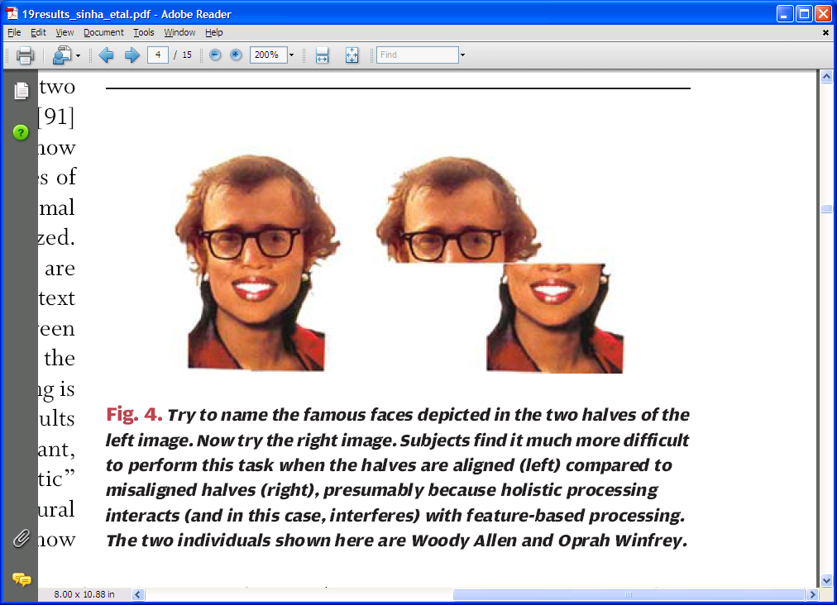
Holistic vs. part-based reasoning
top-down
bottom-up
We do both.
Who are these folks?
If I were two faced, why would I be wearing this one?
- Abraham Lincoln
Notes:
Lincoln’s quote!
11

Slide 12
Holistic vs. part-based reasoning
It is more difficult to recognize distinct halves of faces, when aligned.
Holistic? Part-based?
Notes:
Lincoln’s quote!
12

Slide 13
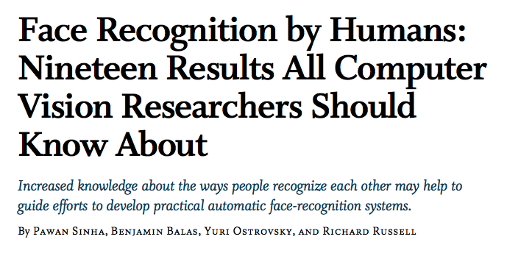
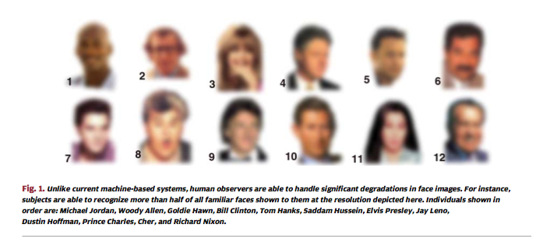
My source ('06)
Notes:
Lincoln’s quote!
13

Slide 14
My source ('06)
Notes:
Lincoln’s quote!
14

Slide 15
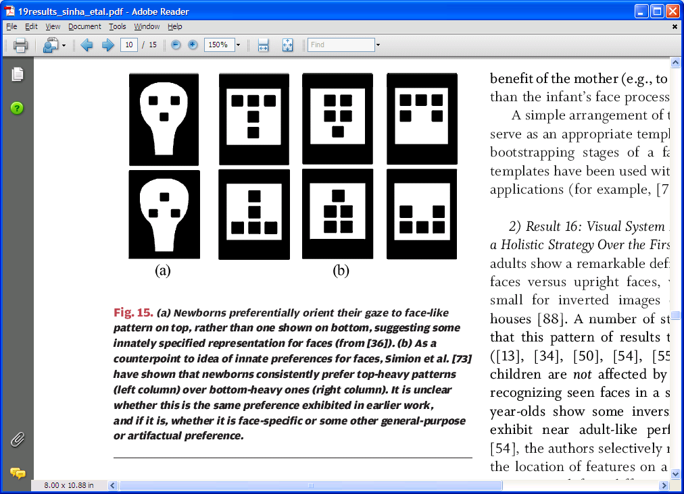
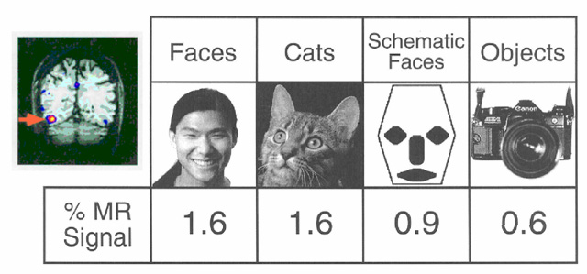
Innate face detection?
Infants prefer the top image to the bottom one…
Evidence for the fusiform face area (FFA), a specialized face-detection module

Slide 16
Innate detection?
Infants prefer the top image to the bottom one…
But they also prefer the first row here:
Still debated as to whether infant preferences are for “faces” or “top-heavy” images

Slide 17
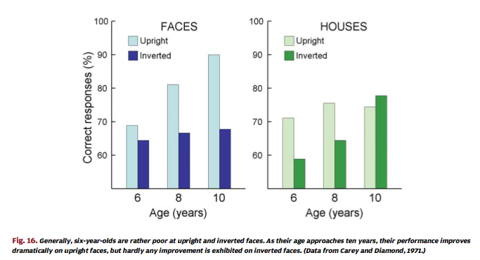

Learned recognition.
Infants prefer the top image to the bottom one…
Evidence for the fusiform face area (FFA), a specialized face-detection module

Slide 18
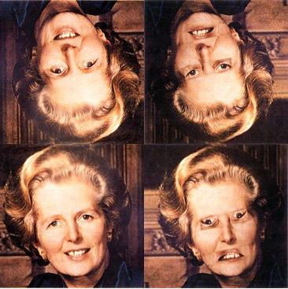
Peter Thompson 1980
Holistic? Part-based?

Slide 19
Peter Thompson 1980
Holistic? Part-based?

Slide 20
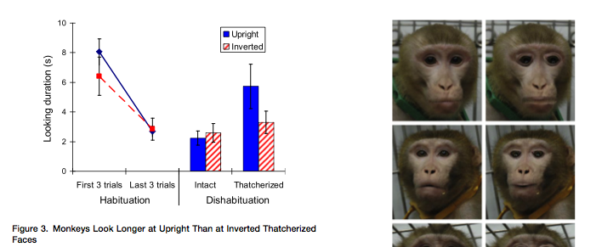
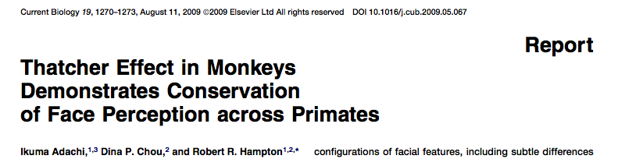
Peter Thompson 1980
Holistic? Part-based?

Slide 21
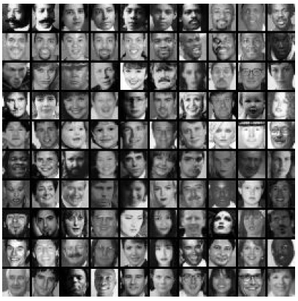
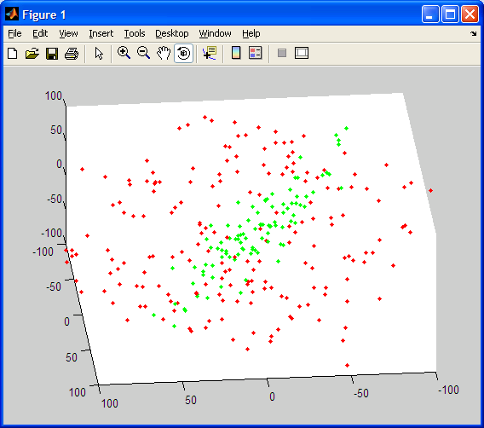
100x100 patches
Eigenfaces
Idea: faces have distinctive appearance
Consider appearance space (face space)
Each face image is a point in the space of appearances (texture)
How many dimensions here?
Choose the N axes that best capture "faceness" ~ they may not align with the original space's axes.
What would those axes mean ?
Notes:
21

Slide 22
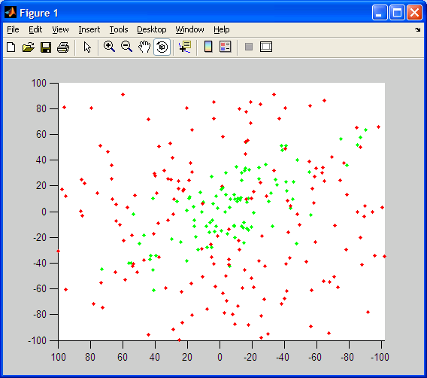
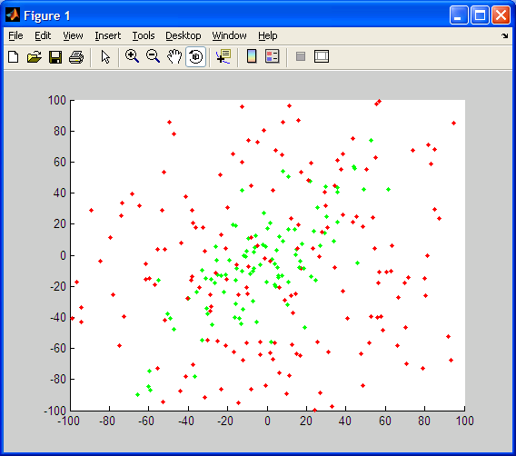
Only a few dimensions needed
x-y projection
x-z projection
but which ones?

Slide 23
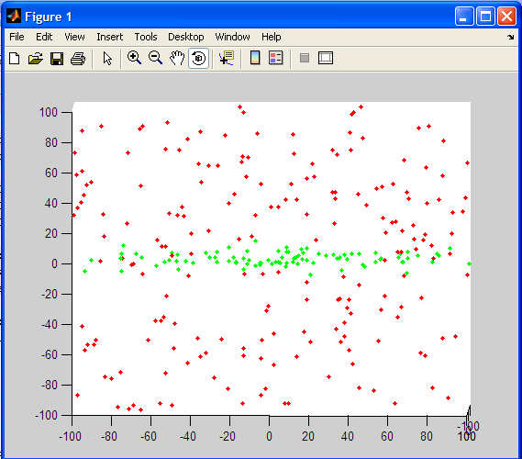
Only a few dimensions needed
x-y projection
x-z projection
this is a promising view!

Slide 24

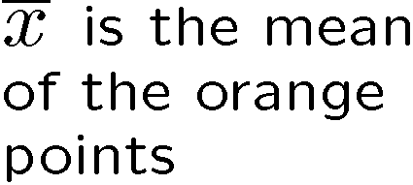





Linear subspaces
convert x into v₁, v₂ coordinates
What does the v₂ coordinate measure?
distance to line
use it for classification—near 0 for orange pts
What does the v₁ coordinate measure?
position along line
use it to specify which orange point it is
Classification can be expensive:
Big search prob (e.g., nearest neighbors) or store large PDF’s
Suppose the data points are arranged as above
Idea—fit a line, classifier measures distance to line

Slide 25
Dimensionality reduction
How can we find the data’s natural coordinate system?
v1 and v2 instead of x and y
Dimensionality reduction
We can represent the orange points with only their v₁ coordinates (since v₂ coordinates are all essentially 0)
This makes it much cheaper to store and compare points
A bigger deal for higher dimensional problems

Slide 26
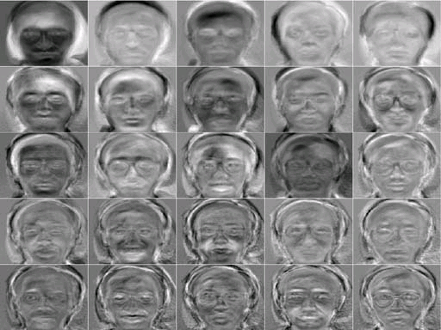
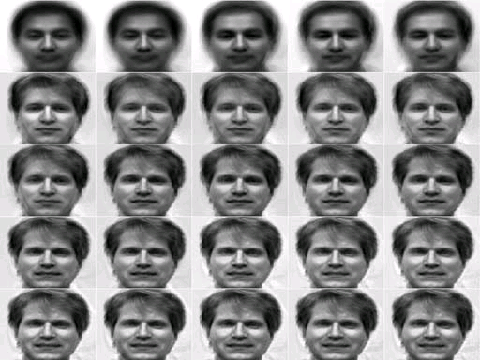
Eigenfaces: pictures!
Aka… intuition
Who is this?
Eigenfaces (the axes of face space)
Progressive reconstructions…

Slide 27
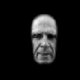









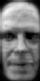
Eigenfaces
(1) Take the top N axes ~ eigenfaces
largest 8 directions in face space
(2) project a query image onto those axes
(3) obtain a low-dimensional representation of the original…

Slide 28
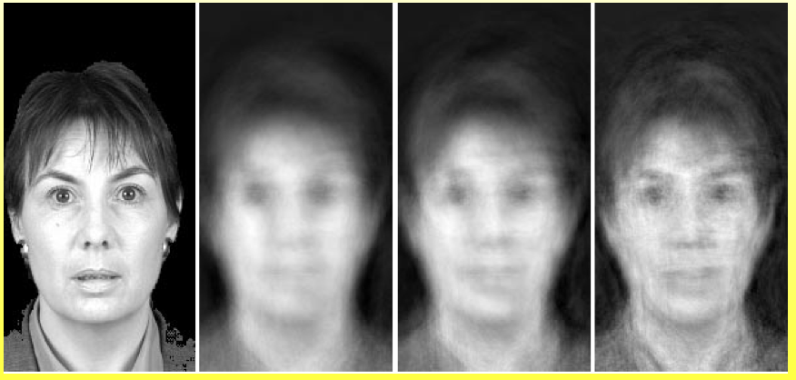
Eigenfaces
(1) Take the top N axes ~ eigenfaces
(2) project a query image onto those axes
largest 8 directions in face space
(3) obtain a low-dimensional representation of the original…
40 dims
100 dims
150 dims
out of >10,000

Slide 29
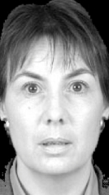

Eigenfaces
non-faces in purple
How to use these low-d projections?
faces in orange
To recognize a face
To detect a face
… how well does it work?
Notes:
29

Slide 30
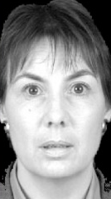
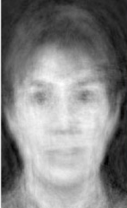
Eigenfaces
non-faces in purple
How to use these low-d projections?
faces in orange
Use intra-class variation
The data point it’s closest to when projected onto the eigenfaces!
To recognize a face
Use inter-class variation
(The remainder after projecting onto the K top eigenfaces.)
To detect a face
Works reasonably well for recognition; poorly for detection…
But it does optimally capture data variance… What’s wrong?
Notes:
30

Slide 31
Eigenfaces
non-faces in purple
How to use these low-d projections?
faces in orange
Use intra-class variation
The data point it’s closest to when projected onto the eigenfaces!
To recognize a face
Use inter-class variation
(The remainder after projecting onto the K top eigenfaces.)
To detect a face
It does not distinguish among the parts of the image!
Works reasonably well for recognition; poorly for detection…
But it does optimally capture data variance… What’s wrong?
Notes:
31

Slide 32
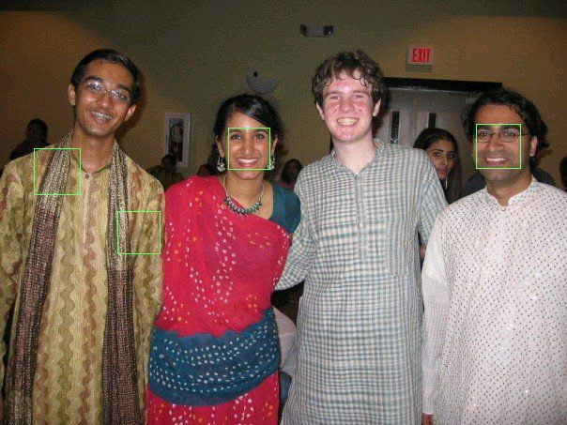
Eigenfaces: detection
Difficult to avoid false positives…
Top 4

Slide 33
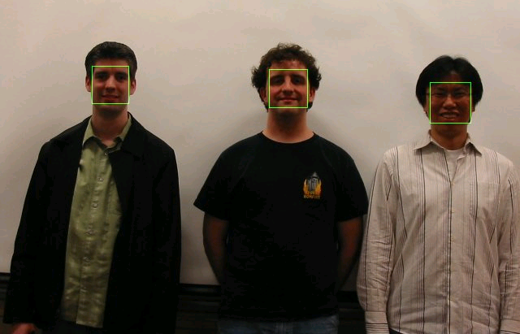
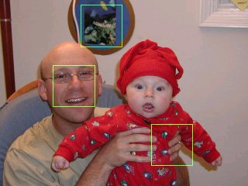
Eigenfaces: detection
Difficult to avoid false positives…
Top 3

Slide 34
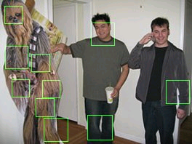
Eigenfaces: detection
Top few

Slide 35
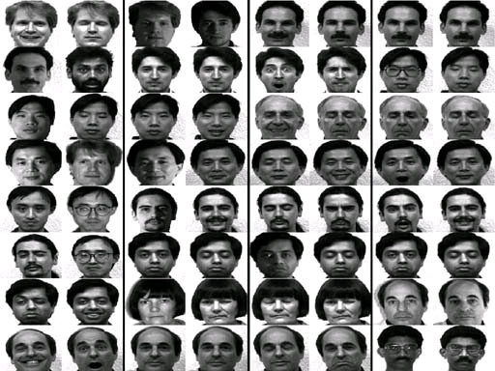
Eigenfaces: recognition (id)
32 test cases
Novel image on left; best-matching image on right
What image conditions does this technique not handle?

Slide 36
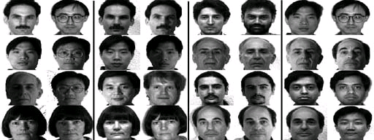
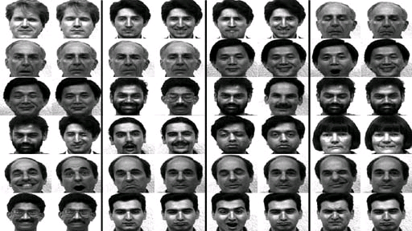
Eigenfaces: recognition (id)
Different lighting conditions
Different facial expressions
On which set do you think eigenfaces will perform better?

Slide 37
Eigenfaces: recognition (id)
Different lighting conditions
Different facial expressions
9/16 for lighting changes … 23/26 for expression changes

Slide 38
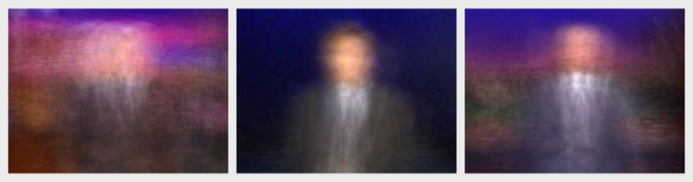
Jason Salavon: “The Late Night Triad”
Art via eigenfaces ~ commonalities by averaging data...
Detection ~ how well does a new image match?
Recognition ~ which previous person is this closest to?
http://www.salavon.com/

Slide 39
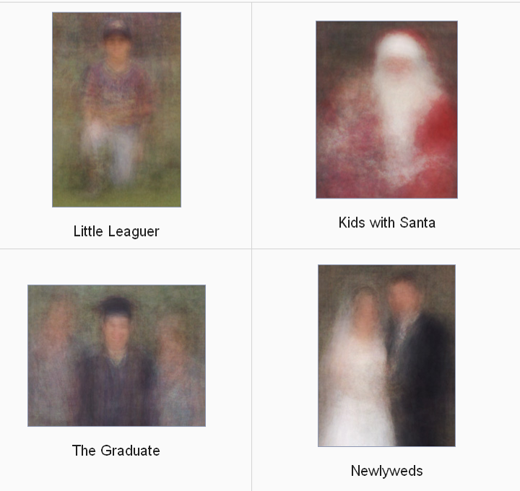
Jason Salavon: “100 Special Moments”

Slide 40
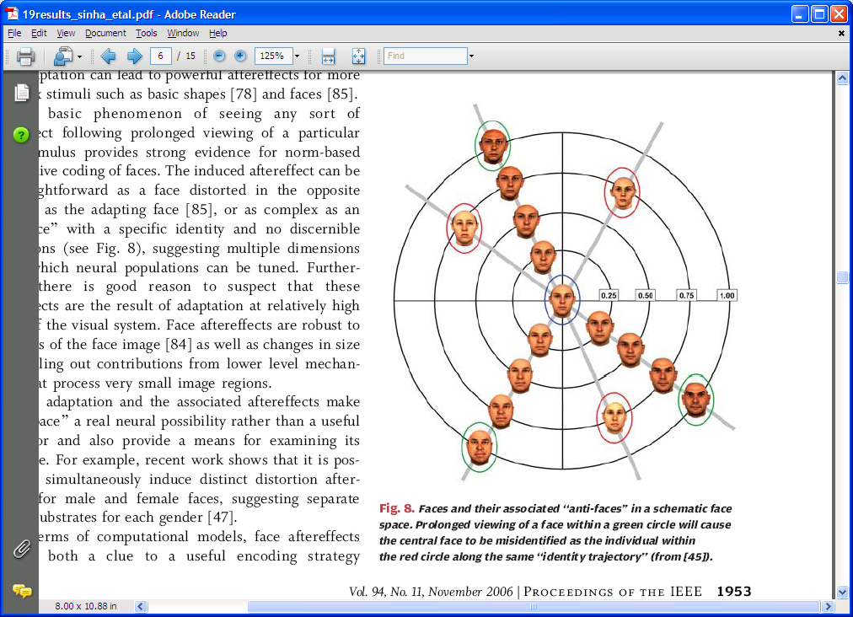
Humans do use face space
In fact, we go further… caricaturing to help with identification!
Notes:
Lincoln’s quote!
40

Slide 41
Manipulating face space ?
How can we make a face look more male/female, young/old, happy/sad, etc.?
Obtain the prototypes spanning the desired axis (gender, age, expression, etc.) and find the difference vector between them
Add scaled versions of this vector to a given image
"Old"
"Young"
Current face
D. Rowland and D. Perrett, “Manipulating Facial Appearance through Shape and Color,”

Slide 42
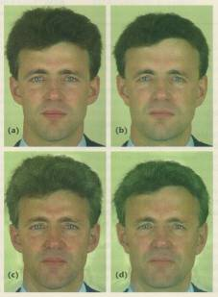
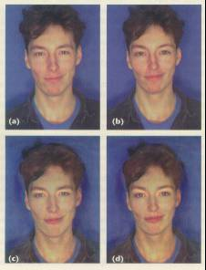
What's changing?
axis 1
older
axis 1
feminine
axis 2
axis 2
older
feminine
Red: original image

Slide 43
What's changing?
shape
older
shape
feminine
coloring
coloring
older
feminine
Red: original image

Slide 44
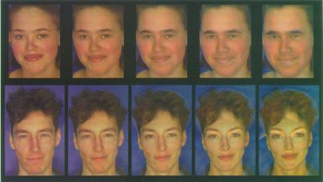
More results...
both shape and color are varying...
originals
more like original
less like original
Artifacts from using whole faces!

Slide 45

Parts!
Vector of normalized landmark coordinates (inter-landmark distances)
Slide credit: A. Efros

Slide 46


Parts clearly matter…

Slide 47

Parts clearly matter…

Slide 48

Parts clearly matter…
http://www.youtube.com/watch?v=m56F4EKN9hg

Slide 49

Some parts are more equal than others
The eyebrows turn out to be more important than the eyes…

Slide 50
Some parts are more equal than others
Nixon
Winona Ryder
The eyebrows turn out to be more important than the eyes…

Slide 51
Robust real-time face detection
by computers…
Paul A. Viola and Michael J. Jones
Intl. J. Computer Vision
57(2), 137–154, 2004
Learn which “parts” are most important…

Slide 52


Face features
face ~ simple parts
24x24
each box filter is present or absent
gray regions are subtracted (after summing)
white regions are added (after summing)
“Rectangle filters”
also: "Haar wavelets"
Differences between sums of pixels in adjacent rectangles
Simple thresholding

Slide 53

Huge library of “parts”
“rectangle filters” ~ differences of region intensities
24x24
How huge?

Slide 54


Integral images!
Upper-left partial sums
Computed for each image pixel

Slide 55
Integral images!
Upper-left partial sums
Computed for each image pixel
How could you compute the sum of the pixels in rectangle D?

Slide 56

Classifier learned from Labeled Data
Training Data
5000 faces
All frontal
10⁸ non faces
Faces are normalized
Scale, translation
Many variations
Across individuals
Illumination
Pose (rotation both in plane and out)
Notes:
56
This situation with negative examples is actually quite common… where negative examples are free.

Slide 57
AdaBoost algorithm
For each round of boosting: (AdaBoost)
Evaluate each rectangle filter on each example
Sort examples by filter values
Select best threshold for each filter (min error)
Use sorting to quickly scan for optimal threshold
Select best filter/threshold combination
Weight is a simple function of error rate
Reweight examples
(There are many tricks to make this more efficient.)

Slide 58
AdaBoost
Weak
Classifier 1
(0) Initialize the training data so that all of it has equal weight.
(1) Choose the best single feature among many possibilities – none of which may be particularly accurate.
Weights
Increased
Weak
Classifier 2
(2) Reweight the training examples (so that the next iteration will find a different weak classifier). Go to 1.
Weak
classifier 3
(3) The final, strong classifier is majority vote of the weak classifiers so chosen.
Final classifier is
linear combination of weak classifiers

Slide 59

Viola and Jones: Results
How is searching over many scales simplified?

Slide 60

Robustness…
Speed
0.7 seconds for a 384 x 288 pixel image
Receiver – operating curve for best 200 features
shows true positive vs. false positive rate

Slide 61

First two filters
First classifier:
2 features
100% detection
40% false detection

Slide 62
Key Properties of Face Detection
Eigenfaces don't take advantage of this...
Each image contains 10 - 50 thousand locs/scales
Faces are rare: 0 - 50 per image
1000 times as many non-faces as faces
Extremely small # of false positives: 10⁻⁶
Notes:
62
As I said earlier the classifier is evaluated 50,000
Faces are quite rare…. Perhaps 1 or 2 faces per image
A reasonable goal is to make the false positive rate less than the true positive rate...

Slide 63



Trading speed for accuracy
Cascade the classifiers ~ “decision tree”
nested tests for “faceness”

Slide 64
First two filters
First classifier:
2 features
100% detection
40% false detection
The whole cascade:
38 stages
6000 features in total
On dataset with 507 faces and 75 millions sub-windows, faces are detected using 10 feature evaluations on average.
On average, 10 feature evals/sub-window

Slide 65

Results?
Receiver – operating curve comparison

Slide 66
Speed of face detector (in 2001!)
Speed is proportional to the average number of features computed per sub-window.
On the MIT+CMU test set, an average of 9 features (/ 6061) are computed per sub-window.
On a 700 Mhz Pentium III, a 384x288 pixel image takes about 0.067 seconds to process (15 fps).
Roughly 15 times faster than Rowley-Baluja-Kanade and 600 times faster than Schneiderman-Kanade.
Weeks of training time…

Slide 67


Applications!
Smart cameras
Safety
auto focus,
red eye removal,
auto color correction
Lexus LS600 Driver Monitor System
smile!
Others?

Slide 68



Anonymization!
A Google maps' image over Chad
Opportunity!?
Notes:
opportunity: sell spots to actors!

Slide 69

Face replacement
Nayar et al. Columbia University, 2008
May be able to improve on blurring faces...

Slide 70
Face replacement
by replacing faces from a library of options...
Recognize either of these actors?

Slide 71
Face replacement
Gweneth Paltrow
Denzel Washington

Slide 72
First, create a large library...
Download images from the Internet and process them using a face detector
Approximately 33,000 faces found
Detector returns face pose (yaw, pitch, roll) and six fiducial points
Sort faces according to yaw and pitch angles, and align to a common coordinate system using fiducial points

Slide 73
Algorithm
Detect faces in new image, estimate their pose angles and fiducial points
Matching criteria:
Pose: yaw and pitch angles
Resolution: inter-eye distance (at least 80% of original)
Blur: histogram of gradient magnitudes in the eye region
Seam signature: ribbon of pixels within a small radius of the replacement boundary (resampled, intensity normalized)
Adjustments made:
Roll: the angle of the face relative to the camera plane
Lighting and Color: approximate the face by a cylinder, estimate face brightness and coefficients for a specified illumination basis
Retrieval performance
=> Less than 1 sec to generate a list of 50 (good) candidate replacements out of 35,000 faces

Slide 74
Algorithm, visualized

Slide 75
How well does it work?
Try it out…
Which of the two images is the original?

Slide 76





Which of these are real?

Slide 78
Face replacement results

Slide 79
Image de-Identification
Original
Notes:
Here is another example… The input image..

Slide 80

Image de-Identification
Replaced
Notes:
And the result of face de-identification

Slide 81



Limitations: Gender
Input
Candidate
Output
Notes:
Since our system does not currently enforce consistency for gender, it is possible for a female face to be replaced with a male one.

Slide 82

Limitations: Occlusion
Input
Candidate
Output
Notes:
Occlusion presents a significant problem to the current implementation of our system.
In this example, the input image is occluded by a hand which causes strong artifact in the result.

Slide 83

User study
50 face images, 12 subjects, 5 seconds per image

Slide 84

Modeling changes to individual features...
many data sources
scale

Slide 85

Modeling changes to individual features...
many data sources?

Slide 86

Modeling changes to individual features...
many data sources~
different paths through facial appearance space
unnormalized likelihoods
UCLA 2008

Slide 87
Summary (Viola-Jones)
Fastest known face detector for gray images
Three contributions with broad applicability:
Cascaded classifier yields rapid classification
AdaBoost as an extremely efficient feature selector
Rectangle Features + Integral Image can be used for rapid image analysis
Possible final project? implementing, evaluating, and/or using AdaBoost Cascade
Better face detectors have subsequently emerged…

Slide 88




Other algorithms have gone further…
Viola & Jones
Schneiderman Kanade

Slide 89

Happy face!
Notes:
89

Slide 90

Still not perfect…

Slide 91
Dimensionality reduction
How can we find the data’s natural coordinate system?
v1 and v2 instead of x and y
Dimensionality reduction
We can represent the orange points with only their v₁ coordinates (since v₂ coordinates are all essentially 0)
This makes it much cheaper to store and compare points
A bigger deal for higher dimensional problems

Slide 92

Principal component analysis
Suppose each data point is N-dimensional
What directions maximize variance?
Solution: the eigenvectors of the variance matrix A
eigenvector with largest eigenvalue captures the most variation among training vectors x
eigenvector with smallest eigenvalue has least variation
We can use only the top few eigenvectors
corresponds to choosing a “linear subspace”
represent points on a line, plane, or “hyper-plane”
these eigenvectors are known as the principal components

