Slide 1
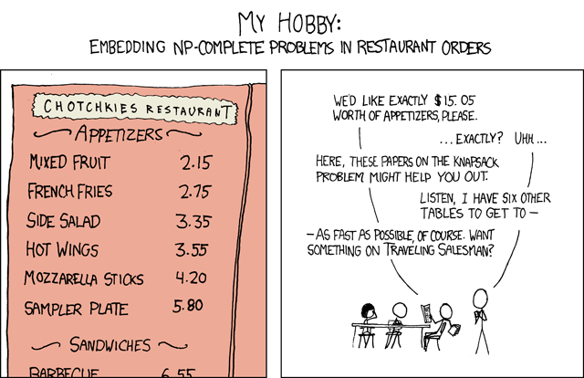
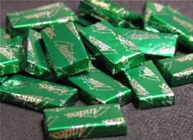
Another "Flexing out" application!
Go green!

Slide 2
There is a SpaMonster! Oh no!
______________________
/SPAMSPAMSPAMSPAMSPAMSPAM
/SPAMSPAMSPAMSPAMSPAMSPAMSP
/SPAMSPAMSPAMSPAMSPAMSPAMSPAM
/SPAMSPAMSPAMSPAMSPAMSPAMSPAMSP
|SPAMSPAMSPAMSPAMSPAMSPAMSPAMSPAM|
|SPAMSPA/ SPAMSPAMSPAM/ SPAMSPA|
|SPAMSP/ SPAMSPAMSP/ SPAMSP|
|SPAMS( O )SPAMSPAM( O )SPAMS|
|SPAMSP /SPAMSPAMSP /SPAMSP|
|SPAMSPA _/SPAMSPAMSPAM _/SPAMSPA|
|SPAMSPAMSPAMSPAMSPAMSPAMSPAMSPAM|
|SPAMSPAMSPAMSPAMSPAMSPAMSPAMSPAM|
|SPAMSPAMSPSPAMSPAMSPAMSPAMSPAMSP|
|SPAMSPAMS/ SPAMSPAMSP|
|SPAMSPAM/ SPAMSPAMS|
|SPAMSPA| |SPAMSPAM|
|SPAMSPA| |SPAMSPAM|
|SPAMSPA|_______________|SPAMSPAM|
|SPAMSPAMSPAMSPAMSPAMSPAMSPAMSPAM|
|SPAMSPAMSPAMSPAMSPAMSPAMSPAMSPAM|
|SPAMSPAMSPAMSPAMSPAMSPAMSPAMSPAM|
|SPAMSPAMSPAMSPAMSPAMSPAMSPAMSPAM|
|SPAMSPAMSPAMSPAMSPAMSPAMSPAMSPAM|
|SPAMSPAMSPAMSPAMSPAMSPAMSPAMSPAM|
|SPAMSPAMSPAMSPAMSPAMSPAMSPAMSPAM|
|S/ PA/ MS/ PA/ MS/ PA/ MS/ PA/ M|
|/ S/ P/ A/ M/ S/ P/ A/ M|
CS 60 ~ the end of a spamventure
An end to spam? I don't believe it!
write('Your Alakazam used Psychic! It was super effective against Brunos Hitmonlee! His mind was blown...'), nl,
write('I think its time to give this alakazam a rest...get another Pokemon to replace him!'), nl, nl,
write('Youve won! Proceed north to go to the next stage...'), retract(thing_at(alakazam, in_hand)).
This is a game based upon trying to complete your thesis before the end
of the year. There is kind of a solution which is to perform all the
experiments before time runs out (a.k.a. before you have visited Poon's
lab 20 times). You will need to collect items from different places and
take them to the appropriate lab to perform the experiment. Most
experiments require older_rats to be able to perform them. You will
become more and more tired and frustrated at time goes on (either cause
this take a while to grade (sorry :( )or because you can empathize with
your character). There will not always be the suplies you need when you
need them. Rats need time to grow up.
Note: I had a freak accident in lab last year that cuased me to sprout
infinite arms. So I can carry everything! yay!!!
Solution:
south.
take(older_rats).
northwest.
take(pcr).
north.
use(pcr).
south.
(removing 20 steps...)
southwest.
use(western).
east.
take(older_rats).
northwest.
take(qpcr_plate).
...And i'm not even sure you can get all the experients done, but I need
to work on my thesis instead of worrying about it. So if you could
figure out how I'm supposed to RUN ALL THESE WRITE AND RUN EVERYTHING
BEFORE THE END OF THE MONTH, that'd be most helpfull!
describeRead(start) :-
write('Instead of following the wild bunny down the rabbit hole, you decide to read your book.'), nl,
write('The day passes as you sit beneath the tree, absorbed by Alice\'s Adventures in Wonderland.'), nl,
nl,
write('\'Thus grew the tale of Wonderland:'), nl, % note: this is a quote from Alice and Wonderland
write('Thus slowly, one by one,'), nl,
write('Its quaint events were hammered out-'), nl,
write('And now the tale is done,'), nl,
write('And home we steer, a merry crew,'), nl,
write('Beneath the setting sun.\''),nl,
nl,
write('When the sun has finally set, your return to your dorm, and that day of peace and freedom is complete.'), nl,
write('You return to work as usual, eventually graduate, and get the job you always expected.'), nl,
write('Life proceeds, and nothing all that exciting happens.'), nl,
write('A promotion, a family, whatever it was you expected to happen does.'), nl,
write('There are no surprises, just life.'), nl,
write('You die at a reasonably old age, content with what you have done, however uninteresting it may have been.'), nl, nl,
write('The end.'), nl,
write('You are now exiting the game...'), nl, nl,
quit.
42 rooms... 107 steps to solve... 1708 lines!

Slide 3
Final Exam ~ notes
Tuesday, 5/10 at 2:00 pm
3-hour exam on
You may take either one…
Wednesday, 5/11 at 2:00 pm
Worth ~ 2.5 hw assignments
On the semester’s material, with an attempt at bridging different topics.
You may use two double-sided pages of notes (similar to before)…
Exam topics are available on the CS 60 website.
A practice exam is available on the CS 60 website, as well.
There will be a review session on Monday, 5/9 at 7:00 pm (in Pryne)
(first 45-60 minutes) going over practice exam
(before, during, after that) questions and answers
Notes:
extra credit for joining the spring cs talks…

Slide 4
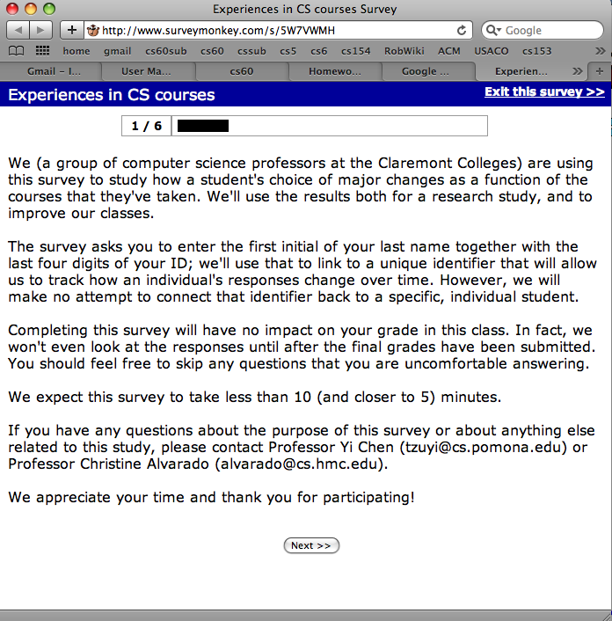
Extra credit this week
survey linked from the bottom of this week's assignment, under Extra Credit
Online Survey…
there are extra credit possibilities next week, as well...

Slide 5
The End of CS (60)
CS
useful
creative
CS

Slide 6
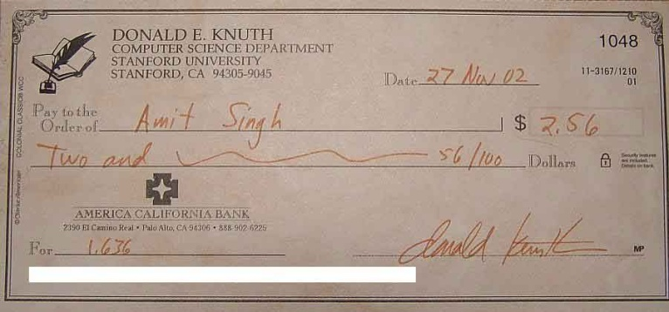


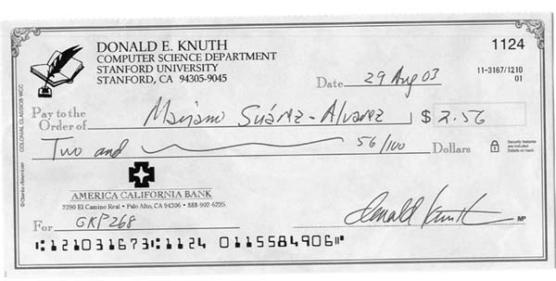
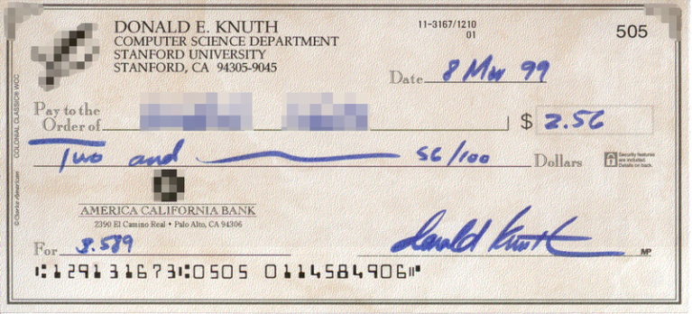
the person, not the server
Knuth
Ziegler's Candy, Milwaukee, WI
various priorities for anonymizing these…
Don K, candy afficionado, working on an IBM 650
This week's charge:
Do less!
the art and science of designing fast algorithms
Notes:
crazy Hanoi stuff!
http://www.kernelthread.com/hanoi/

Slide 7
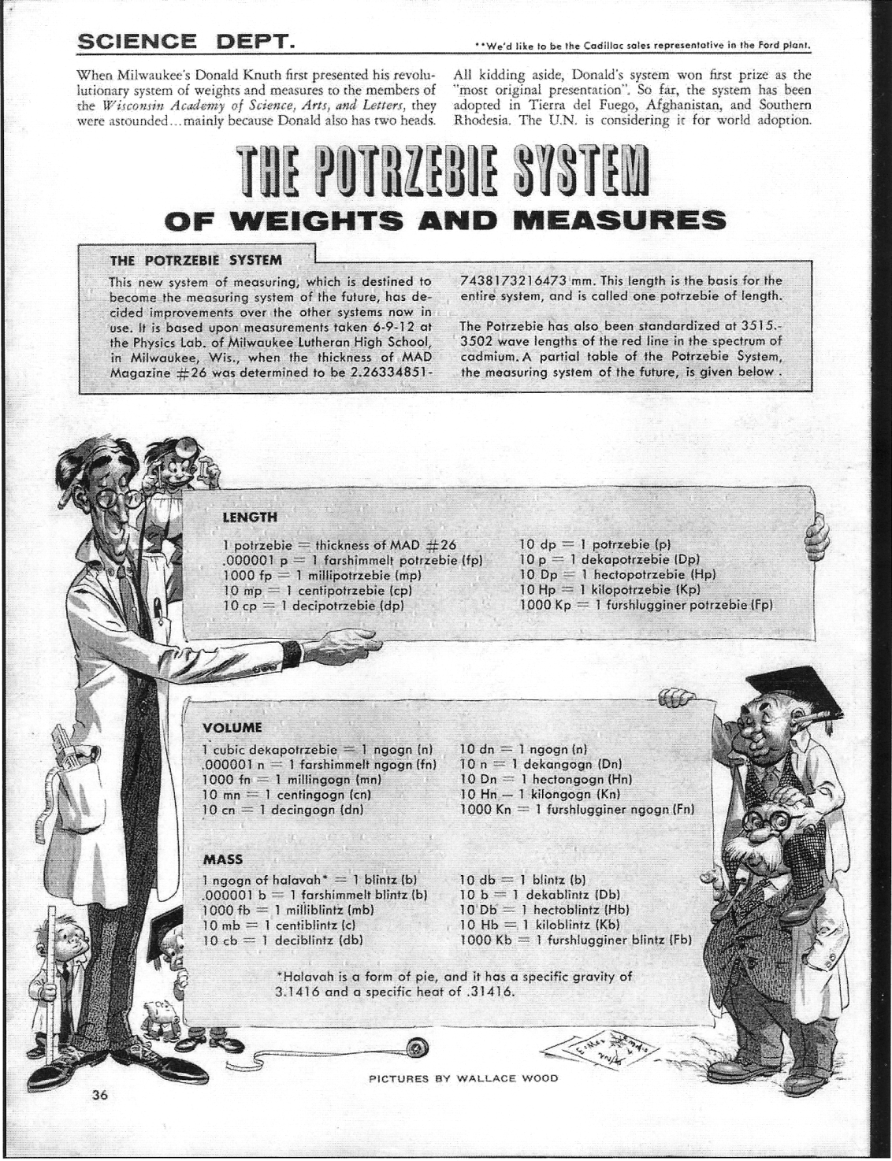
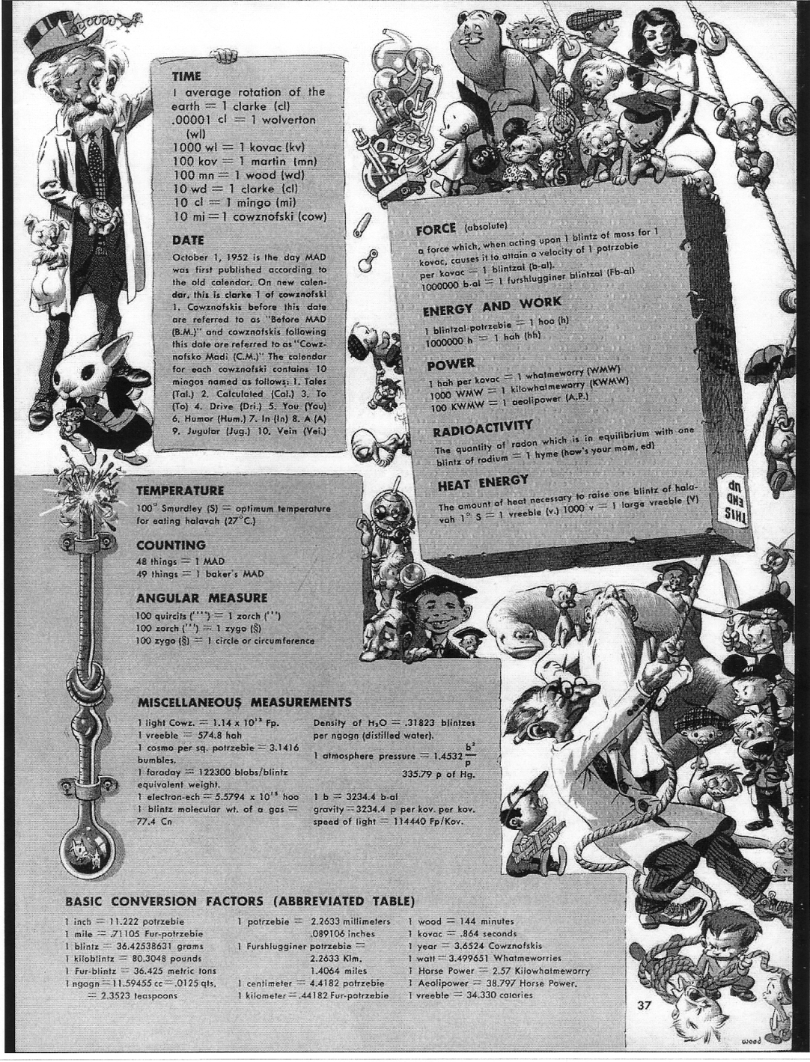
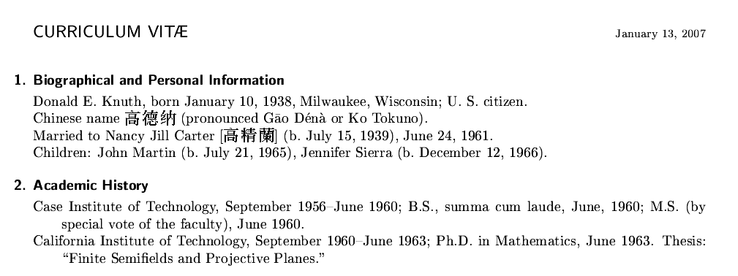
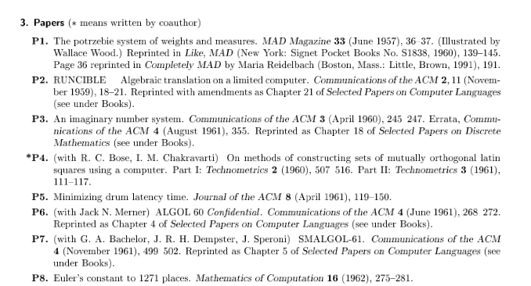

Slide 8
Spring break... ?

Slide 9

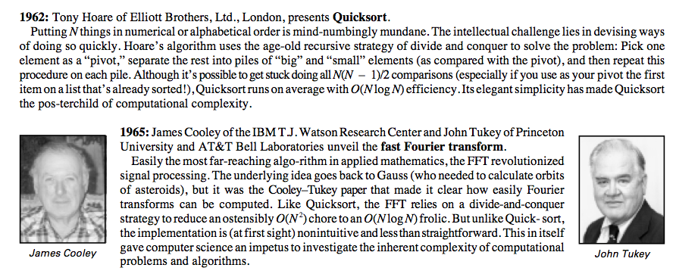
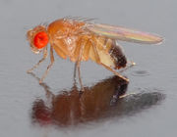
Sorting out Big-O?
The drosophila of computer science…

Slide 10

Quicksort
“Divide and Conquer”
List of length N
Quick Sort
3
4
6
2
0
1
3
7
partition and swap
1
0
2
6
4
3
3
7
1
0
2
6
4
3
3
7
split
0
1
2
3
3
4
6
7
...
worst-case?
best-case?
Notes:
IN-PLACE sorting!

Slide 11
Fast sorting
Mergesort
7
4
3
2
1
5
0
6
7
4
3
2
1
5
0
6
2 calls to merge sort
magic!
2
3
4
7
0
1
5
6
0
1
2
3
4
5
6
7
Big-O running time?
Can we do better?

Slide 12
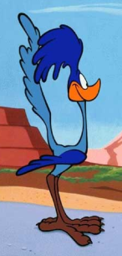

Comparison sorting is at best O(N log(N))
Start with all of the permutations of an n-element list.
[e₁, e₂, e₃, ... , e_{n}]
The Algorithm -- asks questions comparing two elements
[4,1,5,3,2]
[4,5,3,1,2]
[3,1,4,5,2]
[2,4,1,5,3]
[1,2,3,4,5]
[5,4,3,1,2]
Sorting is equivalent to determining which of the permutations we started with…
yes
?
no
e1 < e2
[1,2,3,4,5]
[4,1,5,3,2]
[4,5,3,1,2]
[5,4,3,1,2]
[2,4,1,5,3]
[3,1,4,5,2]
The Adversary -- gives yes or no answers to each question
Adversary Argument

Slide 13


Strategies for algorithm design
Brute Force -- always consider it first!
More than just the computer’s time is valuable!
Divide and Conquer
Recursion & "use-it-or-lose-it"
Root out repeated work!
Look-up tables
Dynamic programming
The center of the CS universe!

Slide 14
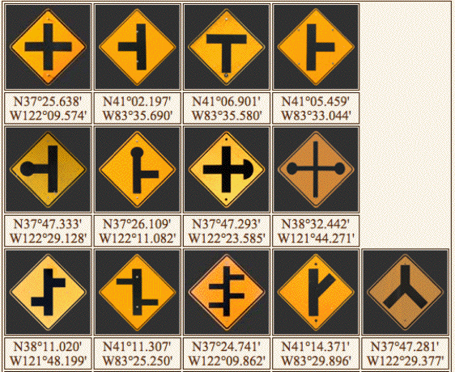
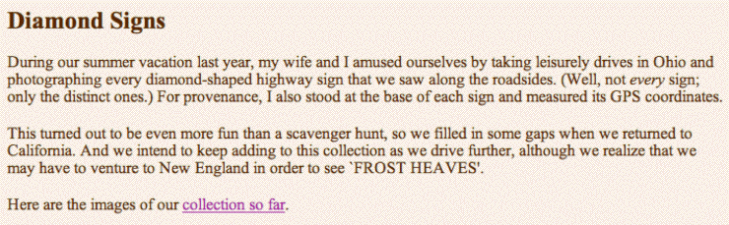
Donald Knuth
www-cs-faculty.stanford.edu/~knuth
Slightly eccentric perfectionist + Fan of road signs =
my favorites…

Slide 15

Donald Knuth
www-cs-faculty.stanford.edu/~knuth
Slightly eccentric perfectionist + Fan of road signs =

Slide 16

Donald Knuth
www-cs-faculty.stanford.edu/~knuth
Slightly eccentric perfectionist + Fan of road signs =

Slide 17
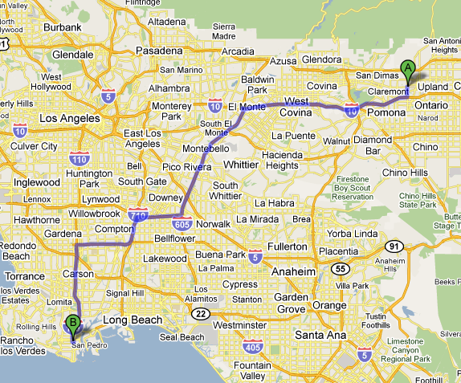
All-pairs shortest paths?
Suppose we'd like the shortest route from any city to any other.
A directed graph:
100
2
14
1
50
14
10
4
3
"shortest"?
14
didn’t we solve this already?

Slide 18
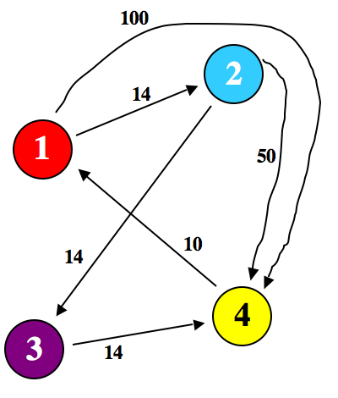
Last time...
to dst
considering paths of length 1..k
use another vertex v?
from src
sP[src][v][k-1] + sP[v][dst][1]
for all v
length of shortest path
sP[src][dst][k] = min
sP[src][dst][k-1]
or don't!
What was the big-O running time of this algorithm?

Slide 19
Even shorter shortest paths…
to dst
using only intermediate nodes 1..k
use vertex k?
from src
sP[src][k][k-1] + sP[k][dst][k-1]
only one k!
length of shortest path
sP[src][dst][k] = min
sP[src][dst][k-1]
or don't!
Consider interim paths only through vertices 1..k
Floyd-Warshall algorithm
Is this O(k)?
big-O ?

Slide 20
Level 0: no intermediates
just the edges
Directed graph as adjacency matrix:
dst
"to"
100
1
2
3
4
2
0
14
inf
100
14
1
1
50
2
inf
0
14
50
src
14
10
"from"
inf
inf
0
14
3
4
3
4
10
inf
inf
0
14
no intermediate nodes

Slide 21
Level 1: using vertex 1
Using vertex 1, which src, dst pair has an even shorter path?
and how do we find it?
dst
"to"
100
1
2
3
4
2
14
1
0
14
inf
100
1
50
2
inf
0
14
50
src
10
14
"from"
inf
inf
0
14
3
4
3
14
4
10
inf
inf
0
no intermediate nodes
What if cities weren't reachable from themselves?
intermediate node #1 ?

Slide 22
Floyd-Warshall algorithm
Make sure you see how to use to get !
dst
dst
"to"
"to"
1
2
3
4
1
2
3
4
1
0
14
inf
100
1
0
14
inf
100
2
inf
0
14
50
2
inf
0
14
50
src
"from"
inf
inf
0
14
inf
inf
0
14
3
3
10
inf
inf
0
10
24
inf
0
4
4
24
0 intermediate nodes
1 intermediate node(s)
1

Slide 23
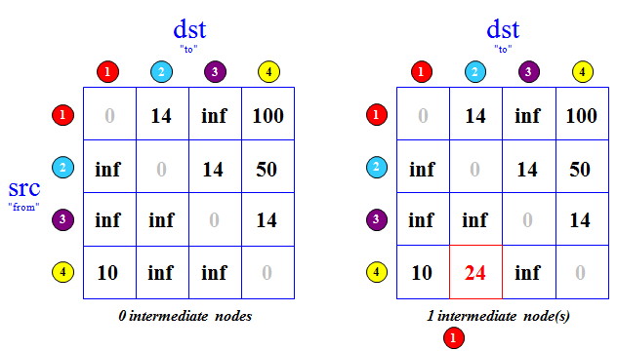
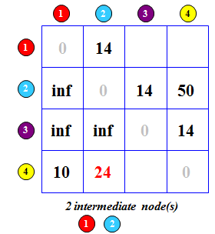
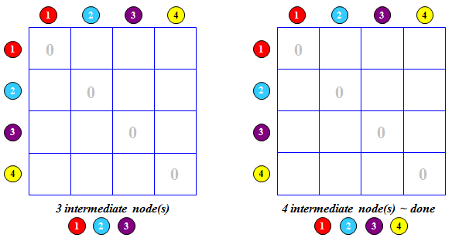
(1) Fill in the 3 layers of the dynamic programming table below.
Floyd-Warshall "Quiz"
- Each cell gets the min dist. from src to dst through 1..k
- Which cells change with each additional vertex?
(2) How could you output the shortest PATH itself
Don't hand this in!

Slide 24
Floyd-Warshall!
dst
dst
"to"
"to"
1
2
3
4
1
2
3
4
0
14
inf
100
0
14
inf
64
1
1
28
64
2
inf
0
14
50
2
inf
0
14
50
src
"from"
inf
inf
0
14
inf
inf
0
14
3
3
24
10
24
38
4
10
inf
0
4
inf
0
1 intermediate node(s)
2 intermediate node(s)
1
1
2
3? 4?

Slide 25
From 2 to 3...
dst
dst
"to"
"to"
1
2
3
4
1
2
3
4
0
14
inf
64
1
28
64
1
0
14
28
42
2
inf
0
14
50
2
inf
0
14
28
src
"from"
inf
inf
0
14
inf
inf
0
14
3
3
10
24
38
4
inf
0
4
10
24
38
0
2 intermediate node(s)
3 intermediate node(s)
1
2
1
2
3

Slide 26
Floyd-Warshall
All-pairs shortest paths!
... and what about those paths?
dst
dst
"to"
"to"
1
2
3
4
1
2
3
4
1
0
14
28
42
1
0
14
28
42
2
inf
0
14
28
2
38
0
14
28
src
"from"
inf
inf
0
14
24
38
0
14
3
3
4
10
24
38
0
4
10
24
38
0
3 intermediate node(s)
4 intermediate node(s) ~ done
1
2
3
1
2
3
4

Slide 27
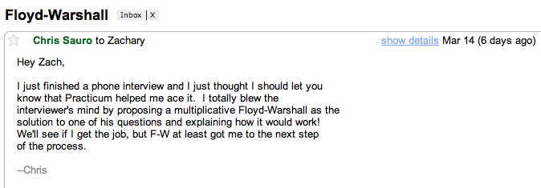
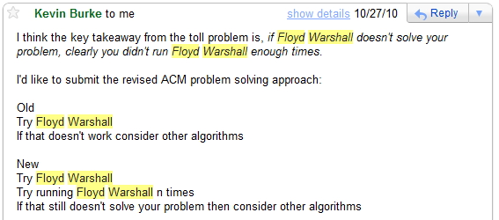
Good news regarding FW...
Kevin's recommendation...

Slide 28
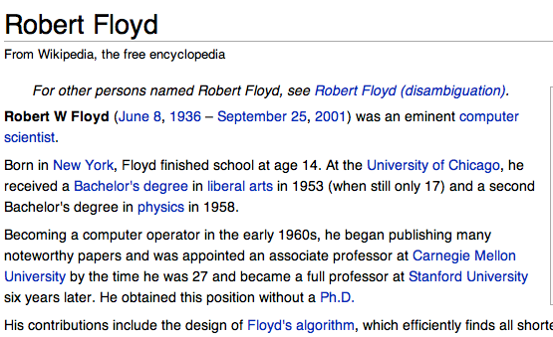
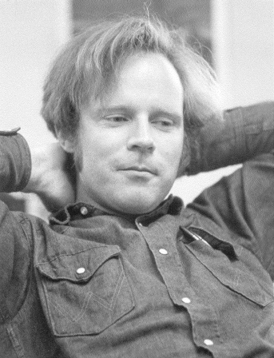
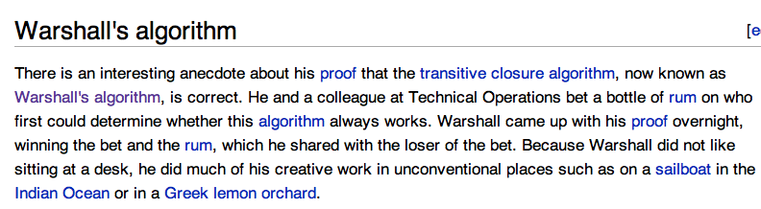
Floyd-Warshall algorithm
Even Better?
Stephen Warshall

Slide 29
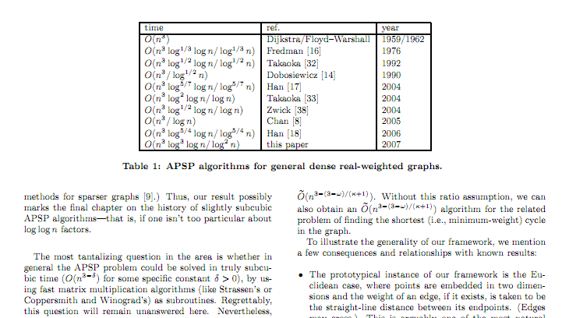
Floyd-Warshall algorithm
Knuth would be proud...
Stephen Warshall

Slide 30

Floyd-Warshall algorithm
Knuth would be proud...
Stephen Warshall

Slide 31
The End of CS (60)
CS
useful
creative
Any examples that don't involve wagers on a bottle of rum?
CS

Slide 32
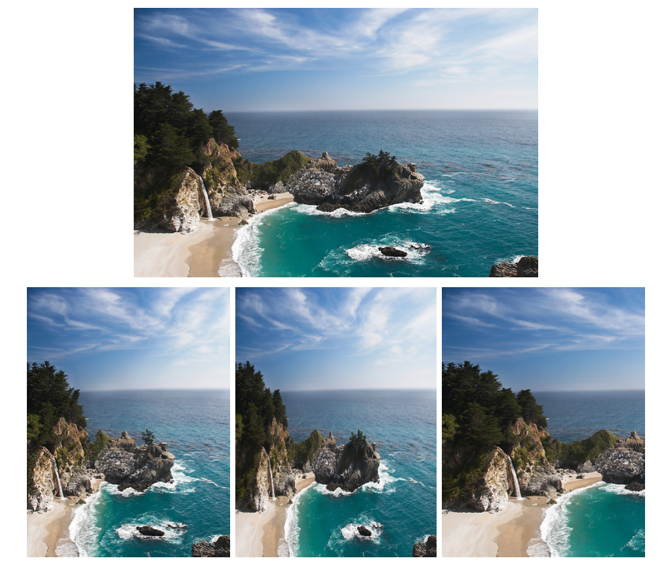
Creative CS (and DP!)
original image
?
device size
The problem

Slide 33
original image
What's happened in each case?
Three possible solutions…

Slide 34
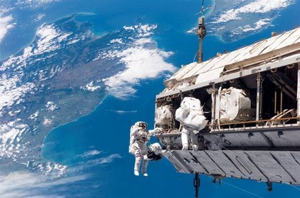
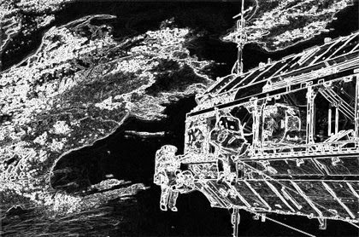

Algorithm?
Consider the steps in choosing the best seam to carve:
Original
Seam ?
Step 2
Step 3 ?

Slide 35
Algorithm?
Consider the steps in choosing the best seam to carve:
Original
Seam
Step 2
Step 3
DP table!
"SHORTEST PATH!"

Slide 36
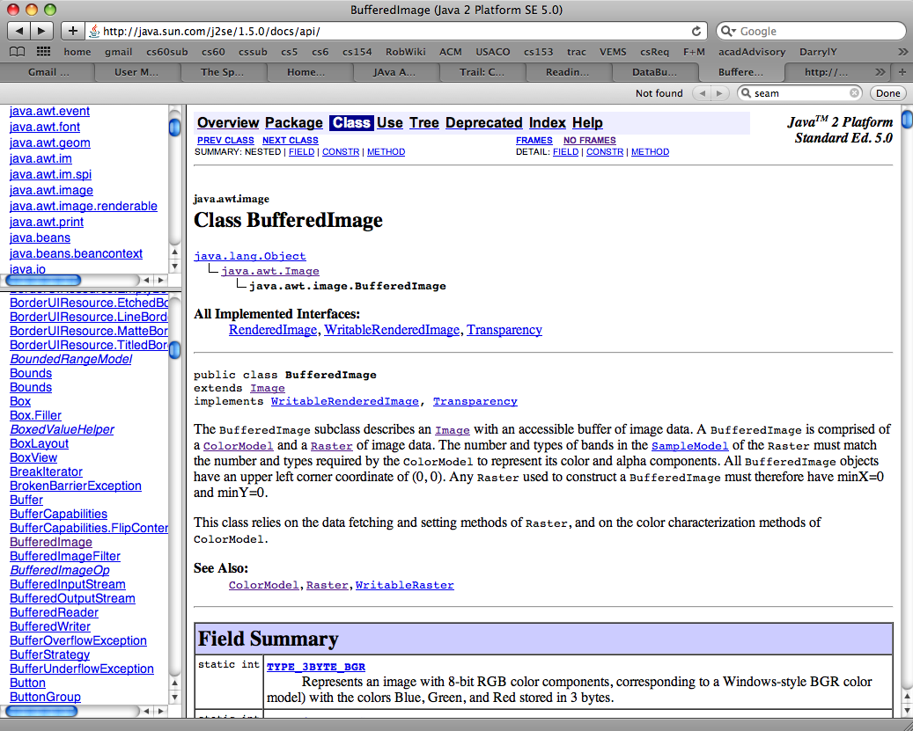
Extra-credit (in Java)

Slide 37

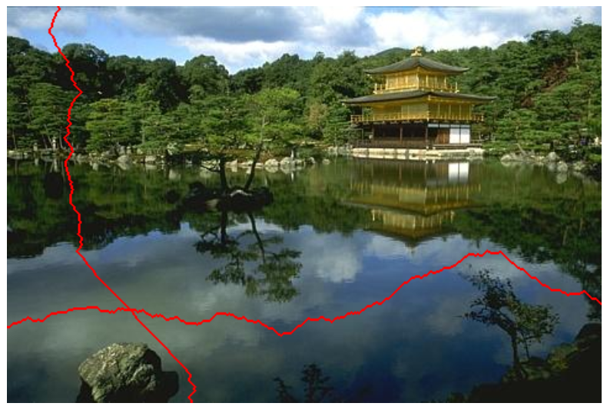
2007 !
seams
original image
you're encouraged to use the original paper as a guide...

Slide 38
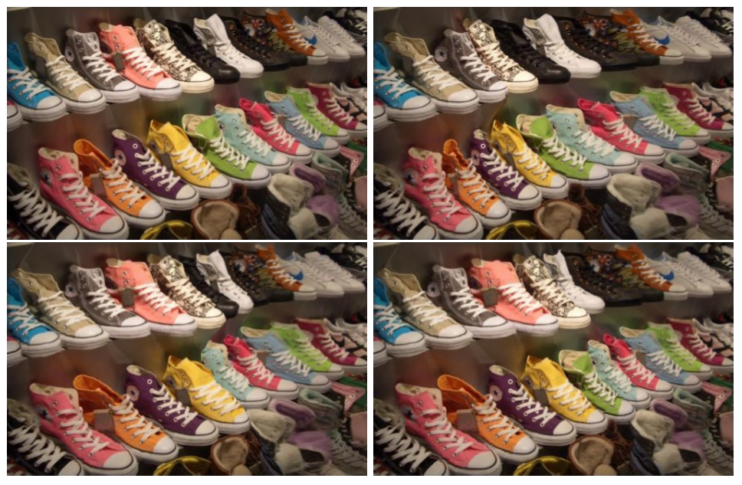
Applications: Lost a shoe?

Slide 39
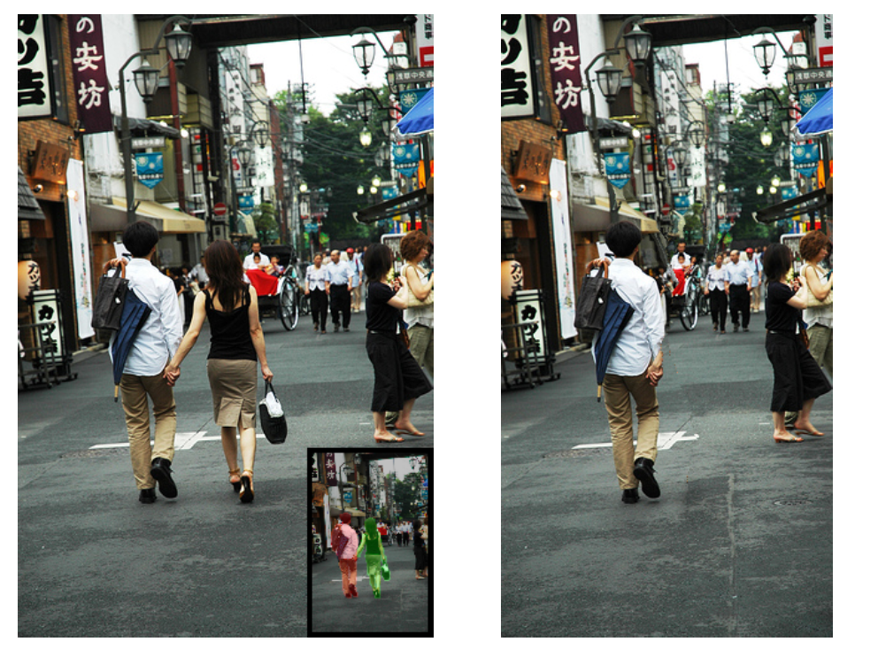
Memory is malleable, 2011 version
pixels to conserve (very high energy)
pixels to remove (very low energy)

Slide 40
Memory is malleable, 2011 version
Look, ma! One hand!
I was alone on that trip…

Slide 41
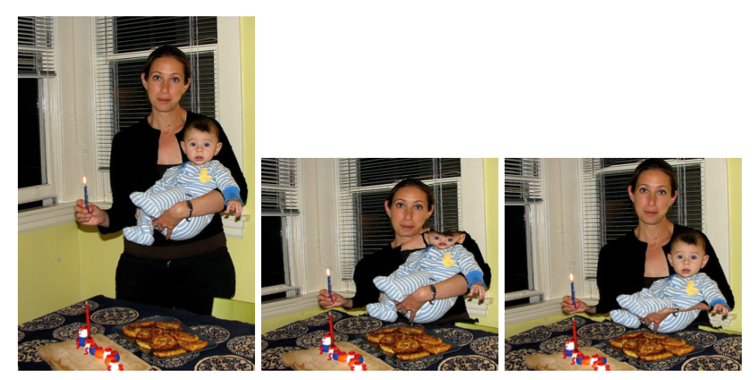
Not perfect…
Straightforward seam carving does not always work!
Target size
What's conspiring against the algorithm here?

Slide 42
Problems?
Straightforward seam carving does not always work!
What's conspiring against the algorithm here?

Slide 43
Not the face!
Protecting the results from a face-detector makes a huge difference…
What's been lost instead?
Shai Avidan was quickly hired by Adobe…

Slide 44
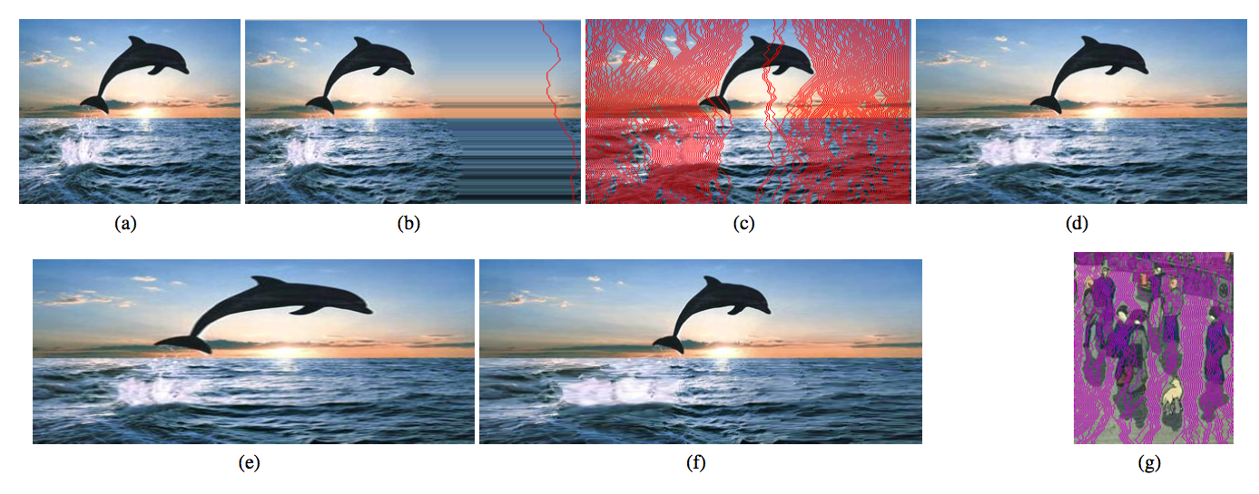
Expanding the image?
This has pushed me over the edge!
Why will seam-carving-based expansion cause a problem?
original image

Slide 45
Expanding the image?
original image
best-seam expansion

Slide 46
Expanding the image?
original image
best-seam (least-energy) expansion
The best 50% of seams used for more uniform expansion

Slide 47
Expanding the image?
200% of original (scaling)
200% of original (seam-insertion)

Slide 48
The one-semester CS major:
CS 60
CS 70 : C++ & data structures
CS 81 : Logic for CS
CS105 : Systems
CS121 : LSD
CS131 : Prog. Languages
CS140 : Algorithms
CS142 : Theory
CS151 : Artificial Intelligence
CS132 : Compilers
CS155 : Graphics
Java / Object-Or. programming
Lists, Stacks, Queues, Deques
BFS + DFS: graphs and trees
Spampede, Inheritance
Racket and fun. programs
Parsing and Grammars
Prolog and Boolean Logic
Computability and TMs
DFAs, NFAs, and Reg. Exps
DP and Big-O analysis
REQUIRED
3 ELECTIVES
among many others...

Slide 49
The one-semester CS major:
CS 60
CS 70 : C++ & data structures
CS 81 : Logic for CS
CS105 : Systems
CS121 : LSD
CS131 : Prog. Languages
CS140 : Algorithms
CS142 : Theory
CS151 : Artificial Intelligence
CS132 : Compilers
CS155 : Graphics
Java / Object-Or. programming
Lists, Stacks, Queues, Deques
BFS + DFS: graphs and trees
Spampede, Inheritance
Racket and fun. programs
Parsing and Grammars
Prolog and Boolean Logic
Computability and TMs
DFAs, NFAs, and Reg. Exps
DP and Big-O analysis
REQUIRED
3 ELECTIVES
among many others...

Slide 50
The one-semester CS major:
CS 60
CS 70 : C++ & data structures
CS 81 : Logic for CS
CS105 : Systems
CS121 : LSD
CS131 : Prog. Languages
CS140 : Algorithms
CS142 : Theory
CS151 : Artificial Intelligence
CS132 : Compilers
CS155 : Graphics
Java / Object-Or. programming
Lists, Stacks, Queues, Deques
BFS + DFS: graphs and trees
Spampede, Inheritance
Racket and fun. programs
Parsing and Grammars
Prolog and Boolean Logic
Computability and TMs
DFAs, NFAs, and Reg. Exps
DP and Big-O analysis
Enjoy CS!
REQUIRED
wherever you encounter it again...
3 ELECTIVES
among many others...

Slide 51
Future CS 60s ?
M-Z: Prof. Alvarado
A-L: Prof. Dodds
based on yesterday's coin flip...
In the survey's Optional Question 1 ... Optional Question 5
We're interested in your thoughts on a couple of CS-60 specific skills:
Optional Q1: CS60 increased my comfort with CS-style abstraction
Optional Q2: CS60 increased my ability to specify what a program should do -- and to establish its correctness
Optional Q3: CS60 increased my understanding of the types of problem that different programming languages are suited for
Optional Q4: CS 60 increased my comfort identifying data requirements and designing data representations to support a solution to a problem.
Optional Q5: Because of CS60, I am more confident in my ability to solve computational problems

Slide 52
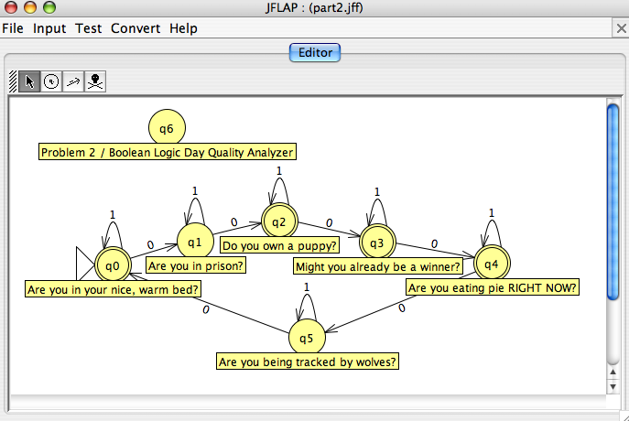
Creative approaches…

Slide 53
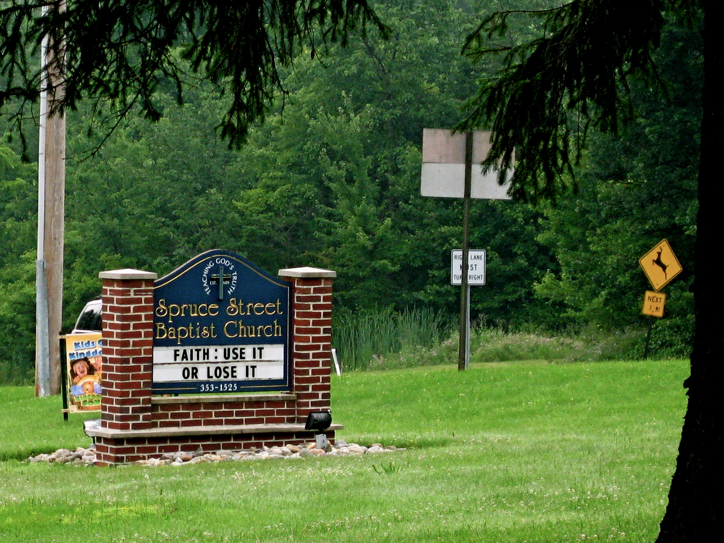
Notes:
Thanks to Allie Russell…

Slide 54
Floyd-Warshall
minimum distance from src to dst using intermediate nodes 1..k
dst
best[src][dst][k]
"to"
1
2
3
4
1
0
14
28
42
T[src][dst][k-1]
inf
2
inf
0
14
28
src
=
min
T[src][k][k-1] +
T[k][dst][k-1]
14 + 10
"from"
inf
inf
0
14
3
4
10
24
38
0
24
4 intermediate node(s)
1
2
3
4

Slide 55
Quicksort !
One Divide and Conquer technique
List of length N
Quick Sort
3
4
6
2
0
1
3
7
partition and swap
pivot
elements < pivot
elements >= pivot
goal: to swap the smaller half of the elements to the left and the larger half to the right
in-place sorting…

Slide 56
Quicksort
“Divide and Conquer”
List of length N
Quick Sort
3
4
6
2
0
1
3
7
partition and swap
1
0
2
6
4
3
3
7
1
0
2
6
4
3
3
7
split
0
1
2
3
3
4
6
7
...
worst-case?
best-case?
Notes:
IN-PLACE sorting!

Slide 57




Floyd-Warshall "Quiz"
Don't hand this in!
(1) Fill in the FW dynamic programming table below.
- Each cell gets the min dist. from src to dst through 1..k
- Which cells change with each additional vertex?
(2) How could you output the shortest PATH itself
- not only the length of the shortest path...
dst
1
2
"to"
3
4
1
0
14
inf
100
0
0
0
0
2
inf
0
14
50
0
0
0
0
3
inf
inf
0
14
0
0
0
0
4
10
inf
24
inf
0
src
0
0
0
0
intermediate nodes are the third dimension here.
"from"
arrows indicate copying an old value

