Slide 1
Beta

Slide 2

How is it going?
Survey next week …
But if you have issues about the beta come see me.

Slide 3
Your Goal stack for iteration 8!
We are not going to experiment with code swapping.
Beta

Slide 4
Your Goal stack for iteration 8!
Beta

Slide 5
Assignments Points to be given on submission for Tuesday 10-2: 350
Model due Thursday 9-20 100 pts
Alpha due Tuesday 9-25
Coding standards 10 pts
Walk through slides 10 pts
Alpha 80 pts
Unit tests due 9-27 50 pts
Walk through follow up 50 pts
Beta due 10/2 100 pts
Back end
Functionality, good design,
clean code
Front end
Functionality, good design, clean code
Supporting documentation: Use cases, UML, README, code standards, write up from code walkthrough, how you addressed the issues, and a critique of your beta.

Slide 6
Beta additions: 100 points required (You can earn a maximum of 130 points)
Grid generation: 100 points
Options worth 10 points each
Win/lose condition/message
Erase cell (immutable only)
Play again
Darken grid cell momentarily when selected
Flash X momentarily when player tries to place inconsistent number
Show/hide consistency check for current number
Show all invalid cells
Erase all invalid values
Show how many times a number needs to be placed
Juice
Super juice (class votes on points)
Other ideas (see me)

Slide 7
Grid Creation: Conceptually
Create solution
Depth-first search
Blank cells while maintaining validity
Randomly shuffle cells
Choose next cell to try to blank
Choose alternative values for cell
Check if there is a solution
If no, we can blank the cell
If yes, we can’t

Slide 8
DFS: It is all about the order
Cell i
Cell i=1
Cell i=9
Cell i=2
…
Cell
i+1
Cell
i+1
Cell
_{i+1}
Cell
_{i+1}
Cell
_{i+1}
Cell
_{i+1}
Cell
_{i+1}
Cell
_{i+1}
Cell
_{i+1}
Use fast consistency checking for each choice.
Choosing values randomly helps.

Slide 9
How to get credit 30 points for this part
Allow player to “show solution”
Allow player to “build new grid”
We’ll do this a few (hundred) times and check that solutions are valid & unique
We will also inspect your code for correctness
Very little partial credit given if it doesn’t work correctly

Slide 10
Grid Creation: Conceptually
Create solution
Depth-first search
Blank cells while maintaining validity
Randomly shuffle cells
Choose next cell to try to blank
Choose alternative values for cell
Check if there is a solution
If no, we can blank the cell
If yes, we can’t

Slide 11
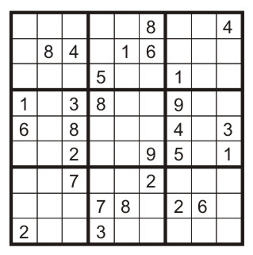
For every possible value other than 1, check if it is solvable
If not solvable for any other value: “blank” it
If solvable for any other value: don’t “blank” it
The current grid is valid.
Can we “blank” the 1 and still be valid?

Slide 12
NOT SOLVABLE
Check if solvable: First do consistency check on new value
2

Slide 13
Check if solvable: First do consistency check on new value
If consistent: try to solve
7

Slide 14
Check if solvable: First do consistency check on new value
If consistent: try to solve using heuristics
Is there a cell with only one consistent value?
Is there a row, column, or block that has only one possible location for a particular value?
If so fill it in.
3
7
9

Slide 15
3
7
6
Check if solvable: First do consistency check on new value
If consistent: try to solve using heuristics
Is there a cell with only one consistent value?
Is there a row, column, or block that has only one possible location for a particular value?
If so fill it in.
If inconsistency found it isn’t solvable.
7
3
2
4
3
7
8
5
2
4
7
6
9
1
5
7
2
4
7
6
3
8
8
3
4
1
5
5
1
5
8
7
No place for 3

Slide 16
Check if solvable: First do consistency check on new value
If consistent: try to solve using heuristics
Is there a cell with only one consistent value?
Is there a row, column, or block that has only one possible location for a particular value?
If so fill it in.
If inconsistency found it isn’t solvable.
If heuristics can’t find a cell we are certain about say it is solvable (i.e. can’t blank cell)
6
Consequence: grids have plenty of blanks but are easy to solve with simple heuristics. Could improve heuristics. (If you want to do this, see me about points.)

Slide 17
How to get 70 points for this part
Demo+
Convincing code walk through
(code must be clean!)
Or other method you deem appropriate
Very little partial credit given if it doesn’t work correctly (or we aren’t convinced).

Slide 18
Beta additions: 100 points, 130 points max
Grid generation: 100 points (very little partial credit)
Options worth 10 points each
Win/lose condition/message
Erase cell (immutable only)
Play again
Darken grid cell momentarily when selected
Flash X momentarily when player tries to place inconsistent number
Show/hide consistency check for current number
Show all invalid cells
Erase all invalid values
Show how many times a number needs to be placed
Juice
Super juice (class votes on points)
Other ideas (see me)

Slide 19
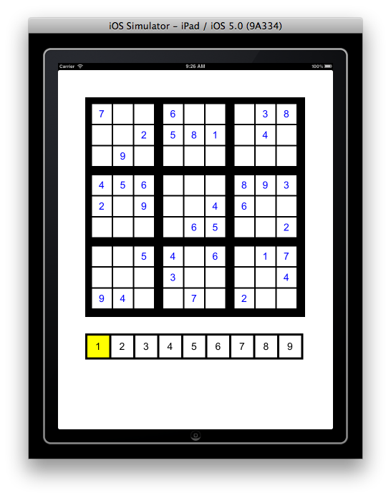
Congratulations! You win!
Player wins use case:
Win message appears

Slide 20
Sorry you lose!
Player loses use case:
No empty cell can be filled with consistent value
Lose message appears

Slide 21
Erase cell: Define your own use case but
It should be extremely difficult to erase a cell in error
The UI design should make clear on how to erase cell

Slide 22
Darken grid cell when selected:
Player selects empty grid cell
Cell darkens
After a moment cell returns to normal (with or without new value depending on consistency)
Note: If you use touchesEnded beware of touch ending on different cell than where it began.

Slide 23
Flash X when inconsistent:
For UI with select number then select grid cell approach:
Player selects empty grid cell for which current number is inconsistent
Cell turns red and an x appears.
A moment later it returns to normal
X

Slide 24
Flash X when inconsistent:
For UI with select cell then select number approach:
Player selects numpad cell that is inconsistent at current grid cell.
The number pad cell turns red with an x.
After a moment it returns to normal.
X

Slide 25
Show all consistent cells for current number:
Player taps Show Consistency button
Show consistency

Slide 26
Show all consistent cells for current number:
Player taps Show Consistency button
Inconsistent cells darken
Button label changes to Hide consistency
Hide consistency

Slide 27
Show all consistent cells for current number:
Player taps Show Consistency button
Inconsistent cells darken
Button label changes to Hide consistency
Hide consistency check:
1. Player taps Hide Consistency button
Hide consistency

Slide 28
Show all consistent cells for current number:
Player taps Show Consistency button
Inconsistent cells darken
Button label changes to Hide consistency
Hide consistency check:
Player taps Hide Consistency button
Grid returns to normal
Button label returns to normal
Show consistency

Slide 29
Show all invalid cells for current number:
Player taps Show Invalid button
9
Show invalid

Slide 30
Show invalid cells:
Player taps Show Invalid button
Invalid cells turn red
Button label changes to Hide Invalid
9
Hide invalid

Slide 31
Show invalid cells:
Player taps Show Invalid button
Invalid cells turn red
Button label changes to Hide Invalid
Hide invalid cells:
1. Player taps Hide Invalid button
9
Hide invalid

Slide 32
Show invalid cells:
Player taps Show Invalid button
Invalid cells turn red
Button label changes to Hide Invalid
Hide invalid cells:
Player taps Hide Invalid button
Grid returns to normal
Button label returns to normal
9
Show invalid

Slide 33
Erase invalid:
Player taps Erase Invalid button
Any invalid entries are eliminated
9
Erase invalid

Slide 34
Show how many times number needs to be placed:
9-# of times number appears is shown in/near numpad cell.
7 5 6 3 5 4 5 6 5

Slide 35
http://www.youtube.com/watch?v=Fy0aCDmgnxg

Slide 36
Beta additions: 100 points, 130 points max
Grid generation: 100 points (very little partial credit)
Options worth 10 points each
Win/lose condition/message
Erase cell (immutable only)
Play again
Darken grid cell momentarily when selected
Flash X momentarily when player tries to place inconsistent number
Show/hide consistency check for current number
Show all invalid cells
Erase all invalid values
Show how many times a number needs to be placed
Juice: art, animation, sound, …
Super juice (beyond 10 points) (class votes on points)
Other ideas (see me)

Slide 37
How to use images, sound, animation?
Google …
Upcoming tutorials:
Xcode storyboards
Memory management (ARC)
Delegation & protocols
Stores & JSON

Slide 38
Today
Complete the survey (or be assigned to a random team)
http://www.surveymonkey.com/s/TBHRM8L
Black box test the alpha you were going to adopt

Slide 39
Alpha black box testing:
Today you will try to break the alpha you were going to adopt.
What is your test protocol?
Poke around a lot.
Try swiping across cells.
Play game to end a few times. (win & lose)
Record any problems.
(Take screenshots that display problems.)

Slide 40
Logistics
One member from each team will be on set up duty: you will set up your game for the other team to test
The other person will be be on tracker duty: you will go with the setter upper of the team you’ll test and make sure you can run the game.
When the setter upper is done, they will join their tracker.
(no really, we can do this)

Slide 41
If you haven’t shown me Tutorial 5, do that before you leave the room.

