Slide 1
Design principles

Slide 2
Design Goals
Make it easy to build
Make it easy to test
Make it easy to maintain
Make it easy to change
SIMPLE
INTUITIVE
FLEXIBLE

Slide 3
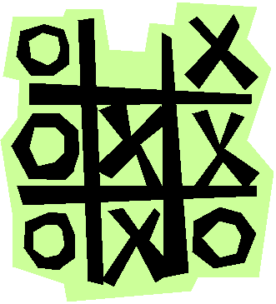
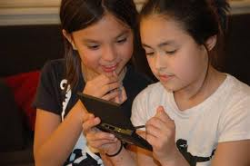
Design principle
INTUITIVE
Use real world objects
Domain
model
Design
model

Slide 4
Key design principles
Classes should have
high cohesion – low coupling
Focused on a single responsibility
Doesn’t know about, care about, depend on too many other classes

Slide 5
Key design principles
Single responsibility principle
Each class should have a single responsibility and that responsibility should be entirely encapsulated within the class.

Slide 6
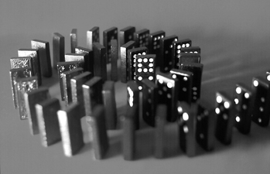
Design principle
related to SRP
Encapsulate variation
every class should have only one reason to change
FLEXIBLE
Change should not cause a domino effect!

Slide 7
Pizza
display()
bakeTime()
price()
Thin crust pepperoni
display()
bakeTime()
price()
Thick crust mushroom
display()
bakeTime()
price()
Two axes of change:
Type of crust
Toppings

Slide 8
Crust
display()
bakeTime
price()
Pizza
display()
setCrust()
addTopping()
bakeTime()
price()
Toppings
display()
bakeTime
price()
ThinCrust
display()
bakeTime()
price()
ThickCrust
display()
bakeTime
price()
ChicagoStyle
display()
bakeTime
price()

Slide 9
Crust
display()
bakeTime
price()
Pizza
display()
setCrust()
addTopping()
bakeTime()
price()
Toppings
display()
bakeTime
price()
ThinCrust
display()
bakeTime()
price()
ThickCrust
display()
bakeTime
price()
ChicagoStyle
display()
bakeTime
price()
Easy to extend

Slide 10
Duck
quack()
swim()
fly()
display()
Another example
Mallard
display()
Red-crested
display()

Slide 11
Duck
quack()
swim()
fly()
display()
Mallard
display()
Red-crested
display()
Rubber
fly()
display()

Slide 12
Duck
quack()
swim()
fly()
display()
Decoy
fly()
quack()
display()
Mallard
display()
Red-crested
display()
Rubber
fly()
display()
Encapsulate behaviors that vary

Slide 13
FlyBehavior
Duck
swim()
display()
setFlyBehavior()
setQuackBehavior
QuackBehavior
Decoy
display()
Mallard
display()
Red-crested
display()
Rubber
display()

Slide 14
Fly
NoFly
Quack
Quiet
FlyBehavior
Duck
display()
setFlyBehavior()
setQuackBehavior
QuackBehavior
Decoy
display()
Mallard
display()
Red-crested
display()
Rubber
display()

Slide 15
Squeak
Easy to extend
Fliy
NoFly
Quack
Quiet
FlyBehavior
Duck
display()
setFlyBehavior()
setQuackBehavior
QuackBehavior
Decoy
display()
Mallard
display()
Red-crested
display()
Rubber
display()

Slide 16
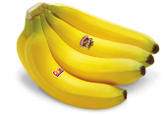
Design Principle
Liskov substitution principle (LSP)
B
void doSomething(B myThingOfTypeB)
void doSomething(C myThingOfTypeC)
isa
this should work as well
C
not just any banana

Slide 17
Design Principle
Liskov substitution principle (LSP)
A
B
B
has a
isa
A
C
has a
C
this should work too

Slide 18

I need shoes … not to mention feet
shoe
high heel
sneaker

Slide 19
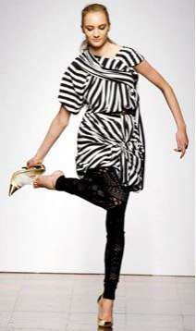
I need high heels
shoe
high heel
sneaker
an arbitrary shoe does not have to replace a high heel

Slide 20
LSP violation
shape
class Rectangle
{
public:
void SetWidth(double w) {itsWidth=w;}
void SetHeight(double h) {itsHeight=h;}
double GetHeight() const {return itsHeight;}
double GetWidth() const {return itsWidth;}
private:
double itsWidth;
double itsHeight;
};
rectangle
square

Slide 21
LSP violation
shape
class Rectangle
{
public:
void SetWidth(double w) {itsWidth=w;}
void SetHeight(double h) {itsHeight=h;}
double GetHeight() const {return itsHeight;}
double GetWidth() const {return itsWidth;}
private:
double itsWidth;
double itsHeight;
};
rectangle
void Square::SetWidth(double w)
{
Rectangle::SetWidth(w);
Rectangle::SetHeight(w);
}
void Square::SetHeight(double h)
{
Rectangle::SetHeight(h);
Rectangle::SetWidth(h);
}
square

Slide 22
void g(Rectangle& r)
{
r.SetWidth(5);
r.SetHeight(4);
assert(r.GetWidth() * r.GetHeight()) == 20);
}

Slide 23
LSP violation
shape
rectangle
A square is not a rectangle!!
It behaves differently
square

Slide 24
LSP violation
shape
rectangle
square

Slide 25
LSP violation
shape
rectangle
square

Slide 26
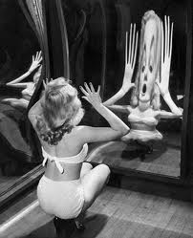
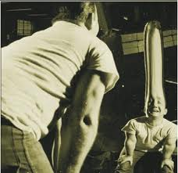
Design principle
SIMPLE, INTUITIVE, FLEXIBLE
Don’t repeat yourself (D.R.Y.)
data/code should occur once and only once

Slide 27
Design principle
Favor composition over inheritance
A
A
B
has a
inheritance
isa
composition
B
BLACK box reuse
WHITE box reuse

Slide 28
Design principle
Favor composition over inheritance
A
A
B
has a
inheritance
isa
composition
B
Caveat: sometime inheritance is the right thing
(i.e. gives us polymorphism)

Slide 29
Design principle
Program to an interface, not an implementation
Reduces cohesion

Slide 30
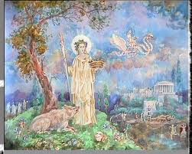
Design principle
Law of Demeter
only talk to your friends
Principle of Least Knowledge
no no no: myGame->theBoard->cells[0][0].update()

Slide 31
Design Principle
INTUITIVE
SIMPLE
FLEXIBLE

Slide 32
Summary
Use real world objects
High cohesion/low coupling
Single responsibility principle
Encapsulate variation
Liskov Substitution Principle
Don’t repeat yourself (D.R.Y)
Favor composition over inheritance
Program to an interface, not an implementation
Law of demeter (talk only to your friends)

Slide 33
Source: [Raymond, "Art of Unix Programming", Addison-Wesley, 2003]
Rule of Modularity: Write simple parts connected by clean interfaces
Rule of Clarity: Clarity is better than cleverness.
Rule of Composition: Design programs to be connected to other programs.
Rule of Separation: Separate policy from mechanism; separate interfaces from engines
Rule of Simplicity: Design for simplicity; add complexity only where you must
Rule of Parsimony: Write a big program only when it is clear by demonstration that nothing else will do
Rule of Transparency: Design for visibility to make inspection and debugging easier
Rule of Robustness: Robustness is the child of transparency and simplicity
Rule of Representation: Fold knowledge into data so program logic can be stupid and robust
Rule of Least Surprise: In interface design, always do the least surprising thing
Rule of Silence: When a program has nothing surprising to say, it should say nothing
Rule of Repair: When you must fail, fail noisily and as soon as possible
Rule of Economy: Programmer time is expensive; conserve it in preference to machine time
Rule of Generation: Avoid hand-hacking; write programs to write programs when you can
Rule of Optimization: Prototype before polishing. Get it working before you optimize it
Rule of Diversity: Distrust all claims for “one true way”
Rule of Extensibility: Design for the future, because it will be here sooner than you think

Slide 34
UNDER-PROMISE
and
OVER-DELIVER

Slide 35
Administrivia
Make appointment with me to do Sudoku walk through
Hold your team meeting (3:30-4:15)
Lab today: Concept test
Round A: Teams 1,2,3 (4:20-4:50 minutes)
Round B: Teams 4,5 (4:55-5:25 minutes)
During round A I’ll hold stand up meetings with teams 4&5
During round B I’ll meet with teams 1,2&3
If you aren’t meeting with me or holding your test, you are a test subject.

Slide 36
Sudoku project assessment
http://www.surveymonkey.com/s/SKYDF5G

