Slide 1
Testing

Slide 2
Administrivia
Armstrong School Visit Friday 12/7 11-12:30
We’ll leave campus at 10:30
Who can come?
Who can drive?
Who will talk about CSEd Week & Grace Hopper?
Grading alphas this weekend:
Give me a zipped file
Make sure your trac is up to date

Slide 3
Test plan
Risk analysis
Unit tests
Integration
System
Instrumentation tests
Memory leaks
Performance tests
Automated UI testing

Slide 4
Unit/Integration tests
Define but don’t implement
Rationalize

Slide 5
System tests (manual)
Define your protocol

Slide 6
Test plan
Unit tests
Integration tests
System tests
Instrumentation tests
Memory leaks
Performance tests
Automated UI testing

Slide 7
ios
Retain, release
ARC

Slide 8
Ios5: reference count
NSObject
retainCount: 3
When retainCount=0 memory is released

Slide 9
MyClass* object A =[ [MyClass alloc] init]
If MyClass is derived from NSOjbect then
NSobject’s init initializes retainCount
objectA
retainCount=1

Slide 10
MyClass* pointer1 =[ [MyClass alloc] init]
MyClass* pointer2 = pointer1
WRONG
pointer1
pointer2
retainCount=1

Slide 11
MyClass* pointer1 =[ [MyClass alloc] init]
MyClass* pointer2 = pointer1
[pointer1 release]
WRONG
pointer1
pointer2
retainCount=1

Slide 12

MyClass* pointer1 =[ [MyClass alloc] init]
MyClass* pointer2 = pointer1
[pointer1 release]
WRONG
pointer2
Zombie: pointer to de-allocated memory

Slide 13
MyClass* pointer1 =[ [MyClass alloc] init]
MyClass* pointer2 = pointer1
[pointer1 release]
WRONG
May work until memory re-used
pointer2
Zombie: pointer to de-allocated memory

Slide 14
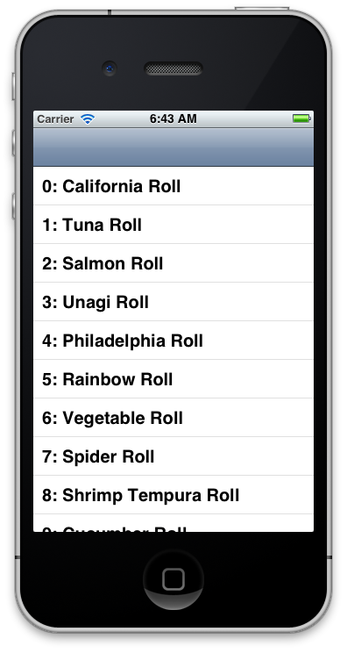

Slide 15
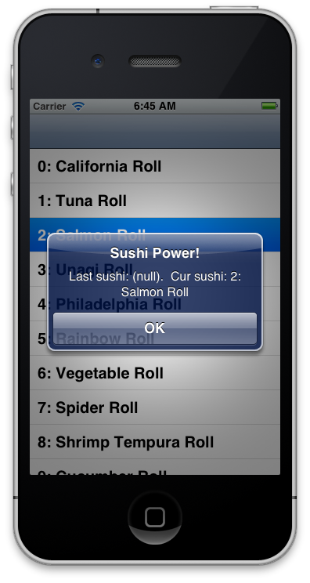

Slide 16
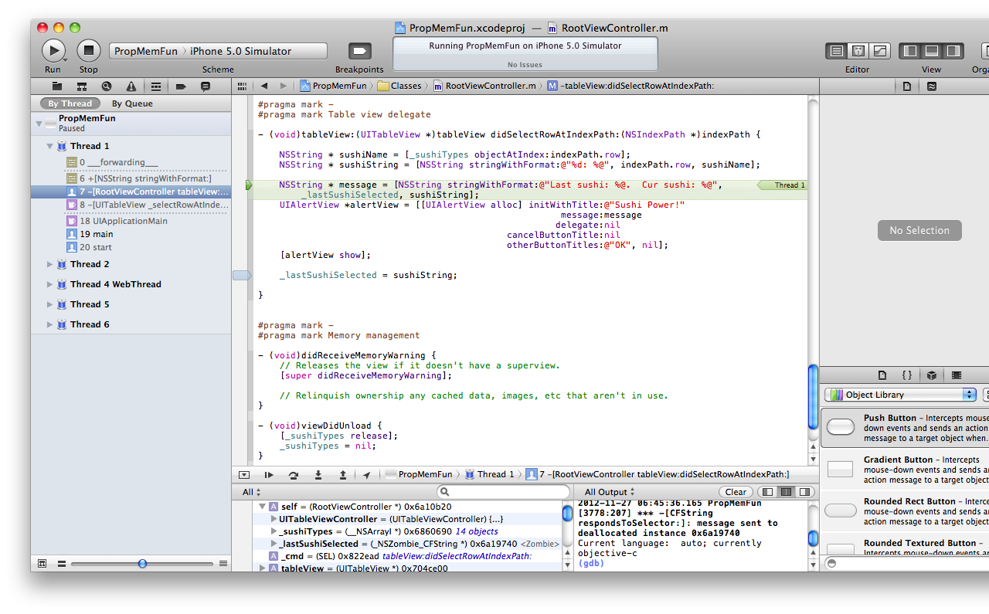
What is the problem?

Slide 18
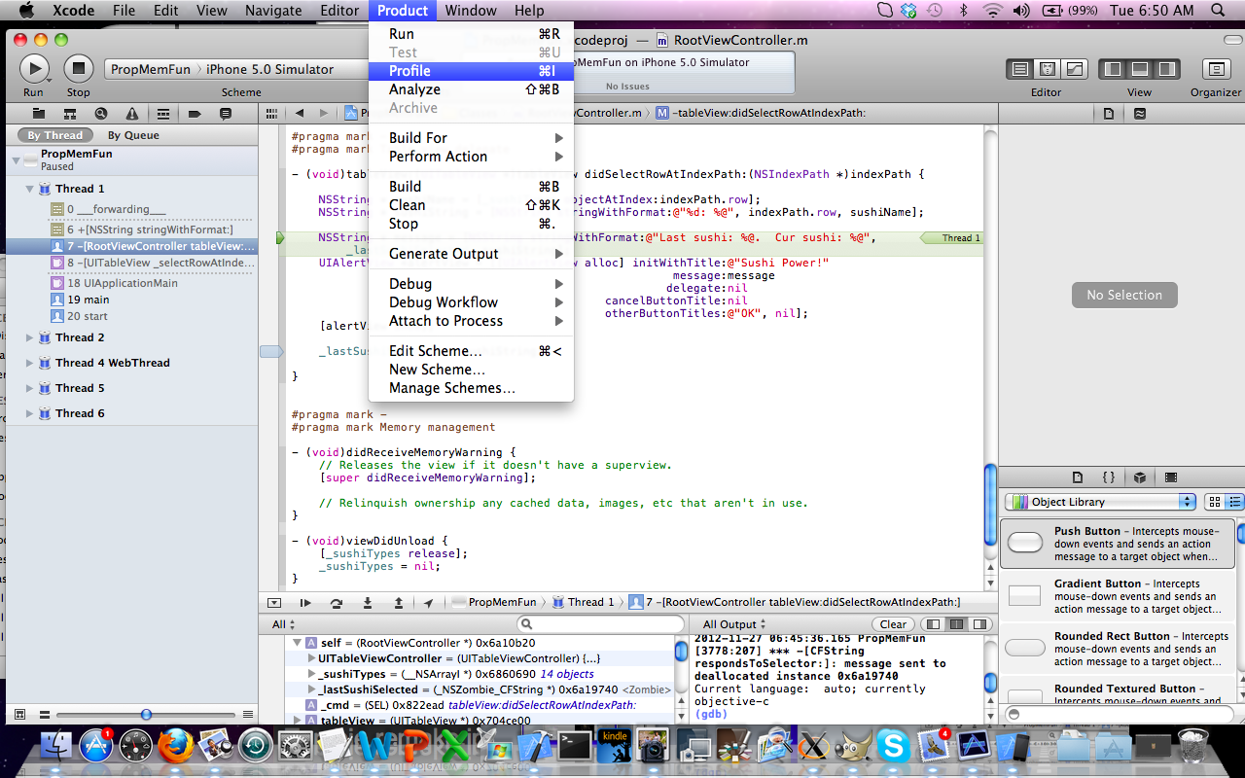

Slide 19
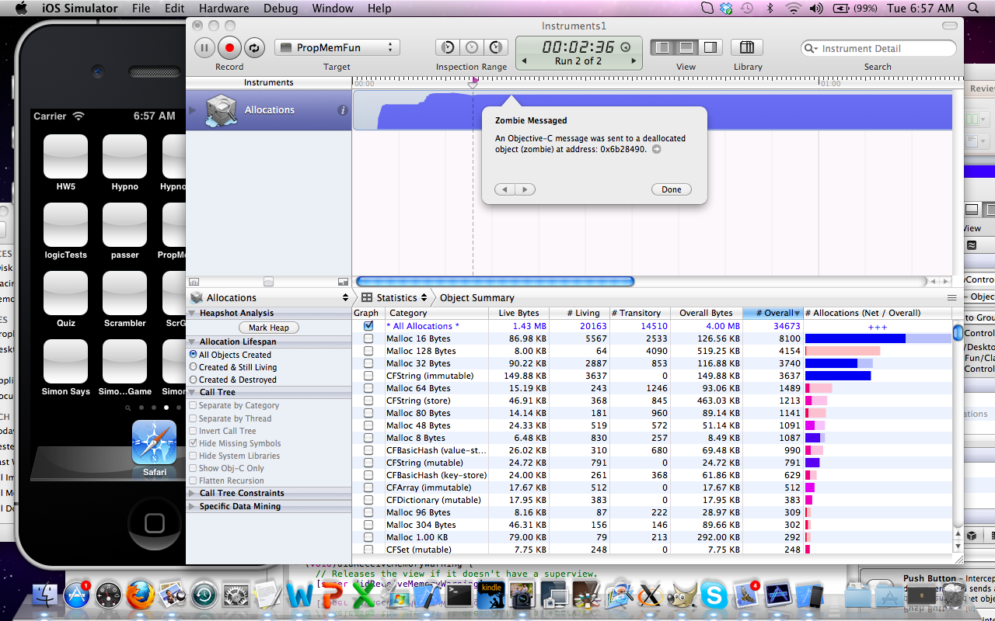
Click here

Slide 20
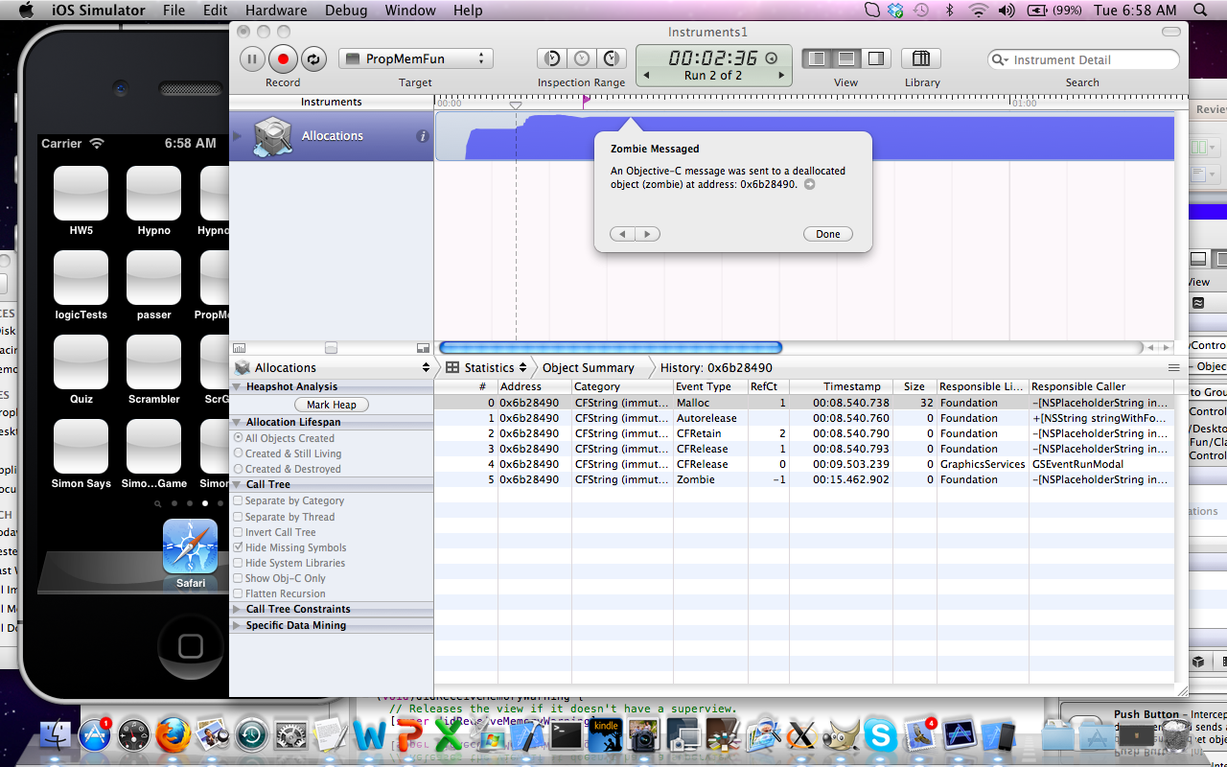
Zombie!

Slide 21
We can fix it
We can also tell xcode to watch out for zombies!

Slide 22
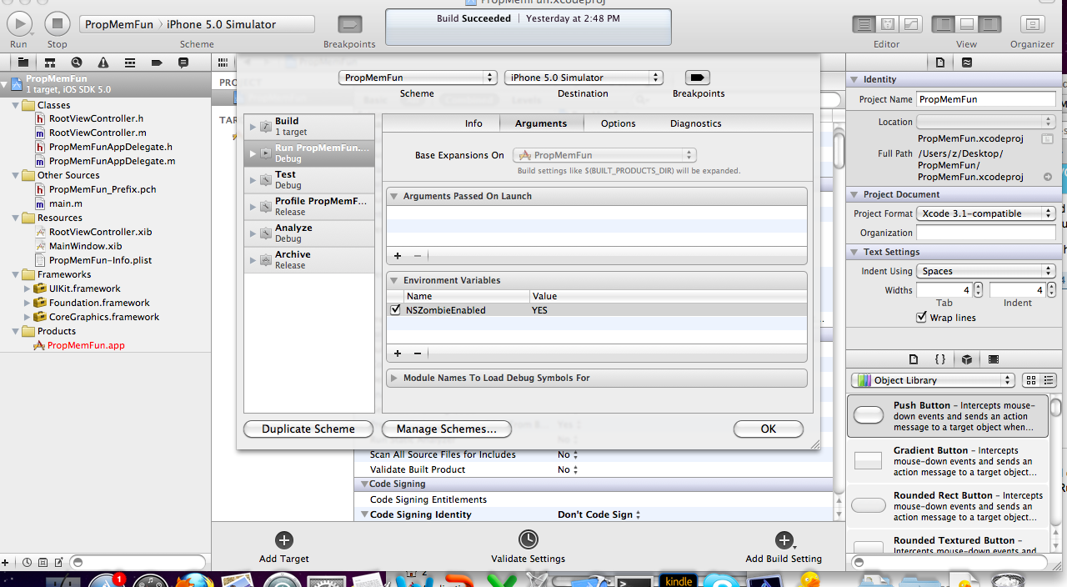
Watch out for Zombies!
Select the project.
Then from the Product tab select Edit Scheme.

Slide 23
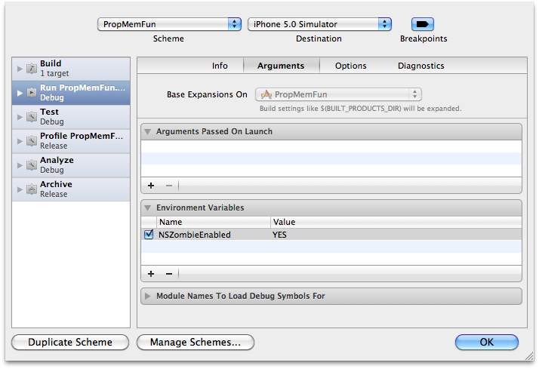

Slide 24
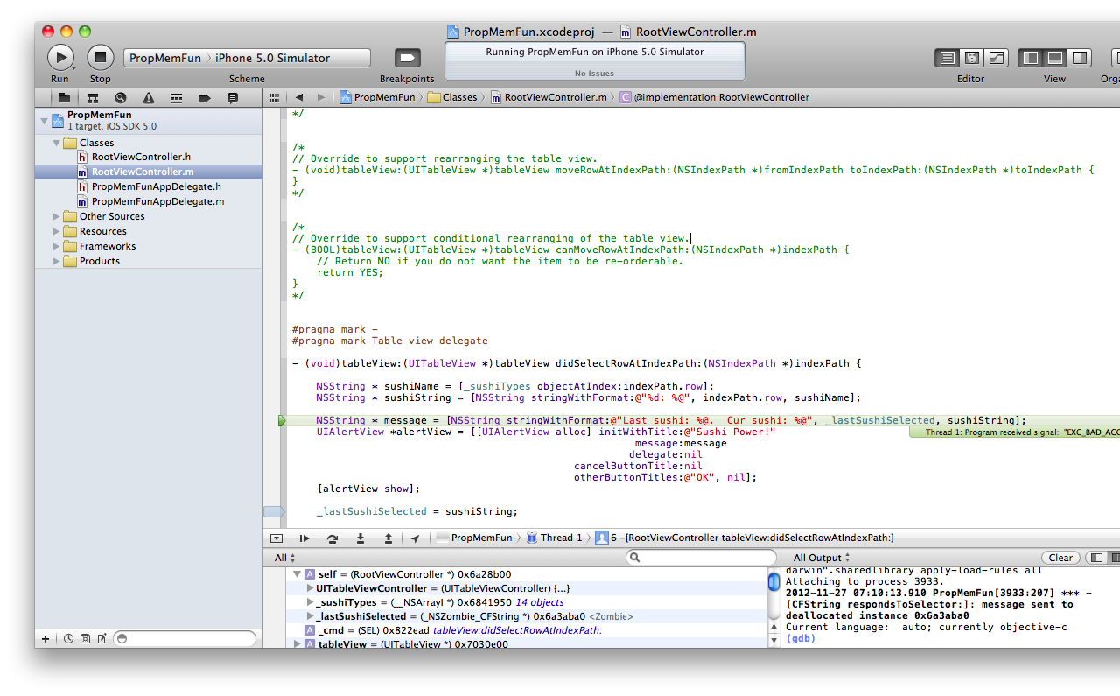
Click here.

Slide 25
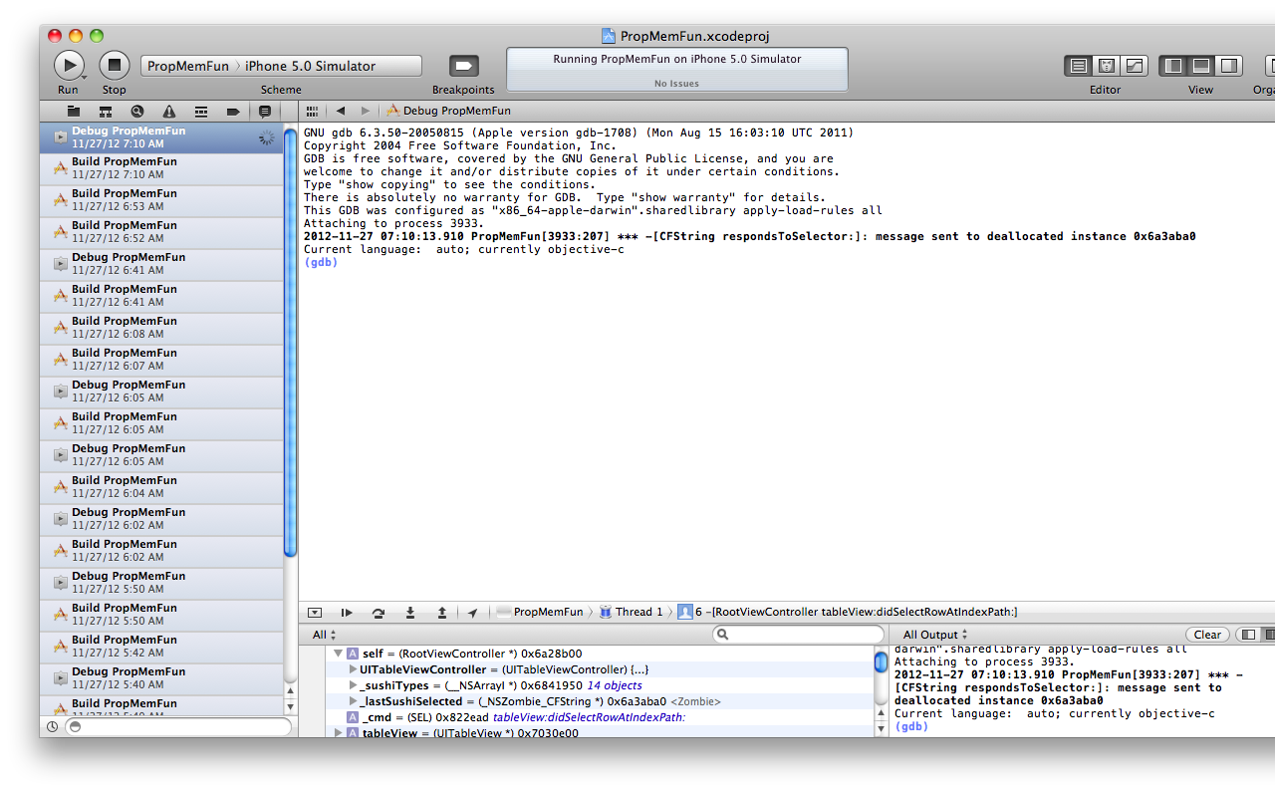
Zombie alert.

Slide 26
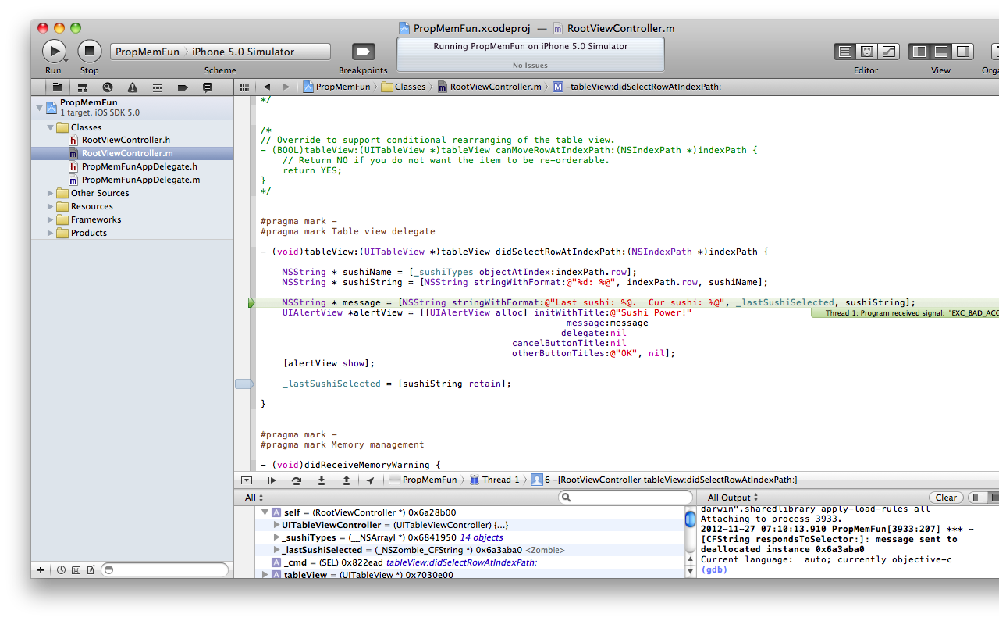
Let’s fix the problem.

Slide 27
Memory Leaks

Slide 28
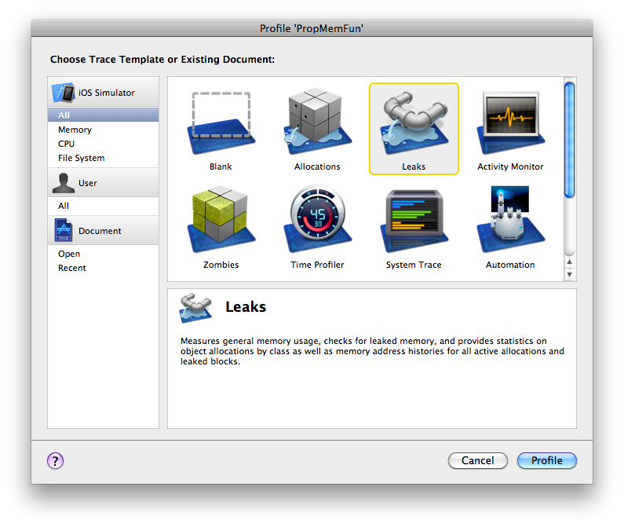

Slide 29
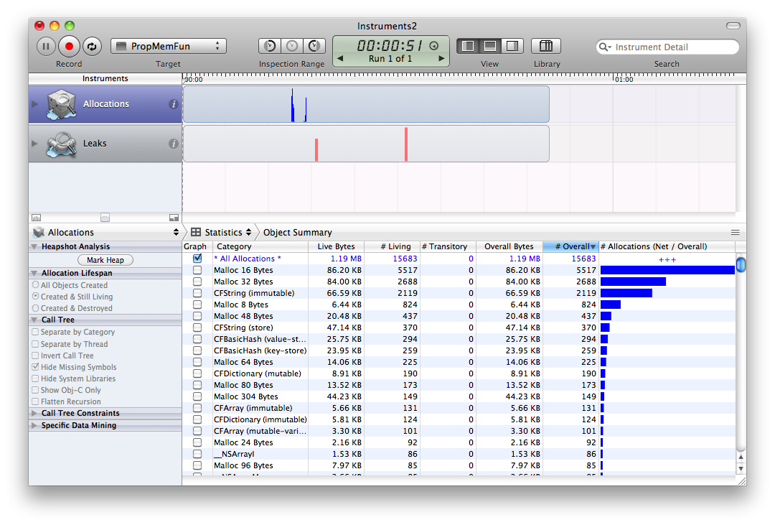
Once a leak shows up, stop the simulation.

Slide 30
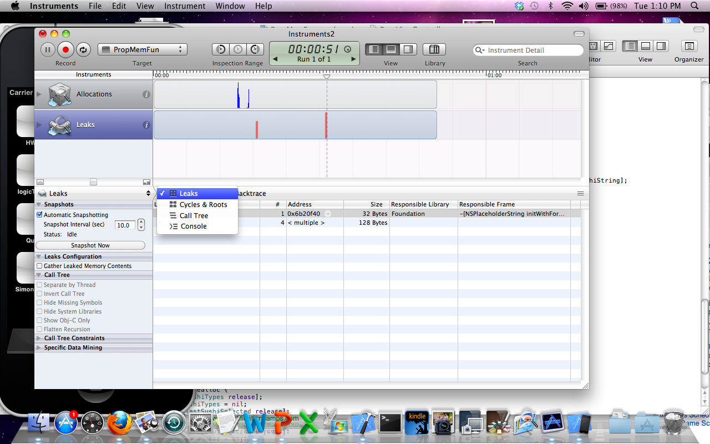
Open the drop-down menu and select call tree.

Slide 31
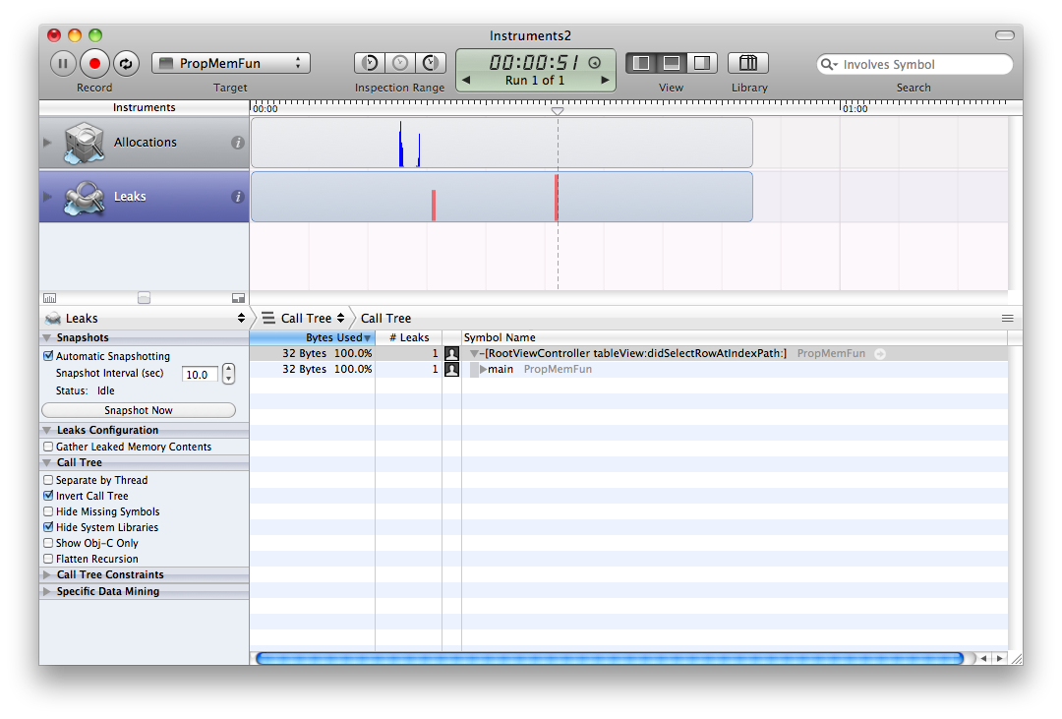
Check the boxes shown.
Double click on a leak.

Slide 32
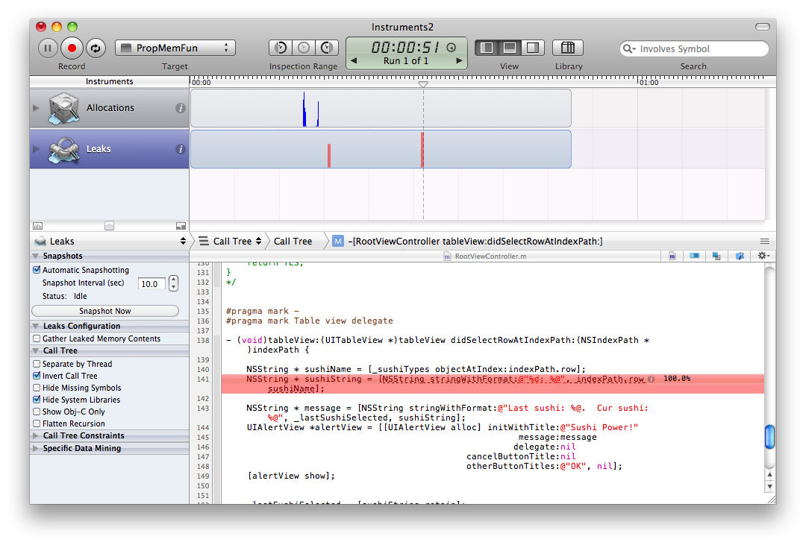
This allocation is causing a memory leak. Why?

Slide 33
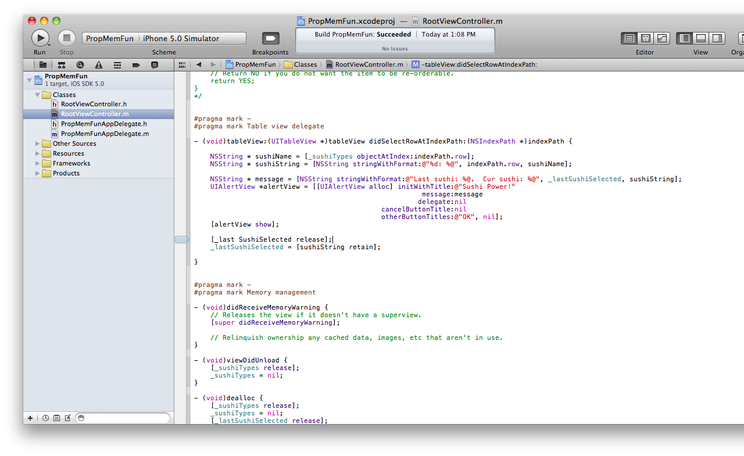
This will fix it.
But there is another one. See if you can find it.

Slide 34
Test plan
Unit tests
Instrumentation tests
Memory leaks
Performance tests
Automated UI testing
Check for leaks in your code!
We’ll do these next week

