Slide 1
More Testing

Slide 2
Administrivia
Armstrong School Visit Friday 12/7 11-12:30
We’ll leave campus at 10:30
Who can come?
Who can drive?
Who will talk about CSEd Week & Grace Hopper?
Code freeze next week Tuesday
Beta presentations next week Thursday (target audience: developers)

Slide 3
More Administrivia
Beta deliverables (linked to trac)
Project folder (zipped)
Use cases (implemented and proposed for future work)
UML of implementation (class, sequence diagrams)
Collaborative critique of final products (strengths, weakness, suggested improvements)
Software design
Game
Code
Final test plan (including profiling results)
Known bug list
User test report
Final presentation slides
Beta walkthrough (after deliverables submitted)
Your (entire) team must give a walkthrough of your beta
You write a critique of another team’s beta (sitting in on the walk though might be useful!)
Dates/times for walkthroughs
Tuesday 12/11 class time (volunteers?)
Wednesday 12/19 2-5
Other?

Slide 4
Changes to CS121
Should we devote the early classes to Objective C? Are the tutorials adequate? Should we have a textbook?
Should there be a first project? And if so, is Sudoku a good one? Should I supply code for grid generation?
When should we introduce testing & profiling?
Should I require individual critiques of another team’s design?
I want to improve interaction with the teachers/students. Do you have suggestions?
Should we have outside artists for every team?
What sort of support should grutors provide?
Any other suggestions

Slide 5
Today
More on profiling
Team meeting
Prepare for user test
Prepare user survey (keep it short!)
Survey monkey ID: cs121
Password: weBuildGames

Slide 6
ios
Retain, release
ARC
Breaking news: Team 3 demonstrates ARC does not prevent all leaks!

Slide 7
Ios5: reference count
NSObject
retainCount: 3
When retainCount=0 memory is released
Does find “abandoned” memory; that is memory that still has a reference but is never used.

Slide 8
Abandoned memory
NSObject1
NSObject1
Retain count=1
Retain count=1
Strong vs. weak
Weak=don’t retain

Slide 9
Detecting abandoned memory
Leaks tool doesn’t work
Use allocation tool to watch heap

Slide 10
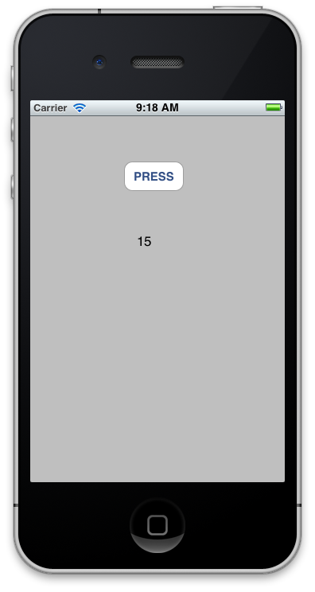
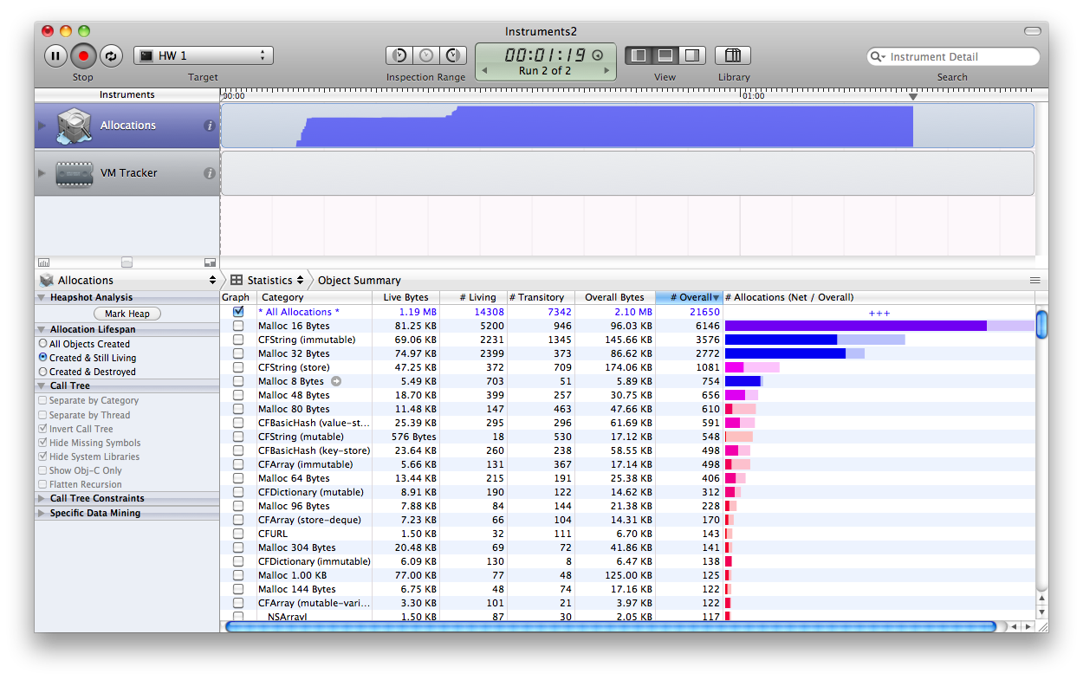

Slide 11



Slide 12
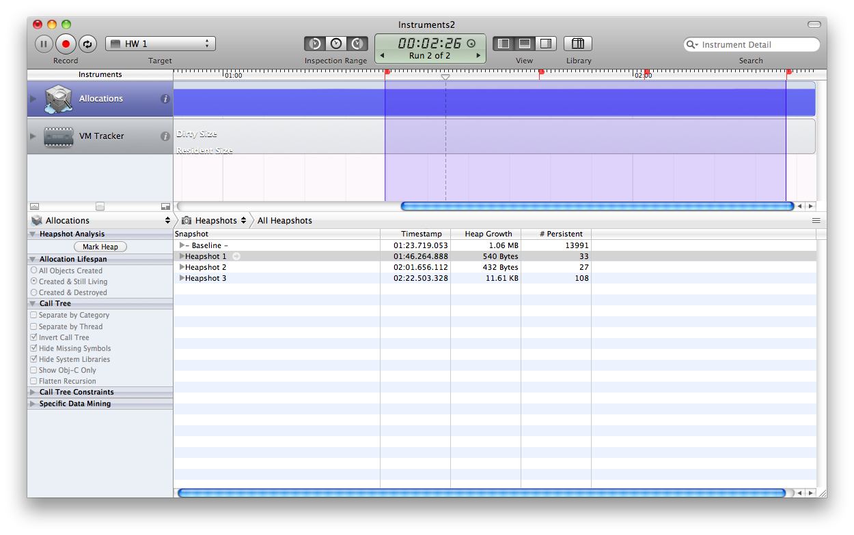

Slide 13
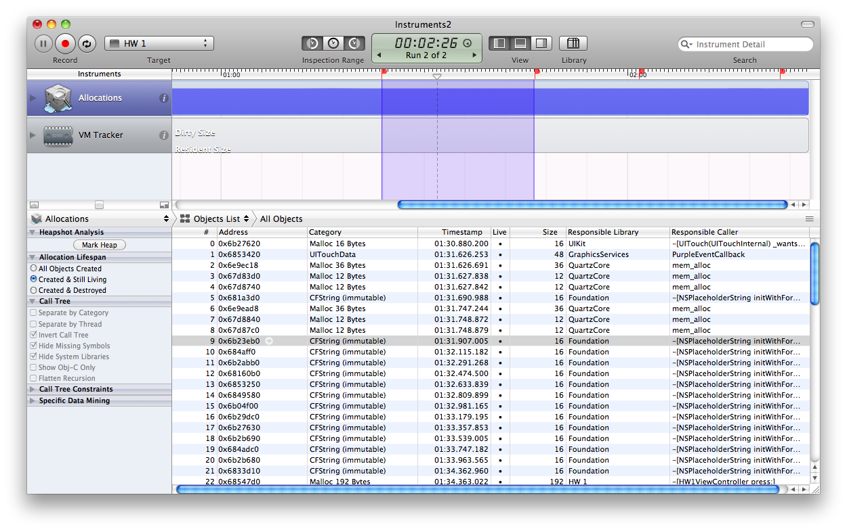

Slide 14
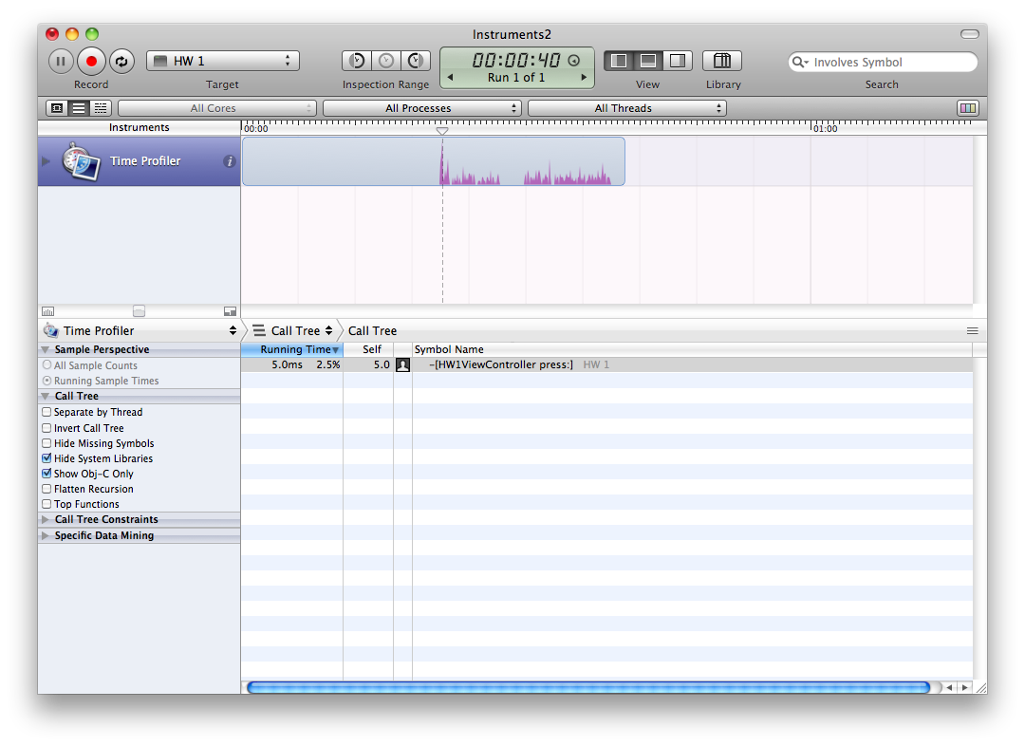
TIME PROFILER

Slide 15
More on time profiling:
http://mobile.tutsplus.com/tutorials/iphone/ios-sdk-time-profiling-with-instruments/
Run time and allocation profiles on your game.

