Slide 1
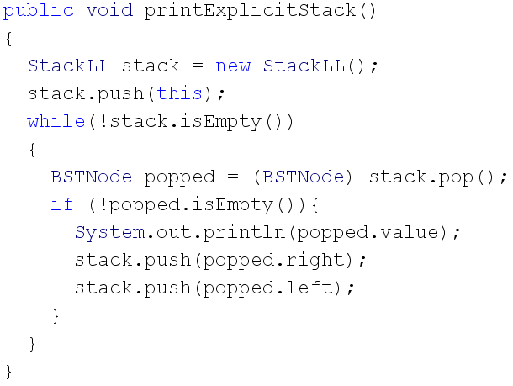
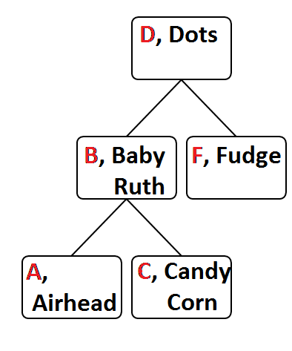
Dots
Baby Ruth
Airheads
Candy Corn
Fudge

