Slide 1
Usability testing

Slide 2
Roses are red
Violets are blue
My valentine gift
Is no quiz for you
OK – that was lame,
but I have sweets too.

Slide 3
Administrivia
Friday user tests with middle school students
Where: 2nd floor of Sprague
When: 11:30 – 1
What else: Pizza
RSVP

Slide 4
Usability testing
Is the software easy to learn and use?
Is the software satisfying to use?
Good user interface design is crucial.

Slide 5
Usability testing techniques
Expert evaluation
User testing (one-on-one)
User surveys
Analytics
In-class UI testing is somewhere here.
(Your classmates are not your target
audience.)

Slide 6
Usability testing techniques
Expert evaluation
User testing (one-on-one)
User surveys
Analytics
Friday student testing
Survey monkey for other schools

Slide 7
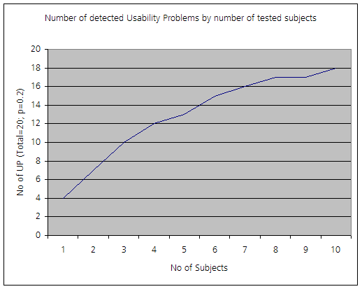
How many?
Jakob Nielsen, Sun

Slide 8
Iterative design
Usability test design
3-5 participants
Revise
design
repeat

Slide 9
Usability test
Steve Krug web interface usability test:
http://www.youtube.com/watch?v=QckIzHC99Xc
Notes:
Intro
Consent
Background questions
UI tour (6:00)
Tasks (8:00)
Analysis (20:30)

Slide 10
More usability
http://www.youtube.com/watch?v=9wQkLthhHKA&feature=related

Slide 11
Process
Intro
Background questions
Initial screen(s) reactions
Tasks
Wrap up

Slide 12
Intro
We are asking students to look at our game interface design to see what they think. This should take about 20 minutes.
I will show you sketches of game screens and ask you questions about how you would use the various controls. Don’t worry if you don’t know the answer, that just means that there are problems with our design. That is exactly what we are trying to find out.
As we go along I’m going to ask you to think out loud; to say what you are looking at, what you are trying to do, what are you thinking about.
Do you have any questions?
Do you mind if we video tape this session? (in-class only)

Slide 13
Background questions
Before we start, let me ask you some questions.
What grade are you in?
What is your favorite subject in school?
Do you play computer games?
What kind?
What are your favorite games?
Why do you like those games?
--------------------------------
If they don’t play games do they go online?
What sort of sites?
What is their favorite site?

Slide 14
Initial screen(s)
Get reaction to initial screen(s)
What do they think?
What would they do first?
What do the buttons do?
What do they think of the layout?
Can they offer suggestions?

Slide 15
Tasks
Set up a few (2-3 important) tasks and ask them what they would do

Slide 16
Wrap up
Ask if they have any other suggestions
Thank them

Slide 17
Next week Tuesday – in class with your classmates
Each team will have an interviewer/scribe pair to run one a half-hour test on classmates. The other 2 team members will be subjects/observer for another team’s test.
Repeat with another interview/scribe pair
Next week Friday – test on Sycamore students

