Slide 1
Code smells & refactoring

Slide 2
Smell organization
http://www.soberit.hut.fi/mmantyla/BadCodeSmellsTaxonomy.htm

Slide 3
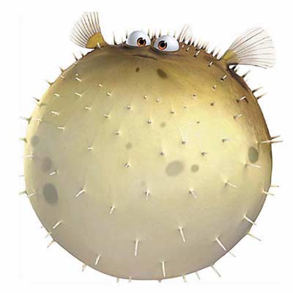
Bloaters
Something has gotten tooooo big!
Method
Class
Parameter lists
Primitive obsession
Data clumps

Slide 4
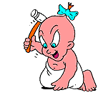
Object orientation abusers
Does not exploit OO
Switch statements
Temporary Field
Refused Bequest
Alternative classes with
different interfaces

Slide 5
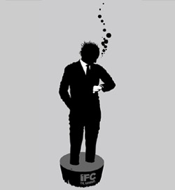
Change preventers

Slide 6
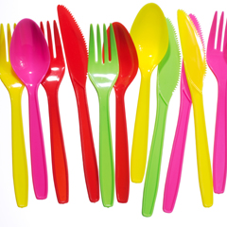
The Dispensables
Unnecessary stuff
Lazy class
Data class
Duplicate code
Dead code
Speculative generality

Slide 7
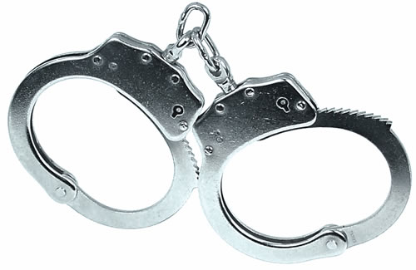
The couplers
Feature envy
Inappropriate Intimacy
Message chains
Middle man

Slide 8
Refactoring
disciplined technique
series of small changes
alters internal structure without changing external behavior

Slide 9
Refactoring techniques
http://martinfowler.com/refactoring/catalog/index.html
But to learn how to refactor you need to do it.

