Slide 1
Surfaces
Polygon meshes
Linear axis design
Bezier patches
Subdivision surfaces
Nurbs

Slide 2
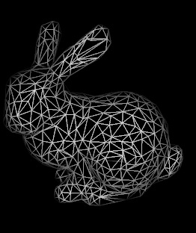

Polygon meshes

Slide 3
Surfaces
Polygon meshes
Linear axis design
Bezier patches
Subdivision surfaces
Nurbs

Slide 4
Linear axis design
revolving curve
(approximate by polygon mesh)

Slide 5
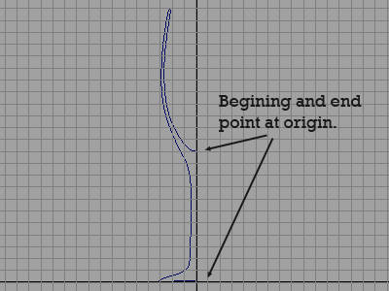
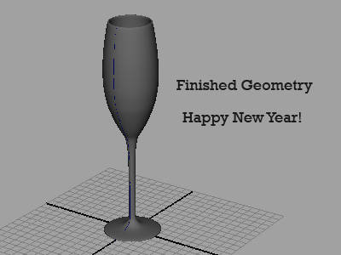
Linear axis design
revolving curve

Slide 6
Linear axis design
profile

Slide 7
Linear axis design
profile

Slide 8
demo

Slide 9
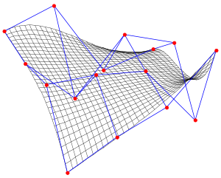
Bezier patch
P(u,v)=∑ ∑ B_{i}^{n} (u) B_{j}^{m} (v)p_{ij}
n
i
B_{i}^{n}(u) = u^{i} (1-u)^{n-i}

Slide 10
http://www.geepers.co.uk/media/flash/software/bezier_patch_explorer.swf

Slide 11
Surfaces
Polygon meshes
Linear axis design
Bezier patches
Subdivision surfaces
Nurbs

Slide 12
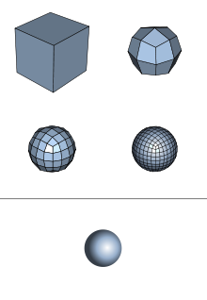
Surface Subdivision
Refine polygon mesh via subdivision rules
Split face into multiple faces
Reposition vertices

Slide 13
Split Vertices

Slide 14
Split Edges

Slide 15
Loop Algorithm
Reposition vertices
rule 1: existing vertices
rule 2: new vertices
Subdivide edges
original mesh
new mesh

Slide 16
Loop Algorithm
Rule 1: new vertex position
is weighted avg. of original vertex position
and its neighbors in original mesh
original mesh
new mesh

Slide 17
Loop Algorithm
1/6
1/6
Case 1a: existing vertex is internal vertex with
valence 6
10/6
Rule 1a: new vertex position
is weighted avg. of original vertex position
and its neighbors in original mesh
1/6
1/6
1/6
1/6
original mesh
new mesh

Slide 18
Loop Algorithm
w
w
Case 1b: existing vertex is internal vertex with
valence k
k>3: w=3/(8k)
k=3: w = 3/16
w
1-kw
w
Rule 1b: new vertex position
is weighted avg. of original vertex position
and its neighbors in original mesh
…
w
w
original mesh
new mesh

Slide 19
Loop Algorithm
Case 1c: Existing vertex is boundary vertex
Rule 1c: new vertex position
is weighted avg. of original vertex position
and its two neighbors on boundary
1/8
3/4
1/8
original mesh
new mesh

Slide 20
Loop Algorithm
Reposition vertices
rule 1: existing vertices
rule 2: new vertices
Subdivide edges
original mesh
new mesh

Slide 21
Loop Algorithm
Case 2a: internal edge
3/8
1/8
Rule 2a: new vertex position
is weighted avg. of vertices of adjacent
triangles
1/8
3/8
original mesh
new mesh

Slide 22
Loop Algorithm
Case 2b: boundary vertex
1/2
Rule 2: new vertex position
is weighted avg. of vertices of edge
1/2
original mesh
new mesh

Slide 23
Surfaces
Polygon meshes
Linear axis design
Bezier patches
Subdivision surfaces
Nurbs
Nurb surfaces are an extension of Nurb curves.
So first let go back to curves and talk about b-splines.

