Slide 1
CS 60
HOF, lambda
Binary search trees
2013-09-16
Monday – Week 2
Lecture 04

Slide 2
Survey
Do you think we should move to Shan B460
Big Beckman style tables – little slope
Definitely
I don’t care
No
We will be there October 14th!

Slide 3
Administrative Stuff
(Not in your notes)
When you pair program, please put your partner’s login in the partner field as: #cs60-xx
No name on homework.
No “comment out with a box”

Slide 4
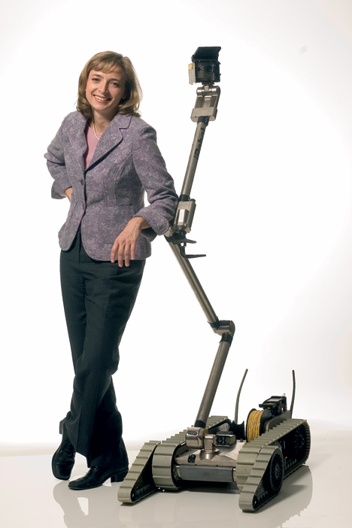
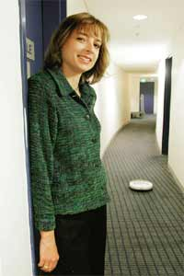
running Scheme!
Helen Greiner, co-founder and CEO of iRobot (at left in each image!)
Notes:
I don’t know if this really works...

Slide 5
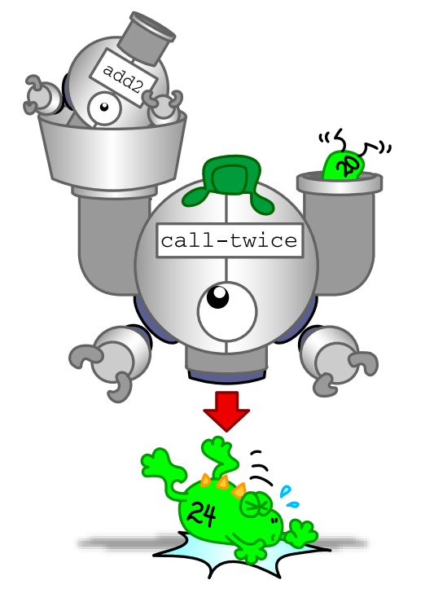
Higher Order Functions
Functions that take another function as input.
(or output a function)
map
foldr
filter
sort

Slide 6
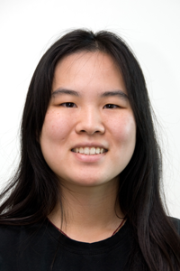
Image Credits
Simply Scheme (black and white diagrams)
http://www.eecs.berkeley.edu/~bh/ss-toc2.html
By Brian Harvey and Matthew Wright
CS Illustrated (color images)
http://csillustrated.berkeley.edu/
By http://csillustrated.berkeley.edu/artists.php
  Images used are all by Ketrina Yim

Slide 7
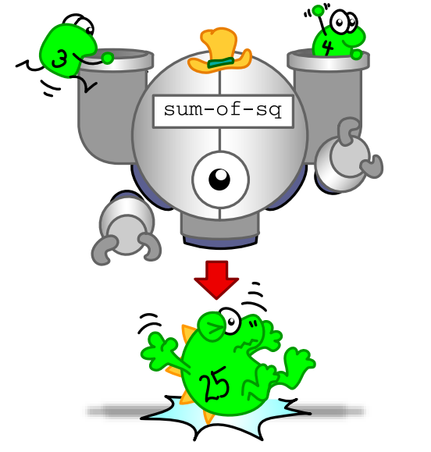


Normal stuff.

Slide 8

Function input is a function
(cool!)

Slide 9
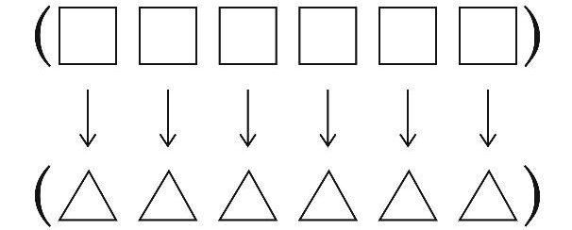
(map proc list)
First argument is a function
Second argument is a list
Returns a list in which the function proc has been applied to each element of the input list (2nd argument)

Slide 10
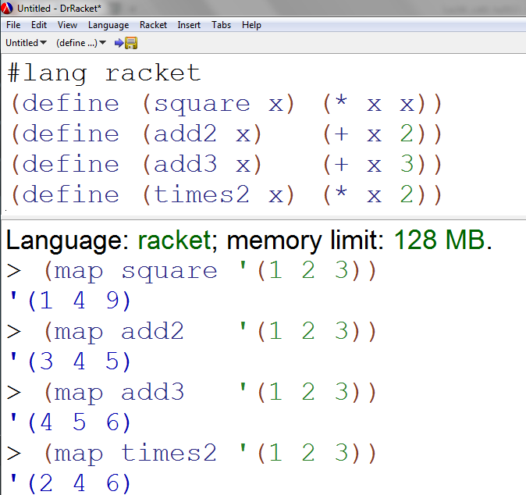
Map Demo

Slide 11


Map Demo (lambda intro)
Instead of defining the function before calling map,
I can make an anonymous function using lambda
Do I want to define a function? Nah – I’ll just use lambda

Slide 12

Write map
This should be practice from the LAST class!!!

Slide 13
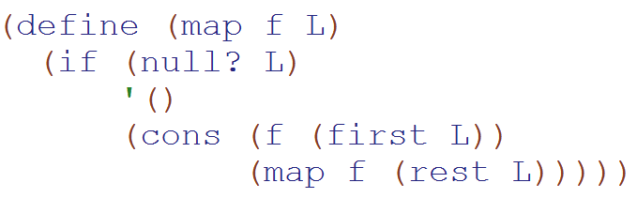
(map func L) SOLUTION
map
(built into Racket)

Slide 14
(map proc list)
First argument is a function
Second argument is a list
Returns a list in which the function proc has been applied to each element of the input list (2nd argument)
>(map + '(1 2 3) '(4 5 6))
'(5 7 9) ; (+ 1 4) (+ 2 5) (+ 3 6)
map can take in multiple lists – the function takes one element from each list
(not as important)

Slide 15
(foldr proc init list)
Like a base case value
> (foldr + 0 '(1 2 3))
6
> (foldr + 10000 '(1 2 3))
10006
> (foldr list '() '(1 2 3))
'(1 (2 (3 ())))
(+ 1 (+ 2 (+ 3 10000)))
(list 1 (list 2 (list 3 '())))

Slide 16
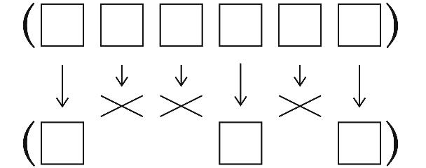
(filter predicate list)
Something that returns #t or #f
> (filter odd? '(3 4 5))
'(3 5)
> (filter (lambda (x) (> x 3)) '(3 4 5))
'(4 5)
Using just > wouldn’t have worked!

Slide 17
(sort list predicate)
Takes 2 inputs
& returns
#t or #f
> (sort '(3 4 5 4) >)
'(5 4 4 3)

Slide 18
Use only higher-order functions, not raw recursion, to write these :
Name: ____________________ Login: ___________________
1
smush should concatenate all of the elements of L, which you should assume are lists
2
addk should add k to each element of L (all will be numeric)
( smush '((t h i) (s i s) (s o c o) (o l) )
'( t h i s i s s o c o o l )
( addk 60 '( -18 101 7940 ) )
'( 42 161 8000 )
(define (addk k L)
(map L))
What should this be?
3
Lotto-winner takes a list of tickets: '( (name n1 n2 n3 n4 n5) (name n1 n2 n3 n4 n5) ... ) and a list of winning numbers W as input. Then, lotto should return a list of the name of the winner (most matches with W) and the number of matches made.
( lotto-winner '( (Amy 2 3 41 42 50) (Bea 3 40 50 51 52) ) '( 1 3 41 51 52 ) )
'( Bea 3 )
Here, write a helper function: (matches T W) returns the number of elements T and W have in common.
( matches ' (Bea 3 40 50 51 52) '( 1 3 41 51 52 ) )
3
(define (matches T W)
(
Hint: use filter + member...

Slide 19
1
smush should concatenate all of the elements of L, which you should assume are lists
( smush '((t h i) (s i s) (s o c o) (o l) ) → '( t h i s i s s o c o o l )
(define (smush L)
(foldr _______ ______ L))
(foldr proc init list)

Slide 20
2
addk should add k to each element of L
(all will be numeric)
( addk 60 '( -18 101 7940 ) ) → '( 42 161 8000 )
(define (addk k L)
(map L))
(map proc list)

Slide 21
3
(matches T W) returns the
number of elements T and W have in common.
(matches '(Bea 3 40 50 51 52) '(1 3 41 51 52))→ 3
(filter predicate list)

Slide 22
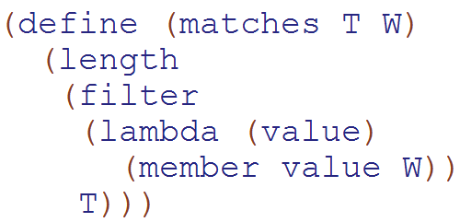
3
(matches T W) returns the
number of elements T and W have in common.
(matches '(Bea 3 40 50 51 52) '(1 3 41 51 52))→ 3
(filter predicate list)

Slide 23

Function output is a function
(Woah!)

Slide 24
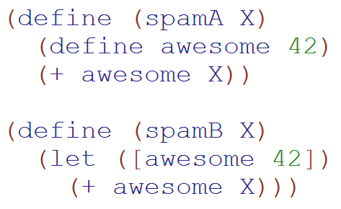
Language Detail:
You can use define inside a function
These return the same thing.
You can also define functions

Slide 25
Example: Function output is a function
(define (make-adder x)
(define (adder-function y) (+ x y))
>(make-adder 3)
#<procedure:adder-function>
>((make-adder 3) 4)
7
(+ 40 2) )
adder-function )
What is x? a) 3 b)4 c)??

Slide 26
Write make-adder with lambda
(define (make-adder x)

Slide 27
Lambda λ
Makes a procedure!

Slide 28
Syntactic Sugar (λ makes a function)
(define (square x) (* x x))
(define square (lambda (x) (* x x))
>(square 3)
9
>((lambda (x) (* x x)) 3)
Function name
Args
Body
The function to call
Input
Remember to keep track of your input/output type(s)!

Slide 29
Function output is a function
From earlier slide
(define (make-adder x)
(define (adder-function y) (+ x y))
adder-function)
(define (make-adder x)
(lambda (y) (+ x y)))
This is equivalent!
(Lambda makes things more concise.)
Beautiful!

Slide 30
(define (cat y)
(lambda (x) (+ x 1)))
(define dog
(lambda (x) (+ x 1)))
Which of these gives the answer 2?
I (cat 1)
II ((cat 1) 1)
III(dog 1)
IV ((dog 1) 1)
A) I&III
B) II&IV
C) I&IV
D) II&III
E) Not sure
Notes:
30

Slide 31
Binary Tree Representations

Slide 32
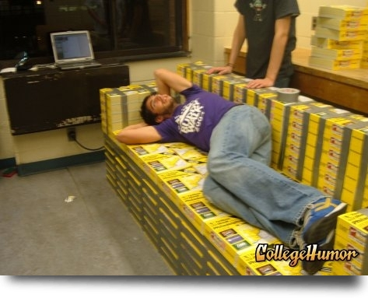
Lists' disadvantages
AAA Aardvark Training
909-555-NICE
key
value
Fran’s Foto
909-555-FOTO
phone books hold the key
Mo’s Mermaids
909-555-SWIM
If we use assoc, this will take O(N) time, where N is the # of entries in the association list.
Pam’s Pretzels
909-555-PRZL
Zyzzyva Exterminators
909-555-GONE
Notes:
I don’t know if this really works...

Slide 33
Trees are fast!
What do you use to look things up?
Key
Value
??
Idea: use our phone-book search to structure our data!
Mo’s Mermaids
909-555-SWIM
“key”
“value”
Fran’s Foto
909-555-FOTO
Pam’s Pretzels
909-555-PRZL
AAA Aardvark Training
909-555-NICE
???
???
Zyzzyva Exterminators
909-555-GONE
How deep will this tree be?
Notes:
I don’t know if this really works...

Slide 34
Tree Vocab
Target Set = all the children of a node
Root
R
"child" node
"parent" node
E
A
U
Height = number of nodes on the longest path from root to a leaf
Subtree
D
X
N
G
Leaf
Notes:
I don’t know if this really works...

Slide 35
Tree species
General search Tree / Trie
Binary Search Tree
Root!
/
42
usr/
home/
bin/
20
100
local/
pwd
12
21
211
z/
mike/
35
bin/
courses/
25
39
spamc
cs60/
hw2.rkt
each node holds an entire piece of data
each node holds part of a piece of data
What is special about the data here?
Notes:
I don’t know if this really works...

Slide 36
Binary Search Trees
42
Identifying features:
Every node has two subtrees
Each node has a “key”
The root value is always greater than all nodes in a left subtree (or empty)
The root value is always less than all nodes in a right subtree (or empty)
Each node has a distinct key
20
100
12
21
211
35
25
39
BT = '( 42 ( 20 (12 () ()) (21 () (35 (25 () ()) (39 () ())) )) (100 () (211 () ()) ) )
All these parens look like leaves!
Can you discern the structure here?
Notes:
I don’t know if this really works...

Slide 37
How would you create the tree T?
How many left parentheses?
A) <6 b) 6 c)7 d)8 e)>8
T
42
30
77
(define T

Slide 38
Recommended Helper Functions
(define (make-BST key left right)
(list key left right))
(define (make-empty-BST)
'())
(define (emptyTree? tree)
(null? tree))
(define (leaf? tree)
(and (null? (leftTree tree))
(null? (rightTree tree))))
(define (key tree)
(first tree))
(define (leftTree tree)
(second tree))
(define (rightTree tree)
(third tree))

Slide 39
Binary Search Tree Delete
(homework 2)

Slide 40
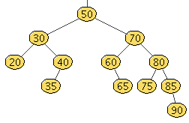

Slide 44
Binary Search Tree Delete Algorithm
No children – just delete
One child – replace with child
Two children? (Booo!)
  Find the NEXT item (just bigger than node to delete)
    Smallest thing on right subtree
  Call delete the NEXT item
  Put the NEXT item to replace the original node

Slide 45
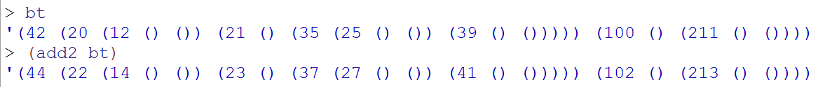
Write add2 for Binary Trees

Slide 46
getting the most from BSTs
(in) a list representing a non-empty BST
N = # of nodes
(find-max BT) = (out) the largest of BST's elements
42
(define (find-max BT)
(let* (( root (first BT) )
( LEFT (second BT) )
( RIGHT (third BT) ))
(
20
100
12
21
211
35
25
Notes:
I don’t know if this really works...

Slide 47
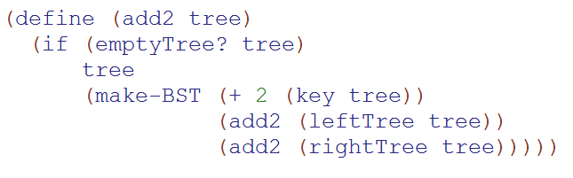
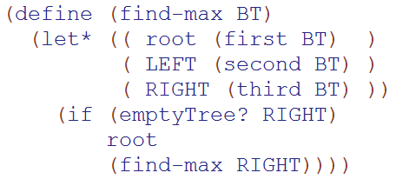
Solutions

Slide 48
Graphs
2013-01-31
Thursday – Week 1
Lecture 04

Slide 49
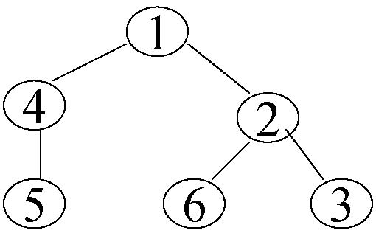
How Trees become Graphs
Notes:
A graph G is a set V of vertices (sometimes called nodes), and a set E of edges (sometimes called arcs) that each connect two vertices together.
This is just like the trees – but with the trees we had the requirements and now any node can reference any other type of node.
Really we could think about any tree as a graph and really even any linked list as a tree and any linked list as a graph. It is just based upon the relationships of nodes.
Introduce E here and N!!
Point out potential infinite loop here!

Slide 50




Two Types of Graphs
Directed
Graph
Undirected
Graph
This vocab is important
Notes:
Two types of graphs. Directed – which is using directional arrows and undirected. Which is just as if there is an arrow in each direction for a given edge.
Define undirected and directed here.

Slide 51
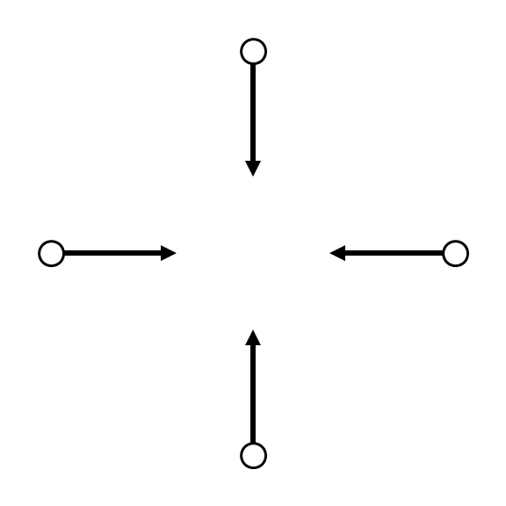
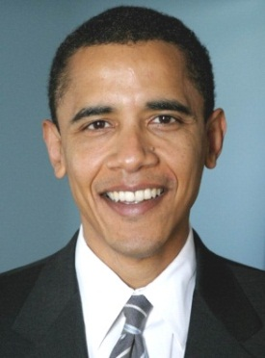
Nodes – Twitter users
Edges – Indicates following
Notes:
Obama is the third most followed person on twitter.
This shows the arrows – just because you follow obama doesn’t mean that he follows you – although Obama COULD follow you and another obama follower could follow other obama followers. (ANIMATION)
If every arrow went in both direction it would just be a undirected graph

Slide 52
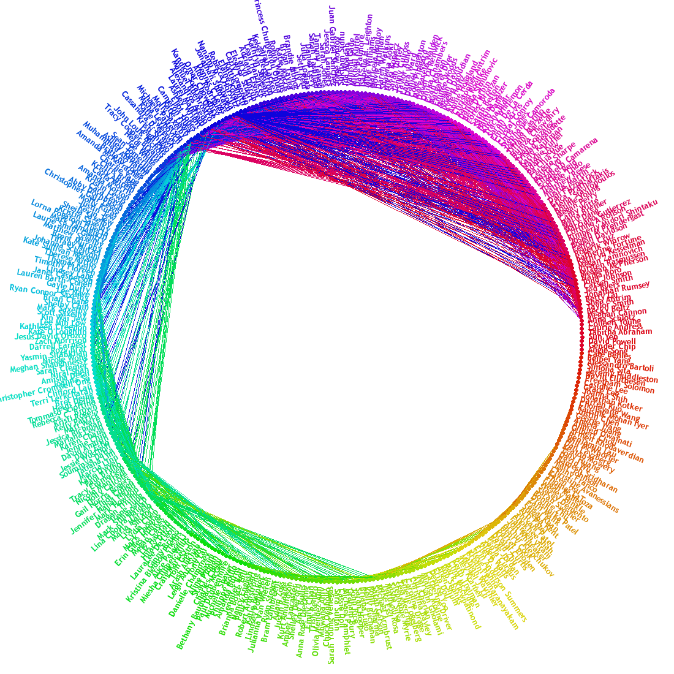
Nodes – FB Users
Edges – Friendships
Notes:
This is FB’s friend wheel. It shows which of my friends are friends with each other. And it is clustered.
This is undirected – if I’m friends with someone they are also friends with me.
We could think of facebook as a directed graph – where most edges are bi-directional. However, maybe when you create a friend request – that is like creating a directional arrow.

Slide 53
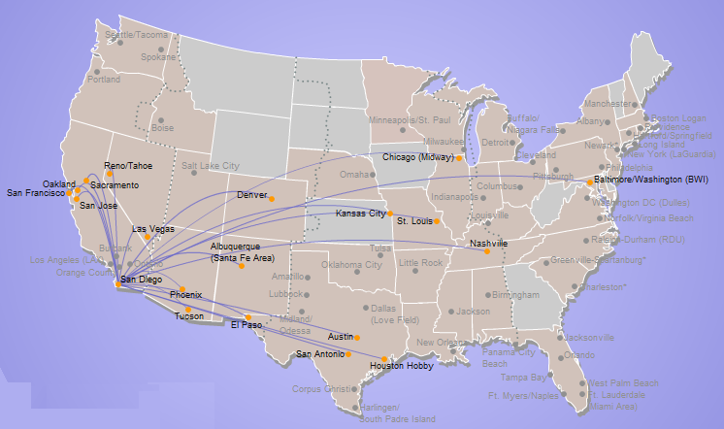
A map is a graph
Nodes – Airports
Edges – Flights
Edge weight
  Distance
  Flight cost
  Travel Time
Notes:
A map is a graph. Here we have southwest’s direct flights from SD.

Slide 54
Graph Vocabulary
 | Weighted | Un-weighted
Directed | Flights | Twitter
Undirected | Interstates | Facebook

Slide 55
Graph Representations
2013-01-31
Thursday – Week 1
Lecture 04

Slide 56
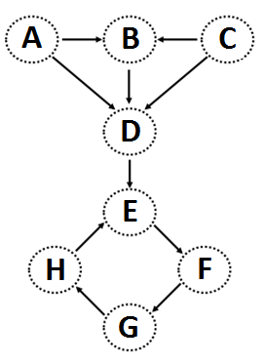
Graphs can be stored as Lists
Edge List
This vocab is important
(define unicycleGraph
'(
("A" "B") ("A" "D") ("B" "D") ("C" "B") ("C" "D") ("D" "E") ("E" "F") ("F" "G") ("G" "H") ("H" "E")
))
I can think of other ways to represent this graph!

Slide 57
(define Gt '((e b 100) (a b 25) (e a 42)
(a c 7) (a d 13) (a e 15)
(b c 10) (b d 5) (d e 2)
(b e 100) (c d 1) (c e 7)) )
What might these weights represent?
weights
15
42
25
b
100
This graph looks heavy!
a
10
7
e
100
c
7
5
13
1
2
Weightedgraphs
d

Slide 58
Graph Practice
2013-01-31
Thursday – Week 1
Lecture 04

Slide 59
(nodes unicycleGraph)→'("A" "B" "D" "C" "E" "F" "G" "H")
(define (nodes graph)
Hint: how could we use remove-duplicates
(kids "A" unicycleGraph) → '("B" "D")
(kids "B" unicycleGraph) → '("D")
(define unicycleGraph '(("A" "B") ("A" "D") ("B" "D") ("C" "B") ("C" "D") ("D" "E") ("E" "F") ("F" "G") ("G" "H") ("H" "E") ))
(define (kids n graph)
big-O( ) ~ edges or nodes?
parents?
Hint: could we use filter?
Notes:
big-O: could be edges or nodes!

Slide 60
Feel free to use available functions: remove-duplicates, nodes, kids, parents, and higher-order functions...
Write these functions for directed graphs.
(define (leaf? n G)
(leaf? n G) should return #t if n is a leaf in G and #f otherwise.
(
(leaf? "E" unicycleGraph)→ #f
Hint: call (kids n G)
(define (gkids n G)
(gkids n G) should compute the list of grandchildren of n in G: all nodes two edges away.
(
(gkids "E" unicycleGraph)→ '("G")
(gkids "A" unicycleGraph)→ '("D" "E")
Hint: use kids and map - It's a bit tricky...
(define (reach? a b G)
(reach? a b G) should return #t if there is some path from a to b in G and #f otherwise.
(
(reach? "B" "E" unicycleGraph)→ #t
there is definitely not enough room here – plus, we’ll talk about a solution in the next lecture...
(reach? "E" "B" unicycleGraph)→ #f
Notes:
I don’t know if this really works...

Slide 61
All you need is Love
Lambda
(you don’t need cons – you can write it with lambda)
2013-01-31
Thursday – Week 1
Lecture 04

Slide 62
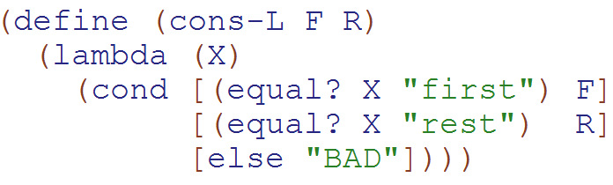
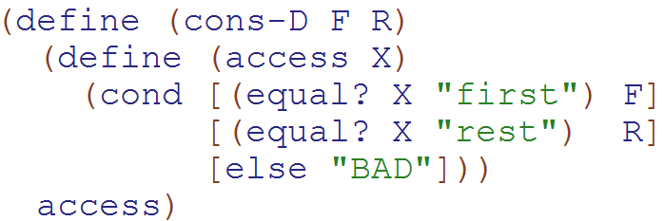
cons written with lambda & with define
Showing both in case people aren’t down with Lambda yet.
Both cons-L and cons-D return a function!!!

Slide 63
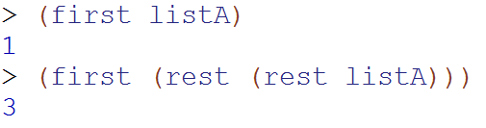


Normal (built-in) cons
Our
Cons-L
We can get the first and rest out – but it isn’t pretty

Slide 64
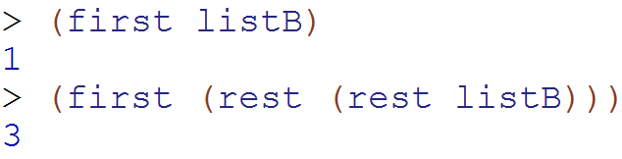
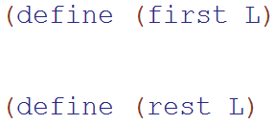
Write first and rest for cons-L
What type of thing is L?
a) "string" b) function
c) Number d) ???

Slide 65
BONUS

Slide 66


Slide 67
Estimating Time
Most people grossly underestimate how long it takes to program (not thinking about time to debug and test)
You appear incompetent at programming (not true) if you can’t estimate how long something will take.
This is one of the hardest things to learn!!! Start to practice now! For each task estimate how long it will take and keep track of how wrong you were

Slide 68


Computer
Science
&
= AWESOME

Slide 69
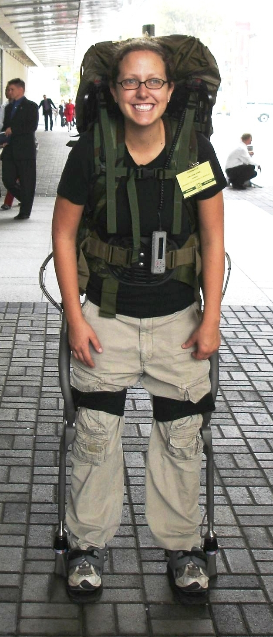
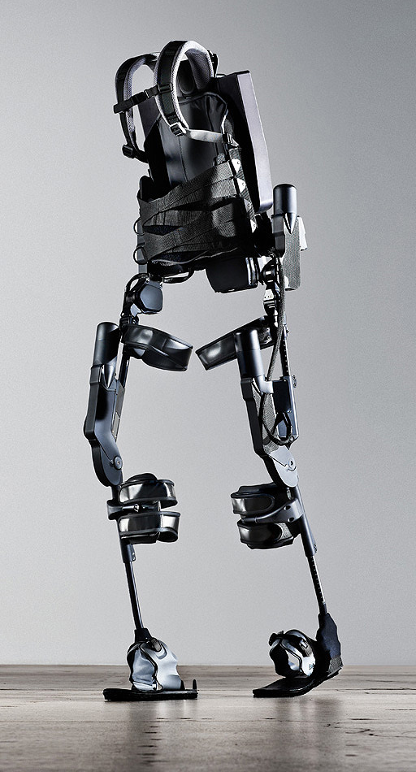
http://www.youtube.com/watch?v=pzRmNYA8LlY

Slide 70

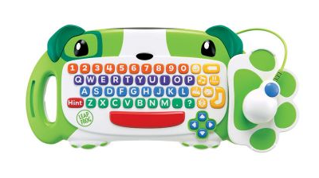
ClickStart

Slide 71
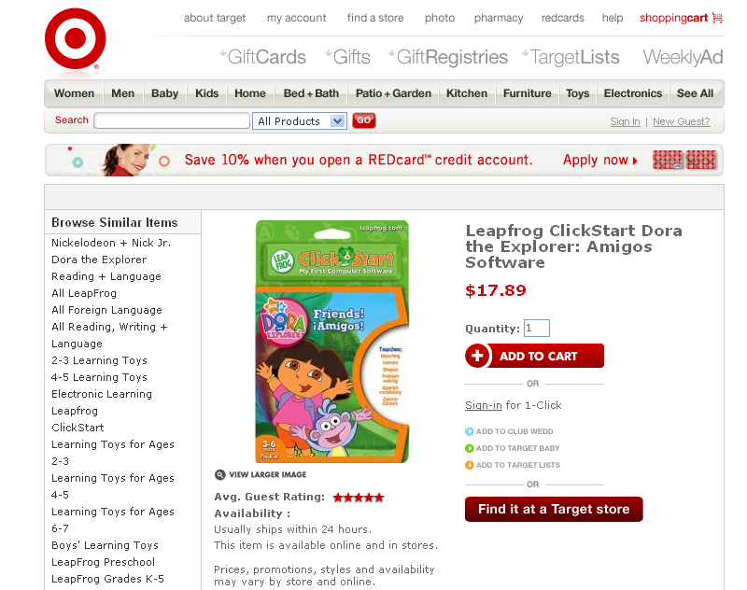

Slide 72

How should we represent the blocks in the computer?
Independent variables
2D Array
OpenList
I don’t know

Slide 73
The value in the array tells me what art asset to use
Each level is really a 3x10 vector!
0 | 0 | 7 | 0 | 4 | 0 | 0 | 0
1 | 2 | 3 | -4 | 5 | 6 | -7 | 8
B | B | B | B | B | B | B | B
Negative values tell me what block needs to go here to win!

Slide 74
0 | 0 | 7 | 0 | 4 | 0 | 0 | 0
1 | 2 | 3 | -4 | 5 | 6 | -7 | 8
0 | 0 | 0 | B | 0 | 0 | 0 | 0

Slide 75
BUGS!

Slide 76
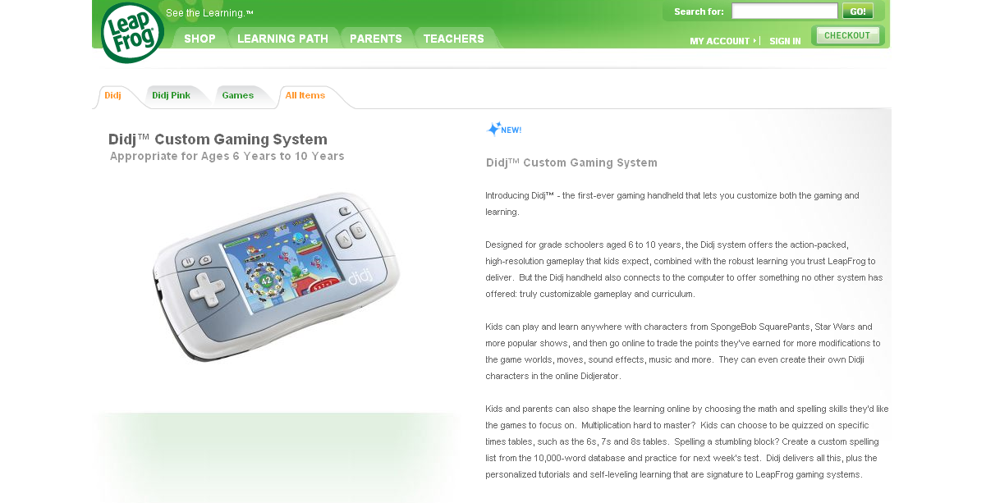

Slide 77
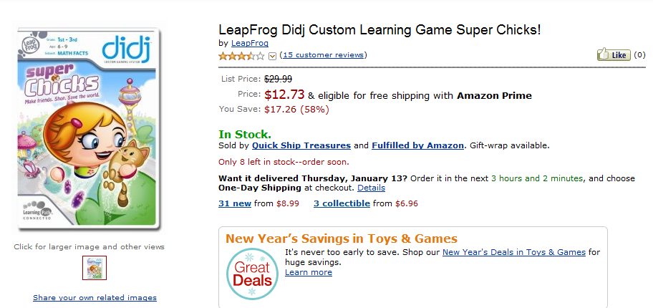
It is really sad when stuff you’ve made is on sale!

Slide 78



Which image is fake?
  A. Top Left
  B. Bottom Left
  C. Bottom Right

Slide 79
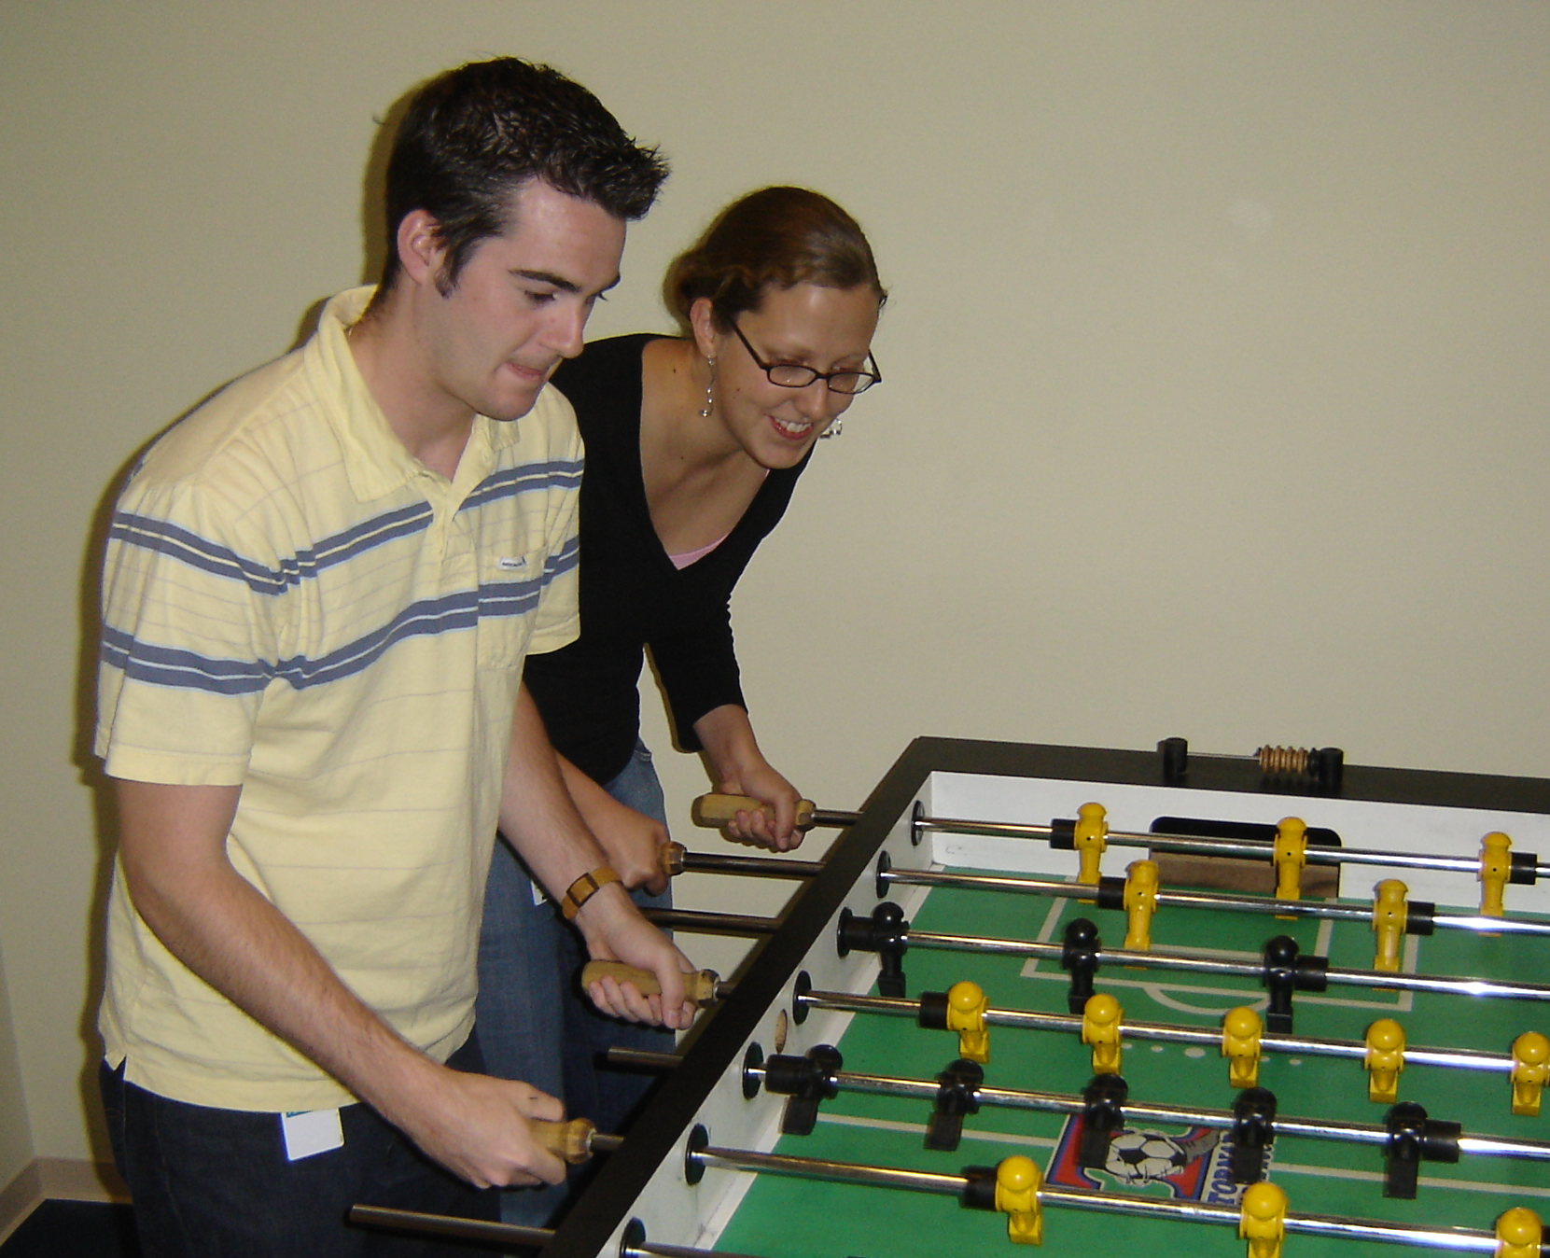

Slide 80
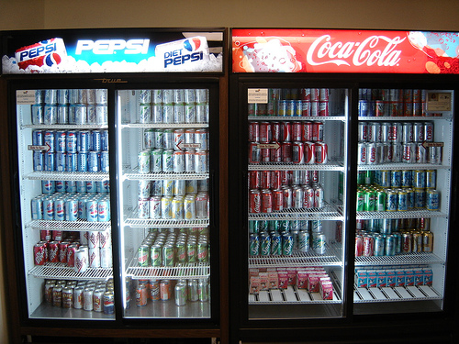

Slide 81
Scheme is BEAUTIFUL!

Slide 82
We don’t need no stinkin’ pairs
(define (cons x y)
(lambda (which)
(cond
((equal? which 'first) x)
((equal? which 'rest) y)
(else (error "Bad message"
which)))))
(define (first pair)
(pair 'first))
(define (rest pair)
(pair 'rest))

Slide 83
Try It!
Try to use this new cons!
Does it work the same way as before?
Yes
No
I don’t know

Slide 84
Big-O
2013-01-24
Thursday – Week 0
Lecture 02

Slide 85
What is the runtime of this?
(define (mystery a b)
(cond
((empty? b) (se a b))
((< a (first b)) (se a b))
(else (se (first b)
(mystery a (bf b))))))
A) Constant runtime
B) Linear runtime
C) Linear*Linear (quadratic)
D) Something else
E) No clue
Try to guess what type of thing the variables a & b will be
Try to come up with (small) input that triggers each case
Correct Answer

Slide 86
Bad variable names!
Make your code harder to read!
  Don’t do this!
Even though we do
  We will use bad variable names on exams so that you have to read/understand the code

Slide 87
Better variable names!
(define (insert num sent)
(cond
((empty? sent) (se num sent))
((< num (first sent)) (se num sent))
(else (se (first sent)
(insert num (bf sent))))))
STk>(insert 7 ’())
(7)
STk>(insert 1 ’(2 5 8))
(1 2 5 8)

Slide 88
Insert
STk>(insert 8 ’(2 5 6 9))
(2 5 6 8 9)
(insert 8 ’(2 5 6 9))
(insert 8 ’(5 6 9))
(se 2
(se 5
(insert 8 ’(6 9))
(se 6
(insert 8 ’(9))
(se 8 ’(9))
(se 2 (se 5 (se 6 (se 8 ’(9)))))
Notes:
88

Slide 89
Best vs. Worst Case
(define (insert num sent)
(cond
((empty? sent) (se num sent))
((< num (first sent)) (se num sent))
(else (se (first sent)
(insert num (bf sent))))))
STk>(insert 1 ’(2 3 4 5 6 7 8))
(1 2 3 4 5 6 7 8)
STk>(insert 9 ’(2 3 4 5 6 7 8))
(2 3 4 5 6 7 8 9)
BEST CASE
WORST CASE

Slide 90
Assumptions
We want something independent of the speed of the computer
We typically use N which is some reference to the “size” of the data.
  It might be the variable N (in factorial)
  It might be the size of your sentence
We don’t care about constant factors
  This is pretty silly in some cases but makes the math more beautiful
We typically think about the worst case!
It only matters for BIG input!

Slide 91
What is the runtime of this?
(define (sort sent)
(if (empty? sent)
sent
(insert (first sent)
(sort (bf sent)))))
Constant runtime
Linear runtime
Linear*Linear (quadratic)
Something else
No clue!
Correct Answer

Slide 92
Sort
STk>(sort ’(8 3 9))
(3 8 9)
(sort ’(8 3 9))
(sort ’(3 9))
(insert 8
(insert 3
(sort ’(9))
(insert 9
(sort ’())
’()
(insert 8 (insert 3 (insert 9 ’())))
Notes:
92

Slide 93
(insert 3
(insert 6
(insert 4
(insert 7
(insert 1
(insert 8
(insert 3
(insert 9
’()
))))))))
(sort sent) if sent length is N
1 + 2 + 3 + 4 + … + (N-1)+ N
Add to sent size 7
Add to sent size 6
Add to sent size 5
Add to sent size 4
Add to sent size 3
Add to sent size 2
Add to sent size 1
Add to sent size 0

Slide 94



Some Algebra to calculate:
1+2+…+n
// Written backwards

Slide 95

Some Algebra to calculate:
1+2+…+n

Slide 96


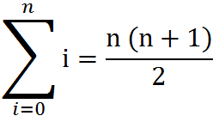
Some Algebra to calculate:
1+2+…+n
OR

Slide 97
How to use Let
(create new variables in definitions)
(let
  ( [<variable1> <value1>]
  [<variable2> <value2>]
  )
  <body>
  )
(define (spam)
(let ([a 3]
[b 4])
(+ a b)
))

Slide 98
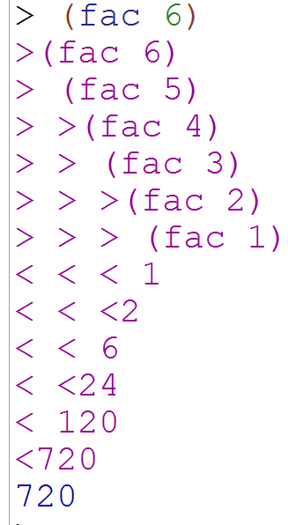
Debugging in Racket
Import the library
(require racket/trace)
(trace fac)
Use this to see what recursive calls get made

